Slide 1
Ethyl alcohol as a solvent and extractant. Dilution and strengthening of alcohol solutions. Determination of the concentration of alcohol solutions.

Slide 2
Lecture plan
Solvents and extractants. Requirements toextractants. Ethyl alcohol as a solvent and extractant.
Dilution and strengthening of alcohol solutions.
Determination of the concentration of alcohol solutions.

Slide 3
Requirements for extractant
The extractant must:
- dissolve the maximum amount of active substances and the minimum amount of ballast substances; - be selective (selective); - easily penetrate (diffuse) through the cell walls; - to be physiologically indifferent, i.e. not to have a harmful effect on the human body; - to be chemically indifferent, i.e. the solvent should not interact with the extracted substances; - must be volatile, have a low boiling point; - to be fire- and explosion-proof; - be affordable, cheap; - prevent the development of microorganisms, fungi, mold.

Slide 4
Choice of extractant
Choice of extractant depends on the physicochemical properties of the extracted substance, including the degree of hydrophilicity.
For the extraction of polar substances, polar solvents are used: water, glycerinum;
In the case of the extraction of non-polar substances - acetic acid, chloroform, ethyl ether and other organic solvents.
There is no ideal solvent for the extraction of plant raw materials that meets all of the above requirements. By combining famous extractants you can get such solvents that will provide selective extraction of a certain substance or complex of substances, chemical or physiological indifference, fire safety, stability, resistance to microflora and other properties.

Slide 5
Non-polar extractants
chloroform,
benzene,
petroleum ether,
hexane and etc.
These solvents recover well aglycones of cardiac glycosides, the bases of most alkaloids, sapogenins, flavones, essential oils, fats, waxes, resins, etc., but do not dissolve proteins, pectins, sugars, minerals and other hydrophilic substances.

Slide 6
Low polarity extractants
Ethanol,
Isopropyl alcohol,
butyl alcohol,
acetone, etc.
They dissolve well both salts and bases of alkaloids, glycosides and their aglycones, flavones and their aglycones, coumarins, carotenoids, vitamins of group B, P, PP, essential oils, pigments, chlorophyll, resins, balms, etc., but do not dissolve proteins, mucus, pectins, sugar, wax, tannins etc.

Slide 7
Polar extractants
water,
glycerinum, etc.
They have the ability to dissolve alkaloid salts, cardiac glycosides, anthraglycosides, saponins, furo-coumarins, vitamins C, K, P, PP, organic acids, salts, sugars, mucus, etc. Water-alcohol solutions also have these properties.

Slide 8
Vegetable oils. For extraction process can be usually used vegetable oils obtained by cold pressing and well settled. The most commonly used oils are peach, almond and sunflower oils. All oils mix well with ether, chloroform, gasoline, essential oils and do not mix (except castor oil) with alcohol and water. Vegetable oils are selective as an extractants for those substances which can be dissolved in fats. Liquefied gases.In industry, liquefied gases are used for extraction: propane, butane, carbon dioxide, liquid ammonia, freons (chlorofluorinated hydrocarbons), etc. Carbon dioxide is good at extracting essential oils and other hydrophobic substances. Hydrophilic substances are well extracted by liquefied gases with high dielectric constant (ammonia, methyl chloride, etc.).
Supercritical fluids. At temperatures and pressures exceeding the critical ones, the state of the substance is called supercritical, and the substance itself, which acquires new and unusual properties, is called a fluid. Supercritical substances - supercritical fluids -the form of the aggregate state of matter, into which many organic and inorganic substances are capable of passing when a certain temperature and pressure is reached
For the extraction of biologically active substances from plant raw materials, supercritical carbon dioxide is used. Supercritical carbon dioxide is capable of dissolving many organic substances.

Slide 9
Supercritical fluids
Supercritical fluids are a cross between liquid and gas. They can compress like gases (ordinary liquids are practically incompressible) and are capable of dissolving solids, which is not typical for gases.
So, supercritical ethanol (at temperatures above 234 ° C) easily dissolves some inorganic salts (CoCl2, KBr, KI).
Carbon dioxide, ethylene and some other gases in the SCF state acquire the ability to dissolve many organic substances. The properties of supercritical CO₂ as a solvent can be controlled - with increasing pressure, its dissolving capacity increases sharply. In this case, supercritical fluid extraction processes, traditionally implemented in the form of closed extraction cycles (with minimal emissions of extractant into the environment) are not new generators of CO ₂. They only use carbon dioxide, which is usually a byproduct of other technological processes. Thereby, SCF technologies reduce the volume of CO ₂ emissions into the atmosphere

Slide 10
Supercritical fluids have been widely used since the 1980s, when the general level of industry development made its facilities widely available. From that moment on, the intensive development of supercritical technologies began.
First of all, the researchers focused on the high dissolving power of Supercritical fluids - against the background of traditional methods, the use of supercritical fluids turned out to be very effective.
SCF is not only good solvents, but also substances with a high diffusion coefficient, that is, they easily penetrate into the deep layers of various solids and materials.

Slide 11
Benefits of Supercritical Carbon Dioxide
The most widely used supercritical CO2, which has taken a leading position in the world of supercritical technologies, since it has a whole complex advantages:
It is quite easy to transfer it to a supercritical state (tcr - 31 ° C, pressure cr - 73.8 atm),
it is non-toxic, non-flammable, non-explosive
cheap and affordable.
From the point of view of any technologist, CO2 is an ideal component of any technological process. It is especially attractive because it is an integral part of atmospheric air and, therefore, does not pollute the environment. Supercritical CO2 can be considered an absolutely environmentally friendly solvent.

Slide 12
The pharmaceutical industry was one of the first to turn to the new technology, since SCF allowed the most complete isolation of biologically active substances from plant materials, while keeping their composition unchanged. The new technology fully complied with modern sanitary and hygienic standards for the production of medicines. In addition, the step of distilling off the extracting solvent and its subsequent purification for repeated cycles was excluded. Currently, the production of some vitamins, steroids, and other drugs is organized using this technology.

Slide 13
The most common and frequently used solvent in the manufacture of herbal medicines is ethyl alcohol.
Ethyl alcohol is a colorless, transparent, highly mobile liquid with a characteristic odor, pungent taste, physiologically non-indifferent, miscible with water, ether, chloroform and many organic solvents in any ratio. Ethyl alcohol is flammable liquid. For medical purposes as a solvent and extractant only rectified alcohol is used, obtained by fermentation of starch and sugar-containing products, followed by purification and rectification and complying with the requirements of pharmacopoeial monographs. Currently, RPh monograph is 42-3071-00 (ethyl alcohol 90%, 70%, 40%) and RPh monograph 42-3072-00 (ethyl alcohol 95%) are in force.

Slide 14
Ethanol
In pharmacy as independent extractants and in the manufacture of complex extractants allowed to use:
ethyl alcohol (absolute ethanol) (RPh 42-3072-94);
ethanol rectified (Standard N 5962-67).
Ethyl alcohol as extractant has its advantages and disadvantages.
Benefits:
It dissolves well medicinal substances that are rather poorly soluble in water.
In comparison with water, it to a lesser extent promotes the course of hydrolytic processes (depends on the concentration of ethanol).
Inactivates many enzymes.
Has a bactericidal effect.
Volatile enough, has a boiling point in the range from 88.5-78.8 ⁰C when changing the concentration from 20 to 90%, which allows you to maintain thermolabile substances during evaporation and drying.
Disadvantages:
It is more difficult than water to penetrate the cell walls.
Flammable (requires special working conditions).
Pharmacologically non-indifferent.

Slide 15
Methods for the quantitative determination of ethyl alcohol can be divided into physical, physicochemical, and chemical.
Physical and physico-chemical methods
for determining the concentration of ethanol it is necessary to find any physical parameter of the test solution, which changes naturally with a change in its concentration. More often than other indicators determine the density, refractive index, the difference between the refractive indices of the test substance and water. Having measured one of these values, according to tables or calibration graphics it is possible to find the actual ethyl alcohol content of the product.
Tables and graphical relationships between alcohol concentration and physical constants are drawn up for pure aqueous-alcoholic solutions. The presence of extractives in the investigated products distorts the actual alcohol content in them, since in their physical properties they differ sharply from ethyl alcohol. For example, their density is always greater than one, and that of ethyl alcohol is less, therefore, extractives always under estimate the actual alcohol content in the studied products. In this regard, the products, which include extractives, are first subjected to distillation before determining the alcohol.

Slide 16
Pycnometric method
The density of the aqueous-alcoholic solution changes regularly from 1.00 to 0.79 g / cm³with an increase in the concentration of ethyl alcohol. The density of alcohol is found in an aqueous solution.
The density of aqueous-alcoholic solutions is determined using pycnometers. The accuracy of the pycnometric method depends mainly on the accuracy of finding the density of the aqueous-alcoholic solution. Having established the density of the solution with a pycnometer with an accuracy of 0.0001, the concentration of alcohol in the solution is determined with the following accuracy: the accuracy is ± 0.10 - 0.08% - in solutions containing 1 - 30% vol. alcohol; the accuracy is ± 0.08 - 0.05% - in solutions containing 30 - 50% volume of alcohol; the accuracy is ± 0.05 - 0.04% - in solutions containing 50 - 70% vol. alcohol; the accuracy is ± 0.04 - 0.02% - in solutions containing 70 - 97% vol. alcohol.
It can be seen from the data presented that the accuracy of the method significantly decreases in the region of low alcohol concentrations. When analyzing aqueous-alcoholic solutions containing 1 - 2% alcohol, the relative error of the method reaches 25 - 13%. Therefore, such solutions are analyzed by more accurate methods (flotation or chemical). In the region of medium and high alcohol concentrations, the relative error of the method is insignificant, –0.5 - 0.05%, and therefore the pycnometric method is successfully can be used in the indicated concentration range. In the practice of factory laboratories, this method is widely used in the analysis of alcoholic solutions.

Slide 17
Areometric method
To determine the content of ethyl alcohol in aqueous-alcoholic solutions, special-purpose hydrometers are used - alcohol meters. With their help, the content of ethyl alcohol in solutions with a temperature from minus 25 to plus 40 ° C is determined. Knowing the temperature of the solution and the reading of the alcohol meter, according to special tables, the relative content of ethyl alcohol in water-alcohol solutions is found in terms of a temperature of 20 C⁰.
At present, the content of ethyl alcohol in aqueous-alcoholic solutions is determined with a glass alcohol meter. A metal alcohol meter can also be used for this purpose.
A glass alcohol meter designed to measure the strength of aqueous-alcoholic solutions is a constant mass hydrometer, which is made in the form of a cylindrical float. Scale divisions at a solution temperature of 20 C⁰ show the alcohol content in it in percent by volume.

Slide 18
Alcohol meters
Metal and glass alcohol meters are used. A metal alcohol meter is a variable mass hydrometer, graduated in conventional units. This alcohol meter consists of a brass ball, to the upper and lower parts of which rods are soldered: the upper - with a scale, the lower - with a slight thickening at the end for hanging weights. To prevent oxidation, the alcohol meter and weights are gilded. On the upper rod (scale) there are 10 large equal divisions, which have the numbers 0, 1, 2, 3, 4, 5, 6, 7, 8, 9, 10 from the bottom up. Below, under the zero line, there is the number 100. Each major division of the scale is in turn subdivided into five minor ones; therefore, each minor division is equal to 0.2 major divisions. All divisions are counted from bottom to top.

Slide 19
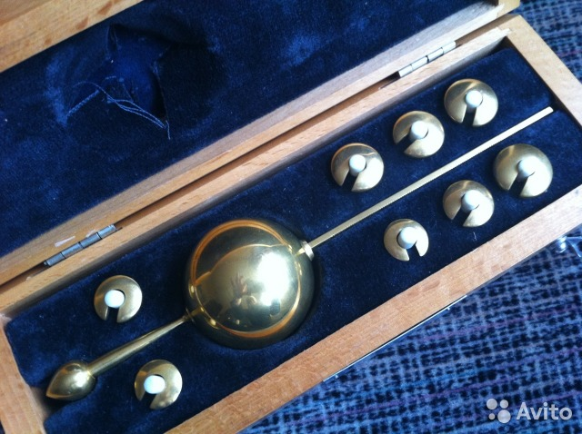
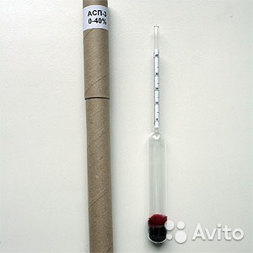

Slide 20
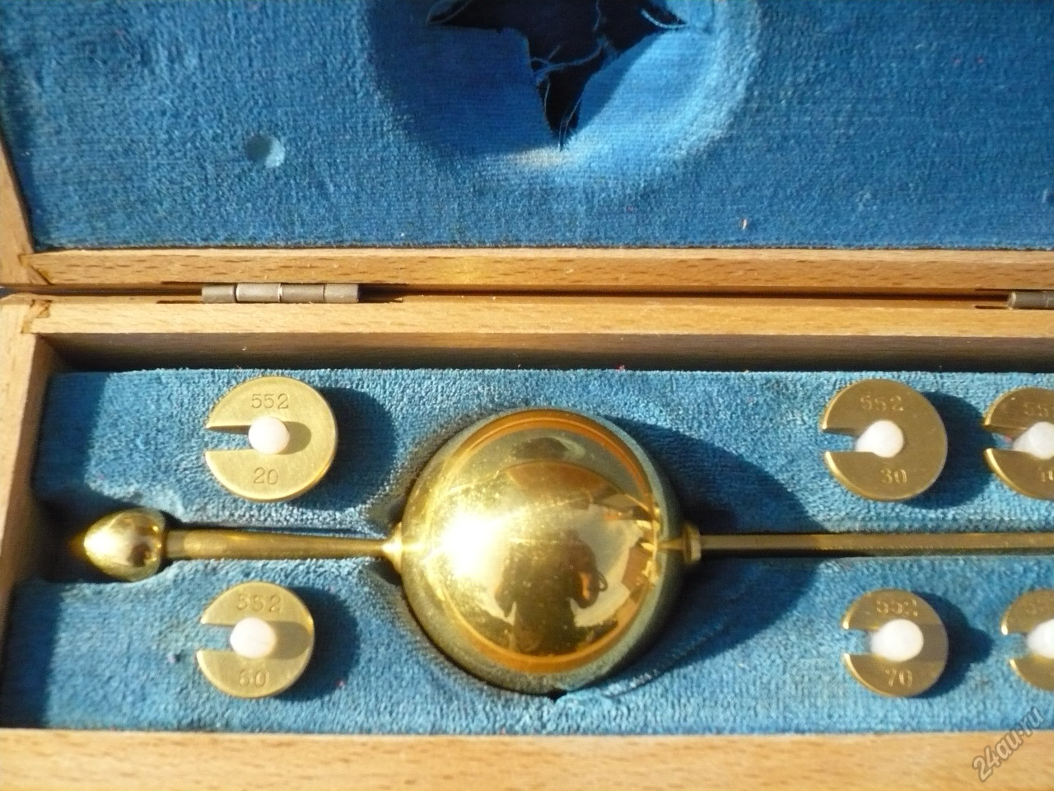

Slide 21
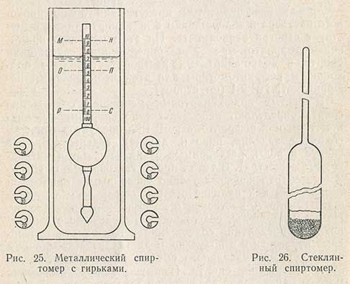

Slide 22
The metal alcohol meter comes with eight round (with a cutout in the middle) weights, designated by the numbers 20, 30, 40, 50, 60, 70, 80, 90; the higher the serial number of the weight, the lighter it is. Previously, a set of ten weights with the designations 0 and 10 was made for alcohol meters in addition to those indicated above. When determining the weights, they are hung, as required, on the lower rod of the alcohol meter using a cutout, and the put on weight should be turned with the convex side down and lie tightly on the lower thickened part of the rod.
It is necessary to put the weights on the upper thinned part of the rod carefully so as not to scratch the gilding of the rod and hold it slightly until it reaches the lower part of the rod. Each alcohol meter has its own number, which is printed on all weights to it. The weights of one metal alcohol meter cannot be used to work with another alcohol meter.

Slide 23
Determination of alcohol content with a metal alcohol meter
To work with an alcohol meter, a glass cylinder of such a diameter is required so that the alcohol meter freely descends into the cylinder without touching its walls. Before determination, the cylinder should be thoroughly washed, wiped and rinsed with the tested alcohol. Alcohol meter readings depend on the relative density of the alcohol-water solution and its temperature. The temperature of the test solution is measured with a special thermometer with a scale from -25 to + 40 ° C and a graduation of 0.5 degrees. Before determination, the aqueous-alcoholic solution is thoroughly mixed and poured into a cylinder. Removal of air bubbles that appear in the cylinder during pouring is accelerated by stirring, which can be carried out before immersion in the alcohol meter solution.

Slide 24
It is necessary to completely remove air bubbles, since when the alcohol meter is lowered into the cylinder, they will push or throw the alcohol meter upwards and thus can cause incorrect readings of the alcohol meter. After removing all air bubbles, without removing the thermometer, the alcohol meter is carefully lowered into the cylinder, holding it by the narrow ribs of the upper rod with the thumb and forefinger and without touching the submerged part with your hands. The alcohol meter should not touch either the thermometer immersed in alcohol or the walls of the cylinder. The alcohol meter must be completely clean. A contaminated alcohol meter must be rinsed in strong alcohol and wiped off, lightly squeezing it, using a specially designed soft towel or gauze.

Slide 25
Air bubbles from the surface of the alcohol meter are removed by gently shaking the alcohol meter without removing it from the liquid. If the alcohol meter rod is wetted more than two small divisions above the meniscus, the alcohol meter is raised without exposing the body, and the rod is wiped. After keeping the alcohol meter and thermometer in the liquid for 3-5 minutes, the immersion of the alcohol meter and the thermometer are simultaneously counted. When reading, the eye should be slightly below the liquid level, since it is in this position that the line of intersection of the liquid level with the scale is more clearly visible.
The readings of the alcohol meter are counted after it has completely settled down in the liquid. It is impossible to equalize the temperature of the liquid while the alcohol meter is in it by stirring with a thermometer, since the thermometer can accidentally break and amalgamate by mercury alcohol meter. After recording the readings, the thermometer and alcohol meter are removed from the liquid, gently wiped off with a towel and placed in specially designed storage cases.

Slide 26
Countdown of indications of a metal alcohol meter
Having lowered the alcohol meter into a liquid without a weight or with one or another weight, they look at how much it has plunged; if the lower (zero) line on the scale is above the liquid, then the alcohol meter is removed and the weight is replaced with a heavier one; if the liquid level is above the upper line of the scale, the weight is replaced with a lighter one. Having picked up the weights, successively moving from the smallest to the largest, and having found the immersion point, the count is carried out as follows. If the alcohol meter without a weight plunged to the level, the reading of the alcohol meter will be 109.6, since the liquid level is three divisions above 9 (recall that the price of each small division is 0.2). The number 100 is added to 9.6, indicated on the rod of the alcohol meter above the zero line. If the alcohol meter with a weight of 50 plunged to the M-H level, its reading would be 59.6.

Slide 27
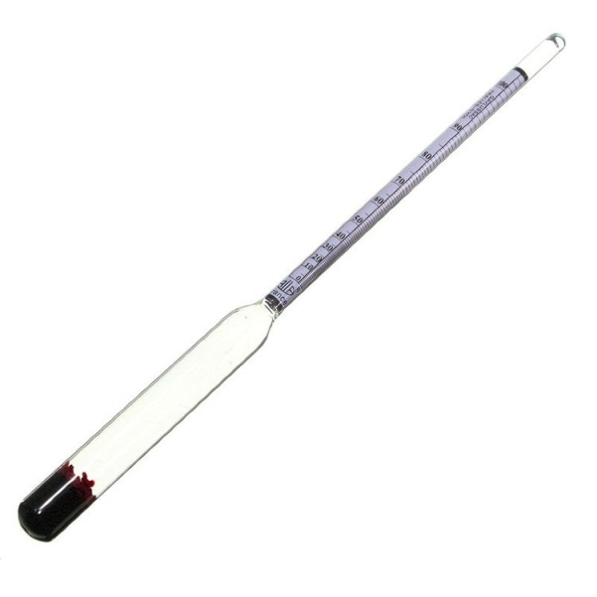
Glass alcohol meter
A glass alcohol meter is a constant mass hydrometer. It is a float of regular cylindrical shape, consisting of two parts: a lower large diameter, where a weight in the form of a metal shot is placed, and an upper smaller diameter with a measuring scale. Scale divisions at 20 ° C show the alcohol content in the solution in percent by volume.
The set of glass alcohol meters includes 11 alcohol meters with the following scale limits in% vol .: 0-10, 10-20, 20-30, 30-40, 40-50, 50-60, 60-70, 70-80, 90- 100, 95-105. Alcohol meter with a scale of 95-105 used for the analysis of high-strength solutions at temperatures above 20 ° C; the scale in the range from 100 to 105 is expressed in arbitrary units. Glass alcohol meters are produced of types A, B, C, D without thermometers and type D with a thermometer. They differ in the price of the smallest division and in the limits of measurements. Alcohol meter type A with the smallest graduation 0.1% vol. used in the analysis of alcohol.

Slide 28
Determination of alcohol content with a glass alcohol meter
The determination of the alcohol content with a glass alcohol meter is carried out in the same way as with a metal one. Glass alcohol meters show the alcohol content in % vol. at a temperature of the investigated aqueous-alcoholic solution of 20 ° C. Bringing the temperature of the aqueous-alcoholic solution to 20 ° C is often difficult and not always possible. Therefore, tables are used to determine the alcohol content at 20 ° C according to the readings of a glass alcohol meter obtained at a different temperature.

Slide 29
Determination method
The alcohol content in a water-alcohol solution is determined in clean glass cylinders that allow free immersion of the alcohol meter and thermometer. Before determination, the cylinder is rinsed three times with about 500 cm³test solution. A clean and dry alcohol meter is wiped with a soft (preferably linen) towel before immersion in the solution. After that, the test solution is poured into the cylinder and the thermometer is immersed in it. Having measured the temperature of the solution, a glass alcohol meter is carefully lowered into the cylinder. The alcohol meter is taken by its upper thinned end and carefully lowered into the liquid so that the measuring part is not moistened more than 2 - 3 mm above the upper part of the meniscus. The first measurement is approximate, the next 2 - 3 measurements are used for calculations. During repeated measurements, the measuring part of the device must be dried with a towel. After keeping the alcohol meter and thermometer for 3 - 4 minutes in the liquid, readings are made on the scale of the alcohol meter and thermometer. After removing the alcohol meter from the solution, check the accuracy of the temperature determination. To do this, carefully stir the liquid with a thermometer, set the thermometer along the axial line of the cylinder and take a reading. If the temperature has changed by more than ± 0.1, the determination of the alcohol strength is repeated. The method is accurate, easy to carry out and gives good reproducibility analysis results.
Knowing the readings of an alcohol meter and a thermometer, the strength of the solution is found using special tables.

Slide 30
Taking readings
When counting the readings of the alcohol meter and thermometer, the following rules are followed: for an accurate reading of the readings of the scale of the alcohol meter, the observer's eyes must be below the liquid level so that the base of the meniscus in the form of an ellipse is visible. Then, raising the head, they notice how the ellipse, narrowing, turns into a straight line, clearly projected on the scale of the device. At this moment, a count is made; the counting is carried out with an accuracy of one smallest division of the alcohol meter scale; if, when measuring the strength, the base of the meniscus of the liquid is lower or higher than the reading scale by more than 1 - 2 divisions, select another alcohol meter; with accurate readings, amendments to alcohol meters and thermometers are taken into account, which are available in the documents on the verification of devices; the temperature of the solution is determined with an accuracy of ± 0.1 or 0.5 C⁰ depending on the thermometer used. If the temperature of the solution, taking into account the amendment, contains hundredths of a degree, its value is rounded to tenths. It is easier to work if the temperature of the solution is an integer number of degrees or ± 0.5C⁰, therefore, in practice, the solution is often heated or cooled by 0.1 - 0.9C ⁰; accurate analysis results are obtained if the temperatures of the solution and the room air are equal or differ by an insignificant amount (1 - 2C ⁰) At a greater temperature difference, the strength is determined only after the test sample has taken the ambient temperature. It is not allowed to measure the strength of the solution near heating devices and in a draft; due to the fact that in the conversion tables the temperature is indicated after 1C ⁰, and the reading of the alcohol meter through 0.5 units, with intermediate values ​​of the readings of the alcohol meter and the thermometer, the strength of ethyl alcohol is determined by linear interpolation.

Slide 31
Tables for alcohol meters
the alcohol meter is graduated in conventional units. To convert its readings into volume percentages, special tables are used. There are tables for determining the alcohol content at 20 ° C according to the readings of glass and metal alcohol meters obtained at a different temperature (Standard tables No. 3 and 4).
The volume of a water-alcohol solution is expressed in liters at a solution temperature of 20 ° C. When alcohol is taken into account, the number of liters of anhydrous alcohol contained in a given volume of a water-alcohol solution is determined. At a temperature of 20 ° C, the amount of anhydrous alcohol is found by multiplying the volume of a water-alcohol solution by the alcohol content in percent by volume.

Slide 32
In most cases, when taking into account aqueous-alcoholic solutions, their volumes have to be measured at temperatures different from 20 ° C, and, therefore, the alcohol content per unit volume changes; with decreasing temperature it increases, and with increasing temperature it decreases. Therefore, there is a table of factors required to determine the volume of anhydrous alcohol at 20 ° C, contained in a given volume of a water-alcohol solution, regardless of the change in the volume of liquid under the influence of temperature fluctuations. The factor is found by knowing the alcohol content in % vol. and the temperature at which the volume of the aqueous alcohol solution was measured. Multiplying the volume of a water-alcohol solution determined at a given temperature by the factor found, the volume of anhydrous alcohol contained in the liquid, referred to a temperature of 20 ° C, is obtained.
All these tables are placed in the book "Tables for determining the content of ethyl alcohol in aqueous-alcoholic solutions at 20 ° C" (Committee of standards, measures and measuring instruments under the Council of Ministers of the USSR. M., 1966). There are 6 tables of Standard.

Slide 33
Example 1.Readings of a glass alcohol meter 89.5 at a temperature of 12 ° C. According to the table N III we find the alcohol content 91.52% vol.
If, when measuring, the temperature of the aqueous-alcoholic solution and the readings of the alcohol meter were obtained in fractional numbers that are not in the table, then the corresponding alcohol content is found by linear interpolation.

Slide 34
Refractometric method
In aqueous solutions of ethyl alcohol, a linear dependence of the refractive index on its concentration is observed, which makes it possible to use the refractometry method to determine the concentration of alcohol.
The refractive index of a water-alcohol solution depends on the content of ethyl alcohol. This dependence has an extreme character: first, the refractive index increases with an increase in the alcohol concentration. There are tables in which the refractive index is expressed as a function of the concentration of aqueous-alcoholic solutions.
However, a significant increase in the refractive index is observed only when the alcohol concentration is increased to 50-55%. Within the limits of alcohol concentration 55-75%, the value of the refractive index changes less noticeably, at a concentration of 75-90% it remains almost constant, and for 90-95% solutions the refractive index decreases. In this regard, solutions in which the concentration of alcohol does not exceed 50-55% can be defined by refractometer directly, and more concentrated solutions must be pre-diluted twice by weight with purified water. Having determined the refractive index, find the strength of the diluted solution according to the graph or table and the resulting value is doubled.
It should be taken in mind that temperature has a significant effect on the accuracy of the results of refractometric analysis of alcohol solutions. Therefore, if the determination of the refractive index was carried out at a temperature other than 20 ° C, then it is necessary to make a correction for the temperature. In the case of determination at a temperature above 20 ° C, the correction is added to the found value of the refractive index, if the analysis is carried out at a temperature below 20 ° C, then the correction is subtracted.

Slide 35
In addition to the above, the alcohol concentration can be determined by the following methods:
Interferometric method
Gas chromatographic method
By chemical methods
Dichromato-iodometric method

Slide 36
Dilution of alcohol
If it becomes necessary to dilute strong alcohol or mix alcohol solutions of various concentrations, calculations can be performed using:
Dilution formulas;
The Rule of the Cross.
Alcoholmetric tables;

Slide 37
Alcohol dilution
X = V x
Where x - the amount of strong alcohol required to prepare alcohol of the desired concentration, ml or g;
V - the required amount of alcohol of the desired concentration, ml or g;
C desired - the required concentration of alcohol,% vol. or % by weight.;
C strong alcohol - concentration of available strong alcohol, % vol. or % by weight...

Slide 38
If the dilution of strong alcohol is made with alcohol of a lower concentration, the calculations are made according to the formula:
X = V •
where
с - concentration of weak alcohol,% (v);
a - concentration of strong alcohol,% (v);
b Is the concentration of alcohol of the desired strength,% (v).

Slide 39
"Rule of the Cross"
If you want to prepare a solution "b %"concentration by mixing solutions in concentration "and % “ and " from %", provided that a>b>c you should know, in what ratio "a % "and"c % " solutions should be used?
Denoting these volumes through "x" and "at ", we get the equation:
ax + cy = b (x + y),

Slide 40
from here
Equating the corresponding members of the relationship, we get:
x = c - c
y = a - b
Therefore, the condition of the problem and the result obtained can be written as follows:
a → b - c
↘ b ↗
c↗ → ↘ a - b

Slide 41
An example of using the rule of the cross for diluting alcohol
You need to get 2 liters of 60% alcohol from 96%.
Decision:
96% 60-0 = 60
60%
0 96-60 = 36
96 liters
96 liters of 60% alcohol requires 60 liters of 96%
2 liters --------------------------------------- X
X = 2x60 / 96 = 1.25 liters
Water up to 2 liters.

Slide 42
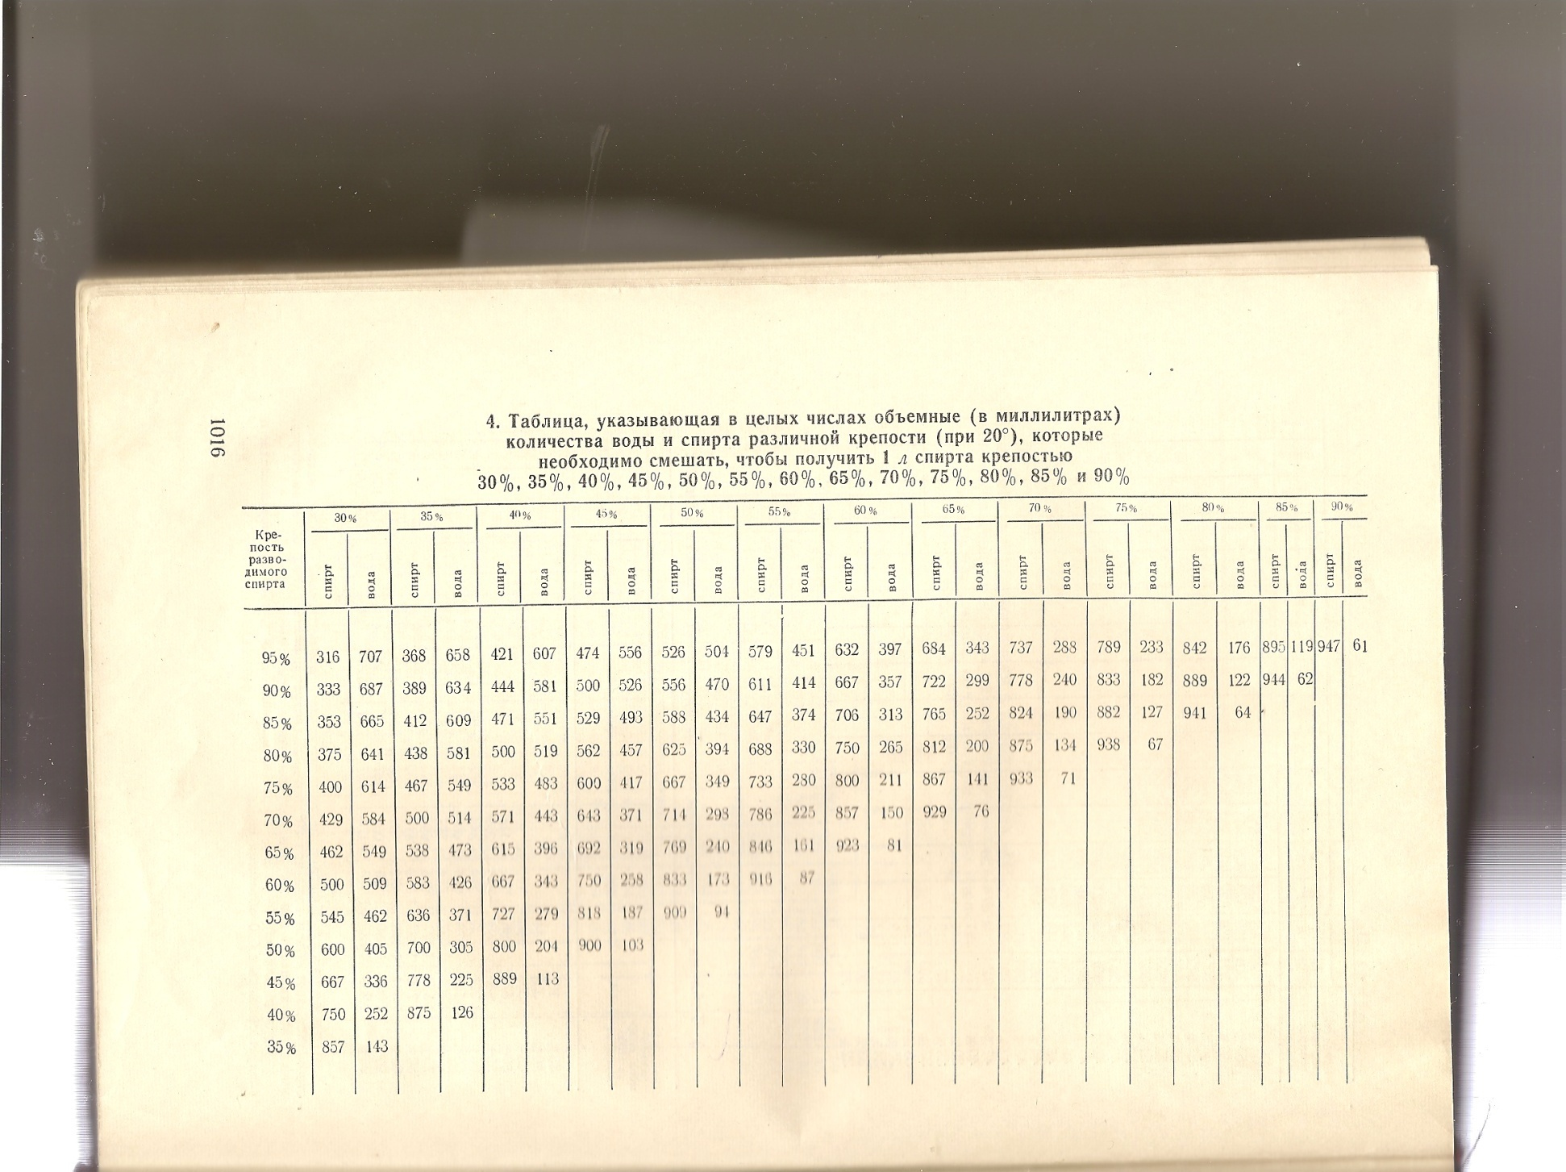
Table 4 shows the amount (in ml at 20 ° C) of water and alcohol of various strengths (from 35 to 95%),
which must be mixed to get 1 liter of alcohol with a strength of 30, 35, 40, 45, 50, 55, 60, 65, 70, 75, 80, 85, 90%.

Slide 43
Prepare 2 liters of alcohol 70% of the available 95%.
According to table 4 of the pharmacopoeia for the preparation of 1 liter of alcohol 70% of 95%
737 ml of alcohol and 288 ml of water are required.
Therefore, 1 liter - 737 ml of alcohol 95%
2 liters ---- X
X = 1474 ml
Water for 1 liter of alcohol ------------ 288 ml of water
for 2 liters -------------- X
X = 576 ml of water
From this table, you can calculate the contraction (1474+ 576) - 2000 = 50 ml Is a contraction

Slide 44
Alcohol accounting
Alcohol is accounted for by weight.
You can make accounting according to the table and according to the formula:
Weight of alcohol = p x V
Suppose you have consumed 50 ml of alcohol 96.3%. You need to make an account.
It is necessary for this to find the density of alcohol 96.3%.
This can be done according to table No. 1 RPh

Slide 45
Table 1shows the relationship between the density of a water-alcohol solution and the content of anhydrous alcohol in the solution. It can be used to convert alcohol concentration from percent by volume to percent by weight and vice versa.
According to table 1 there is no alcohol density of 96.3%. Therefore, in order to find the required density, it is necessary to interpolate, that is, find the unknown value from the two available ones.
P alcohol 96.26% ------- 0.8064
Palcohol 96.31% ------- 0.8062
Find the difference 0.05% ------- 0.0002
0.01% ------- X
X = 0.00004
Therefore, the desired density of alcohol 96.3% will be equal to P = 0.8062 + 0.00004 = 0.80624
Then the mass of alcohol = 50 ml x 0.80624 = 40.312 grams

