Slide 1
The extracts: liquid, thick and dry. Oil extracts. Thermal processes. Heat carriers. Using water vapor as a heat carrier. Heat exchangers. Evaporation. Types of vacuum evaporators and equipment. Evaporation side effects. Drying. Statics and kinetics of drying. Convective dryers, contact dryers, etc. Standardization of tinctures and extracts.
Lecture for 4th year students

Slide 2
Extracts
these are concentrated extracts from medicinal plant materials.
Depending on the used extractant they are divided into 4 groups:
aquatic (extracta aquosa),
alcohol (extracta spirituosa),
ethereal (extracta aetherea),
oil (extracta oleosa).
In addition, standardized extracts - concentrates are used for the preparation of infusions and decoctions.

Slide 3
Classification of extracts
Extracts are distinguished by consistency:
liquid (extracta fluida),
Soft or thick (extracta spissa),
dry (extracta sicca)
Liquid extracts are mobile, concentrated water-ethanol extraction from medicinal plant materials;
Soft or thick - viscous masses containing no more than 25% moisture;
dry extracts are loose or porous, spongy masses containing up to 5% moisture.

Slide 4
Liquid extracts
liquid extracts are prepared 1: 1.
Currently, there are no such strict restrictions, the evaluation criterion is not the ratio of raw materials: preparation, but the content of biologically active substances in the liquid extract and the high depletion of raw materials. The ratio of raw materials: finished product in the production of liquid extracts is usually 1: 1 or 1: 2.

Slide 5
Liquid extract 1: 1 means that one volumetric part of the finished product contains the same amount of active substances as in a unit mass of plant materials. At pharmaceutical enterprises, the extract is prepared by weight, that is, a unit of mass of the finished product is obtained from a unit of mass of raw materials. The most preferred method for obtaining liquid extracts is countercurrent, excluding the step of evaporation of the extraction.
Purification of liquid extracts as analogs of tinctures is carried out by long-term settling at a temperature not exceeding 8 ° C in well-closed containers, followed by filtration of the clarified liquid through a press filter.

Slide 6
Advantages and Disadvantages of Liquid Extracts
Advantages of liquid extracts as a dosage form:
Disadvantages of liquid extracts as a dosage form:
Easier to make than thick and dry ones.
When obtaining liquid extracts, biologically active substances do not undergo any changes, that is, they are in a natural state.
Convenient dispensing (classic extracts!).
High saturation with ballast substances.
Inconvenience in transportation.

Slide 7
Classification of liquid extracts:
Liquid extracts are classified according to the main biologically active substances that provide the effect of this extract, i.e. liquid extracts containing:
alkaloids (liquid jaundice extract);
flavonoids (liquid hawthorn extract);
saponins (extract leuzei liquid);
vitamins (nettle extract liquid);
anthracene derivatives (extract of buckthorn liquid), etc.
As extractant When obtaining liquid extracts, ethanol is used in a concentration of 20 to 70%, which depends on the properties of the biologically active substances to be extracted.
They are also classified by type extractant:
Aquatic
Essential
alcohol

Slide 8
Water extracts
The consistency of the water extracts can be thick or dry. Their nomenclature is very limited.
Water extracts are purified from accompanying substances, various high molecular weigh substances (mucus, pectins, starch, sugars, etc.), which contribute to the rapid reproduction of microorganisms in the extraction.
Aqueous extracts are used as fillers in the manufacture of pills, extracts of licorice root also for the manufacture of syrup and licorice elixir. An extract of the herb wormwood is used as a bitterness to stimulate appetite and enhance the activity of the digestive organs.

Slide 9
Alcohol extracts
Alcohol extracts in consistency can be liquid, thick and dry
Methods are used to obtain alcoholic extracts percolation, repercolation, fractional maceration according to the principle of countercurrent and countercurrent extraction. As extractant when obtaining liquid extracts, ethanol is used in a concentration of 30 to 90%, more often 70%, in the production of thick and dry extracts - also amyl alcohols, propyl, sometimes methyl, which are completely removed during the production of the finished product.
Ethanol is used to produce thick extracts. For complete depletion of plant material when percolating required 7-9 multiples volumes of extractant.

Slide 10
Technological block diagram of obtaining liquid extracts
TS - 1. Sanitary preparation of production
TS - 1.1. Preparation of industrial premises
TS - 1.2. Processing equipment
TS - 1.3. Sanitary preparation of technological clothing
TS - 1.4. Sanitary training of personnel
TS - 2. Preparation of raw materials and extractant
TS - 2.1. Grinding of raw materials
TS - 2.2. Ethanol dilution
TS - 3. Extraction (extraction of biologically active substances) or dissolution of dry or thick extracts
TS - 4. Cleaning Extraction
TS - 5. Standardization
TS - 6. Packing, packaging, marking
TS - 7. Ethanol recovery

Slide 11
Preparation of medicinal plant raw materials for extraction
Before carrying out the extraction process, medicinal plant raw materials are subjected to analysis and preliminary preparation.
The composition and properties of raw materials are determined for compliance with Normative Documents requirements.
Grinding and sieving is carried out
The technological properties of raw materials are determined.
The technological properties of the crushed plant material are determined in order to select the capacity of the equipment, select the loading means, calculate the amount of extractant and optimize the extraction process.

Slide 12
Methods of obtaining
Liquid extracts are obtained by methods:
percolation,
repercolation (in various versions),
continuous countercurrent extraction in a battery of percolators,
dissolving thick and dry extracts,
The best quality liquid extracts are obtained using methods of preparation that exclude evaporation.

Slide 13
Percolation
In the production of liquid extracts at the stages of swelling and infusion, it is no different from percolation in the production of tinctures.
On the stage actually percolation the process is carried out in the same way and at the same speed as for tinctures.
The difference lies in the collection of ready-made extracts.
When obtaining liquid extracts, the final extracts are divided into two portions. The first portion in the amount of 85% in relation to the weight of the raw material is collected in a separate container. Then the percolation is carried out into another container until the raw materials are completely depleted. In this case, 5–8 times (in relation to the weight of the raw material loaded into the percolator) more weak extracts are obtained, which are called “tempering”. This "tempering" is evaporated under vacuum at a temperature of 50-60 ° C to a syrupy residue, which is about 7-8% relative to the weight of the raw material loaded into the percolator. After cooling, this thickened residue is dissolved in the first portion of the extraction and add pure extractant up to 100%. Extracts are obtained in a ratio of 1: 1 (1: 2) in relation to raw materials.
The resulting intermediate product is defended in the cold (7-8 ° C) for the required time, filtered through druk filter and carry out the standardization of the finished product.

Slide 14
Repercolation
those repeated (multiple) percolation allowing maximum use of dissolving power of extractant, to obtain concentrated extracts with complete depletion of raw materials. In all cases, the process is carried out in several percolators (from 3 to 10), which work in conjunction, in the so-called battery of percolators.
There are various options of repercolation with the division of raw materials into equal and unequal parts, with a completed and unfinished cycle. Some of them make it possible to obtain concentrated extracts without subsequent evaporation.

Slide 15
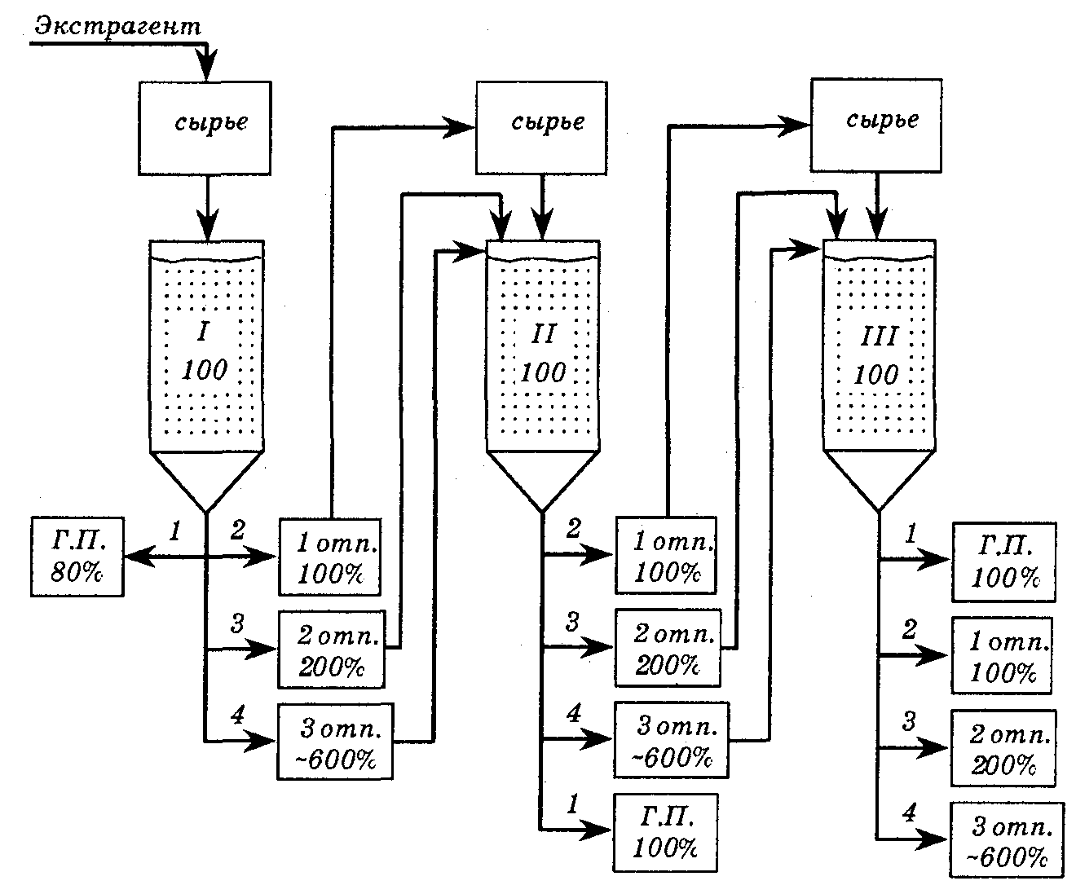
Repercolation with the division of raw materials into equal parts with an unfinished cycle
extractant
The first portion of the raw material intended for loading is pre-soaked in equal or half volume extractant in relation to the mass of raw materials. After swelling for 4–6 hours, the material is placed in percolator 1 and infused for 24 hours with a volume double in relation to the weight of the raw material extractant.
Raw material
Raw material
Raw material
Final product
Final product
Intermediate
100%
Intermediate
100%
Intermediate
200%
Intermediate
200%
Intermediate
100%
Intermediate
600%
Intermediate
600%
Intermediate
200%
Final product
Intermediate
600%

Slide 16
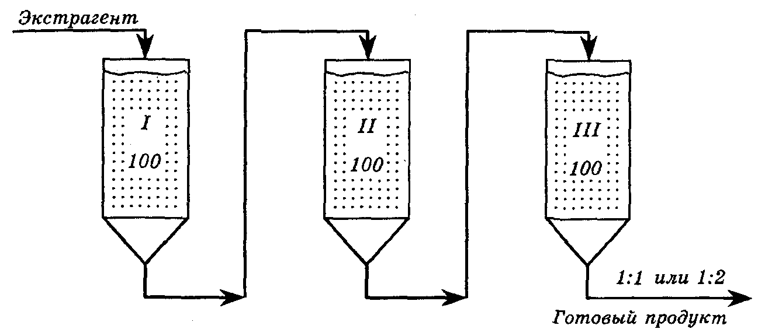
Repercolation by method Bosina
extractant
Final product

Slide 17
Raw materials are loaded in equal amounts into each battery percolator. Raw materials in the 1st percolator are extracted with pure extractant, in subsequent ones - by intermediant product after the extraction of raw materials from the previous percolators. The number of percolators is selected in such a way that the hood turned out from the last percolator in a volume equal to the entire mass of the extracted material, i.e. 1: 1.

Slide 18
Method repercolation according to Chulkov
It was proposed in 1943 and found application in pharmaceutical industries that have been working on this scheme for a long time. Extraction is carried out in a battery of 4 or more percolators. There are two periods: during the start-up period loaded daily by one percolator and the finished product is not drained. An equal amount of raw material is loaded into each percolator, which is pre-filled with an equal amount of pureextractant (for the 1st percolator) or extract obtainedfrom the previous percolator (for the 2nd and all subsequent percolators). The swollen raw material is loaded into the first percolator, pouredextractantto the mirror and leave for a day. The next day, extracts are drained from the first percolator in two steps: the first extraction is in a volume equal to the mass of the raw material loaded into the percolator, used to soak the raw material for the second percolator, and the second extraction is in double the volume in relation to the mass of the raw material used for infusion raw materials in the second percolator. At this time, the first percolator is served with freshextractantin an amount equal to the amount of extractions. On the third day, two extracts are also collected from the second percolator: for working with the raw materials intended for loading into the third percolator. Extracts from the first percolator are fed into the second percolator, and freshextractant. Further, the process is carried out in a similar way. One day after loading the last percolator begins working period. At this time, the first portion of the finished product is drained from the last percolator in a volume equal to the mass of raw materials in this percolator. At the same time, all extracts are drained from the first percolator and fed to the second percolator. The raw material in the first percolator is completely depleted. Freshextractantserved in the second percolator, which now becomes the tail. The first percolator becomes the head percolator in the battery. The collection of the finished product is carried out daily from the head percolator, which is each, again loaded with raw materials.

Slide 19
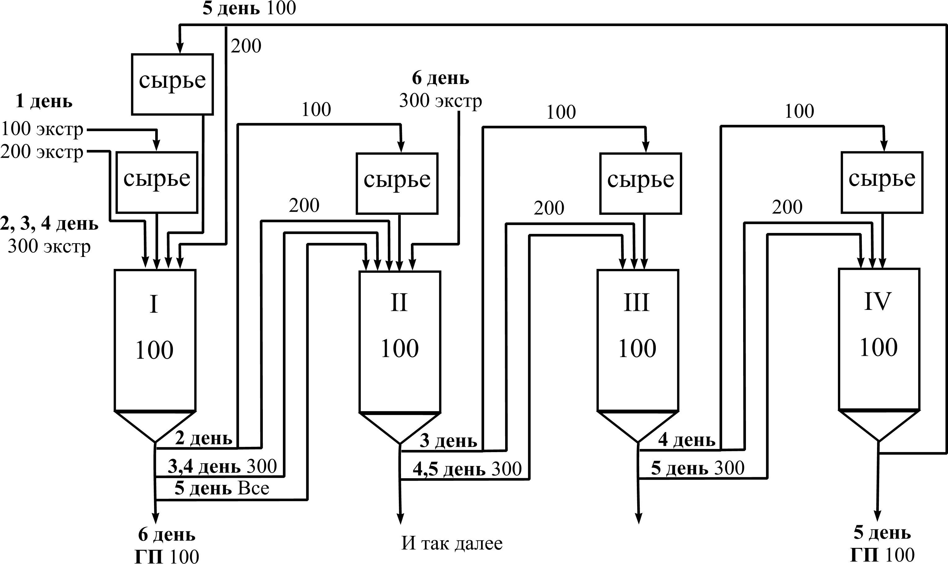
Repercolation according to Chulkov
Raw material
Raw material
Raw material
Raw material
Raw material
Final product
Final product

Slide 20
Purification
Extracts obtained by any of the above methods, in the production of liquid extracts, are defended for at least 2 days at a temperature not higher than 10 ° C until a clear liquid is obtained. Deposition is sometimes allowed in the presence of adsorbents, which contributes to better cleaning and greater stability during storage and transportation. The settled, transparent part of the extraction is filtered from accidentally trapped impurities through druk filters, filter presses or centrifuged. Finally, the residue of the extracts with the precipitate is filtered. The filtered extracts are thoroughly mixed and standardized.

Slide 21
Standardization
In liquid extracts, the content of active substances is determined by chemical methods (with the exception of liquid hawthorn extract, the quality of which is controlled biologically). The quality of some liquid extracts is determined by the amount of extractives. By established methods determine the alcohol content , density, heavy metals

Slide 22
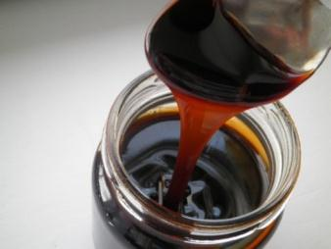
Thick (Dense) extracts are concentrated extracts from medicinal plant raw materials, which are viscous masses with a moisture content of no more than 25%. They usually do not pour out of the vessel, but stretch into threads, which then merge into a solid mass.
Due to their high viscosity, thick extracts are used as binding and forming substances in the manufacture of pills. In addition, they can be used as flavoring agents in syrups, potions or elixirs. Thick extracts are used as intermediates for a number of dosage forms (tinctures, tablets).

Slide 23
Classification of thick extracts by BAS
Basic biologically active substances | Representatives of thick extracts
Alkaloids Saponins Bitter glycosides Bitter glycosides and essential oils Phenolic compounds Vitamins Organic acids and essential oils Phytoncides Capsaicins Iridoids, flavonoids | Belladonna extract thick (Betiol suppositories) Licorice extract thick Dandelion extract thick Wormwood extract thick Male fern extract thick Nettle extract thick (Allohol tablets) Valerian extract thick Garlic extract thick Capsicum extract thick Thick water trefoil extract

Slide 24
Characteristics of soft extracts
Advantages:
Disadvantages:
1. Soft extracts are used as binding agents at the manufacture of tablets and pills due to high viscosity.
2. They also may be corrigents of syrups, liquids, elixirs.
3. Soft extract is used as intermediate products for a number of dosage forms (tinctures, tablets).
1. Inconvenience of their use and weighing .
2. They require sealed packages

Slide 25
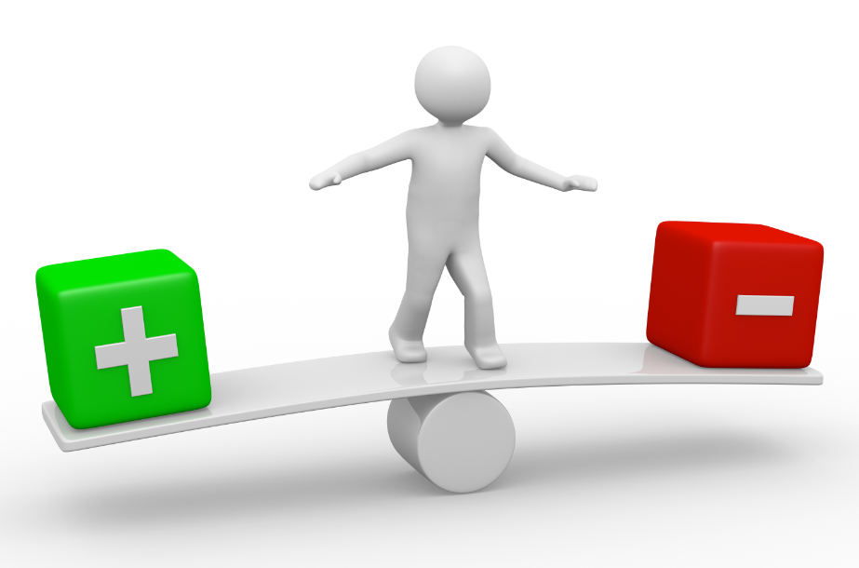
The positive qualities of these extracts are that they contain less ballast substances than liquid ones, they are more transportable.
The disadvantages of thick extracts include the inconvenience of their use, requiring certain techniques in weighing. In addition, in dry air, they dry out and become hard; in humid air - they become damp and moldy. Therefore, they require sealed packaging.

Slide 26
In the production of thick and dry extracts, various methods are used to obtain extracts from raw materials:
1) remaceration and its variants;
2) percolation;
3) repercolation;
4) circulating extraction;
5) countercurrent extraction in a battery of percolators with circulating stirring;
6) continuous countercurrent extraction with the movement of raw materials and extractant; vortex extraction; extraction using electromagnetic waves, ultrasound, electric discharges, electroplasmolysis, electrodialysis.

Slide 27
Block- scheme for obtaining thick extracts
BP - 1. Sanitary preparation of production
BP - 1.1. Preparation of industrial premises
BP - 1.2. Processing equipment
BP - 1.3. Sanitary preparation of technological clothing
BP - 1.4. Sanitary training of personnel
BP - 2. Preparation of raw materials and extractant
BP - 2.1. Grinding raw materials
BP - 2.2. Ethanol dilution
TP - 3. Extraction
TP - 4. Cleaning Extraction
TP - 5. Thickening of the extraction
TP - 6. Standardization
UMO - 7. Packing and packaging
PO - 8. Waste processing

Slide 28
Stages 1 (Sanitary preparation of production) and 2 (Preparation of raw materials and extractant) is carried out similarly to tinctures and liquid extracts.
TS - 3. Extraction. As extractants when obtaining thick extracts, we can apply:
Purified water.
For inactivation of enzymes and increasing microbiological resistance, water has, as a rule, an elevated temperature. Preservatives are often added to water, which also increases microbiological resistance (0.5% chloroform,chlorethon etc.). Acids and alkalis are often added to water to convert poorly soluble compounds into readily soluble salts.
Water-ethanol mixtures of various concentrations (usually 70% ethanol).
Volatile organic liquids (ethyl ether, dichloroethane, carbon tetrachloride).
Liquefied carbon dioxide.

Slide 29
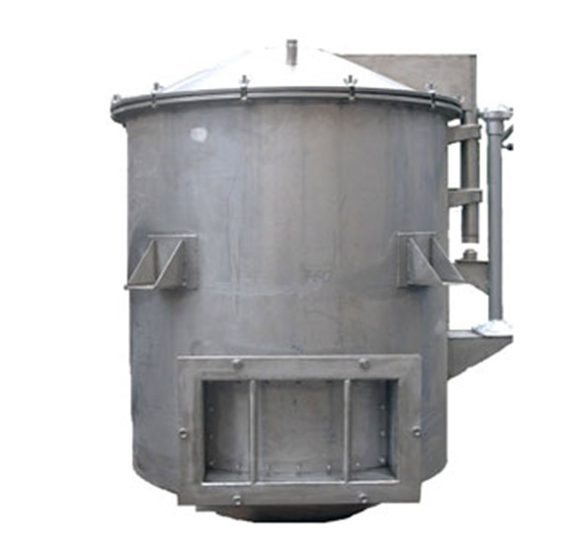
Percolation.
Process percolation at the stages of soaking and infusion, it is carried out in the same way as when receiving tinctures and liquid extracts. Actually percolation lead at the same speed until the complete depletion of raw materials without dividing into primary and secondary extractions, since then all the resulting extractions are thickened or dried.

Slide 30
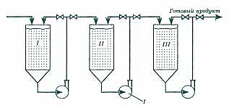
Repercolation.
It has an advantage over percolation and remaceration in that less fresh extractant is consumed and the extracts are more concentrated. Of the repercolation options, countercurrent extraction in a battery of percolators (of 3 or more) is used more often.
The extractant entering the first percolator passes sequentially through the entire battery and is discharged in the form of a saturated extract from the last percolator. A significant concentration difference is maintained in each percolator. Reducing the extraction in the battery allows the use of circulating mixing in each percolator during infusion with the help of a centrifugal pump, as the raw material in the first percolator is depleted, the second percolator becomes the tail (i.e. fresh extractant will be fed into it), and the former first, from which unloaded depleted raw materials and loaded fresh.
The method allows to deplete the raw material in each percolator to the maximum, to reduce the extraction time to a minimum, since the equilibrium concentration is reached faster during the circulation of the extractant.

Slide 31
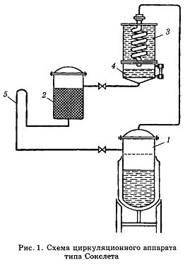
Circulating extraction
The method is based on the circulation of the extractant. The essence of the method is multiple extraction of the material with a pure extractant.
As an extractant, volatile organic solvents with a low boiling point are used - ether, chloroform, methylene chloride or their mixtures. Ethyl alcohol (even 96%) is unsuitable for these purposes, since it will adsorb moisture contained in the raw material and change its concentration, which will lead to a change in the boiling point and extracting ability.
The raw material is loaded into the extractor 2 and filled with an extractant. At the same time, a small amount of extractant is poured into cube 1. At the end of the infusion, so much extractant is drained from the collector into the extractor so that the hood reaches the upper level of the siphon loop and begins to pour into the cube. Then they begin to heat the cube. The resulting vapors of the extractant rise into the condenser, and from it into the collector. Further, the extractant is fed to the raw material. The saturated extract enters the cube again. The extractant is circulated several times until the raw material is completely depleted. The resulting extract is concentrated by distilling off the extractant into a receiver. A concentrated solution of extractives remains in the cube.

Slide 32
Continuous countercurrent extraction with mixing of raw materials and extractant.
The plant material is transported by means of transport devices: augers, buckets, discs, belts, scrapers or spring-blade mechanisms towards the moving extractant. At the same time, fresh raw materials are in contact with the outgoing extractant saturated with extractive substances, which is even more saturated, since the concentration in the raw material is even higher. The depleted raw material is extracted with fresh extractant, which extracts the remaining extractives even more completely.
From the point of view of the theory of extraction, this method is the most effective, since at each moment of the process and in any cross-section along the length (or height) of the apparatus, there is a difference in the concentrations of biologically active substances in the raw material and the extractant, which allows the process to be carried out with the highest yield and lowest cost. In addition, continuous processes are amenable to automation, which eliminates labor-intensive loading and unloading of raw materials from percolators.

Slide 33
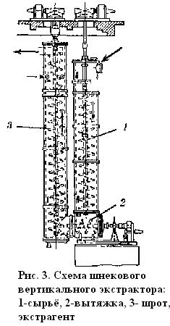
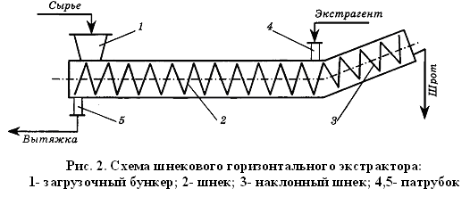
Extraction is carried out in extractors of various designs: horizontal or vertical screw, disk, spring-blade, etc.

Slide 34
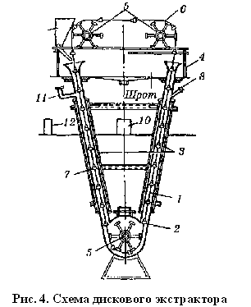
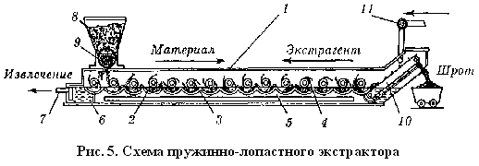

Slide 35
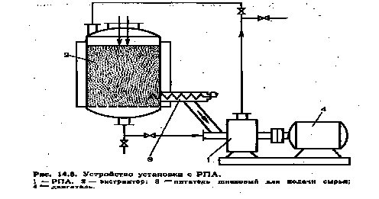
Extraction of raw materials using a rotary-pulsation apparatus (RPA).
This method is based on multiple circulation of raw materials and extractant supplied to the extractor using RPA. During RPA operation, mechanical grinding of particles occurs, intense turbulization and pulsation of the processed mixture occurs. RPA is installed below the bottom of the extractor. The raw material is loaded onto the false bottom of the extractor and filled with the extractant. The liquid phase enters the RPA through the fittings, and the raw material - using the screw. From the RPA, a mixture of crushed material and extractant (i.e., pulp) rises up and through the choke enters the extractor with a stirrer. The process is repeated until a concentrated extract is obtained.
Dichloroethane, methylene chloride, mineral and vegetable oils are used as extractants.

Slide 36
Extraction using ultrasound.
Accelerates the process of extraction from raw materials, ensuring a more complete extraction of active substances. The ultrasound source is fixed on the extractor-percolator body from its outer side. The resulting ultrasonic waves create alternating pressure, cavitation and sound wind. As a result, the material swells faster and the cell contents dissolve, the flow rate of the raw material particles increases, and turbulent and vortex flows appear in the boundary diffusion layer. Molecular diffusion inside material particles and in the boundary diffusion layer is practically replaced by convective diffusion, which leads to intensification of mass transfer. As a result of cavitation, the destruction of cellular structures occurs, which accelerates the transition of active substances to the extractant due to their washing out.

Slide 37
The use of ultrasound allows you to get the hood in a few minutes. The effectiveness of the use of ultrasound depends on the parameters of the process: the intensity and exposure of sounding, the choiceextractant, the ratio of raw materials and extractant and etc. The most optimal temperature for sounding is not higher than 30-60 ° C, in order to avoid the formation of air bubbles, damping ultrasonic waves.
As extractant preferred alcohol-water mixtures with a high concentration of ethanol, which inhibits the redox processes taking place in the ultrasonic field.
The disadvantages of ultrasonic treatment include an adverse effect on maintenance personnel. In addition, ultrasonic vibrations cause: cavitation, ionization of molecules, changes in the properties of biologically active substances, decreasing or increasing their therapeutic activity. Therefore, its application requires a thorough study....

Slide 38
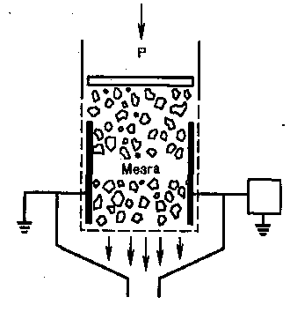
Extraction using electrical discharges.
The use of electric impulse discharges makes it possible to accelerate the extraction from raw materials with a cellular structure.
Inside the extractor from the processed raw materials are placed electrodes, to which a pulse current of high or ultra-high frequency is applied. Under the influence of an electric charge, waves appear in the extracted mixture, creating a high impulse pressure. As a result, intensive mixing of the processed mixture occurs, the diffusion boundary layer becomes thinner or completely disappears, and convective diffusion increases. Shockwave generation promotes penetrationextractantinto the cell, which accelerates intracellular diffusion. Due to the spark discharge in the liquid, plasmacaverns, which, expanding, reach their maximum volume and collapse. At the same time, in a short period of time in a small space, a large amount of energy is released and a microexplosion occurs, tearing the cellular structures of plant material. The extraction is accelerated due to the washing out of biologically active substances from the destroyed cells. In addition, the resulting cavities constantly pulsate, causing an increase in the speed of movement.extractant near the particles of raw materials and increasing the rate of extraction due to an increase in the coefficient of convective diffusion.
pulse electroplasmolyzer

Slide 39
Extraction using
electroplasmolysis and electrodialysis.
Electroplasmolysis - processing of raw materials with electric current of low and high frequency, as a result of which plasmolysis of protoplasm occurs.
The essence of the method lies in the destructive effect of the current on the protein-lipid membranes of plant tissues while maintaining the integrity of the cell membranes. Electroplasmolysis gives the greatest effect when obtaining drugs from fresh raw materials. In this case, the resulting extracts are enriched with active ingredients and contain only a small amount of related substances.

Slide 40
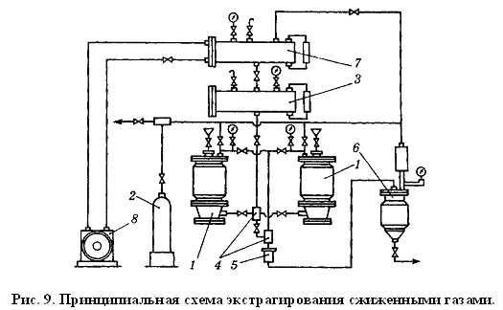
Extraction with liquefied gases.
The extraction process is carried out at an operating pressure of 10-65 atm (depending on the saturated vapor pressure of the extractant) and a temperature of 20-25 ° C. Many extracts obtained using liquefied gases are distinguished by a higher content of biologically active substances and resistance to microbial contamination. This especially applies to raw materials containing polyphenolic compounds, alkaloids, glycosides.

Slide 41
TS - 4. Purification of extracts. The choice of a method for purifying extracts depends on the extractant used.
Purification of water extracts
The purification of water extracts is the most difficult because the water removes a large amount of ballast substances. The following methods are used to purify water extracts:
denaturation (carried out by boiling at atmospheric pressure by evaporating the extraction to 1 / 2-1 / 4 of the volume, while proteins and mucus coagulate and precipitate, which is filtered);
adsorption (carried out by infusion or boiling with adsorbents: talc, bentonite, kaolin, aluminum oxide, activated carbon, crushed filter paper, followed by settling and filtering).
alcohol purification (when cleaning by the specified method, the extraction is evaporated to 1/2 part of the feedstock, strong ethanol (96%, but not less than 60%) is added, as a result dehydrating properties of ethanol IUDs lose their protective hydrated shell and precipitate, after which it is defended (no more than 10 ⁰C) and filtered).

Slide 42
Cleaning water-ethanol extractions
If as extractant are used water-ethanol mixtures of low concentration, it is possible to use all the above cleaning methods. In addition, a solvent exchange method is possible. For example: to water-ethanol water is added to the extraction, while lipophilic substances (chlorophyll, resinous substances) precipitate.
Purification of ether extracts
Purification of ether extracts is not carried out, since ether and similar solvents are extracted only lipophilic substances.

Slide 43
Methods of extracts purification
1. Boiling, then standing in cool place and filtering.
2. Boiling with adding of kaolin, then standing and filtering.
3. Alcohol-purification method:
extract is evaporated to volume lees in twice, adding of Ethylic Alcohol 96 % in double amount, standing in cool place for 7 days.
Transparent solution is poured off, alcohol is evaporated to obtaining soft extract.

Slide 44
TS - 5. Extraction thickening.
Evaporation of extractant to soft extracts production
Evaporation is process of increasing extract viscosity by removing of the extractant by evaporation in the vacuum at the temperature about 50 - 60 °C that allows to save thermolabile Components.
- evaporation temperatures must not exceed 55 ° C.
The temperature in correlation with the evaporation time is of special importance for quality of this step of manufacture, if the extract contains easily volatile or thermolabile constituents.

Slide 45
Thickening of the extract.
The cleaned extracts are evaporated under vacuum at a temperature of 50-60 ° C and a vacuum of 600-650 mm hg to the required consistency. When thickening alcohol extracts or extracts after alcohol purification first, the alcohol is distilled off without turning on the vacuum.
The equipment used for the evaporation of extracts in the pharmaceutical industry has its own characteristics. This is explained by the fact that the extract contains biologically active substances, which, when evaporated, can precipitate on the walls of evaporators heated by steam and lose their activity due to the high temperature of the walls. Therefore, devices in which there is no circulation of the evaporated extract or there is a weak circulation in pharmaceutical production are used extremely rarely. Constructions with intensive circulation are far from all widely used in factory production.
Most applicable at this stage, as reliable in operation, highly efficient, easy to maintain and low-power found such designs as a straight-through rotary, circulating vacuum evaporator and a foam evaporator.

Slide 46
Evaporation
During evaporation, the amount of liquid volatile solvent decreases and the concentration of solid non-volatile substances increases. In most cases, this process is carried out with intensive heat input to ensure that the liquid boils and vapors of the volatile solvent are rapidly generated. The vapor generated over the boiling liquid is called secondary vapor (water, ethanol, etc.).
Depending on the properties of the evaporated liquids (low-concentrated mobile or viscous, the presence thermolabile biologically active substances, etc.) and from the parameters of the heating steam, evaporation is carried out at normal pressure or under vacuum in the working chamber of the device.

Slide 47
Evaporation of solutions at atmospheric pressure
in open evaporation bowls it is rarely used, since the removed secondary steam pollutes the production area, and the concentrated aqueous solution, due to the high boiling point and the duration of the process, is at risk of overheating and loss thermolabile active substances (vitamins, alkaloids, glycosides, etc.).

Slide 48
Evaporation under vacuum
In order to preserve the active substances, evaporation with boiling of the liquid is carried out in installations in which the resulting secondary vapor above the liquid is constantly removed from the working part of the apparatus (boiler), which creates a vacuum (vacuum) and a low boiling point (40–55 ° C). Conducting the evaporation process under vacuum has significant advantages: the boiling point of the solution is reduced, valuable secondary vapor is captured, and low pressure steam can be used to heat the evaporator. Due to the lower boiling point of the liquid, the average temperature difference between the heating steam and the heated liquid increases, which makes it possible to reduce the size of the evaporator.

Slide 49
Equipment for evaporation of the extractant
The rotary directly flow apparatus
Circulating vacuum evaporator by firm Simax
Foam evaporator

Slide 50
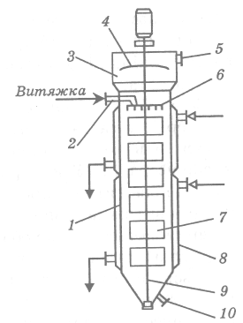
The rotary directly flow apparatus
1. Body (corpus)
2. Inlet for liquid extract
3. Separation camera
4. To backing of drops
5. To vacuum
6. To dividing of extract on the flows
7. Scrapers (blades)
8. Steam jacket
9. Shaft (rotor) rotating
10. Outlet for soft extract

Slide 51
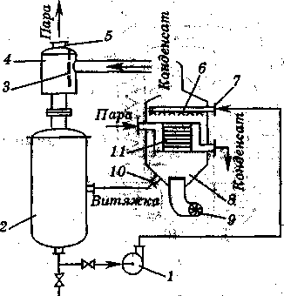
Foam evaporator
1. Pump
2. Working capacity
3. Partition
4. Separator
5. Nipple for vapour
6. Devise for distribution
7. Inlet for liquid extract
8. Camera for evaporation
9. Ventilator
10. Nipple for condensed extract
11. Horizontal hot tubes

Slide 52
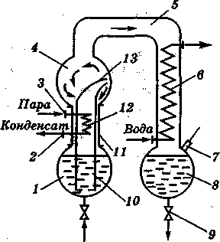
Circulating vacuum evaporator by firm Simax
1. Flask-collector
2, 3 Tubes of the heater
4. Flask for circulating of drops and vapors of extragent
5. Trunk
6. Condenser
7. Inlet for liquid extract
8. Flask for extragent
9. Outlet for extragent
10. Circulating tube for vapors of extragent
12. Heater

Slide 53
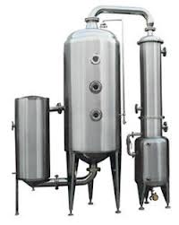
Equipment for evaporation

Slide 54
Evaporation side effects
The evaporation process is accompanied by an increase in the concentration of solutions, sometimes to the state supersaturation and the precipitation of crystals, an increase in the boiling point of the solution due to its concentration, foaming and spray-eater.
Inlay.
As a rule, for most solutions, the solubility of solids increases with increasing temperature. But the opposite picture also takes place, when the solubility of the substance decreases. Precipitation falls out of such solutions at the walls of the heat-transfer surfaces having the maximum concentration. They sharply worsen the heat transfer coefficient, reduce the cross-section of the tubes for the passage of the evaporated liquid in the apparatus and often contaminate it. To prevent the formation of scale, the liquid to be evaporated is stirred (circulation). In case of formation of precipitates, they are removed during periodic repair of the vacuum evaporator.

Slide 55
Foaming and spray-nose.
These phenomena adversely affect the operation of vacuum evaporation plants (transferliquid into the condenser) and on economic indicators for the finished product. There are a number of practical measures to help reduce or eliminate foaming in extracts containing mainly saponins. To do this, it is quite enough to choose a vacuum evaporator with a large separation chamber and centrifugal bumpers so that the foam, rising in height, is destroyed. Air bubbles carrying the liquid film burst, and liquid droplets flow into the boiler.
In tubular vacuum evaporators, the vapor-liquid mixture is given a high speed of movement and is directed to the surface of the bumpers, while the foam is destroyed by impact. To reduce foaming, some evaporator designs have mixers partially or completely immersed in the foam. The method of reducing the vacuum by introducing air into the evaporator to churn off the foam is ineffective, since it violates the evaporation mode in the installation.

Slide 56
TS - 6. Standardization.
Standardization of thick extracts is carried out according to the same indicators as for liquid extracts, plus moisture content (no more than 25%).
With an increased content of biologically active substances, thick extracts can be diluted with dextrin, sugars, molasses. With a reduced content of biologically active substances, thick extracts should be mixed with an extract with a high content of biologically active substances.

Slide 57
UMO - 7. Packing and packaging.
Packing of thick extracts is carried out in wide-necked hermetically sealed dark glass flasks.
The storage of thick extracts is carried out in compliance with the general rules for storing medicines. A feature of storing thick extracts is hermetically sealed cork, since at high air humidity they can become moldy, and at low air humidity they can turn into a solid mass.

Slide 58
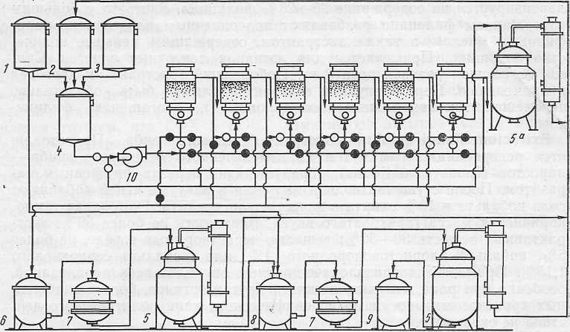
Apparatus scheme for obtaining thick extracts
I-VI - percolators
1 - measuring tank for alcohol; 2 - measuring tank for distillation, 3 - measuring tank for water; 4 - mixer, 5 - vacuum apparatus, 6 - collection, 5 a - distillation apparatus, 6 - collection, 7 - filter, 8 - settler, 9 - collection of finished product, 10 - pump.

Slide 59
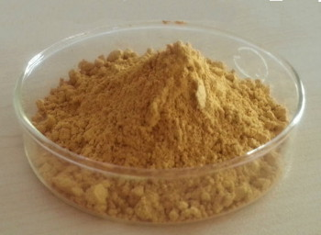
Dry extracts
Dry extracts are concentrated extracts from medicinal plant materials, which are free-flowing masses with a moisture content of no more than 5%.
Dry extracts
Extracts with limited upper limit of active ingredients
Extracts with unlimited upper limit of active ingredients

Slide 60
Extracts with limited the upper limit of active substances is obtained from raw materials containing highly active in a biological relation compounds. Such extracts must contain active ingredients in a strictly defined amount.
This is achieved by adding fillers or mixing in certain ratios extracts containing active substances more and less than the norm.
Milk sugar, glucose, potato dextrin, etc. are used as fillers. Fillers are often added to the dried product at the grinding stage.
Extracts with unlimited the upper limit of the active ingredients is obtained without the addition of fillers thereto. Such extracts are obtained from medicinal raw materials containing non-potent substances.

Slide 61
The positive qualities are that they contain less ballast substances than liquid ones, they are more transportable, very technological (easily weighed, mixed, dissolved).
The disadvantages of dry extracts include their high hygroscopicity, as a result of which they turn into lumpy masses that lose flowability.

Slide 62
The schemes of fulfilling of the dry extracts production:
Evaporation stage is included
1. Obtaining of liquid extract
2. Purification of liquid extract
3. Evaporation
4. Drying of slightly evaporated extract
5. Standardization
6. Packing, packaging and labeling of final product
Without evaporation stage
1. Obtaining of liquid extract
2. Purification of liquid extract
3. Drying of liquid extract
4. Standardization
5. Packing, packaging and labeling of final product

Slide 63
Drying of the extracts in the dry extracts production is the process of moisture removal to obtain solid or powdered product with a moisture content less than 5%.
Drying cleaned extract can be carried out in two ways:
without thickening the liquid extract
through the stage of thickening followed by drying.

Slide 64
Drying
Drying is one of the most common technological processes used in the chemical and pharmaceutical industries. It is difficult to find such a chemical and pharmaceutical production, which would not have the operation of drying one or another substance or preparation. Most often, drying is the final stage of the technological process to obtain the target product.
Drying is the process of removing moisture from a solid or pasty material by evaporating the liquid contained in it due to the heat supplied to the material.

Slide 65
In the first case, the drying of the hoods is carried out in spray dryers, where the liquid hood is sprayed into very fine droplets in a large chamber. From below, towards the settling drops, heated air (t =150-200 ° C), while overheating of the material does not occur, since all the heat of the air goes to change the aggregate state of moisture from the droplets of the extract. The temperature of the material being dried does not exceed 50-60 ° C. According to the first scheme, drying is carried out in roller vacuum dryers. The extract is slightly evaporated (so that a sufficient layer of dry extract is formed on the rotating rollers after drying) and is fed between the rollers rotating towards each other, heated from the inside. The dry crust removed from the rollers extractant, then ground in a ball mill.
Drying from a liquid state can also be carried out in freeze dryers. In this case, the extract is frozen, placed in a sublimation chamber, where a deep vacuum is created. Under such conditions, moisture from the frozen material sublimes, that is, it evaporates, bypassing the liquid phase. The drying temperature in this case is 20-30 ° C. The resulting powder dissolves very easily, contains all biologically active substances unchanged.

Slide 66
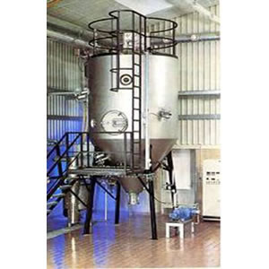
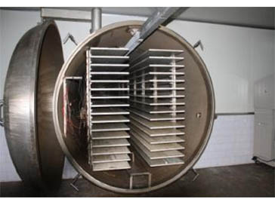
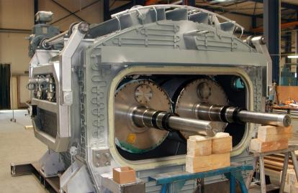
In the second case, drying is carried out in vacuum drying ovens. The thickened extract is applied in the form of a thin layer on baking sheets and dried at a residual pressure of 110-160 mm Hg. Art. (vacuum 600-650 mm Hg). During the drying process, the volume of the extract increases by several tens of times. The result is a very loose light mass in the form of cakes, which are ground in a ball mill.

Slide 67
Drying goals
facilitation and cheaper transportation of materials to increase their strength;
drying of many drugs ensures their preservation and storage;
drying is necessary for the subsequent grinding of some materials.

Slide 68
Drying basics
According to the method of supplying heat to the material to be dried, the following types of drying are distinguished:
1. Convective - by direct contact of the material to be dried with a drying agent, which is often used as heated air or flue gases (usually mixed with air).
2. Contact - by transferring heat from the coolant to the material through the wall separating them.
3. Special.
Special types of drying include: radiation - by transferring heat with infrared rays; dielectric - by heating in the field of high frequency currents; sublimation - drying in a frozen state under high vacuum. Of the special types of drying, which are used relatively rarely, sublimation has become widespread in pharmacy - for dryingthermolabile substances (enzymes, hormones, bacterial preparations, blood preparations, etc.)

Slide 69
Differences
Drying
Removal of less amount of
moisture
Drying occurs below boiling
point
Done to get a stable dry
product
Emphasize on solid product
Evaporation
Removal of large amount of
liquid
Evaporation occurs more at
boiling point
Generally done for
concentration
Emphasize on reducing the
volume

Slide 70
Dryers
Dryers can be periodic and continuous actions. Batch dryers are characterized by low productivity, cumbersome and in some cases do not meet the requirements of the industry due to the high costs of heavy physical labor, loss of finished product and pollution of production facilities. Therefore, as a rule, instead of low-performance batch dryers, it is more rational to use continuous dryers, in which a reduction in drying time is achieved, the quality of the product improves, and in addition, their maintenance is much easier. It is advisable to use batch machines in small-scale industries with a diverse range of products.

Slide 71
Types of dryers
Dryers for dilute solutions, suspensions and slurries
a) Drum dryer
b) Spray dryer
Dryers for damp solid materials
a) Tray or shelf dryer
b) Tunnel dryer
c) Rotary dryer
d) Fluidized bed dryers (FBD)
e) Vacuum dryer
f) Freeze dryer

Slide 72
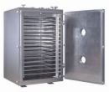
Tray dryer
Also known as cabinet or compartment dryer
These are essentially hot air ovens
Material spread in trays in thin layer
In large scale, heating is done by forced circulation

Slide 73
Convective dryers.
In convective dryers, a drying agent, preheated in a heater, moves in the dryer and comes into contact with the material to be dried. In this case, the dryer can operate according to the basic scheme, i.e. with single heating of the drying agent or with partial heating of air in the drying chamber or other options, in which the drying temperature will be lower than in the dryer according to the basic scheme, with the same total heat consumption.
Depending on the purpose, chamber, tunnel, belt and drum dryers are used.

Slide 74
Chamber dryers
are batch apparatus operating at atmospheric pressure. They are used in low-tonnage industries at a low drying temperature, for example, when drying a tablet mass. The material in these dryers is dried on trays (trays) installed on racks or trolleys located inside the drying chamber. On the frame of the chamber, between the trolleys, visors are installed, which divide the chamber space into three zones located one above the other, along which hot air moves successively. Fresh air, heated in the air heater, is supplied by a fan down the drying chamber. Here it moves (the air path is shown in the figure with arrows), changing direction twice and heating up twice in intermediate heaters. A part of the exhaust air is directed to mixing with fresh air by means of a gate. As a result, the dryer operates with partial air recirculation and reheating, i.e. according to the option providing a lower temperature and milder drying conditions.
However, due to drying in a fixed thick layer, dryers of this type have low productivity, and the duration of the process in them is long. In addition, in these dryers there is a large loss of heat during the unloading of material and a large amount of manual labor.
In such devices, drying is carried out periodically at atmospheric pressure. Dryers have one or more rectangular chambers in which the material on the trolleys or shelves is dried in a stationary state. The chambers are loaded and unloaded through the door, with the trolleys being moved manually or using winches.

Slide 75
Disadvantages of chamber dryers
long drying time, because the layer of the material to be dried is motionless;
uneven drying;
heat loss during loading and unloading of chambers;
difficult and unhygienic conditions of service and process control;
comparatively high energy consumption due to insufficient utilization of the heat of the drying agent (especially in the final period of drying).

Slide 76
Tunnel dryers
They differ from chambers in that trolleys connected to each other slowly move on rails along a very long rectangular chamber (corridor). At the entrance and exit of the dryer there are sealed doors that open for loading and unloading material. The trolley with dried material is removed from the chamber, and a new trolley with wet material enters it from the opposite end. The movement of trolleys is mechanized. The desiccant can be fed in cocurrent or countercurrent.
Such dryers usually operate with partial recirculation of the drying agent and are used to dry large quantities of bulk material. In terms of drying intensity, tunnel dryers are close to chamber dryers. Tunnel dryers have the main disadvantages of chamber dryers. A significant disadvantage of tunnel dryers is the unevenness of drying due to stratification of heated and cold air. For more uniform drying, the speed of the drying agent is increased, but as a result, the length of the corridor must be increased in order for the residence time of the material in the dryer to be sufficient.

Slide 77
Belt dryers
In dryers of this type, materials are dried continuously at atmospheric pressure. In the chamber of the dryer, the layer of the material to be dried moves on an endless belt stretched between the driving and driven drums. The wet material from the hopper is fed by the feeder 6 to one end of the belt, from the other end the material is poured onto the lower belt and so on until the last belt, from which the dried material is poured into the receiver of the dried material. Drying is carried out with a hot coolant, which moves counter-current or cross-flow to the direction of movement of the material. Such a multi-belt dryer successfully works in the production ofholosasa at the stage of drying rosehip seed meal.

Slide 78
Drum dryers
Drum dryerswidely used for continuous drying at atmospheric pressure of granular and loose materials with a moisture content of 5 ÷ 60%. The drum dryer has a cylindrical drum installed at a slight angle to the horizon (1 / 15-1 / 50) and supported by bandages on support rollers. The drum is rotated by an electric motor through a gear train and reducer. The number of revolutions of the drum is usually 5 ÷ 8 min¹... The position of the drum in the axial direction is fixed by thrust rollers. The material for drying is fed through the hopper to the feeder, where it is pre-dried by mixing with the blades of the receiving-screw nozzle, and then enters the inner nozzle located along almost the entire length of the drum. The nozzle ensures good mixing and distribution of the material over the entire section of the drum, as well as close contact with the drying agent - flue gases or hot air - during pouring. Desiccant and material are often fed cocurrently, which helps to avoid overheating of the material, since in this case the hottest drying agent is in contact with the material with the highest moisture content. The drying agent is sucked through the drum with a fan at an average speed not exceeding 2 ÷ 3 m / s. This ensures the minimum entrainment of material particles. Before being released into the atmosphere, the exhaust gases are cleaned from dust in a cyclone. At the ends of the drum, sealing devices (for example, labyrinths) are installed to impede the leakage of the drying agent.

Slide 79
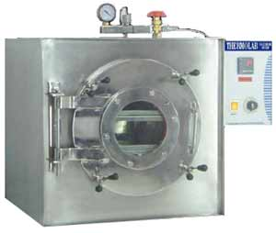
Vacuum dryer
Also known as vacuum oven
Consists of jacketed vessel
Has to withstand vacuum in the
oven and steam present in the jacket
Oven and dryer can be loaded with air tight seal
Connected to a vacuum pump through a condenser and receiver
At a vaccum of 0.03 to 0.06 bar water boils at 35⁰ C

Slide 80
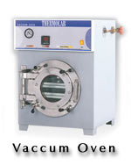
Advantages
Very suitable for heat sensitive products
Porous and friable product is obtained
Valuable solvents can be recovered
Fig: 58.5

Slide 81
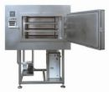
Disadvantages
Heat transfer may be low and non uniform
Limited capacity
Labour and running costs are high
Finely divided powder may be drawn into the vacuum pump
Fig: 58.6

Slide 82
Aerial dryers
Aerial dryers... For drying granularnon-sticking, wet and sufficiently large materials in suspension are used aerialdryers. These are vortex dryers, in which the swirling circulation of the material to be dried takes place. Wet material is fed into the feed hopper, which is captured by the air flow or a mixture of air with flue gases, and enters the drying chamber in the form of an expanding cone. With this shape of the chamber, the gas velocity at the bottom of the chamber exceeds the deposition rate of the largest particles, and at the top it is less than the deposition rate of the smallest particles. In this case, a more organized circulation of solid particles is achieved, which rise in the center and descend at the periphery of the apparatus. By reducing the velocity of gases as they rise, the particle size distribution is improved and dust entrainment is reduced. This, in turn, increases the uniformity of heating (smaller particles rising higher, are in the area of ​​lower temperatures) and allows you to reduce the height of the chamber. In the drying chamber, intensive mixing of the material takes place, since it is in suspension. From the chamber, the material to be dried is carried by the gas flow into the cyclone, where the material is separated from the gas.
The main disadvantage aerialdryers - uneven drying. More even drying is achieved in fluidized bed dryers.

Slide 83
Boiling dryers (fluidized) layer.
In a fluidized bed dryer, the material is deposited on a grate through which a drying agent is blown at a rate required to create a fluidized bed.
This dryer uses directional movement of the material along the grate holding it to eliminate uneven drying. For this purpose, the raw material is fed into the upper part from one side of the dryer, and the dry material is removed from the lower part on the opposite side of the unit. The most common are single-chamber dryers of continuous action. Multi-chamber dryers are also used. They consist of two or more chambers through which the material to be dried moves sequentially. For materials that are not sensitive to heat, two - andthree-section step-counterflow fluidized bed dryers. Advantages of fluidized bed dryers: drying intensity; the possibility of drying at high temperatures, a high degree of heat utilization of the drying agent, the possibility of automatic regulation of process parameters.

Slide 84
Spray dryers.
Over the past decade, the development of new methods for the administration of drugs and devices for inhalation of dry powdery substances and their needleless intradermal injection or prolonged parenteral administration of drugs has led to an increase in the need for a powder dosage form containing active pharmaceutical ingredients (API).
These dryers achieve a high rate of moisture evaporation due to fine atomization of the material to be dried in the drying chamber through which the drying agent moves. When drying in a spray state, the specific evaporation surface reaches such a large value that the drying process is completed extremely quickly (approximately 15-30 s). Under conditions of almost instant drying, the surface temperature of the material particles, despite the high temperature of the drying agent (about 150 ° C), only slightly exceeds the temperature of adiabatic evaporation of a pure liquid. As a result, fast drying is achieved under mild temperature conditions, which makes it possible to obtain a high-quality powdery product that is highly soluble and does not require further grinding.

Slide 85
Drying with a cold heat carrier is also possible when sprayablematerial is preheated. Spray freeze drying typically includes:
1) spraying liquid solution or suspension using single-liquid, pneumo- or ultrasonic nebulizers to form droplets
2) rapid freezing of these droplets in a cryogenic gas or liquid
3) sublimation of frozen water, followed by obtaining the final dry particles.

Slide 86
Standardization
Standardization of thick and dry extracts is carried out according to the content of active substances or biological activity.
The moisture content is also determined. (In thick extracts, the moisture content is not more than 25%, in dry extracts - not more than 5%.)

Slide 87
Nomenclature of thick extracts
1. Belladonna extract thick. Antispasmodic and pain reliever.
2. Valerian extract thick. Sedative.
3. Watch extract three-leaf thick. Appetite stimulant, choleretic, antiseptic.
4. Male fern extract thick. Used in the treatment of teniidosis (invasion by bovine and pork tapeworms), diphyllobothriasis,hymenoleptic dose.
5.Capsicum extract thick. Annoying and distracting.
6. Wormwood extract. It is used as bitterness as well asconstituens in pills.
7. Licorice root extract thick. Expectorant, anti-inflammatory,antiulcer means used as -constituens in pills.

Slide 88
Nomenclature of dry extracts
A. with unlimited the upper limit of active ingredients.
1. Extract of marshmallow root dry.
2. Helichrysum extract dry.
3. Adonis extract dry.
4. Buckthorn extract dry.
five. Extract lyagochilus dry.
6. Madder extract, dye dry.
7. Dry rhubarb extract.
8. Extract senna dry.
9. Dry licorice extract.
10. Dry thermopsis extract
B. with limited upper limit of active ingredients
11. Belladonna extract dry
List B.
12. Adonis extract dry. It is used for milder forms of chronic circulatory failure, soothing the central nervous system, with neuroses.
13. Dry extract of Eleutherococcus. Toning, tonic, central nervous system stimulant.

Slide 89
Oil extracts.
Oil extracts (medical oils) are extracts from medicinal plant materials prepared using vegetable or mineral oils.
Currently, oil extracts from henbane leaves (bleached oil), St. John's wort, rose hips (rosehip oil) and sea buckthorn (sea buckthorn oil) are used in medical practice.
Extraction of plant material is carried out by maceration with oils heated to a temperature of 60-70 °, as well as by countercurrent extraction with 70% ethanol or other organic solvents.

