Slide 1
Radiology is the field of medicine that uses various kinds of radiation for diagnosing and treating.
It consists of Diagnosis and Therapy

Slide 2
Radiation
X-ray
CT
Radionuclide Examination(Nuclear medicine)
Non-ionic radiation
Ultrasound methods
Magnetic resonance imaging (MRI)
Infrared examination

Slide 3
X-ray Characteristics
Penetration capacity
Arouses lightning of the laminating screen (fluoroscopy)
Photochemical reaction- arouses darkening of the film(Radiography).
Biological
Ionizing

Slide 4
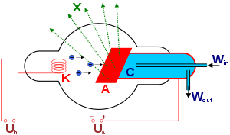
X-ray tube

Slide 5
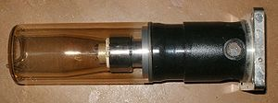

Slide 6
X-ray apparatus
Source
Receiving device (film for radiography,screen for Fluoroscopy)
Patient
Radiologist

Slide 7


Slide 8
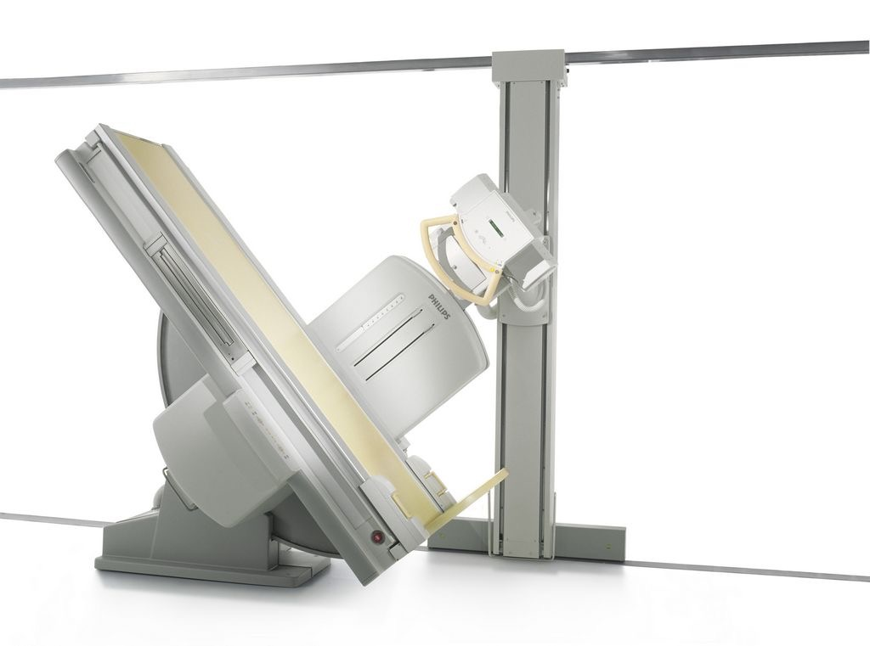

Slide 9
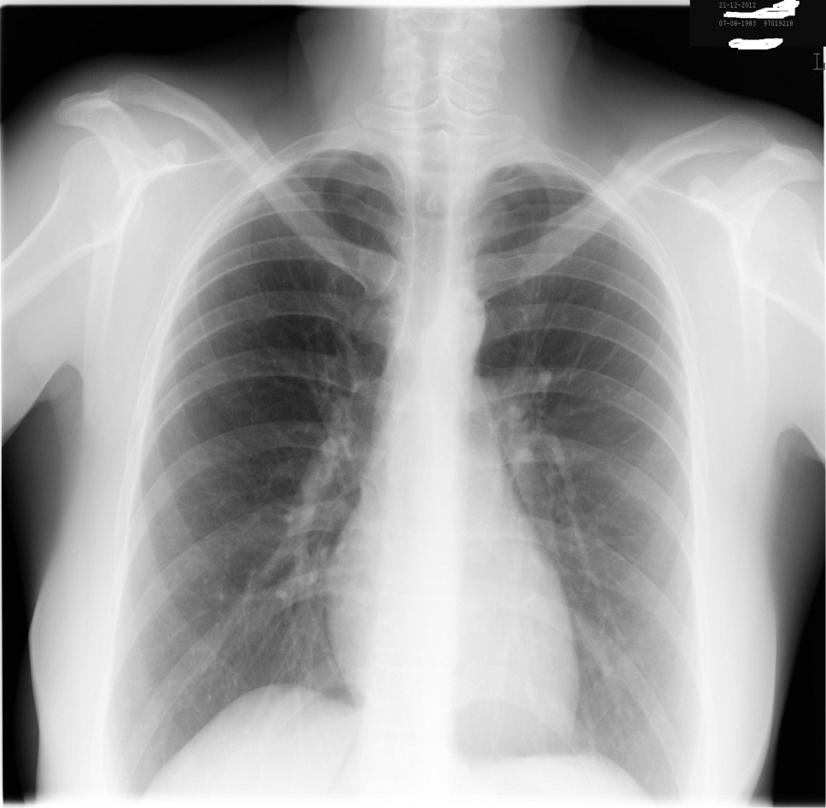
X-ray methods
Radiodraphy-the image developed on the special film.

Slide 10
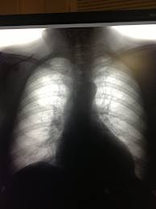
Fluoroscopy-the image is displayed on the screen. It is impossible to be printed.

Slide 11


Slide 12
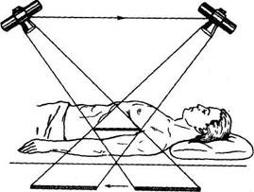
Line (classical tomography)-the reflector and the cassette move in the opposite directions.The image of the examined layer inside is imaged on the film.

Slide 13
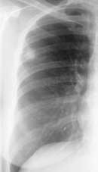
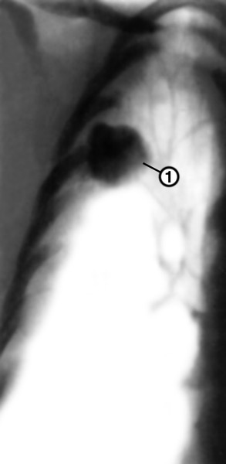

Slide 14
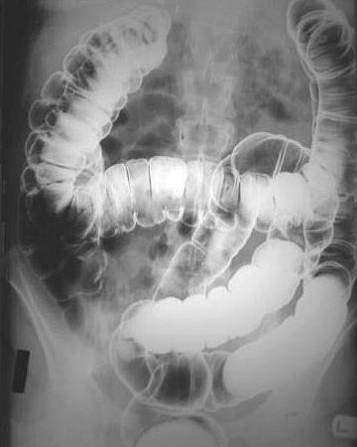
Contrast methods
Contrasts
X-ray positive substances block rays stronger than surrounding tissues
Seabar(BaSo4)
Iodine-containing substances
X-ray negative substances that block radiation weaker than surrounding tissues-gases(О2,CO2,N2O)

Slide 15
The ways of inserting contrasts
1. From natural paths and openings(per os, per rectum, per vaginum etc. .)
2. Puncturing vessels and ducts(arteriography, phlebography, lymphography etc.)
3. Puncturing natural cavities (Pneumoperitoneum, pneumothorax)
4. From the pathological exits and perforations(Fistulography)

Slide 16
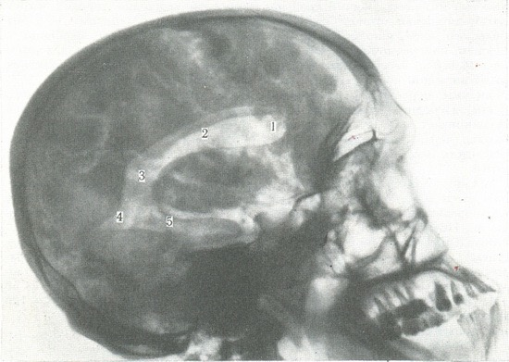

Slide 17
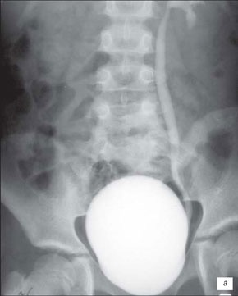

Slide 18
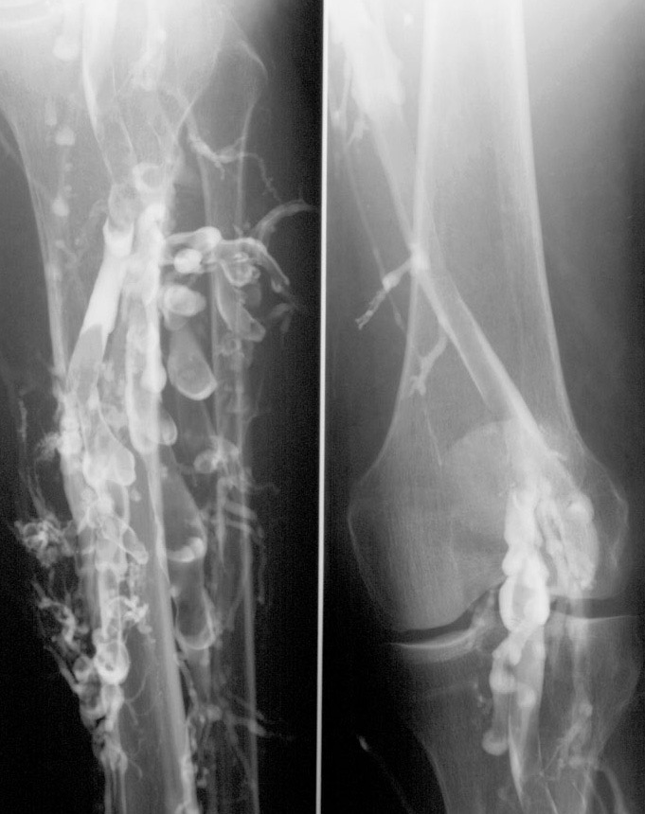

Slide 19
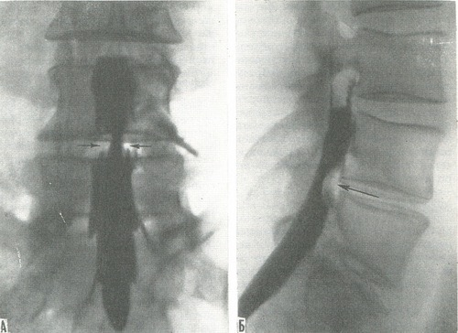

Slide 20
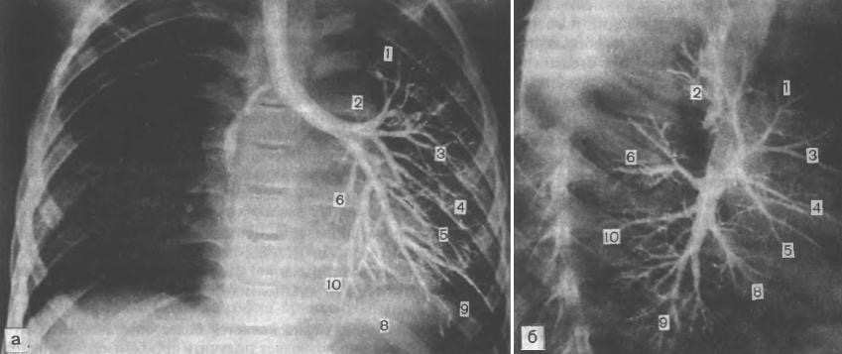

Slide 21
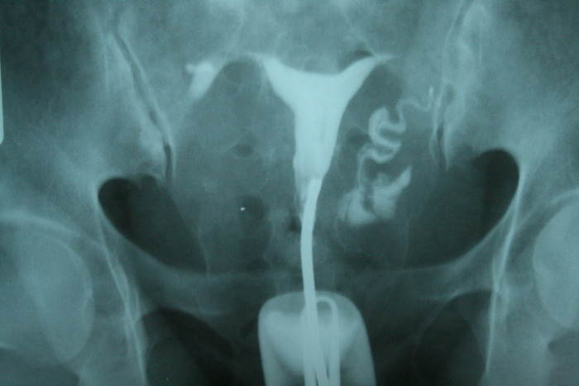

Slide 22
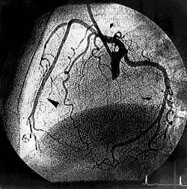
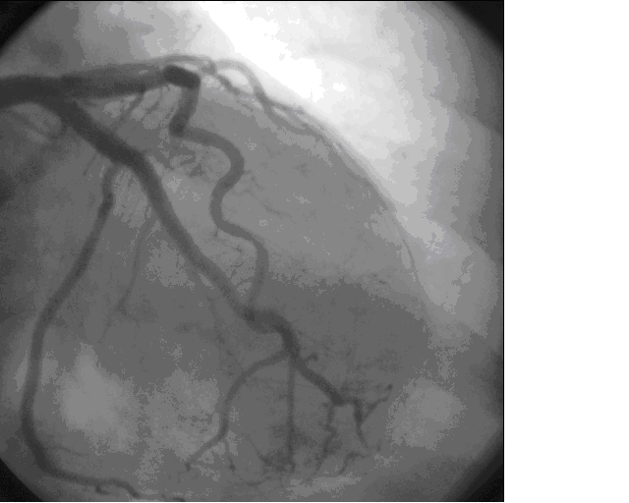

Slide 23
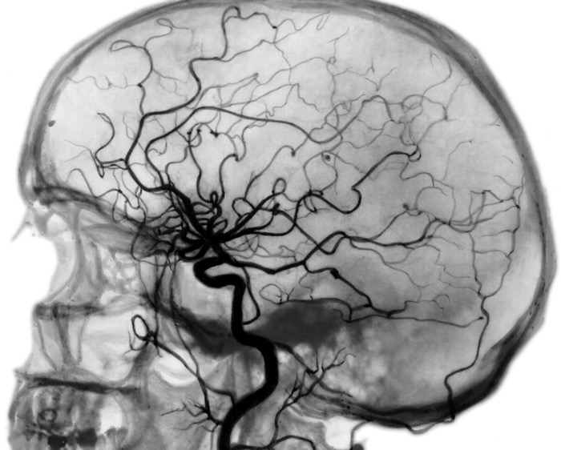

Slide 24
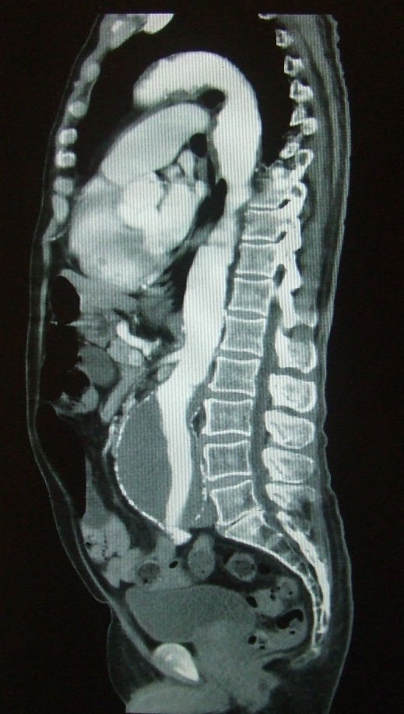
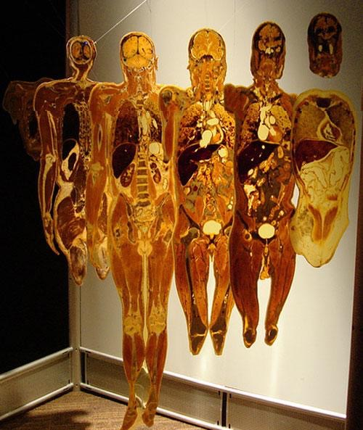
CT
- Tomographical research of inner organs using X-ray.

Slide 25
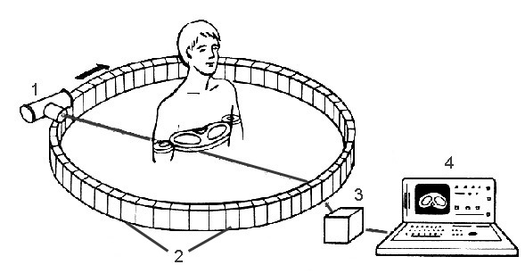

Slide 26
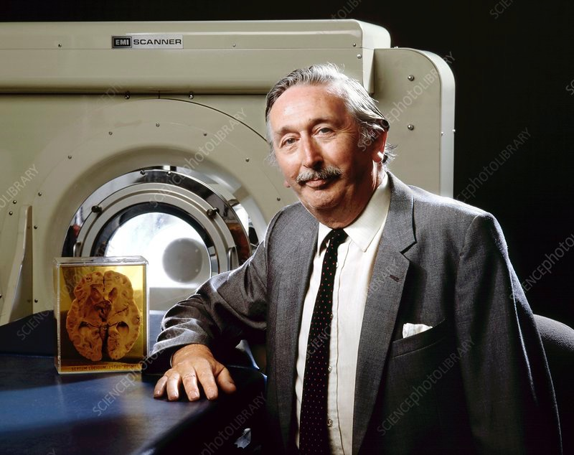
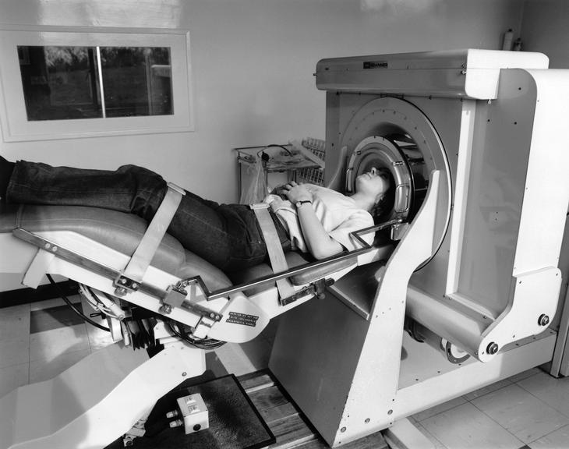

Slide 27
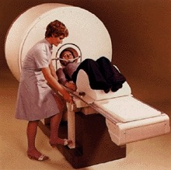
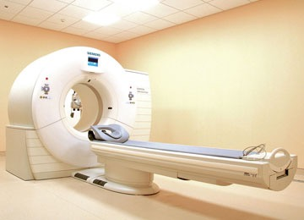

Slide 28
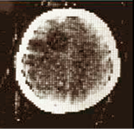
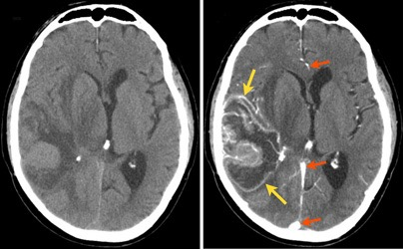
The first tomogram of the brain
1972

Slide 29
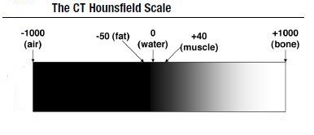
Hounsfield scale

Slide 30
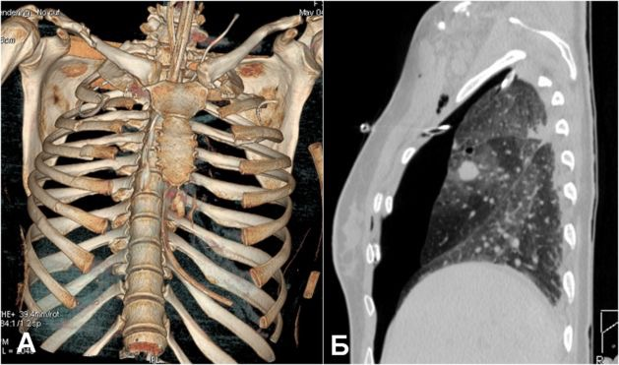

Slide 31
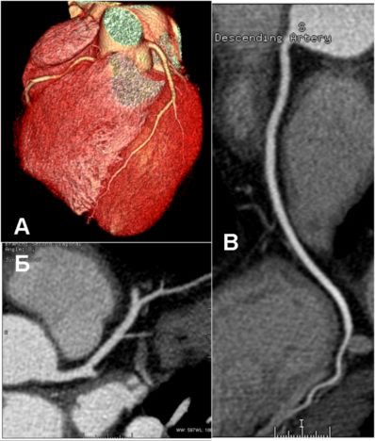
Non-invasive CT-coronography

Slide 32
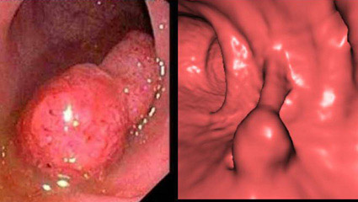
Virtual endoscopy

Slide 33
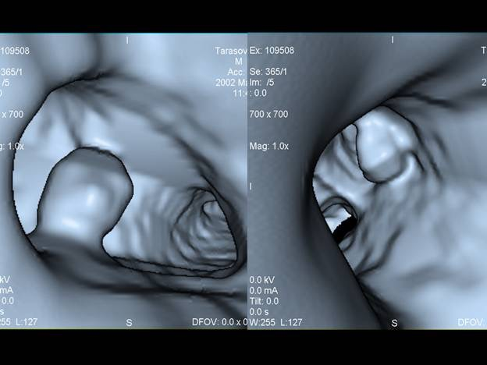

Slide 34
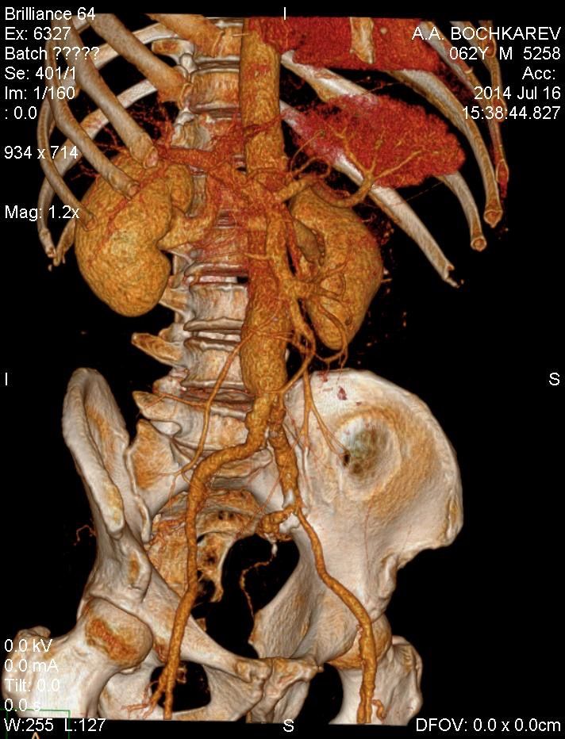

Slide 35
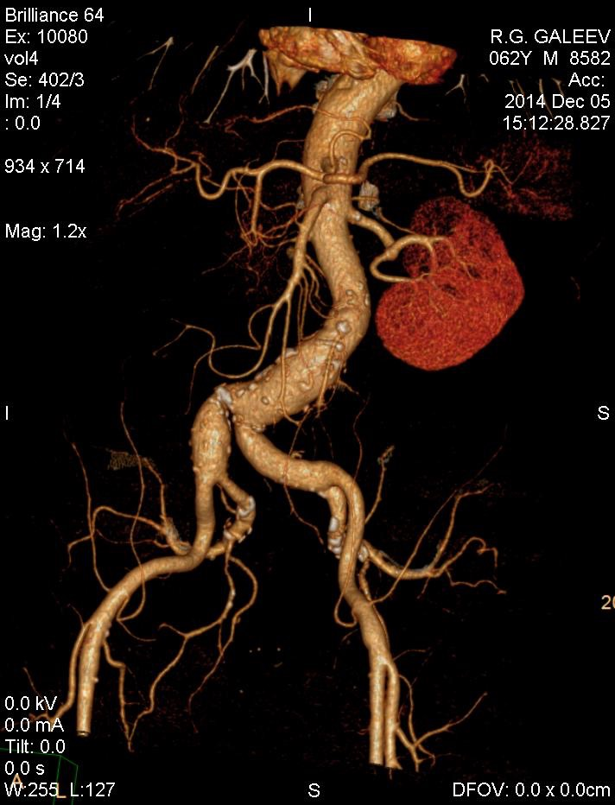

Slide 36
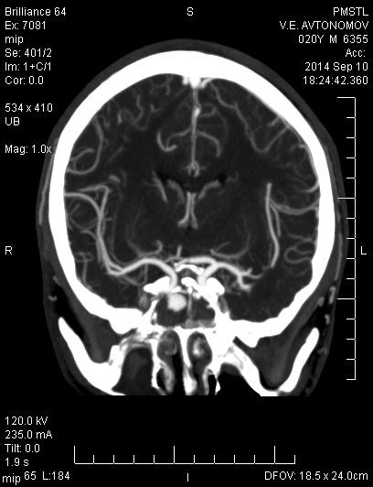

Slide 37
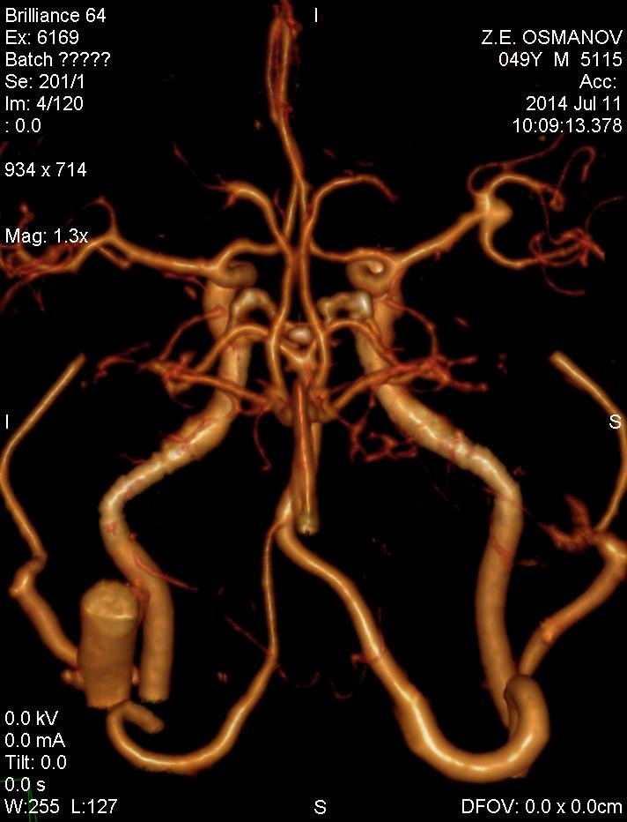

Slide 38
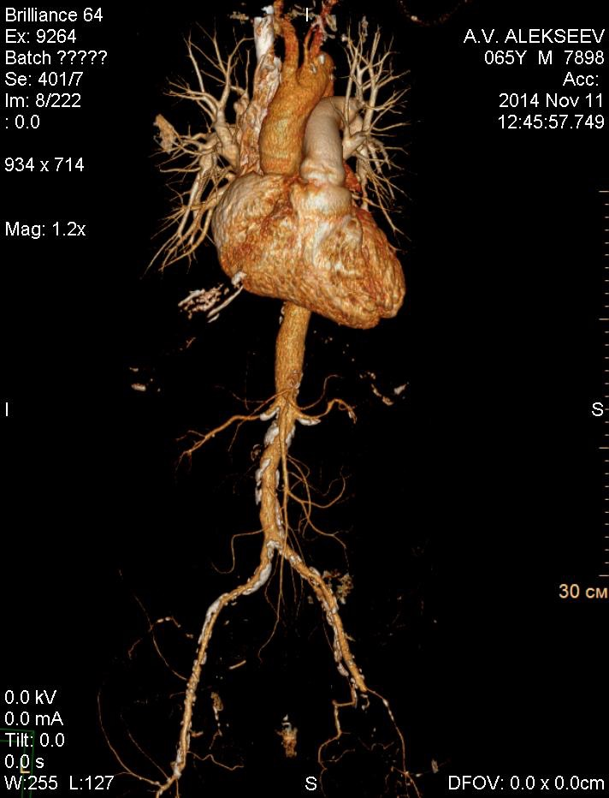

Slide 39
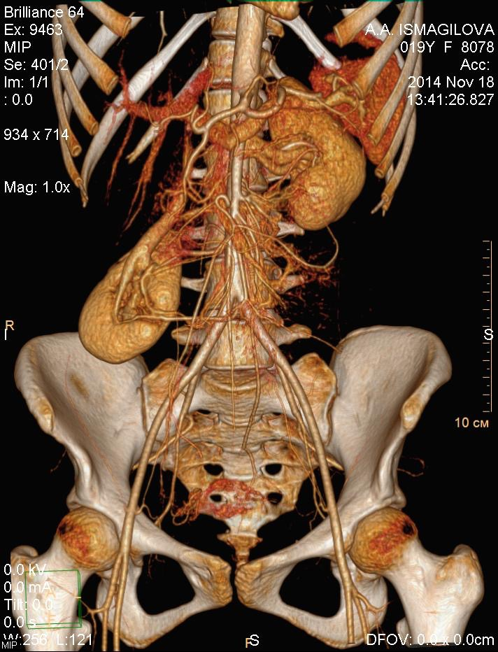

Slide 40
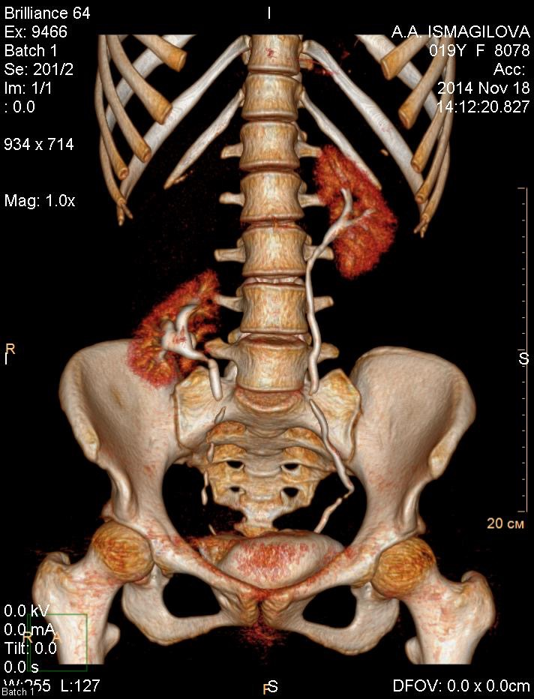

Slide 41
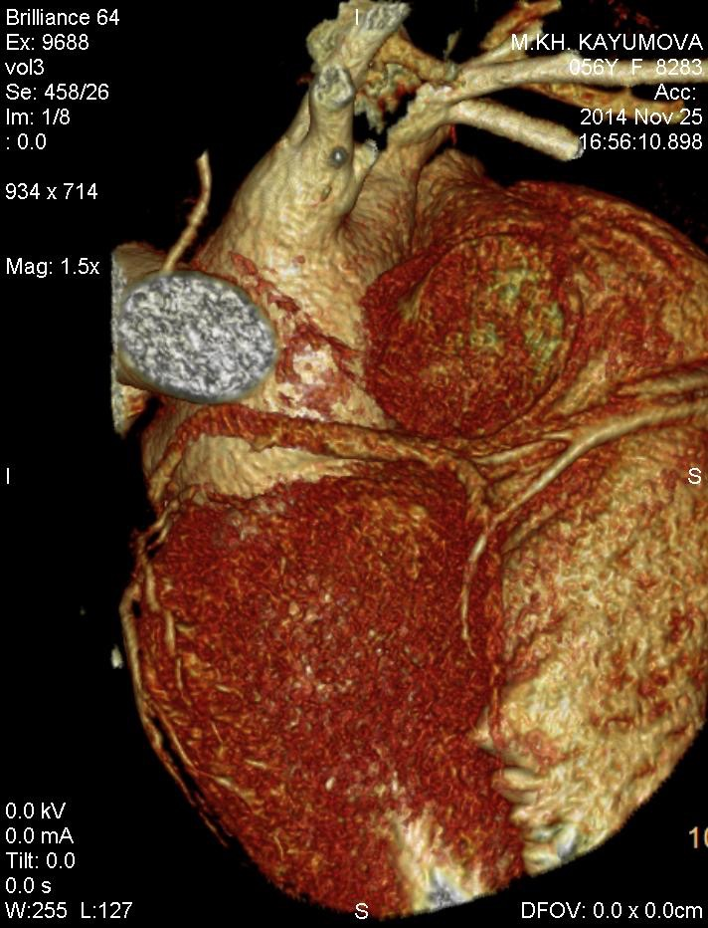
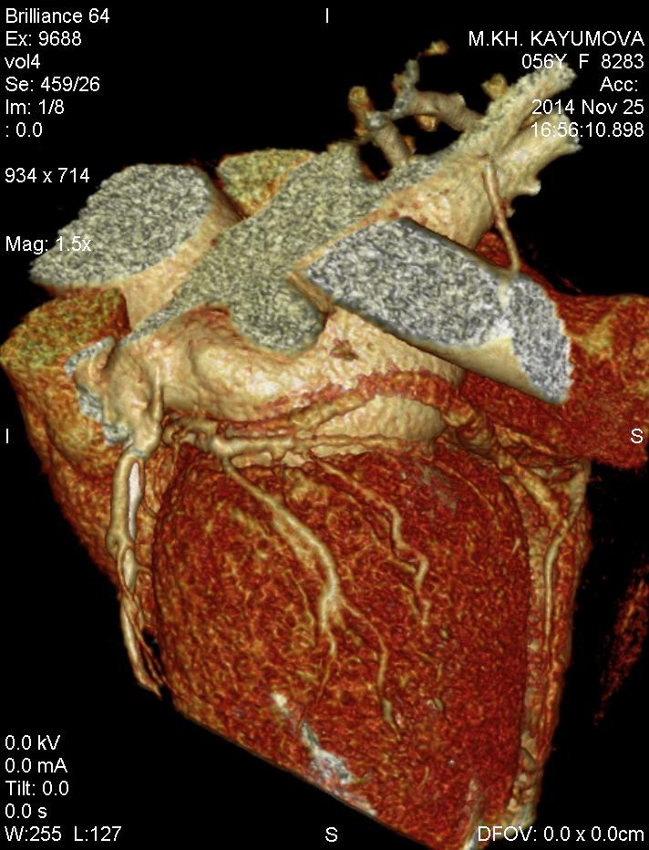

Slide 42
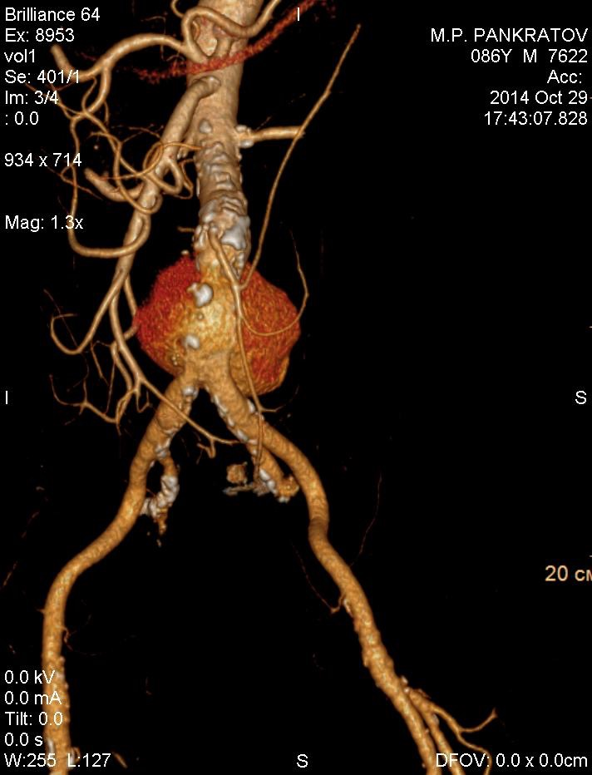

Slide 43
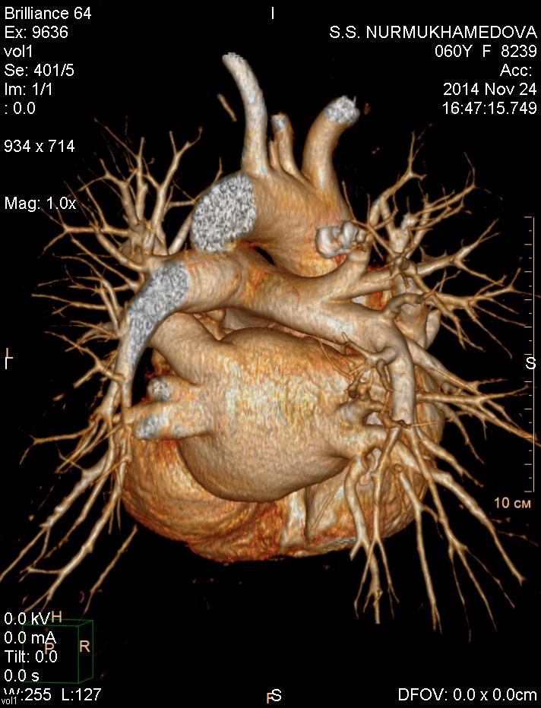

Slide 44
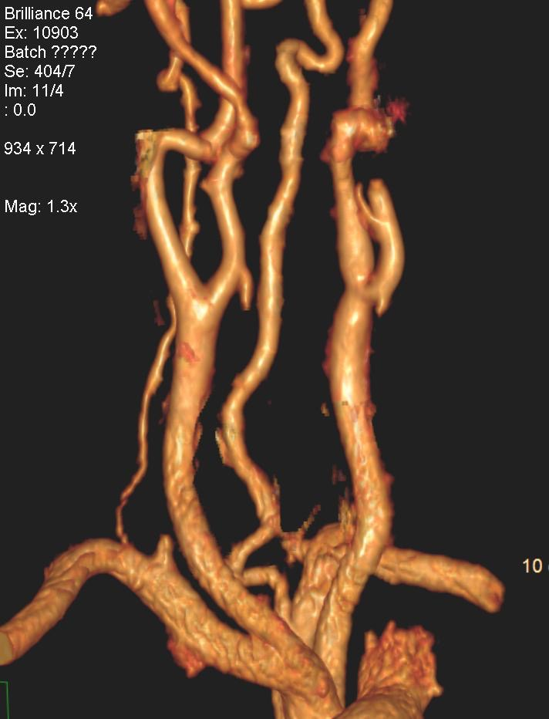

Slide 45
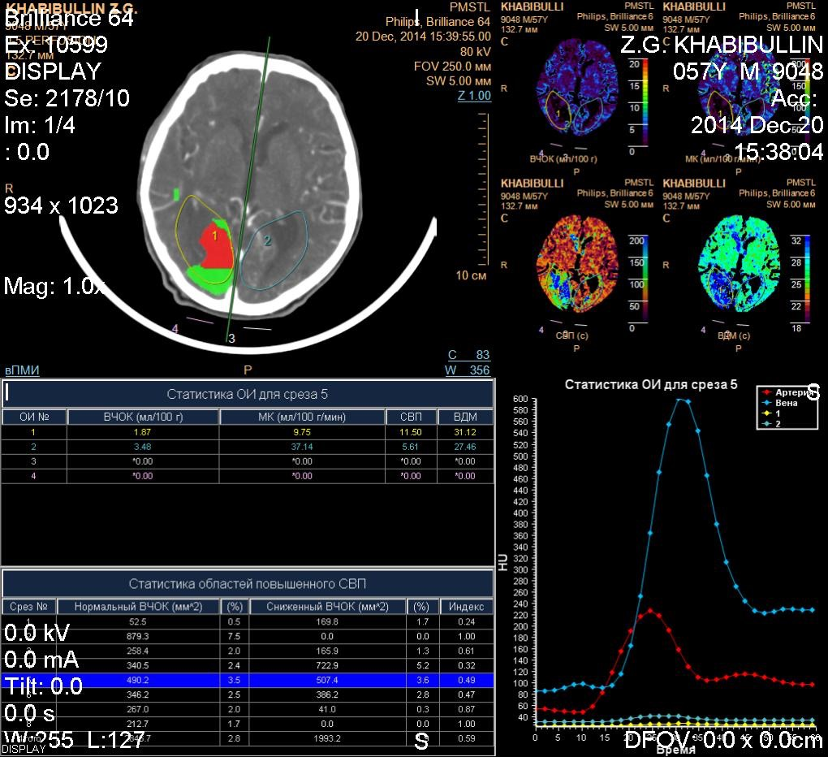

Slide 46
Radionuclide Examination(Nuclear medicine)
-is the method based on registration of gamma rays from inserted artificial radioactive matters

Slide 47
Radiopharmaceutical-Radioactive indicators inserted to the human body(circulation)
Nuclides
99Tс 6 h
113In 99 min
123I 8 d
131I 3 d
201Tl 3 d
67Ga 2,5 d
133Xe 5 d

Slide 48
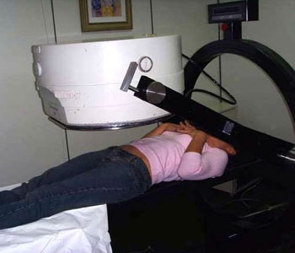
Gamma-chamber is the apparatus for the registration of spreading and dynamic activity of radioactive matter.

Slide 49
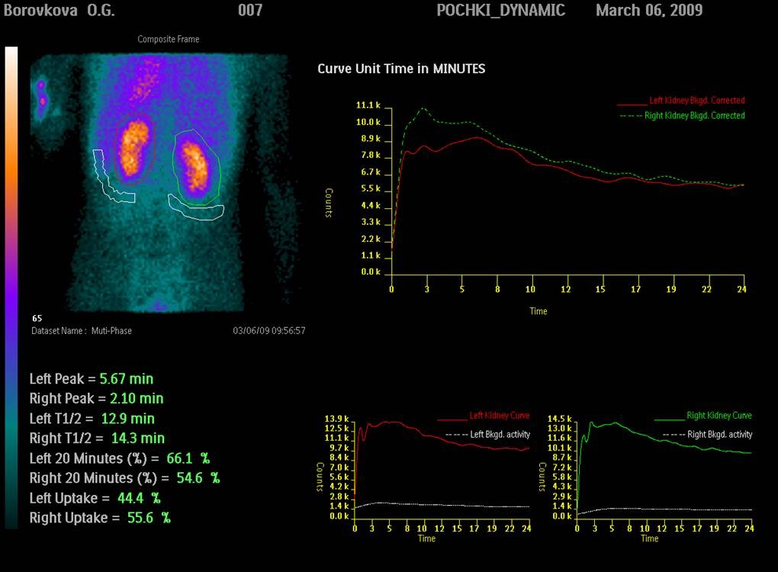
Static
Dynamic
In vivo
In vitro

Slide 50
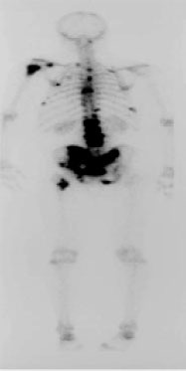

Slide 51
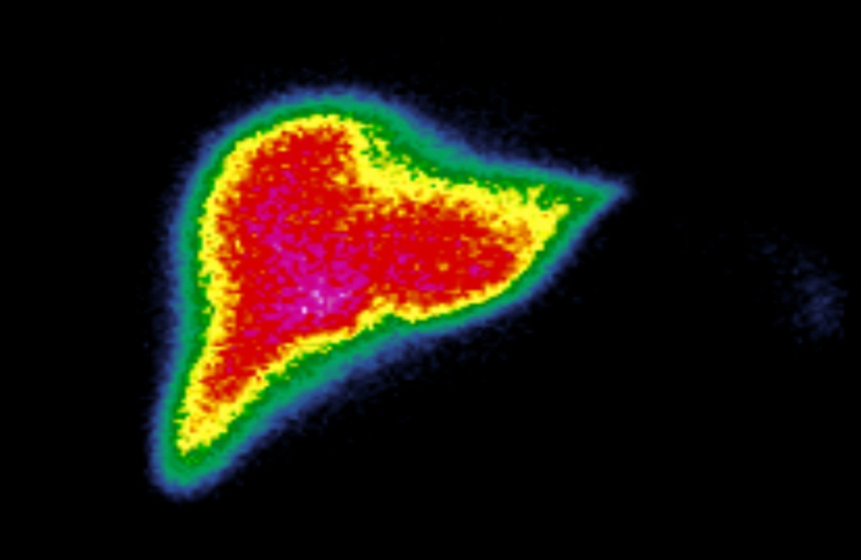
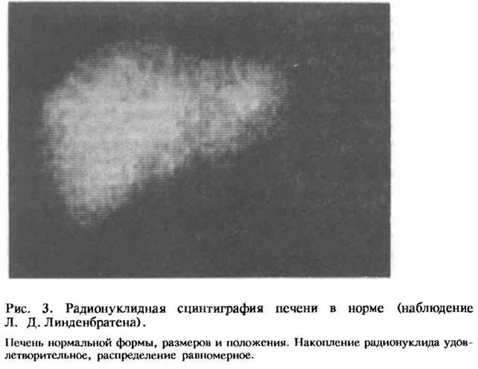

Slide 52


Slide 53


Slide 54

SPECT-Single Photon Emission Computer Tomography

Slide 55

Miocardioscintigraphy

Slide 56


Slide 57

Сцинтиграфия с туморотропными РФП

Slide 58

Positron emission tomography(pet)
The method is based on annihilation of one positron(+) and one electrone. As a result two gamma-qunta appear, which are registered by the detector

Slide 59


Slide 60

Isotops
Carbon-11 (T½= 20,4 min.)
Nitrogen-13 (T½=9,96 мин.)
Oxygen-15 (T½=2,03 мин.)
Fluorine-18 (T½=109,8 мин.)
The most often used radiopharmaceutical tracer Flourine+Glucose

Slide 61


Slide 62


Slide 63
Magnetic Resonance Imaging (MRI)
MRI is the method of topographic imaging based on phenomenon of magnetic nuclear resonance.

Slide 64



Slide 65


Slide 66


Slide 67

MR-angiography

Slide 68


Slide 69


Slide 70



Slide 71



Slide 72


Slide 73
Contraindications
- Medical devices inside the body(cardio stimulator etc.).
- Metal elements in examining area (prosthetic device,clips,debris).
- Impossibility to keep immobility during the examination.

Slide 74
Ultrasound imaging (sonography)
is the method based on receiving the images which are got with the help of Ultrasound.
Echo-signal is the signal ,reflected from the border of divisions of two mediums

Slide 75



Slide 76


Slide 77

А-regime(amplitude)-gives one-dimensional image which depends on resistance of the mediums.
М-regime(«motion»)-is the regime which displays the information about the moving walls of organs( e.g. heart)

Slide 78

B-regime («brightness») is the method based on the registration eco-signals. The image depends on the tissue resistance. The denser is the tissue the brighter is the image.

Slide 79

Doppler sonography is used to examine the blood circulation.The US-wave reflects from the vessel wall and erythrocytes at the same time.

Slide 80

Colour Doppler Imaging

Slide 81


Slide 82


Slide 83


Slide 84


Slide 85


Slide 86


Slide 87


