Slide 1
Methods of radiation diagnostics in dentistry

Slide 2
Relevance
X-ray diagnostics methods are widely used in the practice of therapeutic dentistry (to detect periodontal diseases); in orthopedic dentistry (to assess the condition of preserved teeth, periapical tissues, periodontal), which determines the choice of orthopedic measures. X-ray methods are in demand in the diagnosis of traumatic injuries, inflammatory diseases, cysts, tumors, and other pathological conditions.

Slide 3
Classification
Intraoral radiography
Periapical (contact radiography)
Occlusal radiography
Interproximal radiography
long-focus radiography
Radiovisiography
Overview radiography of the facial skull
in direct and lateral projection
in the axial and semi-axial projection
Teleroentgenography
Targeted radiography (chin; the body of the mandible; branches of the lower jaw; temporomandibular joint)
Special methods
Orthopantomography
Contrast methods (sialography; cystography; fistulography…)
CT
MRI
US

Slide 4
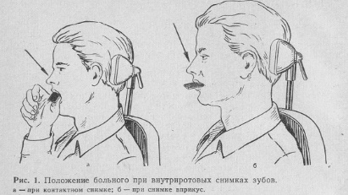
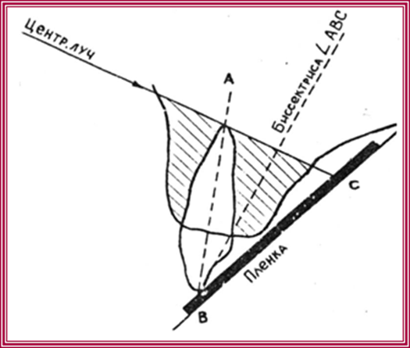
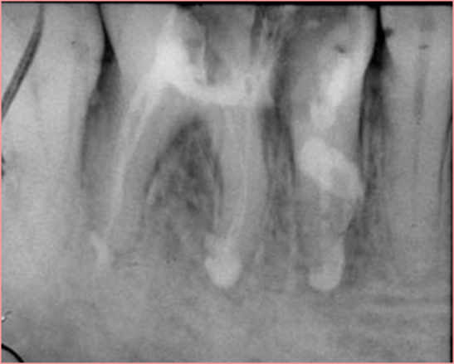
Periapical (contact radiography)
Indications
- to get a clear image of the periapical tissues;
to get an image of teeth that is identical to their true size;
- to determine the spatial relationships of objects located in the area of roots and periapical tissues.
Notes:
the Central beam is directed at the top of the root perpendicular to the bisector of the angle formed by the tooth axis and the film plane.

Slide 5
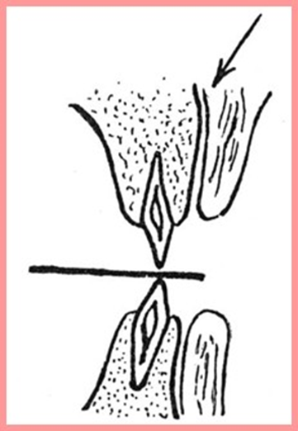
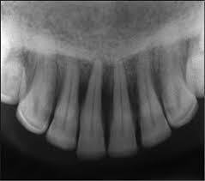
Occlusal radiography
Indications
with a high prevalence of the process (4 or more teeth);
- when searching for retinated and dystopian teeth in children;
- to study the bottom of the oral cavity, if concretions of the submandibular and sublingual salivary glands are suspected;
- to assess the condition of the external and internal cortical plates of the jaws in cysts and neoplasms;
- in cases where contact radiography is not possible (damage to the jaws).
Notes:
A 5x6 or 6x8 cm film is inserted between the dental rows and held by closing them. The Central beam is directed obliquely down to the center of the film

Slide 6
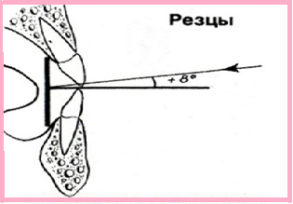
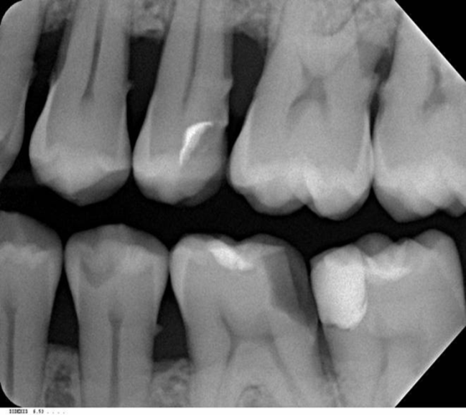
Interproximal radiography
Indications
to obtain a clear undistorted image of the marginal parts of the alveolar processes;
allows you to objectively assess the degree of bone resorption in dynamics;
is the best way to identify the proximal and cervical caries.
Notes:
X-ray film is placed in the oral cavity parallel to the dental crowns using special film holders. X-ray images show both the crowns of the teeth and the marginal parts of the alveolar processes of the upper and lower jaws. To study the entire bite, perform 3-4 shots.

Slide 7
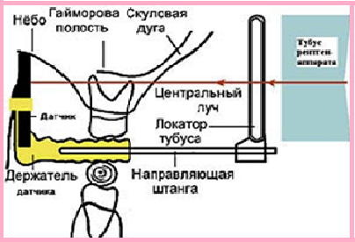
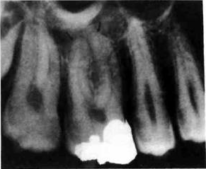
Long-focus radiography
Indications
clear, undistorted image of the marginal parts of the alveolar processes
full image of the tooth;
Notes:
The x-ray film is located in the mouth parallel to the long axis of the tooth. With long-focus radiography, the image is taken at an increased skin-focal length.

Slide 8
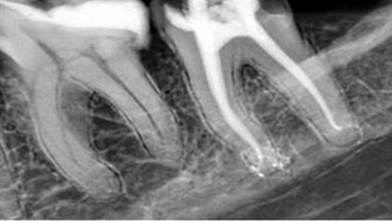
Radiovisiography
The image is recorded not on an x-ray film, but on a special electronic matrix that has a high sensitivity to x-rays.
With the help of digital processing, it is possible to study certain zones in more detail, measure the necessary parameters, in particular the length of root canals, and densitometry.
Advantages
minimum amount of time to create a snapshot;
reducing the dose of ionizing radiation;
image clarity;
the ability of the dentist to work with the image on the computer monitor (increasing the image, highlighting the relief); the ability to perform mathematical calculations to determine the density of bone and tooth tissues, accurate size determination;

Slide 9
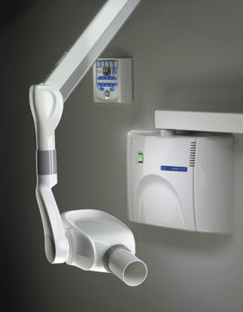
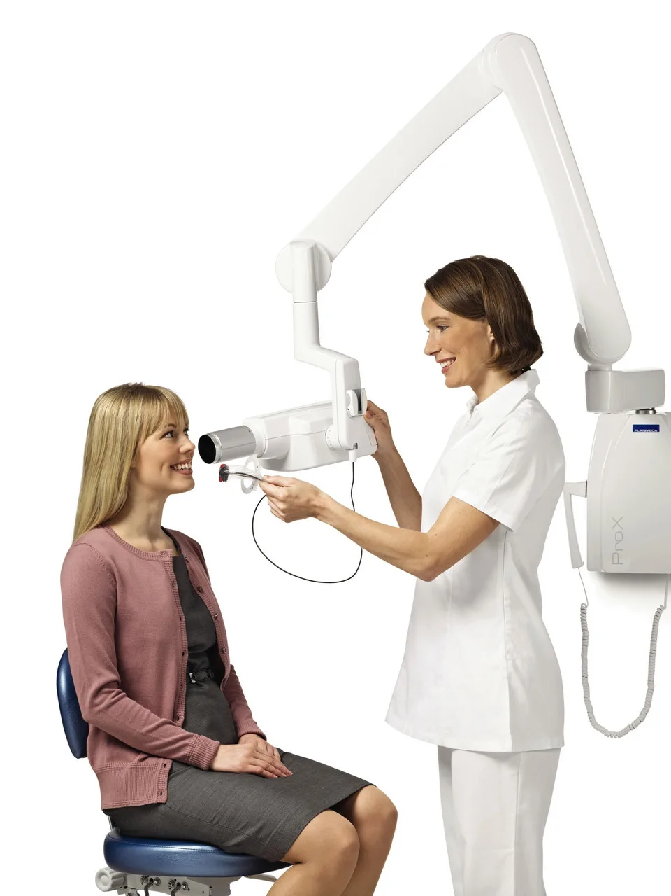

Slide 10
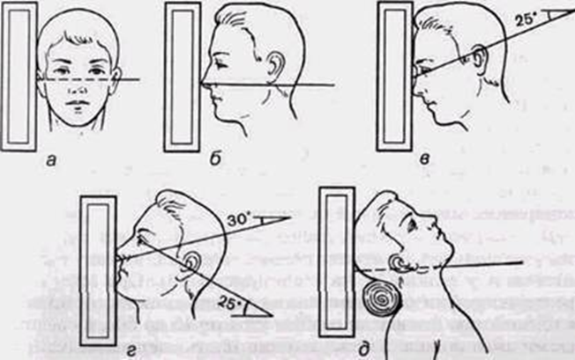
Overview radiography of the facial skull
Indications
Injuries and diseases of the brain and facial skull.
Studies of the upper jaw, maxillary sinuses, nasal cavity, frontal bone, eye socket, zygomatic bones and zygomatic arches.
А-lateral projection
Б- straight projection
В- nose forehead projection
Г - nose chin projection
Д – posterior projection

Slide 11
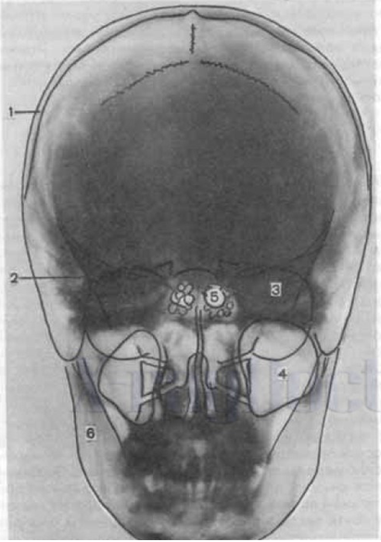
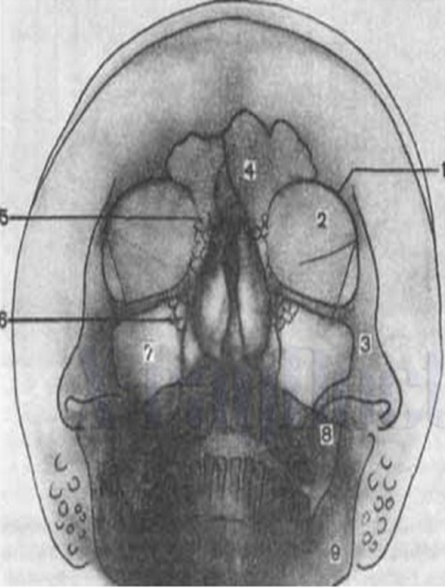
nose forehead projection
nose chin projection

Slide 12
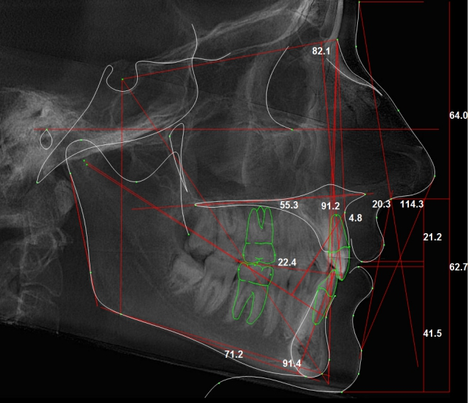
Teleroentgenography
Ability to evaluate
- the correct\incorrect location of the upper and lower jaws in the space of the skull;
- tilts of the teeth relative to the base of the skull;
- study of the ratio of dentition;
- study of congenital deformities of the maxillofacial region;
- study of acquired deformities of the maxillofacial region;
- planning of surgical and orthodontic treatment activities;
- study of the ratio of the brain and facial skull;
- assessment of the soft tissues of the face (soft palate, tongue, back wall of the pharynx).

Slide 13
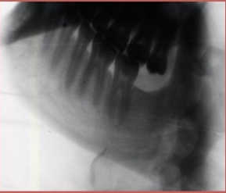
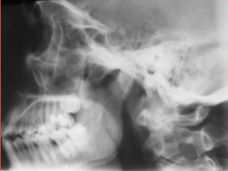
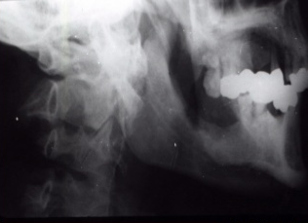
Targeted radiography
Indications
inflammatory changes;
tumor changes;
traumatic injuries of the jaws,
extensive cysts,
periodontal lesions of the lower jaw;
if it is impossible to perform intraoral radiographs
Notes:
this method is used when we want to explore a specific area.
to study the temporomandibular joint, 2 images are taken (with the mouth open and closed)

Slide 14
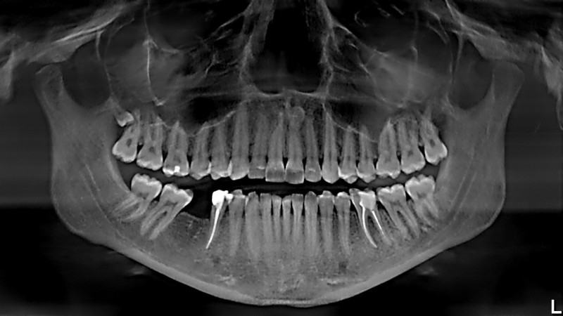
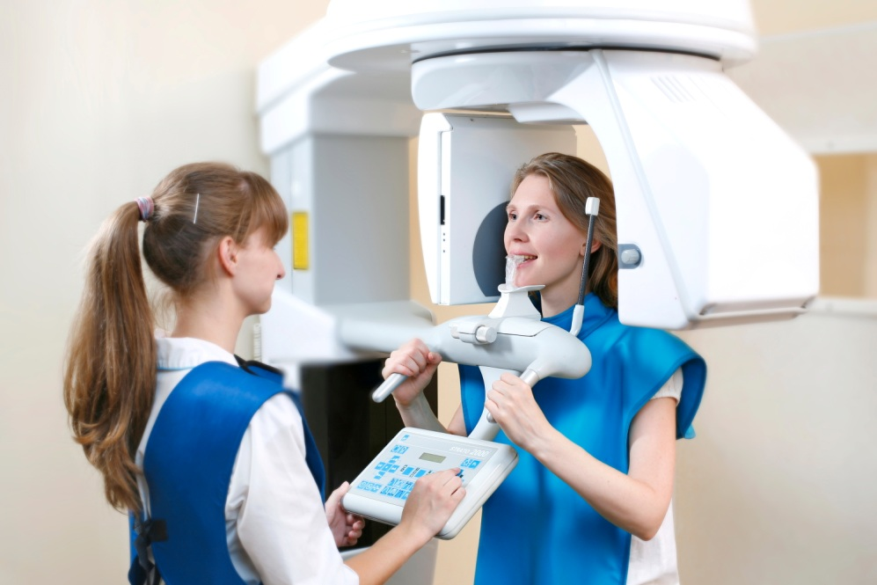
Orthopantomography
A method for obtaining an image of a curved layer on a flat x-ray film. During the shooting, the tube and film cassette describe an incomplete circle around the patient's head

Slide 15
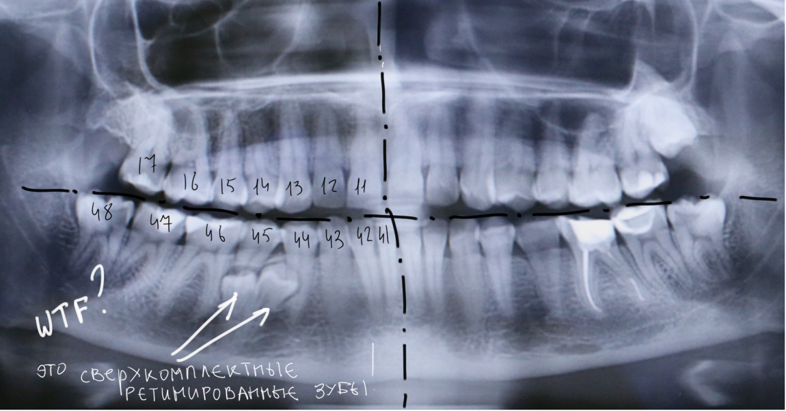
Notes:
impacted supernumerary tooth

Slide 16
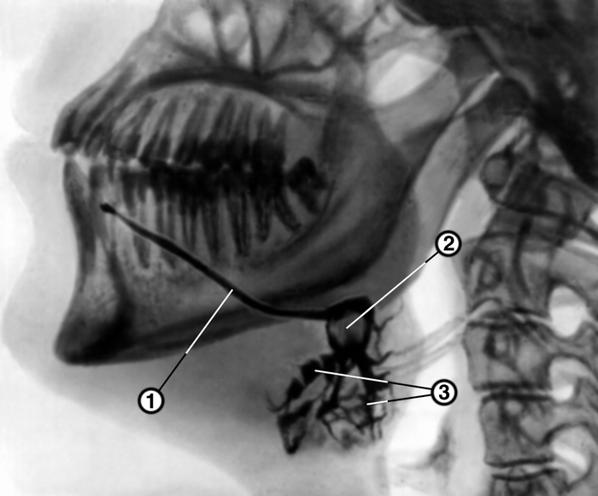
Sialography
Method for studying the ducts of large salivary glands by filling them with iodine-containing preparations

Slide 17
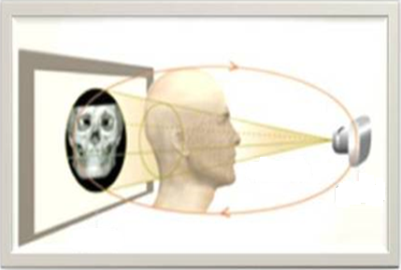
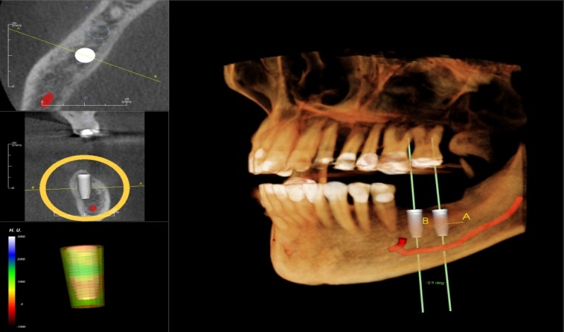
Cone-beam computed tomography
It is performed on specialized flat-sensor x-ray computed tomographs with subsequent computer processing of the obtained images in a specialized program.
Dental volume tomography is indispensable in preparation for the surgical stage of implantation. When certain x-ray anatomical features of the structure of the maxillofacial system and the maxillofacial region are detected, it is possible to avoid complications during surgical interventions and bone-plastic operations.

Slide 18
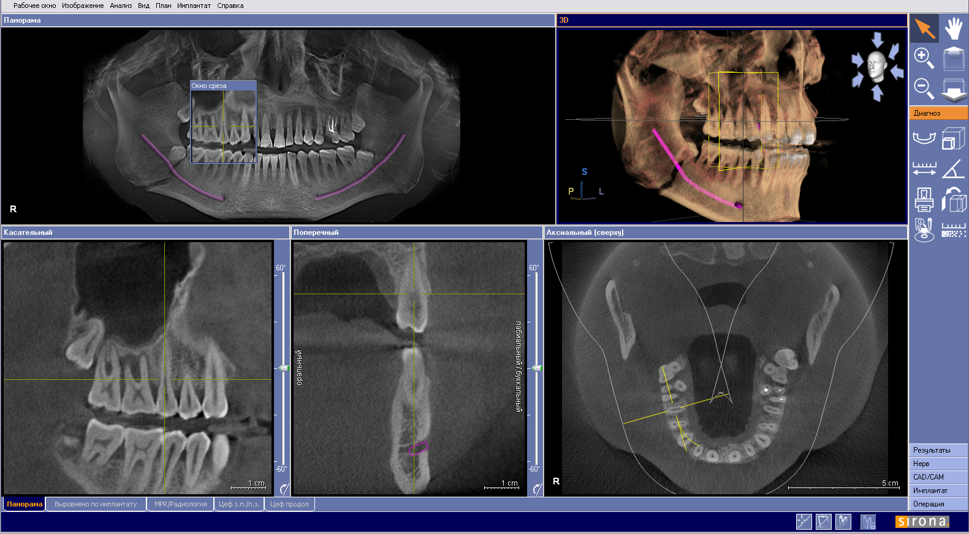

Slide 19
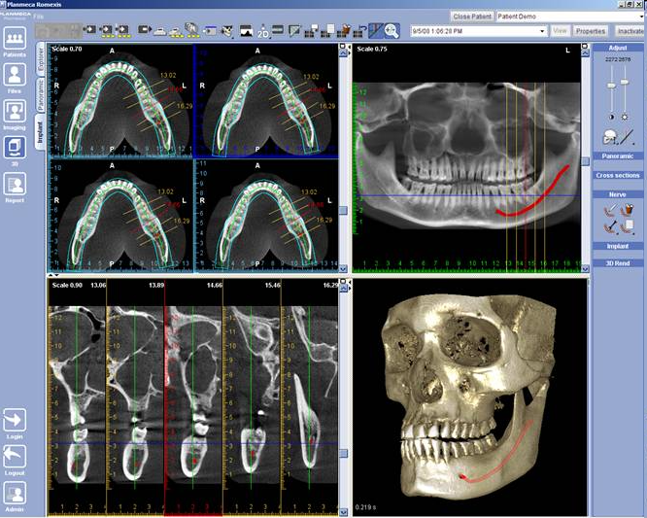

Slide 20
Cone-beam CT is used in diagnostics:
Caries and its complications
Non-carious lesions
Periodontal disease
Cysts
Tumours and tumour-like diseases
Injuries to teeth and jaws

Slide 21
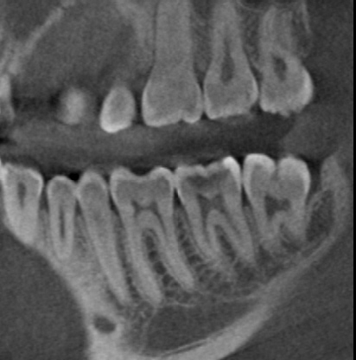
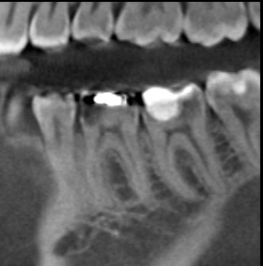
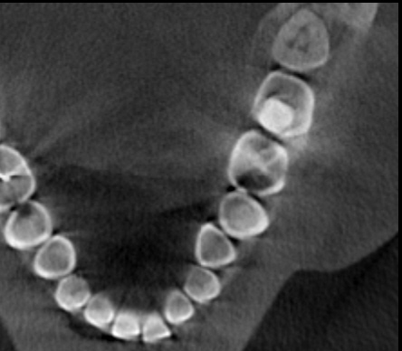
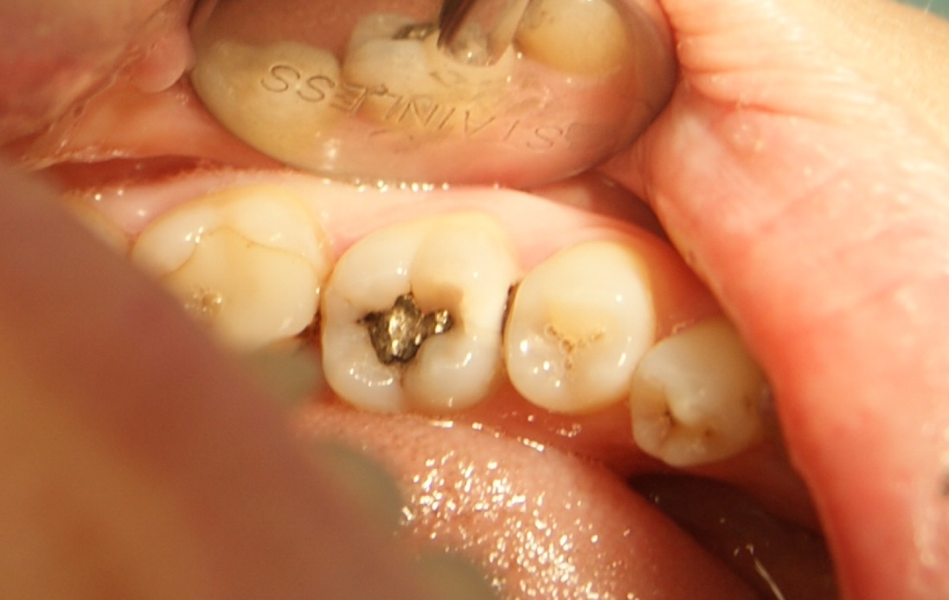

Slide 22
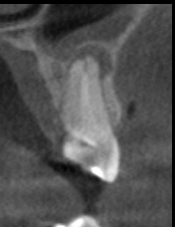
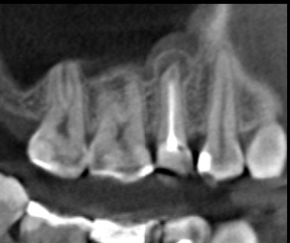
Diagnosis of caries complications
resorption foci at the top of the tooth root

Slide 23
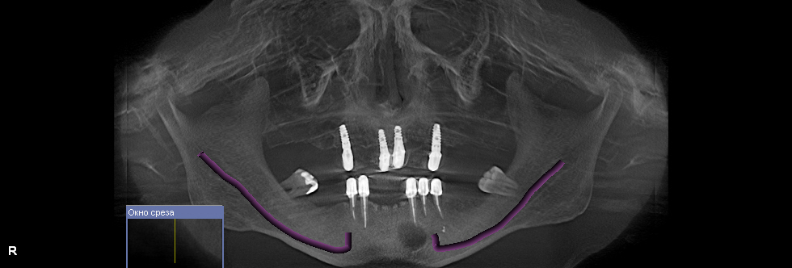
Radicular cyst
Notes:
this is a cavity formation in the area of the top of the tooth root

Slide 24
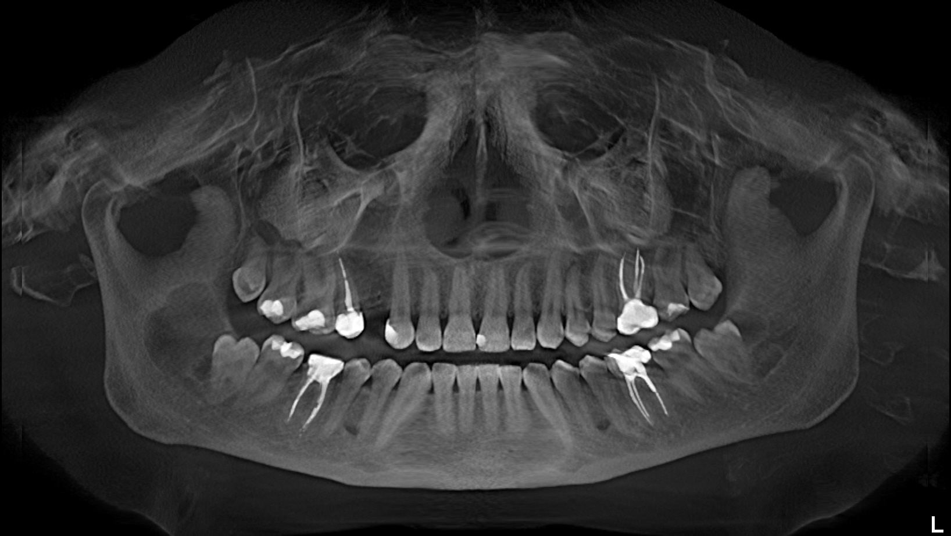
Follicular cyst
Notes:
it develops from the tissue of an uncut tooth. The cyst wall is thin, lined with a multi-layered flat epithelium.

Slide 25
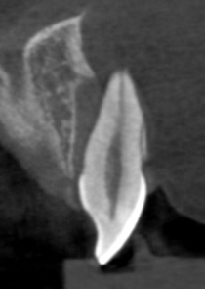
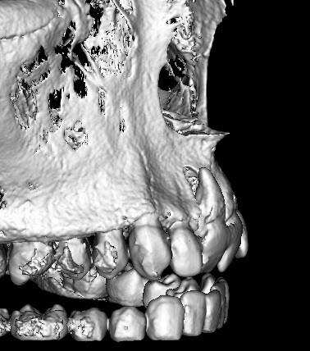
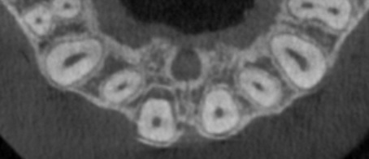
Dislocation of a tooth

Slide 26
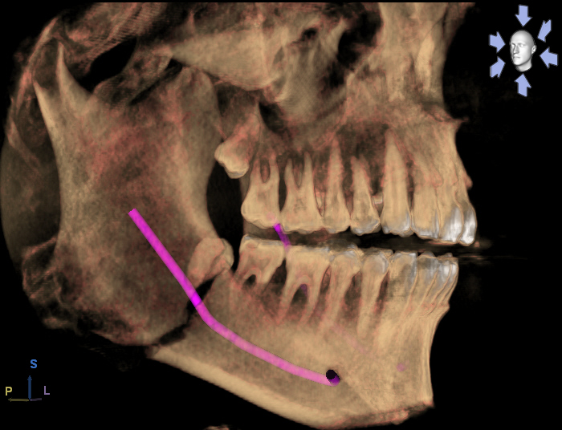
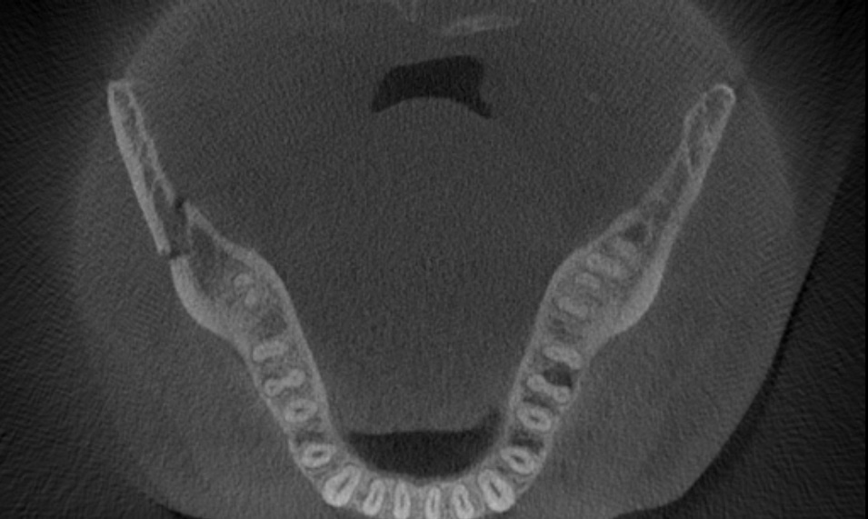
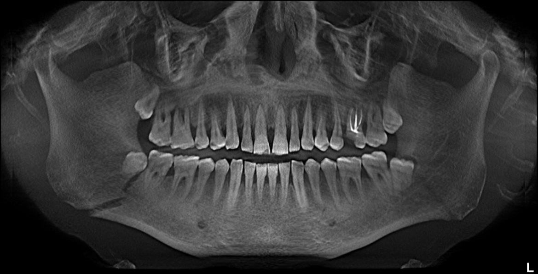
Fracture of the angle of the lower jaw

Slide 27
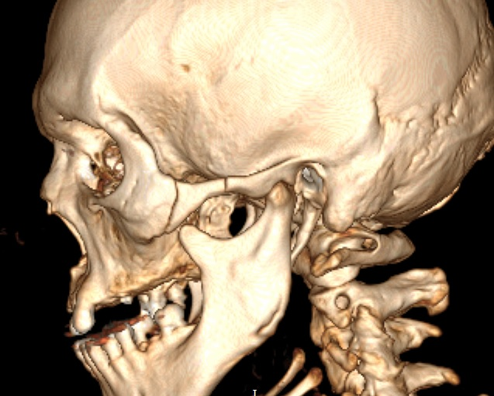
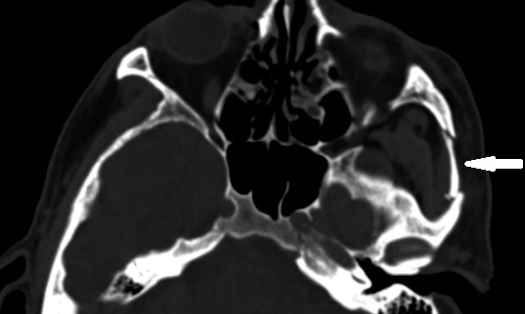
Fracture of the zygomatic arch

