Slide 1
The history of the development of maxillofacial prosthetics
disciplines "Maxillofacial surgery", module "Maxillofacial prosthetics"Topic 1.1

Slide 2
Maxillofacial orthopedics is a branch of orthopedic dentistry that studies the prevention, diagnosis and orthopedic treatment of injuries to the maxillofacial region that have arisen after trauma, wounds or surgical interventions for inflammatory processes and neoplasms.

Slide 3
Tasks of maxillofacial orthopedics
Preparation of patients for surgery;
Creating a support for soft tissues;
Postoperative wound closure;
Creating conditions for feeding patients Stages in the complex treatment

Slide 4
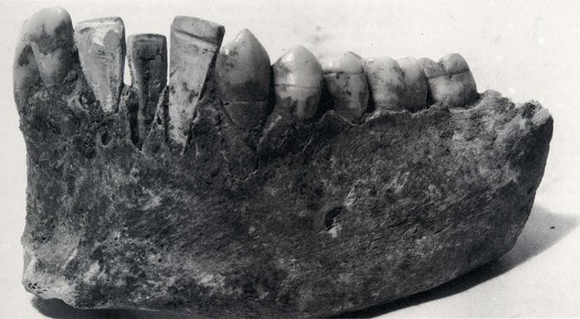
The history of maxillofacial orthopedics goes back thousands of years
Artificial ears, eyes, noses were found during excavations of ancient Egyptian mummies. It has been established that the ancient Chinese used wax to restore parts of the face.

Slide 5
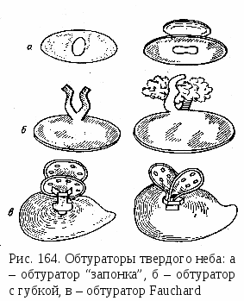
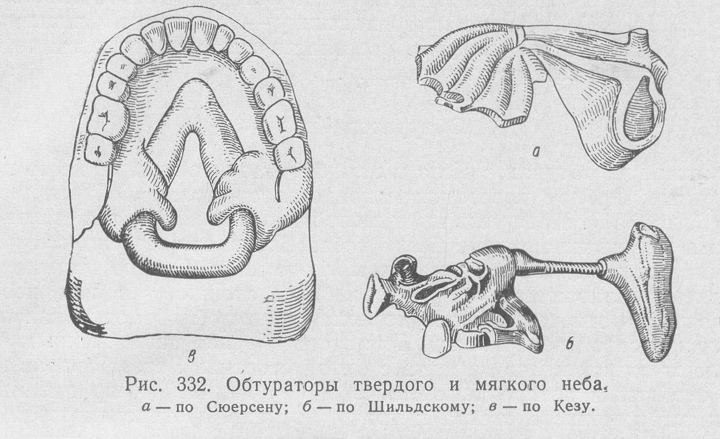
History of maxillofacial orthopedics
1575 – Ambroise Pare - prosthesis for closing the palate.
1880 – Kingsley- prosthesis to replace defects in the palate, nose and orbit.
1889 – Claude Martin, description of the design of prostheses for the replacement of defects in the upper and lower jaws, methods of direct prosthetics after resection of the upper jaw. Since that time, they began to allocate an independent section of orthopedic dentistry – maxillofacial orthopedics

Slide 6
History of maxillofacial orthopedics in Russia
1950-1980-ies CHLO was widely developed in Russia.A.I. Betelmon, Ya.M. Zbarzh, A.L. Grozovsky, Z.Ya. Shur, I.M. Oxman, V.Y. Kurdyandsky, E.I. Gavrilov and others proposed special methods of orthopedic treatment of injuries and deformities of the maxillofacial region.

Slide 7
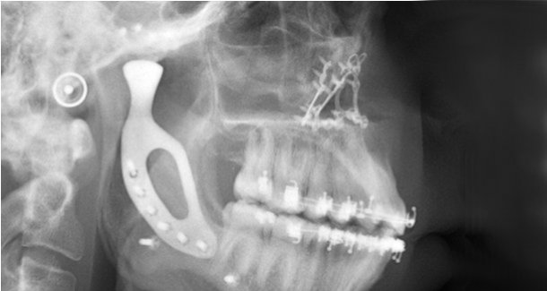
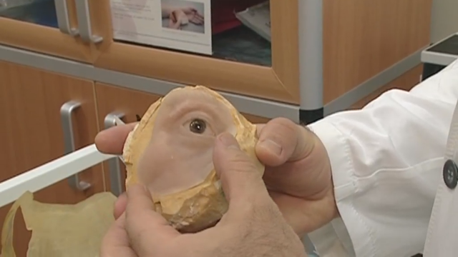
Currently, complex methods of restorative treatment using implantation technologies are being introduced

