Slide 1
Orthopedic treatment of fractures of the upper jaw

Slide 2
Damage to the face and jaws
Gunshot Non-gunshot
] origin

Slide 3
Isolated injuries of soft tissues with violation of the integrity of the skin of the face and oral mucosa (penetrating into the oral cavity)
Damage to the soft tissues and bones of the face with a violation of the integrity of the skin of the face or oral mucosa or closed injuries of the bones of the facial skeleton
Damage to the soft tissues and bones of the face (open and closed), combined with damage to other areas of the body

Slide 4
I. Damage to teeth (upper and lower jaw)
II. Fractures of the lower jaw
a. The nature:
- Single
- Double
b. By localization:
- alveolar part
- chin part of the body of the jaw
- lateral part of the body of the jaw
- jaw angle
- branches of the jaw

Slide 5
III. Fractures of the upper jaw
- alveolar process
- jaw bodies without nasal and zygomatic bones
- jaw bodies with nasal bones (craniocerebral separation)
IV. Fractures of the zygomatic bone and arch
- zygomatic bone with damage to the walls of the maxillary sinus or without damage
- zygomatic bone and arch
- zygomatic arch

Slide 6
V. Fractures of the nasal bones (with or without displacement of fragments)
VI. Combined injuries of several bones of the face (both jaws, lower jaw, zygomatic bone)
VII. Combined injuries of the face and other areas of the body

Slide 7
Fractures of the alveolar process (partial fracture or defect, complete avulsion or defect)
Suborbital fractures (fracture or defect within the dentition with opening of the maxillary sinus and defect of the palate; unilateral and bilateral fracture with opening of the maxillary sinus and defect of the palate; perforated fracture)
Subbasal fractures (avulsion of the entire upper jaw is possible with crushing)
Fracture of individual bones of the facial skeleton (nasal, zygomatic)

Slide 8
Restoration of anatomical integrity
Restoration of the full function of the affected organ

Slide 9
Comparison of fragments in the correct position - ???
REPOSITION
Holding fragments in the correct position until the fracture heals - ???
IMMOBILIZATION

Slide 10
Fractures of the upper jaw are among the most severe injuries of the facial skeleton, because. upper jaw:
- located in the center of the facial skeleton
- connected to the surrounding bones and connected to the base of the skull
Frequent combination with:
rupture of blood vessels and nerves
damage to the brain and organs

Slide 11
Le Fort (1900) identified the weakest areas of the skull skeleton, where frequent fractures occur.

Slide 12
Le Fort 1. Fracture of the body in / h in the horizontal plane, in which the bottom of the maxillary sinus and the bottom of the nose break off. With a bilateral fracture, a horizontal fracture of the nasal septum occurs. The fracture line runs from the edge of the piriform opening horizontally posteriorly, above the alveolar process to the tubercle in / h and to the pterygoid process of the sphenoid bone

Slide 13
Le Fort 2. The fracture line runs horizontally through the nasal bones, passes to the inner surface of the orbit and reaches the inferior orbital fissure along it. Then it goes forward along the lower wall of the orbit, crosses the infraorbital margin near the zygomatic-maxillary suture or along it, and passes along the suture from the anterior wall of the upper jaw to the lower part of the pterygoid process. With a bilateral maxillary fracture of type 2, as a rule, the nasal septum breaks in the vertical direction and somewhat from front to back. A. A. Limberg defines type 2 as maxillofacial separation.

Slide 14
Le Fort 3. The fracture line in this type passes transversely through the nasal bones, passes to the inner wall of the orbit and reaches the infraorbital fissure. From it, the fracture line runs forward along the outer wall of the orbit, crosses the outer edge of the orbit along the fronto-zygomatic suture or near it, and goes posteriorly, to the upper part of the pterygoid process of the sphenoid bone, which is separated along with the upper jaw. In addition, with this type, a fracture of the temporal process of the zygomatic bone occurs near the zygomatic-temporal suture. With bilateral fractures of this type, a vertical fracture of the nasal septum is determined, as in type 2. A. A. Limberg calls this type of fracture a craniofacial separation.

Slide 15
Fractures of the upper jaw:
Unilateral
bilateral
Impacted
Full break
Mixed (combinations of Le Fort from different sides)
With displacement (the main symptom is a violation of the closure of teeth in the form of an open bite)

Slide 16
The displacement of fragments of the upper jaw occurs:
- under the influence of external influence of force backwards
- under the influence of its own gravity from top to bottom

Slide 17
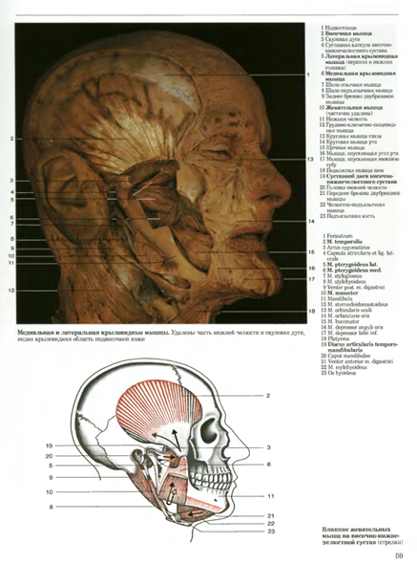
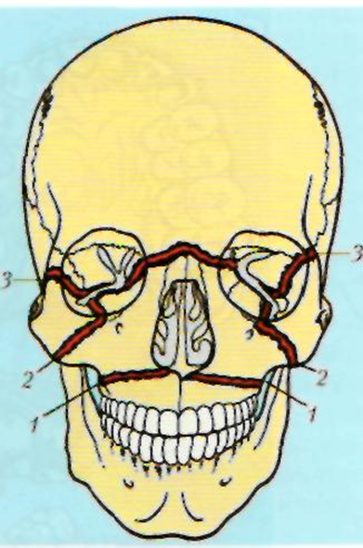
The posterior section of the upper jaw is displaced downward more than the anterior section due to the pterygoid muscles. With type 3 fractures - due to contractions of the masseter muscle

Slide 18
Clinic. Complaints about:
Pain when closing jaws
The impossibility of biting food with the front teeth due to the formation of an open bite
Loss of sensation in the midface (type 2)
Loss of consciousness at the time of injury (due to concussion or contusion of the brain)
Epistaxis (damage to the nasal mucosa, maxillary sinus and ethmoid labyrinth)
Bleeding from the ears (for fractures of the base of the skull)

Slide 19
When offset
fragments at a fracture:
type 1 - lengthening of the lower part of the face (upper lip)
type 2, 3 - middle part of the face (nose)

