Slide 1
Orthopedic treatment of mandibular fractures

Slide 2
Primary wound care
Reposition and immobilization of fragments
Infection control measures
Bone grafting
Soft tissue plasty
Measures to prevent contractures

Slide 3
Statute of injury
The severity and nature of the damage
General condition of the patient
Type of dominant injury
Features of the occlusal relationship of the jaws
Fragment displacement

Slide 4
prehospital
hospital
Posthospital

Slide 5
Timeliness
Individuality
Complexity
Continuity
Functionality

Slide 6
Coping with respiratory problems and pain
Anti-shock measures
Temporary immobilization of fragments (performed at the site of injury with a device for fixing fragments of the lower jaw (V.M. Zotov, 1990)

Slide 7
Scheme of a device for fixing fragments of the lower jaw (Zotov V.M. et al., 1990):
head cap with movable joints
chin sling (mobile fixators)
elastic traction (strength can be adjusted)

Slide 8
Hospital stage - early specialized treatment in a complex of specialists is advisable, the devices should not interfere with the function of the lower jaw, feeding, effective oral care

Slide 9
In case of fractures of the lower jaw without displacement of fragments, wire, plastic splints

Slide 10
In case of fractures of toothless jaws Removable dentures (as transport tires) involve the imposition of a chin sling

Slide 11
Most common localization?
More common are fractures of the alveolar process of the upper jaw in the region of the anterior teeth:
- no offset
- with offset

Slide 12
The displacement of fragments is due to the direction of the applied force

Slide 13
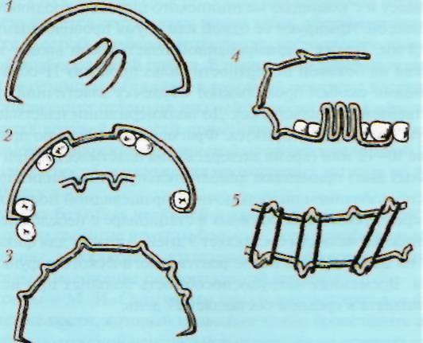
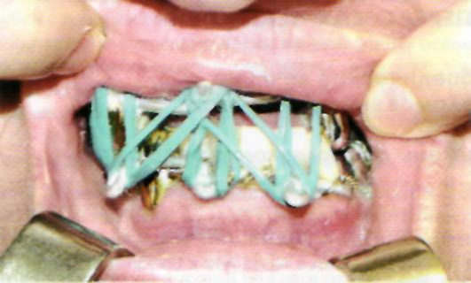
For non-displaced cases, a single-jaw aluminum splint (smooth wire shackle) is used.

