Slide 1
Tasks of orthopedic treatment of patients with diseases and injuries of the maxillofacial region
disciplines "Maxillofacial surgery", module "Maxillofacial prosthetics"Topic 1.2

Slide 2
Systematization of orthopedic devices
By appointment;
By the method of fixation;
According to the manufacturing technology.
According to the materials of manufacture

Slide 3
According to the purpose , orthopedic devices are divided into:
Correcting (replicating);
Guides;
Fixing (holding);
Substitutes;
Formative;
Disconnecting;
Combined.

Slide 4
What devices will be used to treat jaw fractures?
Correcting (replicating);
Fixing (holding);
Guides;
Substitutes;
Formative;
Disconnecting;
Combined.
______________________________________
______________________________________
______________________________________

Slide 5
Repositioning devices
Correcting (repositioning) – devices with which the fragments are installed in the correct position (wire, plastic tires for inter-jaw traction, devices with screws, with extra-screw control levers.

Slide 6
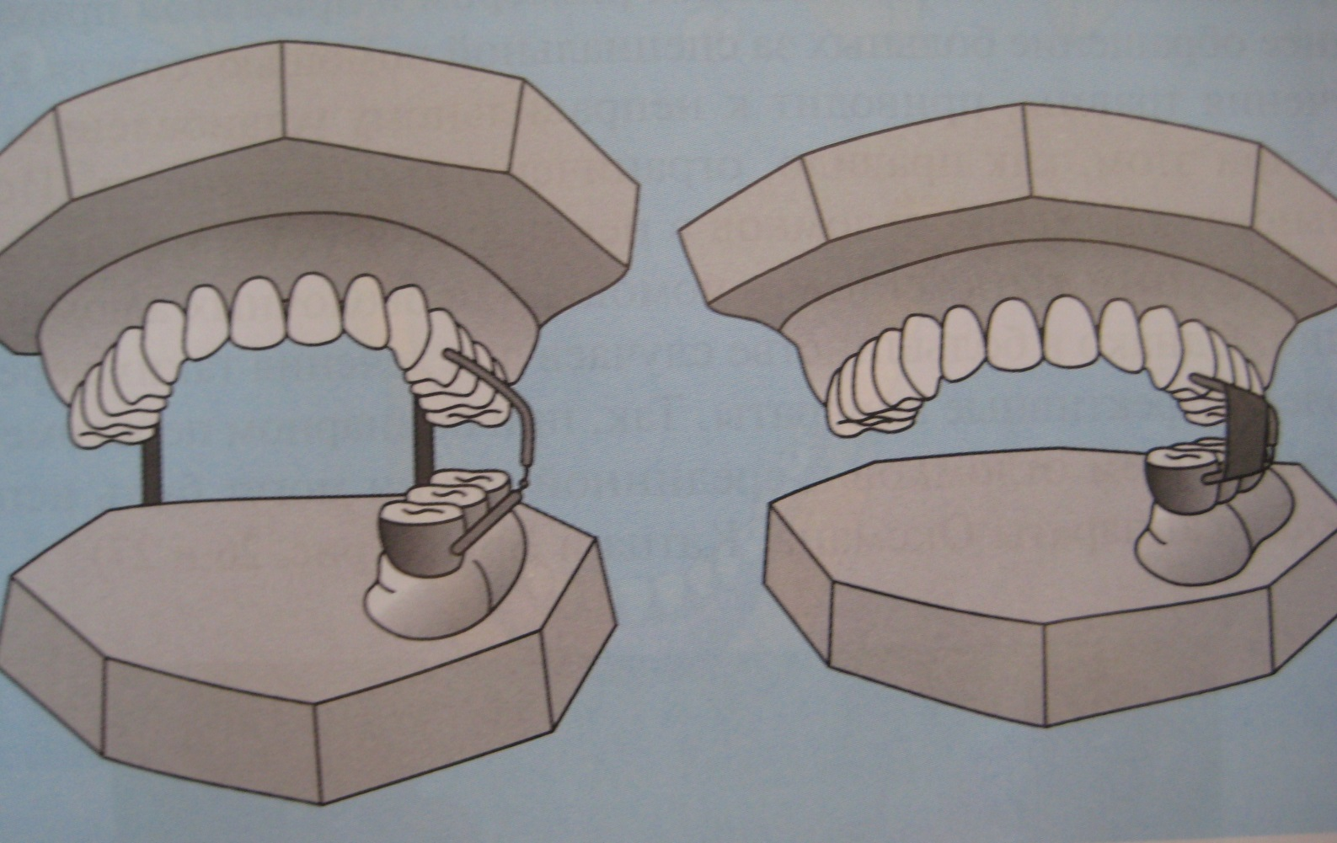
Repositioning devices
The Shura apparatus on the working model

Slide 7
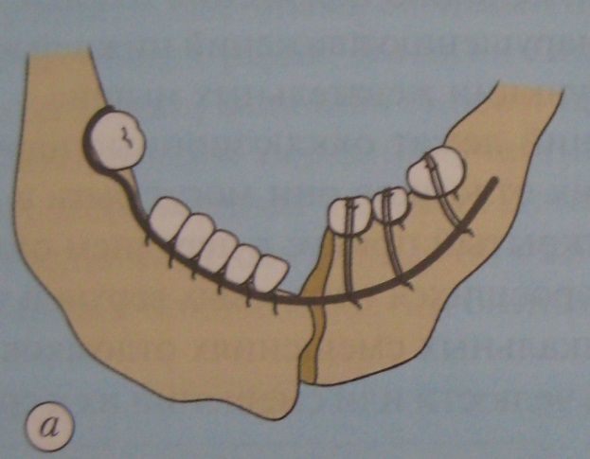
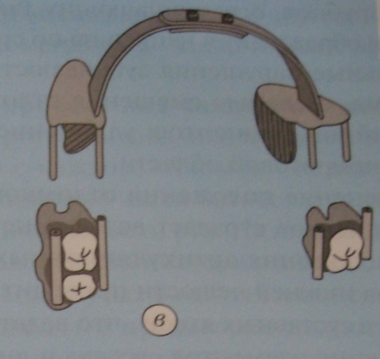
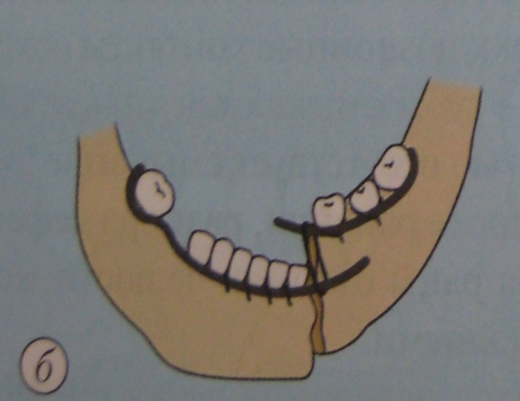
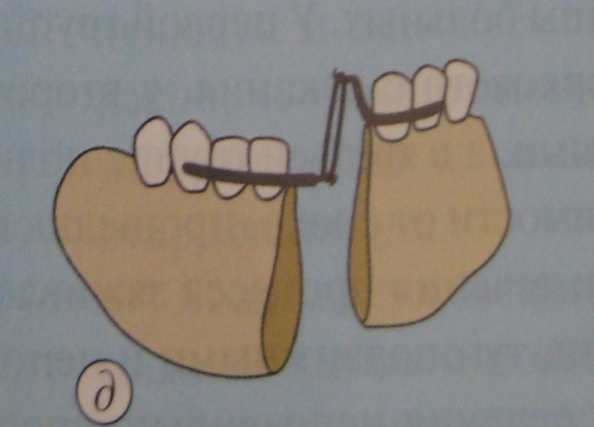
Repositioning devices for the reduction of fragments of the lower jaw:
a – on Urbanskaya
In - on Sometimes and Psom
b – according to the Grozovsky
d – the Kurlandsky apparatus

Slide 8
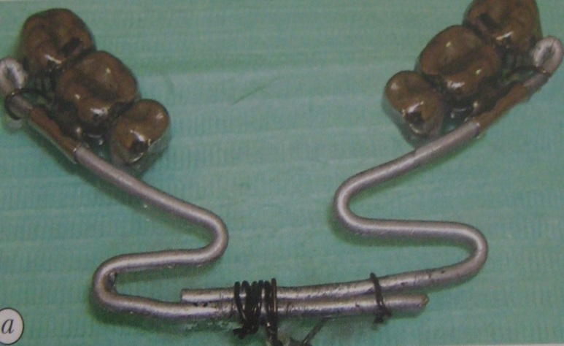
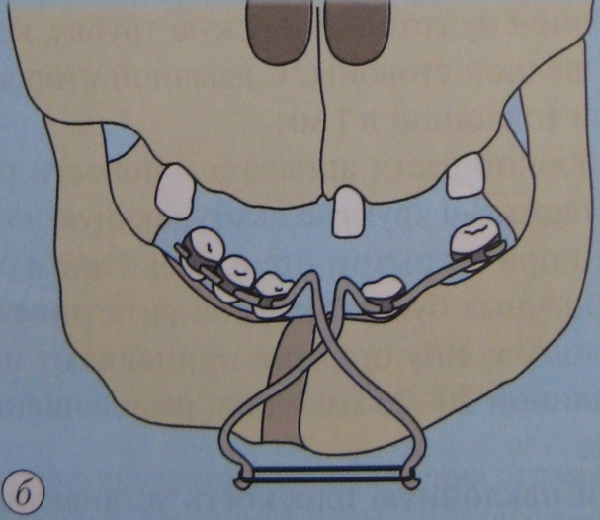
Repositioning devices
a – Katz apparatus with springy levers
b – Brun apparatus with rubber traction

Slide 9
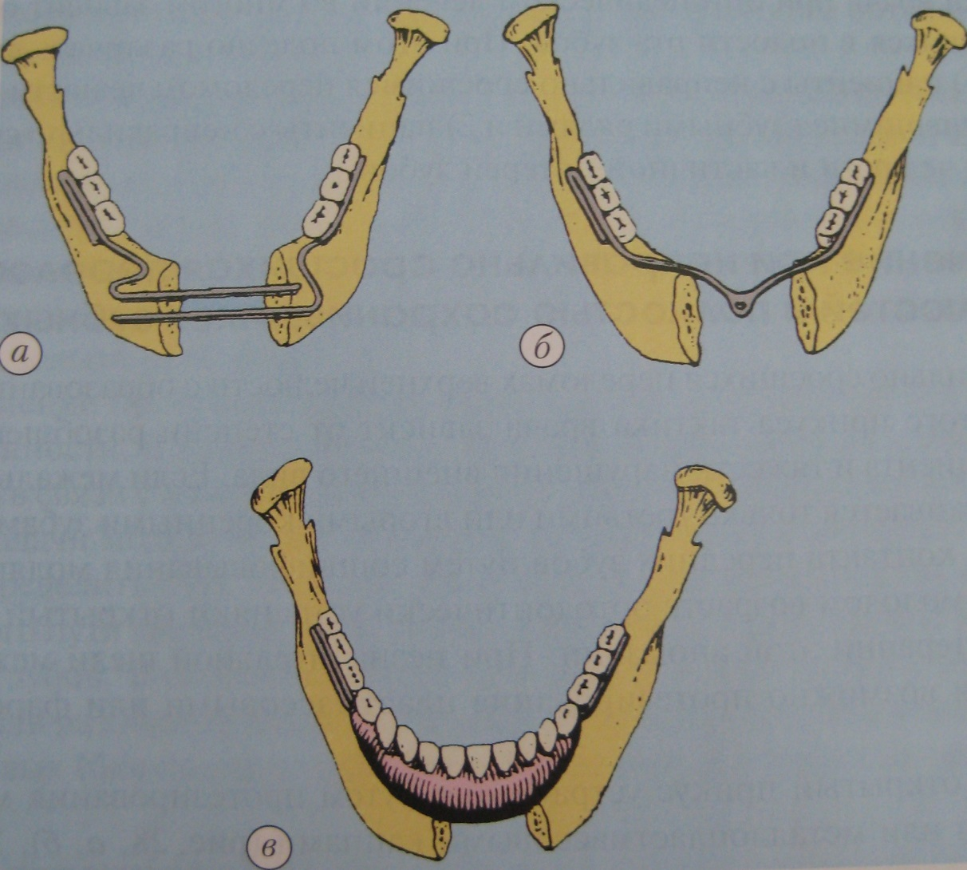
reponding devices. Oxman:
a–reponent;
b– fixing;
b– fixing and replacing

Slide 10
Repositioning devices
Reposition:
one-step - performed manually during the operation;
2. prolonged (gradual) – performed with the help of apparatuses (if during the operation it is not possible to correctly match the fragments of the jaw manually.)

Slide 11
Repositioning devices
The mechanism of action is based on the ability to pull displaced fragments or exert pressure on them)
According to the mechanism of action are divided:
1. mechanical;
2. functional.
V

Slide 12
Репонирующие аппараты
Components:
Support (crowns, mouthguards, rings, base plate, head cap);
2. operatingmechanical - devices capable of developing forces for displacement of fragments (rubber rings, screws, elastic brackets);
functional – to move the fragments, the force of muscle contraction is used, which is transmitted through the guide planes to the fragments and shifts them to the correct position (shina Vankevich, etc.).

Slide 13
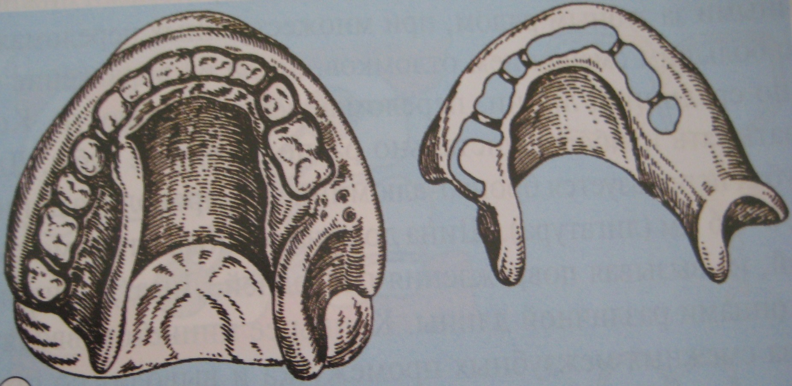
Functional repositioning devices:
Splint Vinkevich

Slide 14
Guiding devices
The guiding devices include devices with inclined planes or a sliding hinge, which provide the fragments with a certain direction when combined (Vankevich tire, Weber, wire splint with Schroeder hinges, Pomerantseva-Urbanskaya, etc.)

Slide 15
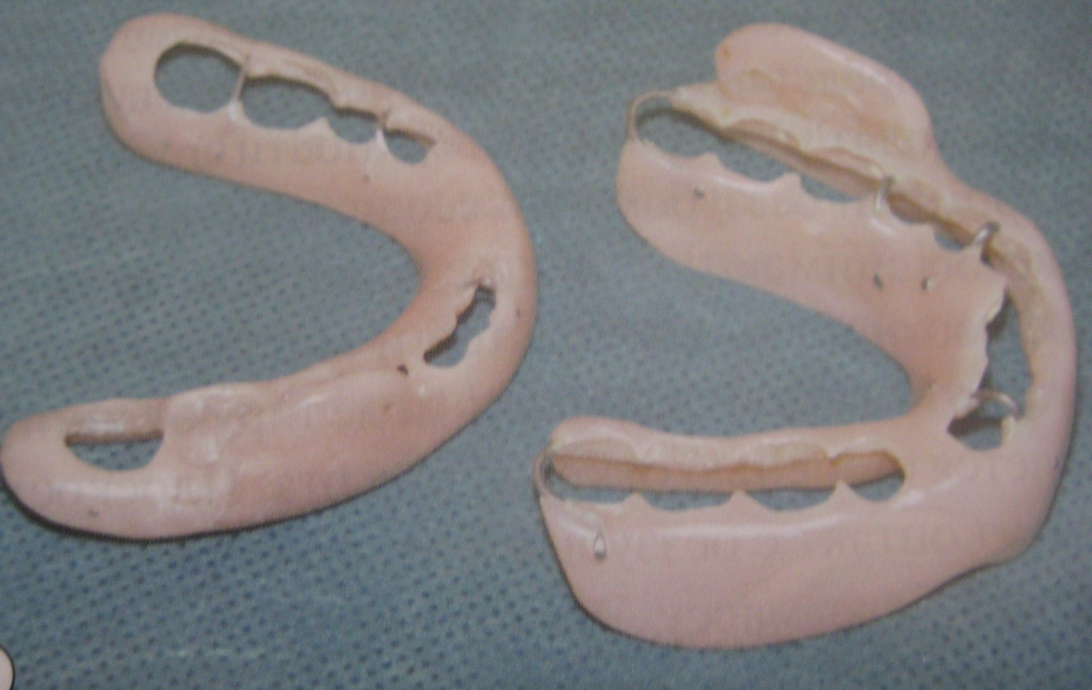
Guiding devices:
Weber 's splint

Slide 16
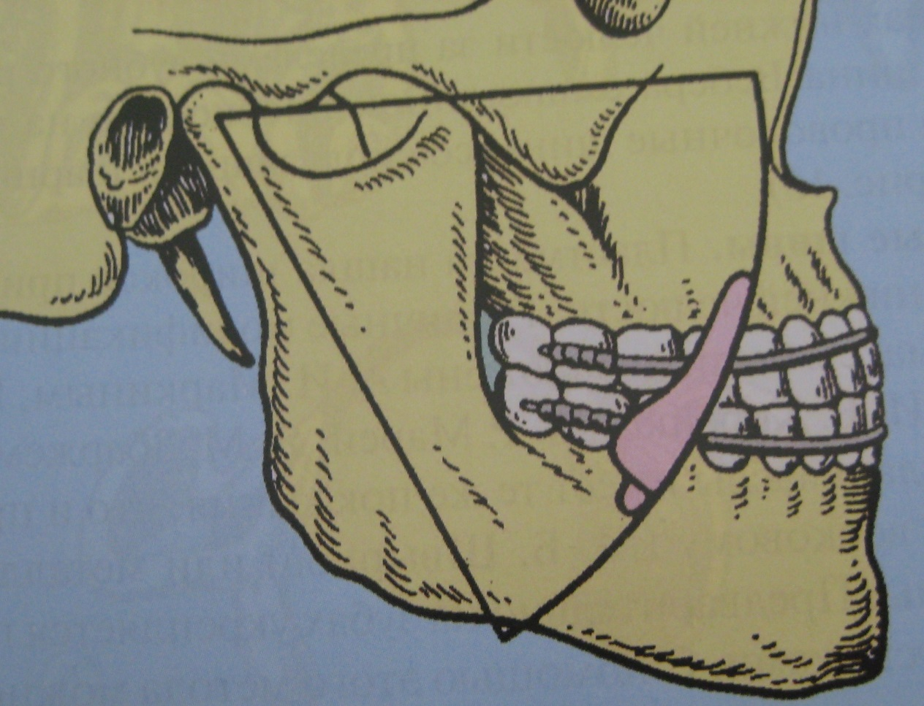
Guiding devices:
Wire splint with shredder hinges

Slide 17
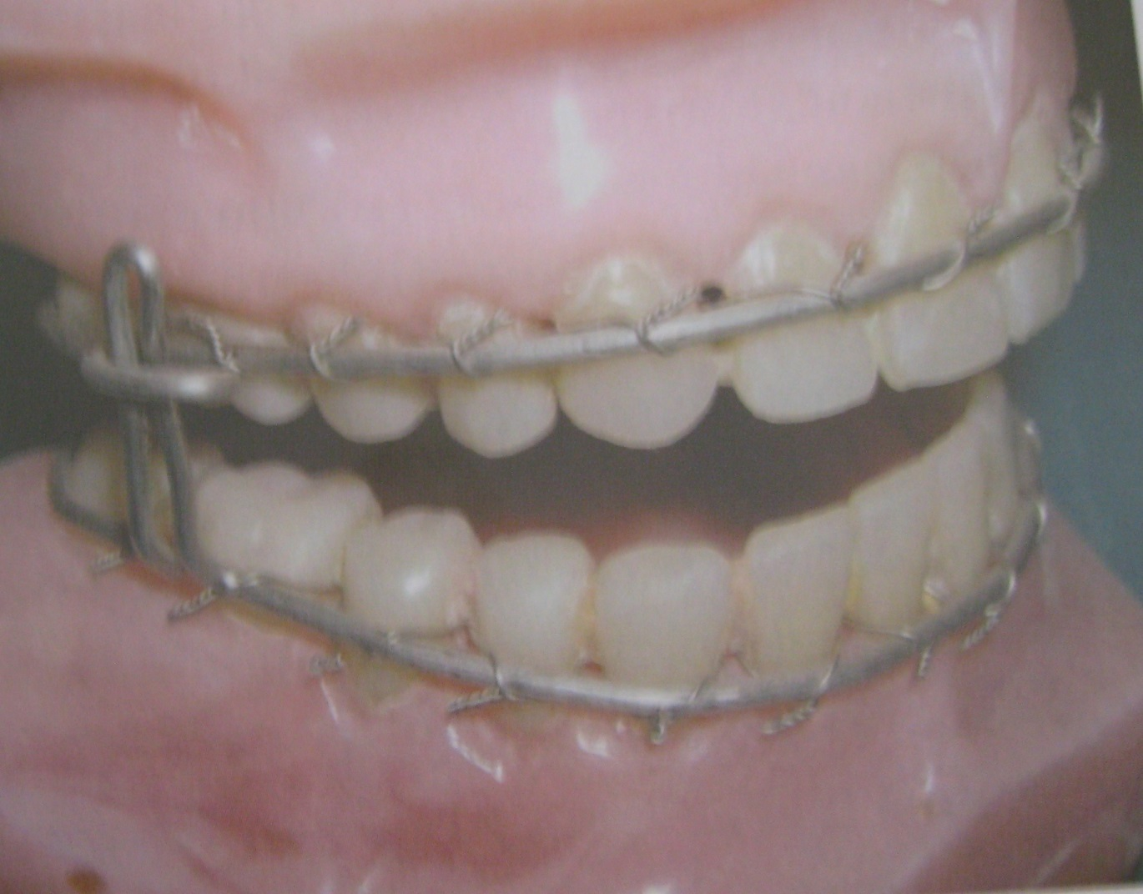
Guiding devices: wire splint with Orange-Urban hinges

Slide 18
Holding devices
Retaining (fixing) - devices that hold the fragments of the jaw in the correct position and ensure their immobility

Slide 19
Retaining (fixing) devices
They are used when:
Treatment of jaw fractures;
Bone grafting (for example, when holding fragments of the lower jaw after resection).

Slide 20
Retaining (fixing) devices for various clinical situations
I. preservation of the dentition
stabilization by dental splints -smooth wire brace-aluminum wire splint with spacers -extra-oral devices for fixing fragments of the lower jaw

Slide 21
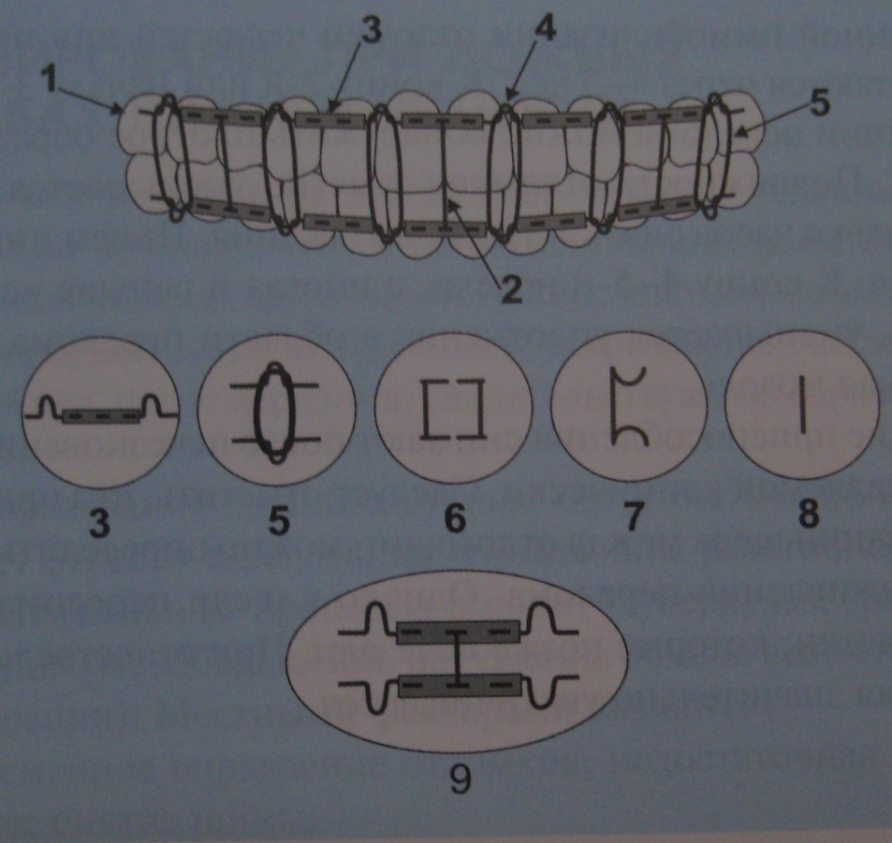
Retaining (fixing) devices: modified Tigerstedt splint
1-curved aluminum wire with hook loops;
2-spacers with support pads on the end parts;
3-nylon coupling;
4-hook loops;
5-rubber rods;
6-U-shaped spacer in the absence of a sufficient number of teeth;
7-spacer with support pads for abnormal bite;
8-straight spacer with normal bite;
9-fixing the spacer by puncturing the coupling on both jaws

Slide 22
Retaining (fixing) devices for various clinical situations
II. mobility of teeth, atrophy of the alveolar process
Stabilization by dental splints is not possible
The use of dental splints (simultaneous coverage of teeth and alveolar processes)

Slide 23

Holding (fixing) devices:
Weber's dental splint

Slide 24
Holding (fixing) devices
III. complete loss of teeth
The base plates simultaneously cover both toothless jaws, join together at the right distance
monoblock

Slide 25
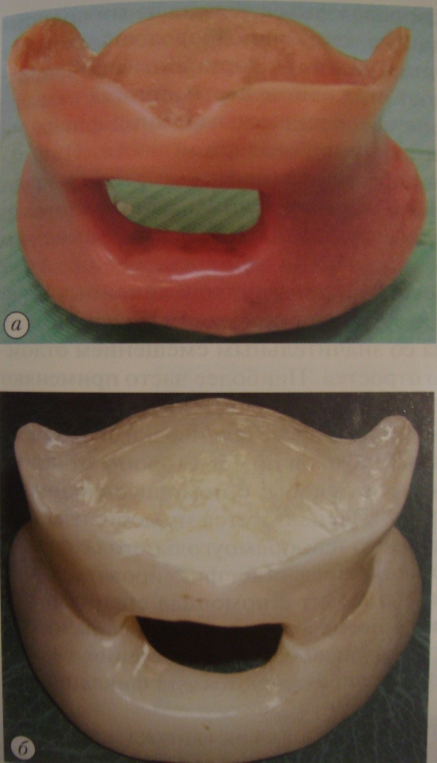
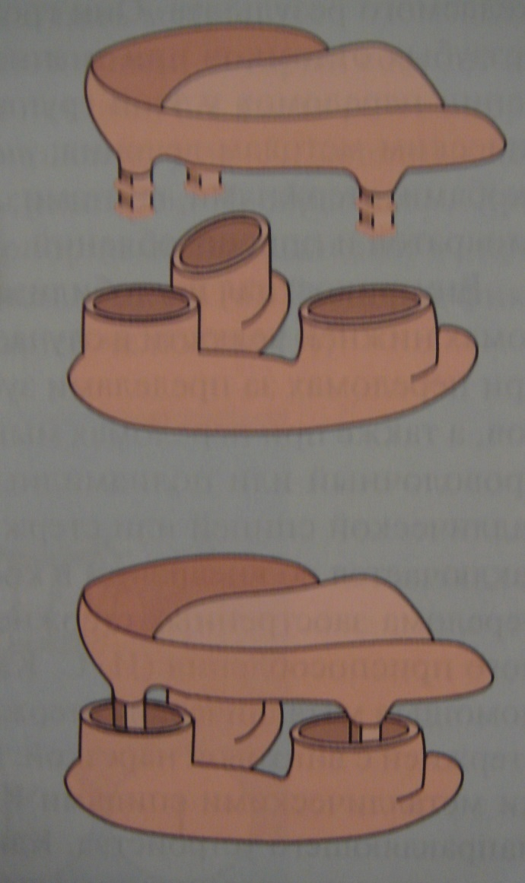
Holding (fixing) devices
Splint Pont
Splint Gunt
Splint Limberg

Slide 26
Forming devices
Formative – devices with the help of which a prosthetic bed is created (formed). They serve as a support for plastic material (a fixator of plastic material for the period of engraftment)

Slide 27
Forming devices
Forming devices are used for plastic compensation of defects in the soft tissues of the face, serve as a support for plastic material for the period of engraftment

Slide 28
Forming devices
I. Toothless jaws
operations to improve the conditions for fixing prostheses
the forming apparatus creates a prosthetic bed

Slide 29
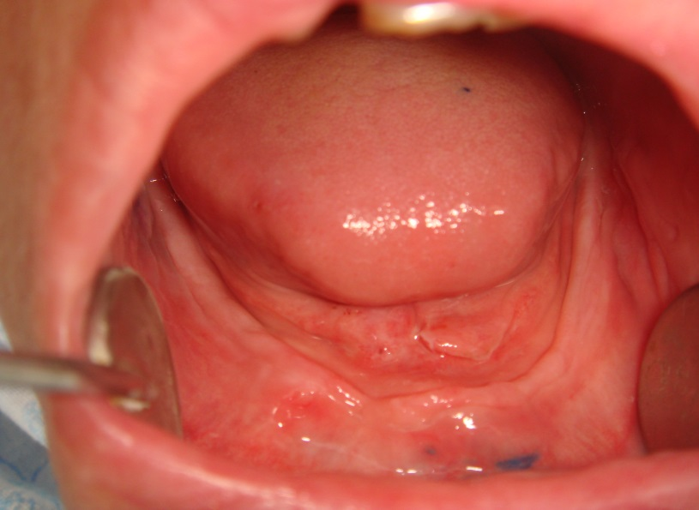
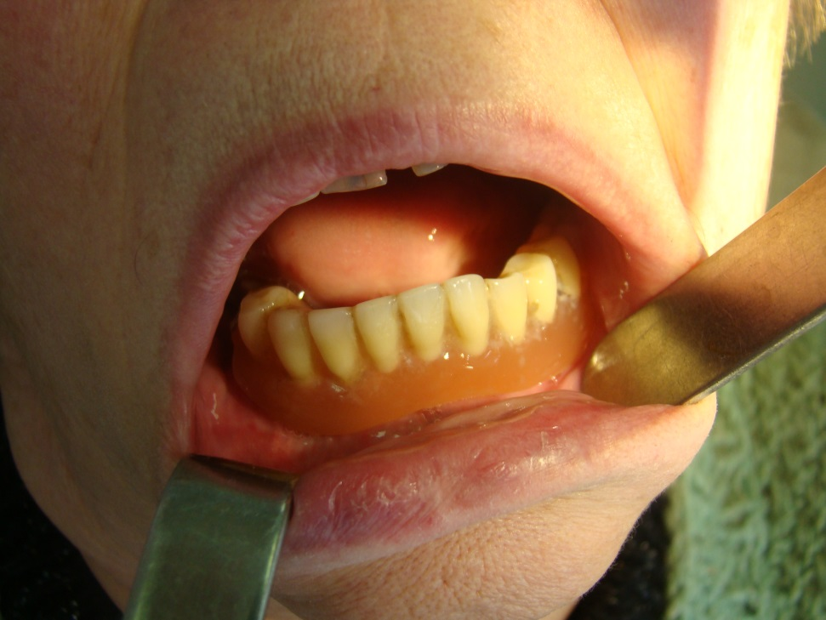
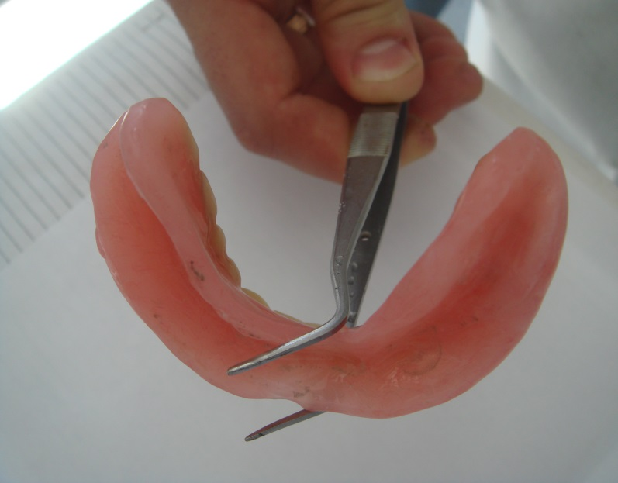
Forming devices
A clinical case. A patient with fibromatosis.
Ready-made prosthesis forming a prosthetic bed on the lower jaw

Slide 30
Forming devices
Application:
maintenance of facial soft tissues after surgery;creating a rigid support;
prevention of scar formation.

Slide 31
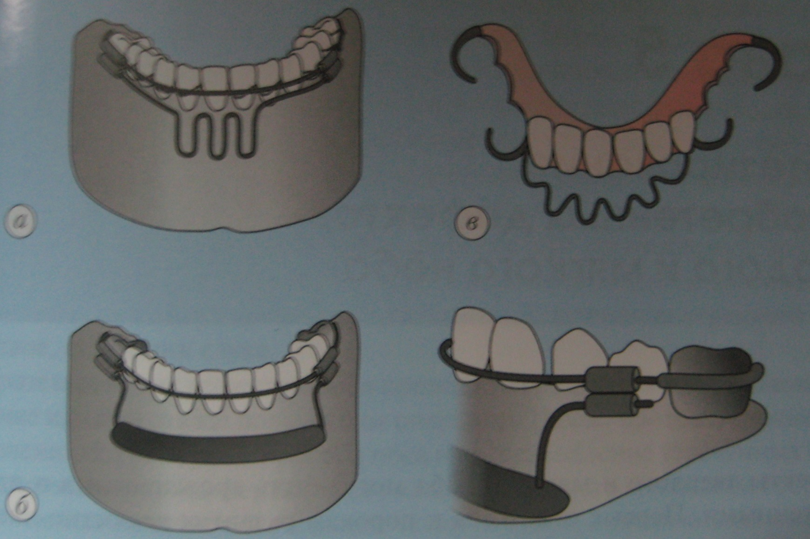
Forming devices
Devices for the formation of a transitional fold when eliminating cicatricial changes.
A – Aluminum wire loop
b – removable forming prosthesis
b – forming structure for retaining the thermoplastic mass in the wound area

Slide 32
Replacement devices
Replacement devices replace lost tissues after jaw resection, with defects in the maxillofacial region of traumatic origin or after surgery

Slide 33
Замещающие аппараты
Replacement devices are divided into:
by field of application:dental alveolar;maxillary;facial;combined;
2. by manufacture:standard;individual.

Slide 34
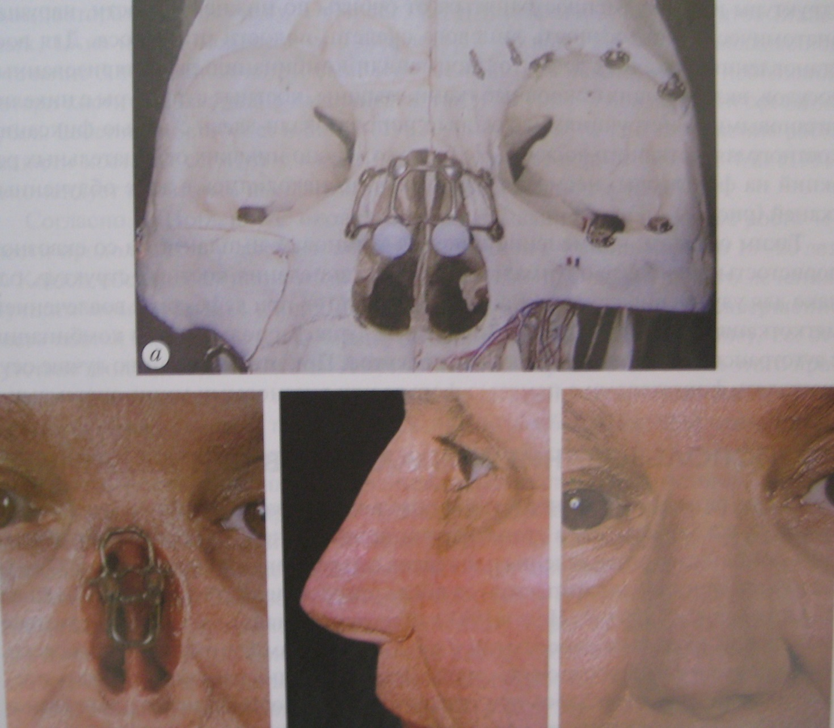
Replacement devices
Implantation during nose surgery

Slide 35
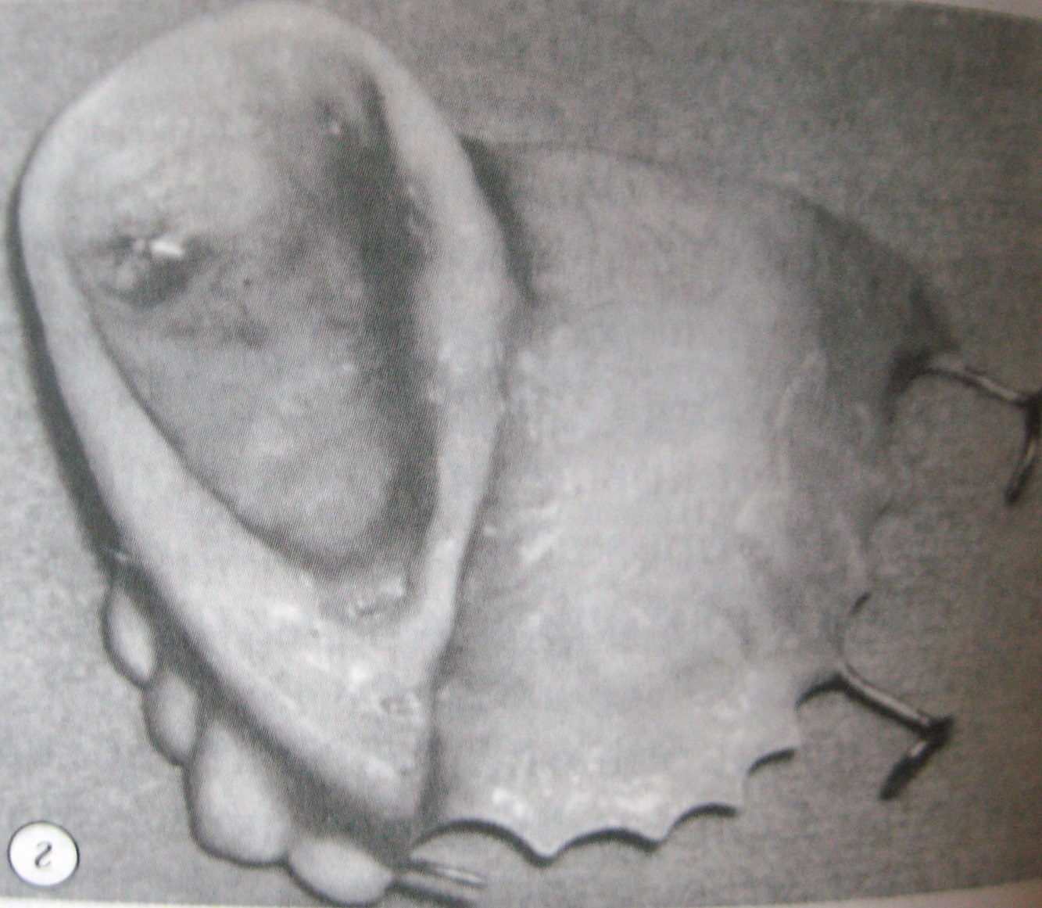
Replacement devices
Prosthesis with retaining clamps after resection of the upper jaw

Slide 36
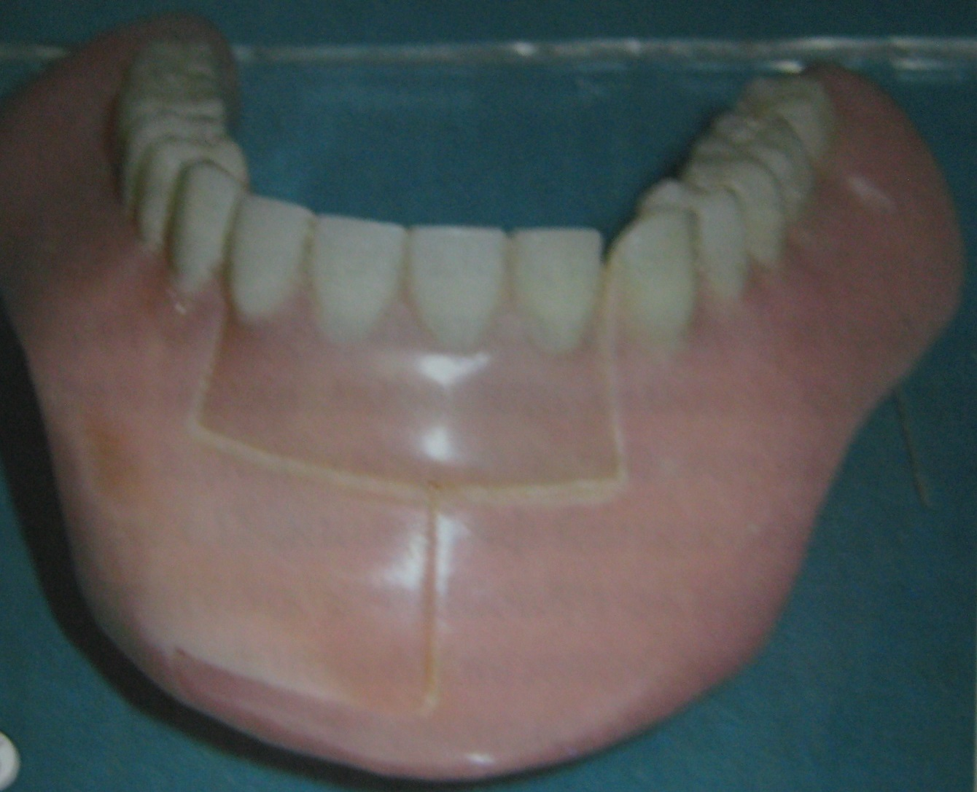
Replacement devices
Direct prosthesis after resection of the chin of the lower jaw (according to Oxman)

Slide 37
Disconnecting devices
Disconnecting – devices that separate the oral cavity and nose (obturators, protective palatal plate, devices used for the plastic elimination of acquired defects of the hard palate).

Slide 38
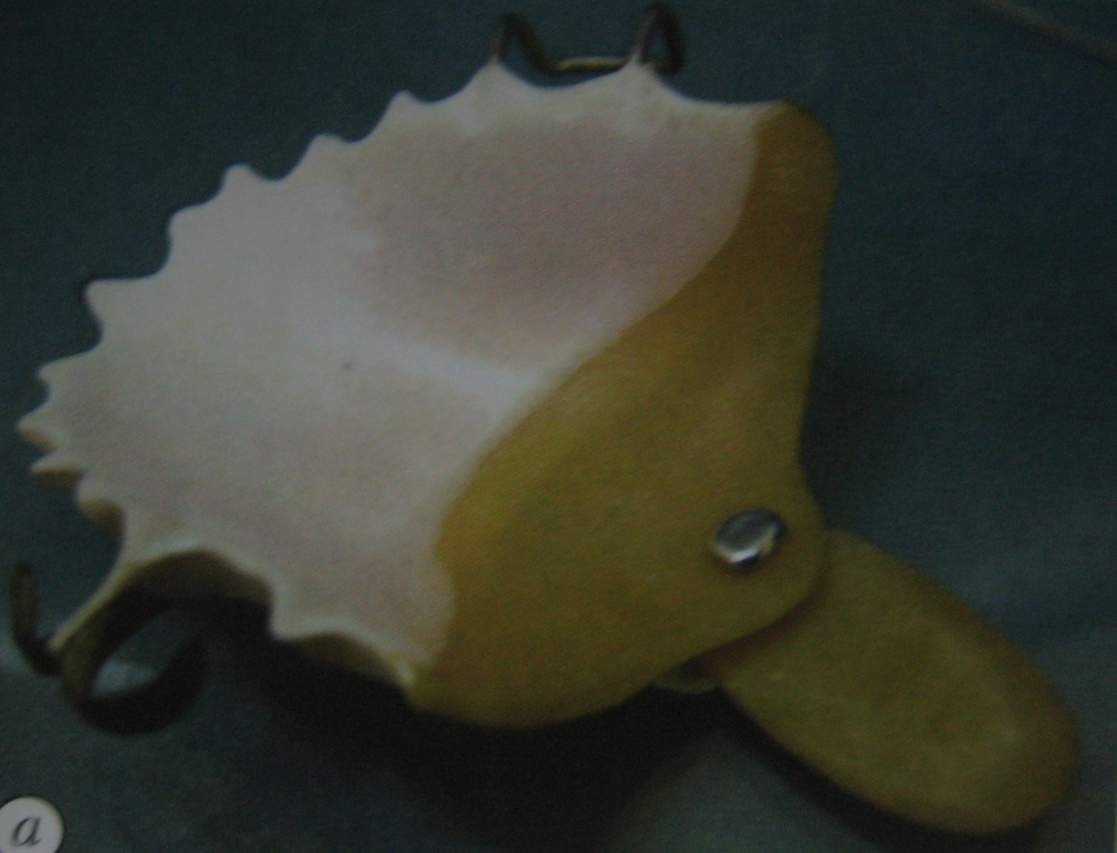
Disconnecting devices
Obturator for replacement of soft palate defect by Ilina-Markosyan

Slide 39
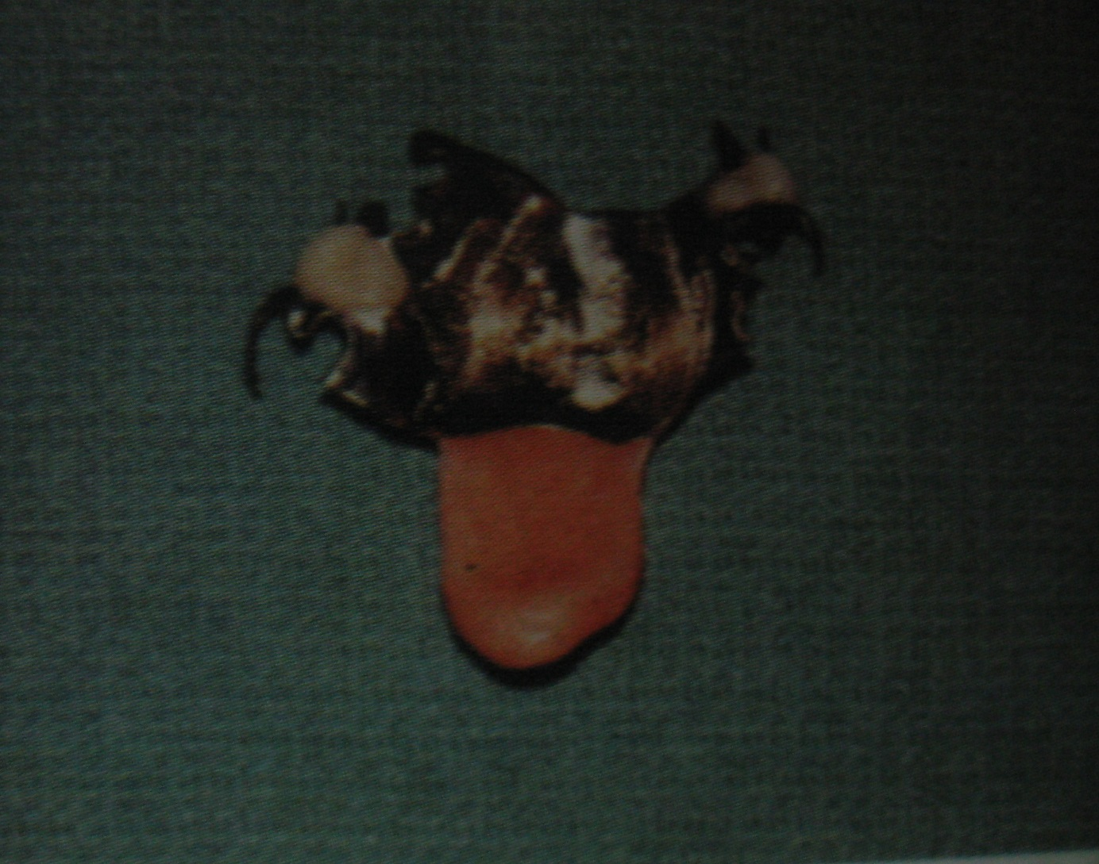
Disconnecting devices
View of the obturator prosthesis from the side adjacent to the cleft of the soft palate

Slide 40
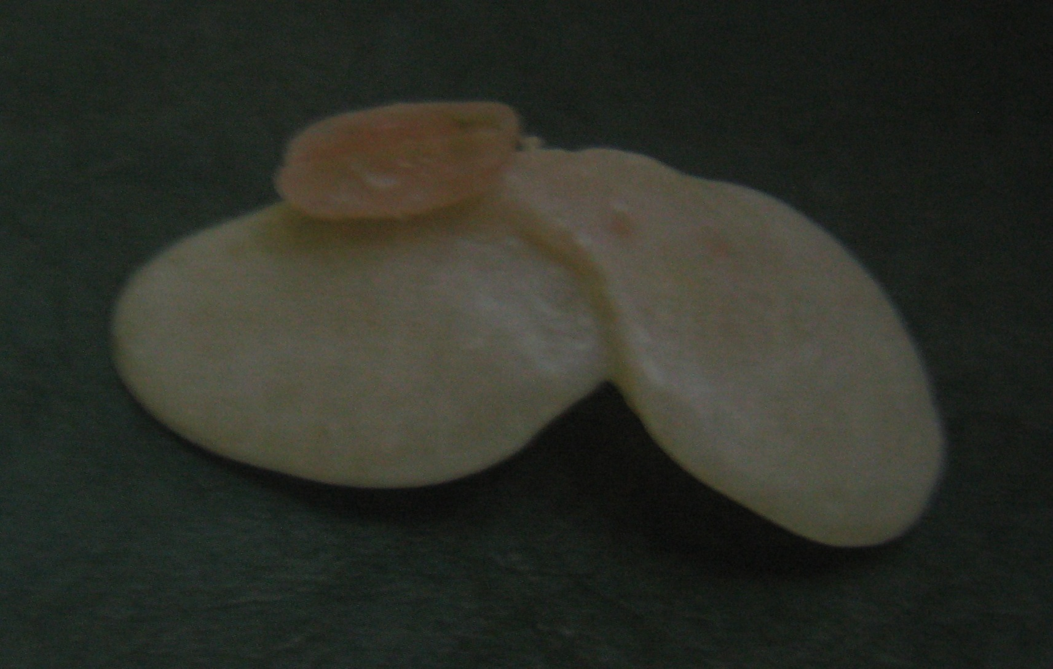
Disconnecting devices
Floating obturator

Slide 41
Combined devices
Combined devices provide several functions, for example:
1. for fractures of the jaws:
repositioning of fragments;
their immobilization;
2. during plastic surgery, retention of fragments of the lower jaw;
formation of the lower lip.

Slide 42
Systematization of orthopedic devices
By appointment;
By the method of fixation;
According to the manufacturing technology.
According to the materials of manufacture

Slide 43
Maxillofacial devices
according to the method of fixation, they are divided into:
intraoral (located in the oral cavity, strengthened on the teeth and alveolar part);
2. extraoral (located outside the oral cavity on the tissues of the head and face);
3. inside-outside the mouth (one part is fixed inside, the other outside the oral cavity).

Slide 44
Maxillofacial devices
according to the method of manufacture , they are divided into:
1. standard;
2. individual (made in a dental laboratory).

Slide 45
Maxillofacial devices
according to the materials used,
they are divided into:
plastic;
composite;
of metal alloys (bent, cast, soldered, combined)

Slide 46
Maxillofacial devices
according to the therapeutic purpose, they are divided into:
basic (has an independent therapeutic value):
fixing;
substitutes;
correcting:auxiliary (ensure the successfulperformance of bone (skin) plastic surgery).

