Slide 1
Implantology in maxillofacial and dental prosthetics.
disciplines "Maxillofacial surgery", module "Maxillofacial prosthetics"Topic 6.1

Slide 2
History
6th century BC ancient Incas – implants from the shell of sea mussels.1-6 century AD in Europe, evidence of the use of implants made of metal and stone.6th–18th century - dental transplantationThe end of the 19th century-scientists returned to the idea of implantation: S.Perry, N.Znamensky, A.Hartmann, U.Greenfield, A.Strock, H.Dahlen.

Slide 4
Modern implantation
In the 50s – 60s, more than 300,000 implants were installed in Italy, Sweden and the USA.Since 1980-2000, more than 2000000 implants have been installed in the USA.

Slide 5
Modern implantation
1963 – Dr. Ingvar Branemark, using vital microscopy, discovers and describes the phenomenon of osseointegration
1965 - Branemark developed and installed the first cylindrical implant.

Slide 6
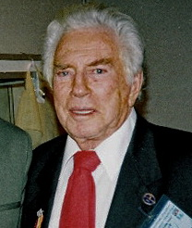
Leonard Linkov
Professor at the University of New York and the University of Pittsburgh, founder of the world's first Department of dental Implantation

Slide 7
Classification of implants
Form
Type of coating
Surgical protocol
Connection type with abutment

Slide 8
The shape of the implants
Screw
Cylindrical
Lamellar Others (basal, endodonto-endossal, subperiosteal, intra-mucosal)

Slide 9
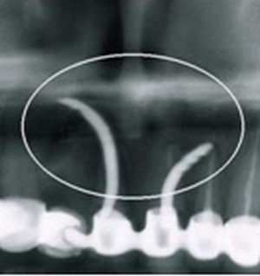
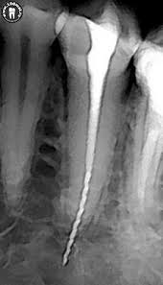
Endodonto-endossal implants

Slide 10
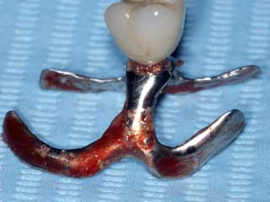
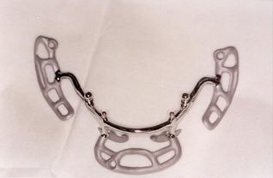
Subperiosteal implants

Slide 11
Intra-mucosal implants

Slide 12
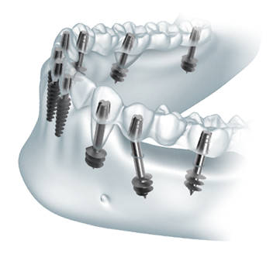
Basal implants

Slide 13
Basal implants

Slide 14
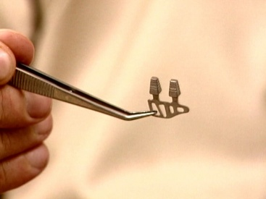
Plate implants
Outdated methodology
Limitations in terms of prosthetics
Applicable with a narrow ridge

Slide 15
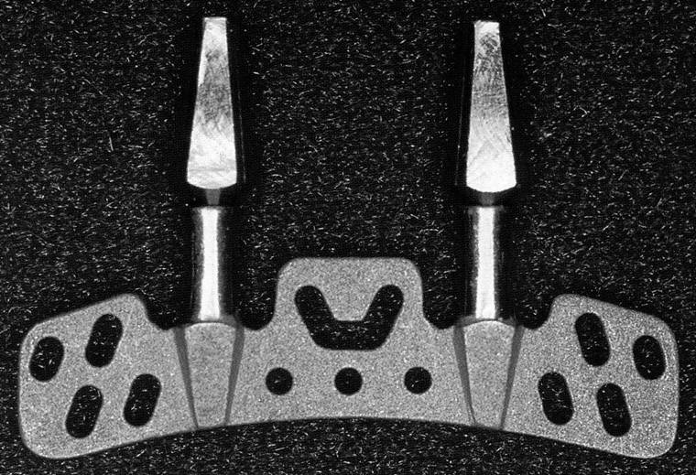

Slide 16
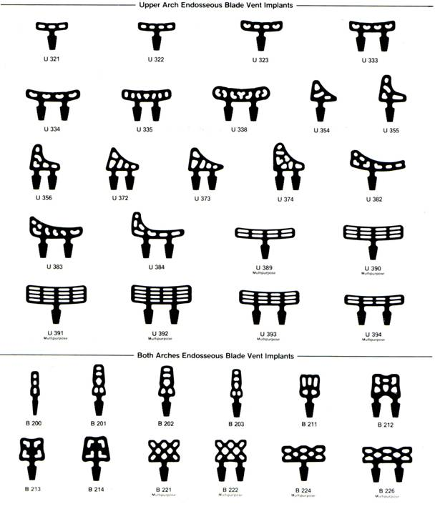

Slide 17
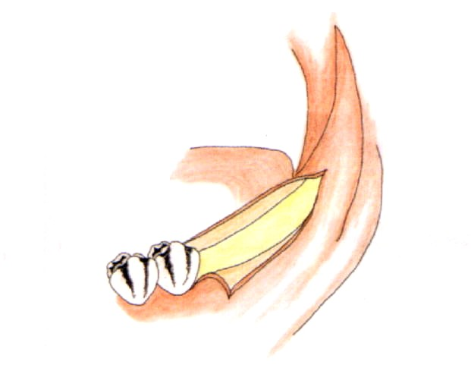
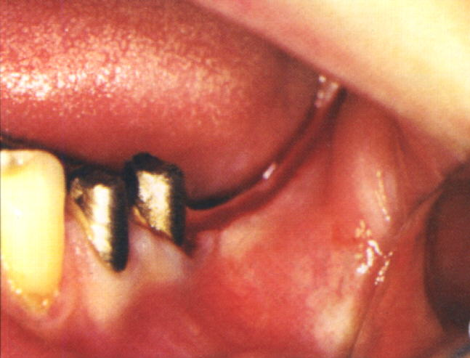
Mucosal incision

Slide 18
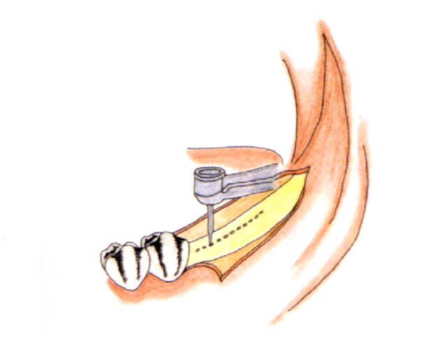
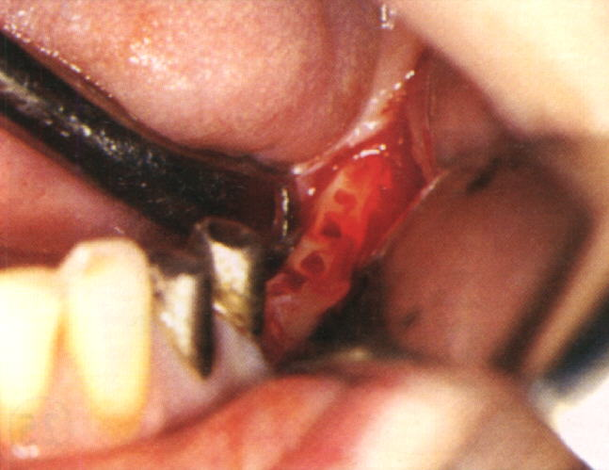

Slide 19
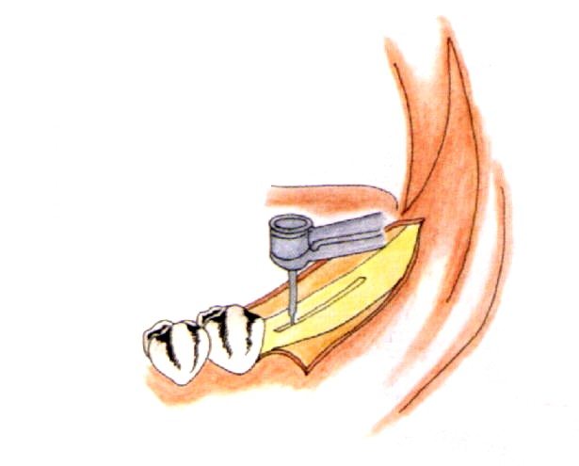
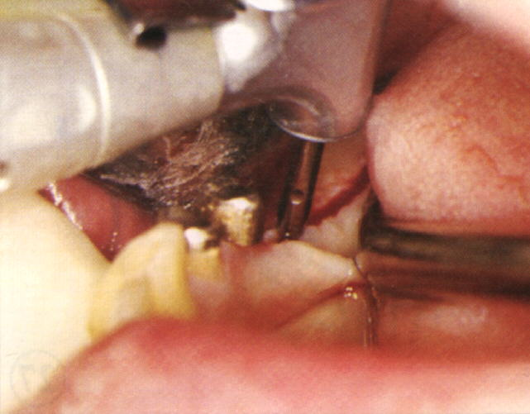

Slide 20
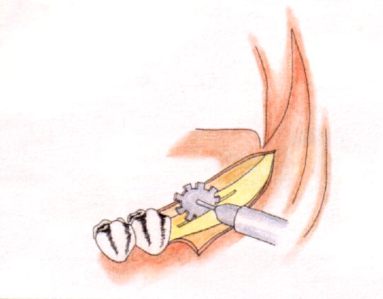
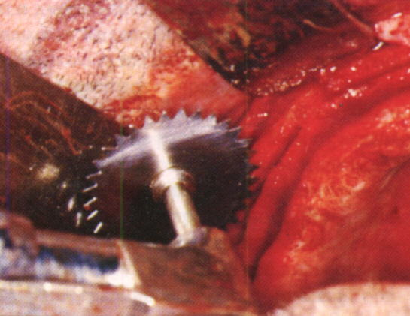

Slide 21
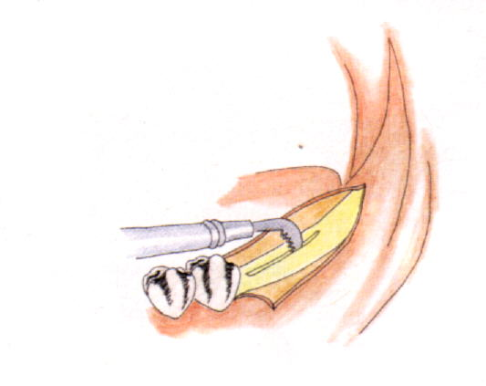
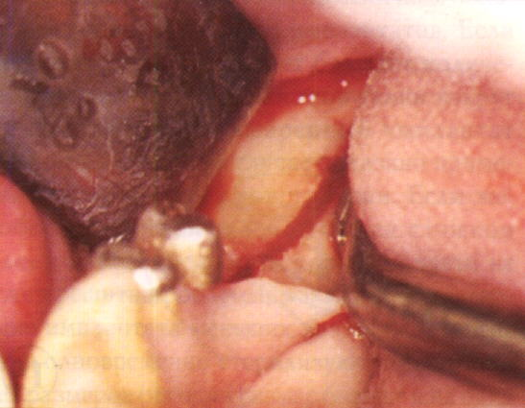

Slide 22
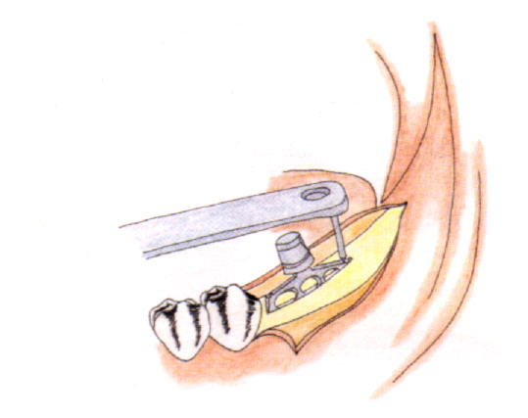
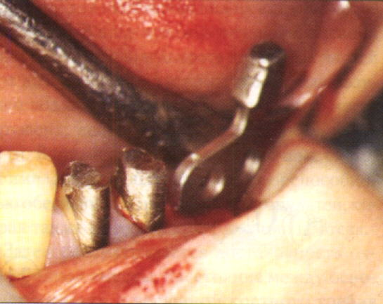

Slide 23
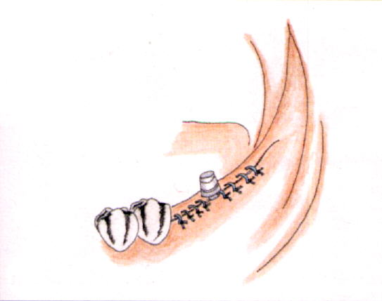
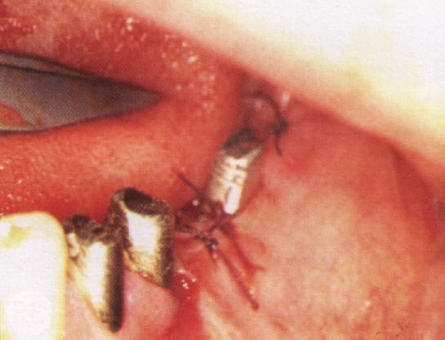
Ушитая рана в полости рта

Slide 24
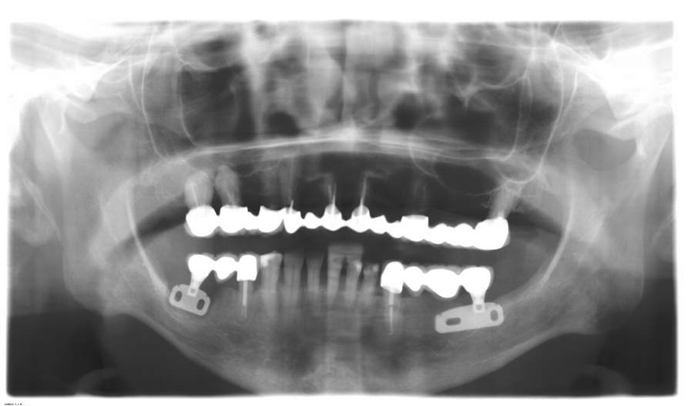

Slide 25
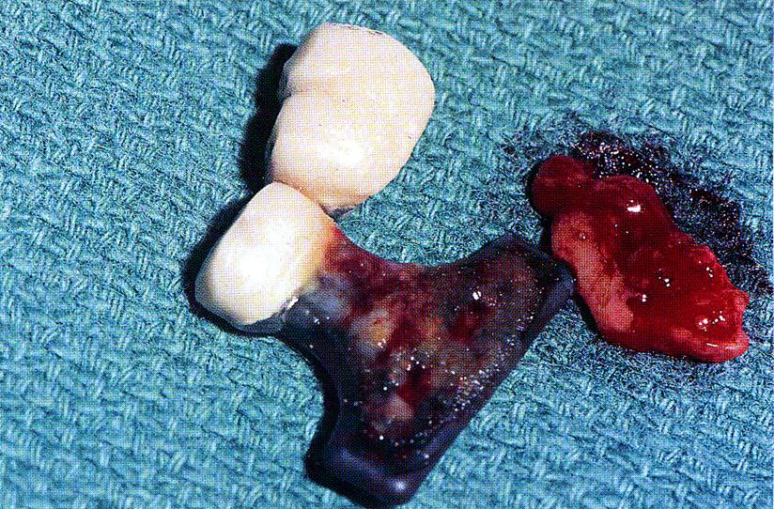

Slide 26
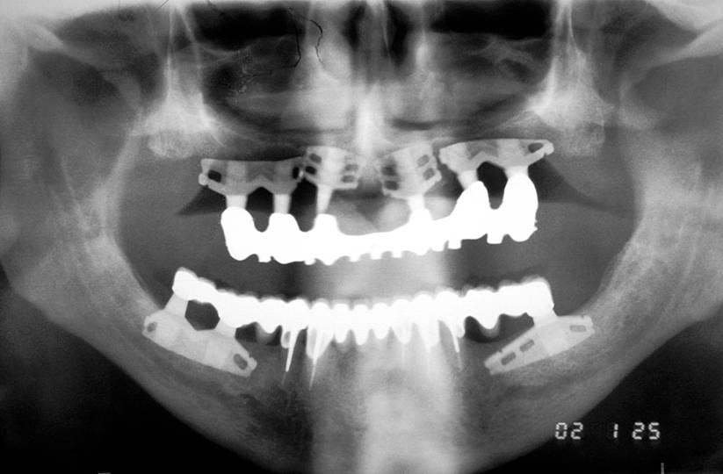

Slide 27
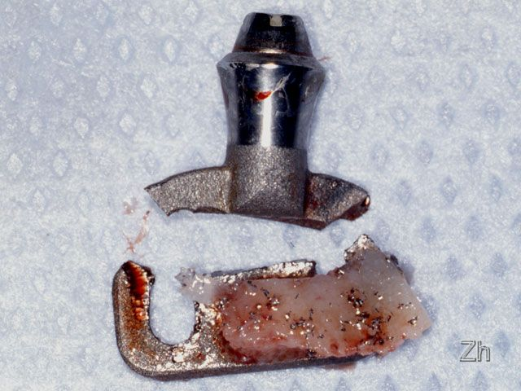
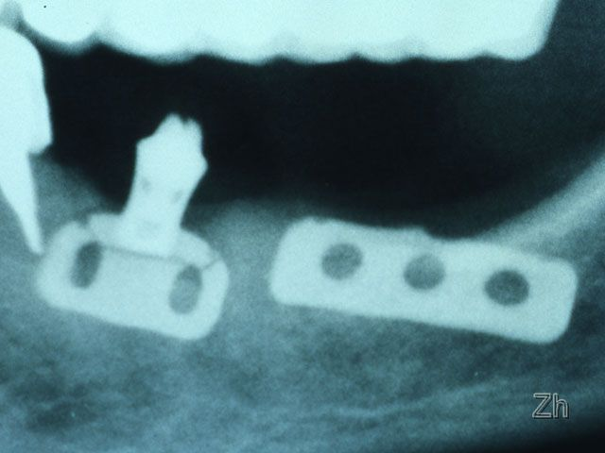

Slide 28
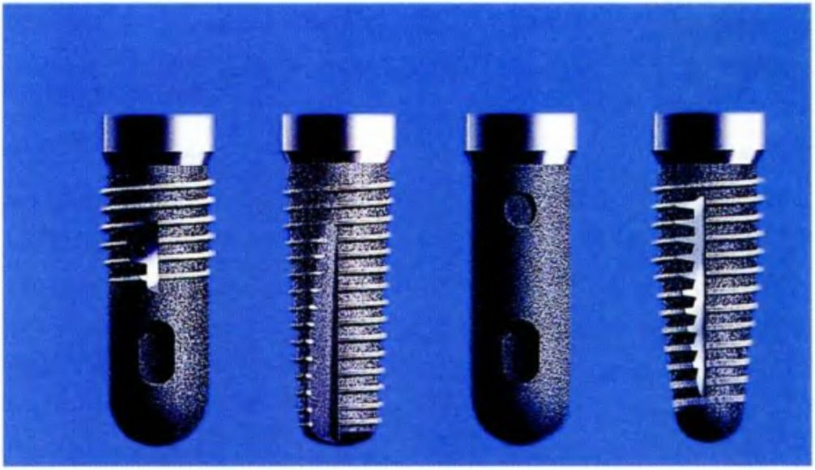
Screw and cylindrical implants
Screw
Cylindrical

Slide 29
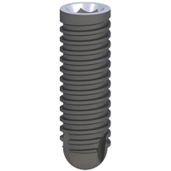
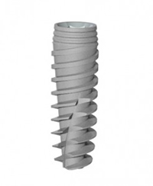
Screw implants
Implants with parallel walls
Root-shaped implants

Slide 30
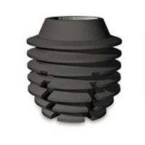

Slide 32
Type of coating
Hydroxyapatite
Titanium-plasma spraying
Uncoated
A new generation of coating

Slide 33
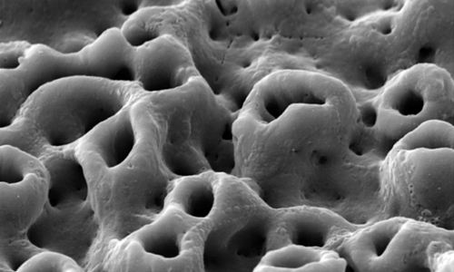

Slide 37
Implantological protocol
Two-stage
Single – stage
One-step protocol with immediate non-functional prosthetics
One-step protocol with immediate functional prosthetics

Slide 53
Lekholm и Zarb, 1985
Density
Type 1 | Mostly the cortical bone
Type II | Dense cortical-spongy bone
Type III | Loose cortical-spongy bone
Type IV | A thin cortical layer with a very porous spongy substance

Slide 54
Lekholm и Zarb, 1985
I II III IV

Slide 63
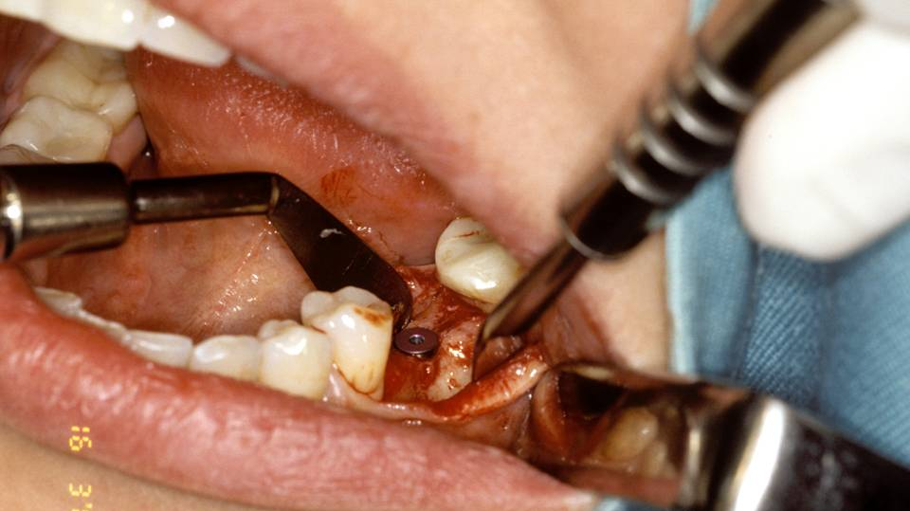

Slide 64
