Slide 1
Orthopedic treatment with removable dentures (laminar, clasp, removable bridge). Preparation of the oral cavity for orthopedic treatment. Clinical and laboratory stages of manufacturing. Terms of use, oral hygiene and care of prostheses. Adaptation. Correction

Slide 2
Indications for prosthetics with removable dentures
1. Bilateral defects of the dentition (class 1 according to
Kennedy)
2. One-sided defects of the dentition (class 2 according to
Kennedy)
3. Extended included defects in the dentition
(in the anterior-lateral sections)
4. Defects in the dentition with periodontitis of medium and
severe
5. Immediate or urgent prosthetics

Slide 3
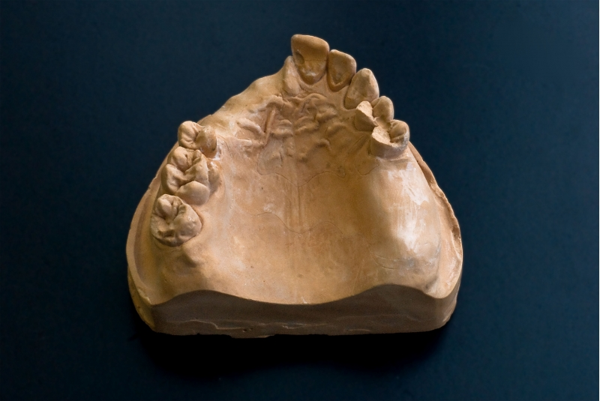
Partial absence of teeth in the upper jaw 2 class 3, 4 subclass according to Kennedy

Slide 4
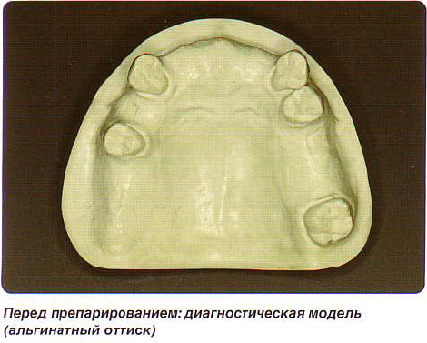
Partial absence of teeth in the upper jaw 2 class 3.4 subclass according to Kennedy

Slide 5
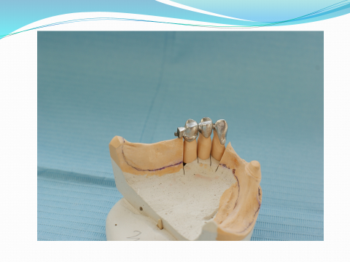

Slide 7
