Slide 1
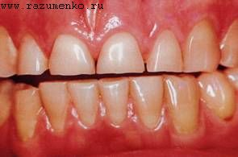
Methods of examination, diagnosis, prevention of patients with defects of hard tissues of teeth

Slide 2
As a result of pathological processes of carious and non-carious origin, defects in the hard tissues of the teeth occur. At the same time, the anatomical shape of the crowns of the teeth changes, which leads to violations of the function of chewing, speech, aesthetic disorders of the face.In order to determine the nature and degree of morphological changes associated with the disease, functional disorders caused by this disease, as well as in order to establish a diagnosis, choose a treatment method and develop preventive measures, a patient is examined.The examination of patients is carried out according to the generally accepted methodology with the inclusion in the examination scheme of patient complaints and anamnesis data (verbal methods), clinical data (examination, palpation, probing, percussion, examination of diagnostic models) and paraclinical examination (X-ray examination, electrodontometry, etc.).

Slide 3
When examining each tooth, pay attention to the following:
• shape, color and position in the dentition;
• condition of hard tissues (carious and non-carious lesions);
• the degree of destruction of the crown part;
• the presence of fillings, inlays, artificial crowns, their condition;
• the ratio of its extraalveolar and intraalveolar parts;
• sustainability;
• position relative to the occlusal surface of the dentition.

Slide 4
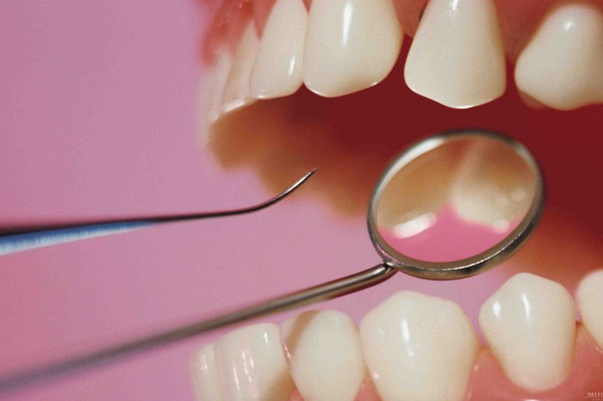
In parallel with visual analysis, manual (palpation) and instrumental methods are used: probing, percussion, determination of tooth mobility.

Slide 5
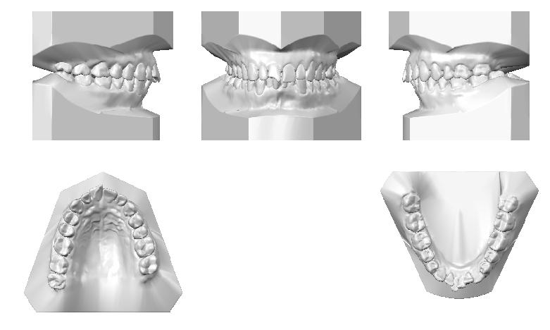
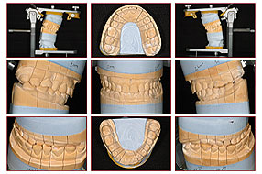
Important information is obtained when analyzing diagnostic models of jaws. The volume of loss of hard tissues, the topography of the defect, the ratio with adjacent teeth and antagonists are investigated. It is possible to conduct morphometric studies (measuring the size of the tooth crown) and comparison with the norm, etc.

Slide 6
Invaluable information in the examination of patients with pathology of hard tissues of teeth is provided by X-ray examination (orthopantomogram, panoramic and sighting radiographs): assessment of the topography of the pulp chamber and crown defect, assessment of the condition of periapical tissues, the marginal fit of fillings, inlays, crowns and proteses.
Electrodontometry provides important information about the functional state of the tooth pulp, which is important for optimal treatment planning.

Slide 7
When making a diagnosis , it is necessary to highlight:
• the main disease of the dental system and a complication of the underlying disease;
• concomitant dental diseases;
• concomitant diseases are common.

Slide 8
In order to facilitate the planning of reasonable therapeutic and rehabilitation measures, it is advisable to carry out the diagnostic process in a certain sequence, in which the evaluation is carried out:
• the integrity of the dentition;
• the condition of the hard tissues of the teeth;
• periodontal condition;
• condition of occlusion, temporomandibular joints and muscles;
• the condition of the existing prostheses and prosthetic field (mucous membrane of the mouth, tongue, vestibule, lips, toothless alveolar ridges).

Slide 9
Сlassification of dental crown defects
Dental crown defects:
Hypoplasia
Hyperplasia
Fluorosis
Сaries
Injurywedge-shaped defect
Erosion
tooth color change:
Dysplasia
Hypoplasia
tetracycline teeth
marble teeth
Pfluger teeth
Getchinson teeth
Fournier teeth awl tooth
microdentia
pathological eras ability
Generalized
localized

Slide 10
Diagnostics:
Clinical methods :
Survey Inspection
Palpation Probing
Percussion
Paraclinical methods:
X-ray examination
EdiDetermining the color of the tooth crown

Slide 11
The best prevention of increased enamel erasure is proper nutrition, rejection of bad habits and, of course, regular dental examinations. You can choose a competent specialist on our website. We have collected a complete database of dentists.

