Slide 1
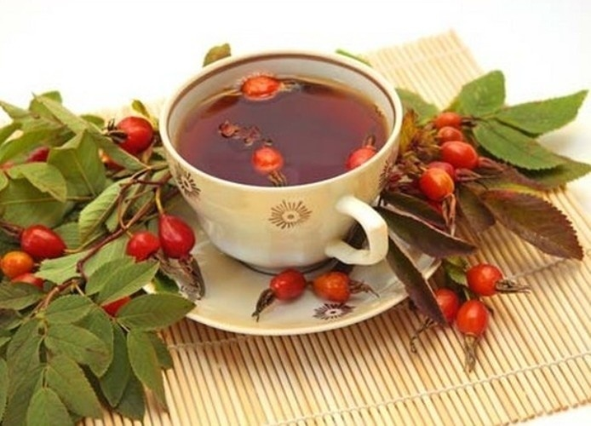
Infusions and Decoctions
Lecture for students of Institute of Pharmacy

Slide 2
Infusions and decoctions
(Aqueous extracts)
plan of the lecture
Infusions and decoctions. Characteristic. Classification.
The main stages of the extraction process.
Factors affecting on the completeness of extraction
Technology of aqueous extracts

Slide 3
Aqueous extracts of plant material are among the oldest pharmaceutical preparations.
Often such preparations are quickly and strongly contaminated by microorganisms and, in addition,
many pharmacologically active substances show severely limited stability in aqueous solutions. For these reasons, aqueous plant extracts should be immediately consumed after preparation (e.g., a medicinal tea).
When not prescribed otherwise, aqueous extracts are prepared from 1 part of herbal material and 10 parts of water (there are some exclusions from this rule).

Slide 4
Infusions and decoctions - Infusa et Decocta - liquid dosage form. There are an aqueous extracts from medicinal plants, as well as aqueous solutions of liquid or dry extracts –concentrates (RPh)
Infusions and decoctions - polydisperse systems with liquid dispersion medium

Slide 5
Infusions and decoctions can be obtained by removing the active substances from the dried and powdered plant.
This is achieved mainly by the process of extraction.
In its most common form, extraction process consists of soaking the powdered material in a liquid solvent (usually aqueous in farmacy).
The solvent diffuses into the powdered material, dissolves the ingredients which then diffuse out into the liquid. Decreasing of particle size of the plant matrix will increase extraction of biologically active substances.

Slide 6
The medicinal plant (MP) to be extracted has a cellular structure. Medicinal products differ in anatomical structure, chemical composition and physical properties. All substances of medicinal plant raw materials, passing into extractant in form of a solution are called extractives.
Extractives include:
1) biologically active substances – substances that have a pronounced pharmacological activity and are of interest from the point of view of treatment and prevention of diseases (alkaloids, flavonoids, coumarins, vitamins, essential oils, etc.);
2) accompanying substances - natural companions of biologically active substances, which play an important role in the life of the plant, are not of particular interest from a pharmacotherapeutic point of view, but somehow influence the manifestation of the therapeutic effect of biologically active substances.
For example: mucus, gums reduce the side effects of biologically active substances and slow down their absorption, due to an increase in viscosity and enveloping action; saponins enhance the absorption of biologically active substances, since they are surfactants; tannins slow down absorption.
3) ballast substances - accompanying substances that do not take a significant part in the manifestation of the therapeutic effect.

Slide 7
Classification
Water extracts are divided into:
infusion (can be prepared from herbs, flowers, leaves, blossoms)
decoction (can be prepared from bark, roots, rhizome)
mucilaginis
An exception: From the leaves of bearberry, cranberries, senna - prepare a decoction;
From roots with rhizomes of valerian - preparing the infusion.

Slide 8
Methods for prescribing aqueous extracts
Rp.: Infusi Herbae Leonuri 200.0
Natrii bromidi 4.0
Misce.Da.
Signa. 1 tablespoon 3 times a day
Rp.: Infusi Herbae Leonuri ex 10.0 - 200.0
Natrii bromidi 4.0
Misce.Da.
Signa. 1 table spoon 3 times a day

Slide 9
Regulatory documents for manufacture of aqueous extracts
RPh
Russian Ministry of Health Order number 309 from 21.10.1997 g. "On approval of the sanitary regime drugstores (pharmacies) instructions
Russian Ministry of Health Order number 751n on 2015 “preparation of dosage forms in farmacy and quality control of the medicines manufactured in pharmacies"

Slide 10
Factors affecting on the completeness of the extraction of active ingredients from the plant
Type of equipment used and the material of equipment
extraction time and duration of cooling
The degree of comminution of raw material
pH of water
standardization of raw materials
The chemical nature of the active substances
stirring

Slide 11
Type of equipment used and the material of equipment
To produce aqueous extracts used the special equipment called infundirki (From the Latin infundo - pour, brew). Infundirki can be enameled, stainless steel and porcelain
Requirements to infundirka:
material infundirki should not interact with plant material;
must possess sufficient thermal conductivity and mechanical strength.
porcelain infundirki badly warmed up, so you need them preheat for 15 minutes.

Slide 12
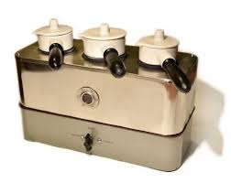
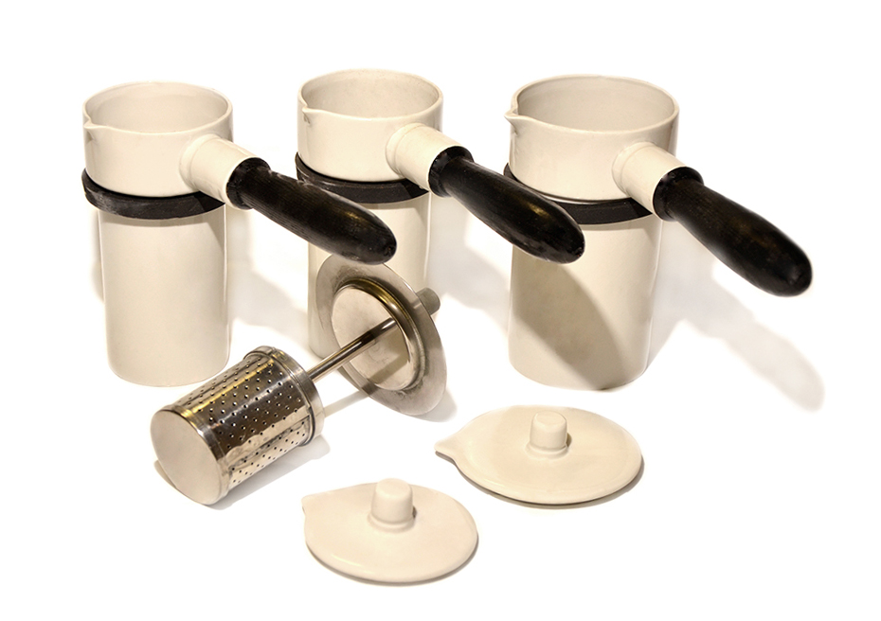
Infundirny apparatus
infundirki
perforated metal cylinder

Slide 13
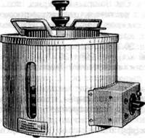
apparatus infundirny AI-3000

Slide 14
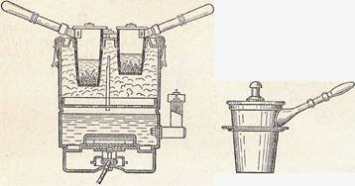
scheme infundirny apparatus

Slide 15
The degree of comminution of raw material
RPh - In the manufacture of infusions and decoctions are used comminuted plant material, the requirements are in documentation:
Bearberry leaves and cranberries - 3 mm
Shoots rosemary, eucalyptus leaves -5 mm
Buckthorn bark, oak - 7 mm
Nettle leaves, mother and stepmother, senns, Plantain, - 7 mm
Grass adonis, St. John's wort, motherwort, Thermopsis, yarrow-7mm
peppermint leaves - 10 mm
Linden flowers - 0.5-20 mm.
not crushed fennel fruit, anise, fennel, juniper, blueberries, rose hips, hawthorn, birch and pine buds, Schisandra seeds, flax seeds, cornflower and chamomile.

Slide 16
Particle size of dried vegetable raw materials in
depending on its morphological group or the group of BAS contained in it
Type of dried medicinal plant materials used | Particle size, mm
Leaves, flowers Herbs | 5 7
Barks, shoots, underground organs (roots, rhizomes, tubers, corms, bulbs, etc.) | 3
Fruits and seeds (mainly whole are used), if necessary, crushed | 0.5 mm
Leathery leaves (lingonberry, bearberry) | 3

Slide 17
The particle size of the dried raw materials of plant origin, depending on
from its morphological group or the group of biologically active substances contained in it (by order 751-n of 2015)
Type of dried medicinal plant materials used | Particle size, mm
Leaves, herbs, flowers | 4
Barks, shoots, underground organs (roots, rhizomes, tubers, corms, bulbs, etc.) | 3
Fruits and seeds | 2
Plant materials containing alkaloids | 1

Slide 18
extraction time and duration of cooling
How to prepare infusions and decoctions
To prepare infusions we must heat on the water bath for 15 minutes and cool at room temperature for 45 minutes, then filter
To prepare decoction we must heat 30 minutes on the water bath and cool at room temperature for 10 minutes, then filter

Slide 19
exceptions:
Decoctions from raw materials containing tannins insist 30 minutes in a boiling water bath and filtered without cooling (To prevent sedimentation of tannins)
Decoctions of the leaves senna cool completely (For complete precipitation of resinous substances)
Infusion prepared from marshmallow root by "cold" method without heating

Slide 20
standardization of raw materials (RPh)
In the manufacture of infusions of raw materials, comprising cardiac glycosides and alkaloids, Used vegetable raw material with a particular biological activity or with a particular alkaloid content.
Raw materials with more biological activity or a high content of alkaloids necessary to take less
Making conversion from the formula: X = A • B / c, Where
A - a prescribed number of medicinal herbs. gram
B - the actual content of active substances in 1 g of raw
c - standard contents of active substances in 1 g of raw material.
raw materials with less biological activity or with a lower content of alkaloids for producing infusions do not apply.

Slide 21
Rp.: Infusi herbae Adonidis vernalis ex 6.0 - 180.0
D.S.1 tbsp. spoon 3 times a day
Standard content of cardiac glycosides 50-66 (average is 58)
Actual raw Activity 75 units
of raw materials (75 ) = 6.0 • 58/75 = 4.64 g

Slide 22
Ratio of Raw material mass to volume of extractant
 | RPh
1:10 | in the absence of instructions on the amount of medicinal plant preparations, infusions and decoctions are prepared in a ratio of 1:10 (all plants, except for potent and specially specified ones)
1:30 | From adonis herb, rhizomes with valerian roots roots of issthod, ergot horns, flax seeds, lily of the valley herb
1: 400 | From raw materials containing potent substances, infusions and decoctions are prepared in a ratio of 1: 400 All plants of the potent group (foxglove, thermopsis, ipecacuanha, etc.)

Slide 23
Power of water absorption
The amount of absorbed water depends on the morphological and anatomical characteristics of the raw material and the degree of grinding. The RPh gives the coefficients of water absorption for various types of plant raw materials, which show the amount of water retained by 1 g of plant raw materials of a standard degree of grinding after it squeezes in a perforated cylinder.
The volume of water required to prepare the amount of infusion or decoction is determined by summing the amount of extraction indicated in the prescription and the additional amount of water. The latter are calculated by multiplying the prescribed amount of raw materials by a coefficient of water absorption.

Slide 24
Coefficient water absorption (K absorption ) shows the volume of water (ml) held by 1 g of crushed plant material after being wrung out (squezzed) in a perforated cylinder
The values K absorption are given in the tables.
If a K absorption not in the table, use averages.
Type of raw material | Average values TO_{in}
Roots, rhizomes | 1.5
Bark, herbs, flowers, leaves | 2.0
seed | 3.0
Briquetted raw materials | 2,3

Slide 25
Coefficients of water absorption (K absorption) of medicinal plant materials
No. | Name of medicinal plant raw materials | Water absorption coefficient | Name of medicinal plant raw materials | Water absorption coefficient
1. | Calamus rhizome | 2.4 | Peppermint leaves | 2.4
2. | Lingonberry leaves | 1.5 | Plantain large leaves | 2.8
3. | Valerian rhizomes with roots | 2.9 | Wormwood herb | 2.1
4. | Spring adonis grass | 2.8 | Motherwort herb | 2.0
5. | Oak bark | 2.0 | Chamomile flowers | 3.4
6. | St. John's wort herb | 1.6 | Rowan fruit | 1.5
7. | Serpentine rhizome | 2.0 | Senna leaves | 1.8
8. | Viburnum bark | 2.0 | Marsh grass | 2.2
9. | Nettle leaves | 1.8 | Bearberry leaves | 1.4
10. | Buckthorn bark | 1.6 | Horsetail herb | 3.0
11. | Lily of the valley | 2.5 | Bursts of grass | 2.0
12 | Linden flowers | 3.4 | Sage leaves | 3.3
13. | Mother and stepmother leaves | 3.0 | Rosehip fruit | 1.1

Slide 26
Technological stages of manufacture of aqueous extracts
Pharmaceutical expertise of prescription
Heating of porcelain infundirka
The calculations on the back side of the PWC
Grinding and sieving the raw materials
Loading of infundirki by raw material, water, auxiliary substances
Insisting on a boiling water bath for a certain time
Cooling at room temperature

Slide 27
Technological steps of manufacture of aqueous extracts
Filtration with recovery depressing of raw materials in the perforated cylinder
Dissolution of drugs (if they were prescribed)
Bring up to volume in cylinder
Transfusion of infusion in a packaging bottle
Introduction galenic preparations (tinctures, extracts if they were prescribed)
The closure and labeling
Making the front side of the PWC

Slide 28
Manufacturing of mixtures containing aqueous extracts from medicinal products and medicinal substances
When we prepare of water extracts from raw materials, the use of solutions in high concentration of medicinal substances is not allowed.
The drug solids are dissolved in the finished aqueous extract.
The resulting solution is filtered into a packaging bottle for dispensing after dissolving the solids.
If necessary, the volume of the dosage form is adjusted with purified water to the specified in the prescription.

Slide 29
Labeling infusions and decoctions
Key labels: "Internal" or
"EXTERNAL"
Additional labels:
"Before the use to shake up" !!!
"Keep in a cool, dark place“
“Keep away from chidren”
Shelf life of infusions, decoctions, mucus,
manufactured in pharmacies - 2 days

Slide 30
Rp.: Infusi Herbae Leonuri 200.0
Da.
Signa. 1 tablespoon
3 times a day

Slide 31
Infusion of herbs Leonurus It is prepared in a ratio of 1:10
The degree of milling of raw material - 7 mm
V_{water}= Vformulation + Mass of plant ·K absorption _{, Where}
V formulation- volume of the aqueous extract
Mass - the mass of the plant
K absorption - coefficient of water absorption for raw material

Slide 32
The calculations on the back of the PWC
Vtotal = 200 ml
M herb of leonuri = 200,0/10,0 = 20.0 gr
K absorbtion herb of leonuri (in the table) = 2.0
V water = 200.0 + (20,0 x 2,0) = 240.0
Insist on water for 15 min
Cool at room temperature 45 min

Slide 33
Technology
Heating of porcelain infundirki
Weigh 20,0 grams of herbae Leonuri and put in the infundirka, measure 240 ml of purified water and add to herba
Insisting on a boiling water bath for a 15 minutes
Cooling at room temperature for 45 minutes
Filter through cotton material Bring up to volume in cylinder and put in the packaging bottle
The closure and labeling
Making the front side of the PWC

Slide 34
PWC front side
05/11/2020 number of prescription 1
Herba Leonuri 20.0
Aqua purificata 240.0
V total = 200.0
prepared:
Check:

Slide 35
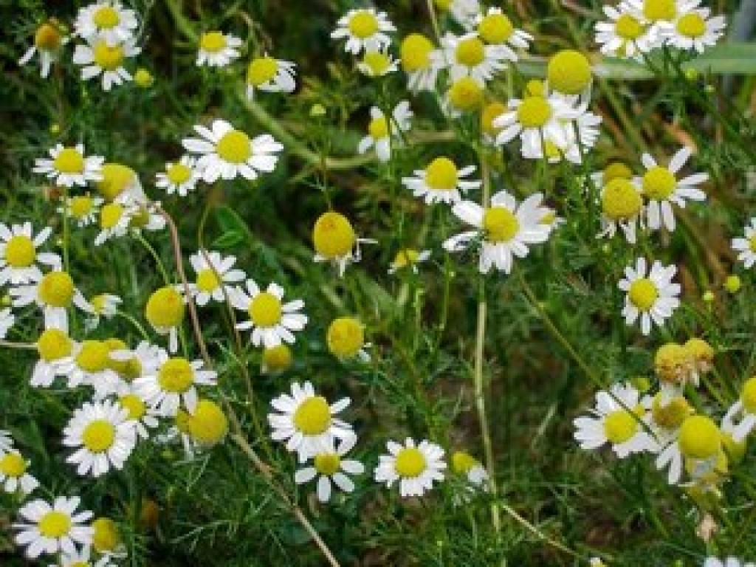
Medicinal plant products containing essential oils (chamomile flowers, anise fruits, rhizomes with valerian roots, peppermint leaves, etc.)
To maximize the preservation of essential oils and other volatile components, only infusions are prepared from raw materials, the extraction is not stirred either when infused in a water bath or when cooled.
Raw materials are non-potent, cook in a ratio of 1:10, except for the infusion of rhizomes with valerian roots, which is prepared in a ratio of 1:30.

Slide 36
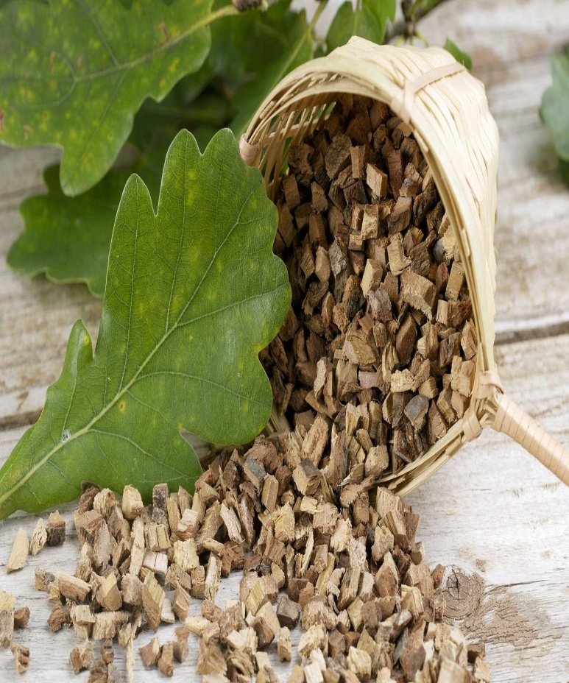
Medicinal plant raw materials containing tannins (oak bark, burnet roots, cherry fruits, serpentine and cinquefoil rhizomes, bearberry leaves, etc.)
Only decoctions are prepared
To maximize the preservation of tannins, the extraction is filtered immediately after being removed from the water bath (when cooled, tannins precipitate and can be adsorbed by medicinal plant raw materials and retained by the filtering material)

Slide 37
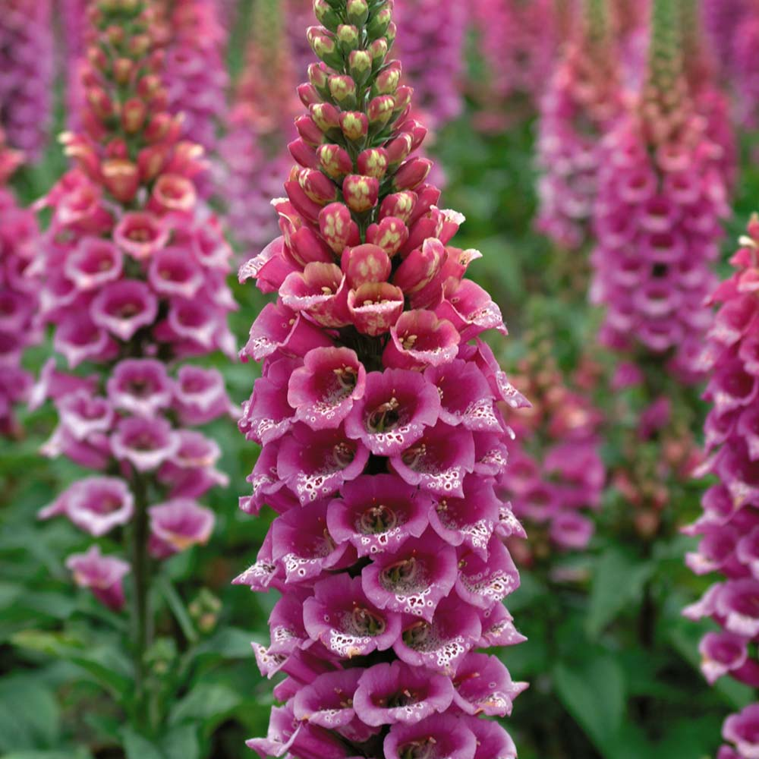
MP containing cardiac glycosides (foxglove leaves 50-66 ICE, spring adonis herb 50-66 active unites, lily of the valley leaves 90, jaundice herb 500 ICE)
Prepare infusions taking into account thermolability cardiac glycosides (do not overheat !!!)
The content of active ingredients in the raw materials used is taken into account. Raw materials with a low content of cardiac glycosides are not used. Raw materials with a high content of cardiac glycosides take less, making a recalculation according to the formula:X = A x V / B
Temperature and time conditions of extraction are strictly observed.

Slide 38
Medicinal product containing anthraglycosides (buckthorn bark, zhostera fruits, rhubarb roots, rhizomes and roots of madder dye, etc.)
Decoctions are prepared (infusion time when heated no more than 30 minutes, in order to avoid decomposition of anthracene derivatives)
The broths are filtered immediately after removal infunits from a water bath
Decoction of rhubarb root and leaves senna cooled completely to precipitate and remove tannins (rhubarb) and resinous substances (senna).

Slide 39
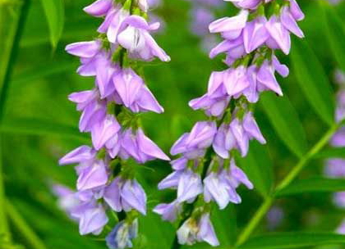
MP containing saponins (licorice root, rhizomes with cyanosis roots, istode roots, aralia roots, etc.)
Prepare decoctions
The extraction of saponins takes place better in an alkaline environment, for this add sodium bicarbonate in an amount
1 g per 10 g of raw material
Before heating

Slide 40
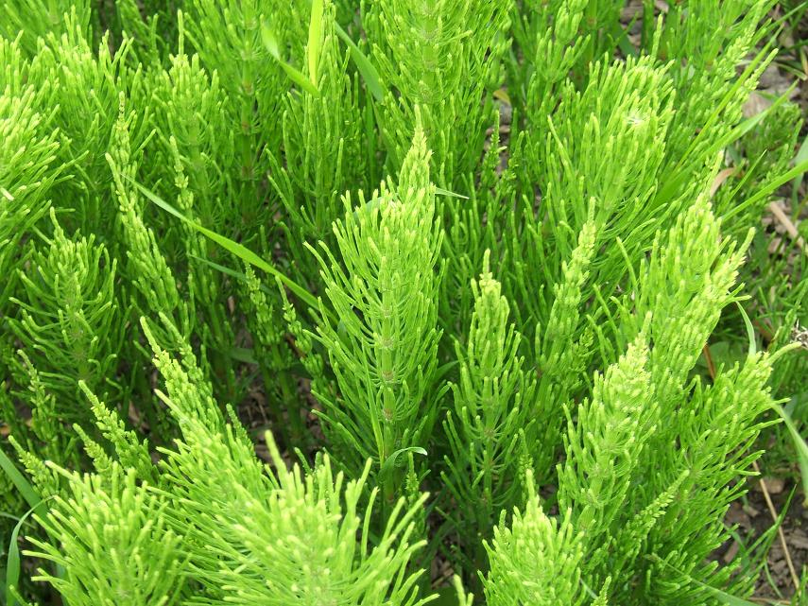
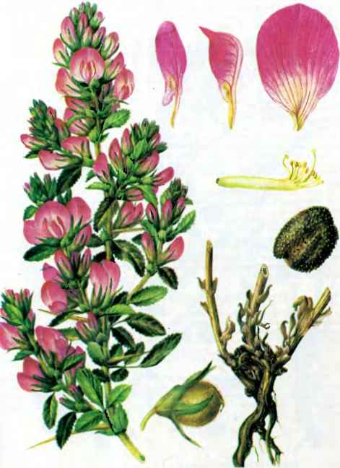
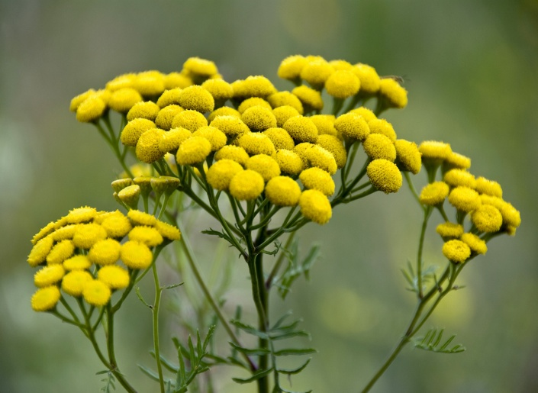
Medicinal product containing flavonoids (flowers of tansy, sandy immortelle, linden, three-leafed watch, knotweed grass, motherwort, field horsetail, etc.)
Prepare infusions
From the roots of steel - decoctions

Slide 41
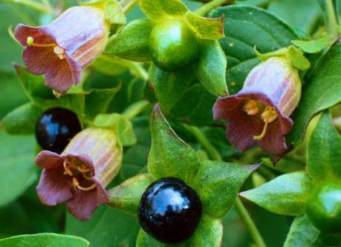
MPs containing alkaloids (celandine herb, thermopsis, belladonna leaves, henbane, dope, etc.)
Prepare infusions.
The content of active ingredients in the raw materials used is taken into account. Raw materials with a low content of alkaloids are not used. Raw materials with a high content of alkaloids take less, making a recalculation according to the formula:X = AxB/ B
To extract alkaloids, use purified water, acidified with citric or hydrochloric acid in an amount equal to the amount of alkaloids in the raw material (to convert the base of alcaloids into salt).

Slide 42
Rp.: Infusi foliorum Belladonnae 200.0
D.S. By 1 tablespoon 3 times a day
The alkaloids content in the Folia of Belladonnae is 0.3%.
We prepare the infusion in a ratio of 1: 400,
Raw materials = 200,0 / 400 = 0.5
0.3 gr alcaloids - 100.0 raw materials
X ---------- 0.5 X = 0.0015 gram
Citric acid necessary to take in amount 0.0015 grams to acidify the water (it is impossible to weigh out, we use a 1% solution (1:100) 0,0015 x 100 = 0.15 ml or 3 drops, measured with a standard pipett
If we add hydrochloric acid solution containing 0.83% hydrogen chloride:
0.83% HCl--------- 100 ml
0.0015 -------------- X X = 0.18 ml

Slide 43
Water extraction technology
The raw material must be crushed to a size of 1 mm.
In warmed up infundirka is weighed with 0.5 grams of belladonna leaves, 200 ml of purified water is poured in (since the raw material is less than 1 gram, the coefficient water absorption to take into account inappropriate). Next, we add 3 drops of a 1% solution of citric acid, place inside, put in a boiling water bath and leave for 15 minutes. Then remove and cool for 45 minutes, filter, pour into a cylinder and bring to a volume of 200 ml. We pour it into a packaging bottle and put main label "Internal", additional "Store in a cool place", shelf life 2 days.

Slide 44
PWC
05.11.20 No. 6
Folium Belladonnae 0.5
Aqua purificata 200.0
Sol. Acidi citrici 1% - guttas III
V total 200.0
Prepared
Checked

Slide 45
MP containing polysaccharides
Rp.: Infusi radicis Althaeae 100.0
Sirupi simplicis 10.0
Liquoris Ammonii anisati 5.0
M.D.S. 1 teaspoon 3 times a day
Marshmallow root contains 35% mucus and
37% starch
An infusion is prepared from the roots of the marshmallow in a cold way (insisted for 30 minutes at room temperature)
We prepare in the ratio 1:20

Slide 46
Features of water extraction from marshmallow root
For medicinal purposes, mucus is used as an emollient, enveloping and expectorant agent. Starch is a ballast. So that only mucus passes into the extraction, the infusion is carried out at room temperature for 30 minutes (because in cold water starch can not be dissolved).
Marshmallow root is not crushed so that starch does not pass into the extraction
After insisting, the marshmallow root is not squeezed out, also in order not to was passing starch in xtraction
If the doctor does not indicate the ratio of raw materials and extractant then cook 1:20. This ratio for the water extract of marshmallow root is accepted by many pharmacopoeias of foreign countries.
In order to obtain 100 ml of extract, it is necessary to increase the amount of water. And in order to maintain the ratio of raw materials and extractant, respectively, increase the amount of raw materials. Thus, when making an infusion of marshmallow root, use consumption coefficient. It shows how many times it is necessary to increase the amount of raw materials and extractant to get the required recovery. For a ratio of 1: 20 K_{consumption} = 1.3.

Slide 47
Consumption coefficients
for the preparation of infusions of marshmallow root
Ratio | K consumption
1: 100 2: 100 3: 100 4: 100 5: 100 | 1.05 1.1 1.15 1,2 1.3

Slide 48
Calculations on the back of the PWC
(we increase the mass of raw materials and extractant taking into account Kconsumption)
K_{cons.}= 1.3
Marshmallow roots 5.0x1.3 = 6.5
Vwater = 100x1.3 = 130.0
Vsugar syrup = 10.0
V Liquoris Ammonii anisati = 5.0
Vtotal = 115 ml

Slide 49
Technology
Marshmallow root is not crushed, 6.5 grams are weighed, placed in a flask, 130 ml of purified water are measured, infused at room temperature for 30 minutes, constantly shaking. The raw material is filtered, without squeezing, so that starch does not pass into the extraction, it is poured into a measuring cylinder, the volume of the extract is brought to 100 ml with purified water. The finished extract is transferred into a bottle for dispensing. Then, in a separate glass, 10 ml of sugar syrup and 5 ml of ammonia-anise drops are mixed, shaken thoroughly and poured into a dispensing bottle. The contents are mixed and the bottle is made out for release.

Slide 50
PWC
05.11.2020 prescription no. 2
Radices Althaeae 6.5
Aqua purificata 130.0
Sirupi simplicis 10.0
Liquoris Ammonii anisati 5.0
Vtotal 115.0
Prepared:
Checked:

Slide 51
Rp.: Infusi Herbae Leonuri 200.0
Natrii bromidi 4.0
Glucosi 10.0
Tincturae Valerianae 5.0
Misce. Da.
Signa. 1 tablespoon 3 times a day

Slide 52
Water extraction and two or more solids
The calculation of the volume of the solvent is carried out taking into account the coefficient of water absorption and the total increase of volume when dissolving dry substances.
Total Volume is 205 ml
Let's calculate permissible deviations:
The permissible deviations are ± 1%. Then for a volume of 200 ml it will be
205 ml - 100%
X --------- 1%. X = 2.05 ml
[202.95 ml to 207.05 ml].
We find out how much the volume of the dosage form will increase when the medicinal substances are dissolved:
M natrii bromidi = 4.0
Mglucosum anhydricum = 10.0
Mglucose water = 10x100 / 100-10 = 11.11
4.0x0.26 + 11.11x0.69 = 8.7059 ml. This does not fit into the norms of permissible deviations, therefore we take into account the CVI.

Slide 53
PWC - calculations on the back side
Vtotal = 205 ml
Mherbae Leonuri = 20.0
K absorption = 2.0
Vwater = (200.0 + (20.0x2.0)) - (4.0x0.26 + 11.11x0.69) = 240,0 – 8,7 = 231.3 ml

Slide 54
Technology
Heating of porcelain infundirki
Weigh 20,0 grams of herbae Leonuri and put in the infundirka, measure 231,3 ml of purified water and add to herba
Insisting on a boiling water bath for a 15 minutes
Cooling at room temperature for 45 minutes
Filter through cotton material in the glass
Weigh solids – natrii bromidum and glucosum – and dissolve in the water extract
Filter again
Bring up to volume in cylinder and put in the packaging bottle
Then closure and labeling
Making the front side of the PWC

Slide 55
PWC
05.11.2020 prescription no.4
Herba Leonuri 20.0
Aqua purificata 231.3
Natrii bromidum 4.0
Glucosum hydricum 11.11
Tinctura Valerianae 5.0
Vtotal = 205, 0
Prepared:
Checked:

Slide 56
Manufacture of infusions and decoctions with the help of extractes-concentrates
We can prepare infusions and decoctions with the help of extractes-concentrates
extractes-concentrates can be manufactured on the factories from the medicinal plant raw materials especially for pharmacies to product from them water infusions and decoctions
extractes-concentrates can be liquid and dry.
Liquid extractes-concentrates are in the ratio 1:2
Dry extractes-concentrates are in the ratio 1:1
Not from all medicinal plants extractes-concentrates are

Slide 57
Benefits of using concentrate extracts:
Speeding up the manufacturing process
Obtaining standardized aqueous extracts with standard content of active ingredients
Possibility of using concentrated solutions of medicinal substances.

Slide 58
In the manufacture we use a liquid extract-concentrate of herbae Leonuri (1: 2)
20% sodium bromide solution
10% glucose solution
Rp .: Infusi Herbae Leonuri 200.0
Natrii bromidi 4.0
Glucosi 10.0
Tincturae Valerianae 5.0
Misce. Da.
Signa. 1 tablespoon 3 times a day

Slide 59
Calculations on the back of the PWC
Vtotal = 200 ml
Mass of herbae = 20.0
V extractum-concentratum (1: 2) = 20,0 x 2 = 40.0 ml
Mnatrii bromidi = 4.0
V20% solution natrii bromidi (1: 5) = 4.0x5 = 20 ml ()
Mglucose anhydr = 10.0
V10% glucose solution = 10.0x10 = 100 ml
Vwater = 200.0 - (40.0 + 20.0 + 100.0) = 40.0

Slide 60
Technology
We prepare in the packaging bottle
Measure purified water 40 ml
Measure Sol. Natrii bromidi 20% -20.0, put in the packaging bottle, measure Sol. Glucosi 10% -100.0, put in the packaging bottle, then measure Extractum – concentratum Herbae Leonuri fluidum (1: 2) 40.0, then measure Tinctura Valerianae 5.0, mix well, germetically close and put a label.

Slide 61
PWC
05.11.2020 prescription no. 5
Aqua purificata 40.0
Sol. Natrii bromidi 20% -20.0
Sol. Glucosi 10% -100.0
Extr.Herbae Leonuri fluidum (1: 2) 40.0
Tinctura Valerianae 5.0
Vtotal = 205.0
Prepared:
Checked:

