Slide 1
Infection
control in Dentistry

Slide 2
• The passage of infection from one
individual to an other in a health care
environment:
-direct contact with blood or saliva -indirect contact
• 1 injection or inoculation via sharp instruments or an open wound
• on fingers - patient to patient,via intermediate surfaces: clothing , chair controls , records
• contaminated instruments
• aerosol, spray , splutter

Slide 3
Severity of infection
Depends on
-The agressiveness
-The number
-The multiplication and resistance capacity
of the microorganisms

Slide 4
Routes of Transmission
• Direct contact
- With blood, saliva or any other body fluids
• Indirect contact
-Injection or inocultaion via sharp instruments or contamination of an open wound
-On fingers or via intermediate surfaces: clothing, chair controls, records
-Contaminated instruments
- Aerosol, spray, splatter

Slide 5
Cross infection control
• Infection control procedures ought to
prevent cross infection from all types of micro-organisms
• Implementing safe and realistic infection control procedures requires the full complience of the dental team
• Procedures should be regularly monitored during clinical sessions .

Slide 6
environment
Hepatitis B virus
Hepatitis C virus
HIV virus
The way of infection is
-Injury by a sharp contaminated instrument -Contamination via the nose, the eye, or the skin

Slide 7
Transmission is percutaneous via contaminated blood
• About 3.9 million cases in the USA
- Most of them are asymptomatic men of 45-65 years of age, who were infected via blood derivates before 1987.
• Today
- 60% of the infected patients are the injection drug users -20% sexually infected
-14% unknown origin, but inferior social facilities -10%:
• 3% tattooing, and bodypiercing persons
• 0.0001% transfusion
• 1-2% health care workers
• Home environment
• Perinatally contaminated (commonly HIV-positive mother)
・ 25% of the alcohol abusers are infected

Slide 8
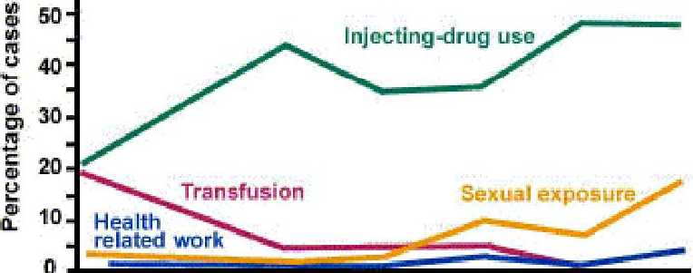
Figure 1. Reported cases of acute hepatitis C by selected risk factors • United States, 1983-1996 son
1983^84* 1985^66* 1967^88* 138940* 1991-92 1991^94 1995,96
Year

Slide 9
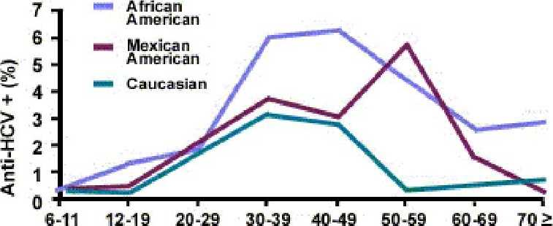
Figure 2. Prevalence of hepatitis C virus (HCV) infection by age and racWethnicit^.United States, 198S-1994
Age Group (Years}
Source: Third National Health and Nutrition
Examination Survey, CDC.

Slide 10
In case of exposition the risk for being infected
• Hep B in case of a non vaccinated person:
-Injuried by a sharp instrument: 6-30%
• Hep C:
-Injuried by a sharp instrument: 1.8 %
-Eye, nose, mouth, skin infection is estimated to be low
• HIV:
-Injuried by a sharp instrument: 0.1%
-Eye, nose, mouth, skin infection: 0-0.1%

Slide 11
personal protection
1 .Immunisation
Hep B
Hep c?
HIV?

Slide 12
Personal protection
• 2.Hand protection :
-jewellery and watches shouldn’t be worn
-hand washing should be performed carefully , using a skin disinfectant
-non-sterile gloves should be worn and changed after every patient
• 3.Eye protection and face masks
-protects against foreign bodies , aerosol, splatter
• 4.Surgery clothing

Slide 14
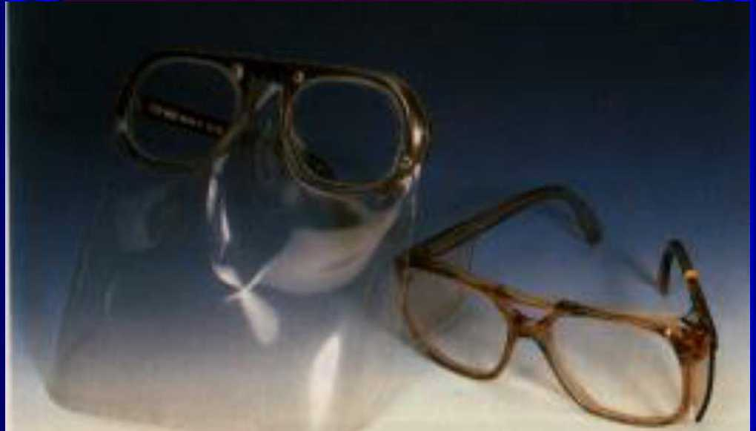

Slide 16
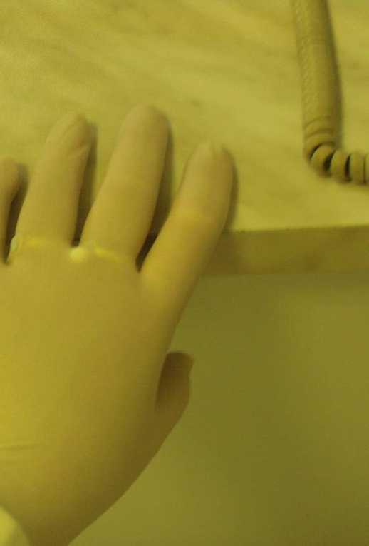

Slide 17
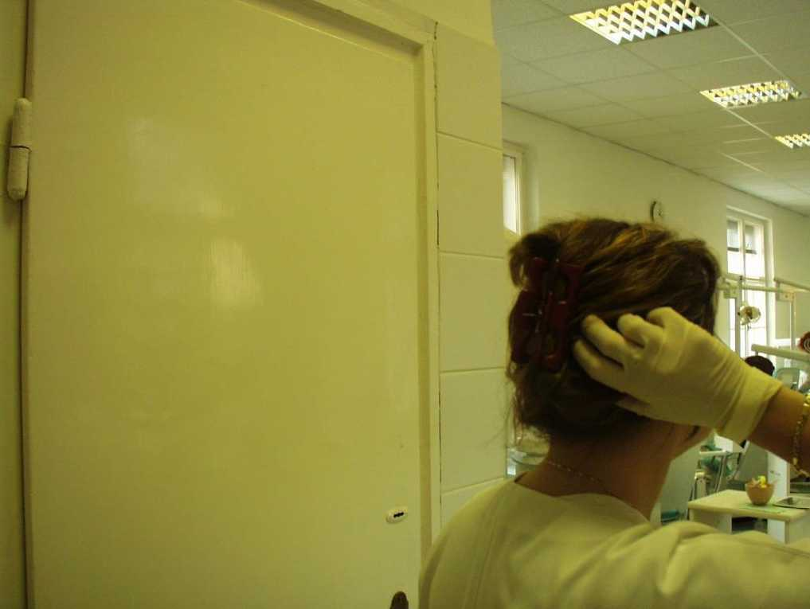

Slide 18
Patient protection
Disposable patient’s bib must be worn during rutine care
Protective glasses

Slide 19
Surgery design
• Simple, uncluttered
• Well ventillated
• Floor covering should be impervious, nonslip and sleam free
• Junctions of the floor and the wall and of the working surfaces and the wall should be coved to aid cleaning

Slide 20
Three Hygiene Zones
-Treatment zone
-Outer treatment zone
-Remainder of the room
• Contaminated items should not be returned to the clean areas, than on a waste tray or holding solution

Slide 21
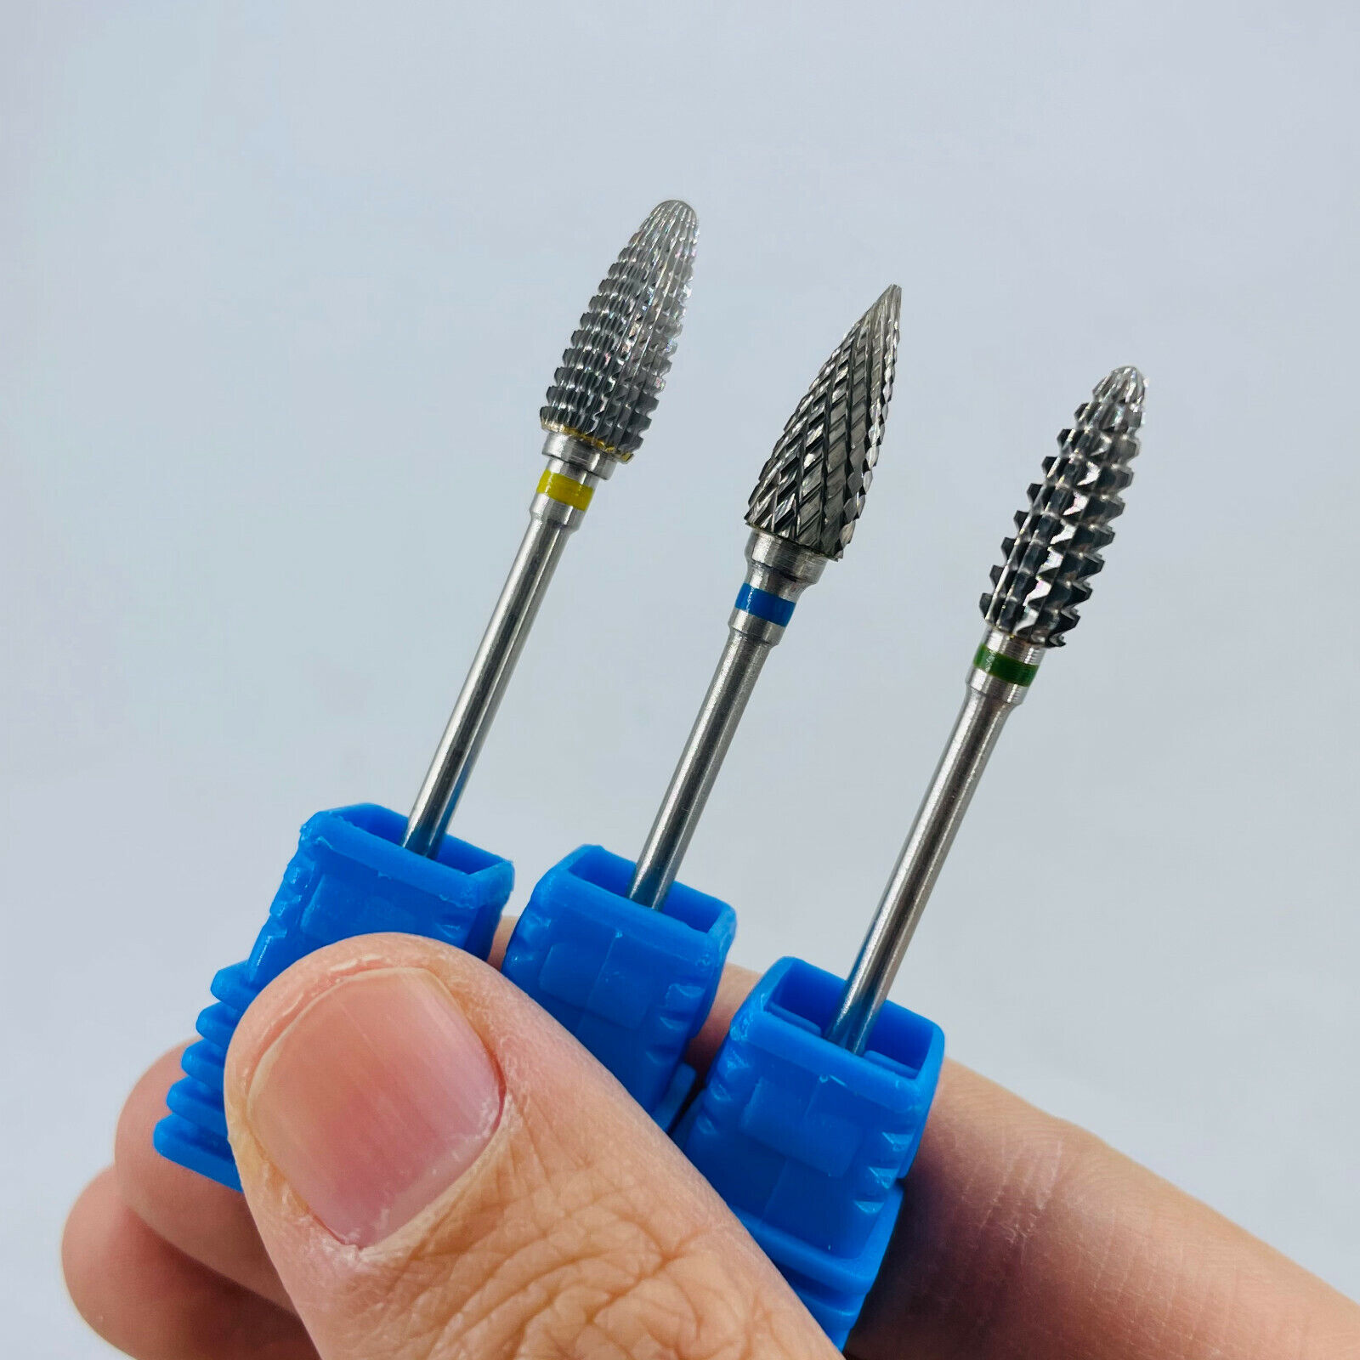

Slide 22
Treatment zone
e
The highest level of hygiene must be applied
-where instruments and materials are placed -bracket table and mobile cart -surrounding worktop
Unused materials and instruments out of this zone , covered
Used materials stored here until the patient is dismissed

Slide 23
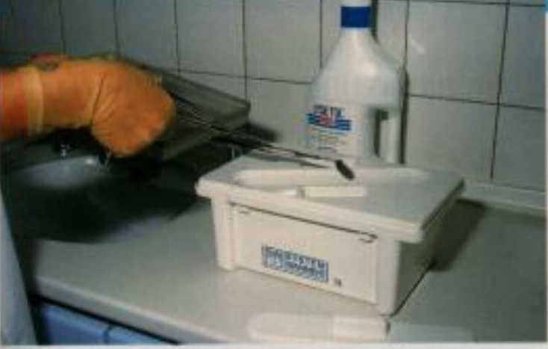

Slide 24
Outer treatment zone
Commonly used items,treated with high level of disinfectant between each patient -handpiece housing
-triple syringe
-X-ray machine
-operating light
-suction hoses
-spittoon
-buttons of the chair , taps,sink -materials and containers

Slide 25
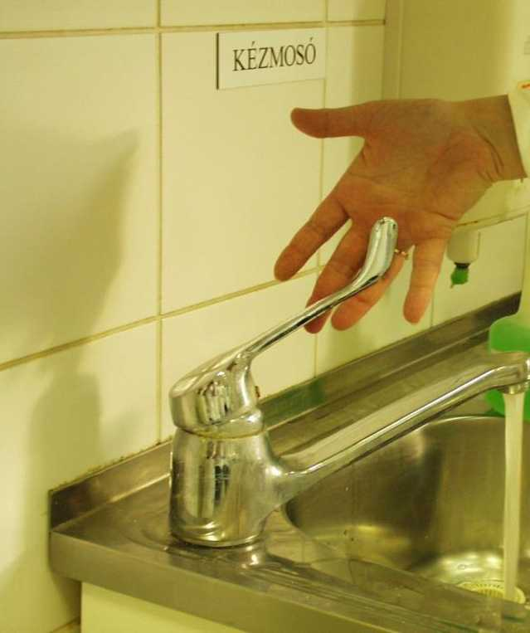
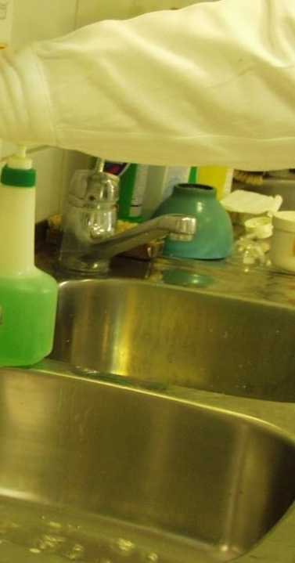
I

Slide 26
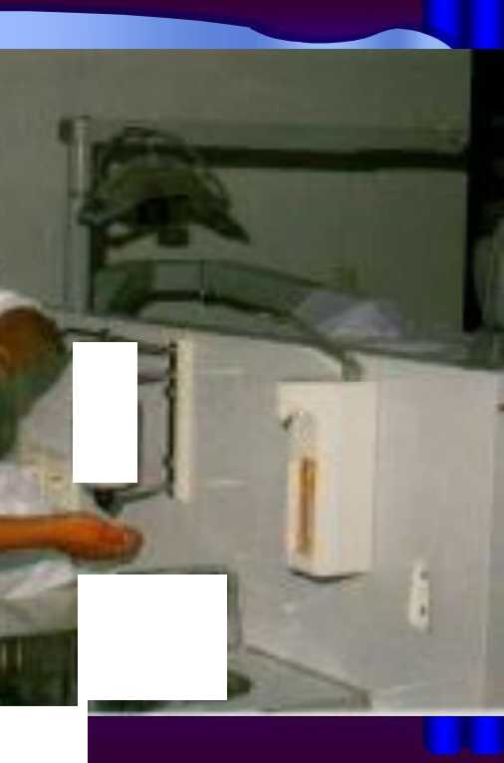
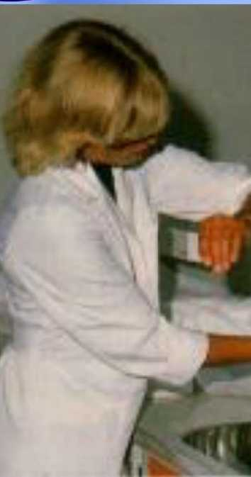

Slide 27
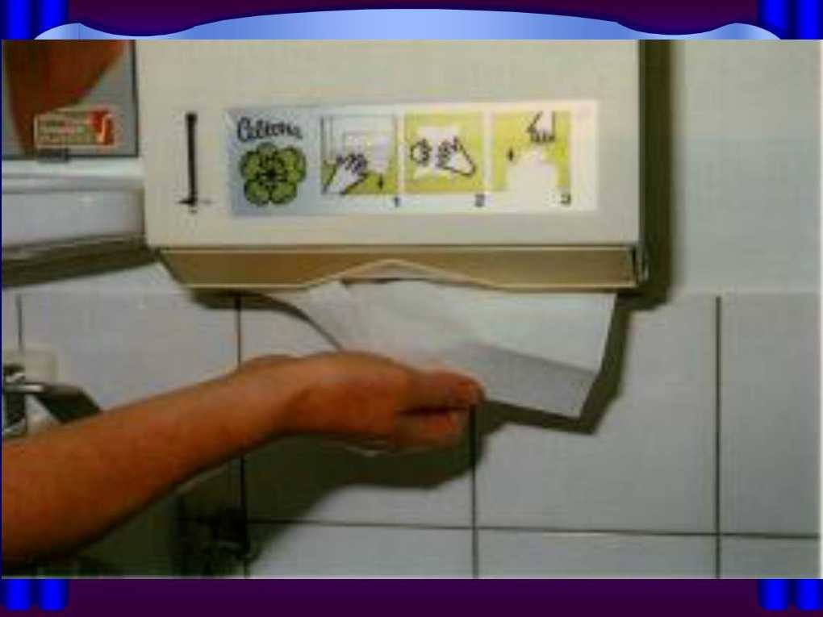

Slide 28
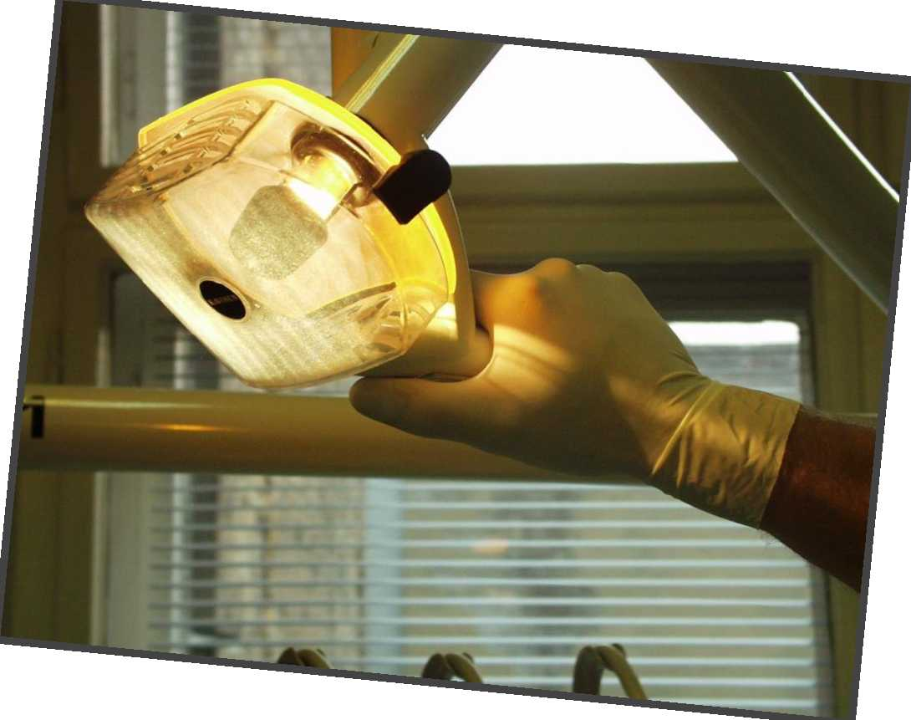

Slide 29
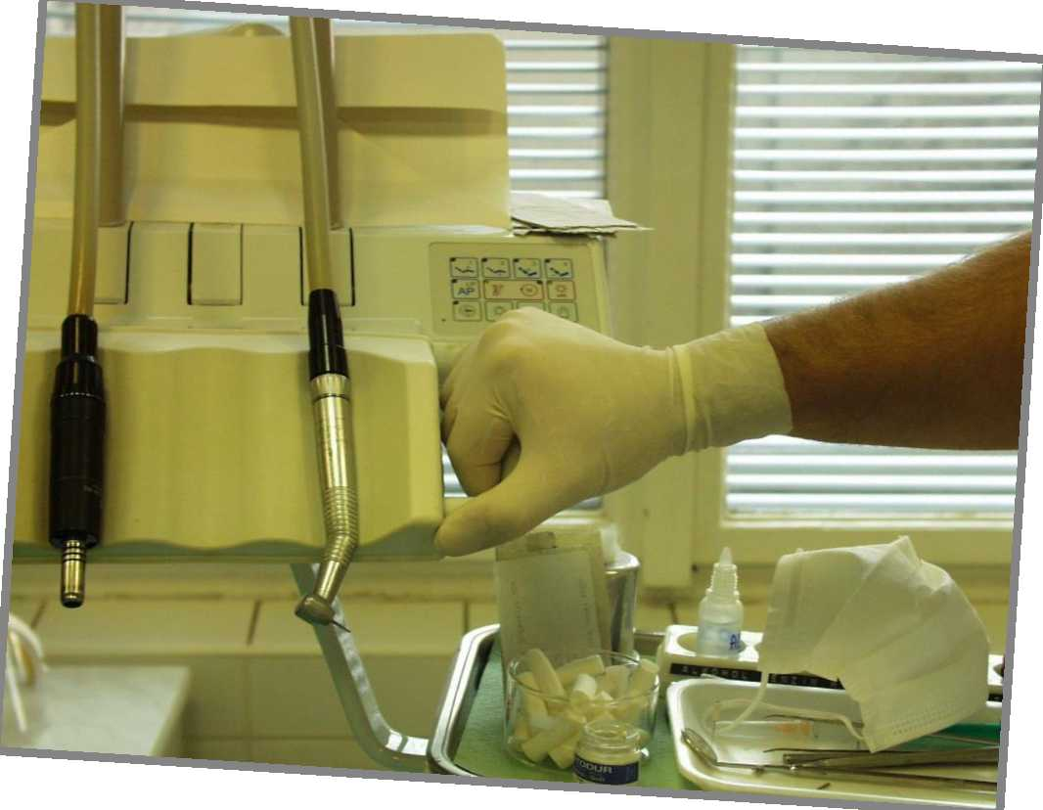

Slide 30
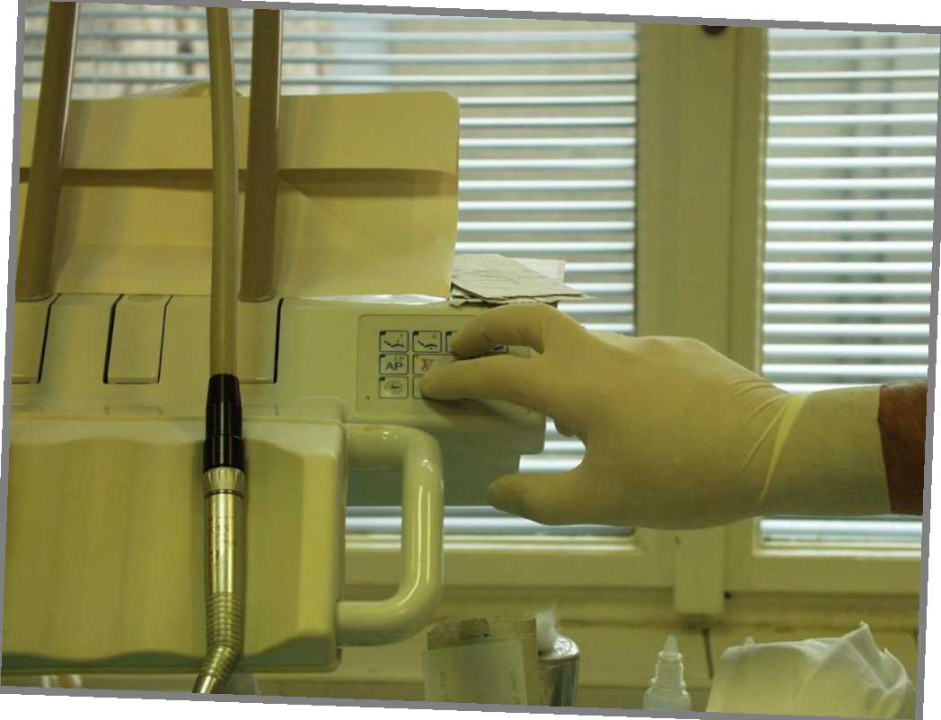

Slide 31
Remainder of the room
Non-critical areas of surgery
-items for individual treatment procedures,
-instruments and materials should be confined to trays or covered areas

Slide 32
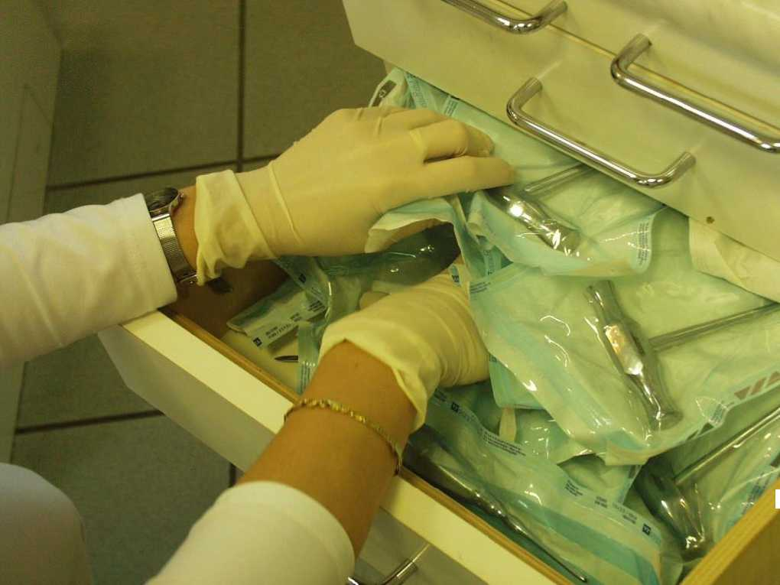
k

Slide 33
Disinfection of surfaces
• Cleaning with disinfectant and a strong disposable tissue or gauze
• Disinfecting (sprayed surface,and the
disinfectant left on the cleaned surface for at least 10 minutes)

Slide 34
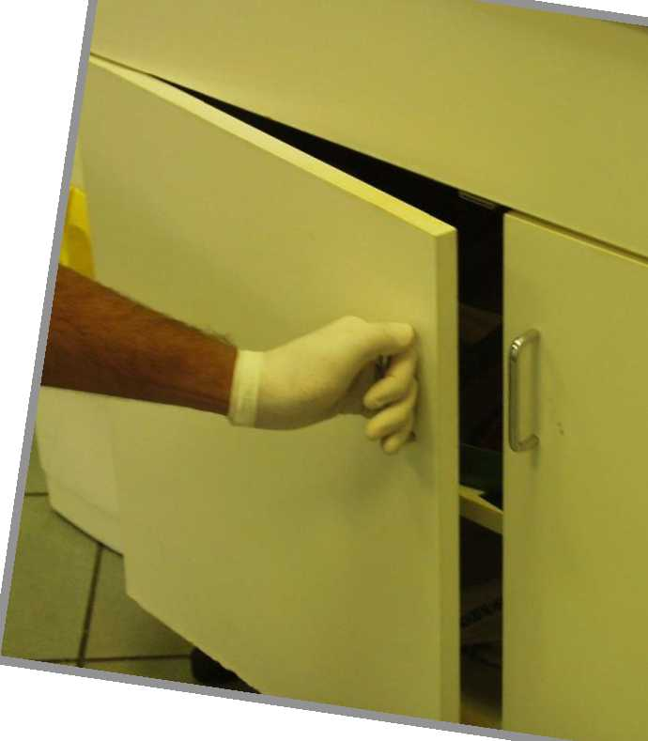

Slide 35
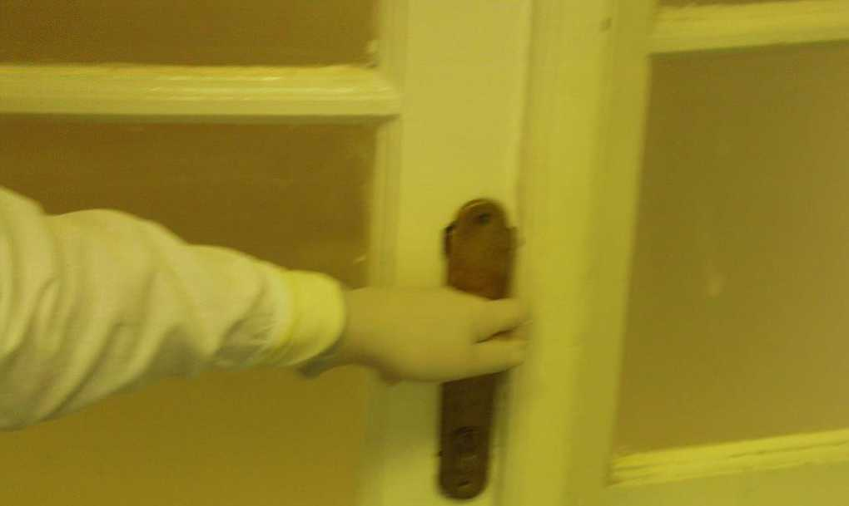

Slide 36
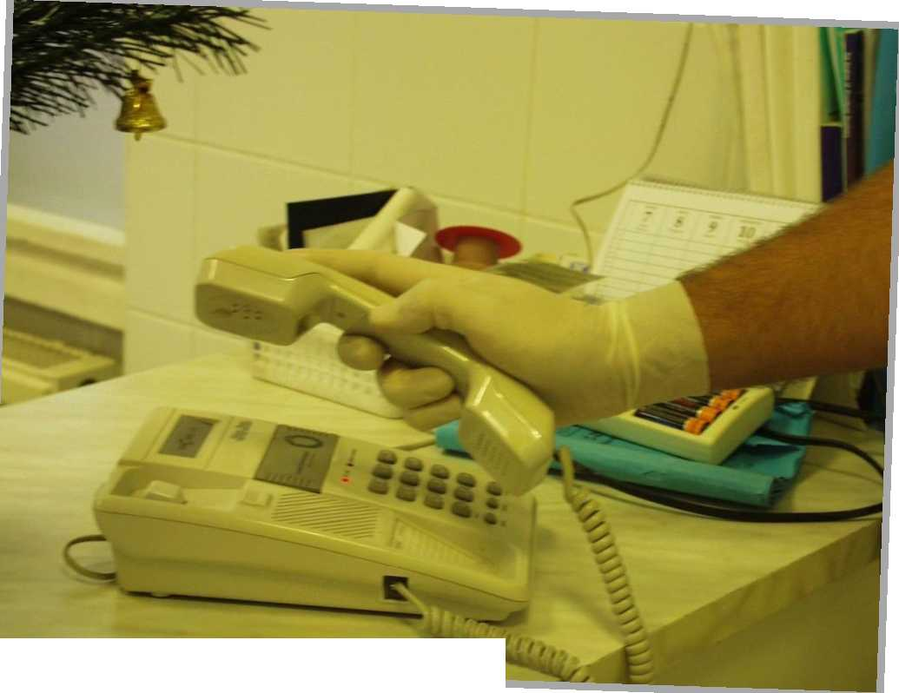
7

Slide 37
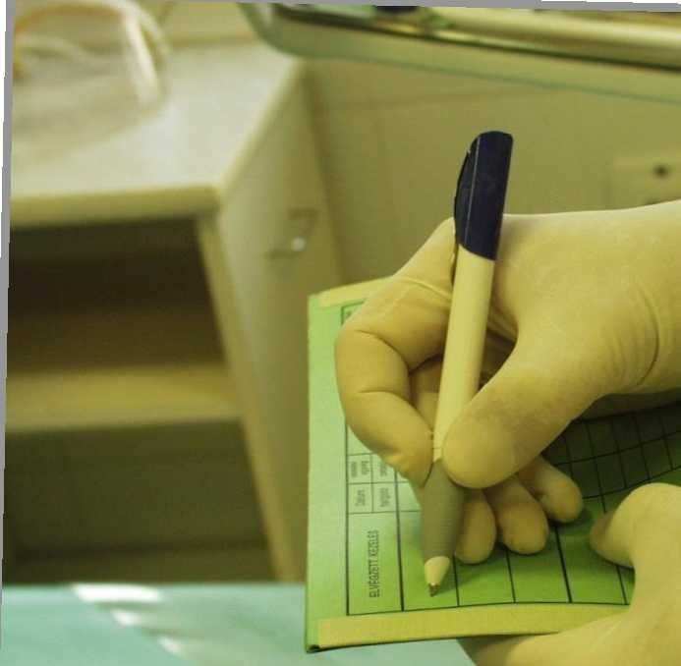
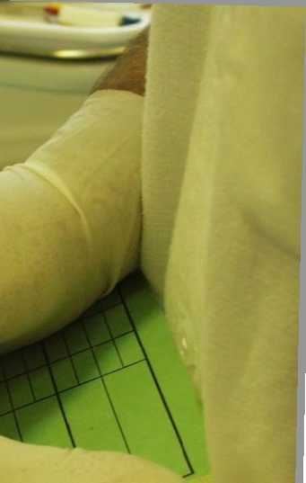
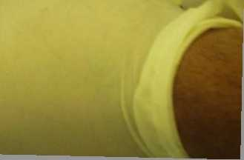

Slide 38
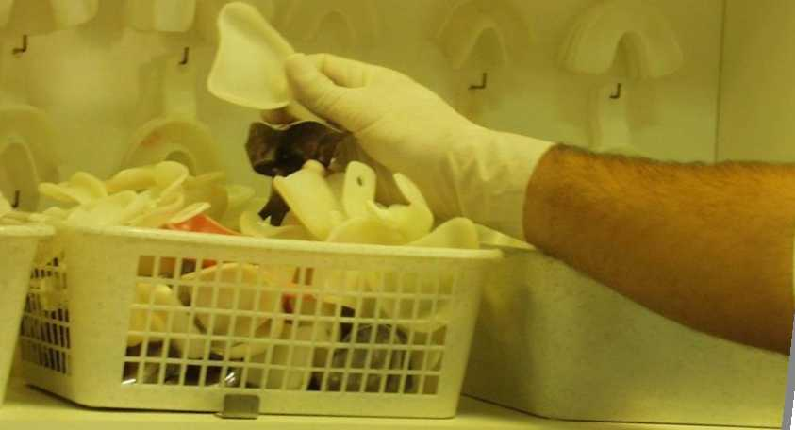
“ IB

Slide 39
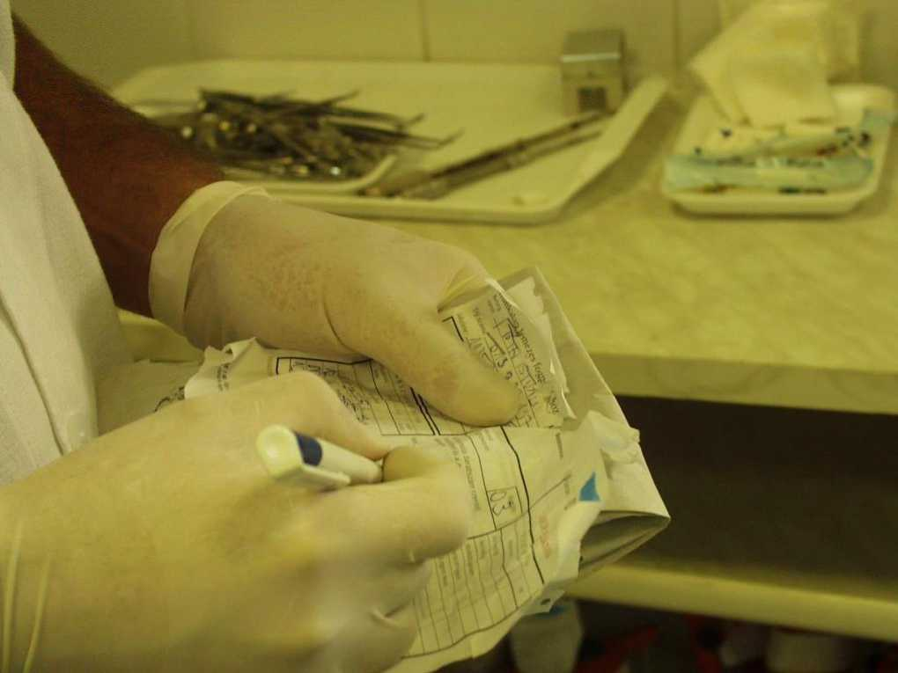

Slide 40
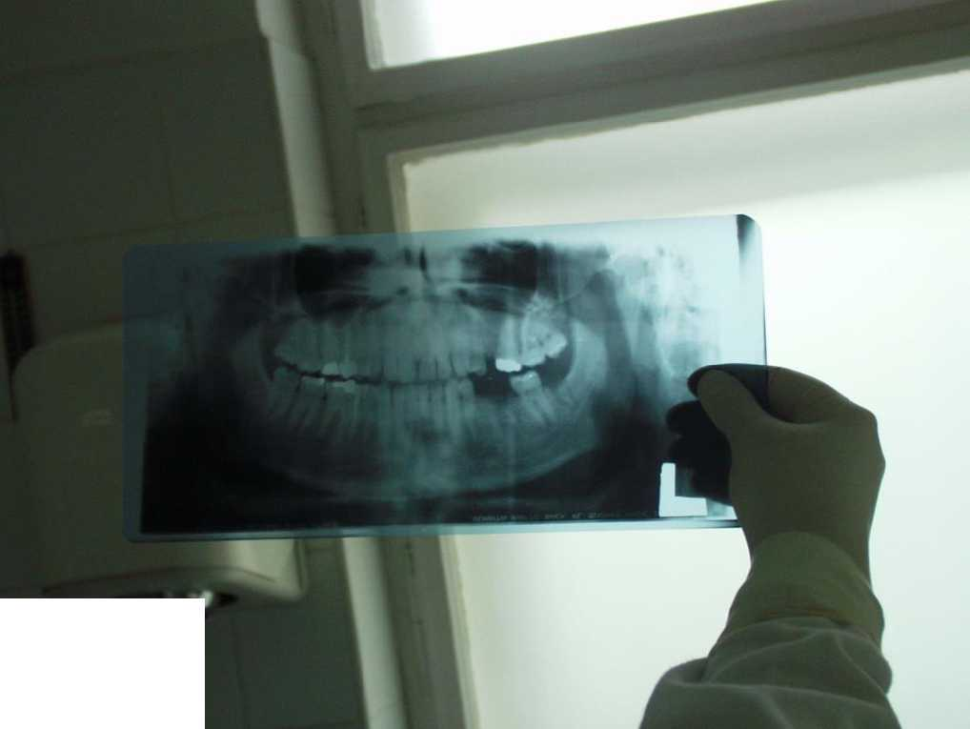
■»

Slide 41
Cleaning and sterilization of instruments and equipment
All instruments contaminated with oral or body fluids are sterilized
-pre-sterilization cleaning
• hand cleaning,detergent, brush
• ultrasonic bath , detergent
• disinfection, packing
-sterilization
• autoclaves
-Aseptic storage

Slide 42
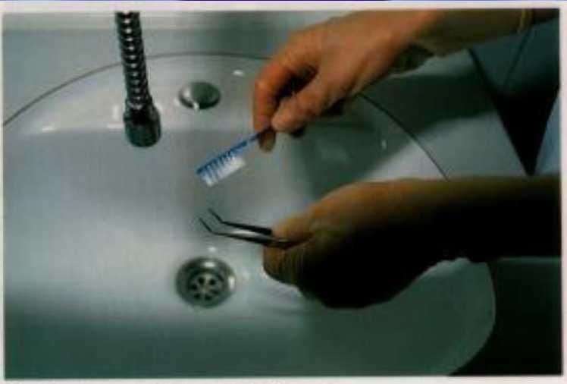

Slide 43
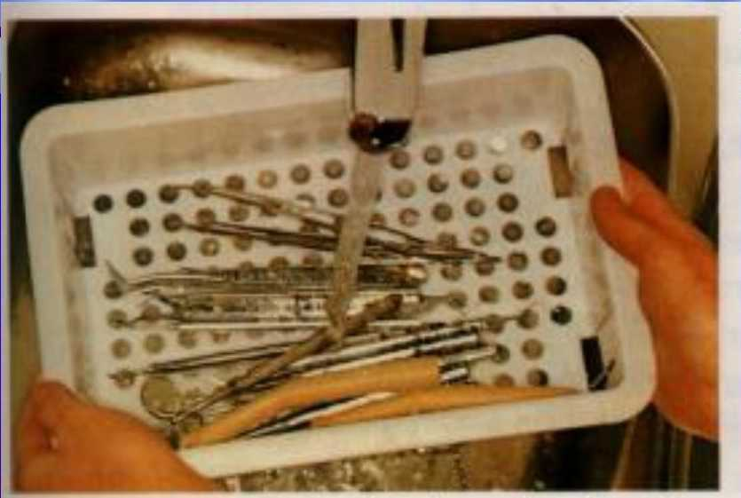

Slide 45
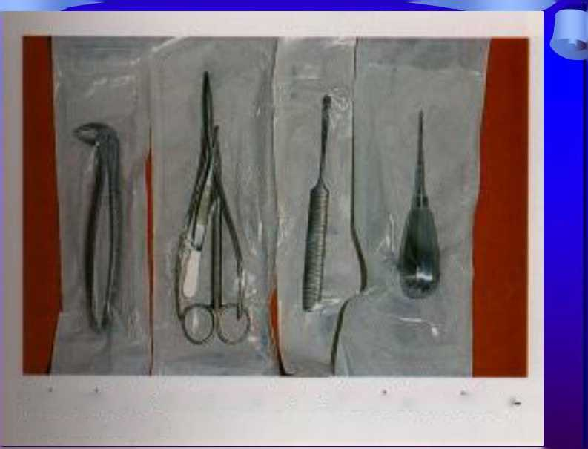
Chifurgische Instณกา©กte in Klarsıchtsterilisier
verpackungen

Slide 46
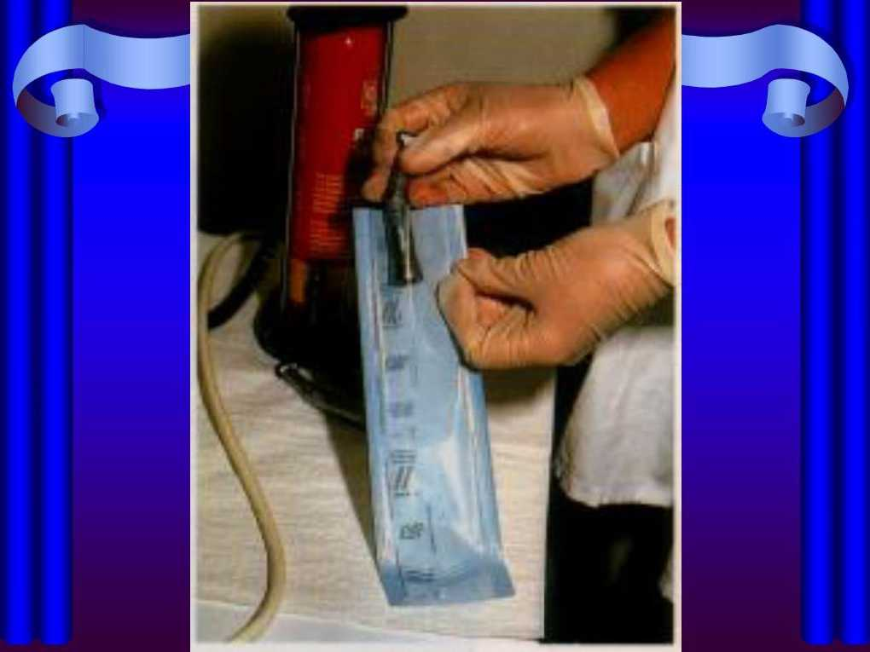

Slide 47
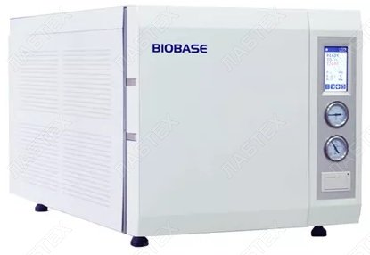

Slide 49
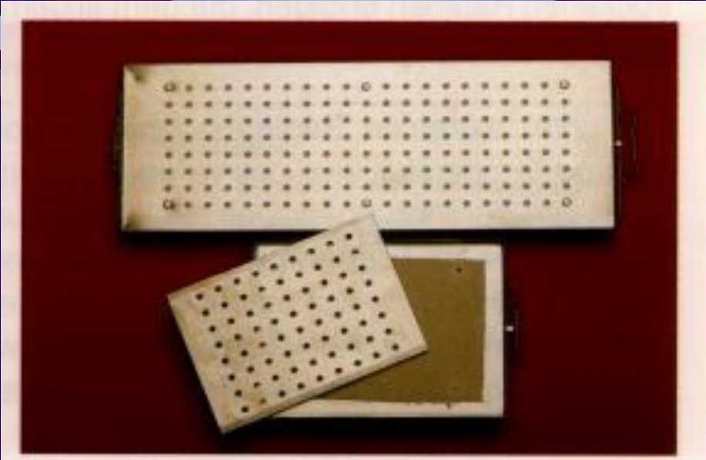

Slide 51
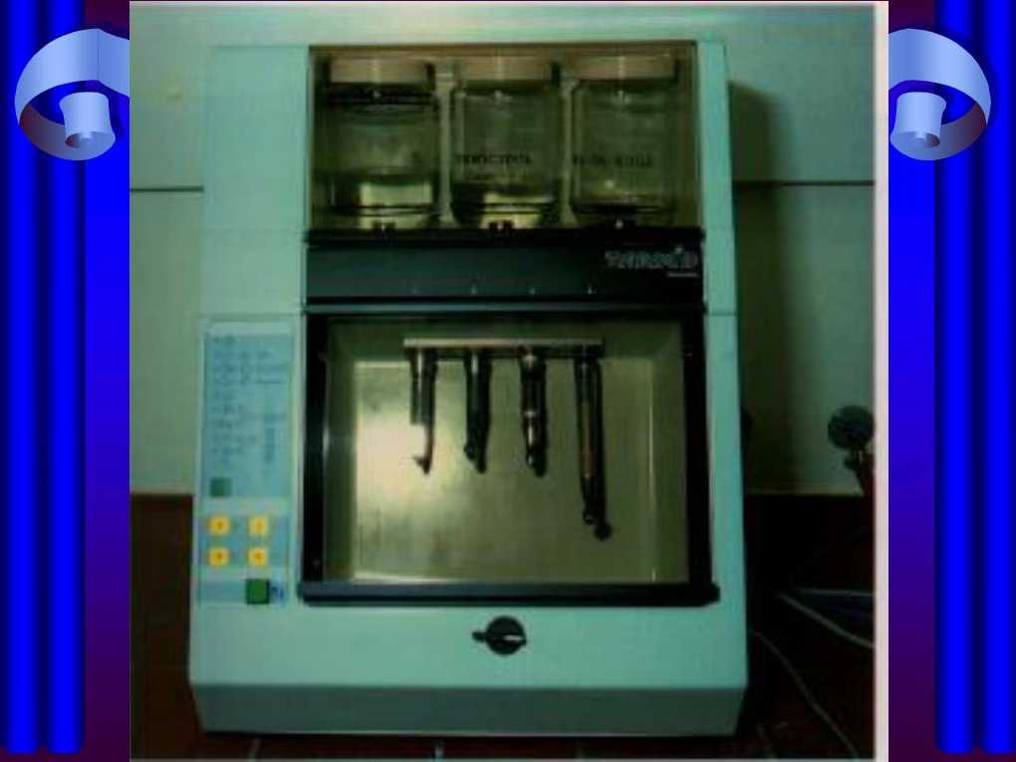

Slide 52
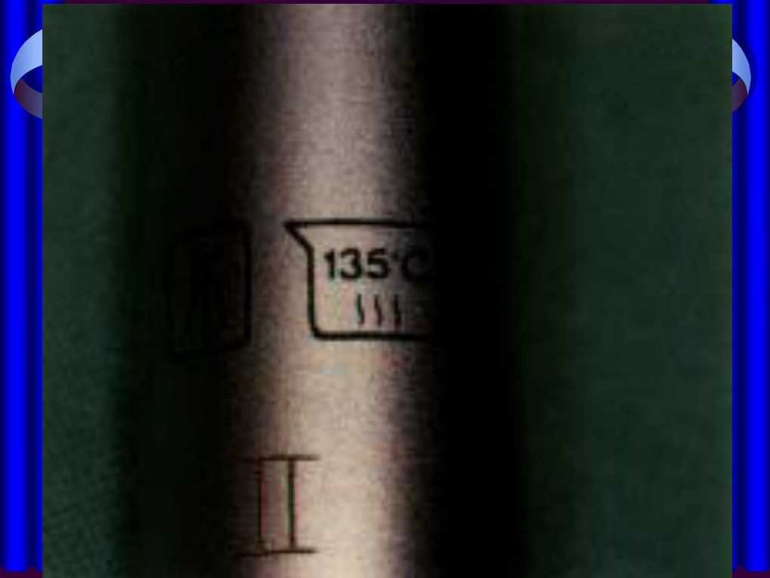

Slide 53
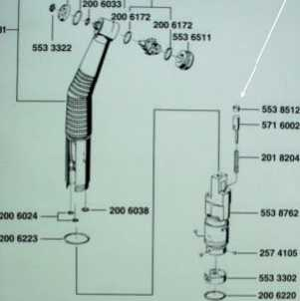
Antiretraction valve
S53S7M
i²⁰® •^{13J} S53 s«ai
M3 MO?

Slide 54
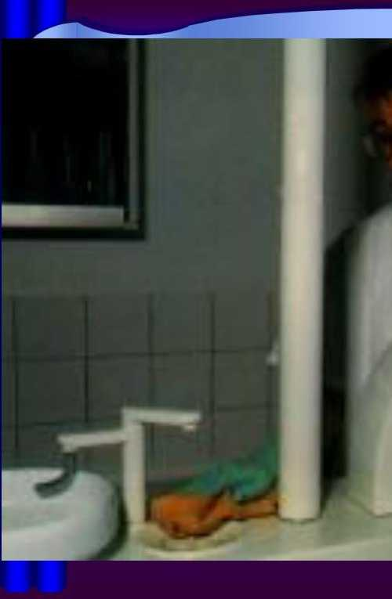
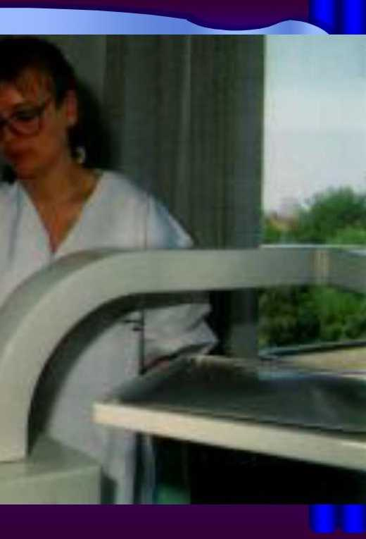

Slide 55
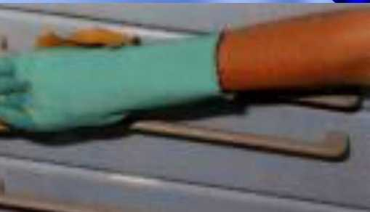

Slide 56
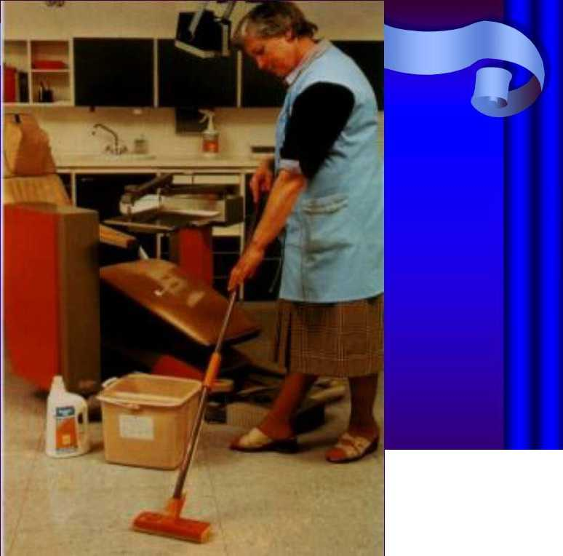

Slide 57
Sharp disposables should be placed in a solid
sharps container
• Contaminated patient borne waste should be
placed in a color coded (yellow) waste bin
• Liquid waste must be poured into a drainer toilet that is directly linked to a sewer sanitary system
• Amalgam scrap must be placed in designated containers
• WASTE MUST NOT BE DROPPED INTO THE COMMUNITY WASTE CONTAINERS IT MUST BE TRANSFERRED BY
SPECIALIZED COMPANIES!!!

