Slide 1
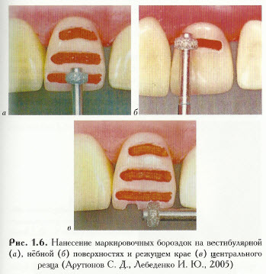
To control the thickness of the sanded layer of hard tissue, it is necessary to make marking grooves

Slide 2
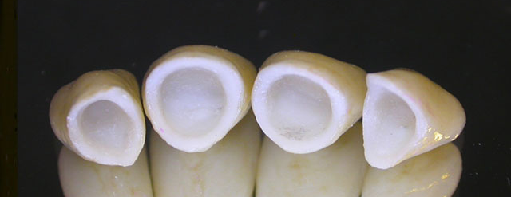
Porcelain crowns

Slide 3
Clinical stages | Laboratory stages
1. (eleven). Anesthesia if necessary;
2. (2). Preparation;
3. (3). Taking an ultra-precise impression (double silicone);
 | 4. (1). Obtaining a collapsible plaster model
 | 5. (2). Making a platinum cap
 | 6. (3). Applying porcelain mass to the cap and firing
 | 7. (4). Fitting crowns onto the model after firing
8. (4). Fitting on a tooth in the oral cavity
 | 9. (5). Removing platinum foil from crowns, applying stains and glazing
10. (9). Checking the crown in the clinic and fixing it with cement

Slide 4
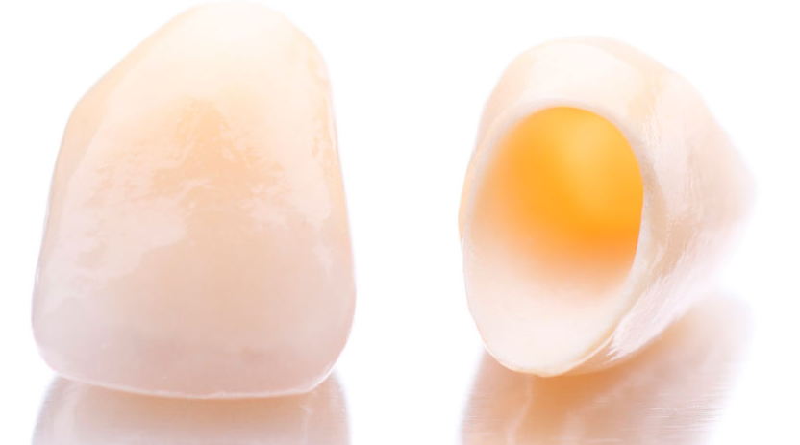
Plastic crowns

Slide 5
Preparation for porcelain and plastic crowns
Anesthesia if necessary.
Preparation begins with separation (disconnection) of the contact surfaces using a disk or a thin needle-shaped diamond head.
Then the cutting edge or chewing surface is ground down to 1.5-2.0 mm.
After this, a layer of enamel and dentin is removed from the buccal or palatal side by 0.5-1.0 mm so that a ledge is formed at the level of the gingival margin.
Using a carbide end bur using low-speed drills, the ledge is immersed below the free edge of the gum, eliminating damage to it and the periodontal junction.
As a result of preparation, the tooth stump acquires a cone-shaped shape with a small angle of convergence of the contact surfaces of the tooth. Preparation for a plastic crown is carried out according to the described method.

Slide 6
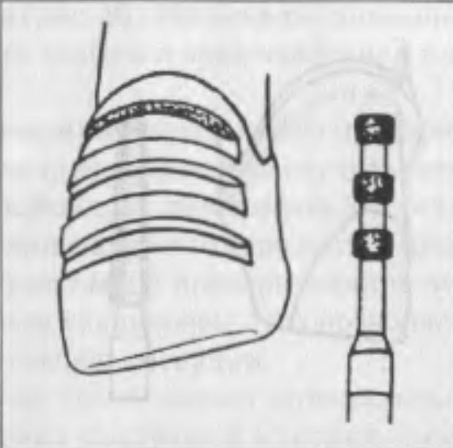
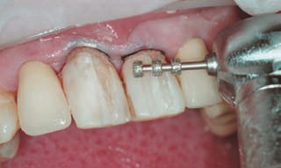
Marking bur
Creating marking grooves

Slide 7
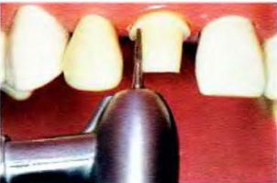

Slide 8

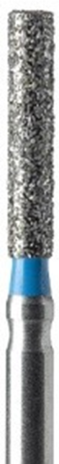
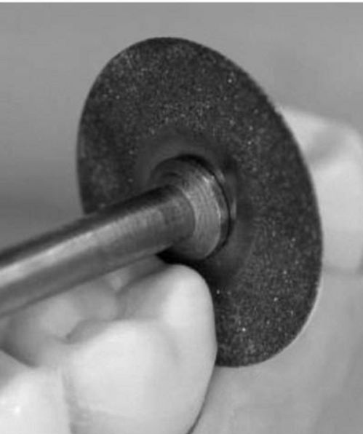
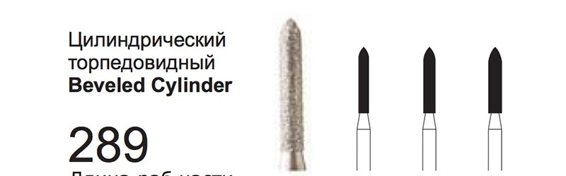

Slide 9
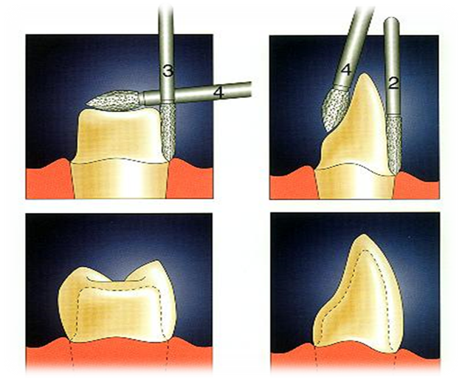
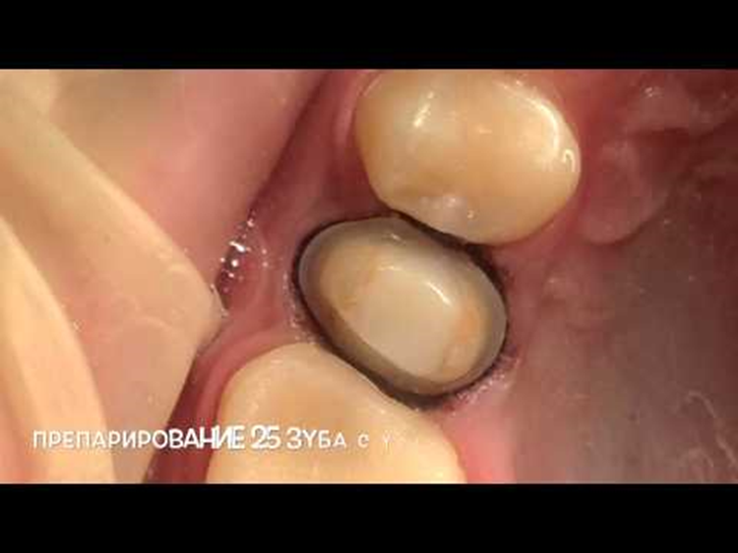
Ledge – a platform in the cervical area for an artificial crown

Slide 10
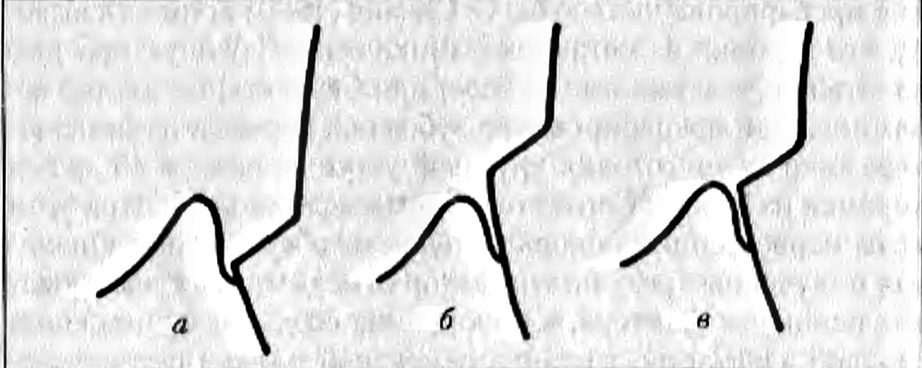
Уступ
Десна

Slide 11
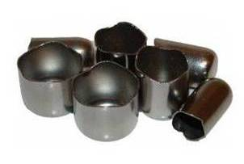
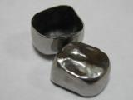
Stamped metal crown

Slide 12
Preparation for a stamped metal crown
Preparation begins with the separation of the contact surfaces of the crown with a metal disk.
In this case, parallelism of the contact surfaces of the tooth is achieved.
A layer of tissue equal to the thickness of the crown (0.25-0.3) is removed from the chewing surface.
When grinding the chewing surface, the anatomical shape of the tooth should be preserved.
The preparation is completed by grinding the equator of the buccal and palatal surfaces of the tooth.
Sharp angles between the contact and buccal surfaces are smoothed.

Slide 13
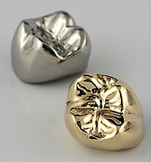
Solid metal crown

Slide 14
Clinical stages | Laboratory stages
1; . (1). Anesthesia if necessary
2. (2). Preparation with creation of a ledge;
3. (3). Impression taking (double);
 | 4. (1). Obtaining a collapsible plaster model;
 | 5. (2). Making a wax reproduction of a crown;
 | 6. (3). Replacing wax with metal;
7. (4) Fitting the crown in the oral cavity on the tooth;
 | 8. (4). Final processing (grinding, polishing) of the crown;
9. (5). Fixation of the crown with cement on the stump.

Slide 15
Tooth preparation for a solid crown:
The processing process is the same as the preparation steps for a stamped crown, but there are several differences.
The walls of the tooth converge at a slight angle from 2° to 8°, taking the shape of a truncated cone.
1 mm is ground off the chewing surface, maintaining its individual anatomical shape, and 0.5-0.8 mm from the lateral surfaces.
Another significant difference is the need to create a shoulder of 0.5-1.0 mm, to improve retention properties and aesthetics, as well as a guide for the technician.

Slide 16
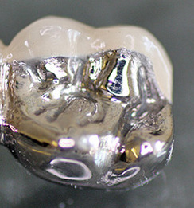
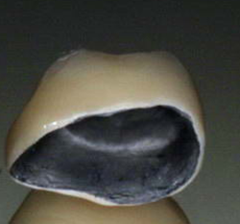
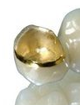
Solid metal crown with veneer

Slide 17
Clinical stages | Laboratory stages
1.(eleven). Anesthesia if necessary;
2. (2). Preparation with creation of a ledge;
Making a temporary crown (direct/indirect methods)
3. (3). Fixing a temporary crown on a tooth
4. (4). Impression taking (double) after 2 – 7 days;
 | 5. (1). Obtaining a collapsible plaster model;
 | 6. (2). Manufacturing of a one-piece metal cap;
7. (4) Fitting the metal cap on the tooth; Choice of cladding color;
 | 8. (3). Facing (coating) a metal cast cap with ceramic (plastic) mass;
9. (5). Припасовка на зубе готовой коронки
 | 10 (4.) Glazing (adding shine) – if ceramics
11. (6). Fixation on the tooth with cement

Slide 18
Preparation for a metal-ceramic crown
is ground down to 2 mm (+/- 1.5 mm) from the tooth surfaces, since the thickness of the metal part = 0.5 mm and the thickness of the ceramic is 1 mm;
The second feature of preparing teeth for metal-ceramic prostheses is that the contact surfaces of the teeth should converge at an angle of 5-8° to the cutting edge of the anterior teeth or at an angle of 7-9° to the occlusal surface of the lateral teeth. Creating a stump of a slightly conical shape is necessary for the smooth application of the prosthesis, as well as to eliminate tension in its solid frame and ceramic lining.
Formation of a circular or vestibular ledge.

Slide 19
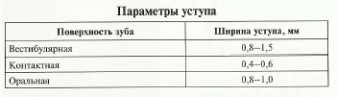
The ledge allows you to create a fairly massive crown edge, which is important for fragile porcelain veneers.
In addition, thanks to the ledge, the edge of the crown does not injure the gums.
The choice of method depends on the clinical picture, the degree of tooth destruction, the location of the cavity, the height of the crown, its shape, the age of the patient and other factors.
The formation of the ledge is carried out with diamond heads - cylindrical, flame-shaped or in the shape of a truncated cone.
The width of the ledge provides aesthetic properties, strength of the crown and varies from 0.5 to 1.5 mm depending on the size and functionality of the tooth

Slide 20
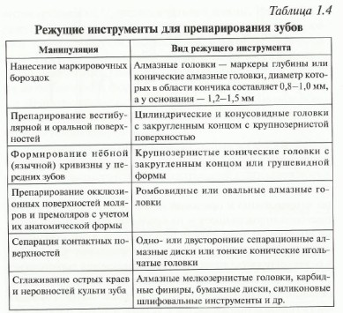

Slide 21
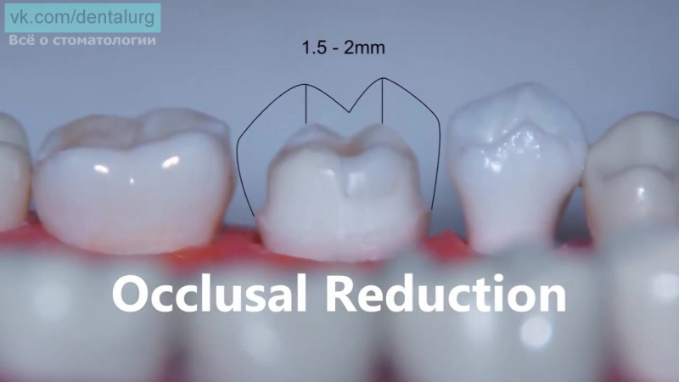
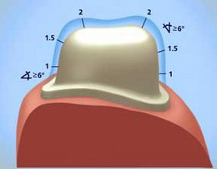

Slide 22
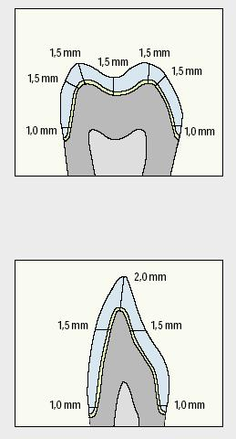

Slide 23
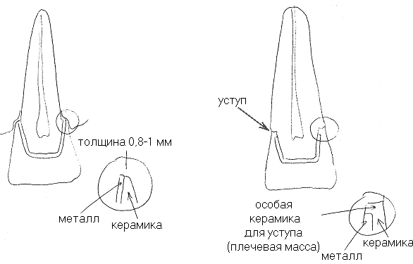
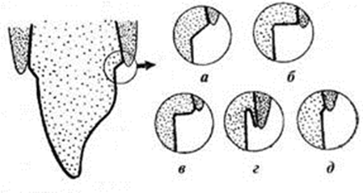

Slide 24
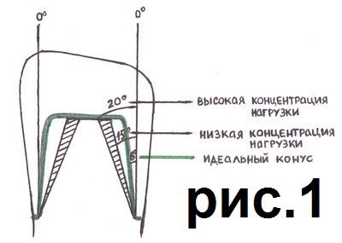
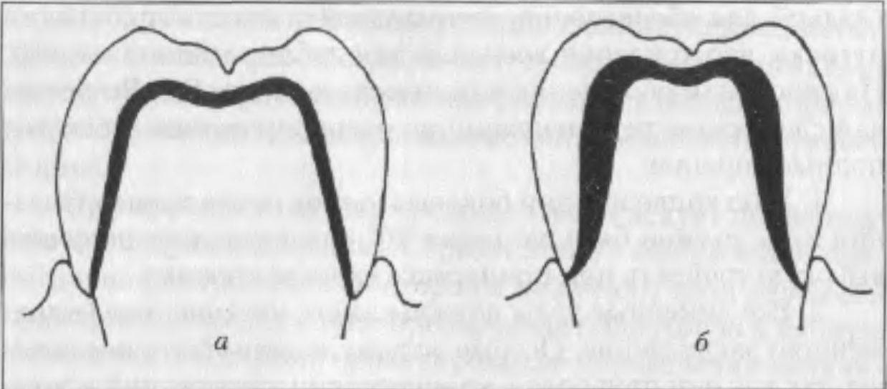

Slide 25
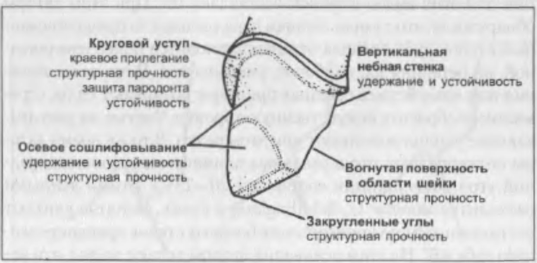

Slide 26
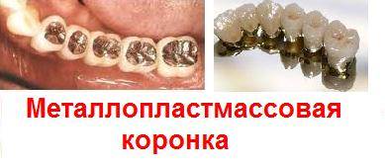
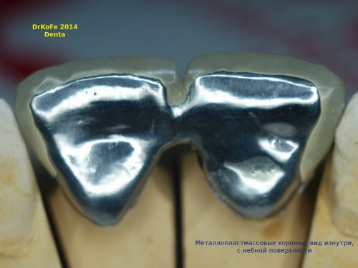

Slide 27
Preparation for a metal-plastic crown
Preparation for a metal-plastic crown is identical to that for a metal-ceramic crown, if all surfaces of the crown are covered with plastic;
If only the front part is lined (coated), then 1.5 mm is removed from the vestibular side (layer of metal 0.5 + 1 mm plastic), and from the other sides 0.5 mm is removed for the thickness of the metal only. And a ledge is created on the vestibular surface.

