Slide 1
Preparation for metal ceramics

Slide 2
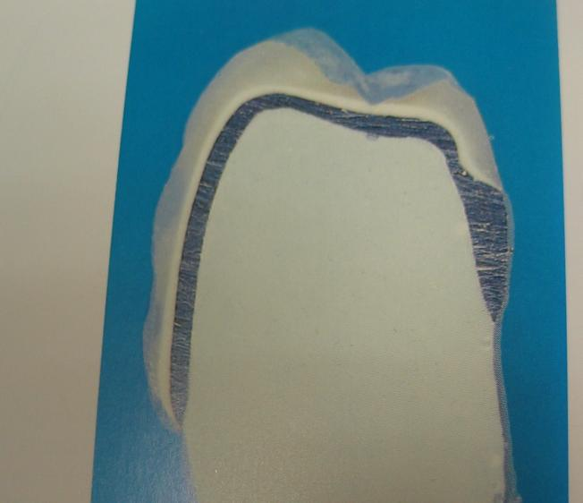
Sectional view of a metal-ceramic crown on a tooth.
The tooth is treated for a crown without a ledge, with the so-called
"knife-shaped" preparation.

Slide 3
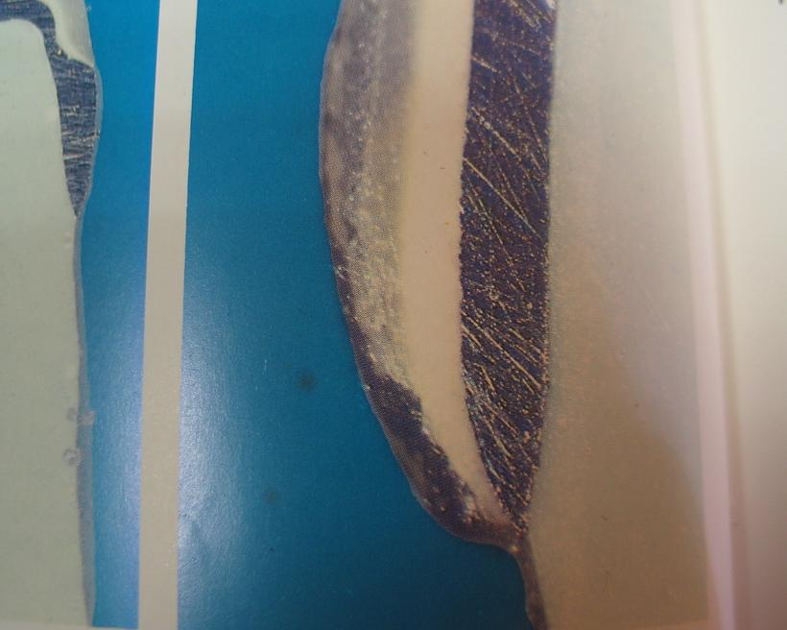
Under magnification, it is noticeable that the outer contours of the artificial crown are much wider than the dimensions of a natural tooth. Space is created for the accumulation of plaque, and a wide crown will exert constant traumatic pressure on the surrounding soft tissues.
"Knife-shaped" preparation is unacceptable.

Slide 4
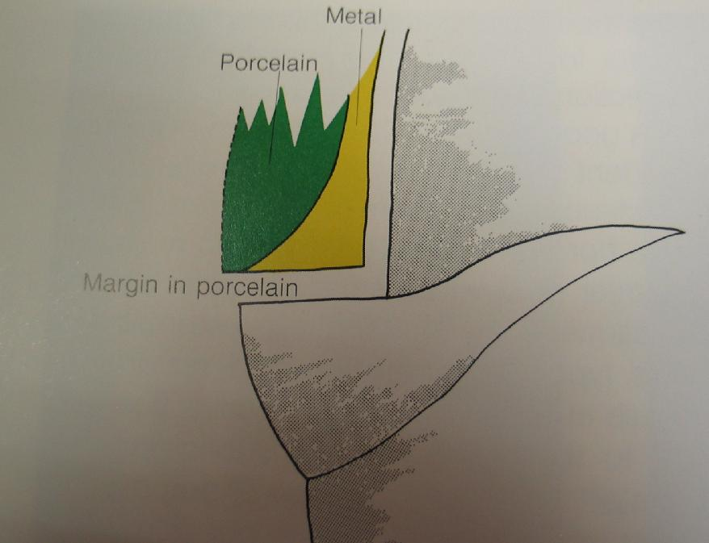
The shoulder ledge is covered with metal and ceramics. Recommended on the vestibular surface to create a more aesthetically pleasing crown.

Slide 5
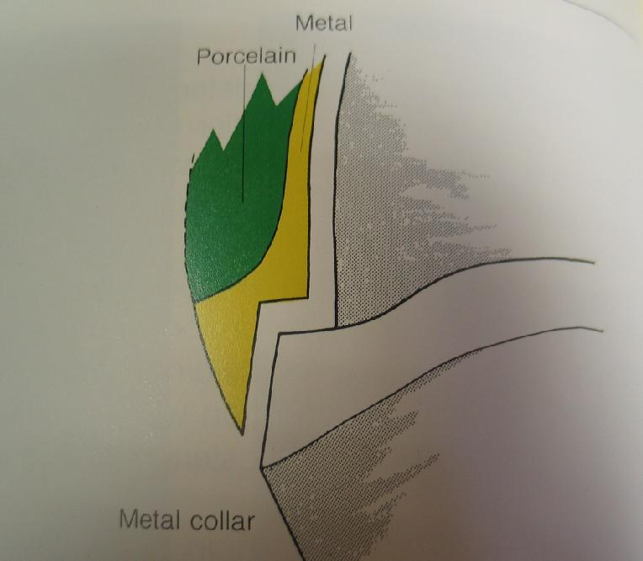
The shoulder ledge with a bevel is covered with metal. Provides a more precise fit. Especially indicated for low clinical tooth crowns

Slide 6
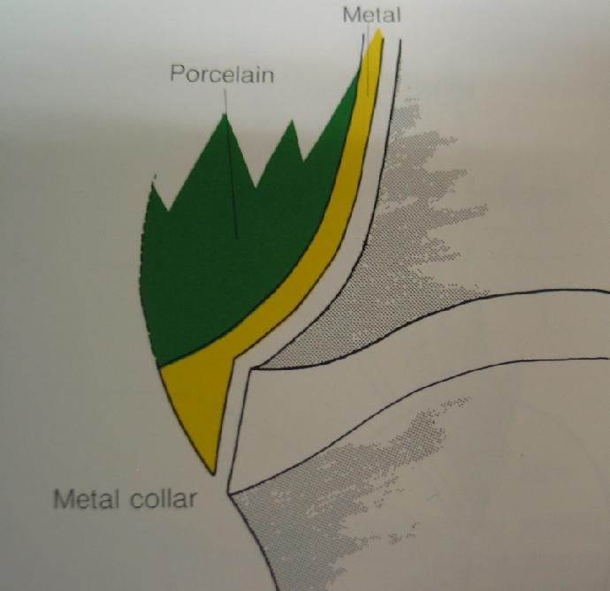
The rounded ledge with a bevel is covered with metal.

Slide 7
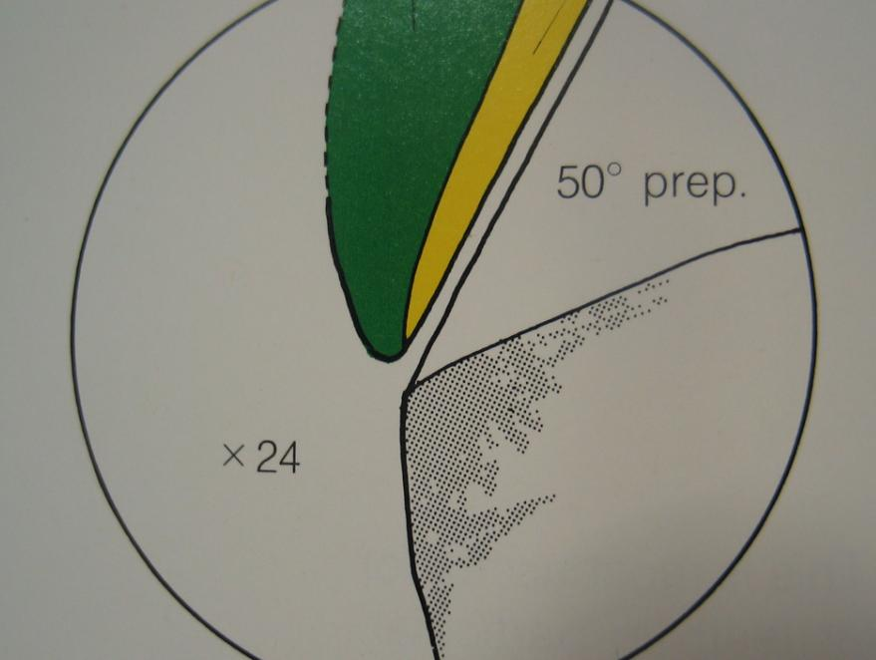
If a 50-degree shoulder is covered with ceramics, then excessive modeling of the outer contour of the crown will occur.

Slide 8
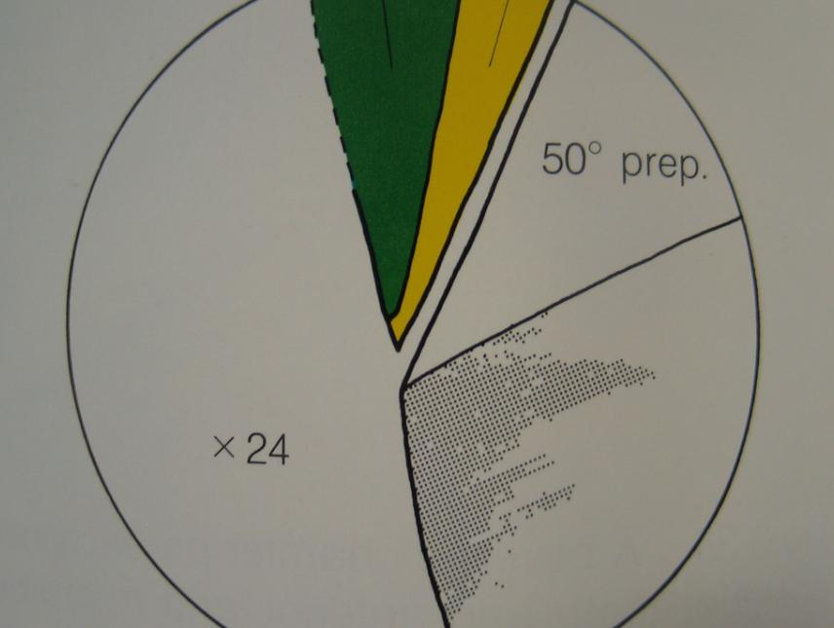
To create the correct contour of the crown, the 50-degree shoulder must be covered with metal.

Slide 9
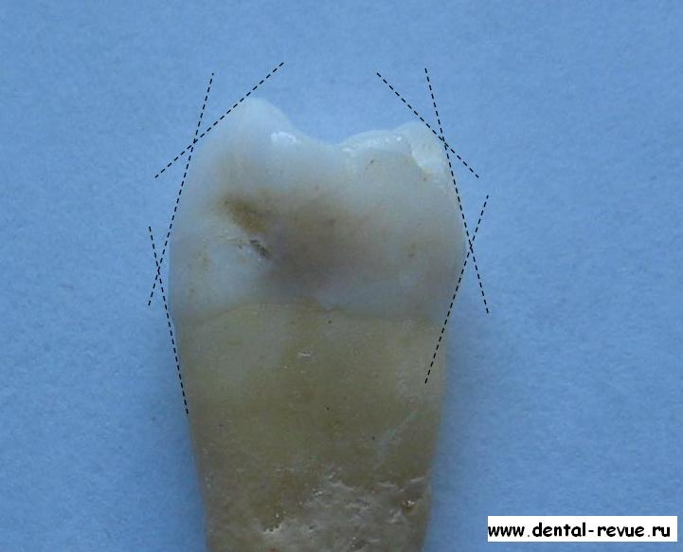
Distribution of planes on the premolar. (For two-plane preparation)

Slide 10
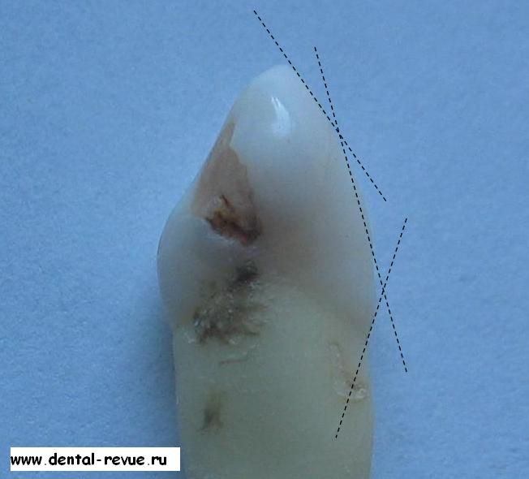
Distribution of planes on the canine.

Slide 11
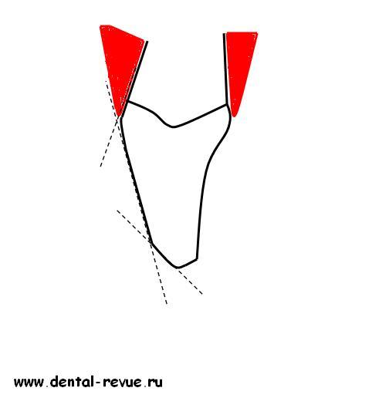
Distribution of planes on the cutter.

Slide 12
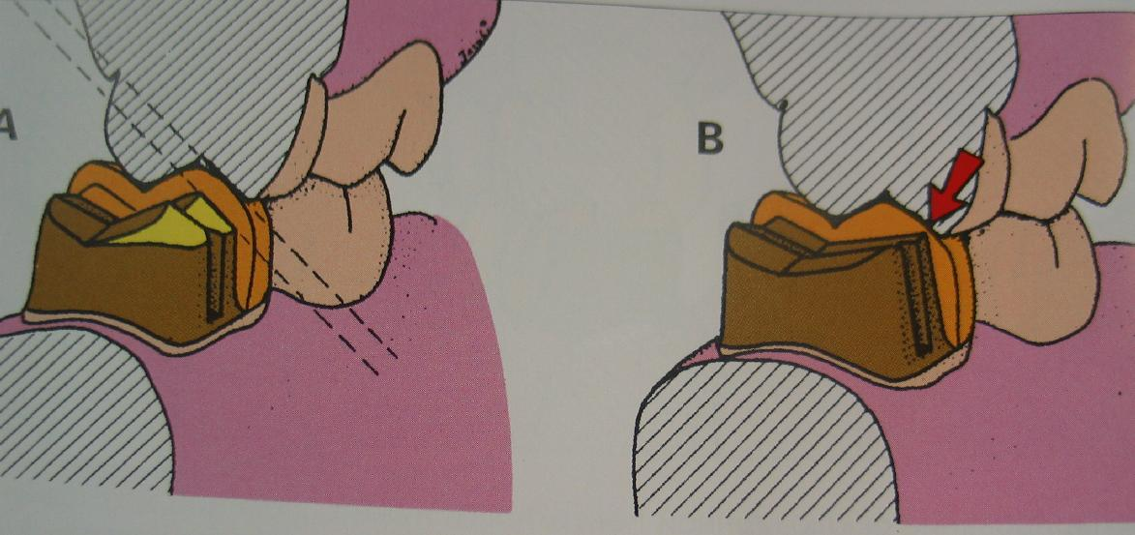
On the left - in the absence of two-plane preparation, the tooth was incorrectly and excessively processed; on the right - there is enough space for a crown, however, the lack of bevel of the buccal cusp can lead to chipping of the ceramic from the frame.

