Slide 1
“TECHNOLOGY FOR MANUFACTURING METAL-CERAMIC DENTAL CROWNS”

Slide 2
Relevance of the project
Metal dentures are gradually losing their relevance, since metal-ceramic dentures have begun to be used in modern dentistry.
The production of metal-ceramic crowns is carried out using a metal cap, which is durable and reliable.
If we compare a metal-ceramic crown with traditional metal prostheses, then metal-ceramics are also characterized by an excellent aesthetic appearance and do not differ from natural teeth.
Thanks to metal-ceramic crowns, not only the functions, but also the appearance and shape of the lost tooth are restored, but also the strengthening of the remaining dental tissues is achieved.

Slide 3
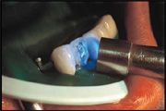
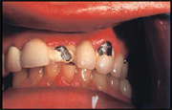
Project problem
Failure to comply with production technology ultimately leads to a violation of the solidity and integrity of the metal-ceramic structure - to chipping of the ceramic coating.

Slide 4
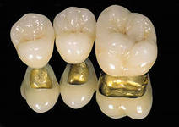
Objective of the project
Make a metal-ceramic prosthesis and identify errors in the manufacture of the prosthesis at various stages, as well as carry out a technological project to describe the technology for manufacturing the prosthesis.

Slide 5
Project objectives
1.To study scientific and theoretical material on the types of fixed structures, indications and contraindications for the use of metal-ceramic dentures, characteristics of the components of porcelain masses, clinical and laboratory stages of manufacturing metal-ceramic dentures, manufacturing technology of porcelain crowns, reasons for chipping of ceramics in metal-ceramic structures and their preventive measures.
2.Complete a design task for the manufacture of a metal-ceramic prosthesis, describe the technology for its
3.manufacture in a technological project.
4.Protect the technological product

Slide 6
Contents of the project assignment
Based on the technology requirements, produce a metal-ceramic prosthesis in laboratory conditions, identify the reasons, study the aesthetic aspects of modeling and apply them in practice.

Slide 7
Project implementation stages
At the first stage, the tasks and goals of the technological project were set, and the main problems of the project were identified. (7.09.13-15.09.13);
At the second stage, the literature was studied and a plan was drawn up for the manufacture of a metal-ceramic prosthesis (09/15/13-10/4/13);
At the third stage, methods and methods for manufacturing a metal-ceramic prosthesis were selected, as well as the materials necessary for the implementation of the project were selected (4th semester of the 2014-2015 academic year)
At the fourth stage, the prosthesis was manufactured (November, 2014), all actions performed at the laboratory stages of its manufacture are described (November, 2014)
At the fifth stage, a report on the technological project was compiled and written, a presentation was created and the defense of your product was carried out according to the written technological project (12/24/2014).

Slide 8
Types of fixed prostheses
By purpose:
Restorative; Supporting
By material: 1. Metal dental crowns: 2. Non-metallic dental crowns
3. Combined dental crowns.
By design: Full crowns, half-crowns, equatorial crowns, stump crowns, telescopic crowns, crowns with a pin

Slide 9
Indications and contraindications for the use of metal-ceramic dentures
Indications
Contraindications
1. Violation of the anatomical shape and color of the crowns of natural teeth, both acquired and congenital;
2. The presence of metal fixed prostheses in need of replacement;
3. Small included defects in the anterior and anterolateral parts of the dentition;
4. Phenomena of allergies to plastic linings of fixed dentures.
1. Non-pulpless teeth in children and adolescents.
2. Low, shallow or flat clinical dental crowns.
3. Large defects in the dentition (in the absence of more than 3-4 teeth).
4. Malocclusion with deep incisal overlap. 5. Increased abrasion of hard dental tissues.

Slide 10
Components of porcelain masses
Porcelain is a ceramic product obtained by firing a porcelain mass prepared from the main components: kaolin and feldspar.
Kaolin is a white clay that is contained in porcelain mass from 5-30%. An addition of 3-10% makes the porcelain mass opaque and reduces fluidity.
Feldspar. It creates a shiny, glazed surface after firing. When melted, it turns into a viscous glass-like mass.
Quartz. It strengthens the ceramic product, gives greater hardness and chemical resistance, reduces shrinkage and removes the fragility of the product.

Slide 11
Reasons for chipping ceramics in metal-ceramic structures
1. Mismatch of thermal expansion coefficients between ceramics and metal alloys from which the frame is made.

Slide 12
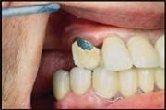
Reasons for chipping ceramics in metal-ceramic structures (continued)
2. Chip of ceramics as a result of errors during the work of an orthopedic doctor.

Slide 13
Reasons for chipping ceramics in metal-ceramic structures (continued)
3. Chip of ceramics as a result of errors during the work of the dental technician.

Slide 14
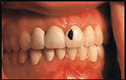
Reasons for chipping ceramics in metal-ceramic structures (continued)
4. Chipping as a result of the patient’s careless or careless handling of prosthetic structures.

Slide 15
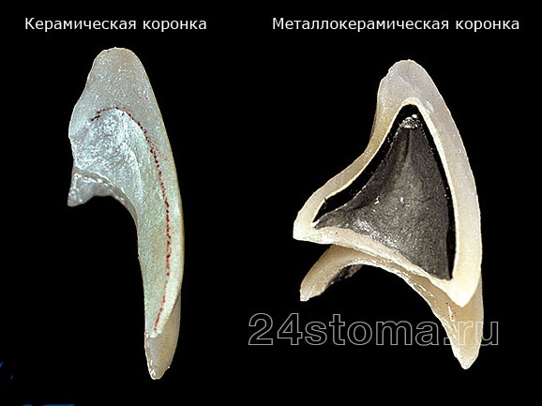
Metal-ceramic crown compared with a ceramic crown.

Slide 16
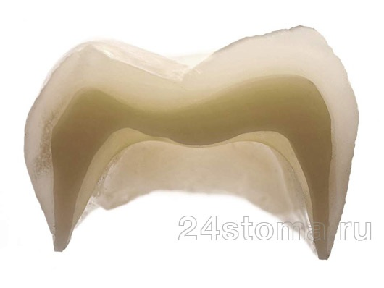
Zirconium crowns.
→ inside - a high-strength frame made of zirconium dioxide, → outside - porcelain mass sintered on the frame.

Slide 17
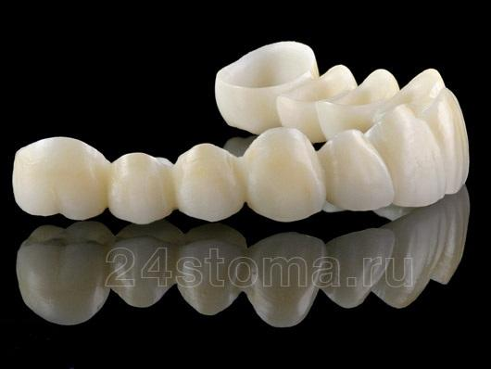
Advantages of zirconium crowns:
Excellent aesthetics - crowns fully reproduce the shades and transparency of natural tooth tissue.
High stability of aesthetic properties - ceramics do not change over time, i.e. it does not fade, does not darken, does not lose its shine (unlike, for example, fillings and restorations).
Reliability and long service life - thanks to the use of “CAD/CAM technology”, very high precision of the crown fit and its fit to the ground tooth is achieved. This minimizes the risks of developing caries at the crown/tooth interface and leakage of saliva and microorganisms under the crown. And thanks to the zirconium dioxide frame, high structural strength is achieved.

Slide 18
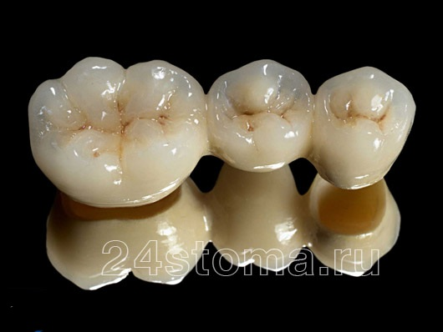
Disadvantages of zirconium crowns:
High cost - zirconium dental crowns are expensive due to the very high cost of the equipment, as well as the high cost of consumables (zirconium oxide blanks). However, in return for this you get the highest quality and aesthetics.

Slide 19
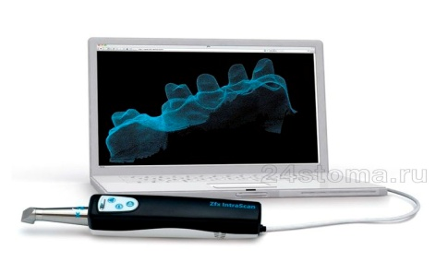
Manufacturing of zirconium dioxide crowns: CAD/CAM technology
  Scanning grinded teeth and creating a three-dimensional model of the patient’s teeth on a computer

Slide 20
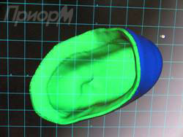
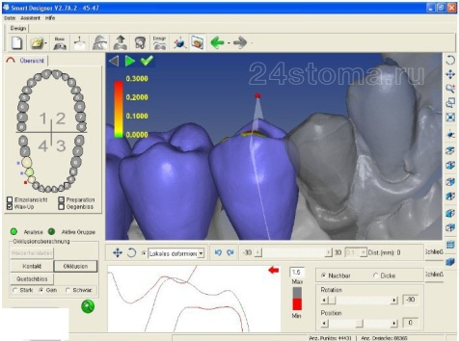
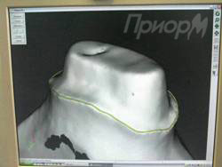
3D modeling of the anatomical shape of the crown.

Slide 21
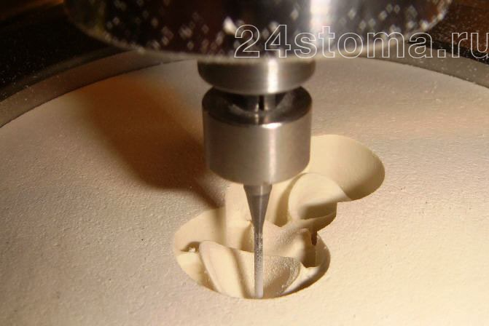
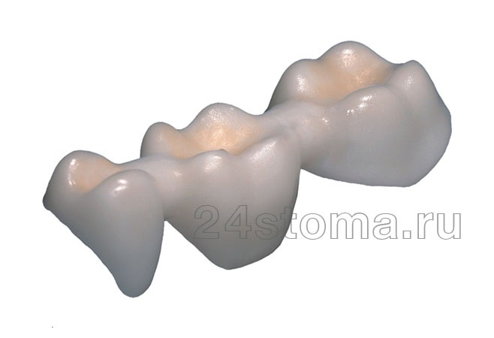
(A three-dimensional model of the zirconium frame is loaded into a milling machine, which, without human intervention, automatically “cuts out” the zirconium frame from the zirconium dioxide workpieceрис.16).
Next, the zirconium frame is fired in a special furnace, after which it acquires the strength of the metal.()

Slide 22
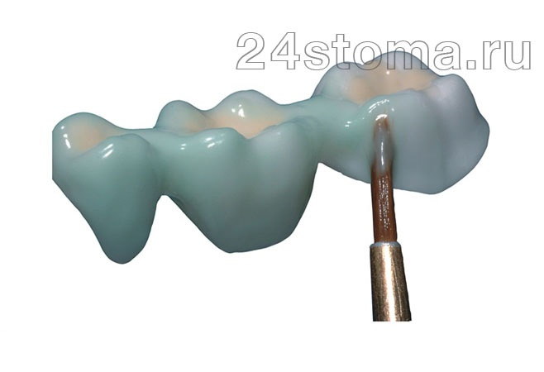
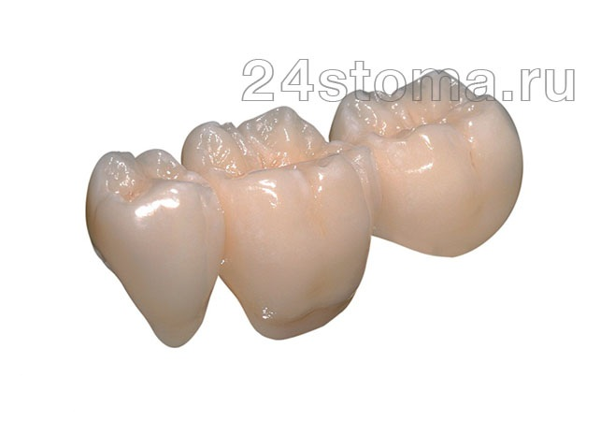
You can see the finished zirconium crowns.
Next, the dental technician applies porcelain mass to the frame layer by layer.

Slide 23
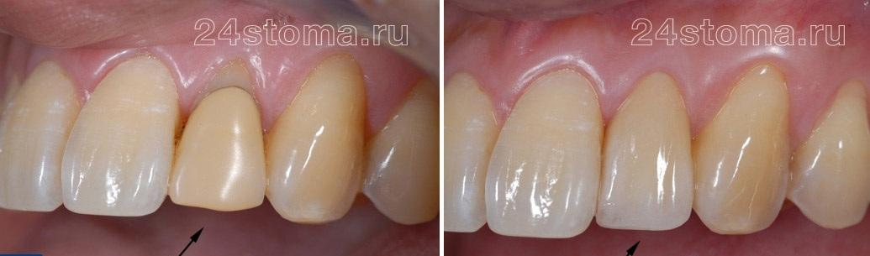
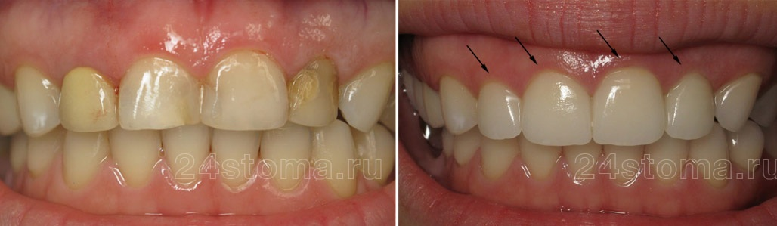
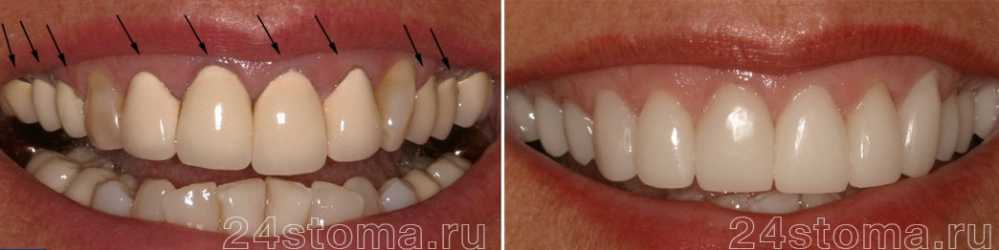
Zirconium crowns: before and after photos

Slide 24
The following conclusions were drawn from the theoretical part of the project:
The main components of porcelain masses are the following elements: kaolin, quartz, feldspar.
When fired, porcelain masses shrink significantly (about 25-30%).
The clinical and laboratory stages of manufacturing a metal-ceramic crown alternate with each other.
Touching the metal frame with your hands after it has been degreased violates the sterility of the metal.
The porcelain mass is fired in automatic ovens under vacuum. Glazing is carried out without vacuum.
When adjusting the crown, an abrasive tool with a diamond coating is used.
Ceramic chips can occur for various reasons. Depending on the reason, 4 groups are distinguished: 1. Mismatch of thermal expansion coefficients between ceramics and metal alloys from which the frame is made. 2. Chips that occurred as a result of errors during the work of an orthopedic doctor. 3. Chips that occurred as a result of errors during the work of the dental technician. 4. Chips resulting from the patient’s careless or careless handling of prosthetic structures, or injuries.
Crowns based on zirconium oxide require less preparation of tooth tissue, since their thickness is much thinner than that of a metal-ceramic crown

Slide 25
Clinical and laboratory stages of manufacturing metal-ceramic dentures
Clinical stages | Laboratory stages
1. Examination of the oral cavity, teeth and dentition. Choice of prosthesis design. Preparation of abutment teeth. Taking a double impression.
 | 1. Casting of a combined model. Modeling a wax cap.
2.Checking the metal cap in the oral cavity. Correction; choice of porcelain color.
 | 3.Applying an opaque layer of ceramics. Burning 4. Applying a dentinal layer of ceramics, modeling the anatomical shape of the tooth. Firing.

Slide 26
Clinical and laboratory stages of manufacturing metal-ceramic dentures (continued)
Clinical stages | Laboratory stages
3. Fitting on the tooth. Correction
 | 5.Applying an enamel layer of ceramics. Glazing. Burning.
4. Fixation of metal-ceramic prosthesis with cement

Slide 27
Laboratory stages of manufacturing a metal-ceramic crown

Slide 28
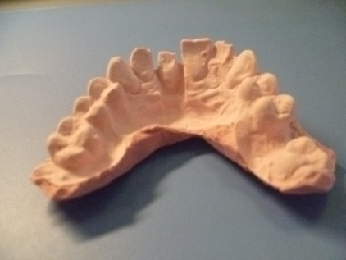
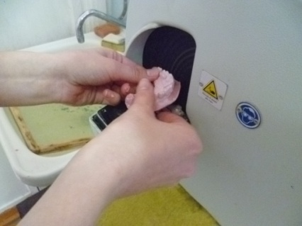
Manufacturing of a collapsible combined pin model
Casting a model from super plaster, processing with a trimmer
First, we mix gypsum of class IV hardness in a vacuum mixer and fill the impression with it to the borders. After the plaster has hardened, we remove the model of the dentition from the impression. We process the model using a trimmer, first from the dorsal side, then trimmed it from the base side until the correct height is obtained. Then the outer contour of the dental arch model was processed using a trimmer.

Slide 29
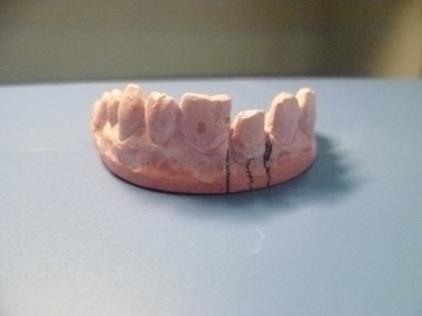
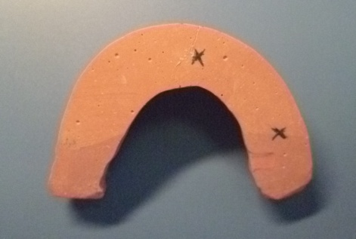
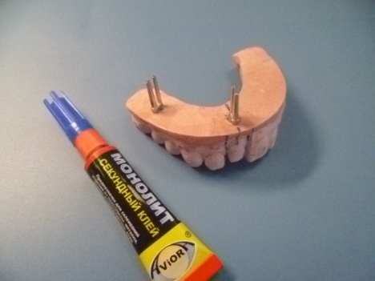
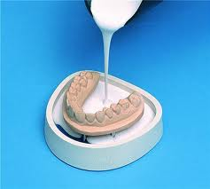
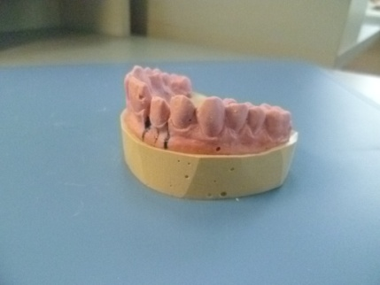
Installing pins, obtaining the base of the model

Slide 30
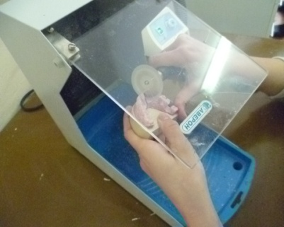
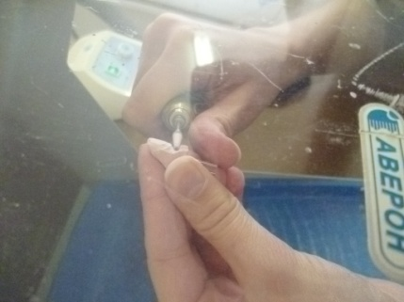
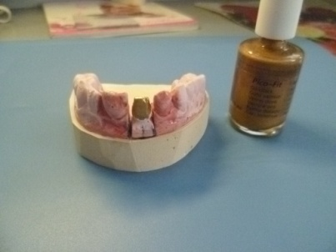
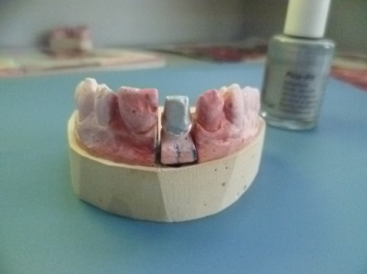
Sawing the model into segments, applying layers of compensating varnish

Slide 31
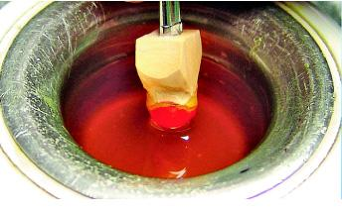
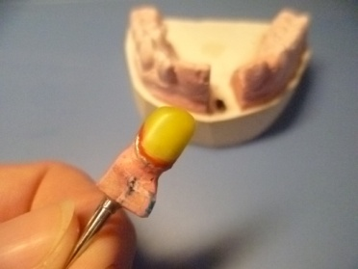
Making a wax coping
Leaning on the edge of the immersion bath, quickly immerse the stamp into the wax. Slowly remove the stamp, pausing while making a point contact between the stamp and the wax. The result is a precise wax coping of uniform thickness. Trim off excess wax below the preparation margin. We decorate the area where the frame adheres to the neck with cervical wax.

Slide 32
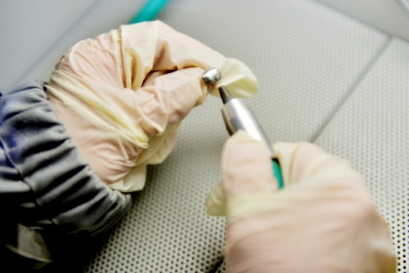
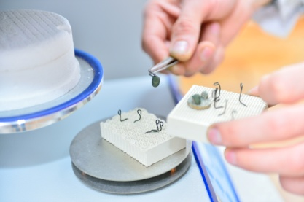
Metal Cap Processing
After casting, the surface of the metal cap was ground with diamond heads and sandblasted.
Then the cap was boiled in distilled water for 3-5 minutes. After degreasing, we hold the frame only with a special clamp, without touching the metal surface with our hands.
The dried cap was fired to create an oxide film.

Slide 33
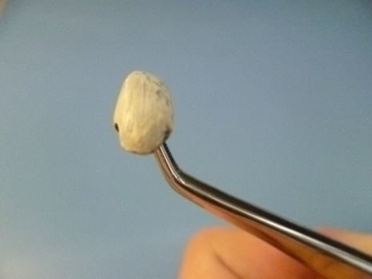
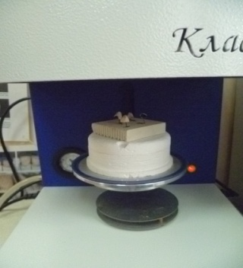
Applying a primer layer. Burning

Slide 34
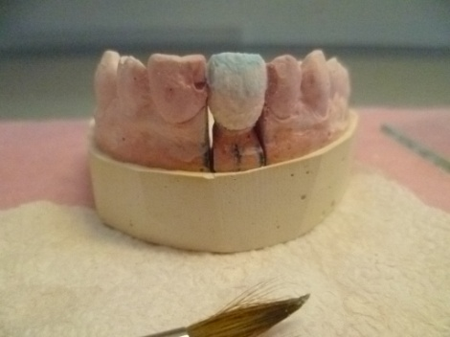
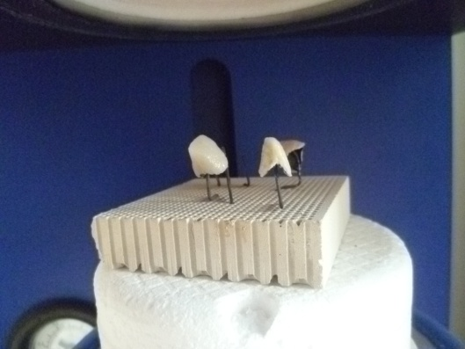
Applying layers of ceramic mass. Burning

Slide 35
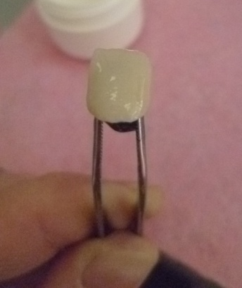
Glazing. Burning

Slide 36
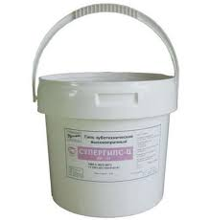
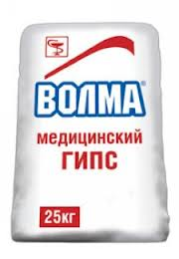
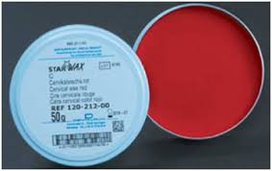
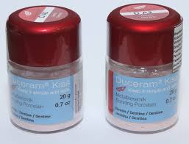
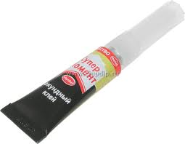
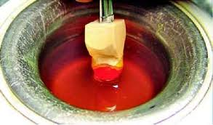
Materials used for the manufacture of metal-ceramic crowns

Slide 37
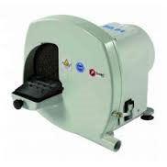
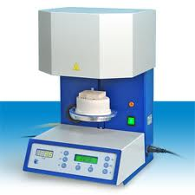
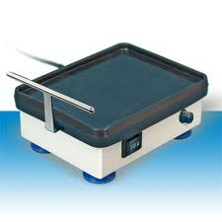
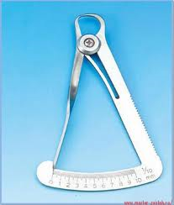




Devices and instruments used for the manufacture of metal-ceramic crowns

Slide 38
Conclusions on the practical part of the project description
As a result of studying the theoretical part of the project, material was obtained, the analysis of which made it possible to produce an artificial metal-ceramic crown that complies with all the rules and technology for manufacturing a metal-ceramic crown, observing all laboratory stages and describing their design and execution of the work.

