Slide 1
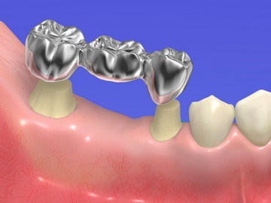
Structural elements of a bridge prosthesis (MP)
Support elements
2. Intermediate part (body)

Slide 2
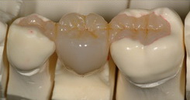
Tabs (overlays)
Support elements
Intermediate part (body)

Slide 3
Types of intermediate part (body) of MP
Saddle-shaped - in metal-ceramic MPs

Slide 4
Types of intermediate part (body) of MP
Hanging form with rinsing space –
in the lateral section.
Requirement: the entire working part of the probe must fit completely between the body and the mucous membrane.

Slide 5
Types of intermediate part (body) of MP
Tangent form -
in the frontal region;
Requirement: the tip of the probe must fit freely without effort between the body and the mucous membrane

Slide 6
Classification
By manufacturing method:
Soldered, the parts of which are connected by soldering;
Solid cast;
Having a one-piece frame.
By material:
All metal;
Plastic;
From porcelain;
A combination of these materials (combined - metal-plastic, metal-ceramic).

Slide 7
Indications for the manufacture of bridges
Included defect in the lateral region (in the absence of no more than 3 teeth);
Included defect in the frontal region (in the absence of no more than 4 teeth)

Slide 8
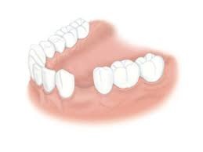
Included defects

Slide 9
Contraindications for the manufacture of bridges
Long-term defects limited to teeth with different functional orientations;
Defects limited distally to a tooth with pathological mobility;
Defects limited to teeth with low clinical crowns.

Slide 10
Rationale for using a bridge prosthesis
When choosing a bridge structure, you should consider:
The length of the dentition defect;
Periodontal condition of supporting teeth;
The height of the clinical crowns of abutment teeth;
It is necessary to correctly determine the number of teeth used as support;
Use as a support for teeth that perform one function (biting and grinding food).
The exception is the canine, as it is located at the turn of the dental arch and resists various pressures.

Slide 11
To reduce the functional load on abutment teeth, it is necessary:
Increase the number of supporting teeth;
Reduce the width of the chewing surface of the prosthesis body (the chewing surface of the body should be smaller / no larger than the chewing surface of the supporting teeth);
Avoid the use of single-sided bridges (i.e., cantilever bridges).

Slide 12
Principles of designing bridges (MP)
The supporting elements of the MP and its intermediate part must be on the same line;
The width of the chewing surface of the body (intermediate part) of the MP should be less than the width of the chewing surfaces of the teeth being replaced (this reduces the load on the supporting teeth);
It is necessary to restore contact points between the supporting elements of the MF and adjacent natural teeth;

Slide 13
Principles of designing bridges (MP)
Creating maximum contact with antagonists;
MPs must meet aesthetic requirements as much as possible;
When constructing the MP, abutment teeth with a not very high clinical crown should be used;

Slide 14
Requirements for a bridge prosthesis (MP)
Toxicological (anti-corrosion properties, do not cause allergies, do not irritate the mucous membranes, do not combine with saliva);
Technical (structural rigidity);
Aesthetic;
Hygienic (the form of the intermediate part - prevention of ulcerative decubitus stomatitis, marginal prosthetic periodontitis in the area of the abutment tooth);
Functional:
A. Therapeutic – restoration of chewing and speech function
b. Preventive (Popov-Godon phenomenon).

Slide 15
Features of the preparation of abutment teeth in the manufacture of a bridge prosthesis
Creating mutual parallelism of the walls of all abutment teeth

Slide 16
Features of the preparation of abutment teeth in the manufacture of a bridge prosthesis
The thickness of the metal-ceramic crown of the metal frame will be 1.5 - 2.0 mm (metal frame = 0.3 - 0.5 mm.
ceramic mass = 1mm.)
Recess = +/- 1.2 mm.
The thickness of the zirconium frame is 0.3-0.4 mm

Slide 17
Features of the preparation of abutment teeth in the manufacture of stamped-soldered MP
Punched crown thickness
is 0.2 – 0.3 mm
After preparation, the tooth should have the shape of a cylinder or a slightly truncated cone;
All surfaces of the prepared tooth must be parallel to each other;
The perimeter of the tooth in the equator area should be equal to its perimeter in the cervical area.

Slide 18
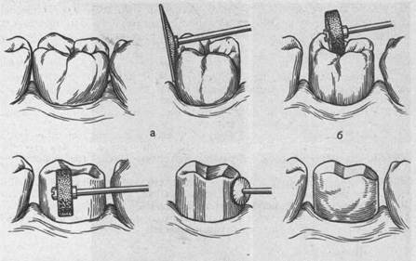
(1) 1st clinical stage
Inspection, design selection;
Preparation of abutment teeth;
Taking impressions.

Slide 19
(2) 1st laboratory stage
Casting plaster models;
Fixation in an occluder;
And making wax templates - if necessary.

Slide 20
(3) 2nd clinical stage
Determination and fixation of CO (central occlusion), if necessary.

Slide 21
(4) 2nd laboratory stage
Production of IR (artificial crowns) using the stamping method.

Slide 22
(5) 3rd clinical stage
Fitting IR into the oral cavity.
And taking impressions with crowns on teeth.

Slide 23
(6) 3rd laboratory stage
Casting plaster models;
Manufacturing of the intermediate part (body) of the MP;
Soldering of MP elements;
Final processing
(grinding, polishing).

Slide 24
(7) 4th clinical stage
Fitting the finished MP;
And fixing it with cement.

Slide 25
(1) 1st clinical stage
Inspection, design selection;
Preparation of abutment teeth;
Taking impressions for the manufacture of temporary (provisional) plastic crowns.

Slide 26
(2) 1st laboratory stage
Casting plaster models;
Making wax templates – if it is necessary to determine the CO.

Slide 27
(3) 2nd clinical stage
Determination and fixation of CO (central occlusion), if necessary.

Slide 28
(4) 2nd laboratory stage
Manufacturing of temporary (provisional) plastic crowns.

Slide 29
(5) 3rd clinical stage
Final preparation of abutment teeth with the creation of a circular ledge in the cervical area;
Fitting temporary plastic crowns
And fixing them with temporary paste.

Slide 30
(6) 4th clinical stage
Taking double jaw impressions
(after 2, 3-7 days)

Slide 31
(7) 3rd laboratory stage
Production of collapsible models from supergypsum;
Plastering models into an articulator/occluder;
Manufacturing of a solid metal frame.

Slide 32
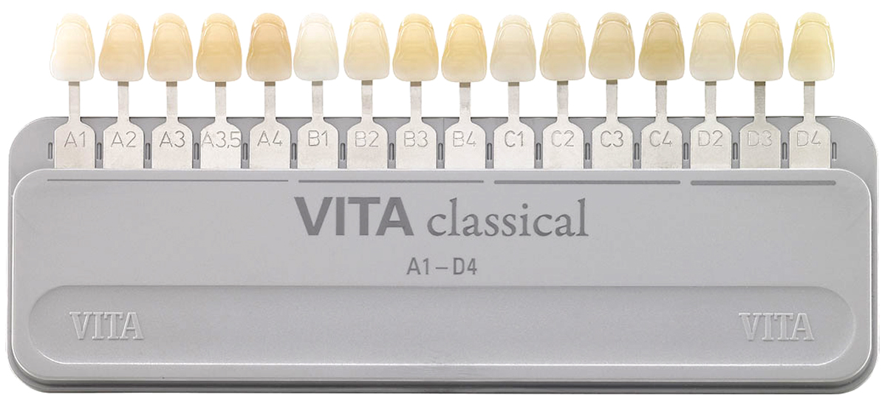
(8) 5th clinical stage
Fitting a solid-cast frame in the oral cavity;
Determination of the color of ceramic cladding.

Slide 33
(9) 4th laboratory stage
Applying ceramic veneer to the prosthesis

Slide 34
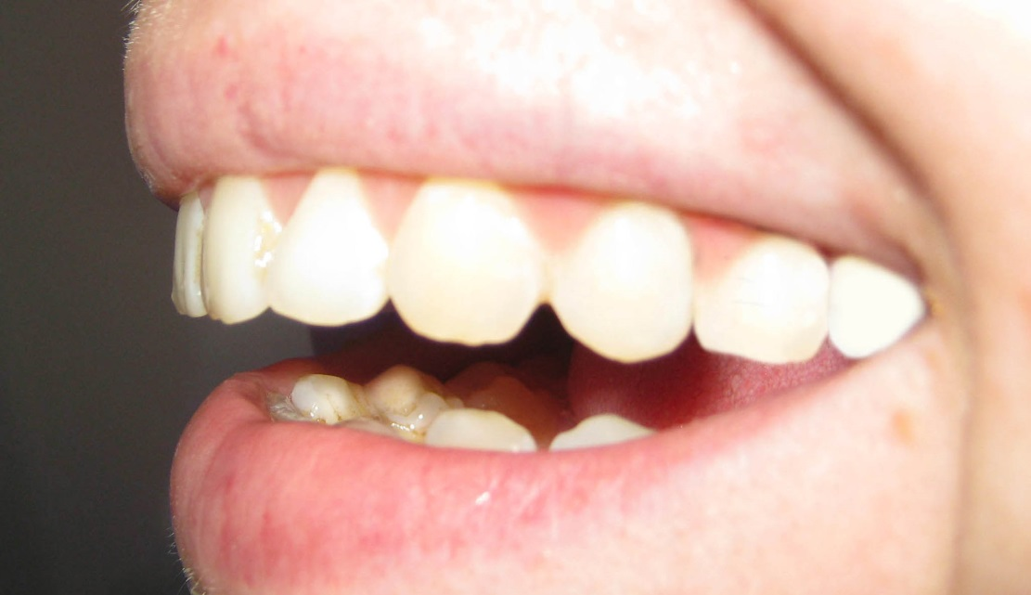
(10) 6th clinical stage
Fitting the finished metal-ceramic MP in the oral cavity;
Correction if necessary

Slide 35
(11) 5th laboratory stage
Glazing of the ceramic coating of the prosthesis.
(12) 6th clinical stage
Fixation of MP with permanent cement.

Slide 36
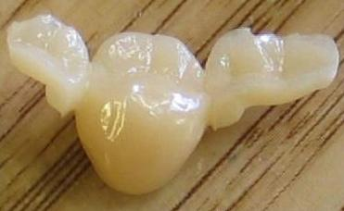
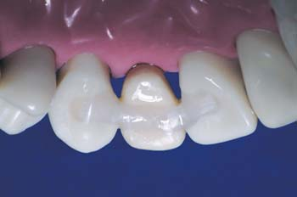
Maryland system (adhesive bridge)

Slide 37
Maryland system (adhesive bridge)
Advantages :
There is no grinding and, accordingly, depulping of abutment teeth;
Reversibility of the process. If the patient decides to change the type of denture, the supporting teeth will not require major restoration;
Convenient as a way to replace one tooth;
Quite low cost of prosthetics, allowing you to save on the amount of work and materials;
Speed of the procedure, saving the patient’s time.

Slide 38
Maryland system (adhesive bridge)
Flaws :
It is undesirable to replace chewing teeth with an adhesive bridge prosthesis due to the high load on the prosthesis;
A slight increase in the thickness of the teeth, which act as support for the adhesive bridge;
An adhesive bridge prosthesis has a smaller margin of safety compared to bridges and crowns;
Fastening elements are visible from the inside.

Slide 39
Maryland system (adhesive bridge)
Manufacturing methods
Straight
(in one visit,
the doctor models in the oral cavity)
Indirect
(in 2 visits, on a plaster model)

Slide 40
Maryland system (adhesive bridge)
The intermediate part (body) is made of various materials:
Acrylic plastic artificial tooth;
Composite material;
Porcelain (ceramics).
The supporting elements are fixed on the supporting teeth:
A pin and fiberglass are placed in the grooves;
Strengthen on the oral surface of supporting teeth.

Slide 41
Manufacturing steps on a plaster model
The oral cavity is prepared for prosthetics: treatment of dental caries;
The inner surface of the supporting teeth is polished and processed or grooves are formed in the teeth;
Taking impressions for the manufacture of a future adhesive bridge prosthesis;
Manufacturing of a prosthesis taking into account all the structural features of the jaw and bite, the position of adjacent teeth on a plaster model;
Fixation of the prosthesis with special cement.

Slide 42
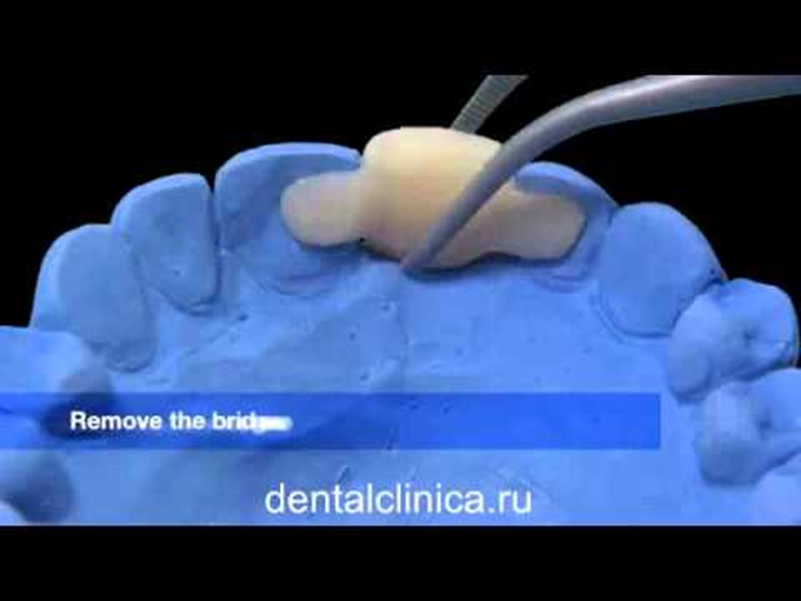
Manufacturing on a plaster model
Fixation of abutment teeth on the oral surface

Slide 43
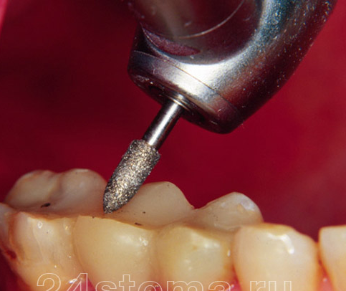
Manufacturing stages
The oral cavity is prepared for prosthetics: treatment of dental caries;
The inner surface of the supporting teeth is polished and processed or a groove is formed;

Slide 44
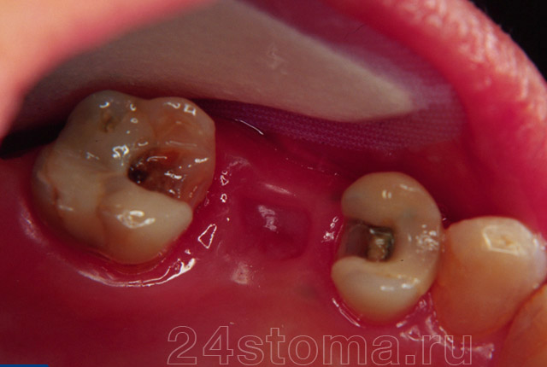
Grooves
(special cavities in teeth for fixation)

Slide 45
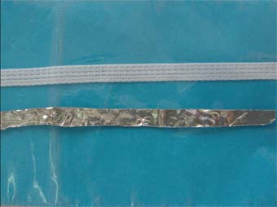
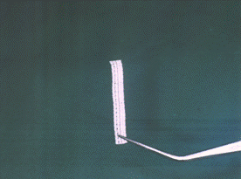
Manufacturing stages
Using foil, which is placed on the future location of the fiberglass, we determine its required length (for example, “Ribbond”);
The work area is etched, dried, and special glue is applied;
Measured reinforcement tape and strip of foil

Slide 46
Manufacturing stages
A composite material is laid on the working surfaces, then a fiberglass or pin is fixed onto it. Polymerization is carried out with a lamp;
Another layer of composite is applied on top of the fiberglass and polymerized again;

Slide 47
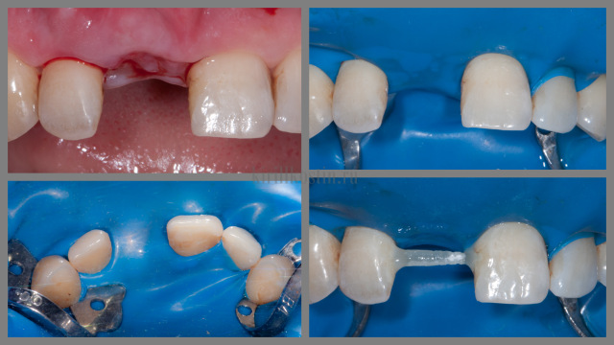

Slide 48
Manufacturing stages
Then the missing tooth is restored using a composite material or an artificial tooth is fixed on fiberglass;
Handle everything carefully

Slide 49
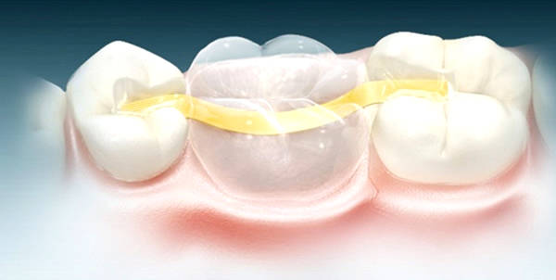

Slide 50
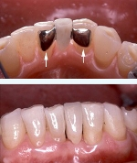
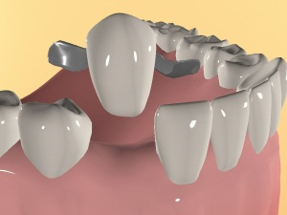

Slide 51
Biomechanics
— the science of the laws of mechanical motion in living systems.
Greek: bios - life and mexane - tool.
mechanics is a branch of physics that studies mechanical motion and mechanical interaction of material bodies

Slide 52
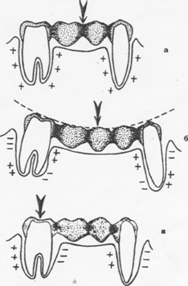
Biomechanics of bridges
The influence of vertical load on the biomechanics of a bridge:
a - the load is applied to the middle of the short body of the bridge;
b - the load is applied to the middle of the long
bridge body
;
c - the load is applied to one of the supporting teeth.

Slide 53
PERIODONTAL – reserve forces.
Practice shows that the supporting apparatus of the tooth, like other organs, is capable of withstanding double load for a long period of time.
Normal, according to V.Yu. Kurlyandsky, the periodontium of teeth uses only half of its power, leaving 50% of reserve forces.
Normally, the periodontium of each tooth has a certain endurance.
This endurance is determined by the pressure that each tooth can withstand before pain occurs. It was these data that formed the basis of the odontoparodontogram..
Kurlyandsky believed that with the loss of bone tissue, the ability of the periodontium to withstand applied loads proportionally decreases and presented this as a purely arithmetic process

Slide 54
Mistakes when using prosthetic bridges
Unsatisfactory preliminary special preparation;
Unreasonable expansion of indications for MP;
Lack of lavage space between the body of the bladder and the mucous membrane of the alveolar ridge;
Incorrect assessment of the clinical condition of the supporting teeth;

Slide 55
Ошибки при протезировании мостовидными конструкциями
Lack of occlusal contacts between artificial teeth and their antagonists;
Incorrect modeling of tubercles without taking into account age;
Premature occlusal contacts;
Aesthetics are unsatisfactory.

Slide 56
Complications during prosthetics with bridge structures
The occurrence of bedsores of the alveolar ridge mucosa – prosthetic stomatitis;
Overload of supporting teeth;
Caries in the area of supporting teeth (under crowns) - with unsatisfactory special training;
Traumatic periodontitis of supporting teeth (with overestimation in the area of the prosthesis).

