Slide 1
Manufacturing of bridge structures in orthopedic dentistry

Slide 2
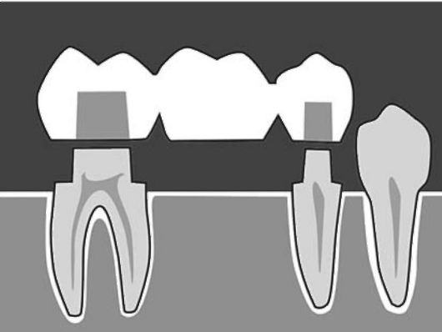
Bridge
-this is an orthopedic structure consisting of one or more artificial teeth replacing missing teeth, attached to adjacent natural teeth (or implants) using fixing elements (crowns, inlays)

Slide 3
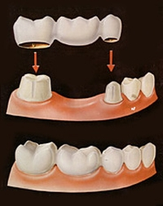
Indications
missing one tooth in the chewing area
absence of one to four consecutive front teeth (take into account the anatomy - fusion of the palatine bones)
the presence on the sides of the missing tooth(s) of healthy supporting teeth that can withstand increased load

Slide 4
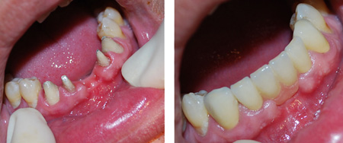
Contraindications
missing more than 4 incisors in a row, 2 premolars in a row, 1 molar
bruxism (involuntary grinding of teeth)
bite pathology
gum damage (periodontal disease or periodontitis)
pathological abrasion of enamel
osteoporosis or osteomyelitis
inflammatory process in the RP
Poor hygiene condition of the RP

Slide 5
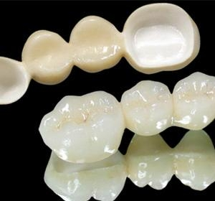
Design principles
Supporting elements and intermediate part are on the same line (only teeth of one group)
Use as a support for teeth with a not very high clinical crown
The larger the size of the suspended artificial tooth, the more the adjacent tooth is loaded
Modeling "normal" occlusion
Aesthetic modeling

Slide 6
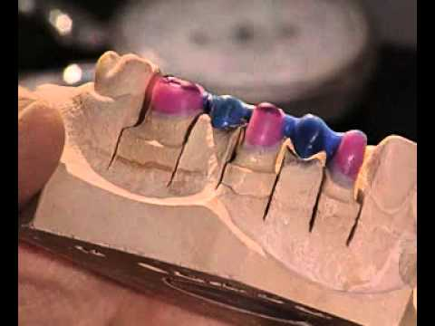
Stages
At the first visit, the oral cavity is sanitized and the supporting teeth are ground. After this, impressions are taken for the bridge, and while it is being produced in a dental laboratory, temporary mouth guards are installed for the patient.
The second visit consists of trying on the finished product, correcting it if necessary, and fixing it with cement or polymerized composite materials.

Slide 7
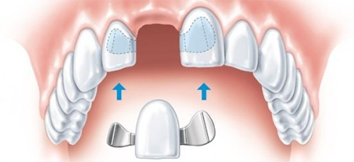
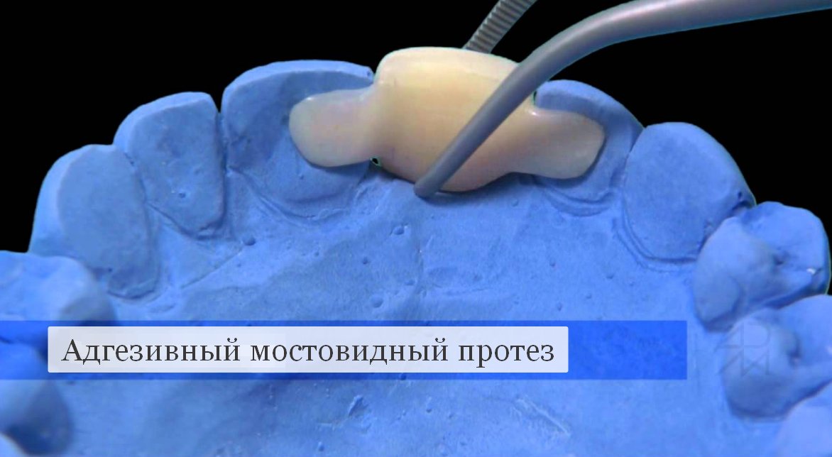
Maryland Bridge
Or adhesive bridge
- this is a bridge-like prosthesis, on both sides of which there are special “wings” that allow the bridge to be glued to the back surface of adjacent natural teeth (possibly without preparation)

Slide 8
Thank you for your attention!

