Slide 1
Treatment of patients with complete absence of teeth is one of the most complex and important areas of prosthetic dentistry. This problem is most often encountered by patients in older age groups, who, as a rule, already have experience using removable dentures. The proportion of patients with complete loss of teeth in general dental morbidity is gradually increasing, so the issue of improving the quality of treatment of patients with complete removable dentures is still relevant in orthopedic dentistry today.
.

Slide 2
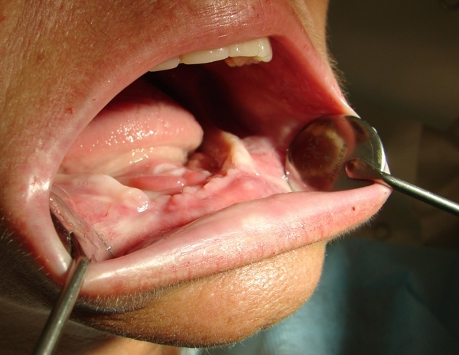
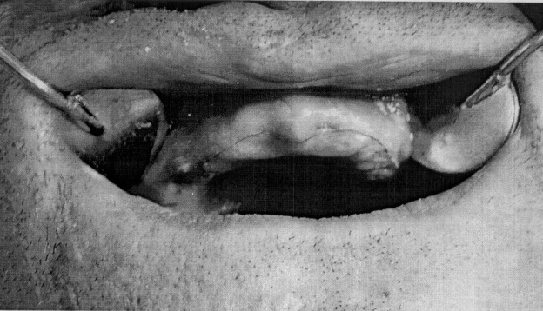
The use of removable dentures inevitably accelerates the processes of bone tissue atrophy, leading to a decrease in the area of support of the base of the removable denture on the tissues of the prosthetic bed. It is also necessary to take into account that in the process of manufacturing complete removable dentures, the working model is severely damaged after replacing wax with plastic, and the quality of manufacturing of a removable denture can be adequately assessed only after fitting and applying the prosthesis in the patient’s oral cavity.

Slide 3
When starting orthopedic treatment of patients with complete absence of teeth, it is necessary to carefully plan the entire treatment step by step. When planning, you must clearly understand the following: 1) the goal; 2) ways to achieve the goal; 3) stages of orthopedic treatment; 4) features of dispensary observation.
The goal of dental interventions in patients with complete secondary adentia is to restore lost dental health and prevent further progression of pathological changes in the dental system and in the body as a whole through orthopedic treatment.

Slide 4
Psychological aspects in achieving the goal:
– psychological preparation of patients before orthopedic treatment;
– explanatory and informational conversations when visiting an orthopedic dentist;
– recommendations for the use and care of removable dentures;
– the principle of “completeness of orthopedic treatment”.
Dental aspects in achieving the goal:
– preparing a dental patient for orthopedic treatment (scope and nature of special measures);
– type of impression, taking into account the characteristics of the oral mucosa of a particular patient;
– choice of method for constructing artificial dentition;
– selection of base material;
– new technologies in removable dental prosthetics.

Slide 5
The collaboration of the orthopedic dentist and the dental technician in achieving the final goal is an important component in prosthetic dentistry, since the orthopedic dentist and the dental technician are members of the same team, whose calling is to solve different problems to achieve the main goal of treatment - the return of lost dental health to the patient.
Planning of aesthetic parameters and assessment of aesthetic parameters of a patient using removable dentures:
1. Assessing the patient’s appearance and facial features.
2. Selection of the color and style of sets of artificial teeth, the appearance of the dentition when talking and smiling - compliance with the topography of the occlusal plane, the absence of “black triangles” when talking and smiling, etc.
3. The patient’s feelings at the end of orthopedic treatment.

Slide 6
Evaluation of treatment results is carried out in two main areas: - subjective criteria: the patient’s feelings - whether he is satisfied with the final result of the prosthesis at the time of fitting and application of the prosthesis and after 2-4 weeks. – objective criteria: implemented using additional research methods (chewing tests, EMG data, etc.). The Department of Orthopedic Dentistry has developed a method for manufacturing a complete removable denture of the jaw. This topic was developed proactively with the aim of improving the quality of orthopedic treatment of patients with complete absence of teeth. From our own clinical experience, we are convinced that the use of this technology can significantly improve the quality of manufacturing complete removable laminar dentures. An application for an invention was submitted to the NCIS RB “Method of manufacturing a complete removable denture of the jaw” dated 03/14/13 No. A20130318.

Slide 7
Method of manufacturing a complete removable denture of the jaw The manufacture of complete removable dentures involves two stages.
First stage. The production of denture bases is carried out on models obtained from functional impressions, and fixation of wax rollers to the bases.
Second phase. On the manufactured bases with fixed rollers, the central relationship of the jaws is determined, the placement of artificial teeth is carried out, and the final replacement of wax with plastic takes place

Slide 8
The main indications for the use of the proposed technique: – long-term use of the working model with repeated application of a wax base with occlusal ridges; – pronounced atrophy of the alveolar processes, when it is almost impossible to correctly position the wax composition of the prosthesis on the tissues of the prosthetic bed; – difficulties in determining the central relationship of the jaws in people who have not used dentures for a long time in the complete absence of teeth; it is difficult to determine exactly the central relationship of the jaws due to the limited time of working with wax bases, even with cooling; – patients with diseases of the musculoskeletal system, cerebral pathology, when the patient cannot fully control the conscious contraction of the masticatory muscles and accurately place the lower jaw in the position of the central jaw relationship; – preparation of the oral cavity for orthopedic treatment in the complete absence of teeth (for example: deepening the vestibule of the oral cavity - a removable denture base is used as a prosthetic bed former); – application of a facebow at the stage of determining and fixing the central relationship of the jaws.

Slide 9
The main advantages of the technique: 1. The ability to manipulate the denture base in the oral cavity for a longer time compared to the wax composition of a removable denture. 2. Clearer and easier control over the correct determination of the central relationship of the jaws. 3. Quality control of creating a valve under the prosthesis base at the stages of determining the central relationship of the jaws and checking the placement of artificial teeth. 4. Ease of obtaining impressions with the bite fork recorder when applying a facebow, long working time for this manipulation. 5. The possibility of a more accurate assessment of the correct placement of artificial teeth on a complete removable plate denture and the future stability of the denture on the prosthetic field during functional movements of the lower jaw. 6. The moment of chewing loading of the base of the finished prosthesis does not differ from the moment of loading of the base of the prosthesis at the moment of fixing the central relationship of the jaws and checking the placement of artificial teeth. 7. Easier control over the correct placement of the anterior teeth in relation to the established curvature of the vestibular slope of the wax ridge of the upper jaw. A clinical example shows an algorithm of actions when planning orthopedic treatment and describes the orthopedic treatment of a patient with complete absence of teeth on both jaws.

Slide 10
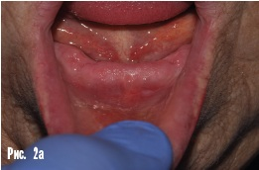
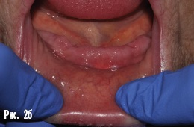
Clinical example. Patient I., 60 years old, applied to the Department of Orthopedic Dentistry for the manufacture of new complete removable plate dentures. Prosthetic status: the patient has been using complete removable lamellar dentures for 1.5 years, the fixation of the upper and lower dentures is unsatisfactory (Fig. 1a, b).
Objectively: complete absence of teeth on the upper and lower jaws, slight uniform atrophy of bone tissue. Abnormalities of attachment of soft tissues in the oral cavity: on the upper jaw there is a low attachment of the frenulum of the upper lip, on the lower jaw there is a high attachment of the mental muscle. When the lower lip is stretched, the height of the tissues of the prosthetic bed decreases by 2 times (Fig. 2a, b). The patient's temperament is sanguine.
Diagnosis: complete secondary edentia of both jaws, upper jaw - 2nd class according to Schroeder, lower jaw - 3rd class according to Keller, anomalies of soft tissue attachment in the oral cavity.

Slide 11
Orthopedic treatment plan for patient I.: 1. Preparation of the oral cavity for orthopedic treatment (elimination of anomalies in the attachment of soft tissues in the oral cavity). 2. Manufacturing of complete removable dentures of both jaws using a two-stage method, taking into account the negative experience of manufacturing previous lamellar dentures. 3. Evaluation of the results of orthopedic treatment, clinical observation. Main aspects for achieving the goal Psychological aspect: the patient is a sanguine person - people with balanced processes of excitation and inhibition of the nervous system, who positively perceive new information. With well-constructed management tactics, adaptation occurs in 100% of cases. Psychological preparation included informing the patient about possible options for the treatment plan using examples from her own clinical experience, explaining the need for surgical preparation of the oral cavity with a description of the stages of surgical preparation, describing the possible expected effect of this manipulation, warning about the healing time of a postoperative wound. At the stage of manufacturing removable dentures, explanatory conversations were held about the entire treatment process and instructions on caring for removable dentures and the features of dispensary observation. Dental aspect: Taking into account the patient's prosthetic status, her temperament and the anatomical conditions in the oral cavity, it was decided to perform surgical preparation of the oral cavity before orthopedic treatment and fabricate two-stage complete dentures for the upper and lower jaws. It is planned to take functional impressions under the patient’s own chewing pressure, and to use the anatomical method of placing artificial teeth in prostheses. Collaboration between an orthopedic dentist and a dental technician: the dental technical part of the work was carried out on the basis of the 4th Minsk State Clinical Hospital, where the two-stage method of manufacturing complete removable plate dentures was first tested and dental technicians are well familiar with the features of its clinical and laboratory stages.

Slide 12
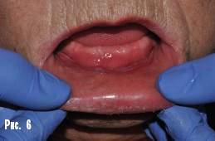
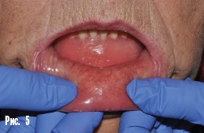
Preparing the patient's oral cavity before orthopedic treatment. 1. Plastic surgery of the oral vestibule on the lower jaw. Before the operation, the base of the removable denture of the lower jaw was increased by layering self-hardening plastic on the vestibular part to achieve a volume of the base sufficient for good fixation of the removable denture on the alveolar process of the mandible (Fig. 3, 4). Before surgery, the prosthesis was fitted in the oral cavity (Fig. 5).
The task of the dental surgeon was to increase the height of the attached gum within the new boundaries of the prosthesis using a surgical method. The patient underwent plastic surgery of the vestibule on the lower jaw according to Edlan-Meicher, observing the new boundaries of the temporary prosthesis.
2. Plastic surgery of the frenulum of the upper lip. After complete healing of the postoperative wound on the lower jaw, the patient underwent plastic surgery of the upper lip frenulum according to Glickman. Rice. 6: clinical picture in the oral cavity after epithelization of the wound on the lower jaw. Rice. 7: lower jaw prosthesis in the oral cavity after plastic surgery of the vestibule on the lower jaw.
As a result of surgical preparation of the patient's oral cavity, a volume of attached gum was obtained sufficient for complete fixation of the denture bases of both jaws.

Slide 13
Manufacturing of complete removable dentures. Functional impressions of the upper and lower jaws were obtained using existing dentures, using the patient’s own chewing pressure. Functional impressions were made in turn: first on the lower jaw (Fig. 8a), then on the upper jaw (Fig. 8b). A monophase a-silicone impression material was used (comfortable consistency and good hydrophilic properties). Before taking impressions, the denture bases were coated with impression tray adhesive. The functional impressions were edged and working models were obtained from supergypsum of the 3rd strength class (Fig. 9a, 9b). Then the denture bases were modeled from wax, the models were plastered into cuvettes using the direct method, the wax was replaced with plastic using the pressure molding method, and occlusal ridges were attached to the finished bases (Fig. 10).

Slide 14
Bases were applied in the oral cavity, a minor correction of the denture boundaries was carried out, and the topography of the occlusal plane on the upper wax ridge was determined (Fig. 11a). The vestibular slope of the upper wax ridge was corrected, and the central relationship of the jaws was determined and fixed using an anatomical and physiological method (Fig. 11b). To transfer the maxillary model into the articulator, a facebow was applied to the patient (Fig. 11c). The models were plastered into the articulator, and the anatomical placement of artificial teeth was carried out. To guide the setting of the anterior teeth, a silicone profile was first obtained (Fig. 12a).

Slide 15
After removing part of the wax roller, the analyzing pin was fixed on the lower base: its inclination should be 90 degrees to the axis of closure of the lower jaw (the axis of closure of the jaw is imitated by the upper frame of the articulator with the magnetic retainer removed: Fig. 12b, 12c). This position of the analyzing pin (and subsequently the central lower incisors) contributes to maximum stability of the future lower denture during function [3]. With a given inclination, the lower incisors and canines were placed (Fig. 13a), then the lateral lower teeth were aligned with the plane of the upper wax ridge, taking into account the curve of Spee (Fig. 13b). Then the upper anterior teeth (the vertical and horizontal incisal overlap was 3 mm) and the upper lateral teeth were positioned (Fig. 13c). We checked the correct placement of artificial teeth in the oral cavity. It is necessary to check the relationship between artificial teeth and soft tissues (Fig. 14a, 14b). After checking the correct placement of the artificial teeth in the mouth, the remaining wax was replaced with plastic in the dental laboratory. Finishing, grinding and polishing of the manufactured prostheses was also carried out here. In the clinic, the dentures were fitted and placed in the oral cavity, and the primary occlusal correction was carried out during the same visit (Fig. 15).

Slide 16
Follow-up examination after 2 weeks: the patient has no complaints, the fixation and stabilization of the upper and lower dentures is good, chewing function and aesthetics have been restored. Follow-up examination after 6 months: no complaints, fixation and stabilization of the upper and lower dentures are within normal limits, chewing function and aesthetics are completely restored. Thus, the obtained immediate and long-term clinical results allow us to recommend this method of manufacturing complete removable dentures for use in difficult clinical situations.

