Slide 1
Presentation Topic: Fixation of removable orthopedic structures.

Slide 2
Principles of fixation of removable dentures:
Physical factor - adhesion
Anatomical retention - created by natural anatomical formations on the upper and lower jaws, which limit the freedom of movement of the prosthesis during conversation or eating (well-defined alveolar ridges, high dome-shaped arch of the hard palate, muscleless zones in the retromolar region)
Mechanical factor – clasp and telescopic fixation systems.

Slide 3
Clasp fixation of dentures
Types of clasps:
1. by function:
1) holding
2) supported – designed to transfer vertical loads to the periodontium of supporting teeth.
3) support-holding
2. by location:
1) dental
2) supragingival (alveolar pellets)
3) dentogingival (clasps according to Kemen)

Slide 4
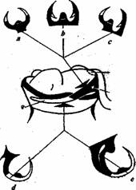
Clasp fixation of dentures
3. According to the type of connection with the base frame of the prosthesis:
1) hard (stable)
2) semi-mobile (semi-labile, springy)
3) movable (labile, articulated)
4. According to manufacturing method:
1) bent
2) cast
3) combined (combined)
5. By design:
1) one-shouldered
2) double shoulders
3) double
4) multi-link
5) endless
6) changeover
7) ring
Кламмерная система Нея

Slide 5
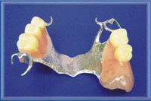
Clasp fixation of dentures
6. According to the material:
1) metal (steel, KHS, Au – Pt 750 samples)
2) plastic
7. According to the section profile:
1) round (D = 0.6 – 1.2)
2) semicircular
3) tape

Slide 6
Telescopic fixation system:
This system is characterized by the presence of two structural elements - a supporting (non-removable) one fixed on the teeth and a removable denture. Prostheses with fixation by telescopic crowns are indicated for defects of Kennedy classes I, II or III. The supporting teeth on which telescopic crowns are attached must be stable, without pathological changes in the periodontal tissues, the axes of the supporting teeth must be parallel. There should be no pronounced Popov phenomenon in the antagonizing dentition. The use of telescopic crowns is considered most indicated for defects with single-standing teeth that have retained normal height.

Slide 7
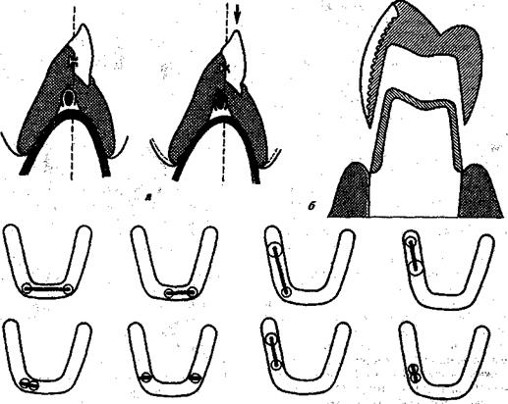
Telescopic systems of fixing elements of removable dentures: a - the ratio of the internal and external parts of the Rumpel-Dolder beam fixation; b - telescopic crowns (external with cladding); c - options for the location of beams.

Slide 8
Making telescopic crowns is contraindicated in the following cases::
the presence of pronounced pathological changes in the periodontium of supporting teeth;
significant inclination of the supporting teeth, which does not allow creating parallelism between them by preparation;
a history of cardiovascular disease that does not allow tooth preparation;
pathological abrasion of hard tissues of teeth II and III degrees.

Slide 9
Clinical and laboratory stages of manufacturing clasp dentures with a telescopic fixation system:
preparation of abutment teeth for internal crowns;
taking impressions, obtaining working models;
laboratory production of internal crowns;
fitting and fixation of internal crowns in the patient’s mouth;
obtaining working impressions for external crowns;
laboratory production of external crowns;
fitting external crowns in the patient’s mouth;
taking impressions for the manufacture of removable dentures;
determination of central occlusion;
checking the wax composition of removable dentures with artificial teeth;
fitting and application of the finished prosthesis.

Slide 10
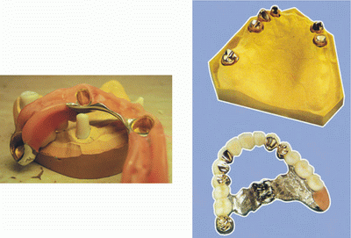
Clasp prosthesis on telescopic crowns:

Slide 11
Beam (rod) fixation
Telescopic systems also include beam or rod fixation of removable dentures. This type of fixation is most appropriate for large class III defects. Crowns are made on the supporting teeth, to which rods are soldered. This construction was first proposed by Weisser (1911). This design includes a supporting non-removable part in the form of crowns or root caps, between which there is a rod or beam (matrix); Accordingly, a metal counter rod (matrix) is located in the base, precisely repeating the shape of the rod. To strengthen it in the plastic, wire branches are soldered to the cover plate. Foreign companies produce plastic and metal blanks for telescopic rods with square, elliptical and teardrop-shaped sections (Fig. 391, a). Such rods secure the prosthesis well during all chewing movements and, in addition, provide reliable stabilization of the supporting teeth. Thanks to the beam, the teeth are combined into a single block, which makes them more resistant to chewing pressure. The best use of these rods is included defects in the lateral sections with a high coronal part of the supporting teeth. With a low crown, there is not enough space for the rod and base.

Slide 12
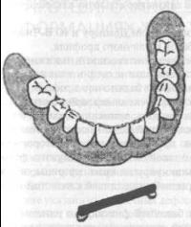
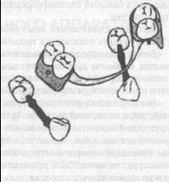

Slide 13
Flaws:
firstly, such a design is complex in its implementation, since instead of one removable prosthesis, it is necessary to make two, that is, fixed and removable;
secondly, it is always associated with the manufacture of a fixed prosthesis, the indications for which should be very limited due to the inevitability of preparation of hard dental tissues.
Therefore, rod fastening is indicated mainly for defects complicated by periodontal disease, when it is necessary to stabilize (immobilize) abutment teeth. The connection is possible in various directions: sagittal, frontal, and even circular

Slide 14
Fixation using locking fasteners (attachments).
Lock fastening (attachment) - consists of two (sometimes more) parts, a matrix and a male, which together form a high-precision collapsible connection. One of these parts can be connected to the surface of an artificial crown, fixed in the tooth root, fixed to an implant, or fixed to the hard tissues of the tooth crown using adhesive technology. The other is integrated into the removable denture and is used to provide mechanical connection.

Slide 15
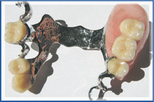
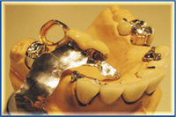

Slide 16
Lock fastenings must functionally provide:
Support - resistance to the movement of the prosthesis towards the tissues of the prosthetic bed;
Retention is resistance to the movement of the prosthesis in the direction from the tissues of the prosthetic bed;
Reciprocating motions are the counteracting forces caused by retention elements;
Stabilization - counteracting the forces that cause the prosthesis to move during function;
Fixation is resistance to the movement of the abutment tooth from the prosthesis and the movement of the prosthesis from the abutment tooth.

Slide 17
Types of locks:
PRECISION DENTAL ATTACHMENTS: Precision dental attachments are highly precise, factory machined on a computer controlled machine and have limited accuracy tolerances. The permissible inaccuracy in the linear dimensions of such locking fastenings is less than 0.01 mm. The composition and strength of the alloys from which precision locking fasteners are made are also strictly regulated. Almost all high-precision locking fasteners are installed by welding (soldering) or cast-on technology. The use of factory-made components makes it relatively easy to repair prostheses.
SEMI-PRECISION DENTAL ATTACHMENTS: Semi-precision dental attachments are manufactured by direct casting onto prefabricated or custom-made plastic or wax blanks. Most blanks for semi-precision locking fasteners are manufactured by injection molding from ashless plastics. Such locking fasteners are called “semi-precision (semi-precise)” because the accuracy of their linear dimensions depends on the process conditions. The positive aspects of semi-precision locking fasteners include their relatively low cost, the possibility of manufacturing from any available cast alloys, the absence of dissimilar metals in the prosthesis, and the absence of the need for soldering/welding parts of the locking fastenings and the prosthesis frame.

Slide 18
Types of retention provided by locking fastenings:
Activated CBs provide active retention between the matrix and patrix; they can be reactivated as the prosthesis is used. They are the design of choice in the manufacture of removable dentures. Non-activated CBs provide passive retention between elements, i.e. The retention force between the matrix and patrix throughout the entire period of use of the prosthesis remains unchanged and cannot be increased or decreased. Most often, such joints are used in the manufacture of collapsible and articulated bridge-like prostheses or removable mini-prostheses.

Slide 19
Classification of lock fastenings
By hardness:
In rigid attachments (solid/rigid attachments), their elements are motionless in relation to each other. It is rational to use this type of valve for prosthetics of small included defects in the dentition, when the entire chewing load is transferred to the supporting teeth.
In labile attachments (resilient attachments), the matrix and patrix are movably connected, which ensures redistribution of the load between the supporting teeth and the mucous membrane of the prosthetic bed. Labile closures are used for prosthetics of end defects of the dentition.
By type of design features:
Extracoronal attachments
Intracoronal attachments
Auxillary attachments
Anchor protection valves (Anchors)
Arcs (Bars)
Other types of shut-off valves

Slide 20
Advantages and disadvantages of lock fastenings:
The advantages of the ZK are:
Higher accuracy compared to clasps
Higher aesthetic qualities of prostheses made using GC and a shorter period of patient adaptation to such prostheses
Availability of standard interchangeable components
Possibility of an adhesive technique for fixing parts of the protrusion to the crowns of intact teeth
Long service life of prostheses made using GC (on average it is 7-10 years).
Ability to change matrices and re-activate
The relative disadvantages of clasps include their higher cost compared to clasps, higher requirements for the quality of technical procedures (modelling, casting of the prosthesis frame) and the presence of additional equipment (parallel cutter, equipment for soldering/welding).

Slide 21
Types of design of lock fastenings:
Intracoronal locking attachments - the matrix is included in the artificial crown (tooth) or installed in the hard tissues of the supporting tooth and does not protrude beyond the contour of the tooth (Fig. 2). The main advantage of intracoronal locking fastenings is that the chewing load is distributed along the longitudinal axis of the abutment tooth. The disadvantages of such fastenings appear when the size of the crown of the abutment tooth is insufficient to accommodate the matrix and lead to an excessive increase in the contour of the crown. In such cases, the anchorage of choice is the extracoronal anchorage. All intracoronal locking fastenings are rigid, which explains the need to connect at least one more adjacent tooth to the abutment one. In the case of a small height of the supporting teeth, in order to ensure sufficient stabilization of the prosthesis, it is necessary to use anti-tipping devices and milled lingual pads.

Slide 22
Types of design of lock fastenings:
Extra-coronal locking fastenings - the patrix of extra-coronal locking fastenings stands behind the contour of the crown of the abutment tooth (Fig. 3), it is installed by welding/soldering with the frame or cast together with the frame of a fixed prosthesis. The advantages of this type of locking fastenings are: preservation of the normal dimensions of the crown of the abutment tooth, no need for massive grinding of hard tissues, and a fairly easy way to insert dentures. Extracoronal anchorages can be rigid, but most are labile. Labile extracoronal locking attachments allow for various types of mobility of the matrix and patrix, which leads to a redistribution of the load between the tissues of the prosthetic bed and the periodontium of the supporting teeth. However, in order to prevent overloading of the abutment teeth, it is advisable to connect adjacent teeth to the abutment teeth.
The disadvantage of extracoronal fastenings is that it is difficult to maintain oral hygiene in the area of the installed fastenings - it is necessary to instruct patients in the use of dental floss and other additional hygiene products in order to prevent the accumulation of plaque and the formation of tartar.

Slide 23
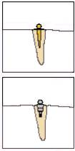
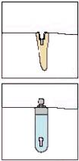
Root and intra-root button-lock fastenings:
To install root and intra-root locking fastenings, special preparation of the supporting roots is required. The matrix or patrix can be installed by soldering/welding to the root part or cast together with a reproduction of the root post. Uni-Anchor or Direct O-Ring type intraradicular locking attachments are cemented into the root canal without making a custom root post. A matrix of intra-root locking fastenings such as Swiss Logic and Zest is installed within the space created in the support root. In the manufacture of "overdentures" type prostheses on implants, factory-made screw-on heads with button fastenings are used. Button clasps ensure a good level of oral hygiene. Another advantage of button-type locking fastenings is the better ratio of the crown and root parts of the supporting teeth, provided by the low profile of the supra-root part, which minimizes lateral loads when using the prosthesis.

Slide 24
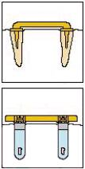
Beam lock fastenings:
Bar clasps are placed over the edentulous areas of the alveolar ridge and connect abutment teeth, roots or implants. Removable bridges, partial dentures or overdentures cover the bar and are connected to its retention elements through a matrix. The main advantage of beam-type locking fastenings is the ability to combine “problematic” supporting teeth (roots) into one functioning group and subsequently exclude supports from it without significant alteration of the prosthesis. When designing removable dentures with fixation on beam-locking fastenings, it is necessary to take into account the condition of the mucous membrane of the edentulous alveolar process to ensure normal oral hygiene.

Slide 25
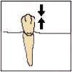
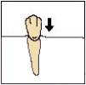
Classification:
Class 1a - rigid locking fasteners that ensure free separation of the matrix and male (Fig. 10). Example - SCORE PD/BR, Beyler, PDC, MGS, etc.
Class 1b - rigid locking fasteners in which the separation of the matrix and patrix is blocked using screws, pins or other mechanical devices (Fig. 11). Example - SCORE-UP, Pin Des Marets, Screw-Bloc, T-Bloc, etc.
Class 2 - labile locking fastenings that provide vertical movements of the matrix and patrix (Fig. 12). Example - TSE, Swiss Hinge, etc.

Slide 26
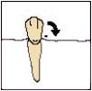
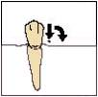
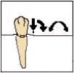
Classification:
Class 3 - labile locking fasteners that provide loop-like movements of the matrix and patrix (Fig. 13). Example - MiniDalbo, Swiss Mini, etc.
Class 4 - labile locking fastenings that provide vertical and loop-like movements of the matrix and patrix (Fig. 14). Example - Dalbo, Ultra-M, etc.
Class 5 - labile locking fasteners that provide vertical and rotational movements of the matrix and patrix (Fig. 15). Example - Swiss Anchor, ASC52, etc.

Slide 27
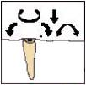
Classification:
Class 6 - universal labile locking fasteners, providing complete freedom of movement of the matrix and patrix (Fig. 16). Example - ORS, Swiss Logic, etc.

Slide 28
Mechanism for connecting matrix and patrix:
Frictional retention of the congenital joint parts - the frictional force of the congruent surfaces of the congenital joint parts - is used in intra- and extracoronal sliding-type concentric joints
Mechanical retention of parts of the joint - used in button joints, joints for “overdenture” type prostheses, in articular joints
Magnetic fixation of parts of the joint - used in the joint for prosthetics on implants (Fig. - Threaded (screw) fastening of parts of the joint - used in the joint for prosthetics on implants and in intracortical root joints
Combined retention of parts of the joint - in some joints, frictional and mechanical mechanisms of articulation of parts of the joint are combined

