Slide 1
Errors: Diagnostic Tactical (at the clinical stages) Laboratory Depending on the nature of the consequences, medical errors are divided into: 1. Errors that do not cause clinical complications. 2. Errors leading to reversible clinical complications. 3. Errors causing irreversible clinical complications.

Slide 2
Diagnostic errors are possible: • incorrect determination of indications for choosing a treatment method; • the design of the prosthesis is incorrectly chosen; • the stages of treatment are incorrectly determined; • diagnostic models have not been analyzed; • the height of the lower part of the face is not determined; • decreased height of the lower part of the face has not been diagnosed; • parallelometry was not carried out on diagnostic models; • unreasonable depulpation of teeth; • the condition of chronic pulpitis or periodontitis has not been diagnosed, the indications for tooth canal filling have not been determined; • pathology of the temporomandibular joint has not been diagnosed; • the periodontal condition has not been diagnosed; • indications for tooth extraction have not been determined

Slide 3
With the loss of fangs (even one), the indications for the use of plate prostheses expand and the indications for the use of supported dentures narrow. This is explained by the fact that the incisors must serve as supporting teeth, which can lead to their loosening.
As teeth are lost and the length of the toothless portion of the alveolar ridge increases, the indications for the use of removable laminar dentures expand.

Slide 4
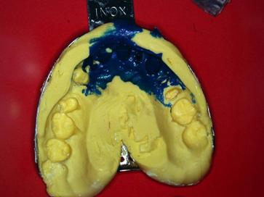
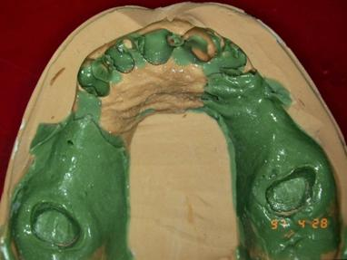
Tactical and technical errors: - errors when taking an impression (the alveolar process, alveolar part, cords and frenulum, transitional fold must be cleared); - inaccuracies in obtaining impressions due to incorrect choice of impression material - significant compression or deformation of the mucous membrane (trauma of the mucous membrane, diffuse hyperemia of the alveolar process);

Slide 5
The most common mistake when taking two-layer prints is simply not following the instructions for using the material. 1. Failure to comply with the proportions of the main mass and catalyst specified in the instructions. When mixing the impression mass “by eye”, the ratio of ingredients may shift towards the catalyst. This results in faster polymerization and therefore reduces working time. A decrease in the amount of catalyst can lead to incomplete polymerization of the material, and, accordingly, to deformation of the print. 2. Failure to comply with the time parameters for working with impression material. If the impression material is mixed for too long, it may “set” before being inserted into the oral cavity. If the impression is taken out prematurely, when the time for complete polymerization of the material is not observed, the impression becomes deformed. 3. Violation of the adhesion of the main and corrective layers of a two-layer impression when using a two-stage method. The main reason is that the first layer is not sufficiently dried and cleared of saliva and blood. The reason may also be the use of the first and second layers of impression materials of different groups. For example, the first layer A is silicone, the second layer C is silicone. 4. Deformation of the first layer of impression material by the corrective material occurs in the absence of the necessary preparation of the base layer. As mentioned several times above, it is necessary to create drainage channels to remove excess fluid mass. 5. Poor quality of the prosthetic bed when taking two-stage, two-layer impressions may be due to insufficient preparation of the first layer. After creating the outlet channels and eliminating all the undercuts, it is necessary to carefully blow out the impression with a stream of air from the void. This is necessary to remove the remnants of the first layer. Otherwise, the pieces of base mass remaining in the print will interfere with obtaining the second layer of the print.

Slide 6
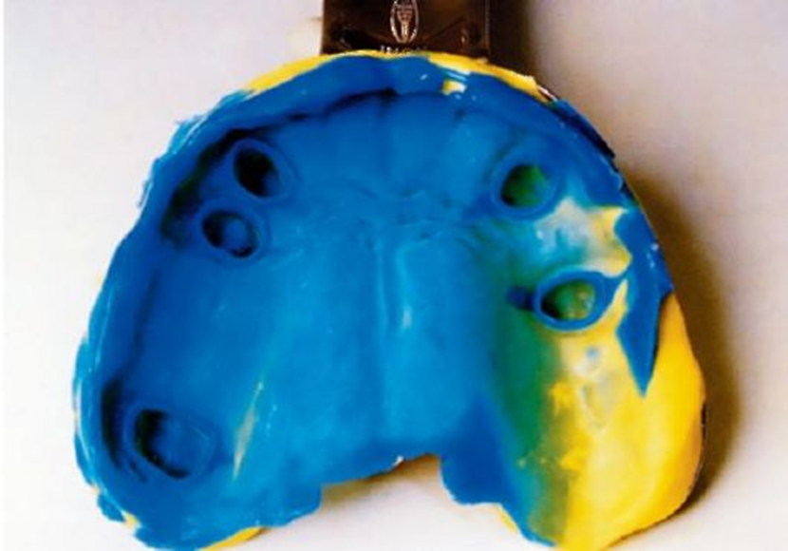
- with excessive compression of the mucous membrane of the prosthetic bed, injury and pain are observed under the arch and base of the prosthesis, multiple corrections.

Slide 7
The lower edge of the lingual arch should be located in such a way that it does not compress the tissues of the floor of the mouth and does not injure the frenulum of the tongue when they rise and fall during the physiological acts of chewing, swallowing, speaking, licking lips, etc.
The lower edge of the arch should be slightly above the bottom of the hyoid transitional fold at the moment of its maximum upper position when the tongue moves towards the palate.
For the correct location of the arch on the lower jaw, it is necessary to obtain impressions using active movements when forming its edges, when soft tissues are displayed during function (extended tongue to the red border of the lips, movements of the tongue to the right, left with the mouth half open)

Slide 8
- errors in determining the central relationship of the jaws
Increase or decrease in interalveolar height
Fixation of anterior or lateral occlusion
Deformation of wax bases with occlusal ridges
Incorrect determination of the height of the upper occlusal ridge
Incorrect formation of the prosthetic plane
Incorrect definition of reference lines

Slide 9
To control the density of closure of the dentition in the position of central occlusion, a special spatula is used, the end of which the doctor tries to insert between the artificial teeth and the antagonist teeth. If the spatula passes between the antagonists, it means that an error was made in determining and recording central occlusion. In this case, a well-heated wax plate is placed on the artificial teeth and the patient is asked to close the teeth in the position of central occlusion.
For any errors after re-fixation of the central relationship, re-plastering (fixing) of the models in the articular and rearranging the teeth is necessary.

Slide 10
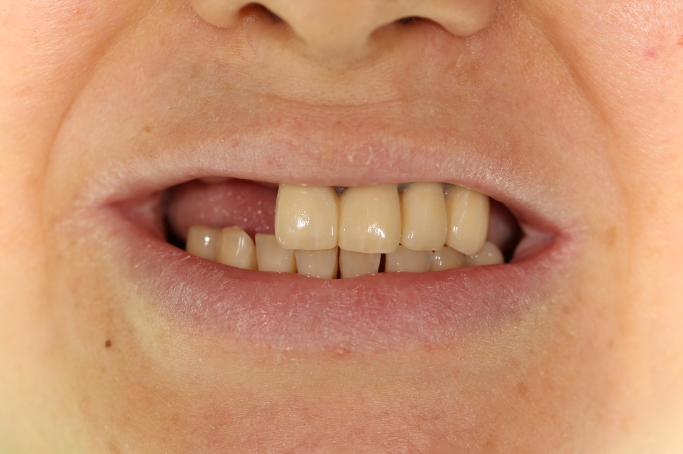
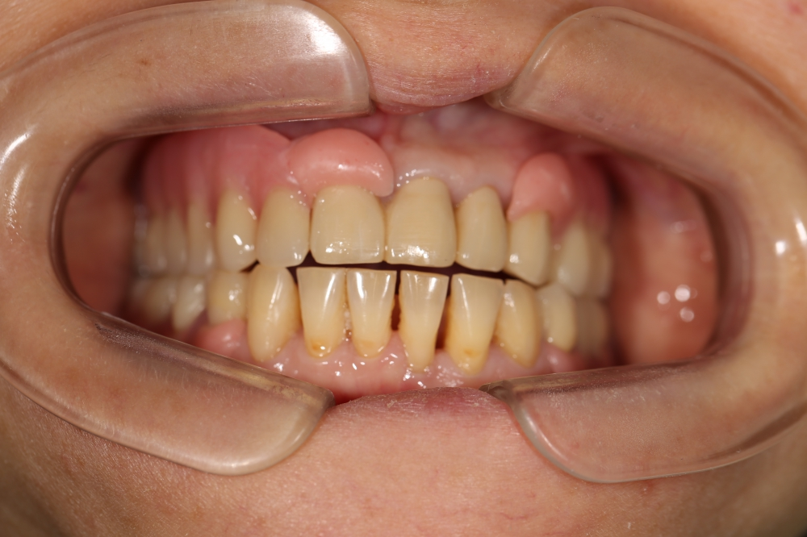

Slide 11
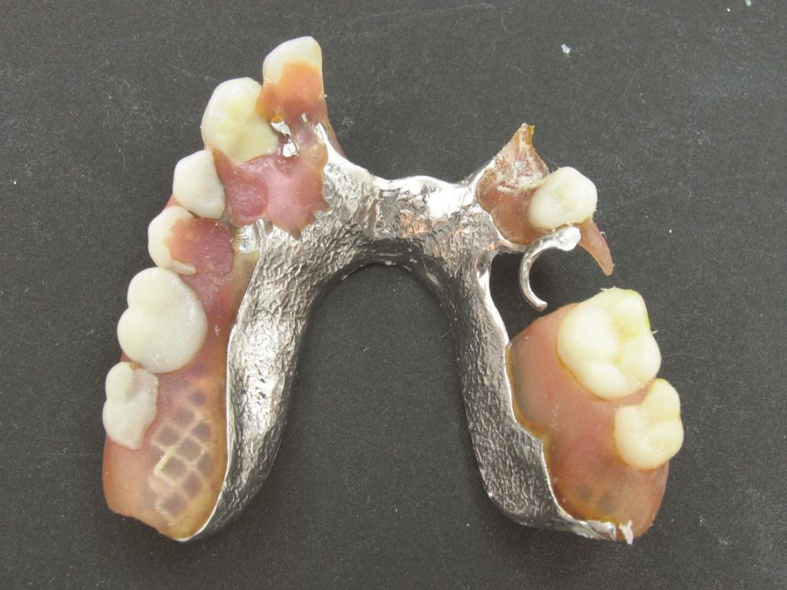

Slide 12
- damage to the model; - lack of insulation in the area of sharp bone protrusions; - lack of insulation or excessive insulation of the palatal ridge; - deformation of the model when pressing plastic; - errors when checking the design of the prosthesis; - inability to correctly assess the quality of prostheses; - a poorly conducted conversation with the patient about the rules for using the prosthesis, the timing of follow-up examinations; - elongated, shortened or thinned edge of the prosthesis; - multiple corrections.

Slide 13
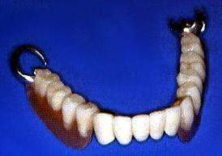
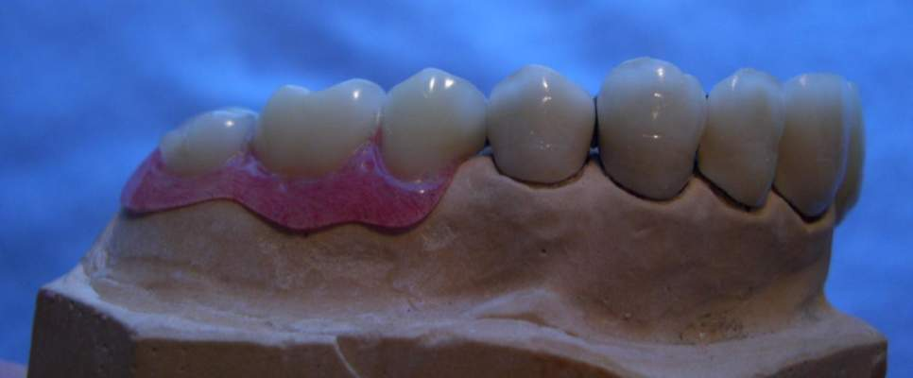
a prosthesis with shortened base boundaries and a color discrepancy between a fixed and removable prosthesis.

Slide 14
Complications: - poor fixation and stability of the prostheses; - complications from the temporomandibular joint due to incorrect determination of the central ratio or height of the lower part of the face; - balance of the prosthesis; - periodontal overload of supporting teeth; - microtraumas of the gingival margin and interdental papillae; - decubital ulcers, erosions; - traumatic papillomatosis; - formation of a “dangling” alveolar ridge.

Slide 15
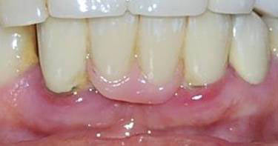

Slide 16
Side effects of removable dentures include overload of the periodontium of the supporting teeth. Traumatic periodontitis can develop under the influence of:
1) clasps due to their small number, incorrect manufacturing, incorrect choice of supporting teeth (without taking into account the condition of the periodontium and the microscopy of the prosthesis during eating);
2) microtrauma of the gingival margin and interdental papillae due to poor quality reproduction of the edge of the prosthesis adjacent to these areas and increasing microexcursions of the prosthesis.

Slide 17
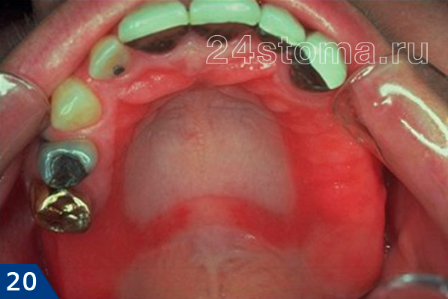
Stomatitis as a result of intolerance to the construction materials of the clasp prosthesis

Slide 18
The role of concomitant pathology (parafunction of the masticatory muscles and teeth clicking, bruxism)
Parafunctions can occur when using a clasp denture due to uncorrected occlusion or unsatisfactory fixation.
Grinding and clicking of teeth leads to hyperemia, thinning of the mucous membrane and atrophy of the tissues of the prosthetic bed.
Constant grinding or strong closure of teeth leads to rapid abrasion of artificial teeth, chipping of the lining of matrix sockets, overloading of supporting teeth, and breakage of the prosthesis base or locks.

Slide 19
Errors when taking a working impression - with excessive compression of the mucous membrane of the prosthetic bed, injury and pain are observed under the arch and base of the prosthesis.
The choice of impression material and the degree of compression are influenced by the condition of the mucous membrane of the prosthetic bed.
A correctly obtained differentiated impression will reduce the tipping (dislocation) effect of end defects.

Slide 20
The lower edge of the lingual arch should be located in such a way that it does not compress the tissues of the floor of the mouth and does not injure the frenulum of the tongue when they rise and fall during the physiological acts of chewing, swallowing, speaking, licking lips, etc.
The lower edge of the arch should be slightly above the bottom of the hyoid transitional fold at the moment of its maximum upper position when the tongue moves towards the palate.
For the correct location of the arch on the lower jaw, it is necessary to obtain impressions using active movements when forming its edges, when soft tissues are displayed during function (extended tongue to the red border of the lips, movements of the tongue to the right, left with the mouth half open)

Slide 21
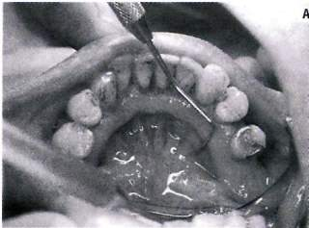
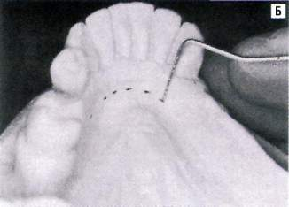
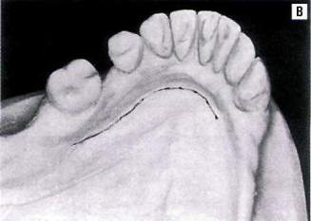
Clinical method for determining the relative depth of the floor of the mouth.
The method involves measuring the depth of the floor of the mouth relative to the gingival edges of the teeth on the lingual side using a periodontal probe.
During the measurement process, the tip of the patient's tongue should lightly touch the red border of the upper lip.
Carrying out these measurements allows you to transfer their results to both the diagnostic and working models, thus guaranteeing a fairly favorable location of the lower edge of the arc.

Slide 22
Preparation of abutment teeth:
Preparing the site for occlusal pads.
Immobilization of insufficiently stable or overly loaded teeth (production of a crown splint).
Changing the contours of abutment teeth:
- grinding of enamel in obstacle areas + retheramia;
- changing the position of the boundary line by grinding the enamel + retherapy or etching + adding a composite material to the tooth surface to shift the boundary line to the gingival margin → increasing aesthetics;
- covering the supporting teeth with crowns to create an optimal position for the boundary line.

Slide 23
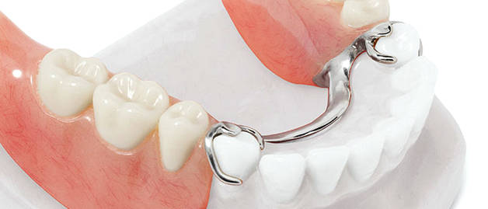
Errors when planning the design of a clasp prosthesis (location of occlusal pads).

Slide 24
Unsatisfactory fixation of the clasp prosthesis may be associated with incorrect position of the retention part of the support-retaining clasp relative to the equator line, i.e. is located above it between the equator and the chewing surface or extends below the line to a depth of less than 0.25 mm.

Slide 25
Breakage of the retention part of the support-retaining clasp is possible due to excessive depth of retention - as a result of errors in parallelometry or its movement to the neck of the tooth by the doctor for cosmetic reasons.

Slide 26
Ignorance of parallelometry leads to undesirable results:
- difficult fitting of the frame (difficult way to insert the prosthesis)
- incorrect definition of the clasp zone;
- the topography of the support and retention zone is incorrectly assessed;
- fracture of the vestibular part of the clasp.

Slide 27
Periodontal phenomena in the area of supporting teeth

Slide 28
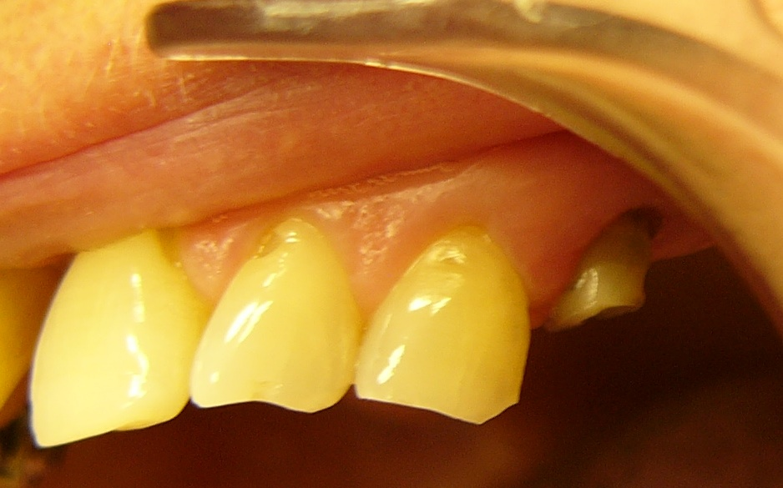
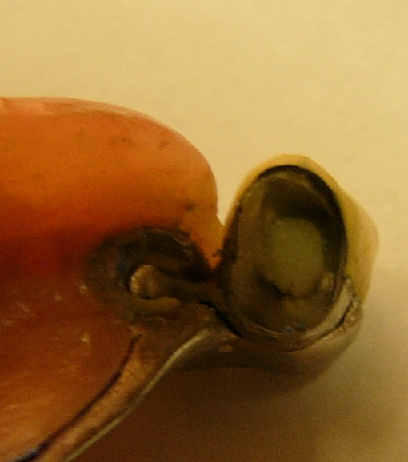
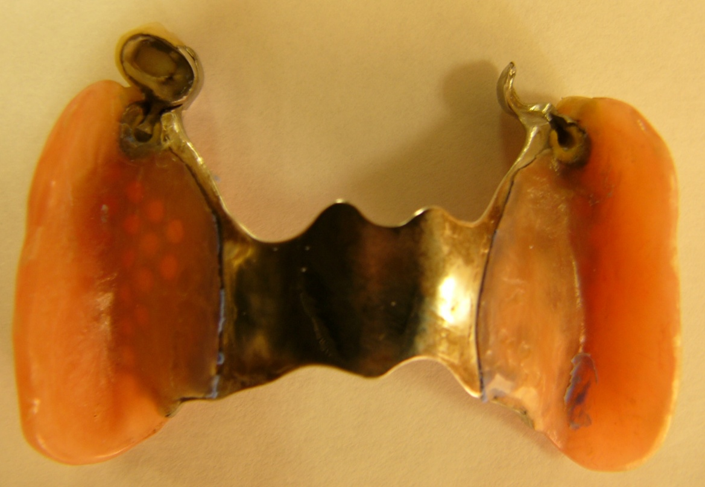
Disintegration of the abutment crown in combination with a fracture of the stump of the abutment tooth as a result of functional overload and insufficient number of abutment teeth

Slide 29
Fixing dentures whose artificial dentition incorrectly restores occlusal contacts (primarily contacts with central occlusion) is a gross medical error. Correction of occlusal contacts, which may result in a decrease in occlusal height and complete grinding of the masticatory cusps, is also unacceptable.

Slide 31
The reasons for the balance may be the manufacture of prostheses based on deformed casts (shrinkage of alginate masses, incorrectly folded pieces of resin, etc.), incorrect (insufficient) isolation of the palatal ridge, deformation of the base when removing the prosthesis from the ditch, its finishing and polishing, insufficient fit of the finished removable prosthesis. But the main mistake is that the doctor fixes a balancing prosthesis in the oral cavity. An attempt to eliminate the balance by activating clasps causes even more harm. It should be remembered that if, after careful fitting, the balance is not corrected, then the prosthesis must be remade.

Slide 32
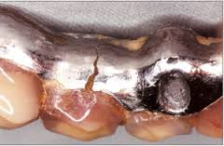
Breakage (crack) of a multi-link clasp

Slide 33
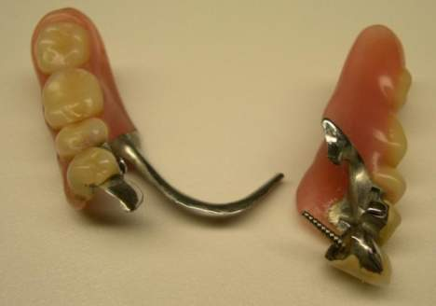
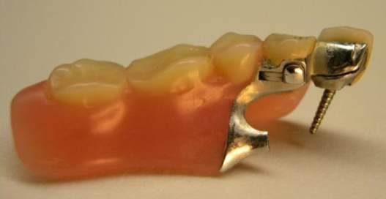
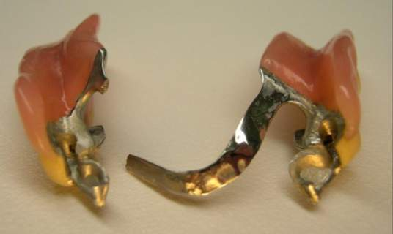
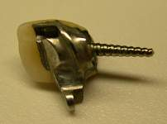

Slide 34
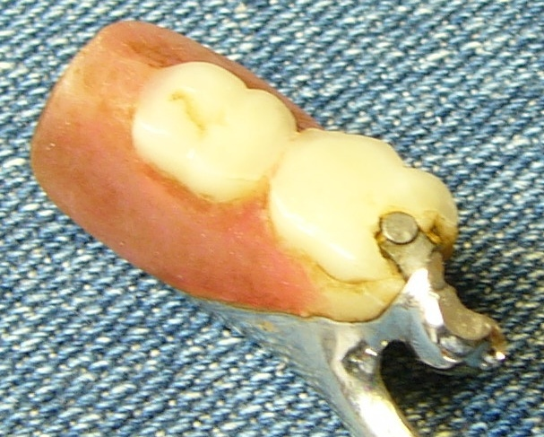
Chipping of the facing material above the attachment

Slide 35
The most common mistakes in plastic polymerization (laboratory)
1) Formation of porosity.
2) Failure to comply with the time interval - an increase in the amount of residual monomer in the prosthesis.
Basic plastics (hot polymerization) contain
0.2-0.5%, fast-hardening - 3-5% or more of residual monomer.
3) Sharp cooling of the prosthesis leads to significant internal stress in the plastic, the appearance of cracks, and frequent breakdowns of the prosthesis.

Slide 36
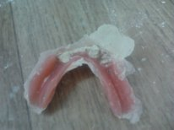
Increasing the bite height on artificial prosthetic teeth due to the loose connection of the cuvette halves and the presence of a burr. As a result, the doctor needs to make significant corrections to the prosthesis.

