Slide 1
Features of examination of patients with complete loss of teeth
.

Slide 2
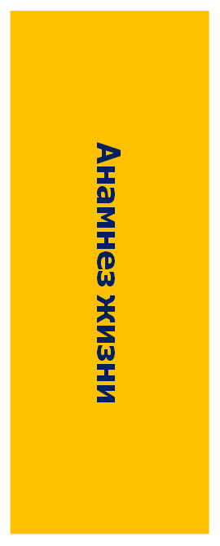
СУБЪЕКТИВНОЕ ИССЛЕДОВАНИЕ
Опрос, сбор жалоб
Физические методы
Специальные методы
Notes:
An examination of any dental patient, as well as a patient with complete absence of teeth, consists of a subjective and objective examination. In turn, the subjective examination is divided into
survey, collection of complaints, collection of anamnesis of illness and life.
Objective examination is divided into physical and special methods.
Diagnosis of complete absence of teeth (complete edentia) is made through a clinical examination and medical history. Diagnostics is aimed at eliminating factors that prevent the immediate start of prosthetics. Such factors may be the presence of: not removed roots under the mucous membrane; exostoses; tumor-like diseases; inflammatory processes; diseases and lesions of the oral mucosa.

Slide 3
Subjective examination
Patient's complaints
Allergy history
General condition of the body
Occupational hazards
Living conditions

Slide 4
Questionnaire
Notes:
In recent years, preliminary questioning of patients attending an orthopedic dentistry clinic has become widespread. We present a similar questionnaire, which we recommend using during the preliminary examination of patients. A questionnaire filled out by the patient significantly saves the doctor’s time and allows for more targeted examination and treatment of the patient who applied.
The questionnaire consists of the following sections: 1) preliminary questions of a general nature; 2) main complaints; 3) assessment of the ability to adapt to prostheses; 4) the desired effect of treatment and its assessment; 5) personal qualities of the patient; 6) features of his speech.

Slide 5
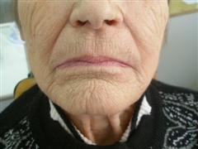
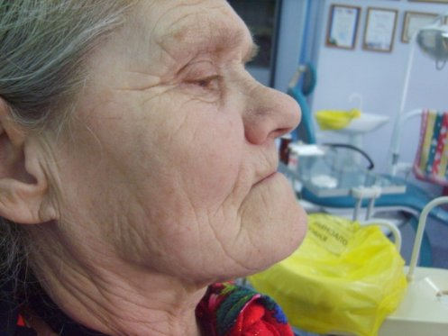
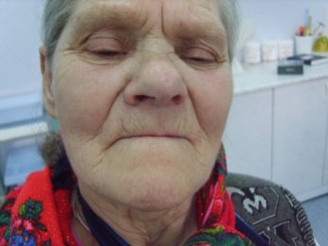
Patient examination
Notes:
Objective research.
Carry out an external examination of the patient and determine the posture, gait, body constitution, face shape, chin position, angle of the lower jaw, decreased bite height, severity of nasolabial and chin folds, retraction of the cheeks and lips, presence of ulceration of the skin and mucous membrane of the corners of the mouth, character and degree of mouth opening. An external examination begins from the moment the patient enters the office and continues throughout the initial appointment, when the doctor, interviewing the patient and collecting complaints and anamnesis, simultaneously records signs of edentia during a conversation and various functional deviations (deviations, dysfunction of chewing, speech).

Slide 6
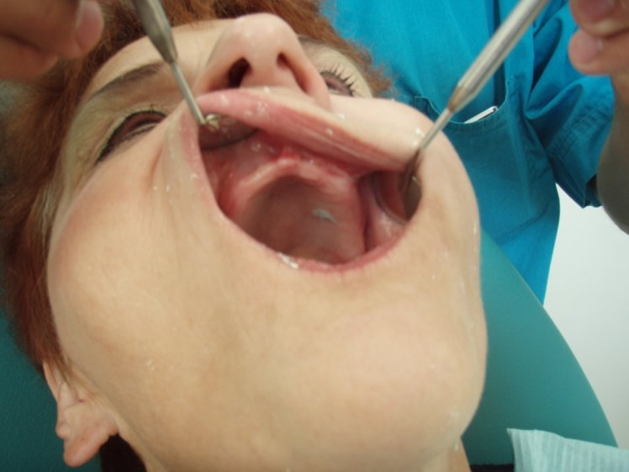
Examination and diagnostics in the oral cavity
Notes:
Examination and diagnostics in the oral cavity
A general examination of the oral mucosa is carried out and the presence of pathological changes of various etiologies is determined, requiring preliminary treatment or the use of special prosthetic methods.

Slide 7
Examination of the edentulous maxilla
Notes:
Examination of the edentulous upper jaw:
a) establishing the height of attachment of the frenulum of the upper lip,

Slide 8
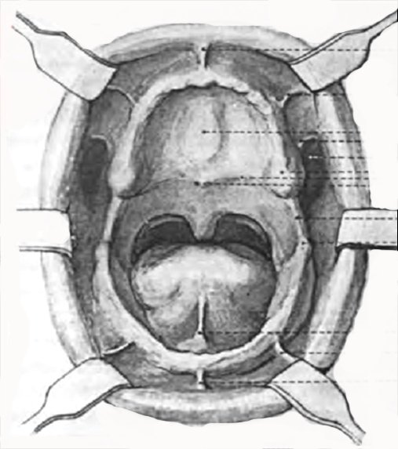
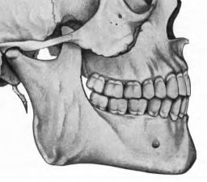
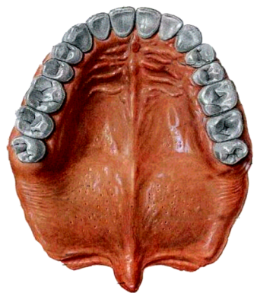
Notes:
buccal cords, transitional fold, the presence of scar cords, the level of location of the zygomatic alveolar ridge, the severity of the buccal recess, the compliance of the membrane along the transitional fold, the degree of atrophy and the shape of the alveolar ridge, the presence of exostoses and bony protrusions and the decision on the need for surgical intervention in order to create conditions for rational prosthetics;

Slide 9
уздечка верхней губы; щечная уздечка; щечная уздечка; уздечка языка; щечная уздечка; уздечка нижней губы

Slide 10
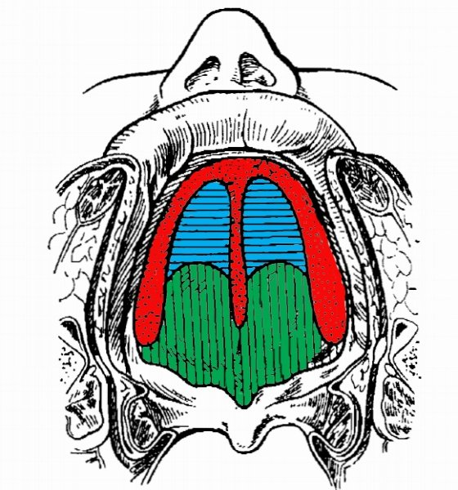
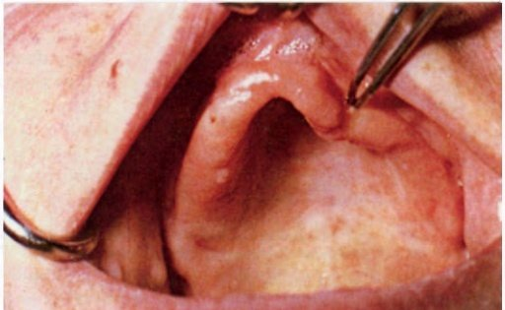
Lund compliance zones
Фиброзная зона
Зона жировой ткани
Железистая зона
Notes:
b) determining the type of mucous membrane covering the alveolar processes (according to Lund, Supple, Kalinina) and deciding on the need for preliminary excision of scar cords, a loose ridge or prosthetics using the appropriate technique for taking impressions;

Slide 11
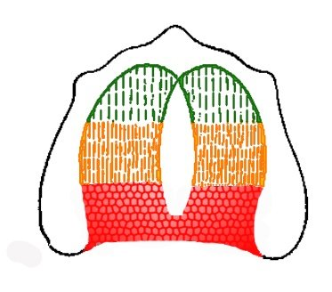
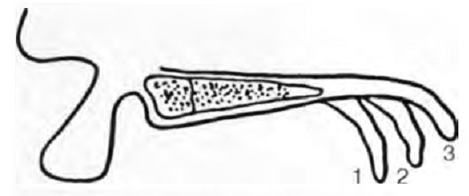
Scheme of buffer zones according to E.I. Gavrilov
Notes:
c) determination of the slope of the soft palate, the severity of the torus, buffer zones, the position of the cicatricial papilla and the choice of the technique for taking an impression and the formation of the posterior valve.

Slide 12
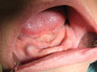
Examination of the edentulous lower jaw
Notes:
Examination of the edentulous lower jaw:
a) establishment of the attachment of the frenulum of the lower lip, buccal cords, dangling ridge, the severity of the external oblique line, the Wedge's pocket, the compliance of the mucous membrane along the transitional fold, the severity of the mandibular tuberosities, the degree of atrophy and the shape of the alveolar ridge, the shape of its slope from the vestibular and oral surfaces, the presence exostoses and bony protrusions, the severity of the maxillary-hyoid line, the sublingual line, the hyoid torus and its size and resolving the issue of the need for surgical intervention in order to create conditions for rational prosthetics;
b) determination of the type of mucous membrane covering the alveolar process (see upper jaw);

Slide 13
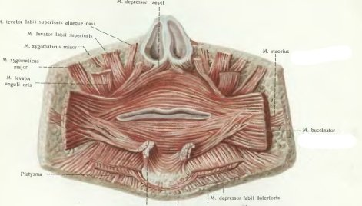
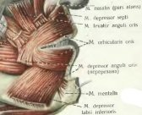
Notes:
c) establishing the size of the sublingual space with a neutral position of the tongue, the severity of the frenulum of the tongue and the height of its attachment, the tone of the muscles of the mental region and mylohyoid muscle, the size of the lingual pocket during function, determining the tone and size of the tongue.

Slide 14
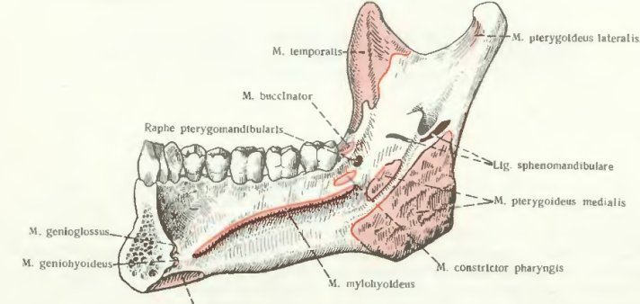

Slide 15
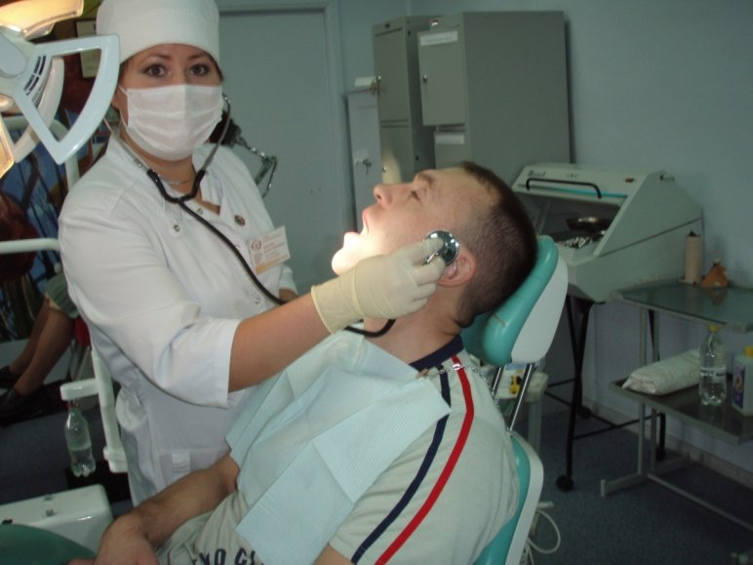
Auscultation of the joint
Notes:
Auscultation of the joint.
It is carried out using a phonendoscope or special devices (electro- and phonocardiographs). It is necessary to carry out comparative auscultation of both joints. Normally, the joints produce the same gentle sounds of the articular head moving along with the disc along the posterior slope of the articular tubercle. In case of joint pathology, crepitus, crunching and clicking are detected.
Auscultatory signs.
· clicks (in case of disturbances in coordinated movements between the articular head and the articular disc due to internal disorders),
crunching (associated with deformation of the articular surfaces, a decrease in the amount of joint fluid),
· friction noise (associated with a decrease in the amount of joint fluid).

Slide 16
Palpation of the joint and masticatory muscles
Notes:
Palpation of the joint and masticatory muscles.
Palpation of the joint is carried out in front of the tragus of the ear or in the area of the external auditory canal with the jaws closed, at the moment of opening the mouth and with the mouth wide open. When palpating the masticatory muscles, their elasticity, tension and pain points are determined.

Slide 17
Special research methods
Anthropometric
Laboratory
X-ray
Notes:
Специальные методы исследования
Антропометрические
Лабораторные
Рентгенологические

Slide 18
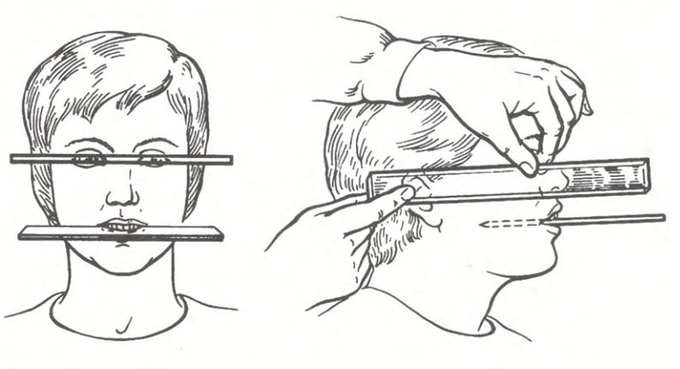
Anthropometric studies
Notes:
Anthropometric studies
These studies allow us to determine the height of the lower part of the face, are mandatory and are always carried out at the stage of prosthetics.

Slide 19
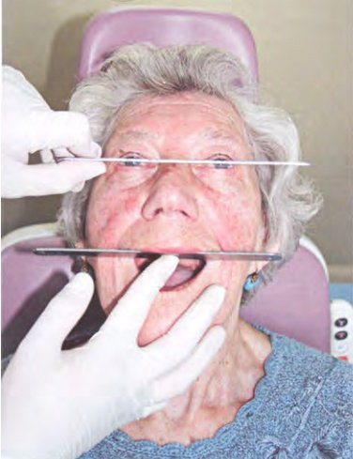
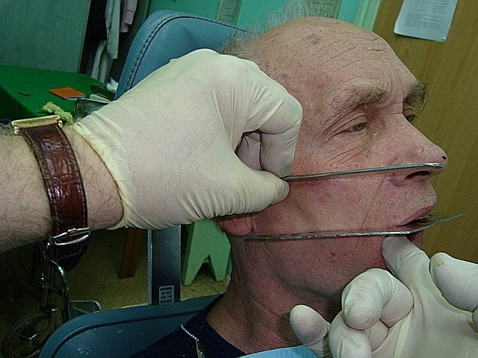
Anthropometric studies

Slide 20
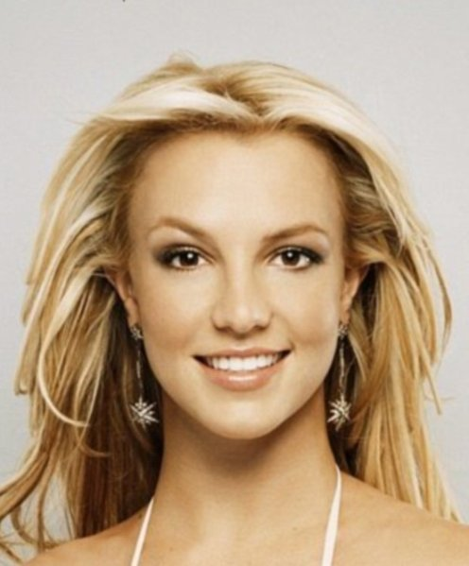
Measurements of anthropometric landmarks
А
С
С
С
С
E E E E E E
D
B B
Notes:
The anthropometric method is based on the principle of proportionality of the structure of the human body and, in particular, individual parts of the face. When examining a patient's face, it is recommended to pull all the hair back to see the full oval of the face.
There are several anthropometric methods. The most common are the following:

Slide 21
According to Kantarovich
С
С
С
С
D
Notes:
a) Kantorovich - dividing the face into three equal parts:
1) from the border of the scalp of the forehead to the middle of the line of the superciliary arches - the upper, or cerebral, third of the face;
2) from the middle of the line of the superciliary arches to the edge of the wing of the nose - the middle, or respiratory, third of the face;
3) from the edge of the nose to the bottom of the chin - the lower, or digestive, third of the face. With age, the upper third of the face increases (the border of the scalp of the forehead moves away), the lower third of the face decreases (due to loss of teeth); Only the middle part of the face remains unchanged, by measuring which it is easy to obtain the height of the bite;

Slide 22
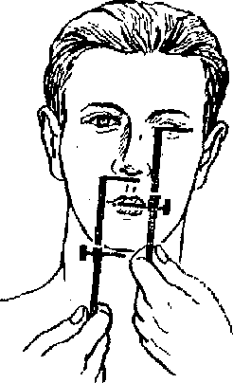
According to Wordsworth-White
Notes:
b) Wadsworth-White - a modification of the Kantorovich method - dividing the face into two equal parts: from the middle of the pupil to the line where the lips close and from the base of the nose to the bottom of the chin;

Slide 23
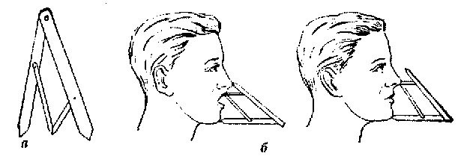
According to Jupitz
Notes:
в) Jupitza - dividing a face in extreme and average ratios using a compass of the “golden section”. Zeissig (1854) pointed out that the human body exhibits in its individual parts the proportions of the “golden section” - division in extreme and average ratios. To divide a person or its part in extreme and average relation means to divide into two unequal parts, of which the larger relates to the whole as the smaller relates to the larger. For the practical application of the principle of the “golden section”, Heringer (1893) invented a compass that automatically indicates the point of the “golden division” and therefore called it the “golden compass”. It consists of two parts: a large (outer) and a small (inner) compass, located in the opposite direction to each other. The point of rotation of the legs of the small compass lies on the line connecting the points of the legs of the external compass, and in all positions divides this line in extreme and mean ratios.
Using this technique when determining the height of the lower third of the face in edentulous patients, the occlusal ridges are adjusted until the point of rotation of the small compass lies at the top of the tip of the nose, while maintaining the outer leg of the compass at the Gnation point.

Slide 24
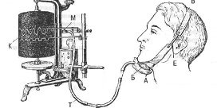
Masticationography
Notes:
Masticatiography is a graphic method of recording reflex movements of the lower jaw (from the Greek masticatio - chewing, grapho - food). To use this method, devices were constructed consisting of recording devices, sensors and recording parts. The recording was made on a kymograph or on oscillographic and strain gauge installations.
The most appropriate place for installing recording devices should be considered the chin area of the lower jaw, where the soft tissues move relatively little during function. In addition, the amplitude of movements of this part of the lower jaw during chewing is greater than its other parts, as a result of which the recording device captures them better.

Slide 25
Kimogram of one chewing period
I – состояние покоя, II – фаза введения пищи в рот, III начальная фаза жевания, IV – основная фаза жевания, V – фаза формирования комка и его проглатывания, O – момент смыкания зубов и раздавливания пищи, O₁ – момент размалывания пищи (в секундах)
I – состояние покоя, II – фаза введения пищи в рот, III начальная фаза жевания, IV – основная фаза жевания, V – фаза формирования комка и его проглатывания, O – момент смыкания зубов и раздавливания пищи, O₁ – момент размалывания пищи (в секундах)
I – состояние покоя, II – фаза введения пищи в рот, III начальная фаза жевания, IV – основная фаза жевания, V – фаза формирования комка и его проглатывания, O – момент смыкания зубов и раздавливания пищи, O₁ – момент размалывания пищи (в секундах)
I – resting state, II – phase of introducing food into the mouth, III initial phase of chewing, IV – main phase of chewing, V – phase of bolus formation and swallowing, O – moment of closing teeth and crushing food, O1 – moment of grinding food (in seconds )
Notes:
Kymogram of one chewing period I – resting state, II – phase of introducing food into the mouth, III initial phase of chewing, IV – main phase of chewing, V – phase of bolus formation and swallowing, O – moment of closing teeth and crushing food, O1 – moment of grinding food (in seconds)
According to these movements, curves are recorded on the kymograph tape.

Slide 26
Myography
Notes:
Myography is the recording of muscle contractions using a special device - a myograph.
During chewing, the thickness of the muscles changes due to an increase and decrease in their tone. The myography method is used to take into account reflex contractions (thickening and thinning) of the masticatory muscles. The introduction of myography into the clinic is promising for recording the function of facial muscles in normal and pathological conditions.

Slide 27
X-ray examination
Plain X-rays of the head
Orthopantomogram
Teleradiography
Layered tomography of the temporomandibular joint.
Notes:
X-ray examination
One of the important additional examination methods is radiographic examination. For complete removable prosthetics, survey X-rays of the head, orthopantomogram, teleradiography, and layer-by-layer tomography of the temporomandibular joint can be used.
X-ray examination allows you to determine the density of the bone tissue of the prosthetic bed, the condition of the temporomandibular joint, and track pathological changes in the bone tissue of the upper and lower jaws.

Slide 28
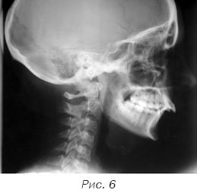
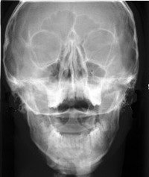
X-ray in frontal and lateral projection
Notes:
X-rays in frontal and lateral projections show the condition of the bones of the skull and help identify changes in the bones

Slide 29
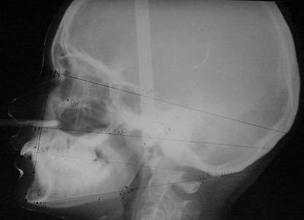
Teleradiogram
Notes:
A teleroentgenogram allows you to determine from the image anatomical bone landmarks and the distance between them, the angle of the lower jaw. This will allow us to more accurately determine the physiological relationship of toothless jaws in the future.
A profile teleroentgenogram of the head allows one to determine the spatial position of jaw models in the interframe space of the articulator relative to the center of the hinge movements and the topography of landmarks used in the design of artificial dentition. This is an essential condition for reproducing individual movements in the articulator.

Slide 30
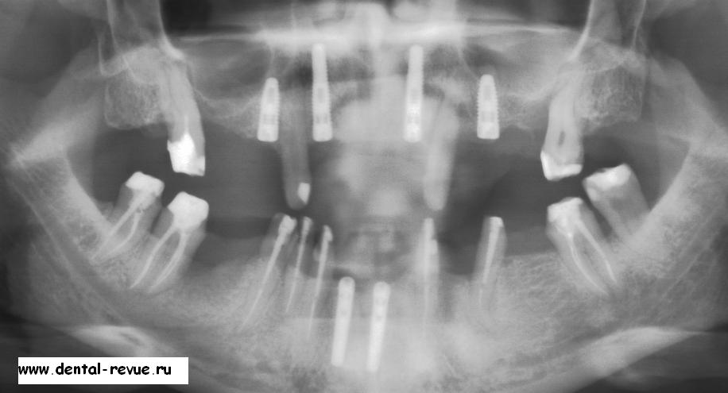
Example of an orthopantomogram
Notes:
Orthopantomogram is a panoramic photograph of the oral cavity.
An orthopantomogram makes it possible to comprehensively assess the condition of the periodontium and bone tissue of the teeth. Based on this, the doctor accurately diagnoses the disease and prescribes a treatment plan.

Slide 31
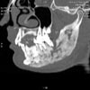
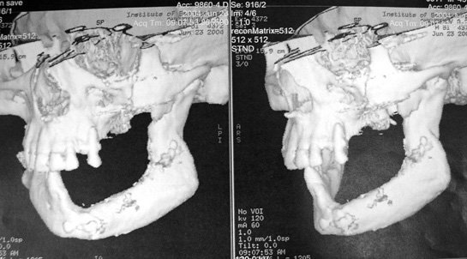
Layered and three-dimensional tomography
Notes:
Computed tomography, a method of non-destructive layer-by-layer examination of the internal structure of an object, was proposed in 1972 by Godfrey Hounsfield and Allan Cormack, who were awarded the Nobel Prize for this development.
CT diagnostic data should be used to plan the type of orthopedic structures that effectively and safely distribute possible chewing loads on the supporting apparatus of teeth and implants.

Slide 32
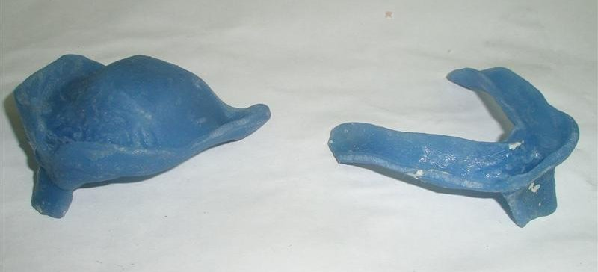
Individual trays for functional impressions
Notes:
Individual trays for functional impressions
In the orthopedic treatment of patients with complete loss of teeth, complete fixation and stabilization of removable dentures can be achieved provided that the boundaries of the base are optimally matched with the transitional fold, as well as the congruence of the relief of the prosthetic bed and the inner surface of the base. Therefore, you should not limit yourself to obtaining an anatomical impression. Only by taking a functional impression can one obtain a clear image of the macro- and microrelief of the mucous membrane and, no less important, the exact boundaries of the transitional fold and its volume. To do this, it is necessary to make individual impression trays or base trays with bite ridges.

Slide 33
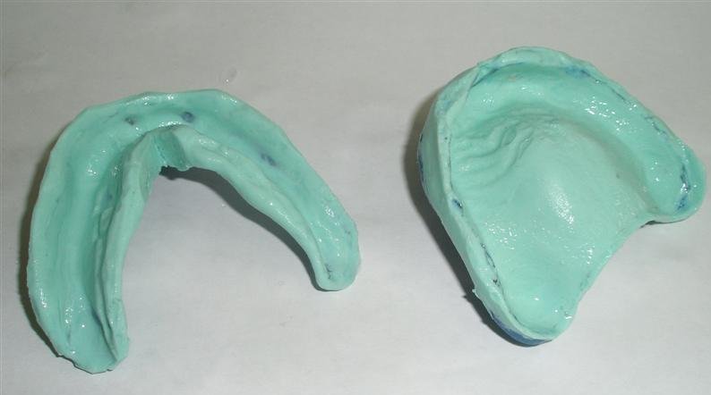
Ready-made functional impressions
Notes:
A functional impression is an impression that reflects the state of the tissues of the prosthetic field during function.
Functional impressions were first proposed by Schrott (in 1864). Metal spoons were made for both jaws. Springs were soldered to the spoons, which fixed them on the prosthetic field. Heated gutta-percha was applied to the spoon and the patient was treated for 15 – 20 minutes. made various movements of the jaw, moved his lips, cheeks and tongue.
Motte (1897) made prosthetics based on anatomical impressions. I applied a layer of gutta-percha and allowed patients to use it for 1–2 days.

Slide 34
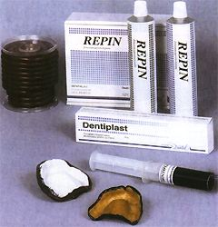
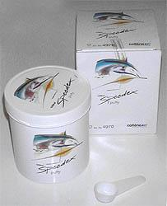
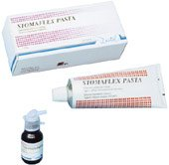
The choice of impression materials is very large
Notes:
Currently, there are a large number of masses and techniques for taking functional impressions. G.B. Brakhman (1940) made individual spoons from wax, and took impressions with liquid plaster.
Weinstein (1952), A.K. Nederlen (1964) used thermoplastic masses using rigid spoons.
Currently, Dentol, Repin, Tiodent, Silan, and Bisico are used.
Herbst (1964) proposed special masses “Subrofix” and “Adgesal”.

Slide 35
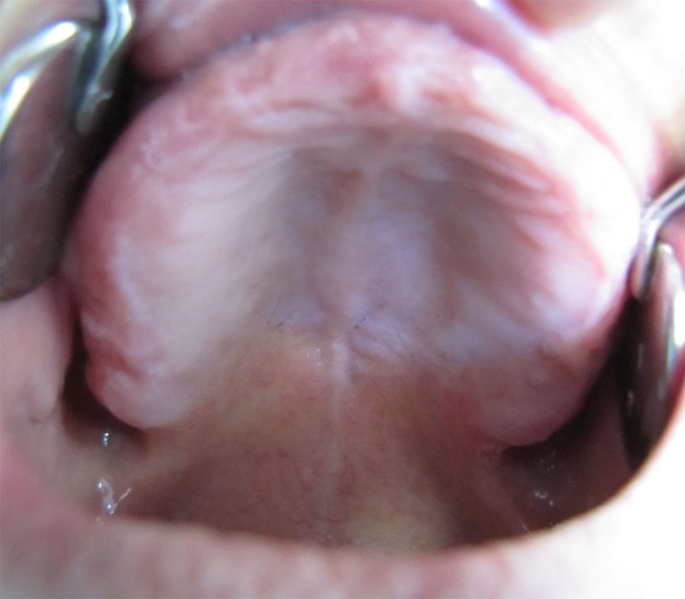
Zone "A"
Notes:
«With Subrofix” Herbst recommended decorating the edges of an individual tray in zone “A” and areas of the hyoid groove of edentulous jaws. When heated to 55 degrees, the “Adgesal” mass becomes liquid and is applied to the edge of the prosthesis with a brush. Prostheses made using this method have expanded volumetric edges that extend beyond the neutral zone and end in movable soft tissues, which are slightly moved back and pulled to the side during impression taking due to the elasticity of the submucosal layer. The “Adgesal” mass smooths out small details of the mucous membrane, which allows you to cast a model of a toothless jaw with a smoothed surface, as a result of which it becomes possible to form a smooth inner surface of the prosthesis, which prevents injury to the mucous membrane at the slightest displacement of the prosthesis that occurs when chewing food.

Slide 36
Functional tests
Speech
Chewable
Swallowing
Notes:
Functional tests
Speech
Chewable
Swallowing
Individual spoons according to the Herbst method are fitted in the oral cavity using functional tests, which are a complex of sequential movements of the lips, cheeks, tongue, swallowing and opening the mouth. Each functional test causes a displacement of moving soft tissues along the edge of an individual tray with a certain sequence and amplitude. Functional tests make it possible to create a marginal closing valve by means of targeted design of the edge of the tray. Using a custom-fitted tray, functional impressions are obtained.
Tests are carried out when decorating the edges of the functional impression with silicone base mass, polyvinylsiloxane mass, wax or thermomass.

Slide 37
Speech tests
Notes:
Speech tests help determine the type of bite, the amount of vertical and horizontal overlap of the teeth, the height of the bite and the size of the interocclusal rest interval.
The study of individual movements of the lower limbs during chewing and swallowing is a functional research method.

Slide 38
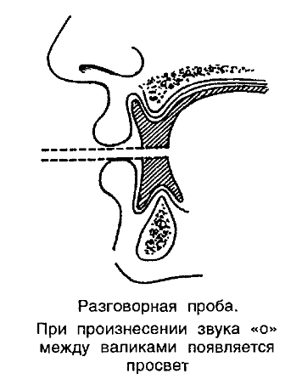
Speech tests
Notes:
An example of a conversation test. When pronouncing the sound “o”, a gap appears between the rollers

Slide 39
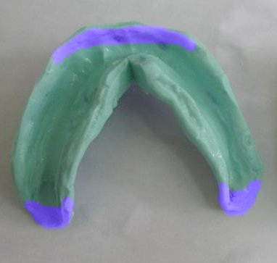
Notes:
Herbst samples
First test - wide mouth opening
The correction zone on the lower jaw is the edge between the fangs and in the area of the buccal-gingival cords and the place behind the tubercle.
If the back of the spoon comes off, it is shortened. If the front part rises, shorten it in the area from canine to canine.

Slide 40
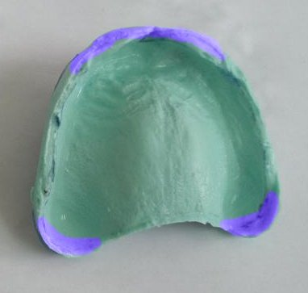
Notes:
Herbst samples
First test - wide mouth opening
Correction zone on the upper jaw - the edge in the anterior section and the place behind the tubercle

Slide 41
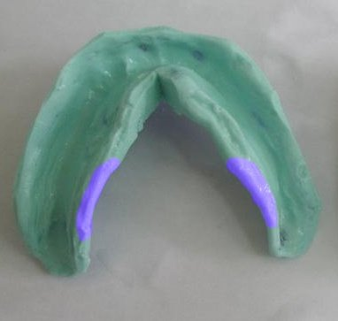
Notes:
Herbst samples
Second test - running the tongue along the red border of the lower lip
Correction zone on the lower jaw - if the spoon rises, then it is shortened in the area of the maxillary hyoidчной

Slide 42
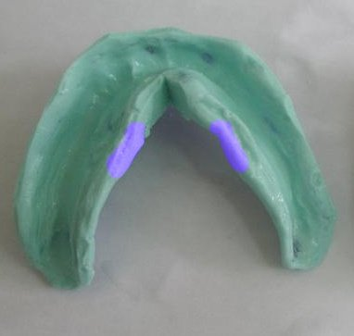
Notes:
Herbst samples
Second test - running the tongue along the red border of the lower lip
Correction zone on the lower jaw - if the spoon rises, then it is shortened in the area of the maxillary hyoid

Slide 43
Notes:
Herbst samples
Fourth test - protrusion of the tongue towards the tip of the nose
Correction zone on the lower jaw - when the spoon is displaced, correction is carried out in the area of the frenulum of the tongue

Slide 44
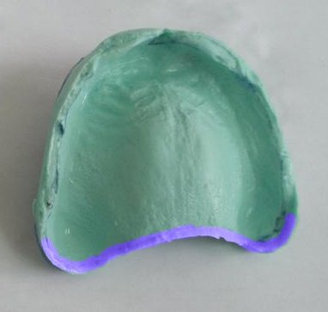
Notes:
Herbst samples
Fifth test - swallowing
Correction zone on the upper jaw - if the spoon moves during swallowing movements, it is shortened accordingly behind the alveolar region.

Slide 45
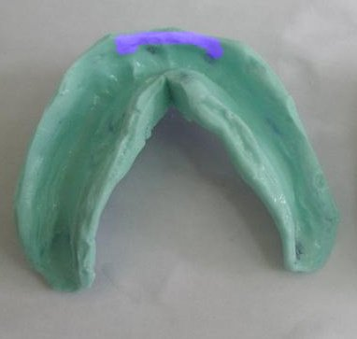
Notes:
Herbst samples
Sixth test - active movements of facial muscles, pulling the lips forward
Correction zone on the lower jaw - if during this movement the spoon moves, it is shortened in the zone corresponding to the front teeth.

Slide 46
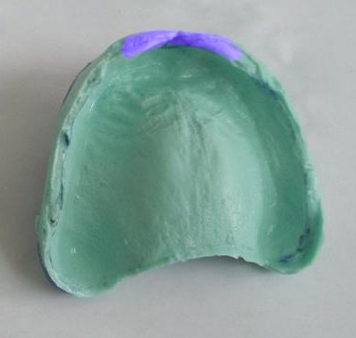
Notes:
Herbst samples
Sixth test - active movements of facial muscles, pulling the lips forward
Correction zone on the upper jaw - edge in the anterior region

Slide 47
Notes:
When using the Herbst method, fixation of the prosthesis can be ensured in 70% of cases.

Slide 48
Notes:
With significant atrophy of the alveolar process and mucous membrane, and the presence of a flat, hard floor of the mouth, suction of the prosthesis on the lower jaw is usually very difficult to achieve.
To design the boundaries of functional impressions, in addition to motor tests, the pronunciation of individual words or entire phrases can be used.
Weinstein B.R. (1964) proposed the phoneme “k” to form the posterior border of the upper complete denture.
Rutkovsky K.V. (1970) developed special texts.

Slide 49
Classification of functional impressions by pressure on the prosthetic bed.
compression
combined
unloading
Chewing pressure
Random chewing
Dosed hardware
Notes:
Classification of functional impressions by pressure on the prosthetic bed.
Functional impressions can be compression, obtained using finger pressure, the patient’s bite pressure and under dosed hardware pressure; decompression (unloading) and combined

Slide 50
Compression impression
Notes:
«Compression impression" (according to E.I. Gavrilov) is taken under continuous pressure, ensuring comparison of the vessels of the mucous membrane of the hard palate. To obtain a compression impression, certain conditions must be met;
First: you need to use a hard spoon.
Secondly: to take an impression, use only thermoplastic mass.
Thirdly: the compression must be continuous, stopping after the mass hardens. Continuity can be ensured by hand pressure (voluntary pressure), but it is more correct to take the compression impression under bite pressure (masticatory pressure).
Solomonov M.A. (1960), Handerson (1931), Kemeny (1955), claim that the compression method promotes atrophic processes in the jaws

Slide 51
Notes:
Kurlyandsky V. Yu. suggests taking an impression of the prosthetic field using quickly hardening plastic under bite pressure.
Mac Millan (1947) believes that the method of taking an impression with the mouth closed is the only way to most accurately design the lingual boundaries, since in this state a tension of the tongue appears that corresponds to chewing.

Slide 52
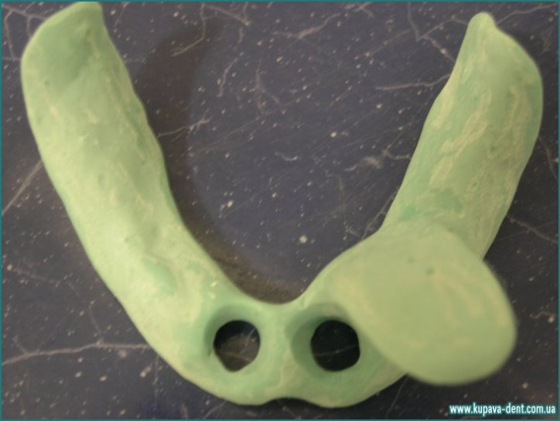
Individual spoon with perforations in unloading areas
Notes:
Individual spoon with perforations in unloading areas
To take a differentiated impression, an individual tray is perforated in the areas of projection of the atrophic or excessively pliable mucous membrane.

