Slide 1
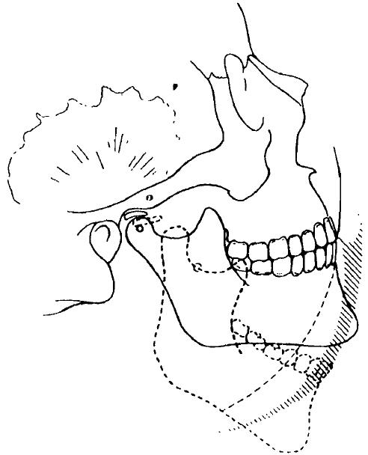
BIOMECHANICS OF THE LOWER JAW

Slide 2
Content
1. Introduction
2. Biomechanics of the TMJ
3. Structure of the TMJ
4. Chewing muscles
5. Bite
6. Occlusion
7. Biomechanics of the lower jaw

Slide 3
Introduction
Biomechanics is the science of human and animal movements. It studies movements from the point of view of the laws of mechanics, inherent in all mechanical movements of material bodies without exception. There are no special laws of mechanics that are specific to animal organisms. Biomechanics, as the science of movements, studies objective patterns revealed during research.

Slide 4
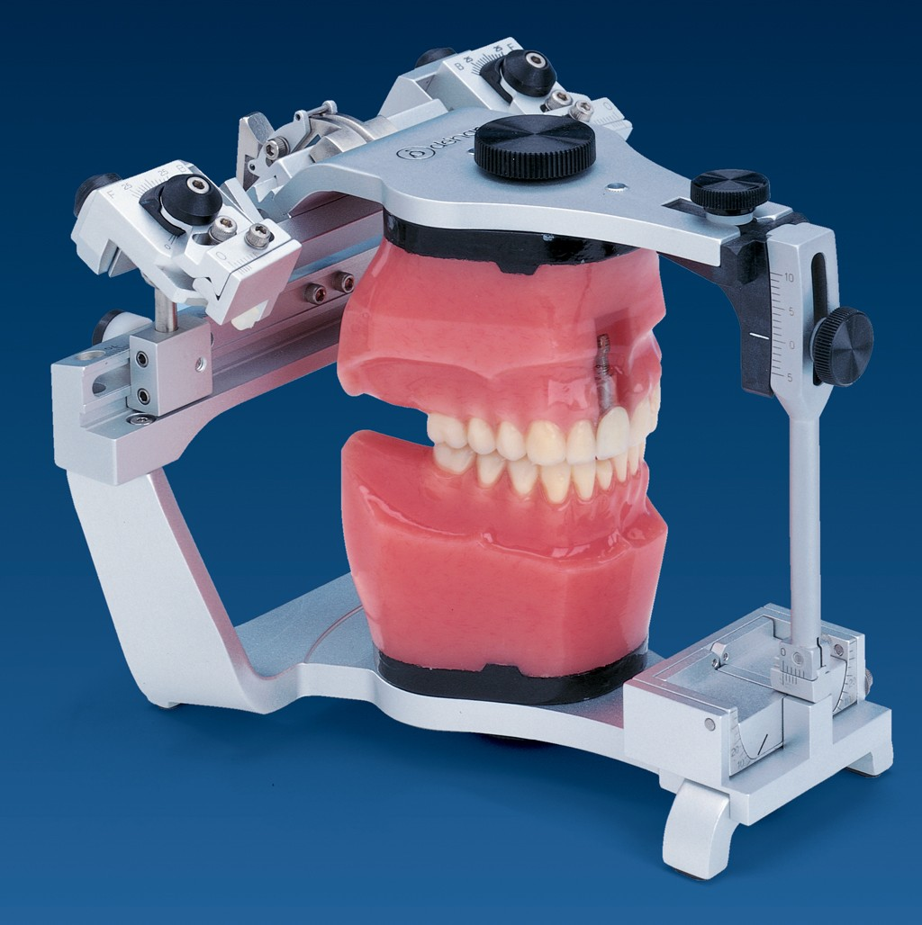
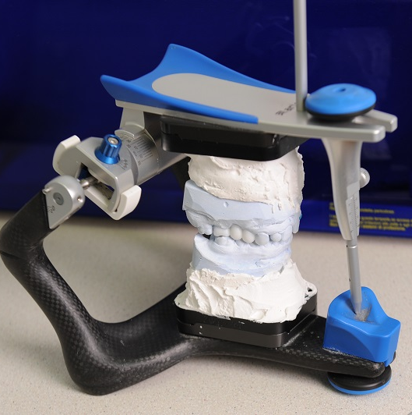
.
Studying the movements of the lower jaw makes it possible to get an idea of their normality. This, in turn, makes it possible to identify disorders and their impact on the activity of muscles, joints, teeth closure and periodontal condition. The laws on the movements of the lower jaw are used in the design of special devices - articulators, which reproduce them.

Slide 5
.
Movements of the lower jaw occur as a result of a complex interaction of the masticatory muscles, TMJ and teeth, coordinated and controlled by the central nervous system. Reflex and voluntary movements of the lower jaw are regulated by the neuromuscular system and are carried out sequentially. Initial movements, such as biting and placing a piece of food in the mouth, are voluntary. Subsequent rhythmic chewing and swallowing occurs unconsciously. The lower jaw moves in three directions: vertical, sagittal and transversal. Any movement of the lower jaw occurs with simultaneous sliding and rotation of its heads.

Slide 6
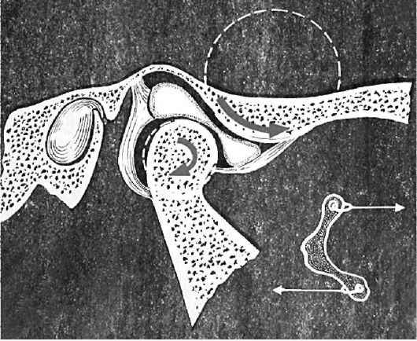
Scheme of forward and downward movements of the heads of the lower jaw

Slide 7
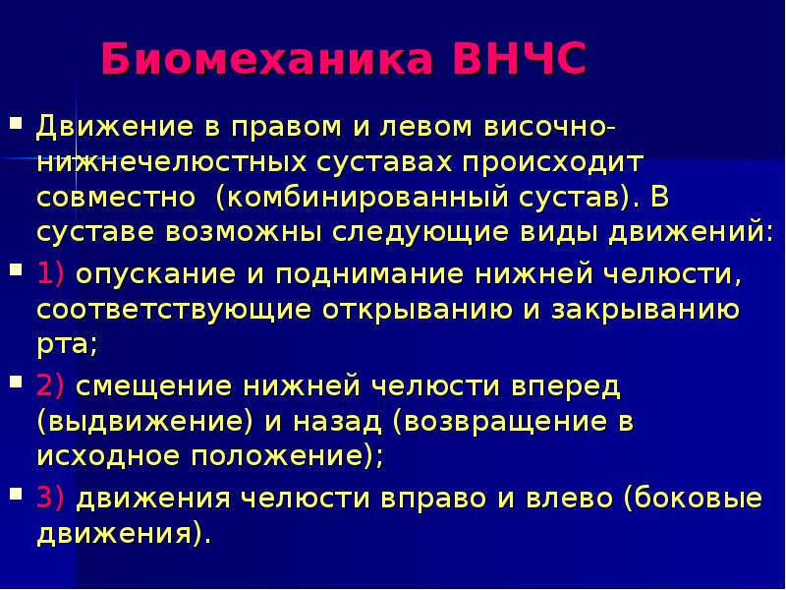
.

Slide 8
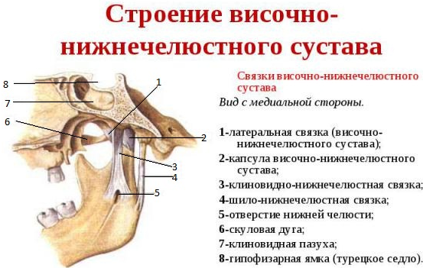
.
.

Slide 9
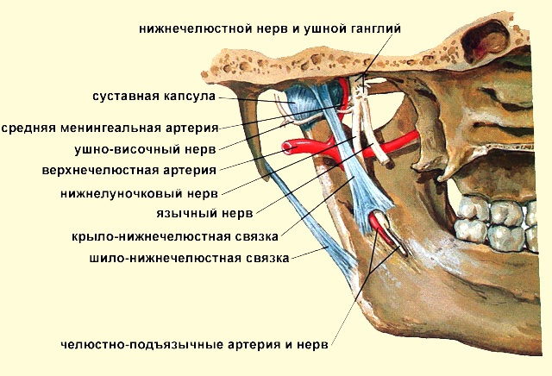
.
.

Slide 10
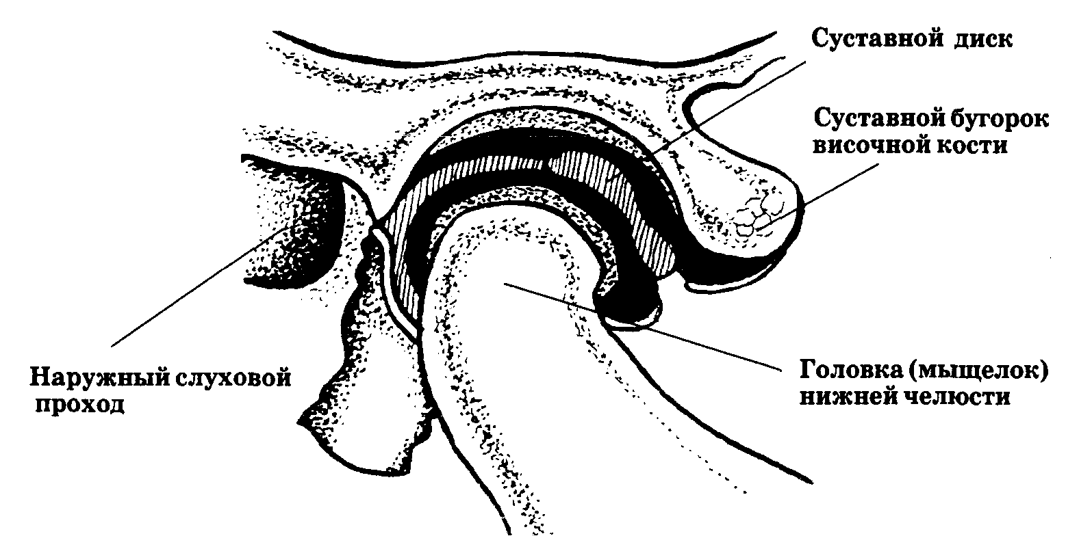
TMJ

Slide 11
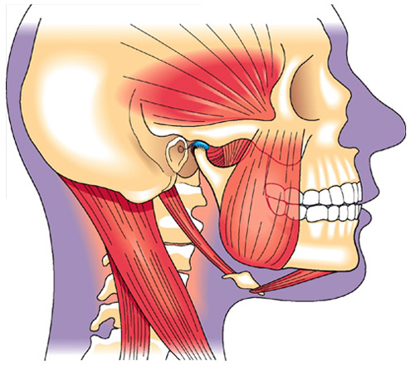
Chewing muscles
- muscles of the head that provide the chewing process. There are 4 muscles of mastication: - Masseter muscle - Temporalis muscle - Medial pterygoid muscle - Lateral pterygoid muscle

Slide 12
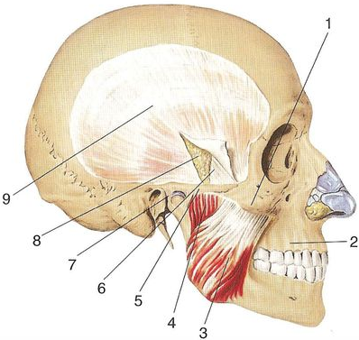
.
A - the temporal muscle is covered by fascia: 1 - zygomatic bone; 2 - upper jaw; 3— superficial part of the masticatory muscle; 4—intermediate part of the masticatory muscle; 5 - zygomatic arch; 6 - superficial plate of the temporal fascia; 7—temporomandibular joint; 8—fiber in the temporal interaponeurotic space; 9 - superficial plate of the temporal fascia
А

Slide 13
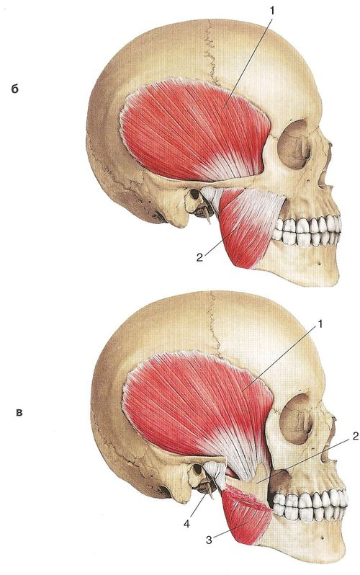
.
Б
B—temporal and masticatory muscles after removal of the temporal fascia: 1—temporal muscle; 2 - chewing muscle;
B - temporal muscle (zygomatic arch and part of the masticatory muscle have been removed): 1 - temporal muscle; 2 - coronoid process of the lower jaw; 3 - chewing muscle; 4 - temporomandibular joint
В

Slide 14
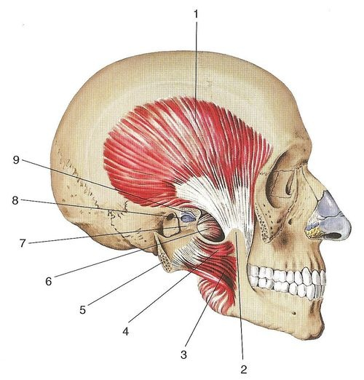
.
Masticatory and temporal muscles (the zygomatic arch is sawed off and pulled back with the masticatory muscle): 1 - temporal muscle; 2 - coronoid process of the lower jaw; 3 - intermediate part of the masticatory muscle; 4 - deep part of the masticatory muscle; 5 — zygomatic arch (sawed off); 6 - lateral pterygoid muscle; 7 - condylar process of the lower jaw; 8 - temporomandibular joint; 9 - articular disc

Slide 15
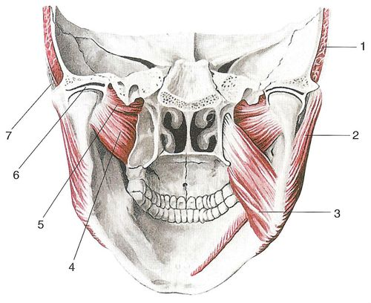
Chewing muscles, rear view:
1 — 1 - temporal muscle; 2 - chewing muscle; 3 - medial pterygoid muscle; 4—lower head of the lateral pterygoid muscle; 5 - upper head of the lateral pterygoid muscle; 6 - articular disc; 7 - zygomatic arch. The anterior bundles of the temporal muscle go down and back, the middle bundles go vertically down, the posterior bundles go from back to front and slightly down.
Function: the anterior and middle muscle bundles lift the lower jaw, the posterior ones pull it back.
Innervation: deep temporal nerves.

Slide 16
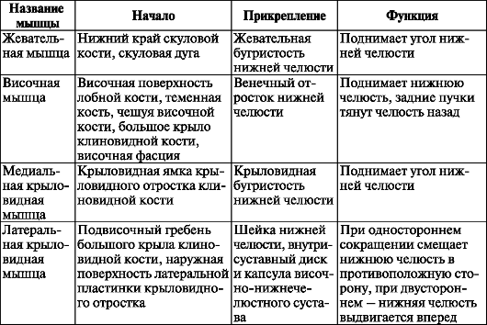

Slide 17
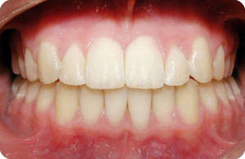
Bite
Occlusion is the relationship of the dentition with maximum contact and complete closure of the teeth of the upper and lower jaws. The type of bite is determined by the nature of the closure of the dentition in the position of central occlusion.

Slide 18
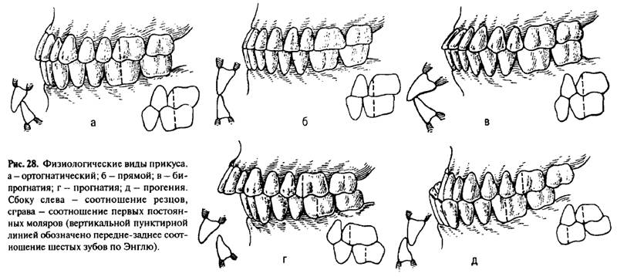
Physiological types of occlusion
A- orthognathic
1. Each tooth comes into contact with two antagonists, of which one is called the main one and the other is called the secondary one. Each upper tooth intersects with the lower and posterior tooth of the same name, and each lower tooth intersects with the upper and in front of the same name.
2. The upper incisors overlap the lower ones by 1/3 of the crown height. The lower incisors, with their cutting edges, contact the palatal surface of the upper ones.
3. When the dentitions close, the lines between the central incisors (central lines) of the upper and lower jaws lie in the same sagittal plane.
4. In the transverse plane, the buccal tubercles of the upper lateral teeth are located outward from the same tubercles of the lower teeth, and the palatal tubercles of the upper teeth are located in the longitudinal grooves of the lower ones.
5. In the sagittal direction, the anterior buccal tubercle 6 | 6 is located in the transverse groove between the buccal tubercles

Slide 19
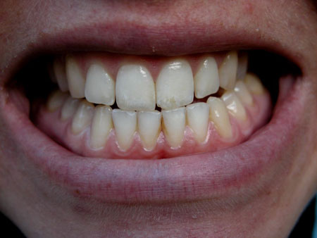
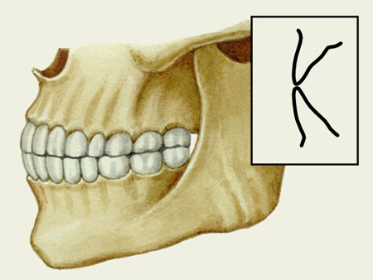
.
B – direct bite
In contrast to the orthognathic bite, with a direct bite, the cutting edges of the upper anterior teeth do not overlap the lower ones of the same name, but are butted with them. The closure of the lateral teeth is no different from their closure in an orthognathic bite, only they have lower cusps.

Slide 20
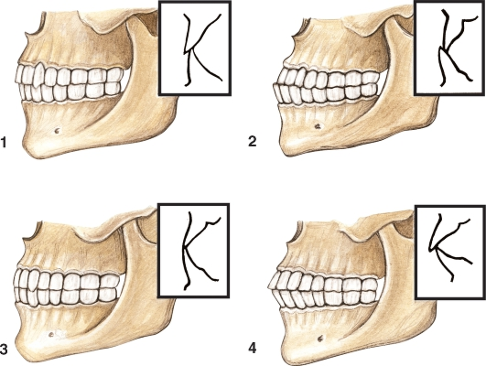
B - Alveolar biprognathia
With alveolar biprognathia, both the upper and lower frontal teeth are tilted towards the vestibule (vestibular). However, in contrast to an abnormal bite - prognathia - with such an inclination, either the cutting tubercle contact is maintained, or the teeth are closed by the cutting edges.

Slide 21
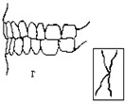
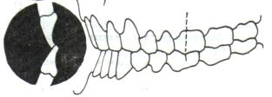
B - Opistognathia
In opisthognathia, both the upper and lower front teeth are tilted toward the oral cavity (orally). However, the contact of the anterior teeth is maintained.

Slide 22
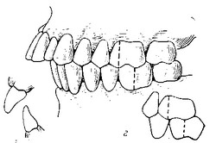
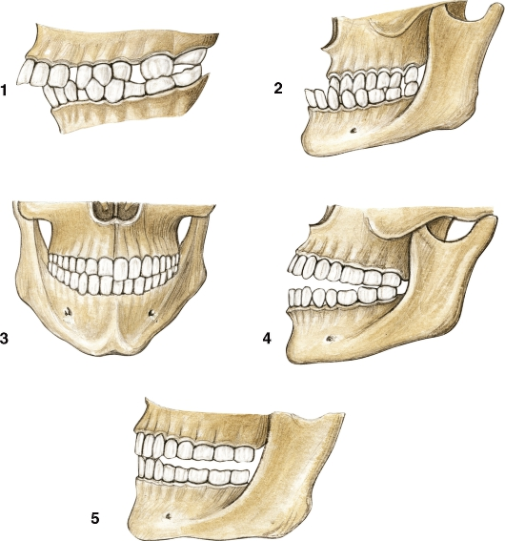
Malocclusions
A - prognathia
(Distal bite) is one of the most common malocclusions, which is characterized by an underdeveloped lower jaw or an overdeveloped upper jaw. In the presence of this malocclusion, during the closure of both jaws, the upper front teeth are significantly pushed forward in relation to the lower ones.

Slide 23
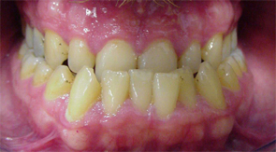
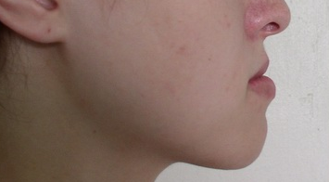
.
B - progeny
Mesial occlusion is a malocclusion in which the upper jaw is underdeveloped and the lower jaw is overdeveloped and, thus, the lower jaw protrudes significantly forward in relation to the upper jaw.

Slide 24
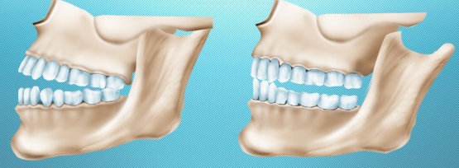
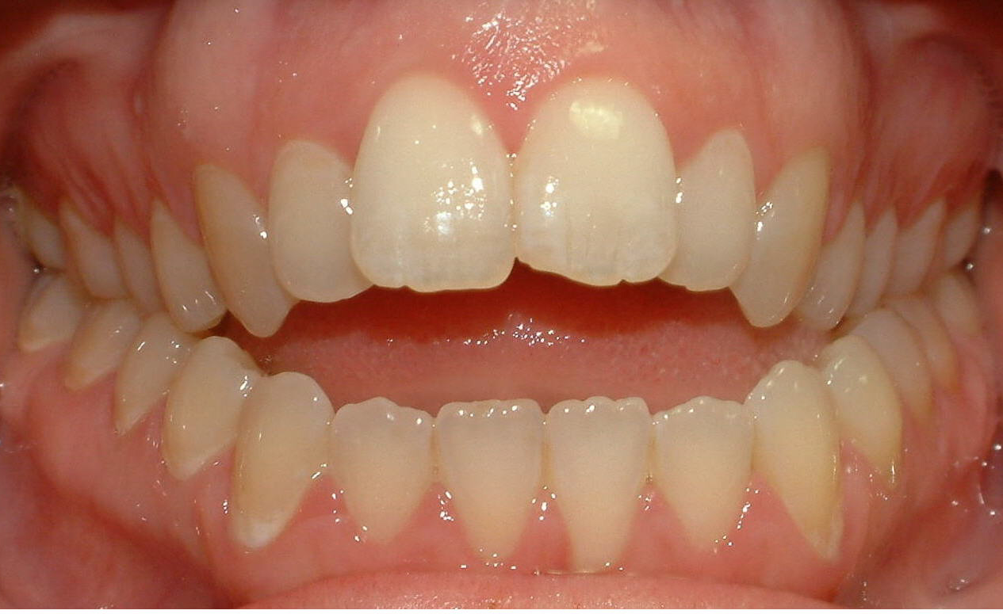
Open bite
- This is a malocclusion pathology in which part of the teeth of both jaws (most often the front teeth, less often the lateral teeth) do not close at all, forming a gap between them.

Slide 25
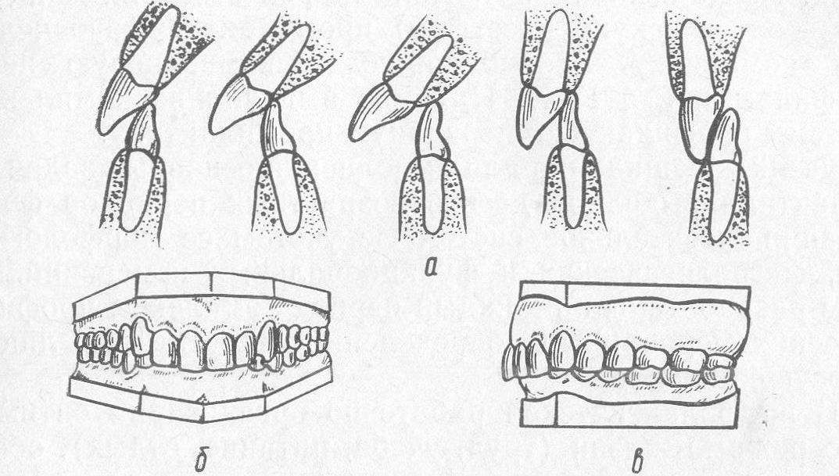
Deep bite
- This is one of the most common malocclusions, in which, during the closure of the jaws, the incisors of the upper dentition overlap the incisors of the lower dentition by more than half their length, and the lower incisors do not rest on the dental cusps of the upper ones.

Slide 26
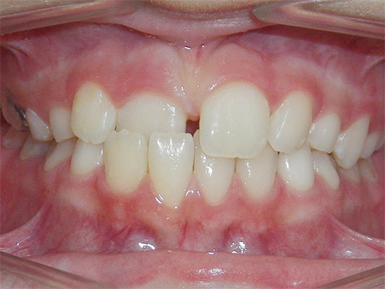
Crossbite
– this is a malocclusion pathology, which is characterized by poor development of one of the sides of any jaw.

Slide 27
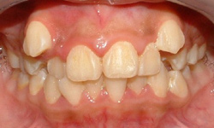
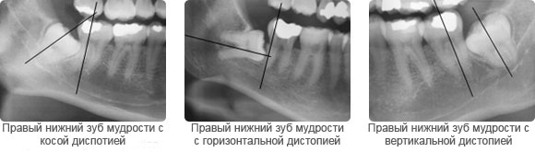
Dystopia
– This is a malocclusion in which the teeth are located out of place in the dentition, shifting from their normal position to the side.

Slide 28
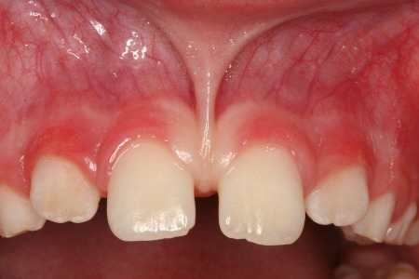
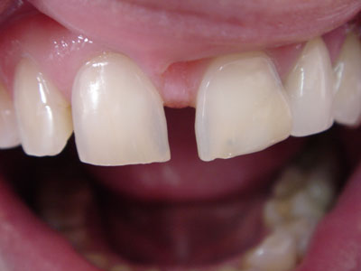
Diastema
– This is a common anomaly in the position of the teeth, which is characterized by the appearance of a gap (gap) between the central incisors with a width of 1 to 6 millimeters (most often observed between the incisors of the upper dentition, but sometimes in the lower dentition).

Slide 29
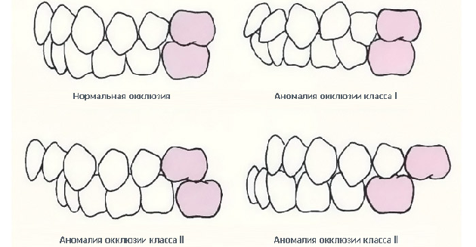
Occlusion
— a particular type of closure of the dentition, meaning the position of the lower jaw in which a certain number of teeth are in contact.

Slide 30
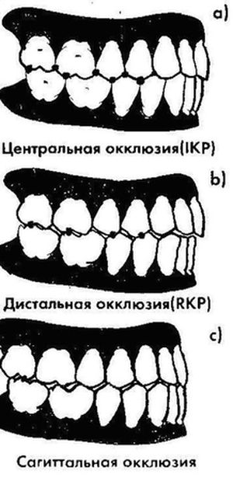
Types of occlusion
.

Slide 31
The nature of the contacts of the posterior teeth during movements of the lower jaw is influenced by several different factors.
They are called "occlusion factors". These include: articular path; Bennett's movement is the lateral movement of the working articular head, on average 1 mm; occlusal plane - the average level of the chewing surfaces in relation to the horizontal; curve of Spee - distal and superior curvature of the occlusal plane; Wilson curve - curvature of the occlusal plane, viewed in the frontal plane; morphology of the chewing surface of the posterior teeth - the height of the cusps, the depth of the pits, the direction of the marginal protrusions and grooves, as well as the angle of inclination of the slopes of the cusps constitute the elements of the morphology of the occlusal surface, which affect the nature of the contact of the posterior teeth during movements of the lower jaw; incisive path - the path taken by the lower incisors when moving the lower jaw forward; distance between articular heads.

Slide 32
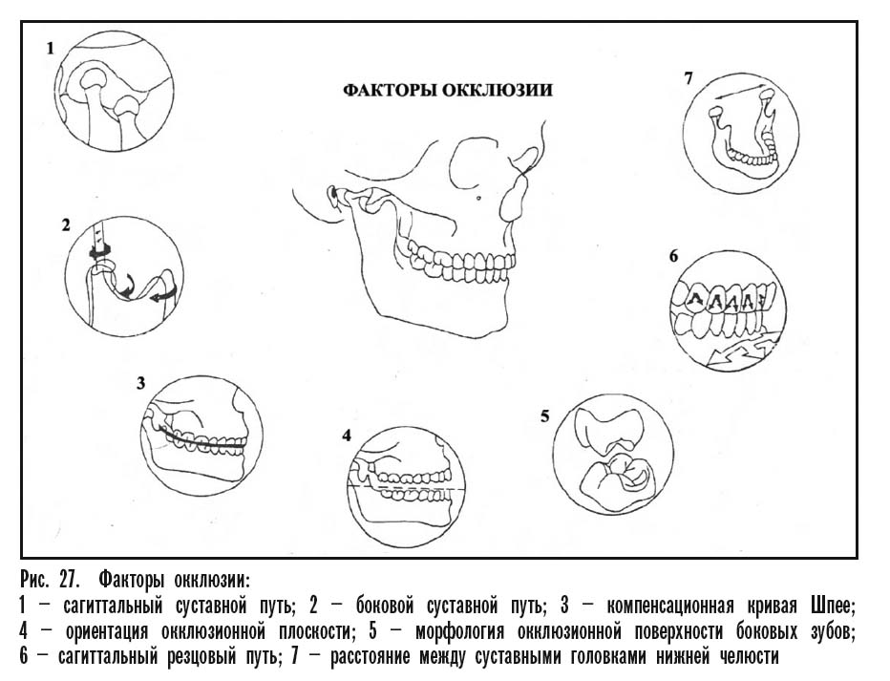
.

Slide 33
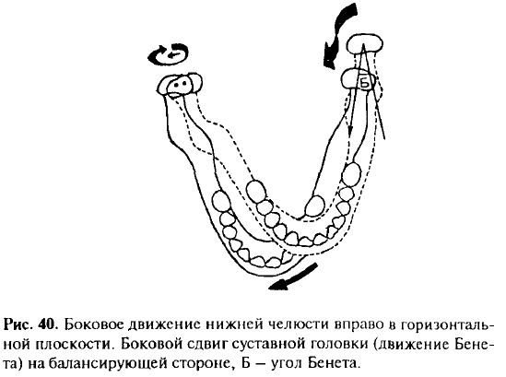
.
.

Slide 34
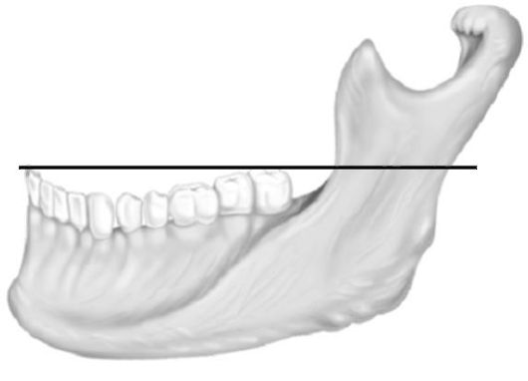
.
The occlusal plane runs from the cutting edge of the central incisor of the mandible to the top of the distal buccal cusp of the second (third) molar or to the middle of the retromolar cusp

Slide 35
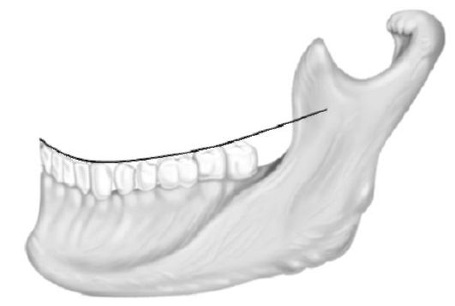
.
Линия, проведенная по режущим краям передних зубов и щечным бугоркам жевательных зубов, образует сегмент окружности, обращенный выпуклостью вниз, и носит название кривая Шпее (сагиттальная компенсаторная кривая)

Slide 36
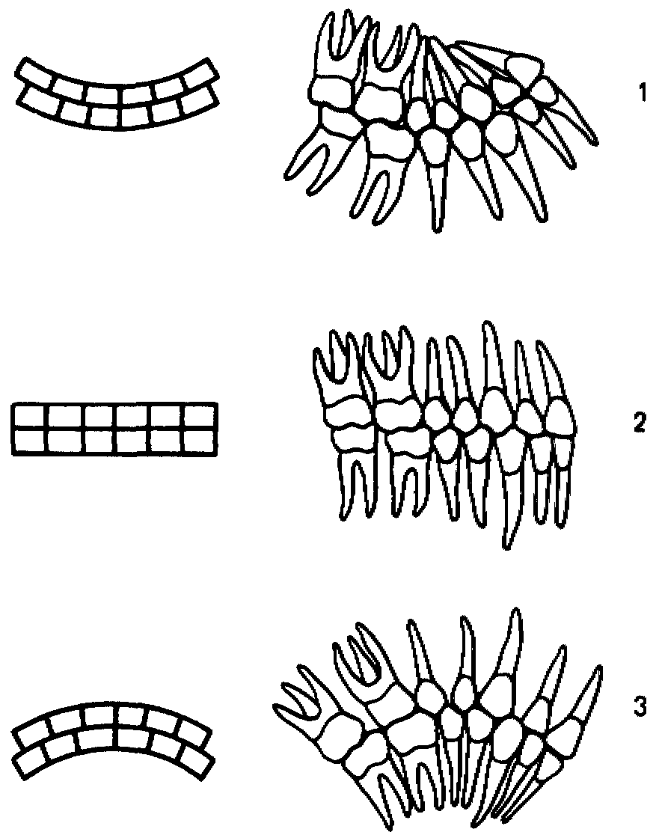
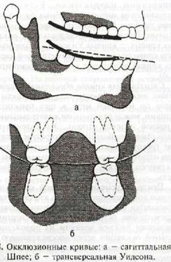
.
.
Кривая Шпее

Slide 37
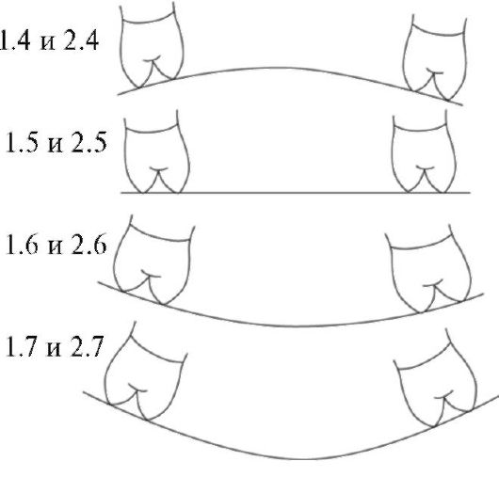
.
In addition to the sagittal occlusal curve, transversal occlusal curves (Wilson-Plizhe curve) are distinguished, which pass through the chewing surfaces of premolars and molars of the right and left sides in the transverse direction. The curve is formed as a result of different levels of location of the buccal and palatal cusps due to the inclination of the teeth towards the cheek in the upper jaw and towards the tongue in the lower jaw (with a different radius of curvature for each symmetrical pair of teeth). The Wilson-Plage curve of the lower dentition has a concavity downwards, starting from the first premolar.

Slide 38
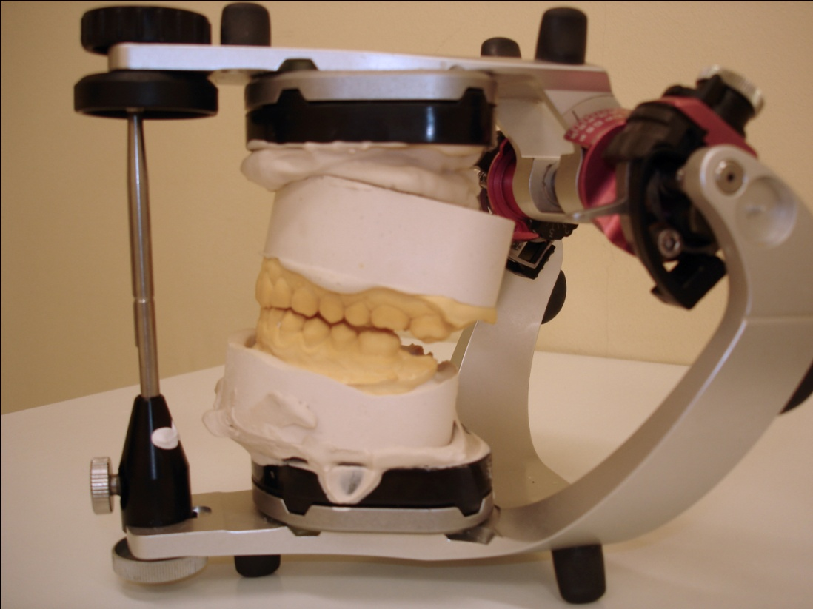
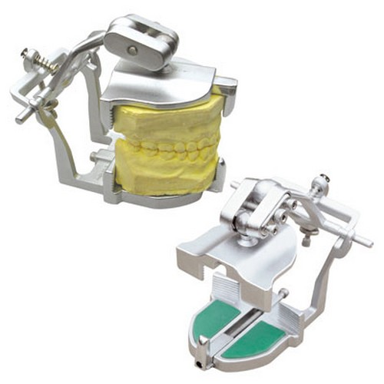
.
To simulate the movement of the jaws, special devices are used - articulators.
They imitate all kinds of movements of the lower jaw.

Slide 39
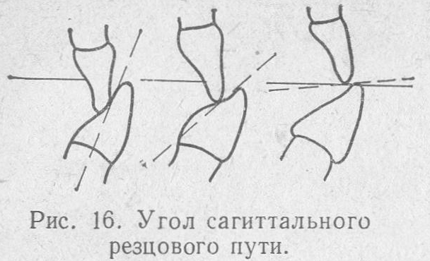
.
incisal path
Sagittal movements of the lower jaw characterize the advancement of the lower jaw forward, i.e. a complex of movements in the sagittal plane within the boundaries of movement of the interincisal point.

Slide 40
.
The forward movement of the lower jaw is carried out by bilateral contraction of the lateral pterygoid muscles, partially the temporal and medial pterygoid muscles. The movement of the head of the mandible can be divided into two phases. In the first, the disc together with the head slides along the surface of the articular tubercle. In the second phase, the sliding of the head is accompanied by its articulated movement around its own transverse axis passing through the heads.
The distance that the head of the mandible travels when it moves forward is called the sagittal articular path. It is on average 7-10 mm. The angle formed by the intersection of the line of the sagittal articular path with the occlusal plane is called the angle of the sagittal articular path. Depending on the severity of the articular tubercle and the tubercles of the lateral teeth, this angle varies, but on average it is 33°.

Slide 41
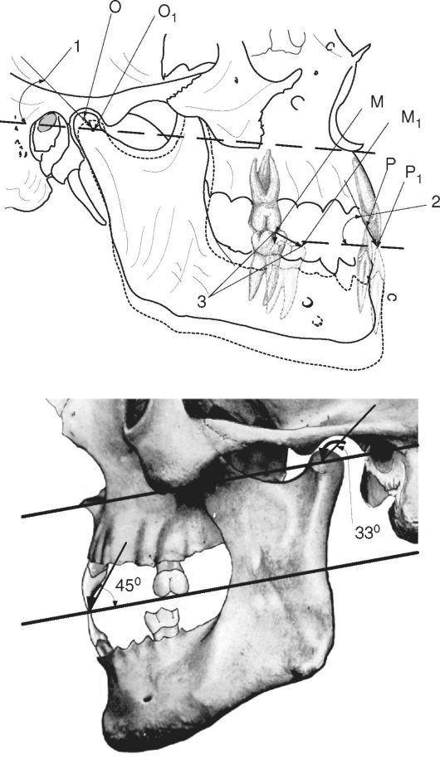
Biomechanics of the lower jaw when moving from central to anterior occlusion:
Biomechanics of the lower jaw when moving from central to anterior occlusion: O-O1 - sagittal articular path, M-M1 - sagittal path of the molar, P-P1 - sagittal incisive path; 1 - angle of the sagittal articular path, 2 - angle of the sagittal incisive path, 3 - separation (disocclusion between molars)

Slide 42
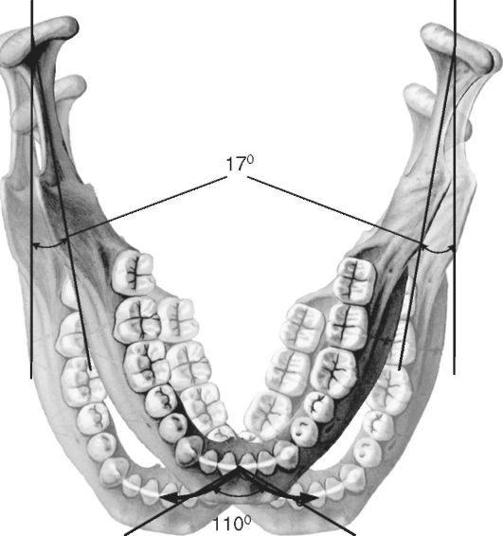
.
Transversal (lateral) movements of the mandible are carried out as a result of predominantly unilateral contraction of the lateral pterygoid muscle. When the lower jaw moves to the right, the left lateral pterygoid muscle contracts and vice versa. In this case, the head of the lower jaw on the working side (displacement side) rotates around a vertical axis. On the opposite balancing side (the side of the contracted muscle), the head of the mandible slides along with the disc along the articular surface of the tubercle downward, forward and somewhat inward, making a lateral articular path. The angle formed between the lines of the sagittal and transverse articular path is called the angle of the transversal articular path. In the literature, it is known as the “Bennett angle” and is equal, on average, to 17°. Transversal movements are characterized by certain changes in the position of the teeth. The curves of the lateral movements of the anterior teeth at the interincisal point intersect at an obtuse angle. This angle is called the Gothic or transversal incisal path angle. It determines the span of the incisors during lateral movements of the lower jaw and is on average 100-110°.

Slide 43
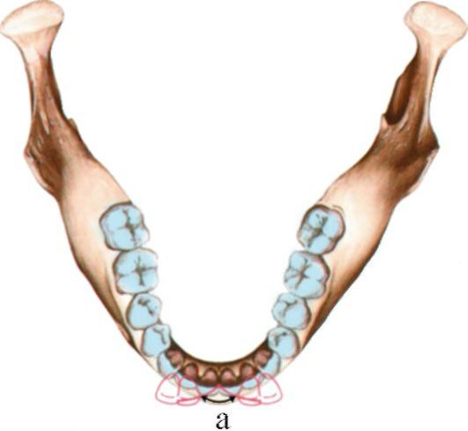
.
The angle of the lateral incisal path (Gothic angle) is the angle between the line of displacement of the incisal point to the right or left - 110° - 120°

