Slide 1
Topic: orthopedic treatment for complete absence of teeth

Slide 2
Dental prosthetics is a field of dentistry whose object is the replacement of dental defects, missing teeth or parts of the jaw with removable or fixed dentures.

Slide 3
Indications for prosthetics with removable dentures:
Complete absence of a tooth (edentia). This defect is the most common indication for prosthetics. The method of prosthetics will depend on the characteristics of the defect. Thus, an included defect (“hole” between the remaining teeth) can be treated with removable and fixed dentures of a variety of designs, as well as using artificial tooth implantation methods.
Multiple dental defects. The older the patient, the more defects he has, which means more indications for prosthetics. All types of prosthetics are used: removable and fixed dentures, implants. The choice of design (bridge, clasp, plate prosthesis, crown, root implant, etc.) will depend on many factors and therefore is determined by the orthopedic dentist together with the patient.

Slide 4
Contraindications:
Temporary contraindications to dental prosthetics:
acute diseases of the whole body or oral cavity;
stages of rehabilitation and recovery;
pregnancy;
drug addiction;
condition after radiation therapy and some others.
Contraindications are also divided into local and general.
Local contraindications include:
Insufficient oral hygiene
Diseases of the bone tissue of the jaw (for example, osteoporosis, osteomyelitis)
Acute inflammatory diseases of the oral cavity and some others
General contraindications include:
Some conditions or diseases that are grounds for refusing surgery.
Any contraindications to local anesthesia.
Some diseases are in the acute stage (severe diseases of the cardiovascular system, respiratory organs, severe diabetes mellitus, oncology, etc.).
Certain types of drug therapy (for example, anticoagulants, cytostatics).
Mental illnesses.
Acute stress.
Severe exhaustion (cachexia).

Slide 5
From all of the above, we can draw a simple conclusion: indications and contraindications for prosthetics are determined by the main medical postulate - “do no harm”, and only then by the need for treatment to prevent the development of other diseases and complications. These problems can be solved only with close cooperation and mutual understanding between the doctor and the patient.

Slide 6
Classification of removable dentures:
Complete removable plate dentures;
Partial removable dentures, which come in several types:
plate prostheses;
clasp dentures;
immediate prostheses;
conditionally removable dentures.
removable sectors or segments of the dentition;
It is also possible to classify according to the place of support of the prosthesis: periodontal, gingival, periodontal-gingival, implant-supported

Slide 7
Complete removable plate dentures
Often they are the only alternative to prosthetics in the complete absence of teeth in both or one of the jaws. In this case, the full denture is attached due to the suction effect of the gums.
Such dentures are made from imported dental acrylic plastics using the following methods:
injection molding method;
hot cold compression polymerization method;
by cold compression polymerization.

Slide 8
Clinic for complete tooth loss:
According to statistical data, the number of people who have completely lost their teeth per 1000 people of the surveyed population is: 40-49 years old - 10 people, 50-59 years old - 55 people, 60 or more years old - 250 people.
After the loss of teeth and the development of atrophic processes in the jaws and soft tissues, new interactions of elements of the dentoalveolar system arise, therefore the clinical picture represents the following state of the oral cavity - senile progeny, atrophy of the alveolar processes, loss of interalveolar height, changes in the appearance of the patient, dysfunction of chewing and speech .

Slide 9
CLASSIFICATION OF THE MUCOUS MEMBRANE OF THE PROSTHETIC BED BY SUPPLE
1 CLASS | Perfect mouth. Well-defined alveolar processes, covered with a slightly pliable mucous membrane, pale pink in color, without pathological processes.
2nd CLASS | Hard mouth. Atrophied, dense, dry mucous membrane, the attachment points of the folds are somewhat closer to the crest of the alveolar process than in class 1.
3 CLASS | Soft mouth. Hypertrophied, loose mucous membrane, low alveolar processes.
4TH GRADE | Loose comb. There are movable strands of the mucous membrane, located longitudinally and easily shifting with slight pressure from the impression mass; the strands can be pinched.

Slide 10
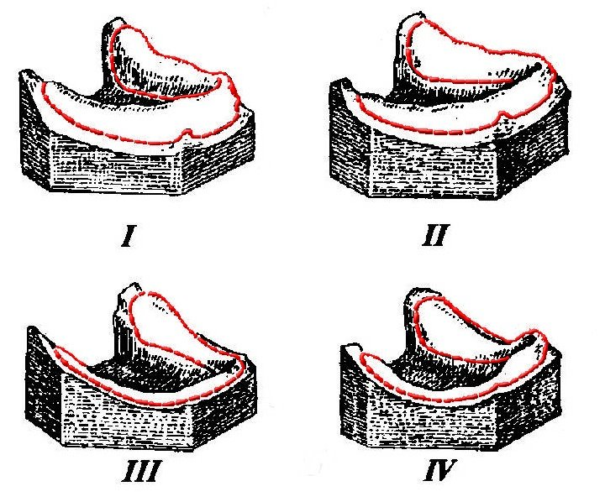
THEM. Oksman identified 4 types of toothless jaws:

Slide 11
V.Yu. Courlandic 5 types:
Type I: the alveolar ridge protrudes above the level of muscle attachments on the vestibular and lingual sides.
Type II: the alveolar ridge and the body of the jaw are atrophied to the level of the muscle attachment points on the vestibular and lingual sides.
Type III: atrophy of the jaw body below the muscle attachments.
Type IV: severe atrophy in the area of the chewing teeth.
Type V: severe atrophy in the area of the front teeth.

Slide 12
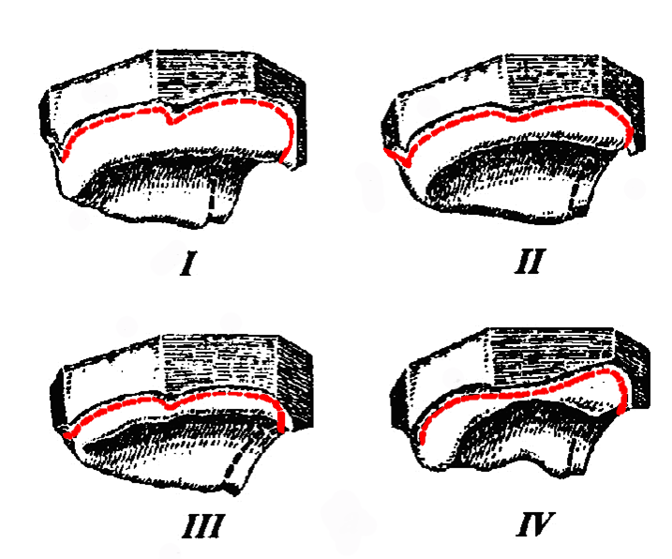
И.М. Оксман в 1967 году предложил свою классификацию для в/ч и н/ч:
The best fixation of the prosthesis can be achieved with the first degree of atrophy.

Slide 13
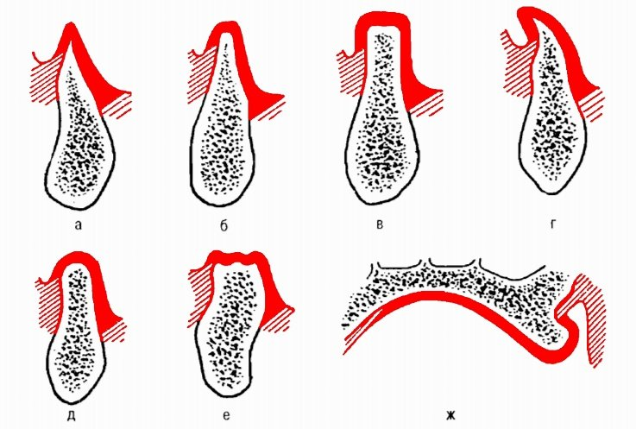
Alveolar ridge shapes
a – triangular-pointed, b – truncated cone, c – rectangular, d – spiky, e – semi-oval, f – flattened,
g - pineal

Slide 14
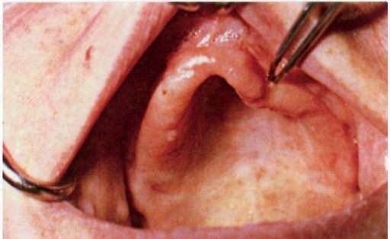
«Dangling Comb" (TERM PROPOSED BY Supple)

Slide 15
Features of examination of patients with complete absence of teeth:
Determination of the degree of jaw atrophy and the shape of the alveolar process in the upper jaw and the alveolar part in the lower jaw: narrow or wide. Atrophy of the alveolar ridge in the upper jaw is more pronounced on the vestibular side, as a result of which the alveolar arch decreases. In the lower jaw, atrophy affects the lingual side more. The characteristic atrophy of the upper and lower jaws contributes to the formation of senile progeny, which is expressed in a sharp discrepancy in the sizes of the alveolar arches of the upper and lower jaws.

Slide 16
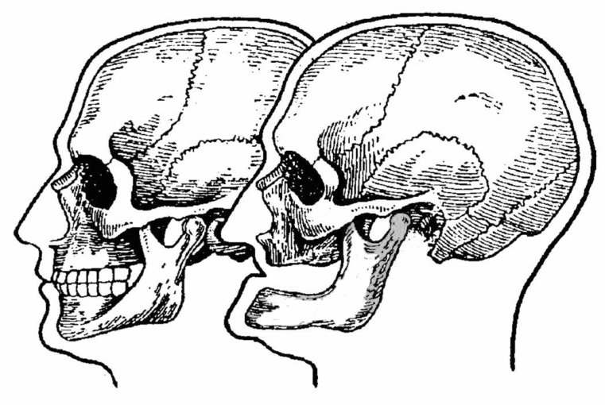
а
б
Profile of the facial skeleton: a—before loss of teeth; b - after tooth loss.

Slide 17
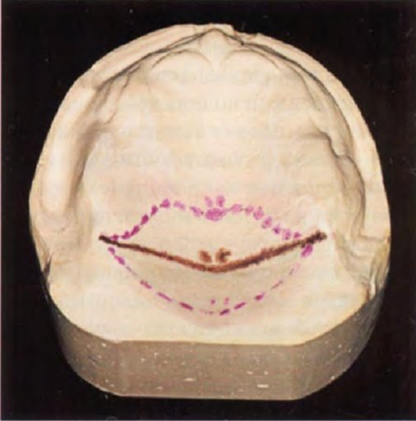
Features of examination of patients with complete absence of teeth:
Study of the shape of the hard palate: high, medium depth, flat. With a sharp atrophy of the alveolar ridges and a massive torus, the hard palate takes on a convex shape. Fixation of the prosthesis significantly worsens with deep and flat palates.
Study of the topography of the soft palate
Line A configuration options

Slide 18
Features of examination of patients with complete absence of teeth:
Determination of mucosal zones according to the degree of compliance, mobility according to the clinical condition:
Compliance values in different zones: alveolar ridge zone 0.6 - 0.9 mm; zone of the incisive papilla 0.7 - 1.0 mm; alveolar ridge zone 0.5 - 0.7 mm; zone of the median seam 0.5 - 0.9 mm; zone of transition of the alveolar ridge to the palatine vault 1.0 - 1.9 mm; line "A" zone 1.6 - 2.5 mm.

Slide 19
Compliance of the mucous membrane of the upper jaw according to Lund:
- 1st zone: sagittal suture area - median fibrous zone. Compliance is minimal. Does not have a submucosal layer. 0.5-1 mm. - 2nd zone: alveolar process - peripheral fibrous zone. The mucous membrane has almost no submucosal layer. 0.5-1 mm. Spring properties due to connective tissue bundles of the mucous membrane. - 3rd zone: the anterior and middle third of the hard palate - a fatty zone that has a medium degree of compliance. 1-2 mm. - 4th zone: the posterior third of the hard palate (paratorussal region) - glandular zone. It has a submucosal layer rich in mucous glands and adipose tissue. Has the greatest degree of flexibility. 3-4 mm.

Slide 20
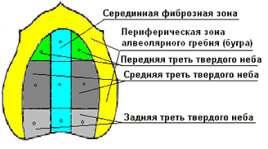
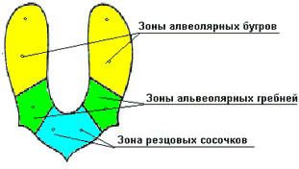

Slide 21
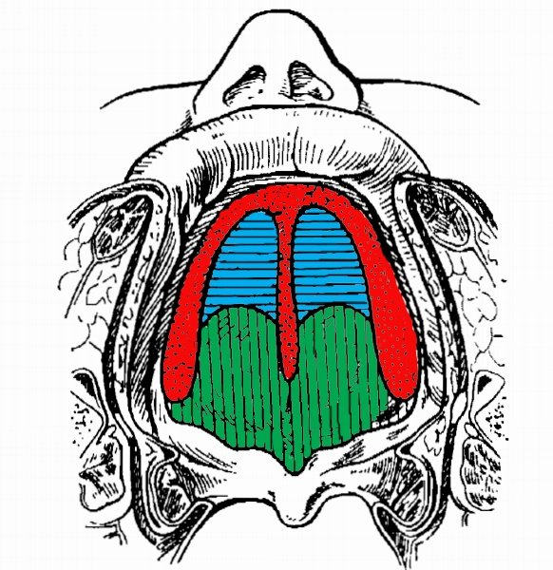
Lund compliance zones
Фиброзная зона
Зона жировой ткани
Железистая зона

Slide 22
Features of examination of patients with complete absence of teeth:
On the lower jaw, the severity of internal oblique lines is noted: sharp, flat, pronounced, unexpressed, painful, painless on palpation
The mucous tubercles are of great importance: dense, immobile, well pliable, mobile, soft
Presence of exostoses

Slide 23
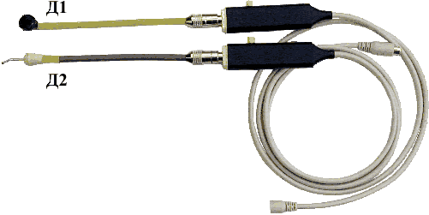
Methodological principles for studying the condition of the oral mucosa:
Sensors DK "Lira-100" - a device for measuring the compliance of the oral mucosa.

Slide 24
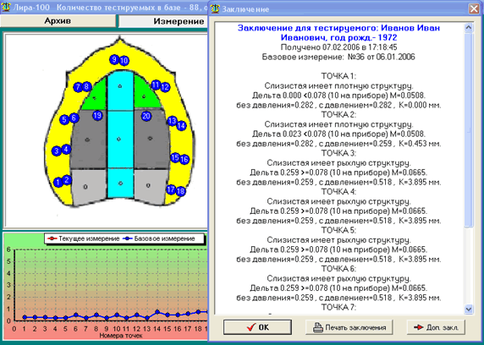
An example of generating a conclusion to determine the compliance and structure of the mucous membrane according to a schedule.

Slide 25
Fixation and stabilization of complete removable laminar dentures:
Mechanical - retention, currently used little. Based on the use of various mechanical devices (springs, staples, ligatures) to strengthen prostheses.
Surgical – auxiliary, aimed at preparing the oral cavity for orthopedic treatment.
Anatomical - the degree of fixation of the prosthesis depends on the anatomical and physiological conditions of the prosthetic bed.
Physical – to hold dentures on toothless jaws, physical phenomena such as:
adhesion - the emergence of a connection between the surface layers of two dissimilar bodies brought into contact;
cohesion is the adhesion of molecules, atoms, ions in a physical body, caused by intermolecular influence and chemical bonding.
Physico-biological - the prosthesis is fixed due to adhesion and functional suction, but for this it is necessary to achieve complete compliance with the surface of the tissues of the prosthetic bed. The strength of adhesion depends on the accuracy of the repetition of the microrelief of the mucous membrane and the area of the prosthetic bed:
valve zone - the edges of the prosthesis in contact with the mucous membrane of the oral cavity ensures the formation of a closing valve along the periphery of the prosthesis and creates conditions for fixing it on the jaw.

Slide 26
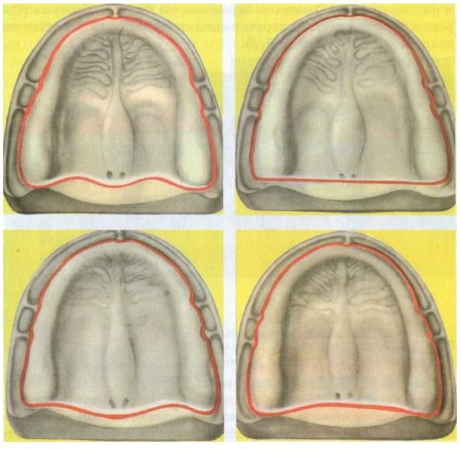
Options for the boundaries of the prosthesis on the upper jaw:

Slide 27
Auxiliary fixation methods:
Using magnets, implants, applying adhesive powder, film, gel to the base
Polyoxyethylene-based adhesives, conditioners (plasticizer and polymer), creams, powders, gaskets

Slide 28
Clinical and technological stages of manufacturing complete removable dentures:
Patient examination. Taking an anatomical impression.
Model casting. Making a custom spoon.
Fitting an individual spoon in the oral cavity. Taking impressions.
Casting models, making a wax base with bite ridges.
Determination of interalveolar height and central relationship of the jaws.
Fixation in articulators. Installation of artificial teeth.
Checking the wax structure in the oral cavity.
Replacing wax construction with plastic
Fitting and delivery of the finished prosthesis.

Slide 29
Determination of the central ratio of the jaws:
Visual inspection. Measuring third face relationships with measuring instruments.
Inspection of models. The wax bases should fit tightly to the model, and their edges should exactly correspond to the boundaries of the future prosthesis; the edges should not be sharp. The midline and the midline of the alveolar process should be drawn onto the base of the model.
Introducing a wax base into the oral cavity and applying it to the HF, while the upper lip should not tense, protrude, or sink. For optimal setting of the height of the upper teeth, the edge of the upper roller should protrude 2 mm from under the lip.
Determination of the prosthetic plane using Schwartz rulers and the Larin apparatus. The prosthetic plane in the frontal region should be ║pupillary line, and in the lateral region - the nasal line
Creation of a prosthetic plane in the lateral sections: 1 ruler - under the upper roller, and the other - at the level of the lower paradise of the nose and ear canal (Kamper horizontal)

Slide 30
Determination of the central ratio of the jaws:
Smoothing of the prosthetic plane using the Naisha apparatus.
Fitting the lower roller to the upper one - the lower roller must be adjusted in such a way that when the jaws are closed, the distance between the marked points (using the Larin apparatus) is 2-3 mm less than with physiological rest; the lower occlusal roller must be identical around the perimeter top.
Fixation of the central relationship of the jaws using brackets, separation discs, a heated spatula, or liquid plaster.
Drawing guide lines for setting the upper teeth: midline, canine line, smile line.

Slide 31
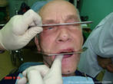
Determination of the central relationship of the jaws

