Slide 1
Clinical and laboratory stages of manufacturing removable dentures.
Features of the manufacture of partial removable dentures from complete removable ones.

Slide 2
Clinical stage
Classification of complete absence of teeth according to Schroeder.
Non-atrophied alveolar process, high position of the transitional fold on the vestibular side, deep arch of the palate.
Uniform average atrophy.
Complete uniform atrophy, flat arch of the palate, transitional fold on the vestibular side at the level of the alveolar crest.
Classification of alveolar processes in the complete absence of teeth according to Keller.
Well preserved alveolar process.
Complete uniform atrophy.
Well preserved in the frontal area with complete atrophy in the lateral areas.
Well-preserved alveolar process in the lateral areas with complete atrophy in the frontal area

Slide 3
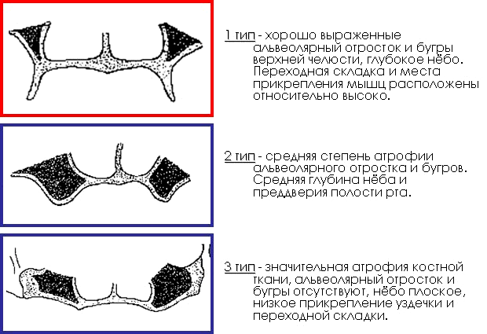
Schröder classification

Slide 4
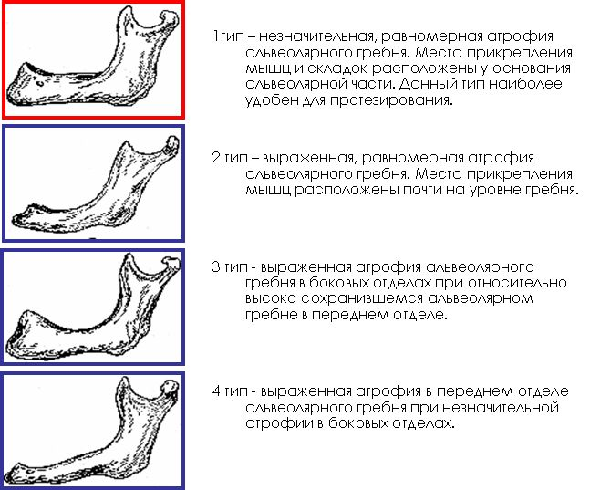
Keller classification

Slide 5
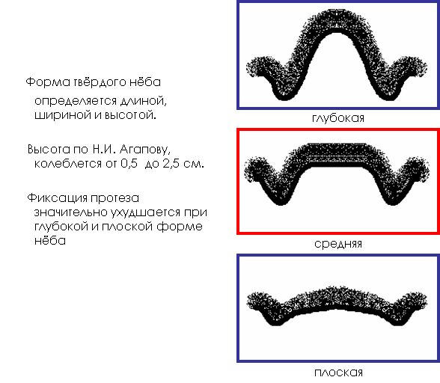
Clinical stage

Slide 6
Clinical stage
Classification of alveolar processes in the complete absence of teeth according to Oksman.
Well preserved alveolar process.
Uniform average atrophy.
Complete uniform atrophy.
Uneven atrophy.
Degrees of mucosal compliance according to Supple.
The mucous membrane is normal in pliability and color.
Atrophic, stubborn, dry mucous membrane, bluish in color.
Hypertrophic, well pliable and mobile, loose mucous membrane, pink.
The mucous membrane with mucous movable folds along the crest of the alveolar process, which, when using a prosthesis, are often pinched between the prosthesis and the bone.

Slide 7
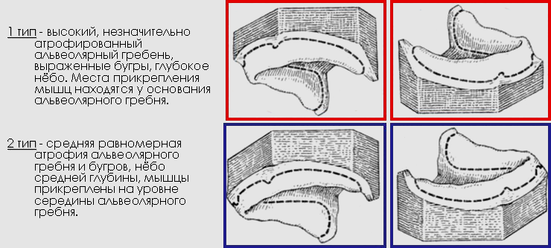
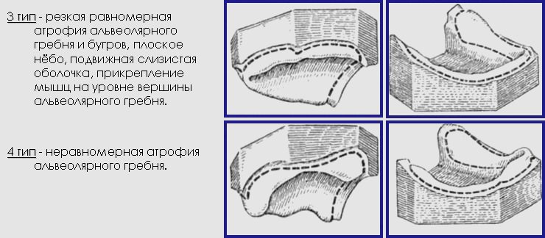
Oksman classification (1978)

Slide 8
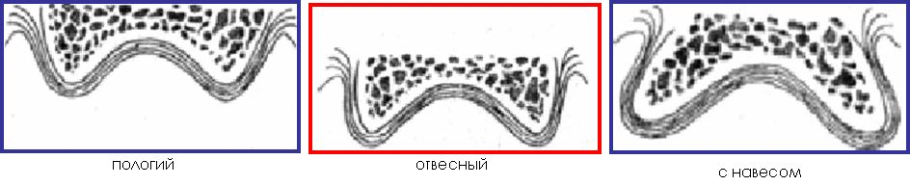
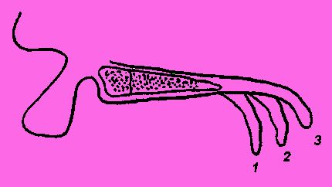
Clinical stage
Slope of the soft palate: 1 – steep; 2 – average; 3 – flat.

Slide 9
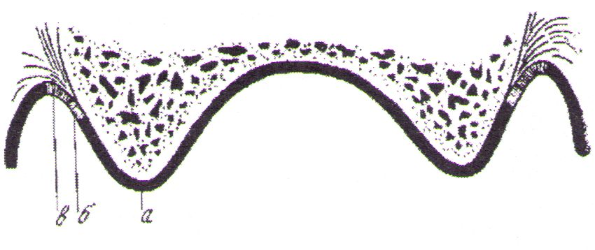
Clinical stage
a) immobile mucosa - fused directly with the periosteum;
b) passively mobile mucosa (neutral zone) - spreads in a strip along the vestibular surface of the upper and lower jaws, along the lingual surface of the lower jaw and along the “A” line;
c) the mucous membrane, located on the muscles and making excursions during their contraction, is called active-mobile (mucosa of the soft palate, cheeks, lips, floor of the mouth, pharynx, pharynx.

Slide 10
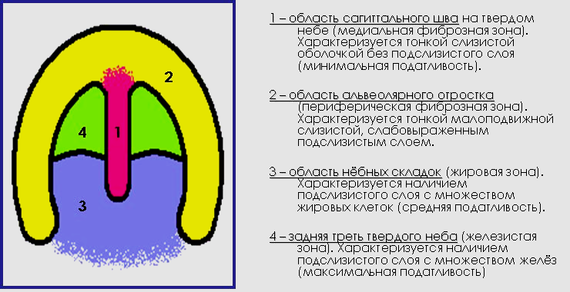
Zones of compliance of the mucous membrane of the upper jaw according to Lund (1924)

Slide 11
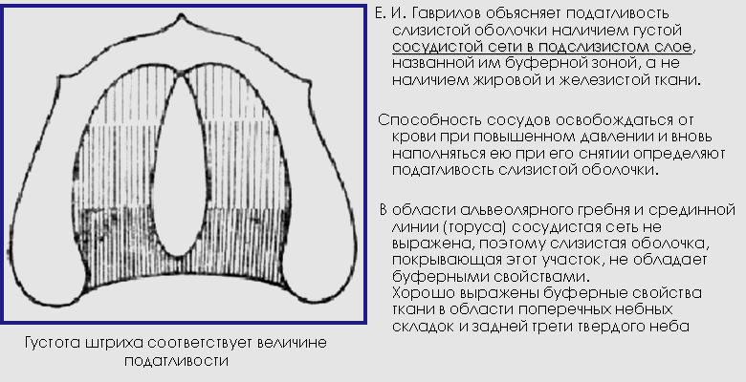
Buffer zones of the mucous membrane according to Gavrilov (1962)

Slide 12
Features of prints
Unloading impressions are recommended for thin, atrophic and excessively pliable mucous membranes.
Compression impressions are indicated for loose, highly pliable mucous membranes.
However, a better effect can only be achieved by using differentiated impressions obtained with different degrees of compression of the mucous membrane, taking into account compliance in different areas of the prosthetic bed.
Improving the conditions of the prosthetic bed can be achieved by performing corrective and restorative operations, such as alveolotomy - partial resection of sharp protrusions on the jaws with the elimination of exostoses before prosthetics.
To improve the conditions of the prosthetic bed in case of significant atrophy of the alveolar part of the lower jaw, it is possible to restore it plastically using implants made from cadaveric cartilage, homocartilage, crushed bone gravel taken from adjacent areas of the jaws, and demineralized dentin made from the roots of extracted teeth.
In case of severe atrophy of the lower jaw by more than 2 cm, it is recommended to use bone grafting with the replanting of a graft from the iliac crest on a vascular pedicle.

Slide 13
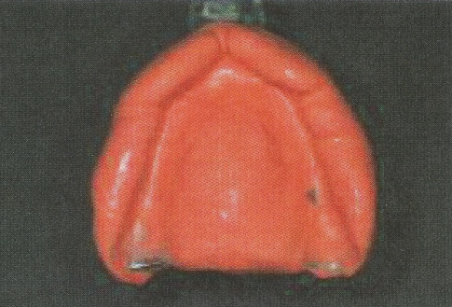

Clinical stage
Оттиски
1. Preliminary alginate or silicone impression for the production of bite ridges and individual trays.
2. The edging of the functional working print is made of thermoplastic or silicone materials.
3. Functional impression with corrective impression material.

Slide 14
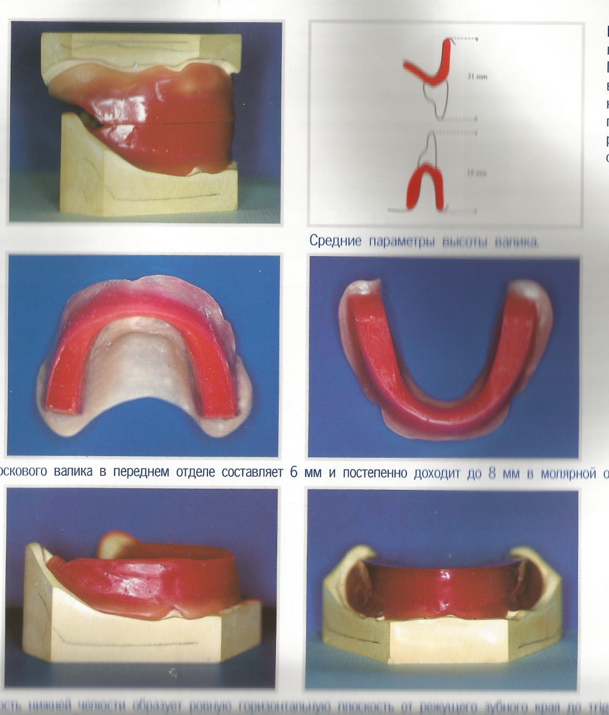
Laboratory stage
In the frontal section, the vestibular part of the ridge should protrude in relation to the vestibule in accordance with bone tissue atrophy.
The thickness of the roller in the frontal section is 6 mm and gradually expands towards the sides to 8 mm.
The chewing surface of the lower from the cutting edge of the future teeth to the retromolar triangle, parallel to the base of the model.

Slide 15
Laboratory stage
Requirements for bite templates (wax rollers):
The production of the edges of the bite templates is carried out taking into account the functional edges shown on the model - cords and frenulums, and the places of muscle attachment remain free.
The wax ridges should be positioned at the midline of the alveolar ridge. When there is atrophy of the alveolar process in the upper jaw in the frontal region, for aesthetic reasons, in the area of the anterior teeth, the roller is moved slightly forward.
The thickness of the roller in the frontal section is 6 mm and gradually expands towards the sides to 8 mm.
The height of the upper ridge should be about 20-22 mm from the deepest place of the transitional fold next to the frenulum of the upper lip to the upper border of the base of the ridge.
The height of the lower bite ridge should be 18-20 mm from the lower point of the transitional fold next to the strand of mucosa to the upper edge of the bite ridge.
The total height of the bite templates does not exceed 40 mm.

Slide 16
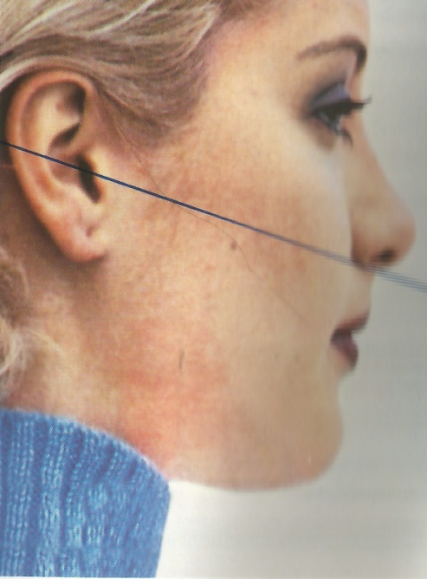
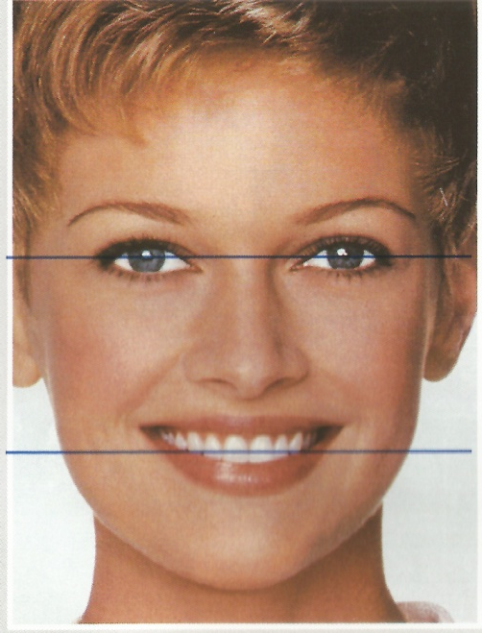
Clinical stage
The edges of the incisors should be parallel to the pupillary line, the occlusal plane and the Camper horizontal (connects the anterior nasal spine of the upper jaw and the lower edge of the tragus of the ear.

Slide 17
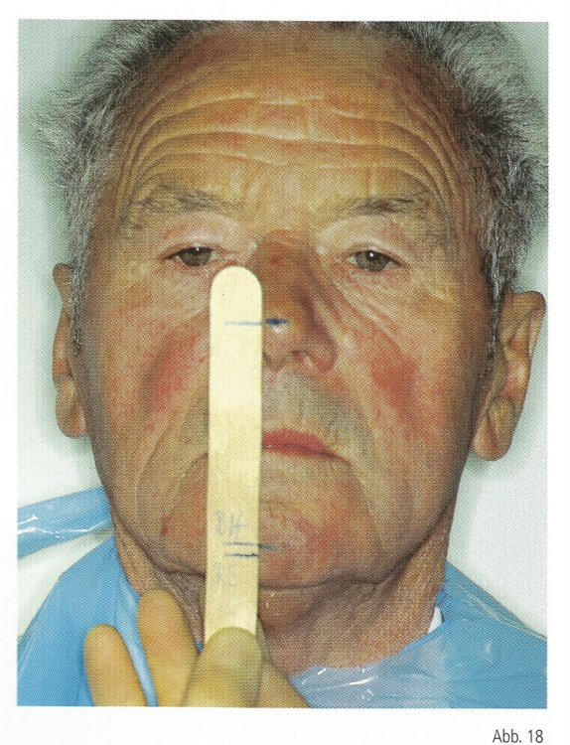
Clinical stage
Determination of bite height
1. Anatomical is based on examination of the facial configuration. 2. Anthropometric is based on data on the proportions of individual parts of the face (Wadsworth-White (the distance between the corner of the eye and the corner of the mouth is equal to the distance between the tip of the nose and the chin in the position of central occlusion), Jupitz using Heringer’s compass using the method of Zeising’s golden section, etc.) . 3. Anatomical and physiological is based on determining the state of relative physiological rest of the lower jaw, i.e. such a position of the lower jaw in which the masticatory muscles are in a state of minimal tension (tone), the lips touch each other freely, without tension, the corners of the mouth are slightly raised, the nasolabial and chin folds are clearly expressed, the dentition is open (the interocclusal gap is on average 2-4 mm), the articular heads are located at the base of the slope of the articular tubercle.

Slide 18
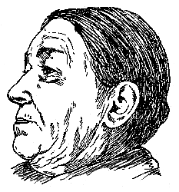
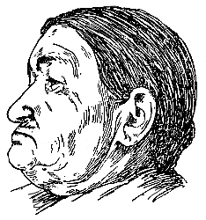
Clinical stage
Anatomical method
While wax templates with rollers are in the mouth with the jaws closed, the facial configuration should be normal, the lips should be calmly folded, the corners of the mouth raised and the nasolabial folds aligned
With higher rollers, the face becomes elongated and tense. At high altitudes, there is a restriction in lateral and anterior jaw movement. When reading and talking, artificial teeth collide with each other, making an unpleasant sound, and in addition, general fatigue of the masticatory muscles is observed. With low bite ridges, the face appears wrinkled, the corners of the mouth are drooping; the chin approaches the nose

Slide 19
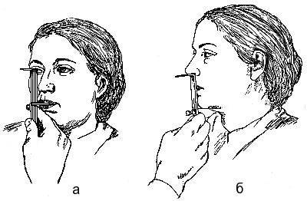
Clinical stage
Anthropometric method
The height of the lower third of the face is determined by two measurements: the first - from the middle of the pupils to the cut of the lips with the jaws closed; the distance found should be equal to the second measurement from the subnasal point to the bottom of the chin.

Slide 20
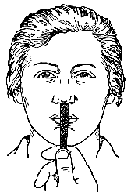
Clinical stage
Functional method
After introducing the bite templates into the oral cavity, the patient is asked to say a few words: “gramophone”, “telephone”, etc. In this case, the distance between the bite ridges should be at least 2-5 mm. This will correspond to the physiological position of the dentition during a conversation.
The second functional test checks the physiological state of the lower jaw at rest, when the dentition is out of occlusion. For this purpose, the patient is asked to close his mouth and, if the height of the lower third of the face with central occlusion is correct, the lips should close slightly earlier than the wax ridges.
In practice, to determine the height of the lower third of the face during central closure, proceed as follows: the patient is asked to close his lips without bite patterns in his mouth, and care must be taken that his face has a completely calm, normal expression. The height of the lower third of the face is measured from the lower end of the chin to the subnasal point and marked on a strip of wax. The distance from the same points, but with bite ridges in the mouth should be slightly less (1-2 mm) than the previously obtained height without wax ridges

Slide 21
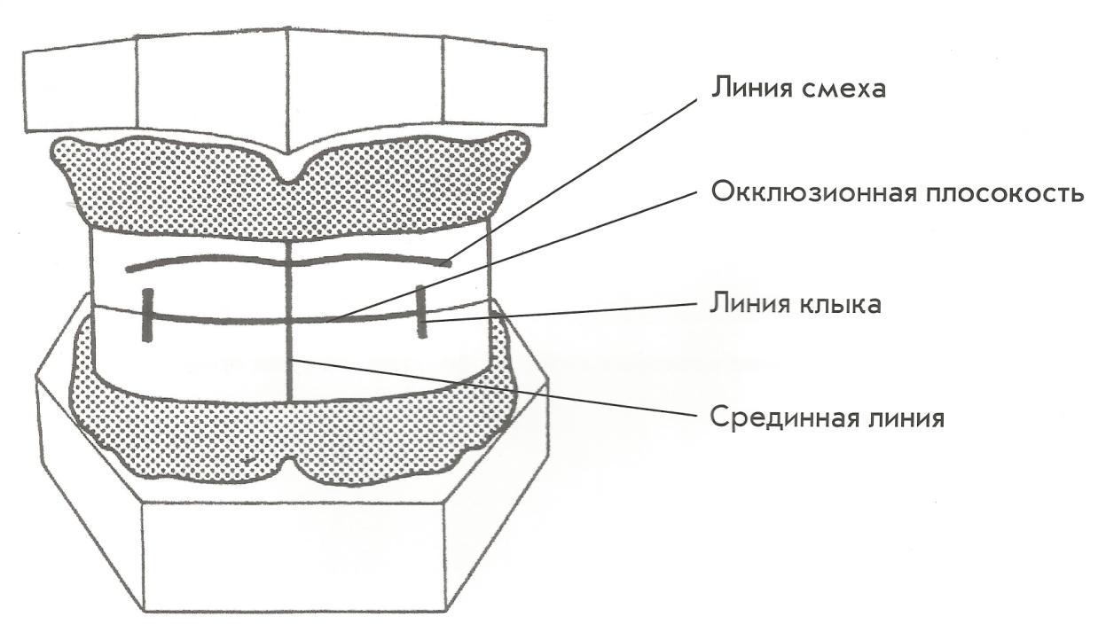
Clinical stage
Midline – coincides with the midline of the face and should coincide with the line of the frenulum of the upper and lower lips, as well as with the middle of the model*.
Canine line - determines the width of the upper frontal teeth and marks the top of the upper canine, is a vertical continuation of the line limiting the wings of the nose.
Smile (laughter) line – determines the size of the upper front teeth, the necks of which are, as it were, “cut off”, i.e. the necks should be above the line..

Slide 22
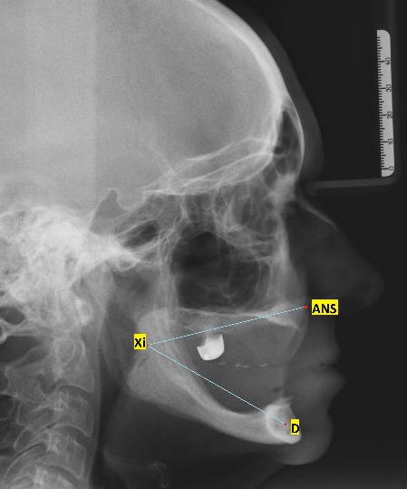
Clinical stage
Angle - ANS, Xi, D. Usually used in completely edentulous lower jaw to determine the height of the lower part of the face. It is 49.8 +/- 4 degrees.

Slide 23
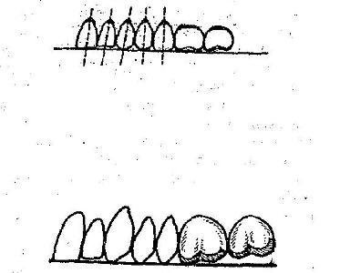
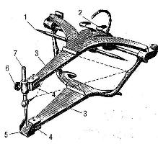
Laboratory stage
Постановка зубов
The anatomical principle of setting teeth on glass (M.E. Vasiliev): 1. Strengthen the glass on the upper jaw, then apply softened wax to the lower jaw and close the articulator until the pin of the interalveolar height contacts the incisal platform.
2. The central incisors touch the glass, the lateral ones are 0.5 higher, the canines touch with their cusps, the first premolar touches with the vestibular cusp, the palatal cusp does not reach 1 mm to the glass, the 2nd premolar touches with both cusps, the 1st molar touches with the medial palatal cusp touches the glass, the medial buccal does not reach by 0.5 mm, the distal buccal – 1.5 mm, the distal palatine – 1 mm. The 2nd molar does not touch the glass; its medial buccal cusp is at the level of the distal buccal cusp of the first molar, and the remaining cusps are 2-2.5 mm above the glass.
3. Having placed the teeth on the upper jaw, remove the glass from the lower wax roller and set the teeth on the lower base along the upper teeth.

