Slide 1
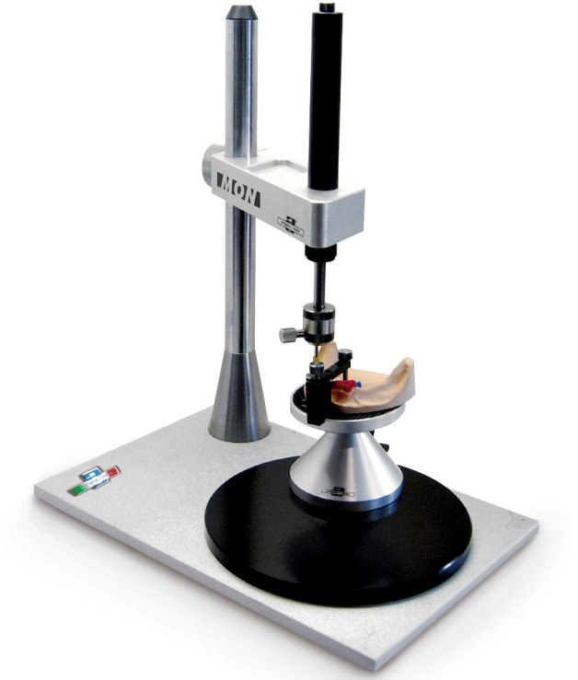
Parallelometry
in orthopedic dentistry

Slide 2
Definition
PARALLELOMETRY The path of insertion and removal of the prosthesis, as well as the boundary line common to all supporting teeth, in relation to which the elements of the support-retaining clasp will be located, are determined using a parallelometer. A parallelometer is an instrument for determining the greatest convexity of teeth on jaw models, identifying the relative parallelism of the surfaces of two or more teeth or other parts of the jaw, such as the alveolar ridge.

Slide 3
PURPOSE
The plane of the base of the device and the horizontal part of the movable part of the stand are parallel to each other, therefore any diagnostic rod fixed plumbly on it is perpendicular to the base of the parallelometer. The table for securing the model has a movable stand with a fixing device, which allows you to give the model any position relative to the diagnostic metal rod and other tools. Consequently, a parallelometer is a device for determining points parallel to each other and located in the same plane on an infinite number of horizontal surfaces of teeth, alveolar processes of the jaws at a certain specified position of the model in relation to the diagnostic rod ( vertical). Five positions of the model in relation to the vertical diagnostic rod are practically significant (Fig. 126):

Slide 4
Rice. 126. Position of models in the parallelometer relative to the diagnostic rod.
1) horizontal - zero inclination: the axis of the diagnostic rod is perpendicular to the occlusal plane of the chewing teeth; 2) posterior, when the posterior part of the dentition is lowered; 3) anterior, when the anterior part of the dentition is lowered; 4) left, when the model is tilted to the left; 5) right, when the model is tilted to the right.

Slide 5
tasks
The effect of tooth inclination on the position of the equator on the crown and the change in the line of sight on each tooth when the diagnostic model is tilted is illustrated by a diagram with an ovoid body (Fig. 127). By changing the position of the model relative to the diagnostic rod, it is possible to change the position of the equator, the area of the occlusal and gingival surfaces selected for the support of the teeth in order to ensure the required depth of retention, a reasonable, from the point of view of fixation and aesthetics, location of the clasp arms in accordance with their chosen design (the latter is dictated by analysis of the clinical condition of the crowns of the supporting teeth, periodontium and its x-ray assessment, type of occlusion). Having replaced the diagnostic metal rod with a stylus, the surfaces of the teeth are outlined in the position of the model found and installed on the table. As a result, a line of sight is obtained - a graphic image of points lying in different planes on all surfaces of the teeth for a given (defined) axis of insertion of the prosthesis, which is called parallelography. This line of sight is the zone of greatest convexity of each tooth in a single axis of insertion of the prosthesis. The diagram with the ovoid body shows that this line of greatest convexity may not coincide (which most often happens) with the anatomical formation on the crown of the tooth - the anatomical equator. Depending on the inclination of the model, the line of sight will be located differently on the supporting teeth, both from the side of the defect and from the vestibular and oral sides.

Slide 6
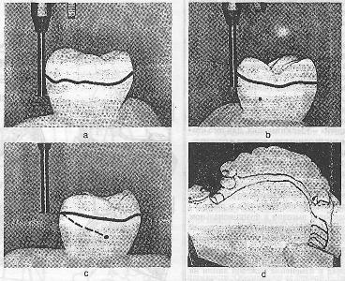

Slide 7
There are 5 options for passing the line of sight on the tooth surface. The first option is that from the side of the defect the line of sight approaches the gingival part, and from the side of the adjacent tooth medially - to the occlusal part of the tooth. As a result, quadrants I and IV have a larger area than quadrants II and III. The second option is that from the side of the defect the line of sight approaches the occlusal part, and from the side of the adjacent tooth medially - to the gingival part of the tooth. As a result, the area of the first quadrant is reduced to a minimum or practically absent. The third option is a sharply diagonal passage of the line of sight, as a result of which the areas of the I and IV quadrants become minimal. The fourth option is to bring the line of sight closer to the occlusal part along the entire length of the vestibular or oral surface of the tooth. Occurs when the tooth is tilted in the corresponding direction. Almost I and II quadrants are absent. The fifth option is to bring the line of sight closer to the gingival part along the entire length of the vestibular or oral surface of the tooth. It occurs when the tooth is tilted in the opposite direction, with a conical shape of the tooth crown. In practice, the III and IV quadrants have a minimal area or are absent. The listed options for passing the line of sight will vary depending on the position of the model, i.e., the chosen axis of insertion of the prosthesis (see Fig. 126, b). Only in the fifth option, provided that the line of sight from both the vestibular and oral sides passes close to the gingival margin (with a conical crown), to improve retention conditions it is necessary to make an artificial crown for the abutment tooth for the selected type of clasp. If we add that with parallelometry we determine the undercut zones near the teeth and in the area of the alveolar processes, creating isolation to avoid the formation of “captures” of the base part of the dentures for the purpose of their unhindered insertion, then it becomes obvious that parallelometry and parallelography should be used in almost all dental structures. prostheses with multiple diverse fixation elements.

Slide 9
parallelometer device
It consists of 4 main parts: a base, a telescopic stand with a clamping nut and two brackets, an articulated table and a tool holder. Device design:
- Base
- telescopic stand with clamping nut and two brackets
- Bracket
- articulated table and cup for interchangeable tools.
The telescopic stand with brackets is fixed at the desired height using a clamping nut. The bracket has movable links; a link with a collet device and a clamping coupling is designed for fixing interchangeable tools. The link has a clamping chuck for fixing the knife of the device or the tip of the drill with a guide axis and a cylindrical spring (I). The cup contains interchangeable tools: a rod, a lead holder, gauges and mounting rods for attachments.
Basic rules of parallelometry: 1) a parallelometer makes it possible to finally determine the design of a clasp prosthesis; 2) the general clasp line, despite the fact that it is curved, should be generally parallel to the occlusal plane; 3) the prosthesis, when fixing it in the oral cavity, must transmit chewing pressure along the axis of the tooth; 4) the prosthesis must be designed so that it rationally distributes chewing pressure between the remaining teeth and the alveolar processes

Slide 10
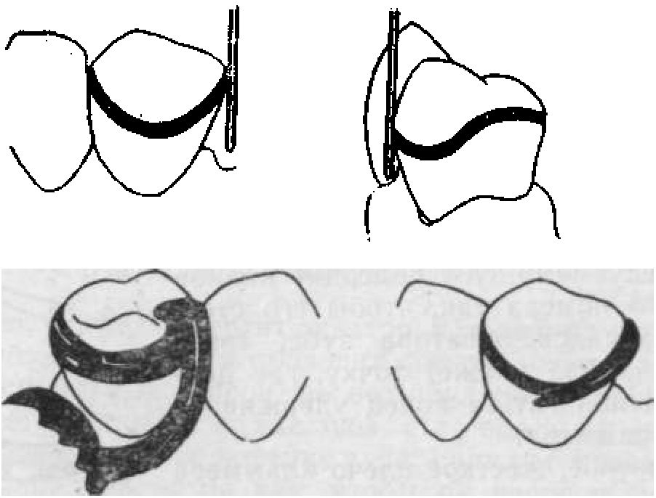
Parallelometry methods.
1) Arbitrary method. The model, cast from high-strength plaster, is installed on the parallelometer table so that the occlusal plane of the teeth is perpendicular to the stylus rod. Then a parallelometer lead is brought to each supporting tooth and a general survey line or clinical equator is drawn. The line with this parallelometry method may not coincide with the anatomical equator, because its position will depend on the natural inclination of the tooth, therefore, on individual teeth the conditions for the placement of clasps may be less favorable. This method of parallelometry is shown only when the vertical axes of the teeth are parallel, their inclination is slight and the number of clasps is minimal.

Slide 11
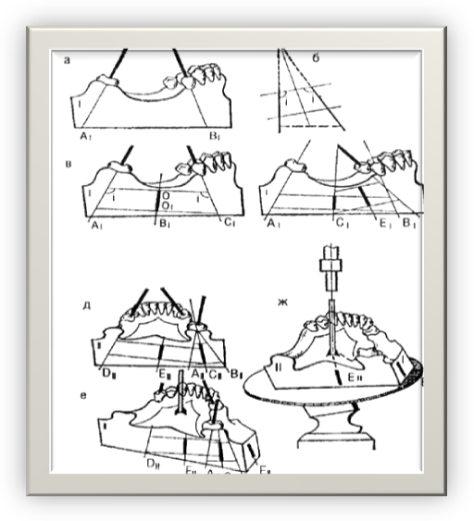
2) Method for identifying the average inclination of the long axes of abutment teeth. The edges of the base of the model are cut so that they are parallel to each other. The model is fixed on the parallelometer table, after which the vertical axis of one of the supporting teeth is found. The table with the model is installed so that the analyzing rod of the parallelometer coincides with the long axis of the tooth. The direction of the latter is drawn on the side surface of the base of the model. Next, the vertical axis of the second supporting tooth, located on the same side of the dentition, is determined and also transferred to the side surface of the model. Then the resulting lines are connected by parallel horizontal lines, after dividing the horizontal lines in half, the average approximate axis of the supporting teeth is obtained. In the same way, the average axes of the teeth on the other side of the model are determined. The resulting average axes are transferred to the free edge of the model base using the analyzing rod of a parallelometer, and the average axis of all supporting teeth is determined from them. Then the table with the model is finally installed in the parallelometer. The test rod is changed to graphite and a sight line is drawn on each abutment tooth. When drawing, the end of the graphite rod should be located at the level of the tooth neck. The disadvantage of the method is the duration, difficulty and likelihood of error when determining the general survey (boundary) line.

Slide 12
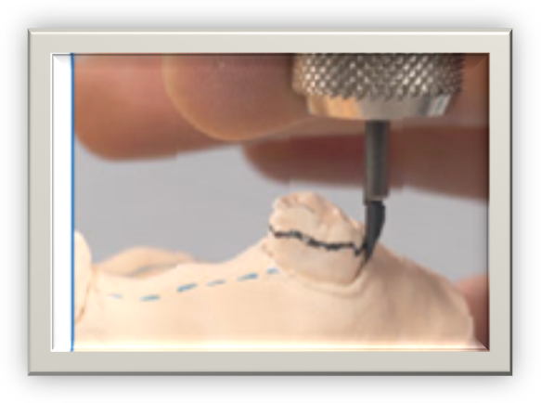
3) Selection method. The model is mounted on a parallelometer table. The table is then positioned so that the occlusal surface of the model teeth is perpendicular to the analysis rod (zero inclination). The latter is brought to each supporting tooth in turn and the presence and size of the support-stabilizing and retaining zones is determined. It may turn out that one or more teeth have good conditions for the placement of clasp elements, while others have unsatisfactory conditions. Then the model must be viewed from a different angle. From several possible inclinations, choose the one that provides the best retention zone on all supporting teeth.

Slide 13
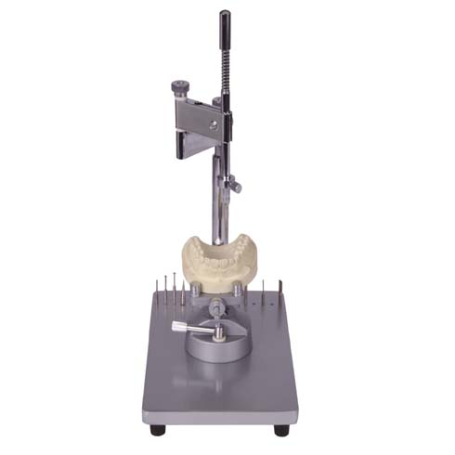
Types of parallelometers
1. Standard parallelometers, designed for general clinical and laboratory work.

Slide 14
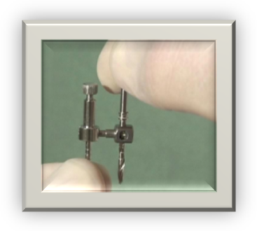
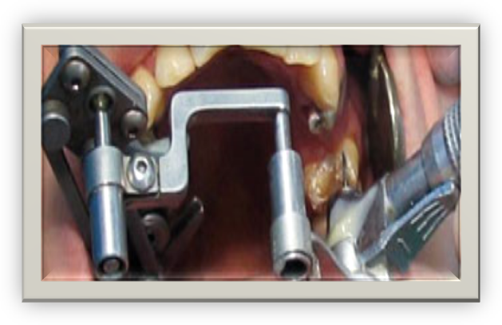
2. Special devices designed to perform strictly defined operations, for example, intraoral microparallelometers that ensure parallelism during tooth preparation.

Slide 15
3. Universal parallelometers that have a multifunctional purpose due to the inclusion of special blocks in their design, for example, a milling device or a collet for installing a drill tip, a coordinate or protractor device.

Slide 16
