Slide 1
Deformation
This is a change in the position of the teeth due to pathology that occurs after the formation of the dentition is completed.

Slide 2
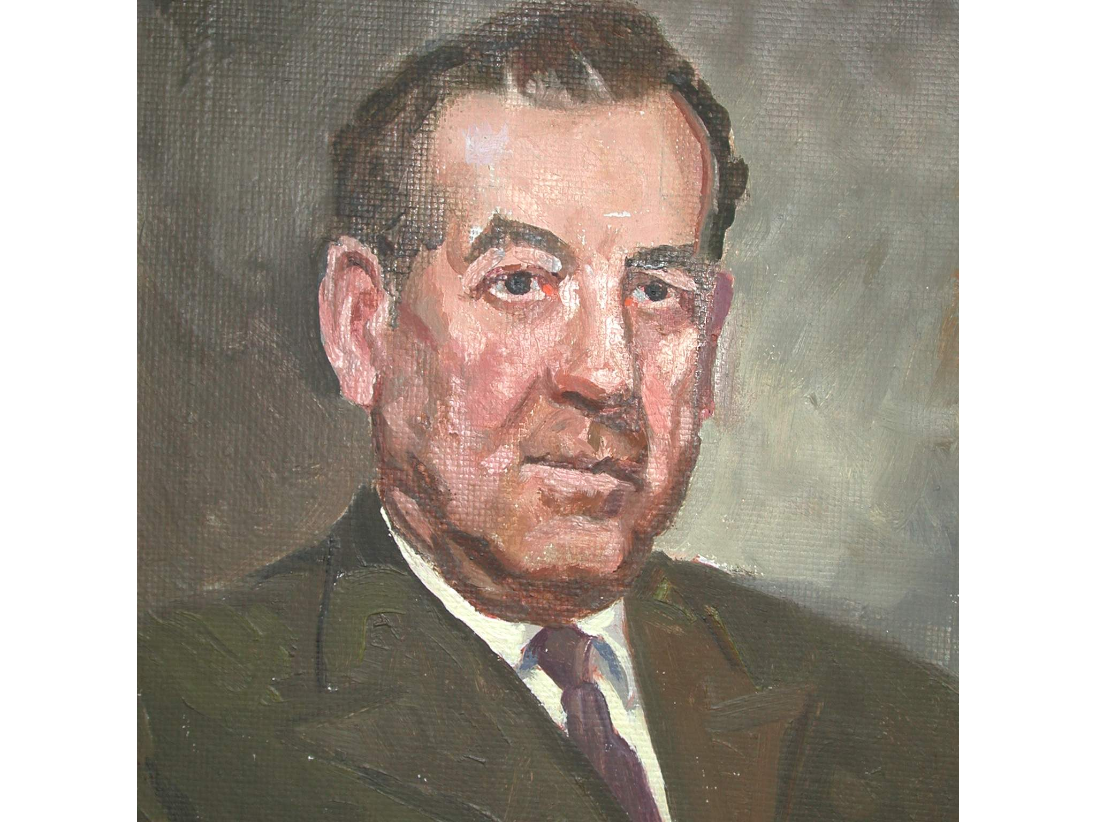
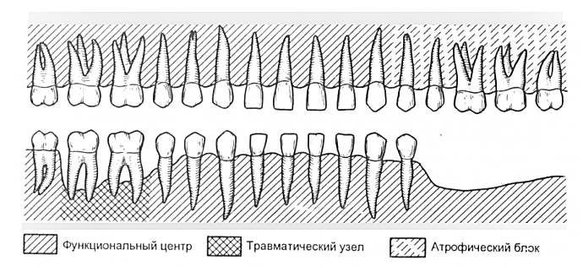
FORCE DISSOCIATION
Функциональный центр
Травматический узел
Атрофический блок

Slide 3
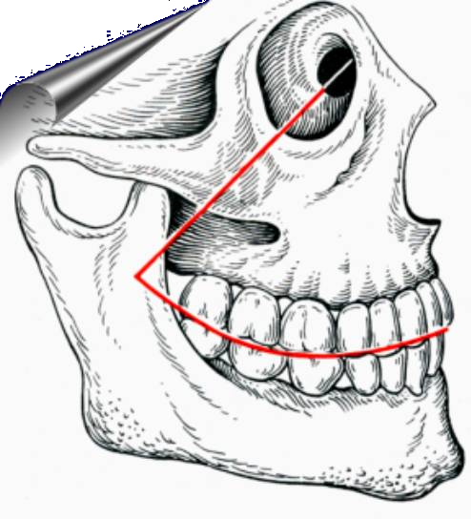
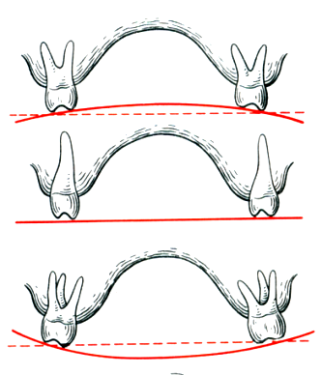
Curve of Spee
Wilson curve

Slide 4
DENTAL DEFORMATION
Depending on the pathology and defects of the dentition
movement of teeth and alveolar process can occur in different directions:
Vertical dentoalveolar elongation of the upper
teeth (one-sided or two-sided).
Vertical dentoalveolar lengthening of the lower
teeth (one-sided or two-sided).
Mutual vertical dentoalveolar elongation
on both jaws (unilateral or bilateral).
Dentition with sagittal (medial or
distal) displacement of teeth in the lower part or lower part
(one-sided or two-sided)
Dentition with lingual, buccal or palatal
displacement of teeth.
Dental rows, the deformation of which arose due to
combined displacement of teeth.

Slide 5
FIRST GROUP OF DENTAL DEFORMATIONS
Deformations caused by
vertical movement of the upper teeth
- Single-sided - Double-sided

Slide 6
SECOND GROUP OF DENTAL DEFORMATIONS
Deformations,
arising from
B) vertical movement of the lower teeth
- One-sided
- Double-sided

Slide 7
THIRD GROUP OF DENTAL DEFORMATIONS
Deformations,
arising from
B) mutual vertical movement of the upper and lower teeth
- Single-sided - Double-sided

Slide 8
FOURTH GROUP OF DENTAL DEFORMATIONS
horizontal
deformation
A) hull
moving

Slide 9
FOURTH GROUP OF DENTAL DEFORMATIONS
horizontal
deformation
B) sagittal displacement of teeth
(mesial and distal)

Slide 10
FIFTH GROUP OF DENTAL DEFORMATIONS
horizontal
deformations caused by tilting teeth
palatal (lingual) or
buccal side

Slide 11
SIXTH GROUP OF DENTAL DEFORMATIONS
Deformations resulting from combined tooth movement

Slide 12
DENTAL DEFORMATION
FACTORS AFFECTING CLINICAL
MANIFESTATIONS OF DENTAL DEFORMATIONS
patient age
number of lost teeth
recency of removal or rate of abrasion
construction material.
-type of bite
-presence of concomitant pathology
(periodontitis)

Slide 13
Deformations of the dentition
Dentoalveolar lengthening without root exposure
Dentoalveolar elongation with root exposure
Up to ¼ length
More than 3\4 length
(В.А.Пономарева, 1951)

Slide 14
I form
Tooth displacement with a visible increase in the alveolar process, without bone resorption, exposure of the tooth root, or formation of a periodontal pocket. The ratio of the extra- and intraalveolar parts of the tooth does not change

Slide 15
II form, 1 subgroup
Tooth displacement is accompanied by a visible increase in the alveolar process with slight periodontal resorption
(no more than ¼)

Slide 16
II form, 2 subgroup
Tooth displacement without alveolar process enlargement with significant periodontal resorption
(more than ¼)

Slide 17
Differential diagnosis:
Partial adentia, complicated by a decrease in occlusal height and distal shift of the lower jaw
-//-, complicated by pathological abrasion and decreased occlusal height
-\\- both jaws, when not a single pair of antagonists has survived

Slide 18
DENTAL DEFORMATION
DENTAL DEFORMATION
Depth of dentoalveolar elongation.
Character of the occlusal curve
The relationship of individual teeth to the mucosa
the membrane of the edentulous alveolar process.
The size of the distal and medial
movement of teeth (body, inclined)
5. Points where movement blockade occurs
lower jaw.
6. Level of tooth shortening.

Slide 19
AFTER THE REMOVAL OF TWO OR MORE TEETH OR EVEN ONE INCISOR, FANQUEN, PROSTHETIC PROSTHETICS IS ALSO CARRIED OUT IMMEDIATELY

Slide 20
SEVERE DEFORMATIONS IN MATURE AGE ARE THE RESULT OF LACK OF TIMELY PROSTHETICS

Slide 21
V.Yu. KURLYANDSKY IT IS NECESSARY TO PROTEST PROSTHETICS FOR PATIENTS WITH DENTAL DEFECTS NOT BECAUSE THE CHEWING EFFICIENCY HAS DECREASED, BUT TO PREVENT DESTRUCTION OF THE WHOLE SYSTEM

Slide 22
The integrity of the dentition is a necessary condition for its normal existence.
Godon

Slide 23
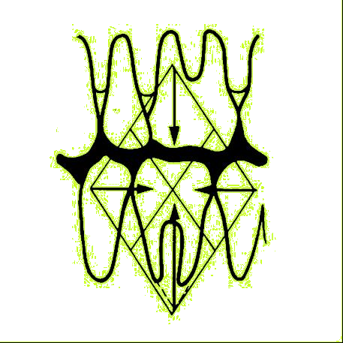
Scheme of articulatory balance with all teeth present
по Годону

Slide 24
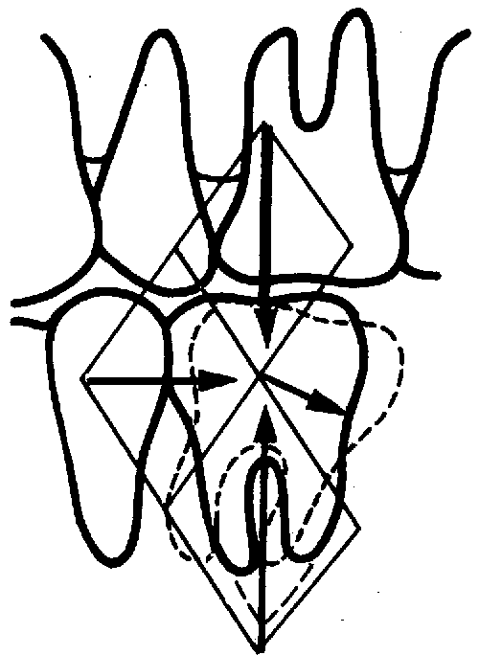
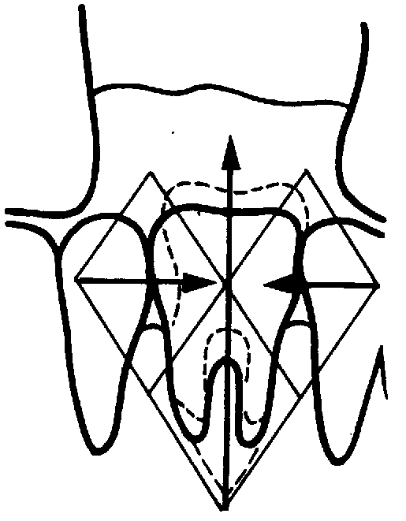
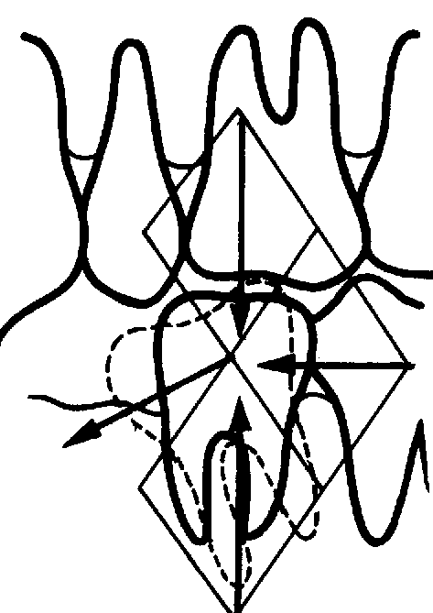
Scheme of articulatory balance with all teeth present
по Годону

Slide 25
TISSUE TRANSFORMATIONS DURING
DENTAL DEFORMATIONS
I form
II form
Thinning of bone beams
More sharply expressed. for II f.
Neoplasm
bones
Resorption
bones
loss of radial directionality of the bone beams

Slide 26
DENTAL DEFORMATION
Therapeutic goals for deformities resulting from partial secondary adentia are to solve the following problems:
Normalization of occlusal deviations
Elimination of blocking movements of the lower jaw
Elimination of functional overload of the periodontal toothов
Creating conditions for the manufacture of rational designs

Slide 27
TREATMENT OF DENTAL DEFORMATIONS
Method for grinding hard tissues
Disocclusion method
Hardware-surgical method
Surgical

