Slide 1
History of the development of dental implantation

Slide 2
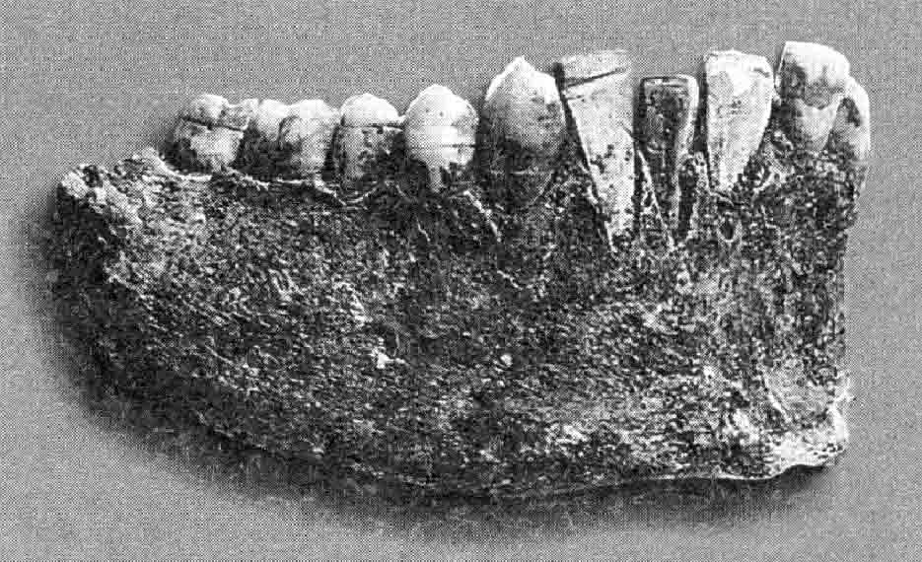
Fragment of the lower jaw of an ancient Inca

Slide 3
Direct evidence of the use of dental implants in the VI-XVIII centuries. AD Not yet. At that time, dentists were more concerned with transplantation rather than dental implantation. Indirect mention of implantation is found only in G. Bauer, who, in his treatise on the history of medicine, published in 1556, wrote about the use of metal dental implants in Sicily. However, the widespread prevalence of infectious diseases such as syphilis and tuberculosis, and the possibility of their transmission during transplantation, have led to criticism of this direction.

Slide 4
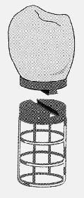
Эскиз внутрикостного имплантата, предложенного U. Greenfield в 1909 г.

Slide 5
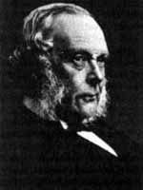
It is difficult to summarize and objectively evaluate the results of implantation in those years, because before Lister introduced the concept of “antiseptics” into surgery, infection of the surgical wound almost always occurred, and implant rejection was common. The use of antiseptics has significantly reduced the risk of infection of the surgical wound, which has ensured enormous advances in all areas of medicine, including implantation surgery.
J. Lister

Slide 6
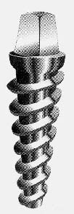
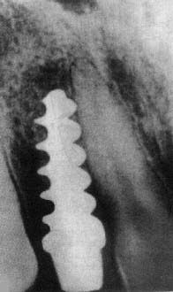
In 1936, C. Venable and W. Struck found a new alloy, “Vitalium,” that was practically immune to the electrochemical effects of the tissue fluid of the body. And already in 1939, A. Strock implanted a screw implant from this material, installing it in the socket of an extracted tooth.
Винтовой имплантат, который
применил в 1939 г. A. Strock
На рентгенограмме верхней челюсти
имплантат Strock после 40 лет
функционирования

Slide 7
In 1947, the Italian doctor F. Formiggini, using in practice an implant of his own design, documented the possibility of functioning of intraosseous implants as a support for dentures. In addition, he formulated the main tasks of implantology, a still nascent area of dentistry:
study of the general and local reaction of bone tissue to the implant
determination of the optimal tissue response to the implant
determining the optimal material and design of the implant
The efforts of specialists over the following years were aimed at solving precisely these problems.

Slide 8
Titanium
Since 1951 as a material for manufacturing
titanium began to be used for implants
Ti, chemical element of group IV of the periodic system of Mendeleev, atomic number 22, atomic mass 47.88. Silver-white metal, light, refractory, durable, ductile. It provides the mechanical reliability required for two-stage systems, is technically easy to process and, thanks to its stable, regenerable oxide layer, has excellent biocompatibility. This means that the tissue will recover after surgery without foreign body reaction.

Slide 9
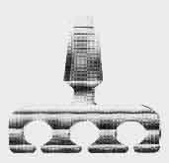
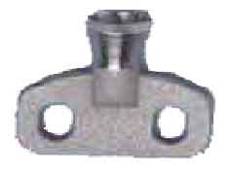
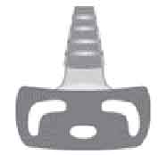
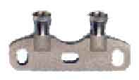

In 1964, L. Linkow invented an implant with an intraosseous part in the form of a plate, which made it possible to use it for narrow alveolar processes of the jaws. L. Linkow became the world-recognized founder of one-stage fibroosseointegrated
implants.
Plate implants have become quite widespread since the early 70s. and improved by many specialists.

Slide 10
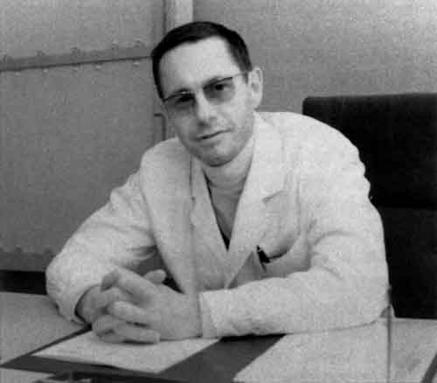
P.-I. Branemark

Slide 11

After numerous experiments on animals, in 1965 the first intraosseous implant in the form of a tooth root was placed in humans for two-stage use. The screw implant was a collapsible structure consisting of an intraosseous part and a support head screwed to it

Slide 12
P.-I. Branemark formulated the necessary conditions for the success of dental prosthetics based on bone-integrated implants:
sterility
surface cleanliness
atraumatic
geometric equality of the implant bed and the structure
engraftment period without load

Slide 13
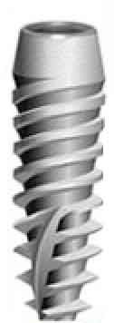
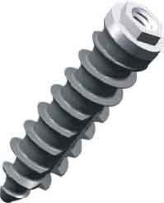
The design of Branemark two-stage screw implants has found wide application in practice, has been officially recognized and approved by dental associations in most countries of the world and has become the basic design for most dental implants currently produced..

Slide 14
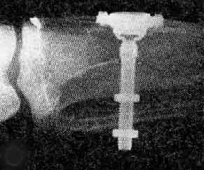
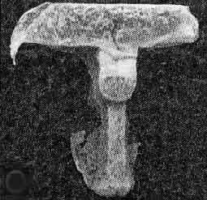
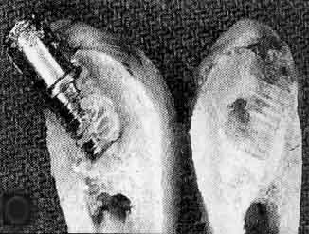
Discovery of osseointegration by Prof. P.-I. Branemark
In 1978, during research, one of the fundamental discoveries of implantology was made: in the bone bed, which is prepared atraumatically and exactly matches the shape of the structure being installed, a strong “fusion” of the metal surface with the bone occurs. P.-I. Branemark and his colleagues fully appreciated the significance of the phenomenon they called “osseointegration,” which opened a new era in the history of dental implantation.
Рентгенограмма установленной
в большеберцовую кость камеры
для витальной микроскопии
Результат одного из первых
экспериментов, показавших объединение
винтового дентального имплантата
с костной тканью
Обросшая костью
титановая камера

Slide 15

According to L. Linkow, dentistry has reached its “golden age” and for this medical specialty the discovery of osseointegration in its significance is quite comparable to the discovery of local anesthesia in 1902.

Slide 16
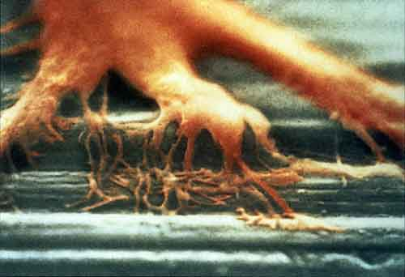
In 1982, a conference was held in Toronto (Canada) on the problems of morphological interaction of implants with bone tissue. Its result was the recognition of osseointegration as the most scientifically sound option for the coexistence of an implant with bone tissue, ensuring long-term and predictable functioning of implants as a support for dentures.

Slide 17
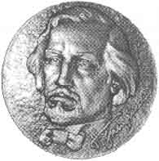
Н. Н. Знаменский

Slide 18
He reported on his own experience of using implants in 1891 in St. Petersburg at the IV Pirogov Congress, and then in the journal Medical Review. The original experimental and clinical studies conducted by N.N. were of great importance for dental implantation. Znamensky. However, porcelain and rubber implants implanted in dogs were rejected after 20-35 days. Implantations in clinical practice also ended unsuccessfully. Despite the unsuccessful choice of material and the negative outcome of the operation in the experiment and clinic, he was able to trace the pathomorphosis during implantation.

Slide 19
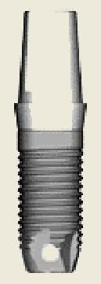


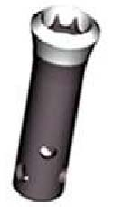
N.N. Znamensky was the first to make a through hole in the apical part of his implant for bone to grow into it, calling this design fenestrated. This idea is embodied in most modern designs of intraosseous implants.

Slide 20
Unfortunately, the scientist was unable to complete his research and create his own school, and did practically nothing to prepare students who could continue his work. This is precisely what can explain the fact that the first wave of dental implantation in Russia did not develop.
Until the 50s of the 20th century, dental implantation was mentioned only sporadically.

Slide 21
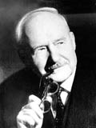
In Russia, implantation began to actively develop in the 1950s. In 1954, on behalf of prof. A.I. Evdokimova E.Ya. Vares installed a plastic implant in a patient who had lost a central upper incisor.
А.И. Евдокимов

Slide 22
However, already at an early stage of implantation of the plastic structure, the so-called “pocket” problem was noted. Subsequently, the mobility of the implant began to increase, destructive changes in the alveolar bone occurred, and it had to be removed. It was this failure, associated with the toxicity of the material, that caused criticism from authoritative scientists and delayed further work by domestic scientists in the field of dental implantation for many years. Since 1958, by Decree of the USSR Ministry of Health, implantation in domestic dentistry has been prohibited.
For almost 30 years, domestic dentists only observed the further history of the development of implantology in world practice.

Slide 23
And so, on March 4, 1986, the USSR Ministry of Health issued Order No. 310 “On measures to introduce into practice the method of orthopedic treatment using implants,” which opened the way for the development of implantology throughout the country.

Slide 24
Conclusion
Having become a generally accepted, accessible and effective method of treating various forms of adentia, dental implantology continues to develop in various directions. But, despite the many clinical approaches and different points of view on certain methods of using implants, their designs, production technology and materials, the basis for improving implantation is the fundamental knowledge that is obtained through long-term study of the biological, physiological characteristics of the body, physico-chemical properties implants and general laws of nature.

