Slide 1
implantation
The pioneer of implantology in Russia can rightfully be called the first associate professor of dentistry at Moscow University, a resident at the clinic named after. N.V. Sklifosovsky, Doctor of Medicine N.N. Znamensky. He held this position for 18 years and carried out a number of major scientific studies during this period.
The terms “implant”, “implantation” proposed
N.N. Znamensky, and currently imply the use of objects of a certain shape, made of non-biological material, which are introduced into the body to perform any functions for a long time.

Slide 2
planning dental implantation
For successful and long-lasting oral rehabilitation with dental implants, a treatment plan is absolutely essential. Each patient for whom implantation therapy is considered needs to carefully weigh the indications and contraindications, which is one of the most important steps when drawing up a treatment plan. Therefore, the implant surgeon must have comprehensive knowledge of the indications and contraindications for the use of implants.

Slide 3
General and medical aspects
Before any dental or surgical procedure, a patient history must be taken. Information about previous or current illnesses, operations and drug treatments helps to identify so-called “at-risk patients”. If in doubt, you should consult your family physician or medical specialist to further clarify the situation.
The general prerequisite for the use of implants is the patient’s body’s ability to heal wounds normally, without interference.

Slide 4
General and medical aspects
Implants cannot be installed until the growth of the jaw bone is complete. If there are special indications, implants can still be placed before bone growth is complete, for example for orthodontic reasons.
The table below presents two groups of common medical contraindications: risk factors and high risk factors.

Slide 5
High risk factors
Severe systemic diseases, such as rheumatoid arthritis or disorders of the bone structure, for example, osteomalacia or osteopsatirrosis (Osteogenesis imperfecta - osteogenesis imperfecta, the so-called "glass bone") are considered high risk factors. In contrast, the presence of osteoporosis is not a contraindication to the use of dental implants (Baxter & Fattore 1993; Dao et al. 1993).

Slide 6
High risk factors
Patients with a suppressed immune system - as a result of viral infection (HIV) or therapy with certain medications (corticosteroids, oncological chemotherapy or other immunosuppressive drugs) - show a marked weakening of the ability to heal wounds and an inadequate response of the immune system.

Slide 7
High risk factors
Persons who abuse alcohol and drugs, as well as patients with mental and emotional disorders, are unreliable in terms of adherence to treatment regimens, care of implants and adherence to post-operative monitoring (the patient does not cooperate with the doctor).

Slide 8
Informed consent
The patient can only consent to the proposed implantation treatment if the following topics have been previously explained in detail to him:
Treatment Alternatives - There may be several treatment options to address a specific treatment problem (example)
Risks of implant surgery - any surgical procedure contains some risk in the form of local complications or unwanted systemic side effects. Local complications include damage to adjacent anatomical structures (nerves, blood vessels, teeth, paranasal sinuses). The patient should also be informed about the possibility of immediate or long-term postoperative complications such as peri-implantitis, implant fracture, implant-supported orthopedic structure or part thereof, etc.
Long-term prognosis with implants - based on the long-term results of clinical studies, the implant surgeon can assess the long-term prognosis of a particular implant system and inform patients about this.
Cost - the approximate cost of the proposed implant therapy.

Slide 9
Diagnostic measures before dental implantation
Photoshoot
Orthopantomogram (panoramic photo)
CT scan
Analyzes
Layout;
This diagnostic stage is also called wax-up
Diagnostic models:
Surgical template:
Computer planning:
Teleradiography;
Thermography.

Slide 10
Teleradiogram
X-ray of the skull obtained by photographing the head of the subject in profile or frontal view. A profile teleroentgenogram reflects the craniofacial skeleton and the contours of the soft tissues of the face. By studying a teleradiographic image, it is possible to determine the characteristics of the growth and development of facial bones, the localization of their altered growth. By comparing images before, during and after treatment, changes can be determined as a result of orthodontic treatment.

Slide 11
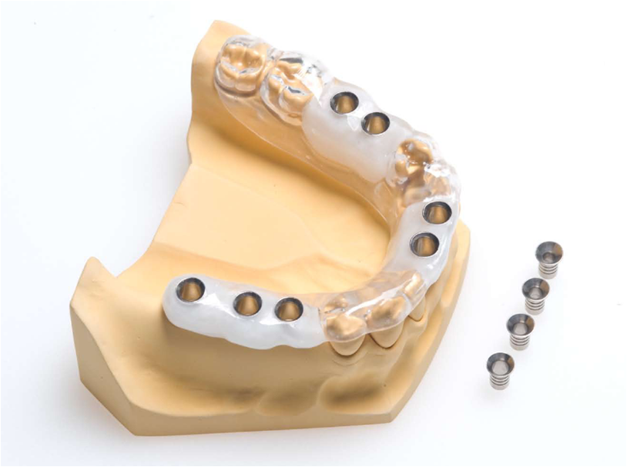
sample

Slide 12
List of main tests:
Clinical blood test
Clotting time, bleeding time.
Fibrinogen.
Prothrombin, INR.
Thrombin time.
Antibodies to HIV (HIV Ag/Ab Combo), syphilis (aticardiolipin test), hepatitis B virus surface antigen, antibodies to hepatitis C virus antigens.
Blood glucose.
Blood biochemistry (amylase, direct bilirubin, total, cholesterol, transaminases, blood electrolytes, alkaline phosphatase, total protein, creatinine, urea).
General urine analysis.
The attending physician may recommend additional consultations with specialists, instrumental and laboratory examinations. Indications are determined in each case individually, taking into account concomitant diseases.

Slide 13
THERMOGRAPHY (thermal imaging) - a diagnostic method based on remote or contact registration of thermal (infrared) radiation emitted by the surface of the body

Slide 14
medicines
The arsenal that the modern anesthesiologist has at his disposal to satisfy such varied and numerous requirements is large. Let's take the path from simple to complex.
Premedication - reduction of emotional arousal;
Local anesthesia – (Anesthetics)
General anesthesia - In fact, with general anesthesia, it is necessary not only to put the patient to sleep, it is also important to ensure normal breathing, blood circulation, eliminate pain and relax the muscles, which in a tense state prevent the surgeon from working. Thus, general anesthesia is a type of drug-induced, easily controlled coma, from which the patient can be brought out at any time.

Slide 15
INSTRUMENTS FOR DENTAL IMPLANTATION
One of the fundamental principles of implantation is the atraumatic preparation of the bone bed of the implant and its correct installation. This principle can be ensured only by using instruments specifically designed for the preparation of bone tissue and the final formation of a bone bed that matches the shape and size of the implant being installed.

Slide 16
TOOLS AND PRINCIPLES OF BONE BED PREPARATION
Marking the site for preparation. For this purpose, a ball-shaped cutter can be used to form a small recess. Avoid immersing the entire working part of this tool deep into the compact layer, since... the ball-shaped cutter is not designed for preparing a canal in the bone, does not provide effective removal of bone chips, and even when the drilling area is irrigated with a cooling solution at moderate rotation speeds, it can cause overheating of the bone. There is no need to mark the preparation site if you use a drill with an acute sharpening angle. In this case, marking and preparation of the guide channel in the bone are carried out simultaneously.

Slide 17
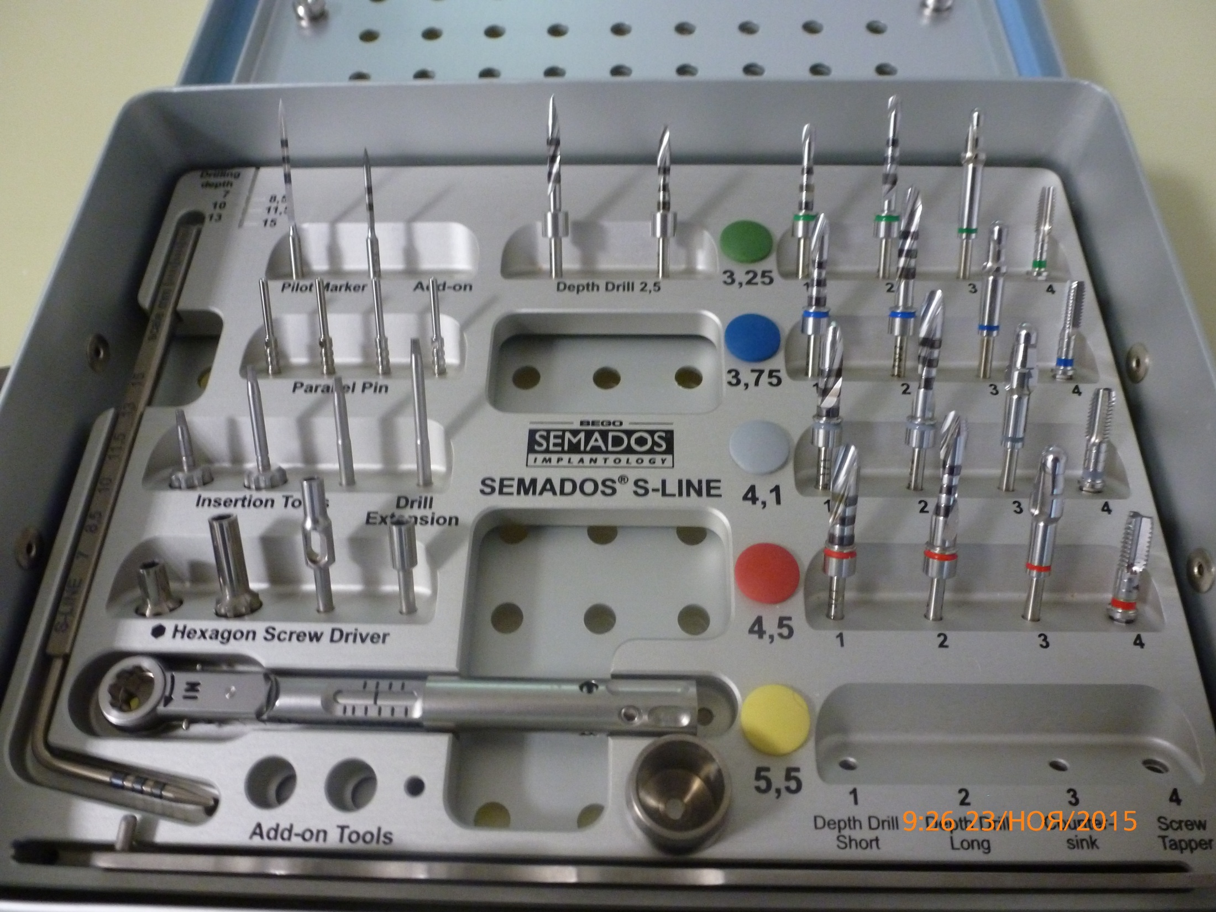

Slide 18
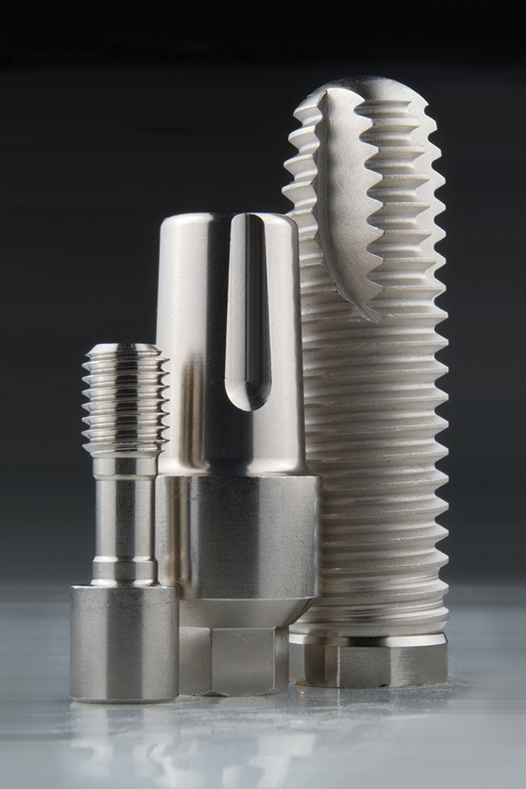

Slide 19
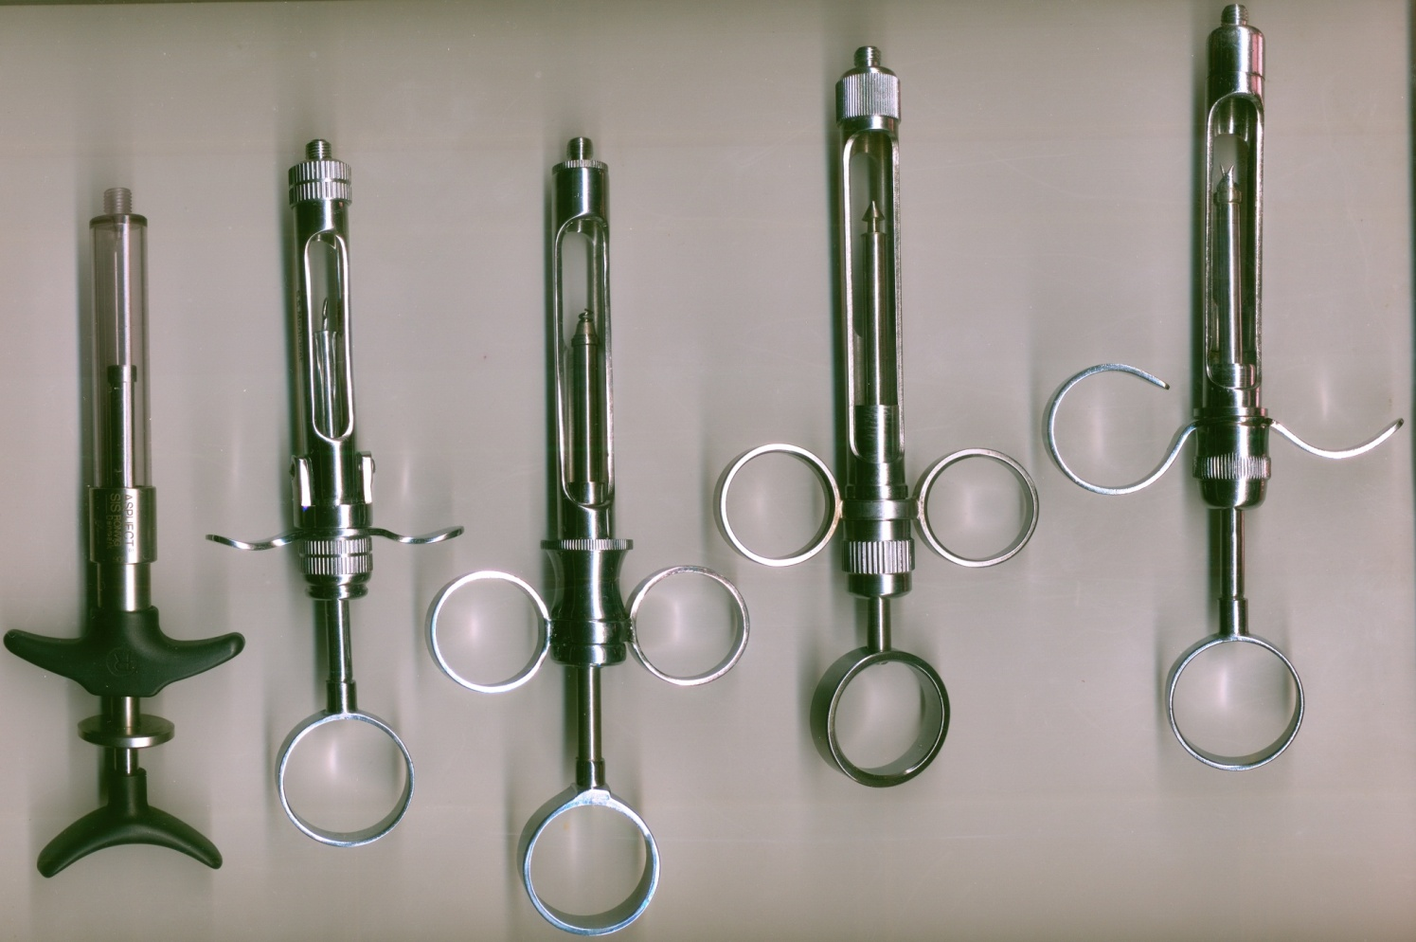
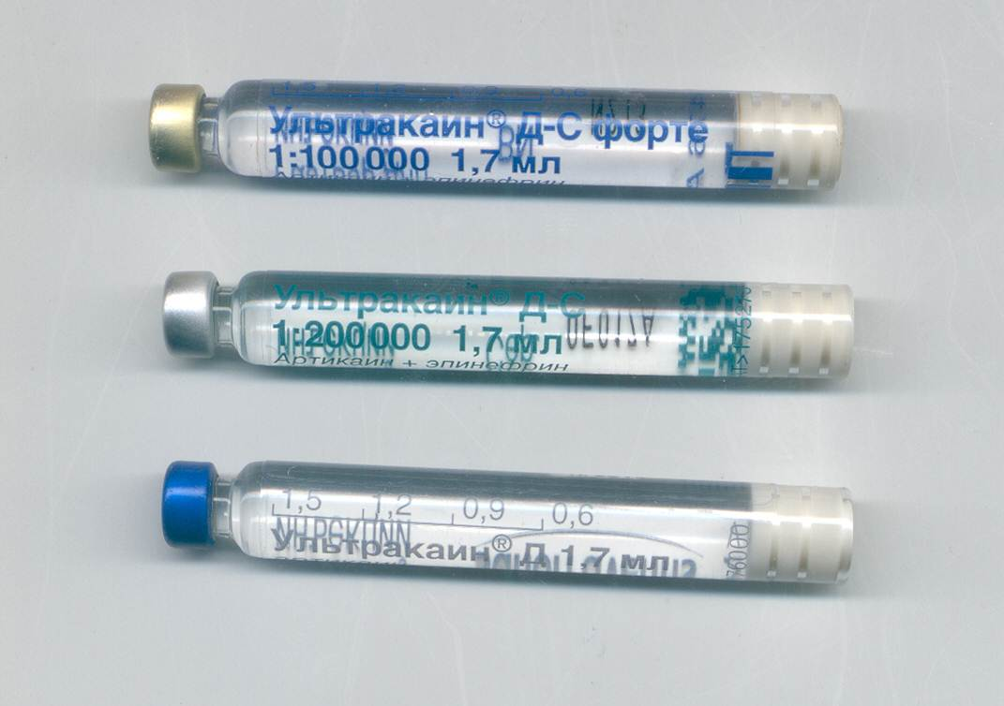
All manipulations are carried out using anesthesia.

Slide 20
Dental implantation algorithm
For the surgical stage of dental implantation, the following tools are required:
- scalpel;
- raspator;
- Farabeuf hook;
- two-pronged sharp hook;
- spherical bur;
- guide drills;
- puncher (mucotomer);
- orientation pin;
- adapter tap;
- depth gauge;
- spiral drills;
-profile drills;
- taps;
- ratchet wrench (torque implant driver);
- screwdriver;
- stub;
- gum former;
- needle holder;
- scissors;
- surgical template with sleeves for drilling.

Slide 21
sample

Slide 22
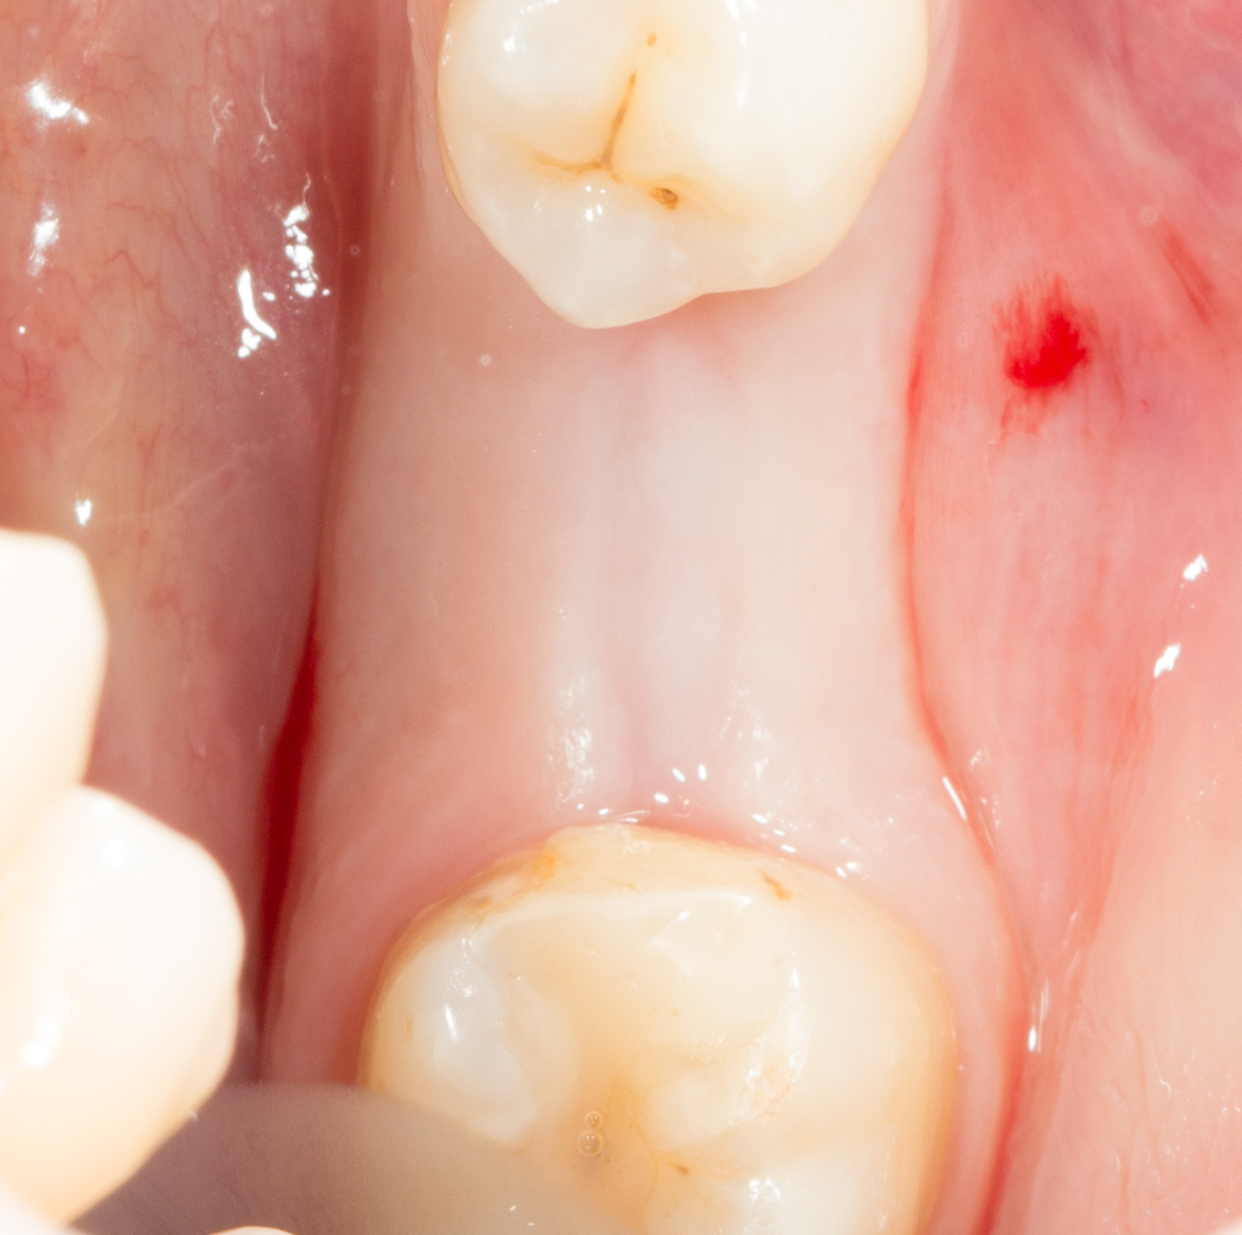

Slide 23
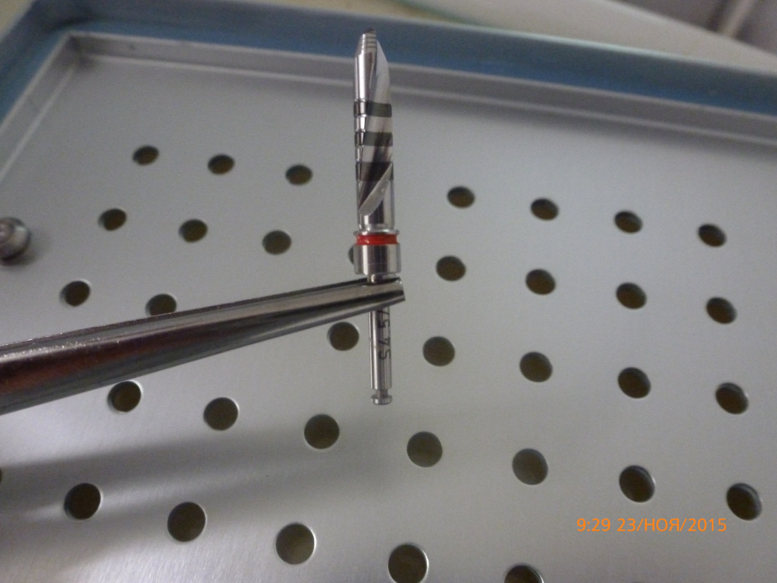

Slide 24
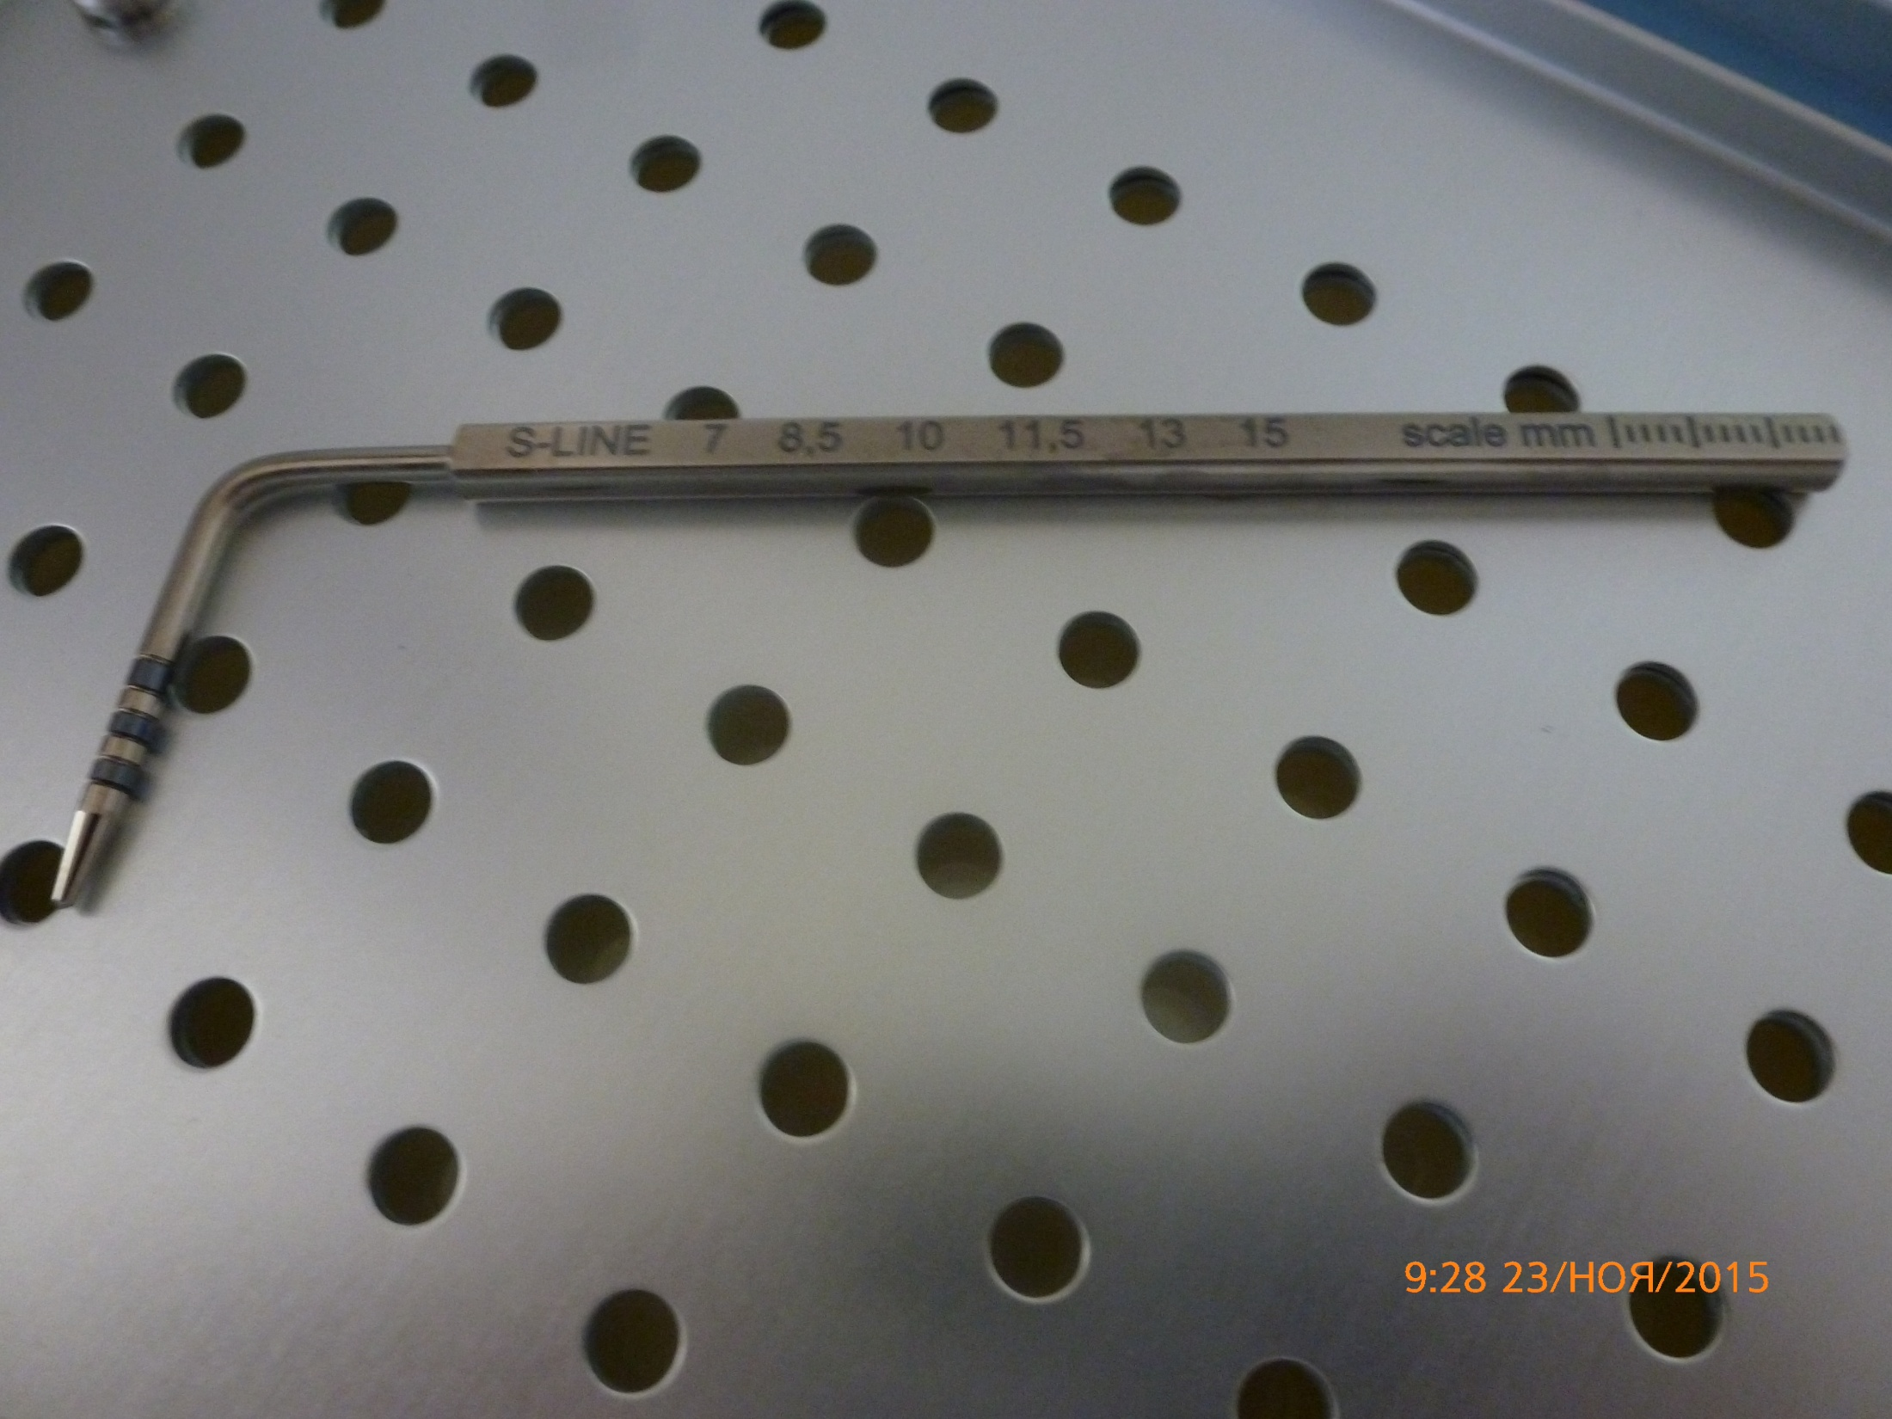

Slide 25
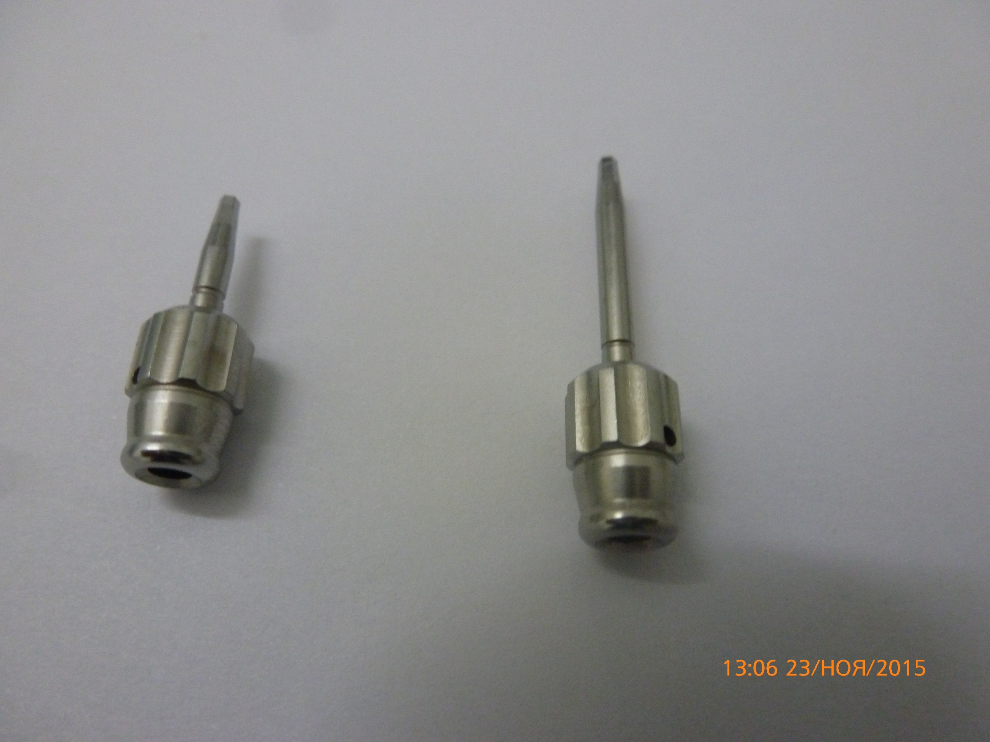

Slide 26
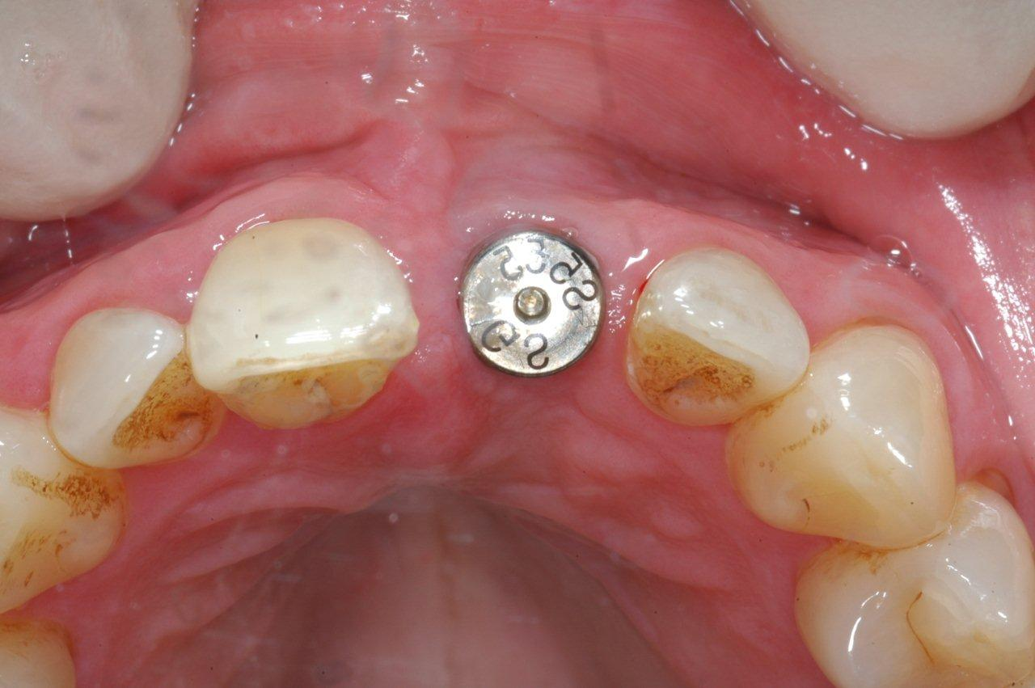

Slide 27
Osteoplastic materials
Osteoneutral Implants - Alloplastic materials (completely inert implants that are used only to fill space. Characterized as biocompatible foreign bodies in tissues that do not support new bone).
рассасывающиеся (β-трикальцийфотфат)
нерассасывающиеся (дурапатит; непористый гидроксиапатит; интерпор; пермаридж; Остеограф D; HTR-полимер)
- металлические (дентальные имплантаты;фиксирующие винты и пластины, применяемые в ЧЛХ)

Slide 28
Osteoinductive implants.
(Osteoinduction – the ability of a material to cause osteogenesis, cementogenesis, growth of the periodontal ligament)
Autografts
-Extraoral (fresh and frozen)
ilium, femur
Intraoral
Bone clot, bone mixture, tubercles of the upper jaw,
extraction zones, chin area,
body and ramus of the mandible (retromolar region).
Alloimplants
- Alloimplant of demineralized lyophilized bone - ADLK
- Lyophilized bone alloimplant – ALC

Slide 29
Osteoconductive implants
(Osteoconduction - the ability to act as a passive matrix for new bone)
Allogeneic materials
with organic matrix
Lyophilized bone alloimplant – ALC
Demineralized lyophilized bone alloimplant - ADLK
with inorganic matrix
Porous hydroxyapatite (Osteomin)
Alloplastic
Porous hydroxyapatite (Osteograph/LD; Algipor)
Non-porous hydroxyapatite (Osteograph/D; Permaridge, Interpor)
Biologically active glass PermoGlas (Biogran, HTR polymer)
Calcium sulfate (Capset)
Xenoimplants
1) Porous hydroxyapatite (Osteograph/N; BioOss)

Slide 30
One-stage and two-stage implantation
Unfortunately, one-stage implantation is not always possible, for example, if the patient requires jawbone augmentation. In this case, prosthetics must be carried out in several stages. Therefore, we are not talking about the fact that two-stage implantation is becoming a thing of the past, since, unlike one-stage implant installation, it takes into account many complications that can arise both during the implantation process and at the stage of patient preparation.

Slide 31
Drug treatment
Before surgery
1. One day before surgery, you should not drink alcohol or coffee.
2. It is advisable to come to the operation in cotton clothes with short sleeves.
3. You must take the medications prescribed by your doctor.
4. Women need to cleanse their faces of makeup.
5. Before starting surgical treatment, professional oral hygiene by a hygienist is mandatory.
6. One day before surgery:
- brush your teeth twice a day (morning and evening);
- rinse your mouth with chlorhexidine solution 3 times a day;
- start taking antibiotics prescribed by your surgeon.
7. On the day of surgery:
- eat approximately 2 hours before surgery;
- brush your teeth thoroughly;
- rinse your mouth with chlorhexidine solution;
- do not smoke or drink alcohol.
Be sure to notify your doctor if your health worsens or if you start taking any medications.

Slide 32
Navigated implantation using a surgical guide
Implant treatment is the optimal solution for losing your teeth. If implants are placed correctly, they will serve like real tooth roots and function for a lifetime.

Slide 33
Basal implantation
The basal implantation method is practically not used today in developed Europe, because it is considered outdated. But since 2008, the main markets for Swiss BOI implants have become the countries of Eastern Europe, India and Russia.

