Slide 1
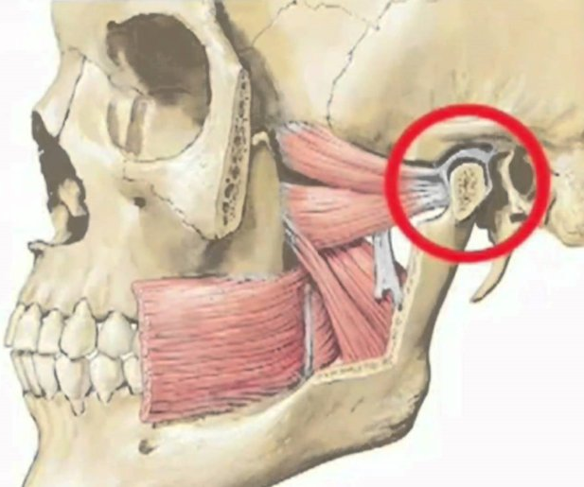
Anatomy of the TMJ

Slide 2
The temporomandibular joint (articulation temporomandibularis) is formed by the head of the mandible and the mandibular fossa of the temporal bone. Its articular surfaces are covered with fibrous cartilage.

Slide 3
TMJ – has a complex and unique structure, it does not interfere with the functioning of the hearing organs, without affecting the nerves and blood vessels.

Slide 5
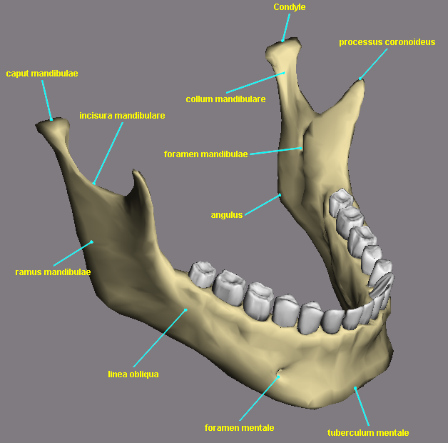
The head of the mandibulae (caput mandibulae) is a roller-shaped thickening of an ellipsoidal shape, elongated in the transverse direction.

Slide 6
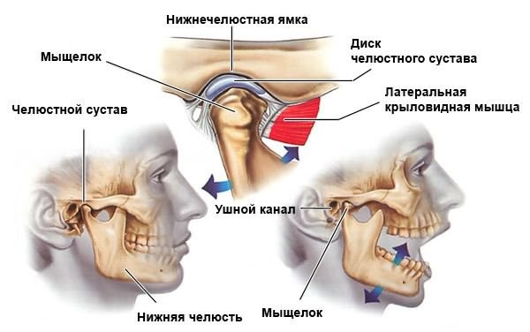
The head of the lower jaw is shaped like an ellipse, slightly elongated, this makes it possible to move the lower jaw in relation to the upper jaw in different directions: back and forth, right and left, up and down.

Slide 7
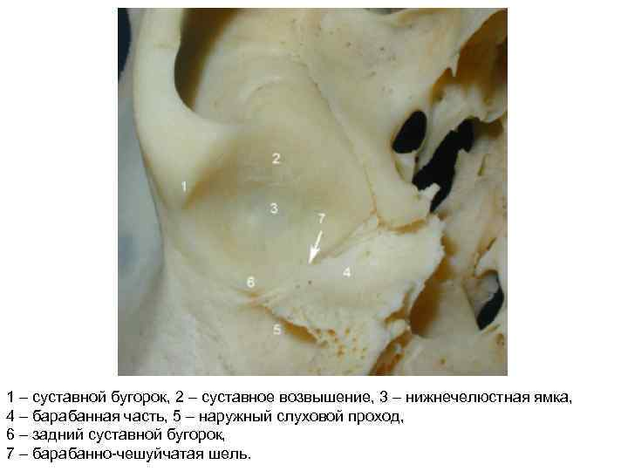
The mandibular fossa (fossa mandibularis) is formed between part of the temporal bone, the tubercle and the zygomatic process. 2-3 times larger than the head of the n/h.

Slide 8
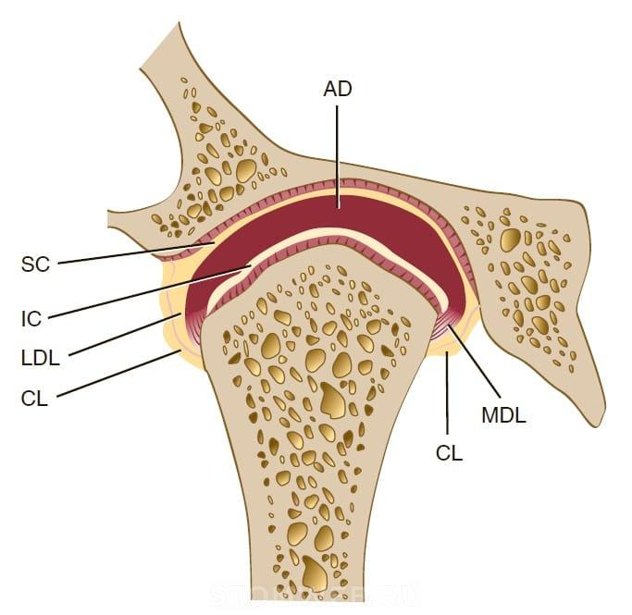
The articular disc (discus articularis), consisting of fibrous cartilage tissue, lies between the fossa and the head of the joint and divides its cavity into 2 isolated slits - upper and lower.

Slide 9
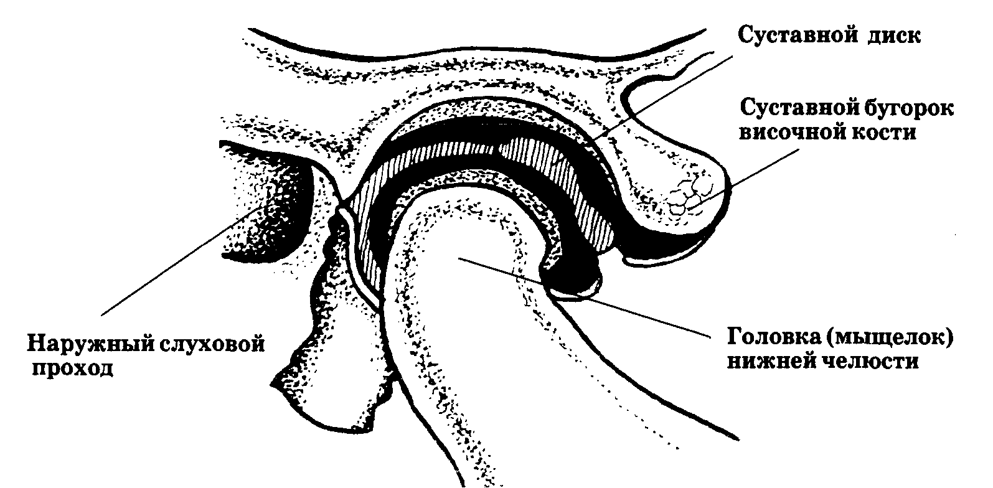
The articular capsule of the TMJ is extensive and flexible, allowing significant movements of the lower joint. At the top, the capsule is attached laterally along the root of the zygomatic arch, posteriorly along the fissura petrosquamosa, medially to the spina ossis sphenoidalis and anteriorly along the anterior slope of the articular tubercle.

Slide 10
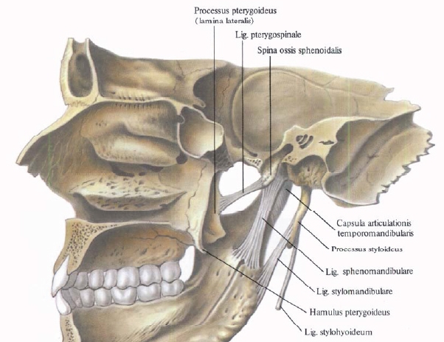
Temporomandibular joint ligaments
are divided into intracapsular and extracapsular.
Intracapsular ligaments include:
a) anterior and posterior discotemporal;
b) lateral and medial disconomandibular.

Slide 11
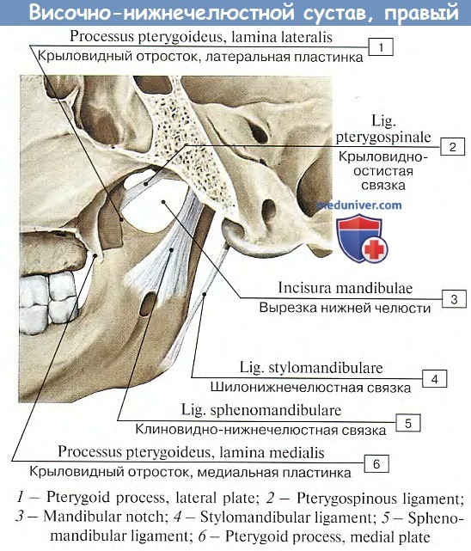
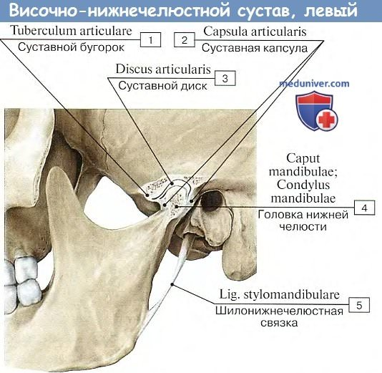

Slide 12
There are 3 extracapsular ligaments:
ligamentum laterale – has the shape of a triangle
2. ligamentum sphenomandibulare
3. ligamentum stylomandibularе

Slide 13
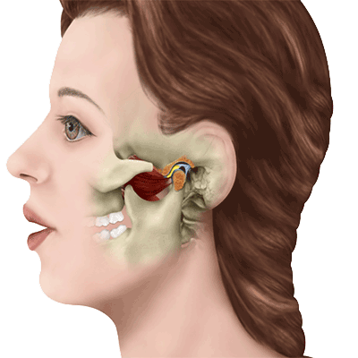
Normally, all movements of the articular heads in the articular fossae are combined and have the following components: vertical - opening and closing of the mouth, sagittal - movement of the articular heads forward and backward, lateral (transversal) - displacement of the jaw to the right and left.

Slide 14
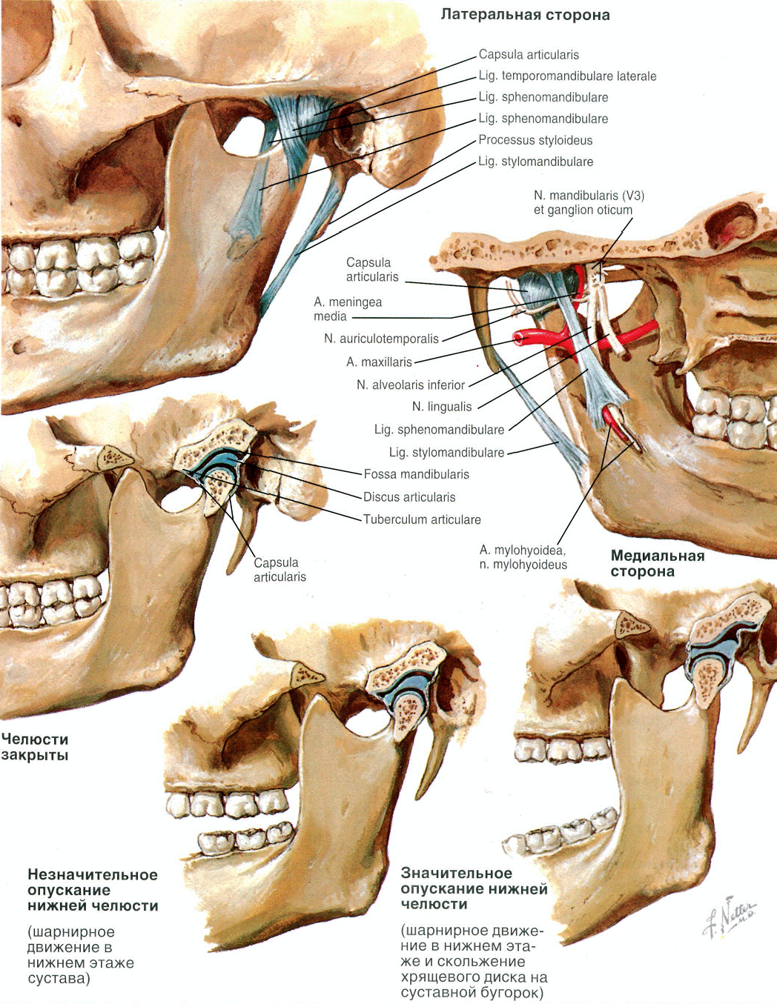
A feature of the movements of the head of the lower jaw is a combination of translational and rotational movements in the joints.

Slide 15
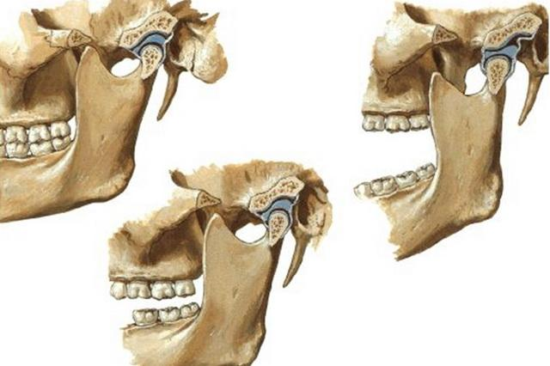
Another functional feature of the temporomandibular joint is the synchronization of movements in the two joints, since both joints (right and left) are connected to each other by the unpaired mandibular bone.

Slide 16
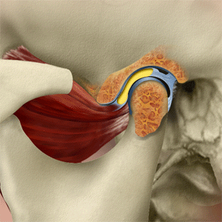
Internal disorders can have 9 clinical forms:
1 – chronic dislocation of the articular head;
2 – subluxation of the articular disc;
3 – recurrent dislocation of the articular disc;
4 – chronic dislocation of the articular disc;
5 – chronic dislocation of the articular disc, secondary osteoarthritis;
6 – chronic posterior dislocation of the articular disc;
7 – chronic dislocation of the articular head with subluxation of the articular disc;
8 – chronic dislocation of the TMJ;
9 – habitual dislocation of the TMJ.

