Slide 1
CT scan.
This is a method of three-dimensional examination of the maxillofacial system using x-rays, which allows you to obtain information for the most accurate diagnosis, planning, and quality control of treatment.
Three-dimensional reconstruction makes the diagnosis of diseases of teeth and gums the most informative, as it allows you to study the area under study from any angle, in all planes and on any section.

Slide 2
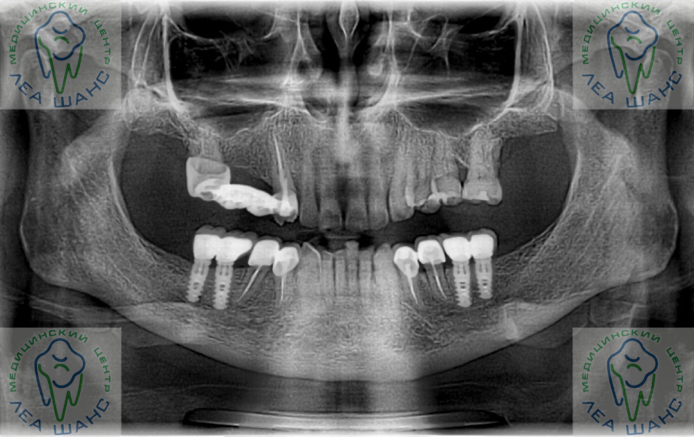
Computed tomography is one of the methods for studying the condition of bone tissue. Along with orthopantomogram and x-ray, it is actively used in dentistry and otolaryngology. It differs from the other two methods in that it allows you to view not a flat, but a three-dimensional image of the entire jaw and various parts of the skull. A regular X-ray provides only 30-40% of the information, a tomographic one provides 100%.

Slide 3
Advantages of CT.
Accurate diagnosis is the key to quality dental treatment.
Unlike a flat panoramic image, tomography allows you to obtain an almost unlimited number of sections: the thickness and height of bone tissue, the distance of the future implant from the mandibular nerve are determined with an accuracy of a millimeter. Moreover, the new diagnostic method allows you to accurately select the type and size of the implant strictly in accordance with the individual characteristics of the patient.
Safety
The radiation exposure to the patient when using Planmeca Promax 3D is minimal and comparable to a conventional panoramic image. Dental volumetric tomographs from Planmeca Promax 3D are created on the basis of cone-beam technology for forming an X-ray beam, which allows you to obtain comprehensive information about the patient’s health status with minimal radiation doses.
High information content of the resulting image
Three-dimensional reconstruction of the study results allows you to effectively build a treatment plan, as well as make predictions for the immediate and long-term results of implantation and orthopedic treatment. This is why leading dental clinics prefer computed tomography.

Slide 4
During the exposure, the tomograph records 300 sections of the dental system in various projections. Then the computer processes the images and builds a 3D model of the dental system. The result of the study is stored in the clinic’s electronic database and is recorded on a separate CD for the patient. Working with the research result is available on any computer: the program will be installed automatically when you start the disk. One image on a tomograph provides an order of magnitude more information than 32 (based on the number of teeth) targeted images and one panoramic image combined.

Slide 5
Minimum radiation exposure
Fast scanning time - only 14 seconds (of which the beam only works for 6 seconds)
High quality of the resulting image, which provides a lot of diagnostic opportunities for doctors in the following specializations:
Dentist (therapist, surgeon, orthodontist, orthopedist)
Maxillofacial surgeon
Otolaryngologist (ENT doctor)

Slide 6
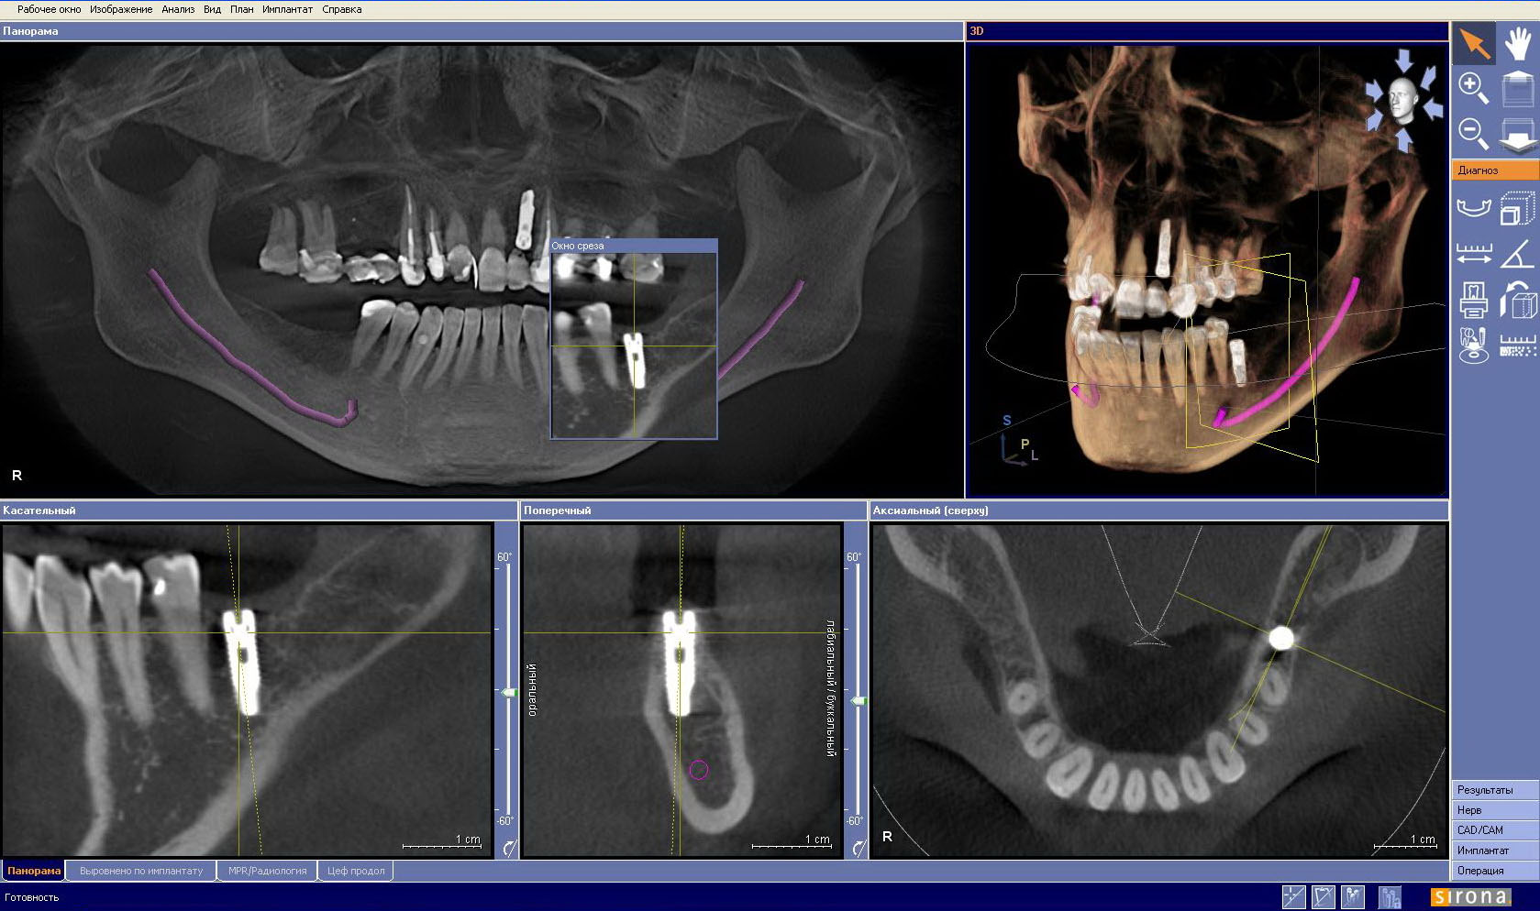

Slide 7
Indications for CT.
Implantation planning
Diagnosis of inflammatory processes in bone tissue in the area of tooth roots
Root canal assessment
Assessing the severity of gum disease
Diagnosis of the temporomandibular joint
Determining the position of unerupted teeth
Diagnosis of anomalies in the development of the dentofacial system (for children)
Diagnosis and evaluation of maxillofacial fractures
Diagnosis of diseases and neoplasms in the maxillary sinuses

Slide 8
Недостатки КТ.
Since the operating principle of the tomograph is based on the use of X-ray radiation, there is still a small chance of developing cancer due to the excessively high dose of radiation received by the patient.
Before undergoing a CT scan, women should inform their doctor and radiologist about the possibility of pregnancy, since tomography cannot be recommended for pregnant women due to the potential risk of developmental abnormalities in the child;

Slide 9
The risk of serious adverse and allergic reactions due to the administration of iodinated contrast agents is very low, and radiologists have special equipment to combat them;
Pharmaceutical companies that manufacture drugs for intravenous contrast indicate in the annotation that nursing mothers should not feed breast milk to their children for 24-48 hours after the administration of the contrast agent into the mother's body.
Since children's constantly growing bodies are more sensitive to the effects of radiation, CT scans can be performed on children only if absolutely necessary to make a diagnosis and should not be repeated without strict indications.

Slide 10
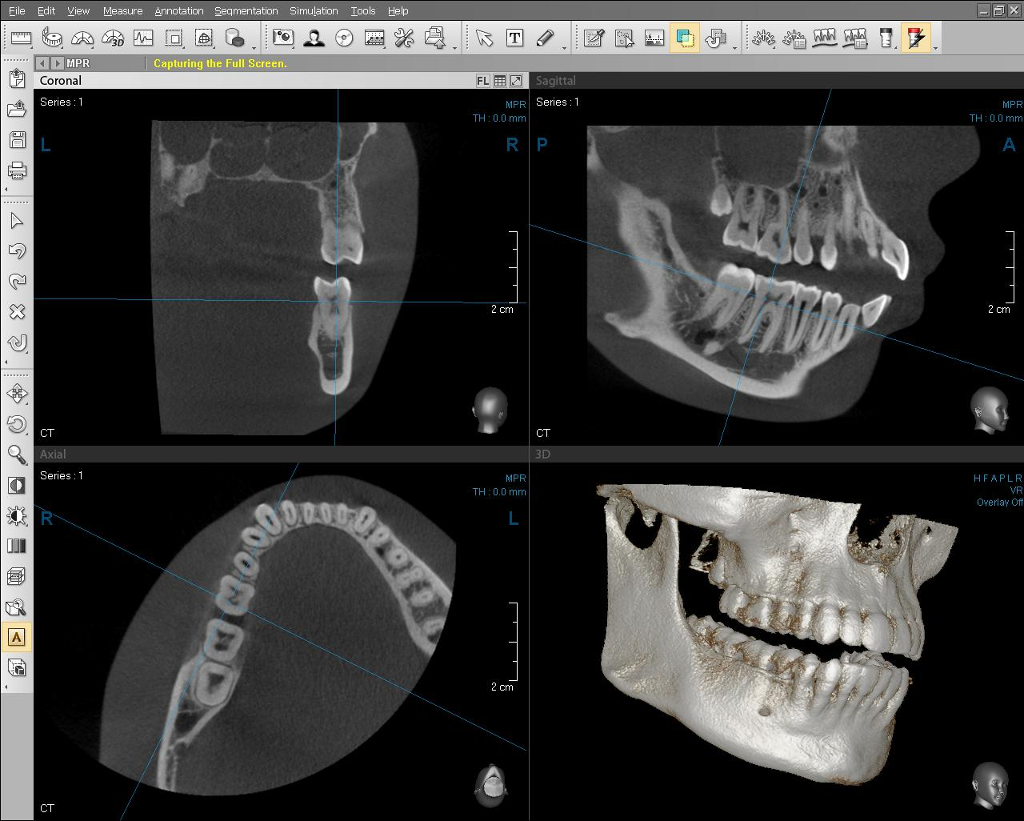

Slide 11
Conclusion:
The capabilities of modern tomographs are not limited to producing only flat sections and images. Now devices can produce a 3D image of the jaw, which allows you to examine the pathology of bones and teeth from different angles. The CT scan procedure itself does not take much time and is absolutely safe.

