Slide 1
Types of dentofacial and jaw prostheses.

Slide 2
Devices used in maxillofacial orthopedics CLASSIFICATION
By location:
a) intraoral; b) extraoral; c) intra-extraoral; d) single-jawed; e) two-jawed; e) dental; g) supragingival; h) dentogingival; e) bone.
By fixation method:
a) removable; b) non-removable;
By manufacturing method:
a) standard; b) individual (laboratory and non-laboratory production);
According to manufacturing materials:
polymer (plastic, composite, polyamide thread);
metal (bent, cast, soldered, combined);
combined (plastic and metal, plastic and polyamide thread, metal and composite, etc.).

Slide 3
By application period:
1) temporary devices for first aid (transport immobilization);
2) permanent devices used to provide specialized medical care and in hospital treatment (therapeutic immobilization);
For therapeutic purposes:
1) main devices, i.e. having independent therapeutic value (for example, fixing, reducing, replacing, combined preventive);
2) auxiliary devices used for bone and skin plastic surgery, when the main type of treatment will be surgical intervention (these include: fixing devices - to hold fragments after surgery and forming devices - serving as a support for plastic material or creating a bed for removable dentures);

Slide 4
By functional purpose:
1) fixing devices (retention devices), hold jaw fragments in the correct position, ensure their immobility;
2) reduction devices (correcting or moving), divided into devices of mechanical and functional action (guides), gradually install jaw fragments into the correct position, used in cases where it is impossible to perform a one-step reduction;
3) shaping devices are used in plastic surgery of soft facial tissues to temporarily maintain the shape of the face, create rigid support, prevent cicatricial changes in soft tissues and their consequences (displacement of fragments due to tightening forces, deformation of the prosthetic bed, etc.).
4) replacement devices (resection and disconnection) are used to replace jaw defects and restore their shape and function;
5) combined devices (multifunctional);
6) preventive devices (mechanotherapy devices, boxing mouthguard, mouth opening limiters) are used to prevent maxillofacial injuries and their consequences;

Slide 5
dentofacial and jaw prostheses

Slide 6
Ligature dental bandages
Intermaxillary ligature fastening is the most commonly used type of temporary immobilization of jaw fragments. Bonding is most often done with bronze-aluminum wire (ligature) with a diameter of 0.4-0.5 mm or polyamide thread with a diameter of 0.5-0.6 mm for a period of no more than 1-3 days (to prevent loosening of teeth).
Indications for use:
For fixing fragments of the lower jaw to each other, provided that each of them has at least 2-3 stable teeth (monomaxillary - single-jaw bandage);
Fixation of fragments of the lower jaw with stable teeth with stable teeth of the intact upper jaw (bimaxillary - two-jaw bandage);
Monomaxillary splinting for alveolar process fractures using a chin bandage;
It is contraindicated to use:
Intermaxillary binding for simultaneous fractures of the lower and upper jaws;
For intermaxillary fastening with mobile teeth and teeth located in the fracture gap.

Slide 7
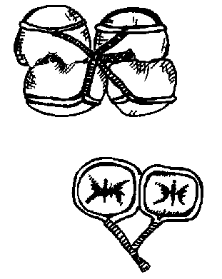
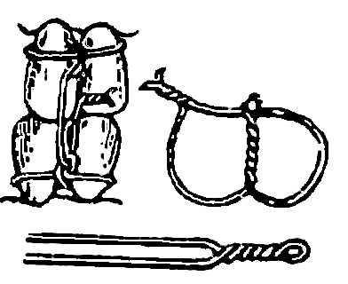
A rigid intermaxillary bandage according to A.A. Limberg is used to fix fragments of the lower jaw to the teeth of the upper jaw by twisting the ends of the ligatures together in the vestibule of the oral cavity. This type of fastening of fragments is used with a sling-shaped bandage for a period of no more than 10 days.
The Ivey method is easy to manufacture, functional and more convenient than other methods, since its use does not form coarse balls of wire in the vestibule of the oral cavity. If you need to open your mouth, just cut 2 vertical wire ligatures passed through the loops

Slide 8
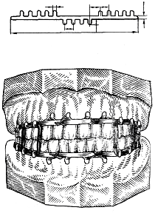
STANDARD Belt bus V.S. Vasilyeva (1967).
A tire made of a thin flat metal strip (2.3 mm wide, 134 mm long, 0.25-0.3 mm thick) with 14 hooks is made using special dies from sheet stainless steel. The tire bends easily in the horizontal plane, but does not bend in the vertical plane. It is fixed to the teeth with a ligature wire.
Indications for use: for uncomplicated fractures of the lower jaw in the presence of stable teeth, on one or both jaws, like the Tigerstedt splint, and often in combination with it, it is fixed to the teeth with a ligature wire; if necessary, an intermaxillary rubber traction is applied.)
For single-jaw splinting, it is undesirable to use a Vasiliev splint due to its low strength. The inability to bend the band splint in a vertical plane leads to injury to the mucous membrane in the lateral parts of the dentition, due to the discrepancy between the curve of Spee.

Slide 9
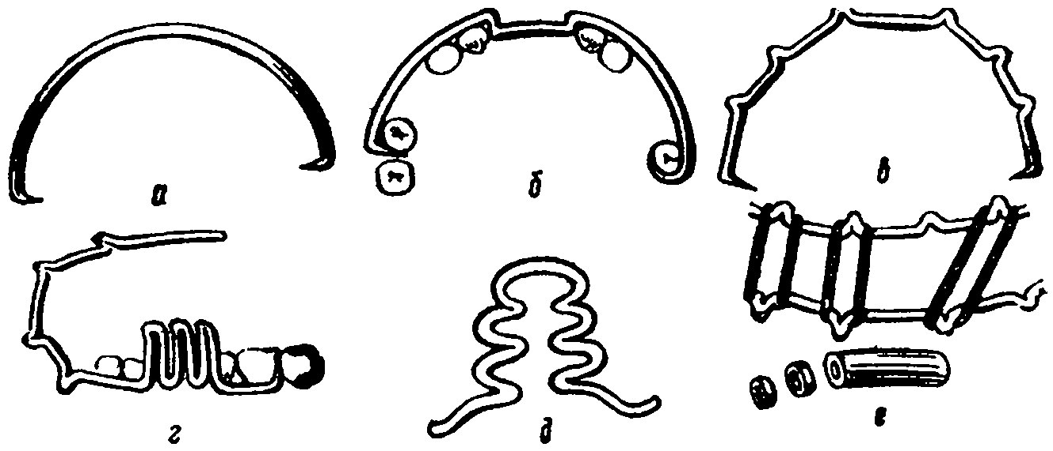
INDIVIDUAL Wire dental splints by S.S. Tigerstedt
There are five main types of these tires:
a) smooth tire-bracket,
b) tire with spacer bend,
c) tire with hook loops,
d) tire with an inclined plane,
e) tire with a supporting plane.
To make dental splints you need: aluminum wire with a diameter of 1.8-2.0 mm and a length of 12-15 cm or stainless steel wire with a diameter of 1.3-1.5 mm; bronze-aluminum ligature wire with a diameter of 0 is used to fix the splints .5-0.6 mm or polyamide thread.
The disadvantage of wire dental splints is that they cannot be used in cases of deep bites with vertical or retruded teeth.

Slide 10
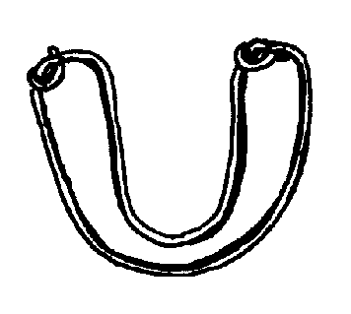
1. A smooth splint-brace can be used to treat fractures of the lower jaw, provided that the larger fragment has at least 4, and the smaller fragment has at least 2 stable teeth. In this case, the teeth located in the fracture gap are not taken into account.
Indications for use:
unilateral linear fracture of the lower jaw, located within the dentition, without displacement or with easily reducible fragments within the frontal group of teeth;
fractures of the alveolar part of the lower jaw and the alveolar process of the upper jaw;
fractures and dislocations of teeth, when there are stable teeth on both sides of the intact parts of the jaw;
splinting teeth for acute odontogenic osteomyelitis and periodontitis.
for the prevention of pathological fracture of the lower jaw, before performing sequestrectomy, cystectomy, cystotomy, resection of part of the jaw, etc.;
incomplete fractures (cracks) of the lower jaw.

Slide 11
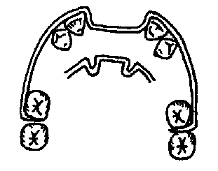
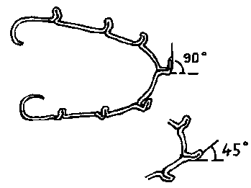
2. A splint with a spacer bend in the area of the dentition defect.
Indications for use:
One-sided fracture of the lower jaw without displacement or with easily reducible fragments, if the fracture gap passes through the alveolar part, devoid of teeth
3. Tire with hook loops.
Indications for use:
fractures of the lower jaw outside the dentition;
fractures of the lower jaw within the dentition when the larger fragment has 4 and the smaller fragment has 2 stable teeth;
fractures of the lower jaw with fragments that are difficult to reduce and require traction;
bilateral, double and multiple fractures of the lower jaw;
fracture of the upper jaw (with the obligatory use of a chin sling);
simultaneous fractures of the upper jaw and lower jaw (supplemented by a chin sling).

Slide 12
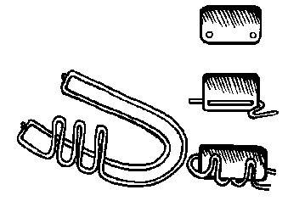
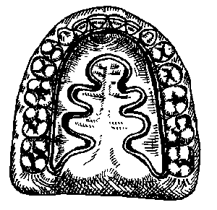
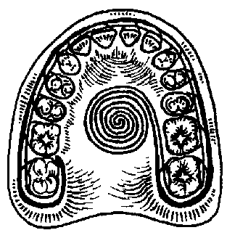
4. Tire with an inclined plane.
Indications for use:
with significant defects of the lower jaw as a result of traumatic osteomyelitis, gunshot wounds or after operations for resections. Prevents the displacement of the fragment towards the oral cavity, establishing it in the correct articulatory relationship with the opposite dentition.
fractures in the area of the ascending branch.
5. Tire with a holding plane.
Indications for use: on the upper jaw to hold tampons, soft tissue flaps of the palate in case of damage or in the postoperative period.

Slide 13
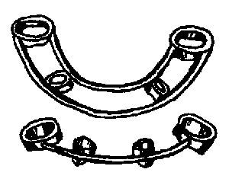
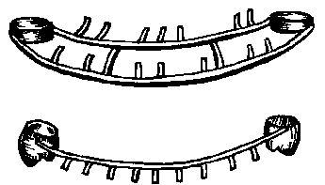
Laboratory-made splints Tooth splints
Ring tires.
The large contact surface of the ring splints with the teeth ensures good stability of the splint. In addition, the chewing surface of the teeth not covered with a splint makes it possible to control the relationship of the dentition in the bite.
Limberg soldered rod (beam) bus.
Indications for use: treatment of jaw fractures with low clinical dental crowns, insufficient number of teeth, and with tooth mobility. If necessary, the crowns in this splint are replaced with rings or turned into crown rings by sawing off their chewing surface.

Slide 14
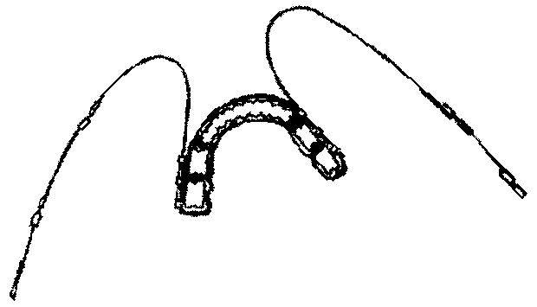
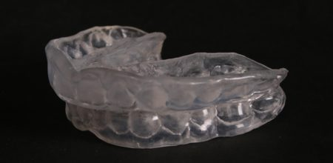
Laboratory-made splints Tooth splints
Solid tires.
Indications for use: used for fractures of the lower jaw without displacement of the fragments or their slight reposition within the dentition, when the teeth on the fragments are placed parallel (without tilting). If there is an inclination of the teeth, dismountable solid splints are used. These splints are removable, so they can be additionally fixed with cement or special glue.
Plastic splints
Made from hot-curing plastic. They are distinguished by high aesthetic qualities. However, due to the elasticity and fragility of plastics, they are not used to fix jaws in case of complete fractures.
Indications for use: tooth dislocations, alveolar bone fractures, treatment of mandibular fractures in children under 3 years of age. In case there is a need for tooth depulpation, a hole is created in the mouthguard before fixation, taking into account better access to the pulp chamber. Fixing the mouth guard on the teeth with cement or quickly hardening plastic. The mouth guard is placed on the victim for 4-6 weeks along with the chin sling.

Slide 15
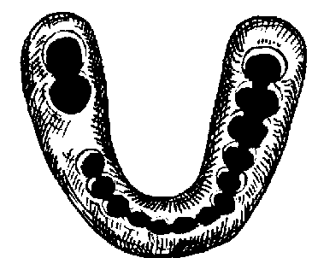
Laboratory-made splints Dental-gingival splints.
Weber gingival splint.
The author made the splint from rubber; currently it is made from acrylic plastics, hot-cured in the laboratory, and cold-cured in the clinic. In the latter case, the mucous membrane of the alveolar process is lubricated with Vaseline to avoid chemical burns from the monomer.
Used for complete dentition or partial loss of teeth. If there is a defect in the dentition, artificial teeth can be welded onto the splint, thereby restoring its continuity. Then the Weber splint not only fixes the fragments, but also plays the role of a replacement prosthesis, and also prevents loosening of the teeth.
Its disadvantages include the fact that it does not keep fragments from vertical displacement, labor-intensive application, and mobility that occurs over time.
Indications for use:
fracture (crack) without displacement of jaw fragments;
for fractures with slight displacement of the fragments, if after reposition they do not return to their previous position;
during post-treatment of fractures, after removal of the bimaxillary apparatus, when consolidation of fragments has occurred, but the callus is not yet reliable;
when the number of teeth is insufficient to fix the dental splints;
with mobility of the teeth remaining on the fragments.
when using the surrounding suture method for fractures of the lower jaw, fragments are fixed to the Weber splint with nylon or wire ligatures.

Slide 16
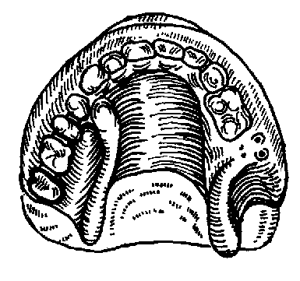
Laboratory-made splints Dental-gingival splints.
Dental gingival splint M.M. Vankevich.
Indications for use: 1) in the treatment of fractures of the lower jaw with significant defects in the anterior area, to prevent displacement of fragments forward, upward and inward, due to the emphasis of the inclined planes on the anterior edges of the branches or on the alveolar part of the lateral parts of the body; 2) in the treatment of fractures of the lower jaw with toothless alveolar processes or with the absence of a large number of teeth. 3) with bone grafting of the lower jaw to retain bone grafts.
The M.M. Vankevich splint can also be used in the orthopedic treatment of fractures of the edentulous lower jaw for the reduction of fragments that have shifted in the transversal direction. For this purpose, the vertical extensions of the device are corrected using cold-curing plastic or using a stens, followed by its replacement with plastic. The rollers formed in this way press on the fragments and gradually move them outward. The disadvantages of the M.M. tire Vankevich refers to its bulkiness and impossibility of use when mouth opening is limited.

Slide 17
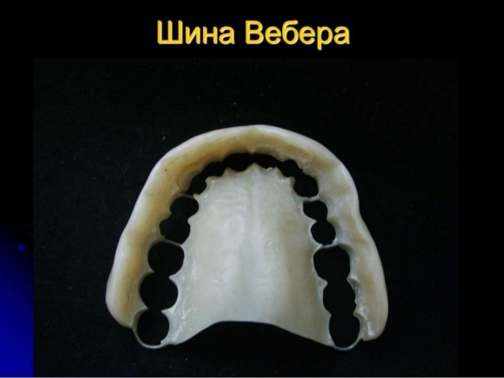
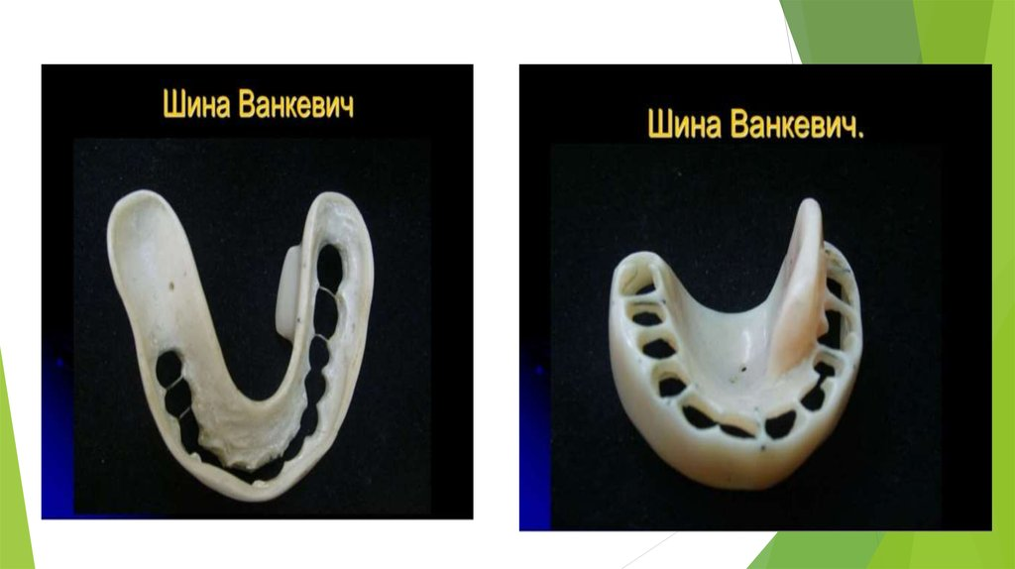

Slide 18
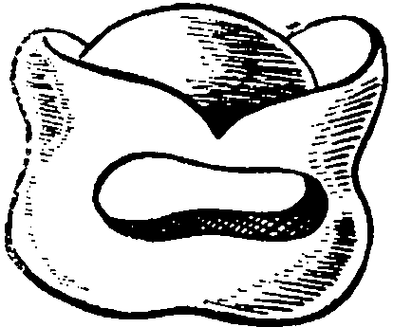
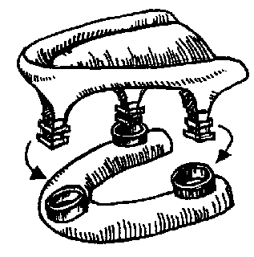
Laboratory-made splints. Supragingival splints.
Tire Porta.
Indications for use: used for fractures of the edentulous lower jaw without displacement of fragments, the patient does not have removable dentures and teeth in the upper jaw. A necessary condition is the unimpeded opening of the mouth.
Limberg tire.
Indications for use: treatment of fractures of the lower jaw with complete edentia and difficulty opening the mouth.

Slide 19
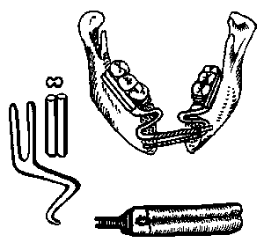
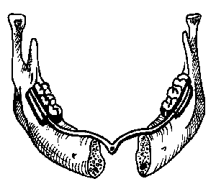
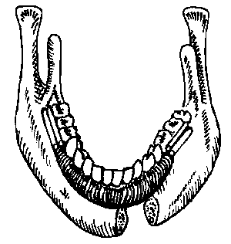
Mechanical reduction devices. (intraoral)
Oxman apparatus. (Modification of the Katz apparatus)
Indications for use: repositioning of fragments in fractures of the lower jaw with a defect in the chin and stiff fragments.
This is a device of sequential combined action - first reducing (1), then fixing (2), forming and replacing (3).

Slide 20
Prosthetics in the treatment of acquired jaw defects

Slide 21
The design of prostheses used for jaw resection is determined by the location and extent of the resected area, the number of teeth on the remaining part of the jaw and the condition of their periodontium.
The fixing part of the prosthesis is held on the remaining teeth using telescopic crowns, dental gingival clamps, multi-link and support-retaining clasps.

Slide 22
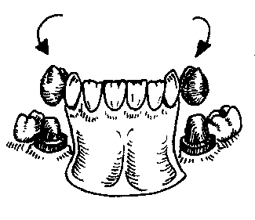
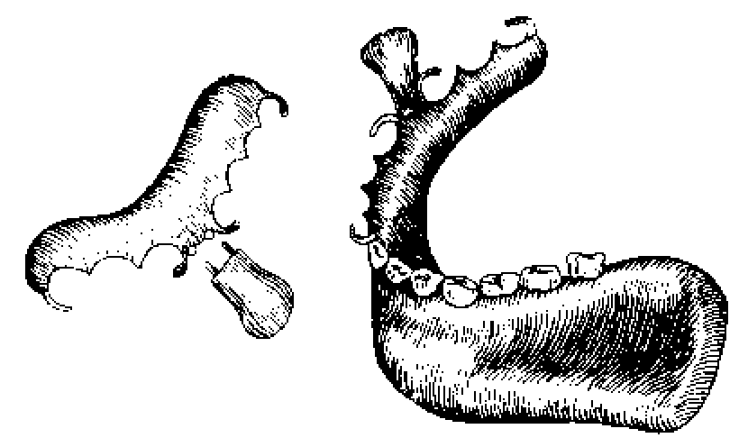
Replacement prosthesis for the chin region of the lower
jaws (with telescopic fixation system).
Direct prosthetics after resection of half of the lower jaw (according to I.M. Oksman).
(multi-clasp fixation)

Slide 23
(Classification by V.Yu. Kurlyandsky):
Group 1 - defect of the hard palate in the presence of supporting teeth on both jaws (upper jaw – paired)
A. midline defect
b. lateral defect of the palate /communication with the maxillary cavity/
V. frontal palate defect
Group 2 - defect of the hard palate in the presence of supporting teeth on one half of the upper jaw
A. median palate defect
b. complete absence of one jaw
V. absence of most of both jaws while maintaining no more than 1-2 teeth on one side
Group 3 - palate defect with toothless upper jaw:
A. median palate defect
b. complete absence of both upper jaws with disruption of the orbital margins.
Group 4 - defects of the soft palate or hard and soft palate
A. scar shortening and displacement of the soft palate
b. defect of the hard and soft palate in the presence of teeth on one of the jaws
V. defect of the hard and soft palate in the absence of teeth in both upper jaws.

Slide 24
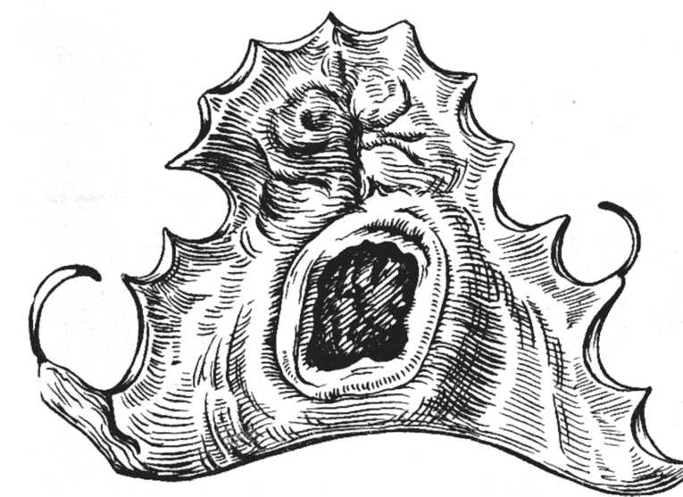
Prosthetics of the first group of defects in the presence of supporting teeth on both jaws.
Prosthetics for small defects of the hard palate located in its middle part, in the presence of a sufficient number of teeth for clasp fixation, can be carried out using clasp dentures. The arch of the clasp prosthesis will carry the obturating part. In the absence of conditions for fixing a clasp prosthesis and in the presence of an extensive defect in the hard palate, removable laminar dentures without an obturating part are used.

Slide 25
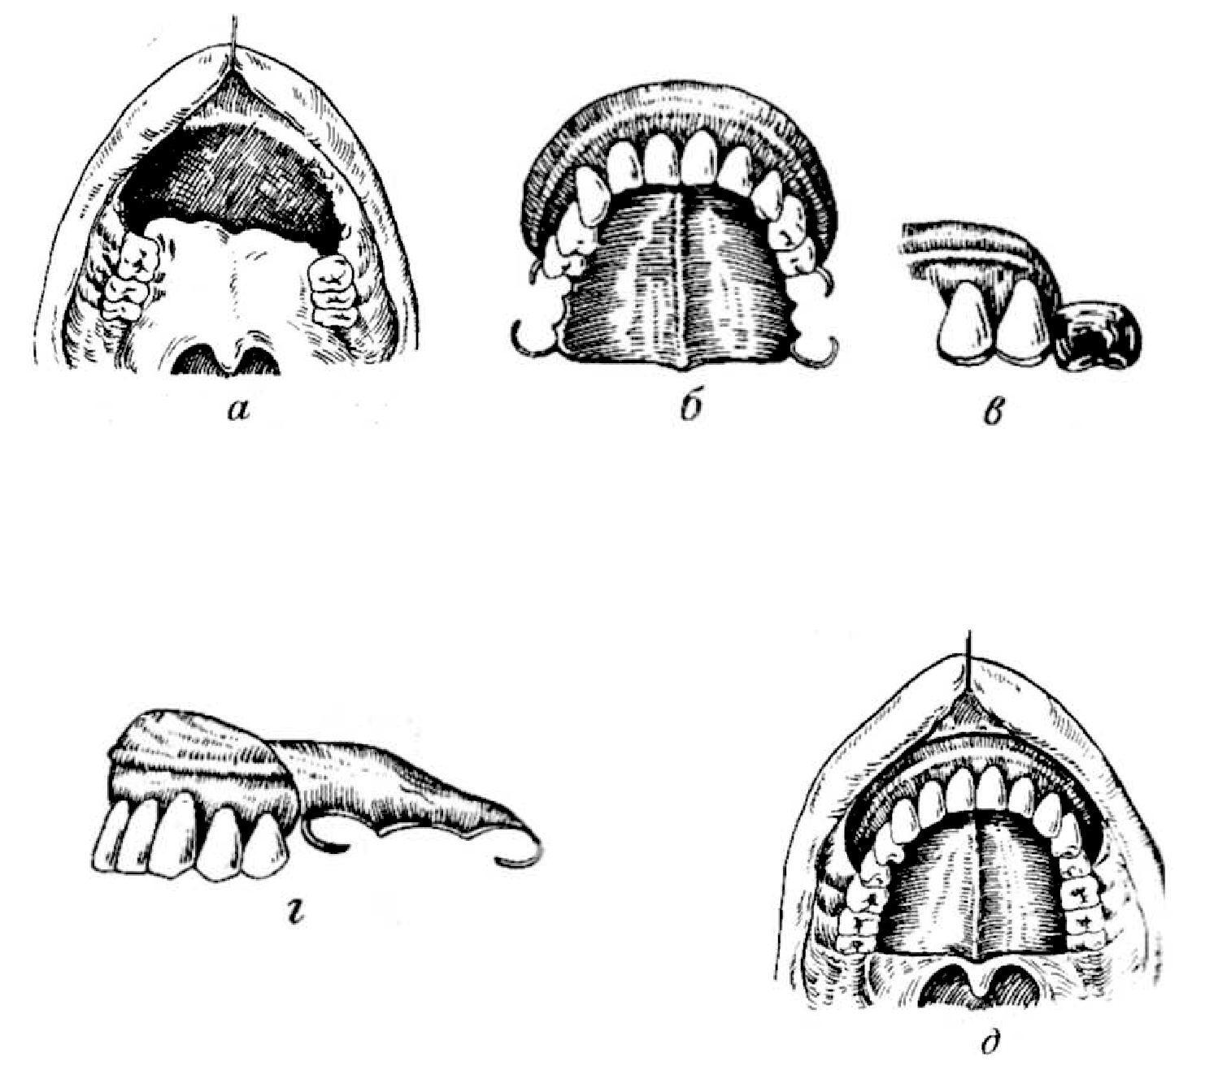
Prosthetics of the first group of defects in the presence of supporting teeth on both jaws.
For lateral defects of the hard palate communicating with the maxillary sinus, in the event of an unsuccessful attempt at surgical closure of the defect V.Yu. Kurlyandsky suggests using partial removable dentures with a similarly designed closing valve.
In case of a frontal defect of the hard palate, a formative and supporting prosthesis should be made in the early stages. V.Yu.Kurlyandsky proposed the following design of the prosthesis. On the forming plate of the prosthesis there is a support roller, according to which a groove is formed in the soft tissues, which additionally helps to retain the prosthesis.

Slide 26
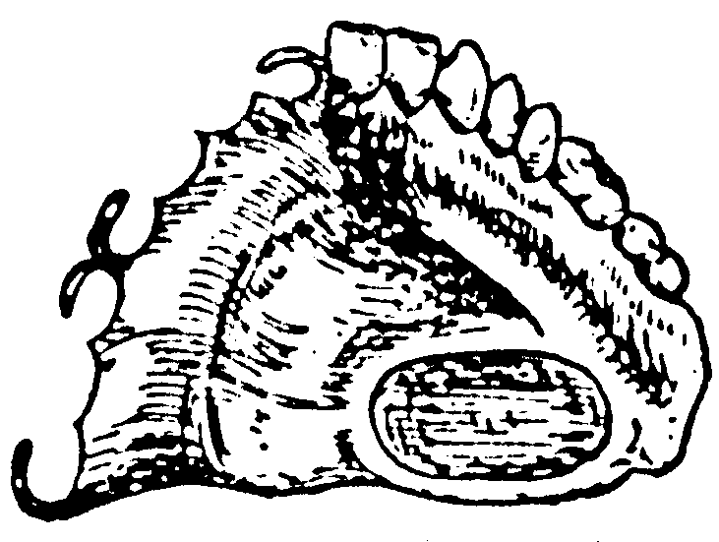
Group 2 - defect of the hard palate in the presence of supporting teeth on one half of the upper jaw
The possibility of prosthesis suction is significantly reduced or completely eliminated. As a result, only clamp fixation and adhesion can be used. Adhesion can be achieved by constructing a system of valves - internal and peripheral.

Slide 27
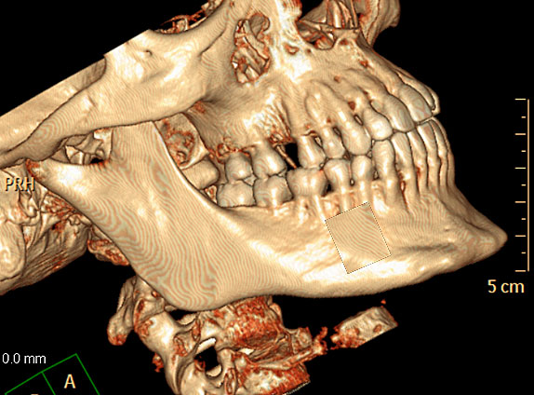
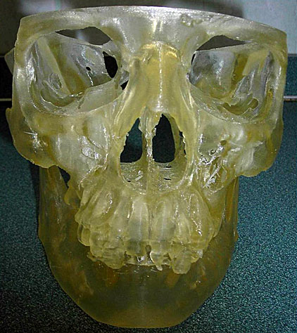
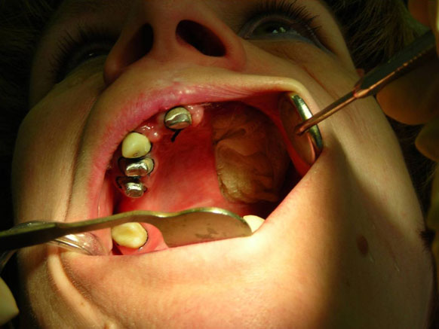
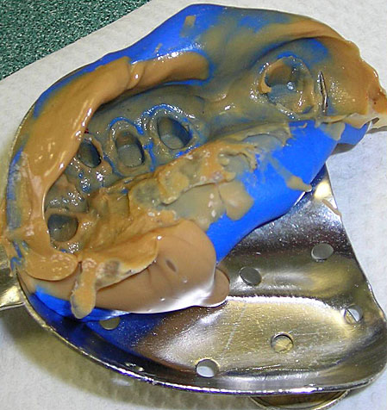

Slide 28
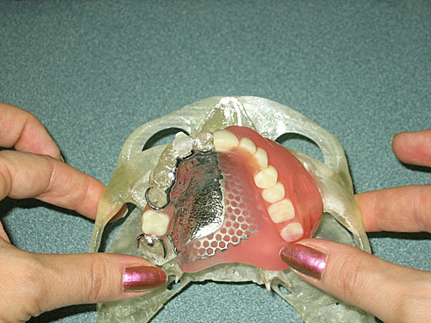
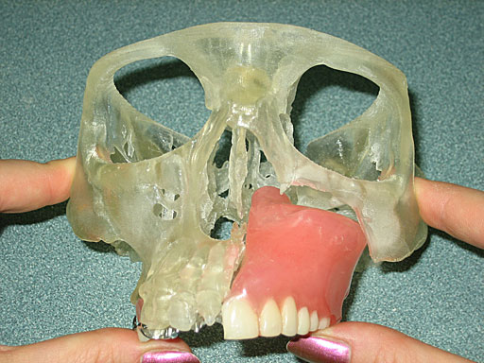
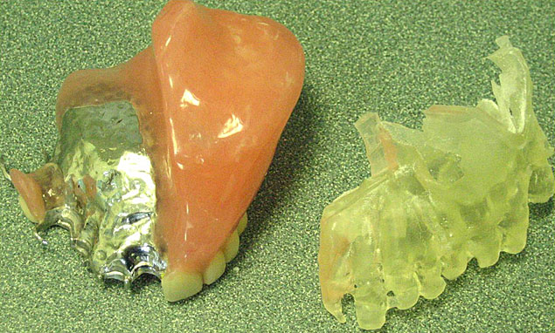
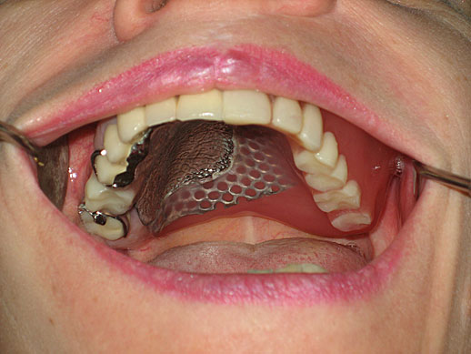

Slide 29
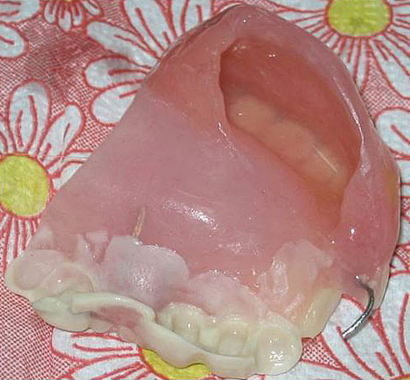
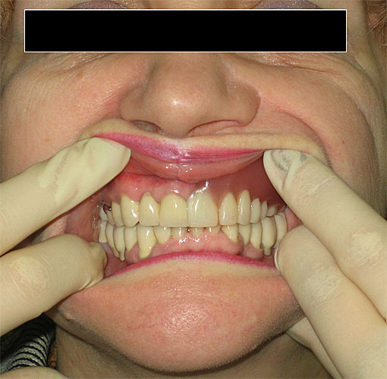
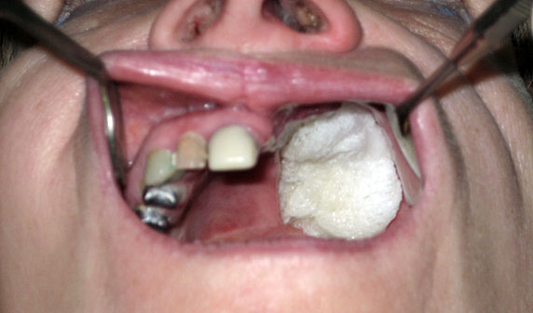
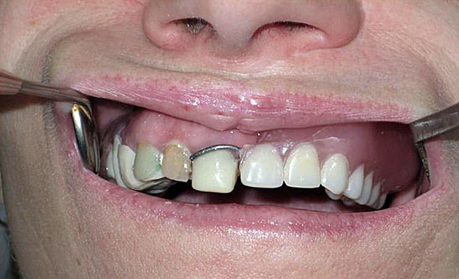
On the upper jaw: a bridge-like metal-ceramic prosthesis supported by 11, 12, 13, 15 with an attachment and milled ledges for fixing retaining clasp elements and a single metal-ceramic crown by 18

Slide 30
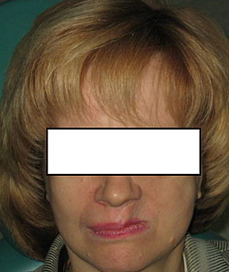
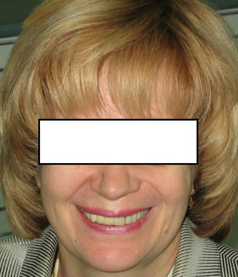

Slide 31
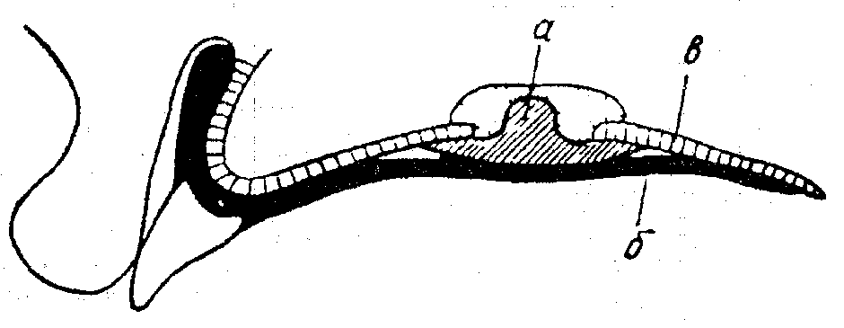
Group 3 - palate defect with toothless upper jaw
It is not possible to ensure good fixation of a complete removable denture using conventional methods: when you inhale through the nose, air gets under the denture and is thrown off. It is not possible to create negative pressure under the prosthesis. To hold the denture on the edentulous upper jaw, it is recommended to use magnets and springs.
Prosthetics of an edentulous upper jaw with a median defect of the hard palate (according to Kelly):
a — obturator; b - complete removable denture; c — toothless upper jaw.
First, an obturator, similar to a cork, is made. Its inner part, which enters the defect and is located in the nasal cavity, is made of soft plastic (Orthosil, Eladent-100), and the outer part is made of hard plastic, since it covers the defect from the oral cavity. Then the patient is fitted with a complete removable denture using the usual method. The prosthesis should not transfer pressure to the obturator, so the oral surface of the obturator is made in the form of a hemisphere.

Slide 32
Group 4 - defects of the soft palate or hard and soft palate
In case of cicatricial shortening of the soft palate, surgical intervention is indicated.
For defects of the soft palate - prosthetics with obturators. The fixing part of the obturator can be in the form of a palatal plate with retaining or support-retaining clasps. The obturating part is connected to the fixing part either motionlessly or with the help of a spring.
In case of an isolated defect of the soft palate and the presence of teeth, an obturator fixed to the teeth using telescopic crowns or support-retaining clasps can be used. These crowns or clasps are connected by an arch, from which a process extends towards the soft palate. An obturating part made of hard or elastic plastic is attached to the process.

