Slide 1
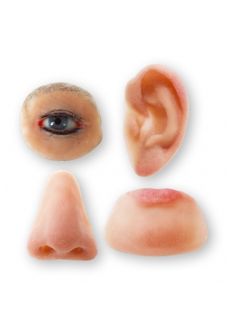
Topic: Classification of maxillofacial and facial prostheses. Retention methods for maxillofacial and facial prostheses.

Slide 2
Two categories of terms are used to describe medical-grade face masks: plastic facial prostheses and epitheses. A prosthesis (from the Greek Pro “instead” and Tithemi “I place”) is a device used in place of a lost natural organ or part of the body, reproducing the form and, if possible, partially or completely restoring function. The term “plastic” (from the Greek Plastein “to shape, model”) defines the ability of a prosthesis to restore the shape of the face. Surgery, on the other hand, is divided into 2 categories that cannot exist in maxillofacial prosthetics: aesthetic and plastic.

Slide 3
The first concerns healthy people, it “decorates” the body and is guided by socio-cultural norms based on generally accepted canons of beauty. The object of the second, as well as prosthetics, are patients with body injuries. Plastic prosthesis is also necessary for sick people, both physically and psychologically. Today, the term “epithesis” is more often used (short for “epithesis”, “marginal prosthesis”, “Epi” on, on top, on the end.) This is a medical product for replacing a missing part of the body, repeating the relief and covering an existing defect.

Slide 4
Typology of facial prostheses.
The typological classification of prostheses is based on the location of the tissue defect. First of all, there are:
External prostheses (ectoprostheses) - external devices, movable, in contact with the skin, mucous membrane or teeth;
Internal prostheses (endoprostheses) are fixed, surgically implanted into the body.

Slide 5
Specialists in maxillofacial prosthetics more often use external prostheses, which are divided into: intraoral - when they are in the oral cavity;
extraoral – located outside the oral cavity.
The role of the latter is to replace skin defects (external nose, auricle, orbital area).

Slide 6
Another type of prosthesis, such as maxillofacial prostheses, which combine static and dynamic designs, is capable of replacing complex defects. The most commonly produced types of epitheses are: prostheses of the nose, auricle, eyelids and eyes, face masks and complex “multi-story” prostheses, which can combine facial and dentofacial prostheses.

Slide 7
Structural elements for fixation of facial prostheses (ectoprostheses)
Facial defects can form due to a number of factors, such as removal of tumors, especially malignant ones, injuries to various parts of the face, burns (thermal, electrical, chemical), birth defects and deformations of the facial area, consequences of diseases (tuberculous lupus, syphilis), etc.

Slide 8
Facial defects can be isolated or combined. Their elimination is possible through plastic surgery and prosthetics. Prosthetics are indicated for large and complex defects of the face (ear, nose). If the patient refuses surgery, prosthetics are also used for small facial defects.

Slide 9
Plastic surgeries give positive results, but they cannot always be performed due to the traumatic nature and duration of treatment, requiring a number of repeated surgical interventions before a satisfactory aesthetic effect is obtained, which is often the reason for patients to refuse this method of treatment.

Slide 10
Contraindications to plastic surgery:
Weakened general condition of the body;
Unfavorable conditions for tissue engraftment created after removal of a malignant tumor and a course of radiation and chemotherapy;
Risk of tumor recurrence;
The extent of the defect in a part of the face and its complex shape (auricle, nose);
Advanced age of the patient;
Small facial defects if the patient refuses surgery.

Slide 11
In these cases, preference should be given to the orthopedic method of treatment. Prosthetics are aimed at restoring the appearance of the patient's speech, protecting tissues from environmental influences, eliminating drooling and food loss, and preventing mental disorders. Ectoprosthetics completes the complex of measures for the rehabilitation of patients with facial damage.

Slide 12
Facial prostheses are made from soft (orthoplast) or hard plastic based on polymethyl methacrylate - PMMA (-7, -9, -10, EGMASS-12), sometimes a combination of plastics is used. Modern ectoprostheses are made from materials based on silicone and PMMA. To obtain the best aesthetic effect, soft plastics are painted with special dyes that are selected according to color. A facial prosthesis made of rigid plastic is painted in two ways. The best results are obtained by painting the prosthesis with oil paints. The second method is to add dyes to the polymer (ultramarine, lead crown, cadmium red, etc.)

Slide 13
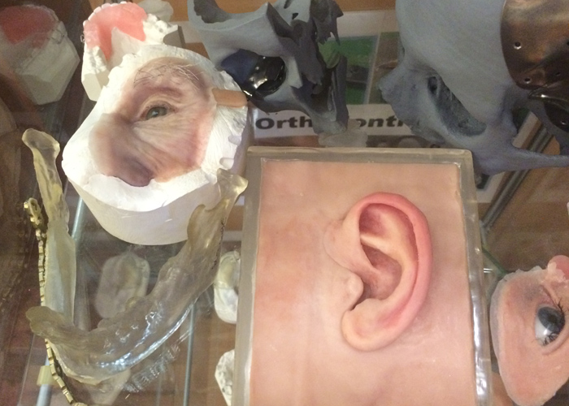

Slide 14
Mechanical fixation.
Ectoprostheses are strengthened using spectacle frames, which are either connected to the facial prosthesis monolithically, or made using locking devices, such as magnets. To fasten ectoprostheses, special clamps are also used, which are inserted into natural or specially created surgically retention points, clamps (as in a hearing aid), rubber band passing under the hair from one temple of the glasses frame to the other. In some cases, the ectoprosthesis is fixed using a screw-shaped implant with a rough surface, which provides the best connection with the bone.

Slide 15
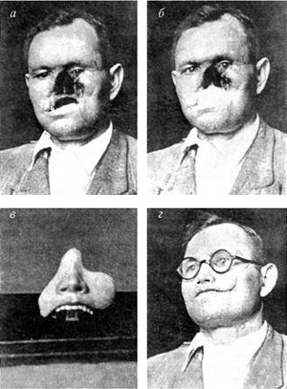
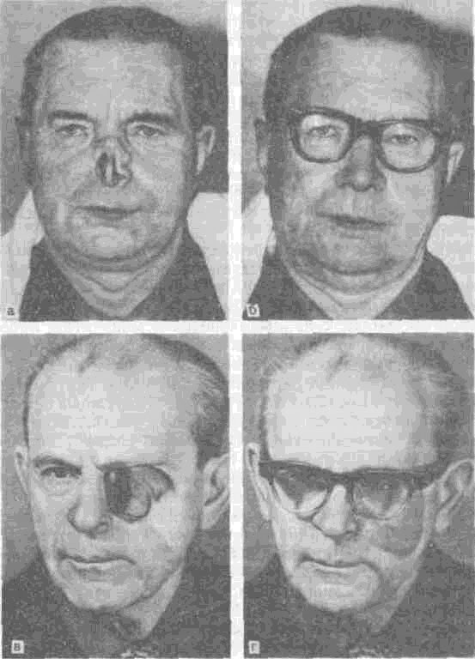
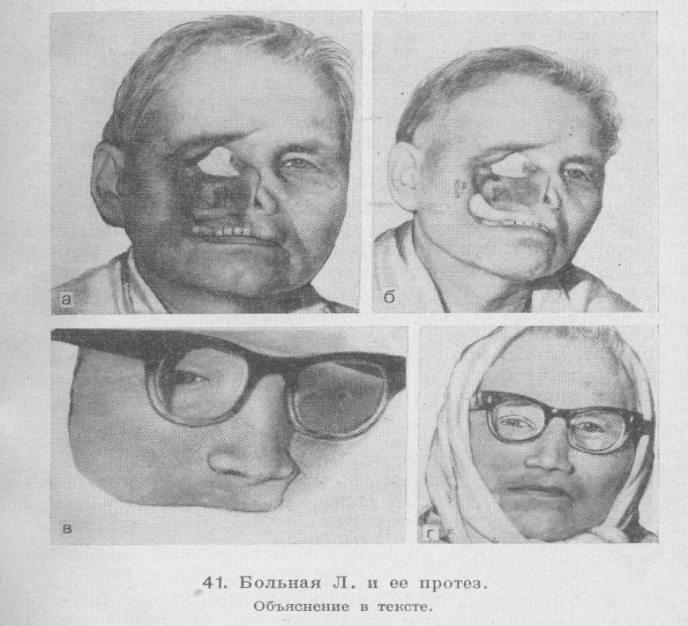

Slide 16
Chemical fixation.
As an additional method of fixing ectoprostheses, special adhesives or theater glue are also used, which for small facial prostheses (for example, when replacing a defect in the wing or tip of the nose), where other methods of fastening cannot be used, are the main method of fixation.

Slide 17
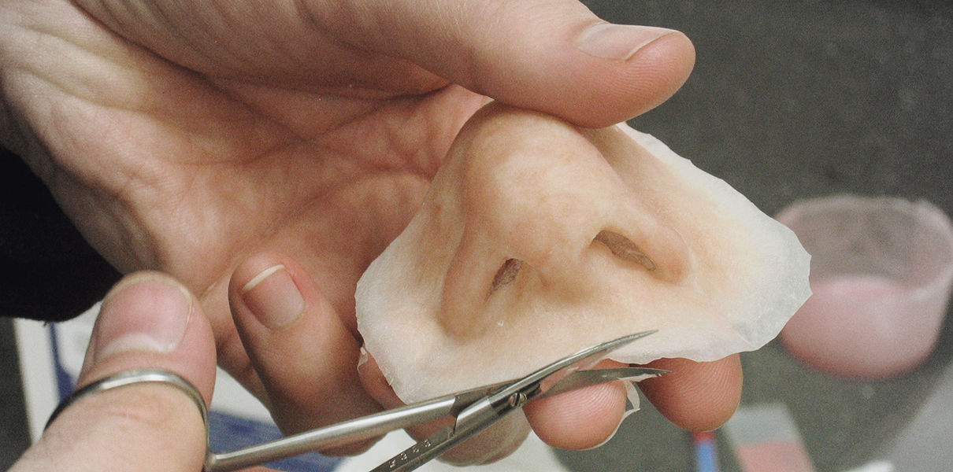

Slide 18
Physical fixation.
Сочетание имплантата с магнитными элементами упрощает конструкцию эктопротеза без снижения качества фиксации и позволяет полностью избежать опасности инфицирования имплантата благодаря сохранению целостности кожных покровов.

Slide 19
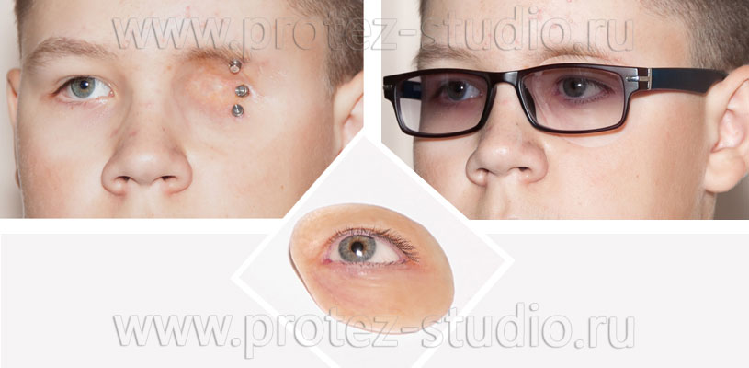

Slide 20
All facial prostheses are prepared on a facial model (plaster mask). When modeling an exoprosthesis, they check the patient’s photographs, take into account the shape of the face, anthropometric data, the symmetry of the paired organ, and take into account personal complaints and wishes.

Slide 21
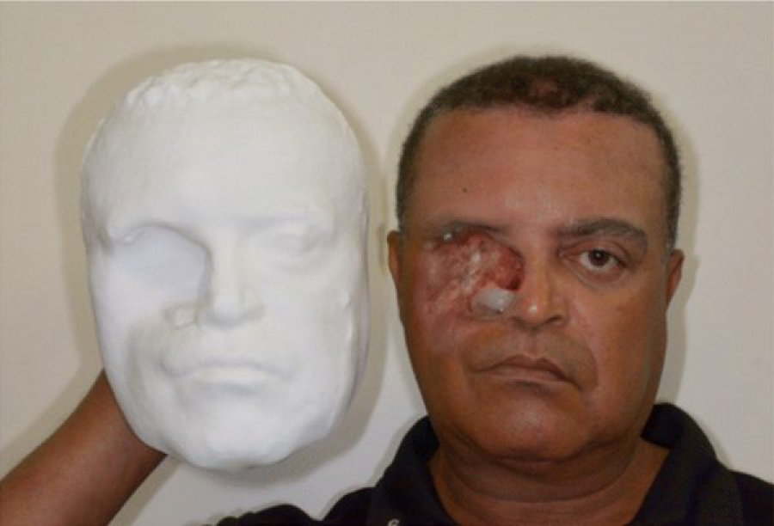

Slide 22
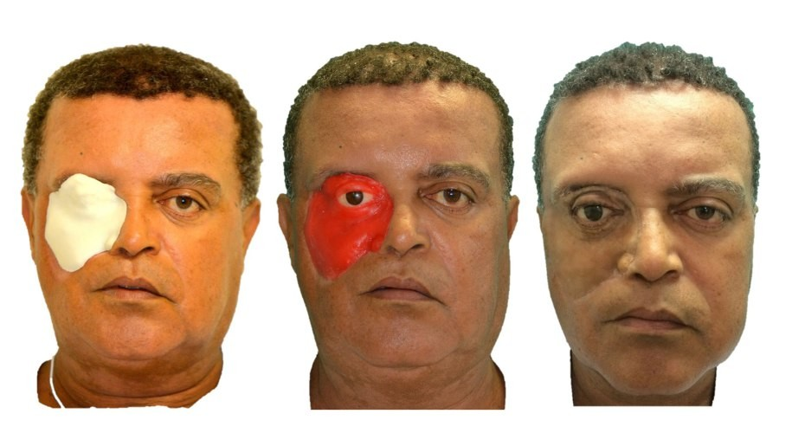

Slide 23
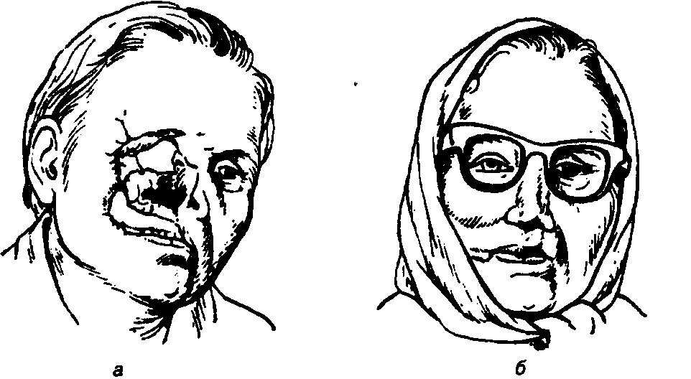
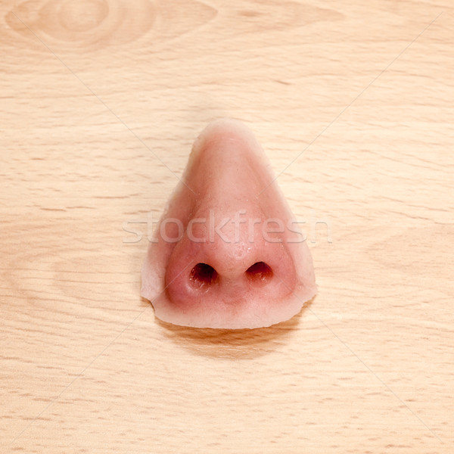
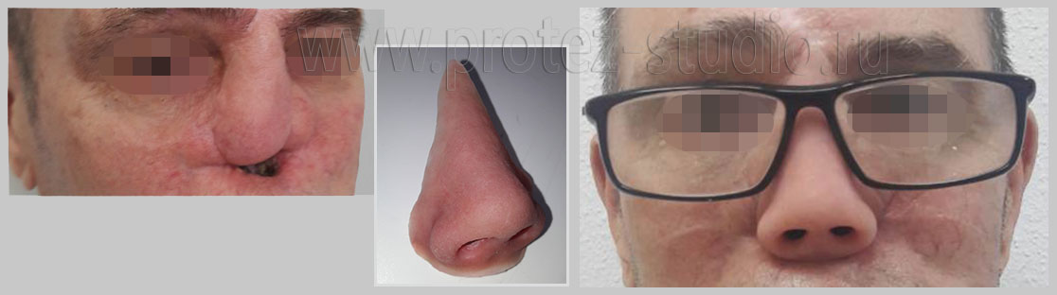
Facial exoprosthetics:
Prosthesis of the orbit and nose with fixation on the frame.
Prosthetic nose.
Prosthetic nose with fixation on the frame.

Slide 24
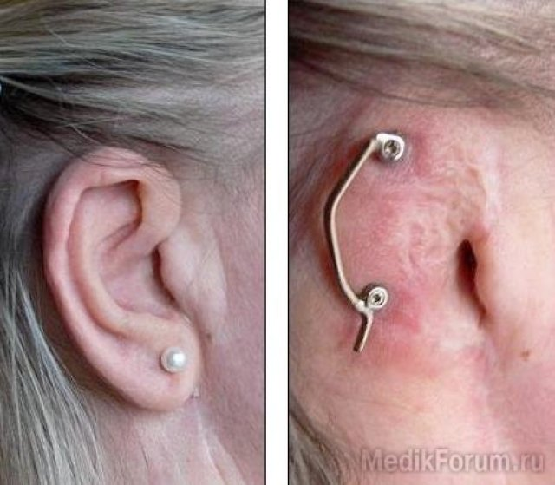
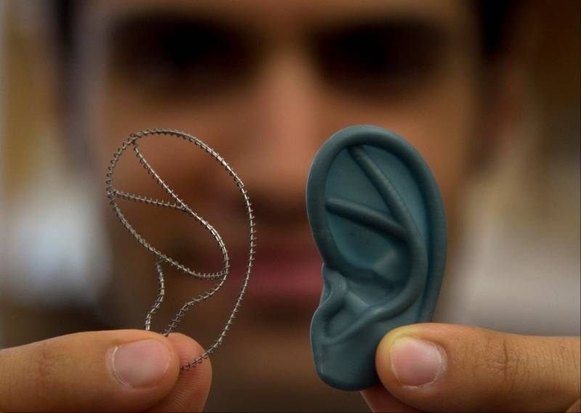
Ear prosthesis.

Slide 25
Replacement prosthesis for soft tissue defects in the perioral area (according to B.K. Kostur and V.A. Minyaeva)
Fixation of the prosthesis is carried out using a solid-cast dental frame with occlusal overlays - a splint, with an intact dentition, and a prosthetic splint - with partial absence of teeth. The intraoral part of the ectoprosthesis can be used as a forming apparatus during delayed osteoplasty, and after it as a replacement prosthesis. When making ectoprostheses in the case of a unilateral combined defect of the upper and lower lip and the corner of the mouth, they are made separately and secured to the dentures, each independently. Taking into account the fact that when the mouth is opened, the defect in the area of the corner of the mouth increases, a special protrusion is modeled on the distal edge of the ectoprosthesis of the upper and lower lips, extending to the ectoprosthesis of the lower lip.

Slide 26
Combined maxillofacial prostheses are a combination of an ectoprosthesis with jaw prostheses. They can be fixed to each other using hinges or magnets, or a rigid connection.

Slide 27
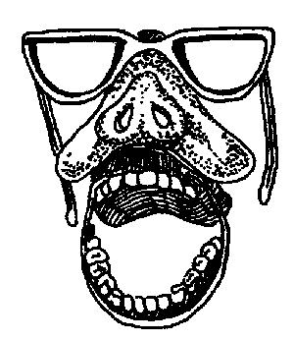
Combined maxillofacial prosthesis (according to I.M. Oksman).
The facial prosthesis is fixed using a frame and rods that fit into the sleeves of the maxillary replacement prosthesis.

