Slide 1
Fundamentals of pharmaceutical marketing
Abdullina Ylia

Slide 2
1. Marketing, 4P theory-? 2. Functions of marketing 3. Five marketing concepts 4. Types of marketing segmentation

Slide 3
-?

Slide 4
The AMA’s* 1985 definition defined marketing as “the process of planning and executing the conception, pricing, promotion, and distribution of ideas, goods and services to create exchanges that satisfy individual and organizational goals.” American Marketing Association, 1985

Slide 5
Marketing refers to activities a company undertakes to promote the buying or selling of a product or service.

Slide 6
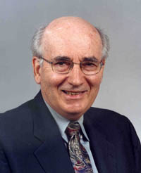
“Marketing is a social and managerial process by which individuals and groups obtain what they need and want through creating and exchanging products and value with other”. (Philip Kotler)

Slide 8
- Levitt made a key contribution to management theory in the area of marketing - His idea was that the survival of a firm depends on the customer - He argues that marketing is a much wider concept than selling - Marketing is neglected because firms feel secure

Slide 9
Infographic By: Avalaunch Media

Slide 10
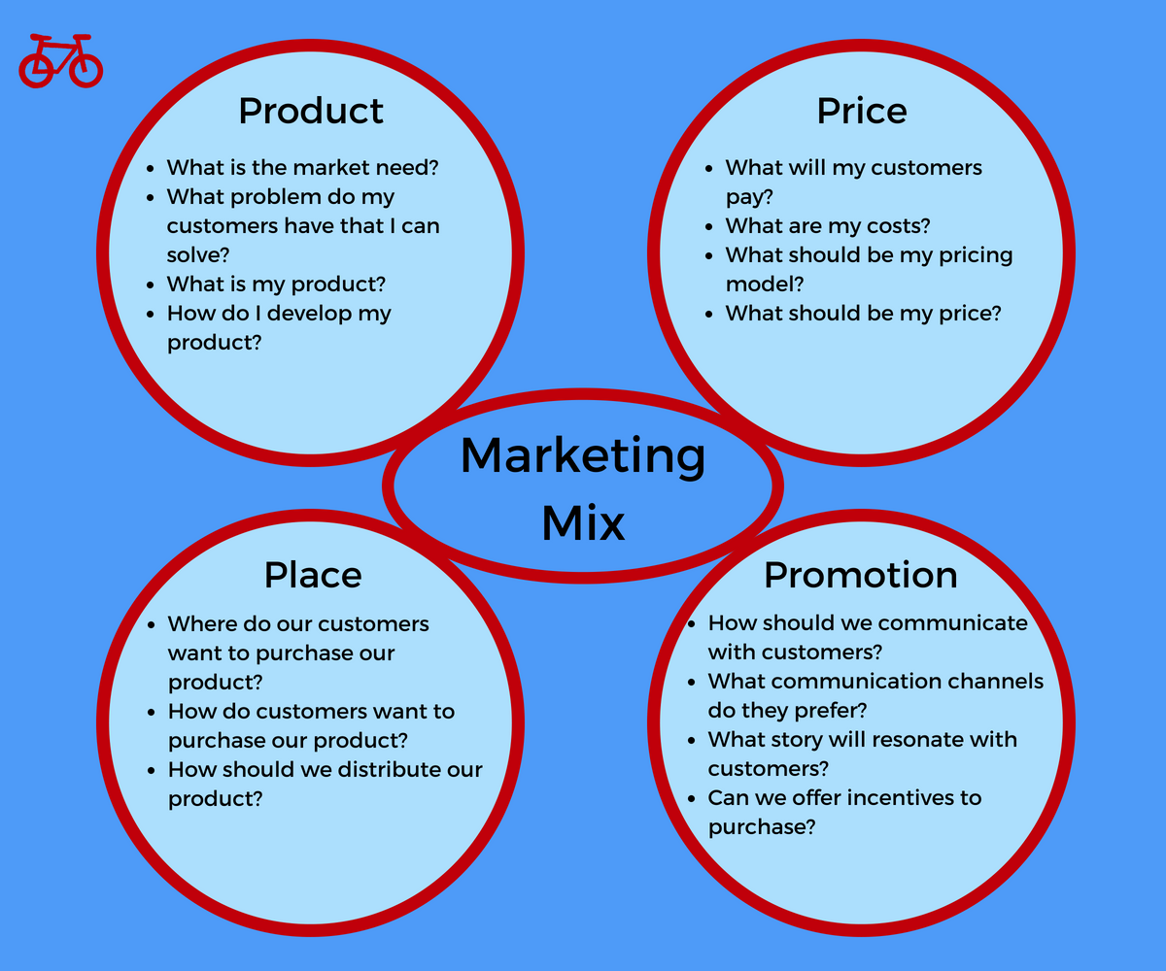
https://redbikemarketing.com/marketing/marketing-mix-4ps/

Slide 11
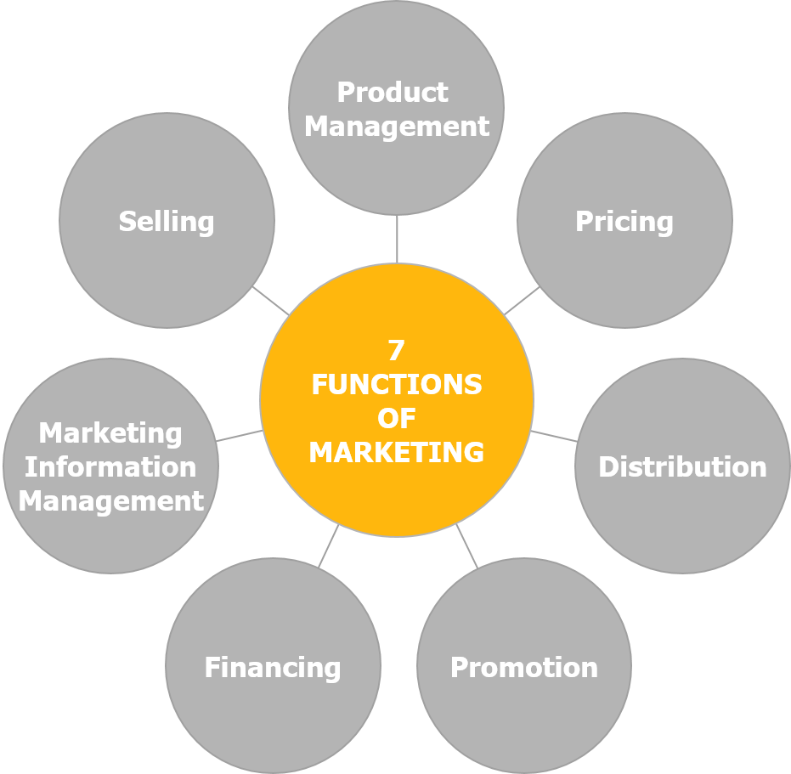
https://marketing-insider.eu/

Slide 12
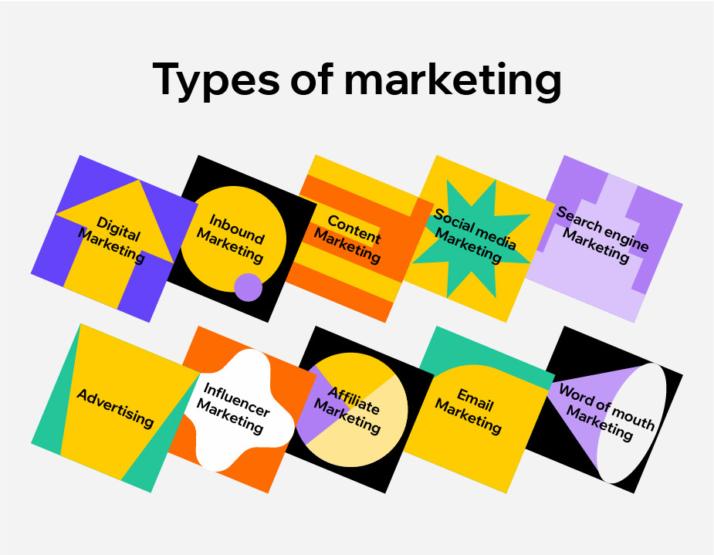
https://www.wix.com/blog/2021/06/types-of-marketing/

Slide 13
Mariya Giletwala

Slide 14
Pharmaceutical marketing is the process of implementing pharmaceutical activities aimed at meeting the needs and requirements of pharmaceutical care.

Slide 16
Market segmentation is an increasingly important part of a strong marketing strategy and can make all the difference for companies in competitive market landscapes, such as e-commerce. Market segmentation offers an opportunity to pinpoint exactly what messaging will drive your customers to make a purchase.

Slide 17
The purpose of market segmentation is to identify different groups within your target audience so that you can deliver more targeted and valuable messaging for them.

Slide 18
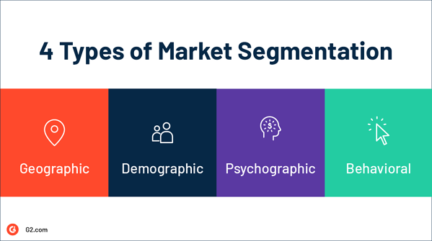
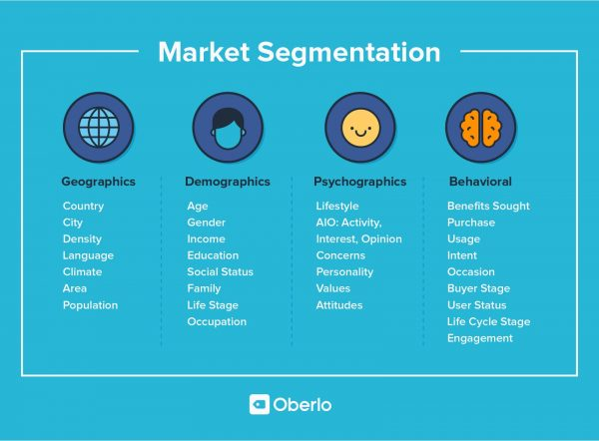
Picture by Hannah Tow

Slide 19
1. Marketing, 4P -? 2. Functions of marketing 3. Five marketing concepts 4. Types of marketing segmentation

