Slide 1
Modern methods of orthopedic treatment of patients with defects of hard dental tissues using ceramic inlays and veneers.

Slide 2
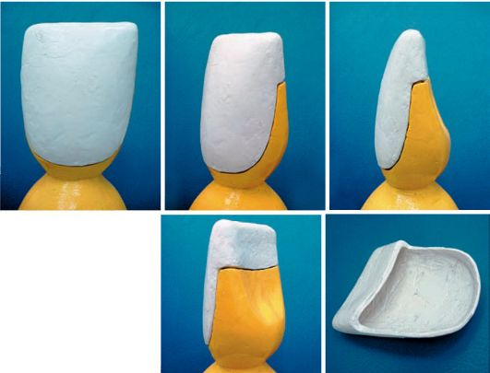
Orthopedic treatment with veneers
Venus is a non-removable prosthesis of part of the tooth crown (microprosthesis). It is used to restore the anatomical shape of a tooth, as well as to restore (or change) the color of a tooth.
Veneers can be made from plastic, composite materials or ceramics.
According to the manufacturing method, they can be divided into veneers obtained by the clinical (direct) method, and veneers obtained by the laboratory (indirect) method.
Ceramic veneers can be produced in the laboratory using several methods: layer-by-layer application, injection molding, milling (using CAD/CAM technologies).
Depending on the time of use, veneers can be permanent or temporary. Temporary ones are made of composites (or plastic) and are used during the production of permanent veneers.

Slide 3
Classification of veneers according to the type of material used to make the plates
Ceramic veneers. For their production, medical porcelain and zirconium dioxide are used. They are considered the best because they are highly durable, do not change color over time, and are indistinguishable from real teeth in appearance. The thickness of ceramic veneers is only 0.3 - 0.5 mm.
Composite veneers. This type of veneers is outdated and less preferred, as it has many disadvantages from an aesthetic point of view and limitations in service life. The advantages of using them are the speed of installation (in the dentist’s office) and the gentle technique.
A type of porcelain ceramic is Hollywood laminates. The thickness of such plates is only 0.2 mm. Compared to conventional porcelain veneers, they are easier to use and have a longer service life. The method of their manufacture allows not to grind down the tooth enamel. Hollywood veneers can be glued to artificial crowns.

Slide 4
Stages of making veneers
Layer-by-layer application of ceramic mass followed by firing (unpressed ceramics).
Injection molding at high temperature under pressure (pressed ceramics). This technology allows you to create very durable veneers. Their service life is longer than structures made from unpressed ceramics.
Composite veneers can be made in two ways:
At the dentist's office. Such constructions are called therapeutic veneers or direct veneers. The doctor removes a small layer of enamel on the front surface of the tooth, and then applies a light-polymer composite material to it in layers, restoring its surface.
In the dental technician's office. To do this, the dentist grinds down the tooth for the veneer and takes an impression. In the laboratory, a plaster impression of the teeth is made from the impression. A veneer made of composite materials will be modeled on it.

Slide 5
Making ceramic veneers
Preparation for dental veneers and making a three-dimensional impression.
The future veneer is modeled on a computer.
Turning the structure on a zirconium dioxide milling machine (without human intervention).
A temporary laminate is applied to the ground tooth.
Treating the inner surface of the veneer (making it rough) for better installation.
Applying cement to the tooth and the inside of the plate and fixing it to the tooth.

Slide 6
Advantages and disadvantages of veneers compared to aesthetic crowns
The use of aesthetic (ceramic and metal-ceramic) crowns has a number of negative features inherent in this technology. First of all, we mean extensive preparation, leading to the irreversible loss of a significant amount of hard tooth tissue, as well as possible further devitalization of the tooth. The consequence of this may be a state of physical and psychological discomfort for the patient. The desire to hide the edge of a metal-ceramic crown forces the doctor to immerse the preparation border into the periodontal sulcus, which is not always adequately perceived by the marginal gum. In addition, the presence of a metal frame can be manifested by its transillumination at the necks of the teeth in the region of the marginal gum, especially in individuals with a thin biotype of periodontal tissue.
In this regard, veneers have an undeniable advantage, since they require significantly less preparation of the tissues of the supporting tooth - their treatment is less invasive, and the absence of a metal frame allows the preparation border to be left at the level of the gingival margin without disturbing the dynamic balance in the periodontal sulcus. Compared to composite veneers, ceramic veneers have greater wear resistance and color stability. On their smooth surface, plaque accumulates less. The disadvantages of ceramic veneers include the need for relatively expensive equipment for their production.

Slide 7
Indications and contraindications for the use of veneers
• Venus is used on fully erupted permanent teeth, most often on the upper incisors and canines, sometimes on premolars. They can also be used on the lower front teeth. • It is possible to use veneers when previously manufactured metal-ceramic structures fail, for example, to restore chipped ceramic cladding. • Absolute contraindications include the presence of increased (stressful) loads on the veneer. Such loads can occur during supercontacts, with occlusal-articulatory disharmony, as well as in the absence of antagonizing pairs of teeth in the lateral regions. • Relative contraindications include low clinical dental crowns. Here the problem comes down to the difficulties that arise when manipulating small and fragile veneers.

Slide 8
The main clinical and laboratory stages of treatment with veneers made by indirect (laboratory) method
• Examination, examination, diagnosis, drawing up a treatment plan, obtaining the patient's informed voluntary consent to treatment. • Determination of tooth color.
• Anesthesia. • Tooth preparation. • Taking impressions. • Veneer production in the laboratory. • Fitting and fixing the veneer.

Slide 9
Clinical stages
•The patient is examined according to generally accepted methods using clinical and special research methods. Using stomatoscopy, probing, targeted radiography, radiovisiography, the condition of dental tissues and the periodontal complex is determined. If necessary, diagnostic models of the jaws are obtained, which make it possible to clarify the characteristics of the bite, the condition of the supporting teeth and antagonist teeth, and plan preparation tactics. Pre-production of veneers can be done on models to familiarize the patient with the expected shape and size. • Color selection. The surface of the tooth is cleaned of plaque and tartar using brushes and special pastes, after which the tooth is washed with water. When selecting a color, the surface of the tooth must be damp, which preserves its natural appearance. It is preferable to determine color in natural light in the middle of the day in clear weather.

Slide 10
Preparation of teeth for veneers. Fixation of veneers
Tooth preparation includes the following stages: • preparation of the vestibular surface; • preparation of proximal surfaces; • preparation of the cutting edge; • preparation of the palatal surface (if necessary).

Slide 11
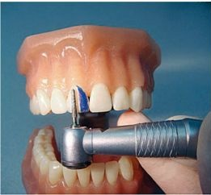
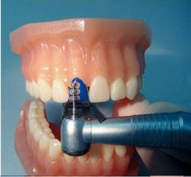
Preparation of the vestibular surface.
It begins with applying transverse grooves to the prepared surface, limiting the depth of grinding of hard tooth tissues with a calibrating diamond bur with a given diameter of 0.3-0.5 mm. Then the hard tissues of the tooth are ground to a specified depth until a smooth surface is created. A ledge is formed in the cervical region. The most widely used is the groove-shaped ledge, which is favorable for marginal periodontal tissues. In most cases, it is sufficient to place the ledge at the level of the gingival margin. When the tooth is greatly discolored, the ledge is immersed in the periodontal sulcus, but not more than half its depth.

Slide 12
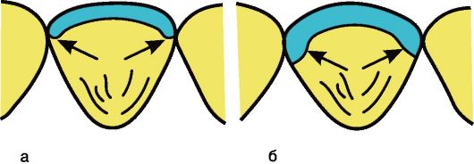
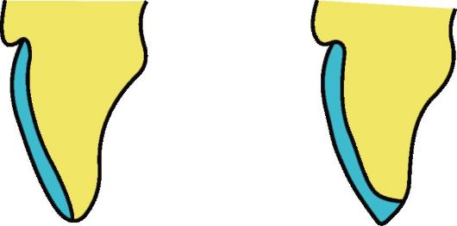
Preparation of proximal surfaces
Has two options. The most common is to move the boundaries of the preparation from the vestibular surface of the tooth to the lateral ones, without violating the interdental contact points, which helps maintain the integrity and stability of the dentition. In this case, it is necessary to form vertical grooves (grooves) 0.5 m deep along the proximal sides. According to another option, it is recommended to place the boundaries of the preparation on the oral surface of the tooth crown, covering the interdental contact points. This increases the strength and retention of the veneer and becomes necessary for aesthetic correction of the shape and size of teeth (trema, diastema, awl-shaped teeth, etc.) Preparation of the incisal edge of the tooth. Here, too, two options are possible: preparation with preservation of the cutting edge or with its overlap. In the case of preparation (overlapping) of the cutting edge, it is ground down by 0.5-1.0 mm, and if necessary, up to 2 mm.
Preparation of proximal surfaces for veneers: a - preparation boundaries without violating interdental contact points; b - preparation boundaries overlap interdental contact points
Препарирование режущего края под винир

Slide 13
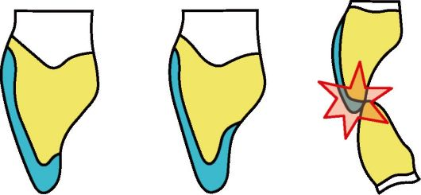
Preparation of the palatal surface of the tooth
If it is necessary to prepare this surface, the boundary and depth of preparation should be clearly defined. The depth of preparation should ensure the strength of the future veneer. The preparation boundary should not be located in the zone of occlusal contact with antagonist teeth. The overlap of the incisal edge and the palatal surface gives the veneer greater stability during the articulatory relationships of the antagonist teeth. The preparation is completed by finishing the tooth surface with finely dispersed diamond burs (for example, with a red marking ring). The doctor needs to eliminate all sharp edges and corners formed when one surface transitions to another. Stresses can be concentrated here, leading to veneer breakage; in addition, such areas make it difficult to manufacture and fit.
Position of the veneer on the palatal surface

Slide 14
Taking an impression
The production of veneers in a laboratory method requires high accuracy in displaying the relief of the tissues of the prosthetic bed. For this purpose, impressions are taken, the methods for obtaining which are different. These can be one-step single-layer, one-step two-layer or two-step two-layer prints. The choice of technique for obtaining an impression is determined by the doctor depending on the clinical picture and preferences. The choice of impression material should be based on the group of silicone or polyester materials, as they meet all modern requirements. If a ledge is formed in the periodontal sulcus, it is necessary to carry out gum retraction before taking an impression to more clearly display the preparation boundary.

Slide 15
Fitting and fixing the veneer
The fitting of veneers made in the laboratory consists of the following steps:
• from the evaluation of the obtained veneers;
• fitting each veneer to the supporting tooth;
• fitting all veneers together;
• assessing the aesthetic result.
When fitting veneers individually, you need to make sure that each of them is effortlessly applied and positioned on the prepared tooth surface and has a good marginal fit. When applying several adjacent veneers, you can use water-soluble correction gels or transparent silicone mass. The veneers applied together should not displace each other and at the same time should have tight proximal contact. When assessing aesthetics, attention is paid to the size, shape, position and color of orthopedic structures. It is important to demonstrate the results obtained to the patient and obtain his approval. If necessary, at this stage it is still possible to correct the veneers by a dental technician in the laboratory.
After fitting, the surfaces of the veneers are carefully wiped with a damp swab and then cleaned with alcohol or acetone to remove traces of saliva or fat.

Slide 16
Fixation
Reliability of veneer fixation is ensured by the strength of adhesion between three main components: hard tooth tissue - fixing material - ceramic veneer. These components are chemically dissimilar materials. Teeth are composed of enamel (86% hydroxyapatite, 12% water), dentin (45% hydroxyapatite, 30% collagen fibers, 25% water), pulp and other structures. Ceramics are not organic. Composite luting materials have an organic matrix and an inorganic filler. The composition of these components explains why it is difficult or impossible to combine them by direct chemical reaction.
Fixation of veneers consists of 3 stages of preparation:
• veneer surfaces;
• tooth surface;
• fixing material.

Slide 17
•Preparation of the veneer surface involves creating a rough surface for its contact surface with the tooth tissue. This is achieved by etching with 10% hydrofluoric acid for 1-4 minutes. It selectively dissolves silicon oxide on the surface of the ceramic, resulting in the formation of micropores. To improve retention, preliminary sandblasting of the contact surface of the veneer is possible. However, the use of this technique requires special care, since the outer surface of the veneer may be damaged. Before fixing, the internal surfaces of the veneers are thoroughly washed with water and dried. A silane coupling agent is then applied to the inner surface of the veneer to achieve a chemical bond between the adhesive and the porcelain. The silane groups combine with the adhesive and hydrolyzed silica molecules. As a result, the adhesive better wets the ceramic surface. Silane is applied for 60 s, after which the surface is carefully dried with an air stream.
•The tooth surface is cleaned of temporary cement, try-in gel and other foreign matter. To do this, use rotating brushes with abrasive paste without fluoride or an intraoral sandblaster. The tooth surface is then etched with 37% phosphoric acid. Acid etching of enamel leads to demineralization of interprismatic areas of enamel and creates a surface microrelief that promotes adhesion. When etching enamel, the exposure is 30-40 s. When etching dentin, the time should not exceed 15 s to avoid collapse of collagen fibers, which will prevent the primer from penetrating into the dentinal tubules. The acid is washed off with plenty of water. The tooth surface is dried and a primer is applied. After 30 s, the surface is dried and adhesive is applied. At the same time, the adhesive is applied to the silanized surface of the veneer. •Composite materials of light polymerization are used as a fixing material. The fixing material is applied to the inner surface of the veneer and carefully placed on the tooth. Excess fixing material is removed before polymerization. After polymerization, the “glue seam” is grinded and polished, the occlusal-articulatory relationships of the antagonist teeth are checked and, if necessary, corrected.

Slide 18
ORTHOPEDIC TREATMENT OF HARD DENTAL TISSUE USING INSERTS
An inlay is a microprosthesis that fills a defect in the crown of a tooth, restoring its anatomical shape.
The inlay is a filling made in a laboratory. Unlike the therapeutic treatment of defects in the crowns of teeth, when the filling material is introduced into the tooth cavity in a plastic state, the inlay is introduced into the formed cavity in a solid state. Therefore, orthopedic treatment using inlays has obvious advantages and provides:
• strong connection of the inlay with the tooth tissues due to the precise fit of the mating surfaces;
• the possibility of reliable restoration of interdental contact points, corners and tubercles of tooth crowns, taking into account the age and individual characteristics of natural teeth;
• prevention of caries relapse by compensating for the shrinkage of the material during the manufacture of the inlay, constancy of the inlay’s volume and its precise marginal fit;
• wear resistance and durability of the insert due to high mechanical strength;
• color stability due to the denser structure of materials formed in the laboratory.
For these reasons, replacing defects in hard dental tissues with inlays in many cases turns out to be more reliable than filling.

Slide 19
Types of ceramic inlays
Zirconium dioxide inlays
Such inlays are made by grinding finished zirconium dioxide blanks. They are ground on the basis of a cast made from a damaged tooth, or rather on the basis of a special plaster model. Moreover, grinding occurs automatically, under computer control. At the end, the finished workpiece is fired, a porcelain mass is fused onto it, and as a result, the inlay is fixed on the patient’s tooth.
In terms of their aesthetic qualities, zirconium inlays are not inferior to porcelain inlays, and thanks to the zirconium frame, they are as durable as metal inlays. Automation of the inlay manufacturing process, which eliminates the human factor, also plays a positive role. Pressed ceramic inlays
These inlays are made by injection molding porcelain under very high pressure and temperature. Porcelain inlays are aesthetically ideal, but are less durable than zirconia inlays. Metal-ceramic inlays
Metal-ceramic inlays are a fairly new invention. They are almost the same price as ceramic ones, but their quality is an order of magnitude worse. Metal-ceramic inlays very often fall out due to different coefficients of thermal expansion between metal and ceramics. Therefore, dentists usually do not recommend installing metal-ceramic inlays - it is better to limit yourself to standard ceramic inlays.

Slide 20
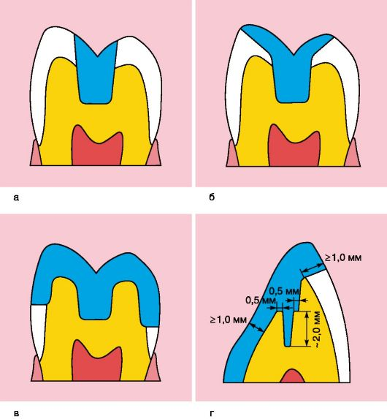
Classification of tabs by design
Depending on the degree of destruction of the coronal part of the tooth and the method of placing the microprosthesis in the hard tissues, the inlays can replace the missing tissues to a greater or lesser extent. There are four main types of inlay designs: • inlay - a microprosthesis located centrally and not affecting the tubercles of the tooth, the least invasive • onlay - a microprosthesis affecting the internal slopes of the tubercles in the form of an overlay • overlay - a microprosthesis that covers the 1 to 3 tubercles. A structure that covers 4 tubercles can already be classified as three-quarter crowns • pinlay - a microprosthesis strengthened in the tooth using pins (pins) located in the hard tissues of the tooth (Fig. 1-1, d). When making such structures on chewing teeth, as a rule, all the tubercles are covered. On the front teeth, it is possible to make a pinlay while preserving the vestibular surface and cutting edge. Thus, pinlay inlays on incisors and canines resemble a half-crown with a pin.

Slide 21
Indications
• Cavity limited by enamel.
• Large cavity on the chewing surface.
• Class II cavities according to Black.
•Gentle tissue preparation compared to gold alloy preparation.
• Aesthetic requirements of the patient

Slide 22
Contraindications
• Poor oral hygiene.
• High intensity of the carious process.
• Bruxism.
• Steep slopes of the hillocks.
• Deep approximal cavity extending into dentin.
• Minor cavity depth (< 1.5 mm).
• Inability to ensure a completely dry field.

Slide 23
Forming a cavity for the tab
The main features of preparing teeth for inlays, as opposed to fillings, are the creation of relative parallelism of the side walls for the possibility of introducing the finished structure, as well as the need for preparation to a depth that ensures sufficient strength of the inlay. To ensure reliable fixation of the inlay while maintaining cavity edges that are resistant to chewing pressure and to prevent relapse of caries during cavity formation, certain principles must be observed. • The cavity is given the most appropriate shape, such that the insert can be easily removed from it in only one direction. In this case, the vertical walls of the cavity should be parallel or slightly diverge (diverge). The slope of the walls is not a constant value and can vary depending on the depth of the cavity: for superficial cavities the slope should be less, for deep ones it should be greater. • The bottom and walls of the cavity should be able to withstand chewing pressure well, and their relationship should contribute to the stability of the inlay. The design of the angle formed by the outer walls and the bottom of the cavity has a certain significance for stability. The angle of transition of these walls into the bottom should be clearly defined and approach a straight line. • The bottom of the cavity should be parallel to the roof of the tooth cavity and be of sufficient thickness to protect the pulp from external influences. Depending on age, the safe thickness of dentin above the pulp cavity can range from 0.6 mm for teeth whose root formation process has already been completed, and 1.4 mm for teenage and young adult teeth with wide and open dentinal tubules.
• To prevent relapse of caries, it is necessary to carry out preventive expansion of the cavity. • When forming a complex cavity that involves several surfaces of the tooth, retention elements should be created to prevent the inlay from moving in different directions. Additional retention points should be created if at least one outer wall is missing or its height is insignificant. Fixation elements can have different shapes: cross-shaped, T-shaped, dovetail. • The cavity for the inlay must have sufficient depth with mandatory immersion into the dentin. • The formed cavity should be asymmetrical or have additional recesses that serve as guides when inserting it into the cavity. There should be no undercuts that would interfere with the removal and insertion of the inlay. In each specific clinical case, the method of preparing hard dental tissues for an inlay will differ depending on the class of hard tissue defect and the material used to make the inlay.

Slide 24
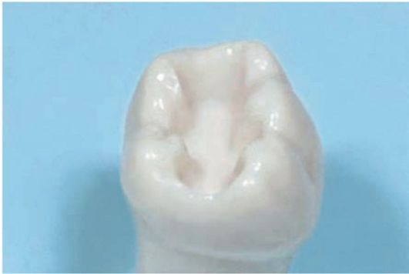
. When making metal-free inlays, creating bevels in the enamel is contraindicated due to the properties of the materials - their fragility in the presence of a thin layer in the area of ​​the transition to the tooth enamel. In addition, when making metal-free inlays, the internal corners of the cavity should be slightly rounded, and the outer boundary of the cavity should be within the enamel. When forming a cavity for composite, ceramic inlays, the edges of the cavity are not finished to ensure a high degree of fixation
Окончательно сформированная полость

