Slide 1
Theoretical analysis of periodontal assessment methods

Slide 2
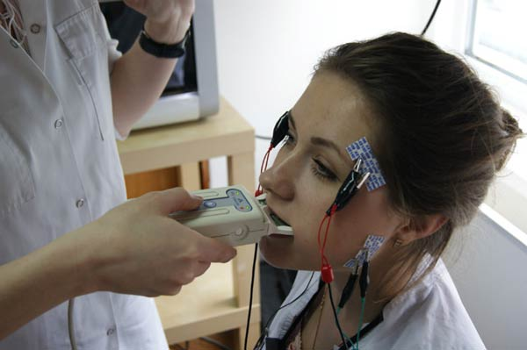
Gnathodynamometry
Gnathodynamometry is a method for determining the strength of the masticatory muscles and the endurance of the supporting tissues of the teeth to perceive pressure when clenching the jaws using a special apparatus - a gnathodynamometer. When squeezing the gnathodynamometry with your teeth, a sensation of pain appears, and this moment is recorded as an indicator of gnathodynamometry.
Gnathodynamometry indicators, depending on gender, age and individual characteristics, range from 15 to 35 kg in the area of the anterior teeth and 45–75 kg in the area of the molars. Individual periodontal tolerance to pressure changes with various diseases (periodontal disease, periodontitis, vitamin deficiency), as well as with partial loss of teeth. Gnathodynamometry data are important in dental prosthetics and orthodontics.

Slide 3
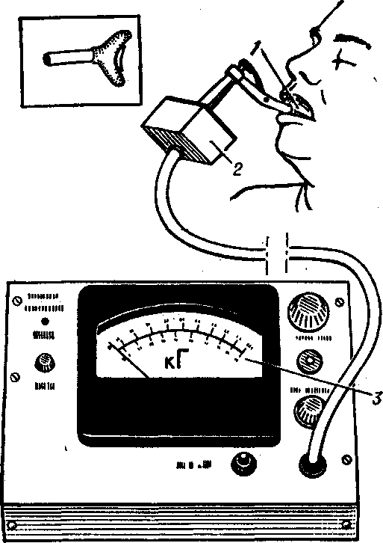
Gnathodynamometry
Gnathodynamometry has the disadvantage that it measures only vertical pressure, and not horizontal pressure, with the help of which a person crushes and grinds food. In addition, the device does not give accurate measurement results, since the spring quickly deteriorates.
Some proponents of gnathodynamometry have established, through numerous measurements, the average chewing pressure figures for the teeth of the upper and lower jaw. However, these numbers, just like others obtained by gnatometry, cannot be used as typical indicators, since the amount of chewing pressure expressed in kilograms depends on the psychosomatic state of the patient during the test, and this state varies from person to person and even among the same individuals at different times. In addition, gnathodynamometry has other disadvantages. Consequently, the given values are not constant, but variable, which explains the sharp discrepancy in the results of measuring chewing pressure according to different authors.

Slide 4
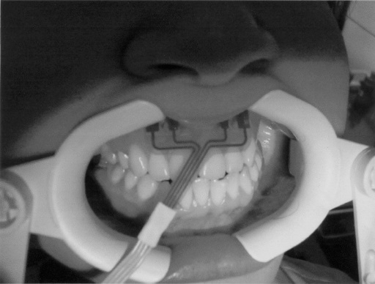
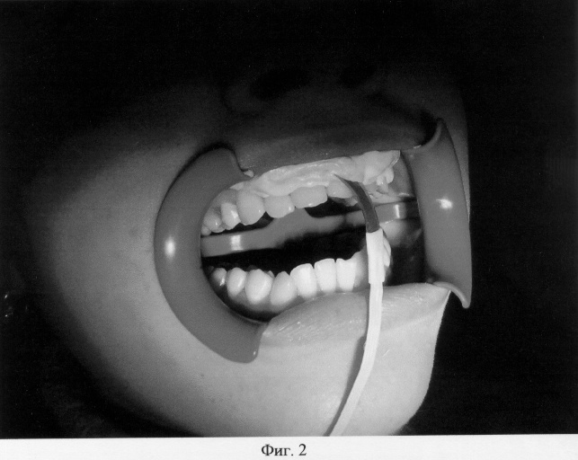
Rheoparodontography
This is a method for assessing the functional state of the vessels of periodontal tissues by recording the blood flow pulsating in them. Pulse blood volume depends on the functional state of regional vessels, and vascular tone depends on blood pressure and local factors, for example, inflammatory mediators and chewing load. Rheoparodontography makes it possible to give qualitative and quantitative characteristics of the blood supply to tissues and the state of tone of regional vessels, based on an assessment of the configuration of the pulse curve and its amplitude-time parameters.

Slide 5
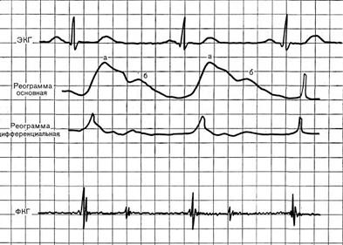
Rheoparodontography
To identify functional changes in the periodontal blood supply system, a visual analysis of rheograms is performed. Among the numerical parameters, the rheographic index (RI) is used, which is linearly related to the amplitude of the pulse curves and characterizes the intensity of the pulse blood filling of the tissues being studied. To assess the vascular tone of a given region, the peripheral resistance index (PRI) and the wall elasticity index (IE) are used. The calculated indicators also include PTS - an indicator of vascular tone, which is based on measuring the time intervals of the pulse curve, depending on the pulse rate.

Slide 6
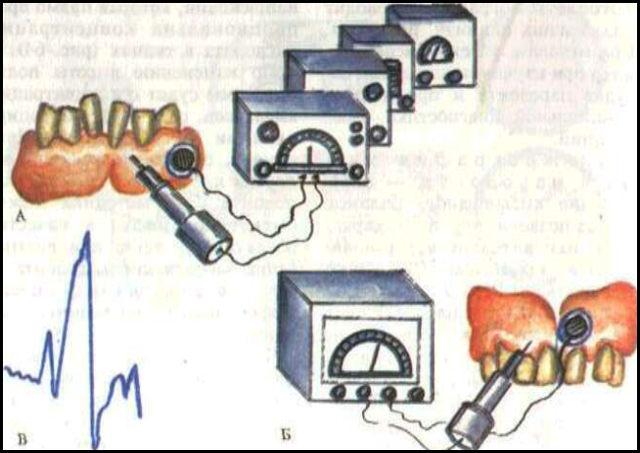
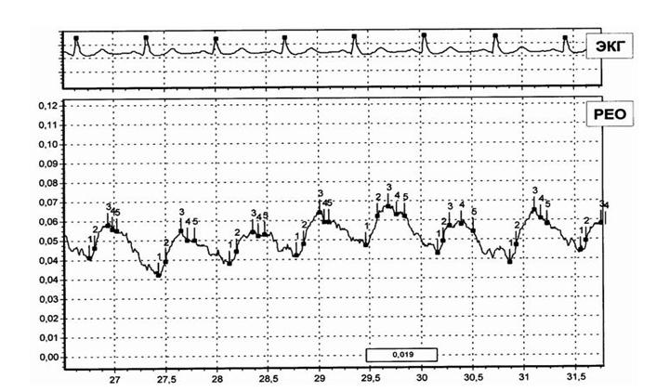

Slide 7
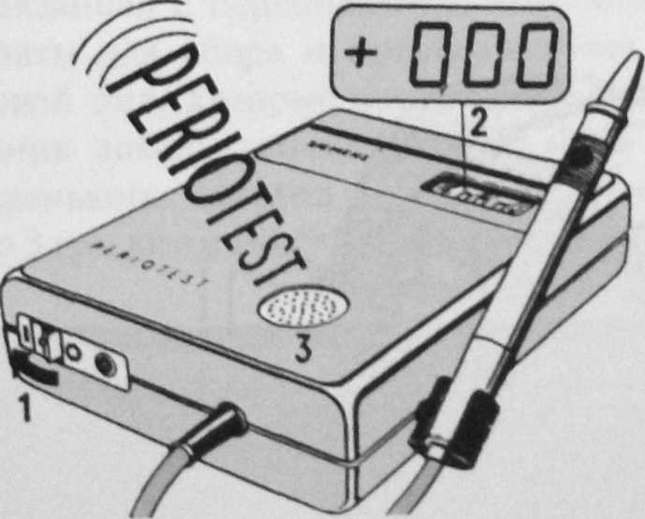
Periotestometry
- this is an indirect assessment of the condition of the supporting tissues of the tooth, i.e. functional capabilities of the periodontium using the “Periotest” device, the ability of the periodontal tissues to return the tooth to its original position is calculated after the action of a certain external load (functional or pathological) on it.
The physical principle of operation of the device is to convert an electrical impulse into a mechanical one. The tooth under study is percussed by the tip of the tip, directed horizontally and at right angles to the middle of the vestibular anatomical plane of the crown of the abutment tooth, at regular intervals with force

Slide 8
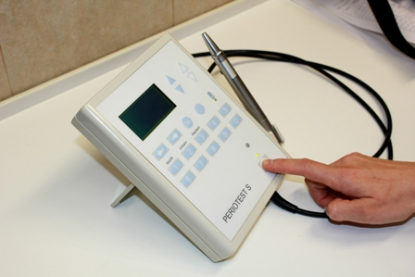
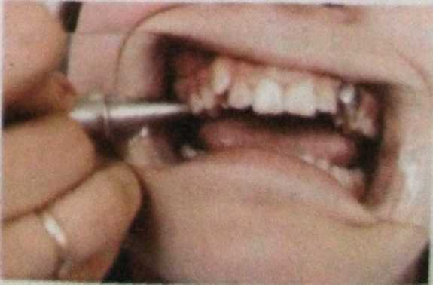
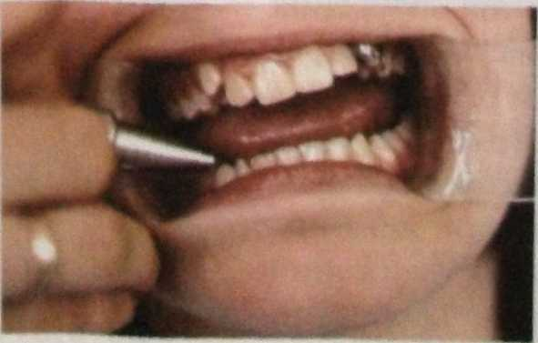
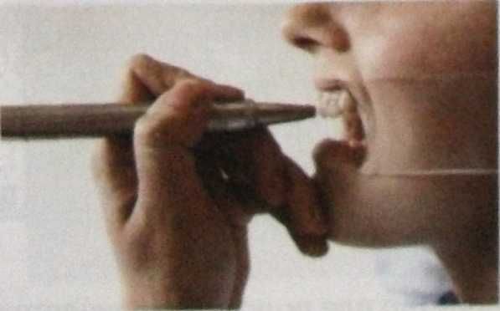
THANK YOU FOR YOUR ATTENTION!

