Slide 1
Press ceramics is an advanced and affordable technology for solving a variety of clinical problems in modern cosmetic and therapeutic dentistry. It has proven itself over the past years; the technology allows achieving truly outstanding aesthetic results..

Slide 2
General characteristics of the material
Material for press ceramics –
these are lithium disilicate glass-ceramic blanks for pressing technology.

Slide 3
Chemical formula:
IPS e.max Press blanks and auxiliary materials consist of the following main components:
- SiO2 Additives: Li2O, K2O, MgO, ZnO2, Al2O3, P2O5 and other oxides.

Slide 4
Blank concept
The color and transparency of IPS e.max Press blanks are based on a unique translucent/opaque concept. IPS e.max Press blanks are available in 3 levels of transparency. The different gradation levels are determined by processing techniques and indications, allowing for maximum flexibility and versatility of application.

Slide 5
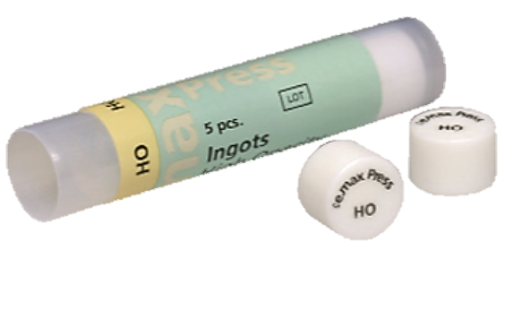
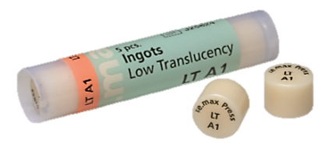
Basic blanks IPS e.max Press

Slide 6
Clinical stage
Indications for the use of press-ceramic prostheses:
- absence of one or more teeth;
- defects of teeth and dentition;
- unaesthetic appearance of the front teeth;
- restoration of damaged teeth;
- alignment of the dentition.

Slide 7
Clinical stage
Contraindications to the use of press-ceramic prostheses:
- bridges with a length of 4 units or more;
- bridges on inlays;
- patients with a significantly reduced number of remaining teeth;
- bruxism;
- cantilever dentures.

Slide 8
Color selection
Correct selection of tooth shade is the basis for a natural-looking restoration. To do this, the color is determined after cleaning the unprepared tooth or adjacent intact teeth. In this case, the individual characteristics of tooth color are taken into account.

Slide 9
Color selection
The final color of the restoration depends on the color characteristics:
– tooth stump;
– ceramic workpiece;
– facing ceramics;
– material for cementing.

Slide 10
Laboratory stage
The stages of laboratory technology for the manufacture of press-ceramic crowns include:
1. Obtaining a collapsible model;
2.Modeling of a tooth crown or frame;
3. Pressing the tooth crown or frame;
4.Final processing.

Slide 11
Obtaining a collapsible model
Making the model using the pin method.
The process of manufacturing a gypsum collapsible model for a press ceramic structure using the pin method can be divided into 3 stages:
Stage I - installation of pins;
Stage II - obtaining a plaster model;
Stage III - sawing the plaster model into segments.

Slide 12
Tooth crown modeling
Wax modeling for press ceramics is carried out in a complete anatomical shape.
– maintaining wall thickness;
– precise modeling of the restoration, especially in the area of preparation boundaries;
– possible occlusal relief must be taken into account starting with the wax-up, since the final firing of stains and glazes also increases the volume of the restoration.

Slide 13
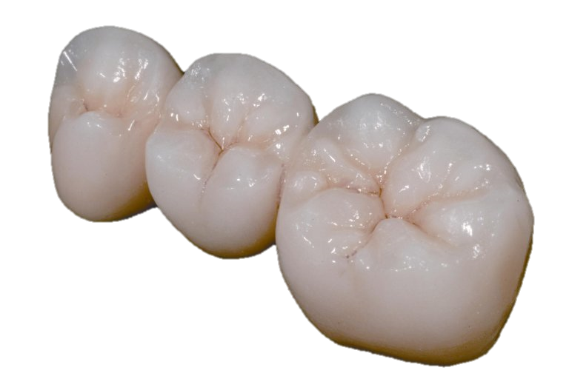
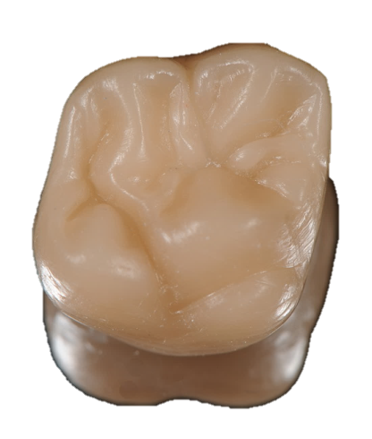
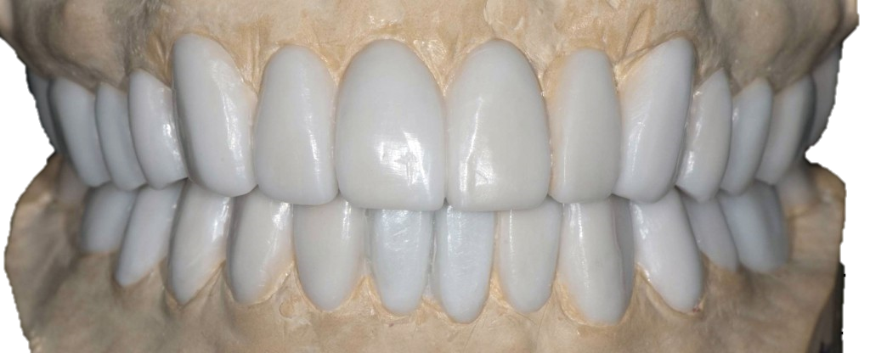
Complete restoration

Slide 14
Crown pressing process
Before starting the pressing process, the following steps are completed:
1. Installation of the gating system;
2.Forging;
3. Warming up the flask.

Slide 15
Gating system installation
The sprue installation begins in the direction of the ceramic flow and at the thickest part of the wax to ensure smooth movement of the viscous ceramic material. The base of the muffle system (100 g or 200 g) is selected depending on the number of objects being packed at the same time.

Slide 16
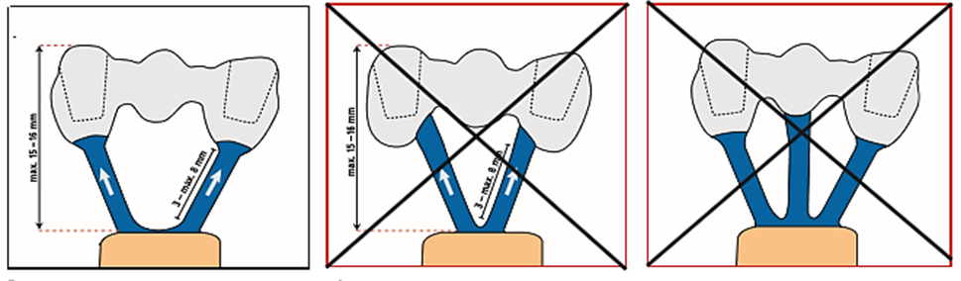
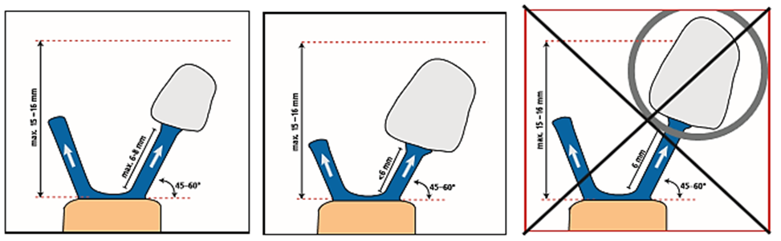
Correct sprue installation

Slide 17
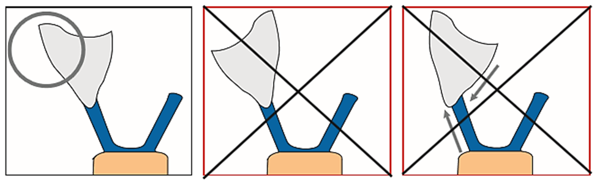
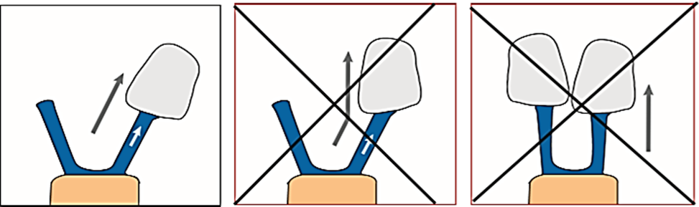
Correct sprue installation

Slide 18
Packing
Packing is done in IPS PressVEST (for example, overnight) or IPS PressVEST Speed (during the day). To accurately determine the mass of wax, the following sequence of steps is recommended:
– weigh the base;
– place the object to be pressed on the base and secure with wax;
– weigh the resulting structure again;
– the mass of wax is determined by the difference between two previously obtained values.

Slide 19
Forging technique
1.Use IPS Silicone Ring for packaging.
2.Fill the investment ring with investment material slowly and thoroughly.
3.Fill the ring with investment material up to the marking and install the stopper with a rotary motion.

Slide 20
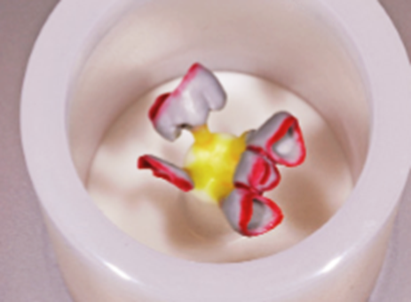
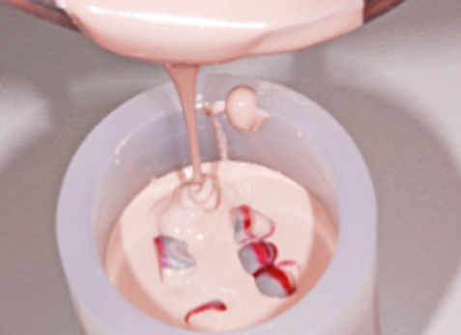
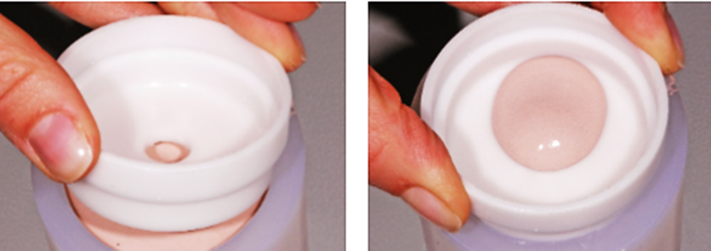
Forging technique

Slide 21
Warming up the flask
At the end of the time, the investment ring is prepared for heating as follows:
– remove the limiter and base using rotational movements;
– carefully squeeze the investment ring out of the silicone ring;
– remove irregularities on the lower surface of the investment box with a plaster knife and check the 90° angle;
– the remains of the investment material should not get into the sprues;
– install the flask at an angle to the rear wall of the muffle furnace with the hole down.

Slide 22
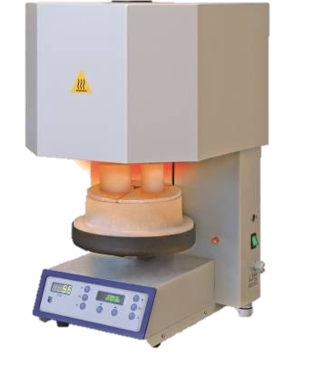
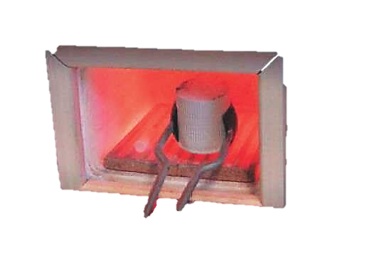

Slide 23
Pressing crowns
Pressing stages:
– prepare a cold insulated IPS e.max Alox plunger and a cold IPS e.max Press blank of the desired color;
– insert the cold IPS e.max Press workpiece with the marking upwards into the heated flask;
– place the heated investment ring in the center of the heated pressing oven using tongs;
– press START to start the selected program;
– after finishing the pressing program, remove the investment ring from the oven using tongs and place it on a wire rack to cool to room temperature.

Slide 24
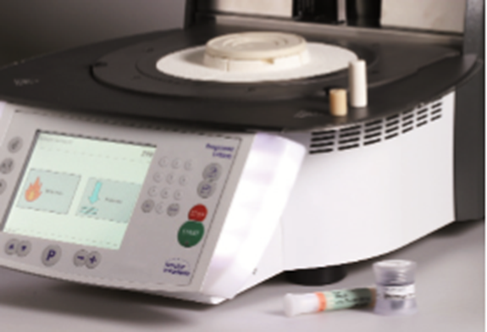
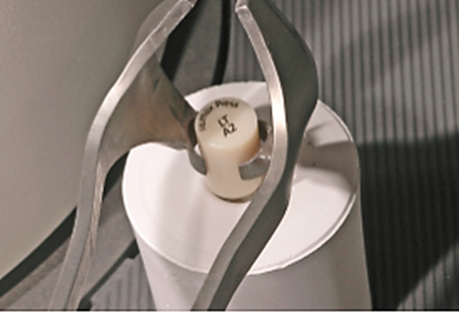
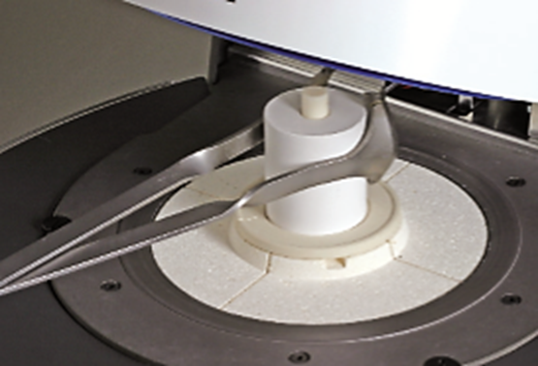
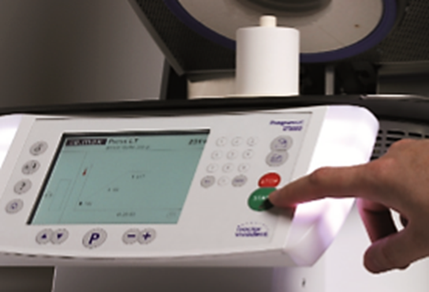
Pressing process

Slide 25
Unboxing
After cooling to room temperature (approximately 60 minutes), you can begin unpacking following the following conditions:
– mark the length of the aluminum oxide plunger on the cooled flask;
– cut the investment ring using a separating disk and break it along the cut made;
– when processing in a sandblaster, maintain the required distance so as not to damage the edges of the restoration;

Slide 26
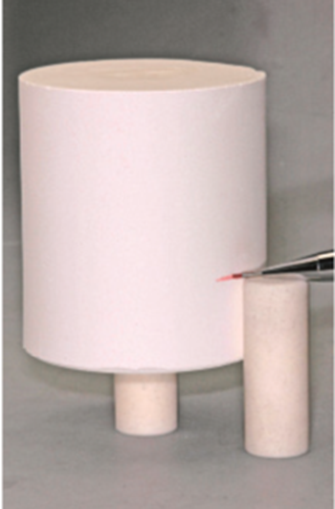
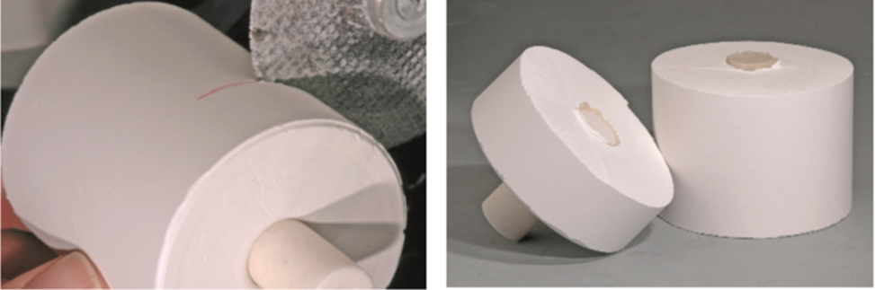
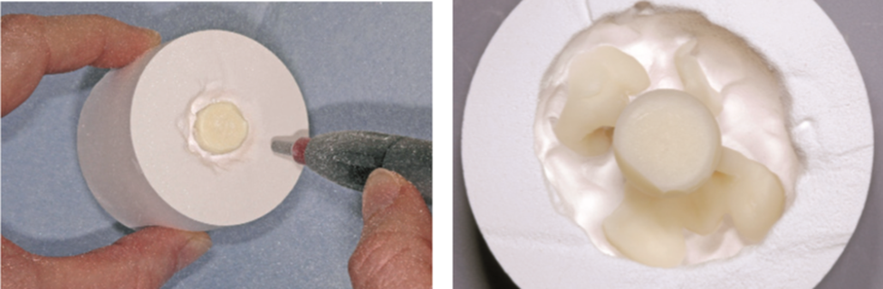
Unboxing

Slide 27
Finishing
–remove the reaction layer formed on pressed objects using Invex liquid in an ultrasonic bath.
– cut off the sprues using a fine-grained diamond disc;
– smooth out the places where the sprues are attached;
– remove the compensation varnish from the model before installing the restoration on it. Carefully fit the frame.
– color the fissures and tubercles;
– Apply the glaze in an even layer over the entire surface of the restoration and bake.

Slide 28
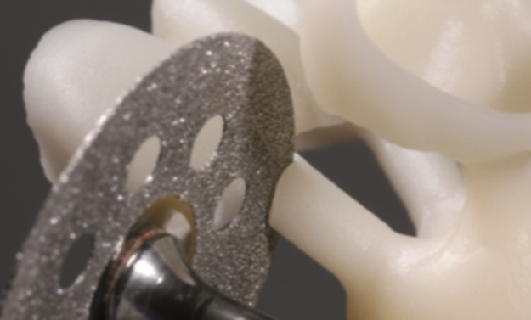

Slide 29
Conclusion
So, the main advantages of press ceramics are:
- guaranteed dental aesthetics;
- the strength of press ceramic crowns is comparable to the strength of natural tooth enamel;
- long service life of crowns with proper care, such crowns can last a lifetime.

Slide 30
Conclusions:
As a result of the work, the following was studied:
- history of the use of press ceramics;
- material and tools for the manufacture of press ceramics;
- indications for the use of press ceramics;
- technology for manufacturing press-ceramic prostheses.

