Slide 1
Partial absence of teeth (partial edentia).
Etiology, pathogenesis. Functional disorders. Diagnostics. Clinic. Classification of dentition defects. Examination of the patient. Establishing diagnosis. Types of removable denture designs.

Slide 2

Edentia –
(“adentia”, a-prefix meaning the absence of a characteristic, corresponding to the Russian prefix “without” + dens-tooth) - the absence of several or all teeth.
Edentia = dentition defect = absence of teeth = loss of teeth.
Notes:
Начнем с того, что такое Адентия?

Slide 3
Acquired adentia –
a disease characterized by a violation of the integrity of the dentition or dentition of the formed teeth in the absence of pathological changes in the remaining teeth.

Slide 4
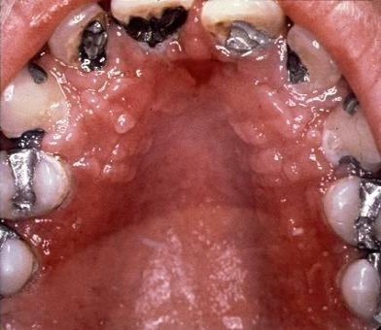
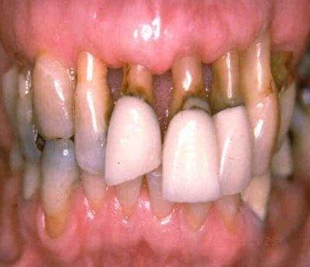
The most common causes of acquired adentia:
Caries and its complications - pulpitis and periodontitis;
Diseases of periodontal tissues;

Slide 5
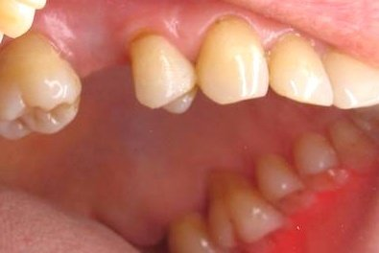
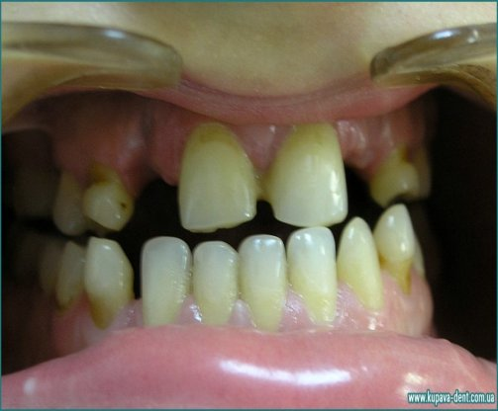
Etiology

Slide 6

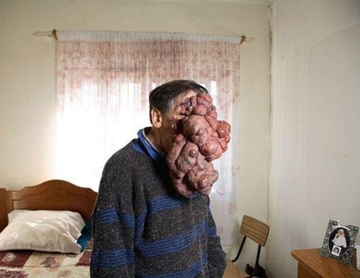
Injuries;
Operations for inflammatory processes and neoplasms.

Slide 7
Congenital (hereditary) adentia-
a disease characterized by a violation of the integrity of the dentition or dentition as a result of:
Disturbances in the embryogenesis of dental tissue, as a result of which there are no rudiments of permanent teeth - “true adentia”;
Disturbances in the eruption process, resulting in the formation of impacted teeth - “false adentia”.

Slide 8
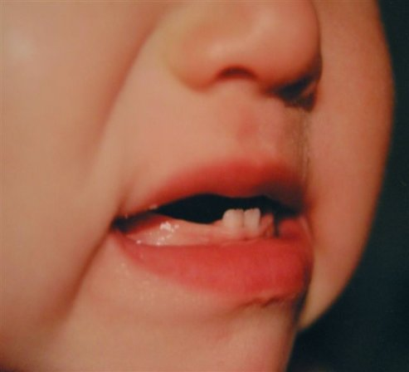
The most common causes of congenital (hereditary) adentia:
Acute inflammatory processes developing during the period of mixed dentition;
Underdevelopment of the bones of the upper and lower jaw;

Slide 9
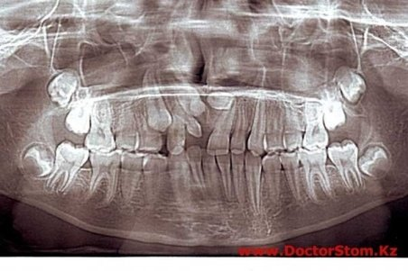
Early removal of baby teeth and displacement in this direction of the erupting adjacent permanent tooth.
Non-resorption of the roots of baby teeth;
Early removal of baby teeth and displacement in this direction of the erupting adjacent permanent tooth.

Slide 10
Leading symptoms in an orthopedic dentistry clinic with partial absence of teeth.
Disruption of the continuity of the dentition.
Disintegration of dental arches into functioning and non-functioning groups.
Functional overload of the remaining teeth (separate groups of teeth).
Secondary movement of teeth (secondary malocclusion).
Impaired chewing and speech function.
Violation of aesthetic norms.
Dysfunction of the TMJ and masticatory muscles.

Slide 11
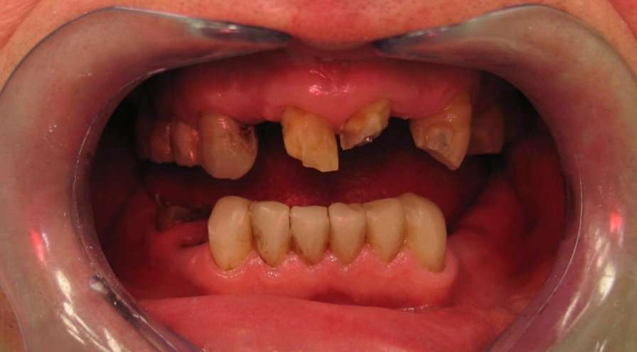
Leading symptoms in an orthopedic dentistry clinic with partial absence of teeth.
Disruption of the continuity of the dentition.

Slide 12
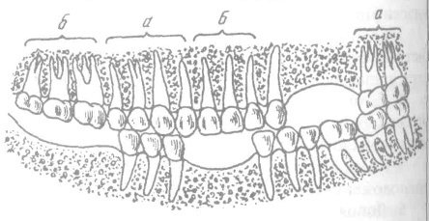
Disintegration of dental arches into functioning and non-functioning groups.

Slide 13
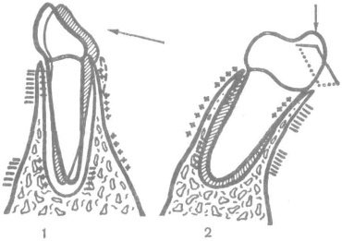
The nature of deformation of the walls of the alveoli under the influence of masticatory forces.
I — under the influence of horizontally directed forces;
2 - when vertical forces act on an inclined tooth; + stretching, - compression.

Slide 14
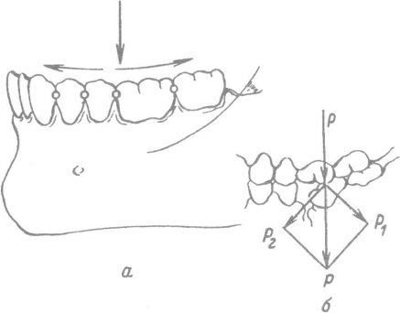
Chewing force distribution diagram.
Notes:
Interdental contacts, ensuring continuity of the dentition, are also ways of distributing chewing pressure along the arch (a). The force P is decomposed into the force acting along the root, as well as into the forces />; and P2, acting along the arch through the interdental spaces. When a defect (b) appears, the force P is decomposed into two forces, one of which (P,) tilts the tooth towards the defect. Thus, a traumatic occlusion appears.

Slide 15
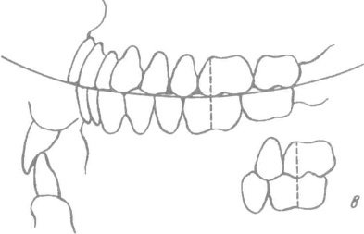
Closing the dentition in the sagittal direction
a - sagittal occlusal curve with orthognathic bite,
b — cutting-tubercle contact;
c — mesiodistal relationship of the first permanent molars

Slide 16
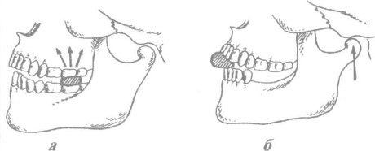
Chewing pressure distribution diagram
a - chewing pressure is transmitted through the molars to the zygomatic buttress;
b - when molars are lost, the joint becomes overloaded.

Slide 17
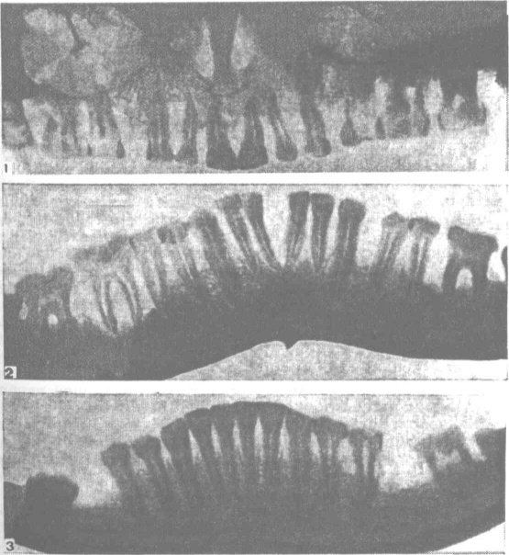
Dystrophic restructuring of the bone tissue of the jaws (x-ray).
.
Notes:
1. 2 — with generalized periodontal disease;
3 — with focal periodontal disease

Slide 18

Functional overload of the remaining teeth (separate groups of teeth).

Slide 19
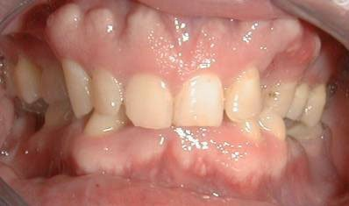
Secondary movement of teeth (secondary malocclusion).

Slide 20
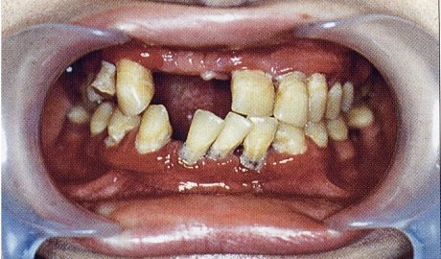
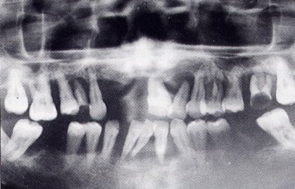
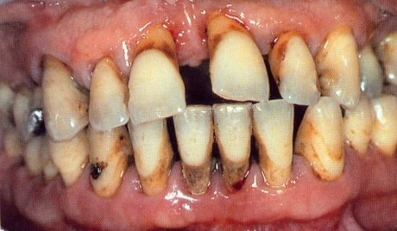
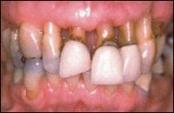
Deformation of the dentition due to periodontitis

Slide 21
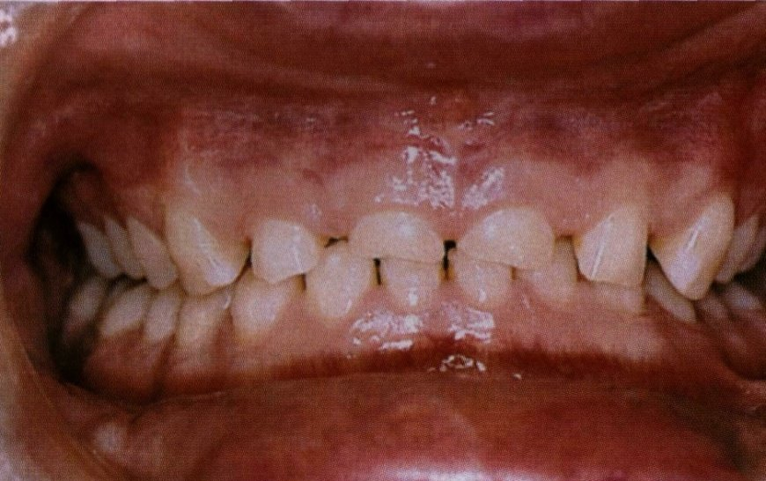
Pathological abrasion

Slide 22
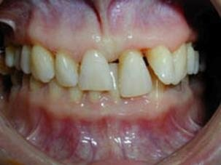
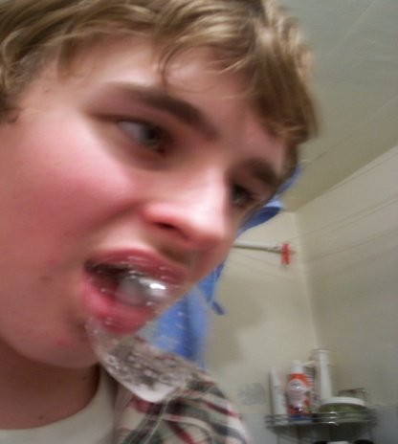
Impaired chewing and speech function.
Violation of aesthetic norms.

Slide 23
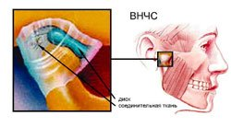
Dysfunction of the TMJ and masticatory muscles.

Slide 24
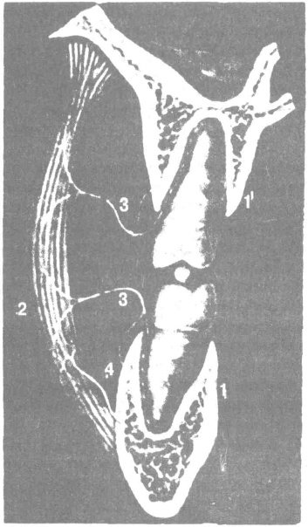
Scheme of the functional chewing link:
Notes:
/ — опорная часть (периодонт),
2 — моторная часть (мускулатура),
3 — нервнорегулирующая часть,
4 — система кровеносных сосудов и трофической иннервации

Slide 25
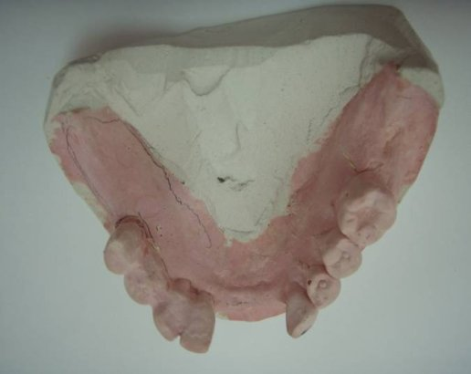
If there are several defects of different localization in the same dentition, then the dental arch is assigned to a lower class
Example:
7 6 5 4 3 2 1 1 2 3 4 5 6 7
0 0 5 4 3 2 0 0 0 3 4 5 6 0
There are class I and class IV defects on the lower jaw. the lower dentition belongs to class I.

Slide 26
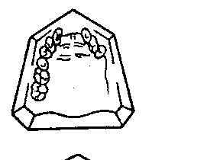
Subclass in the Kennedy classification - the subclass number is determined by the number of additional dental deformations, excluding the main class.
Example:
There are class II and class IV defects on the upper jaw. The upper dentition belongs to the second class, the first subclass.
There are class I and class IV defects on the lower jaw. The lower dentition belongs to the first class, the first subclass.
7 6 5 4 3 0 0 0 0 3 4 0 0 0
0 0 5 4 3 2 0 0 0 3 4 5 6 0

Slide 27
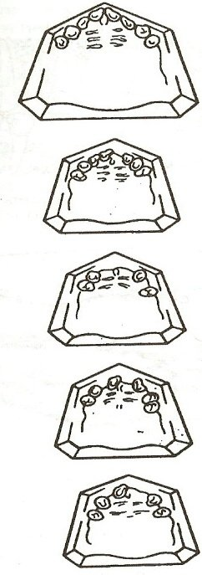
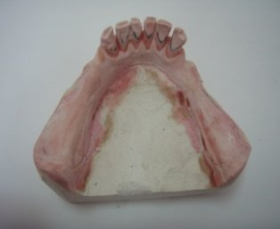
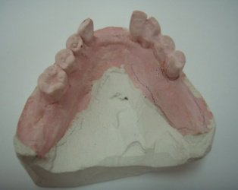
CLASS I – double-sided end defect
I class
I class,
1 subclass
I class,
2 subclass
I class,
3 subclass
I class,
4 subclass

Slide 28
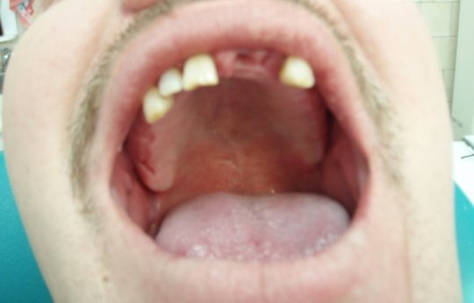
I class,
По Кеннеди

Slide 29
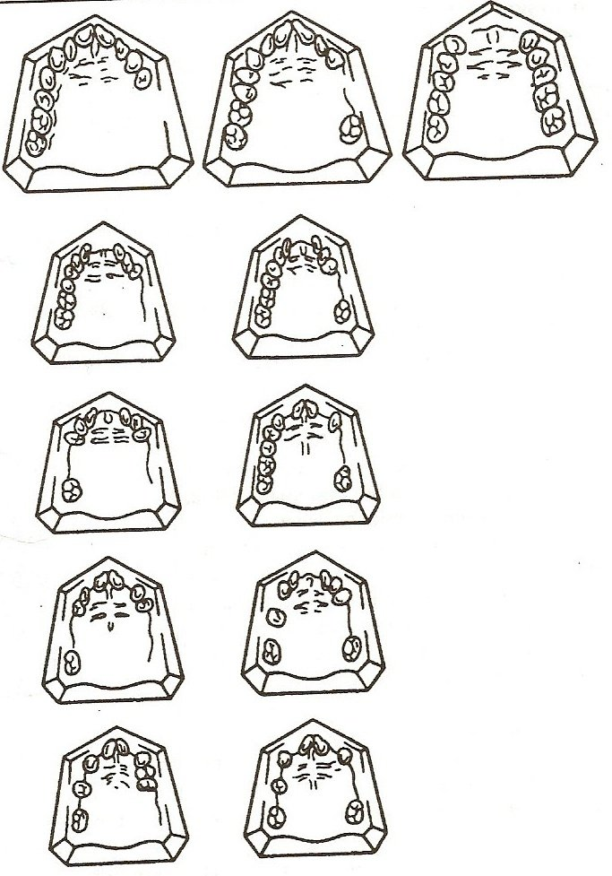
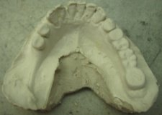
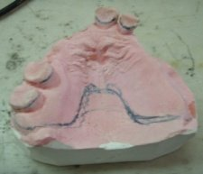
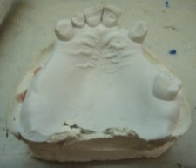
CLASS II - unilateral end defect
II class
II class
1 subclass
II class
2 subclass
II class
3 subclass
II class
4 subclass

Slide 30
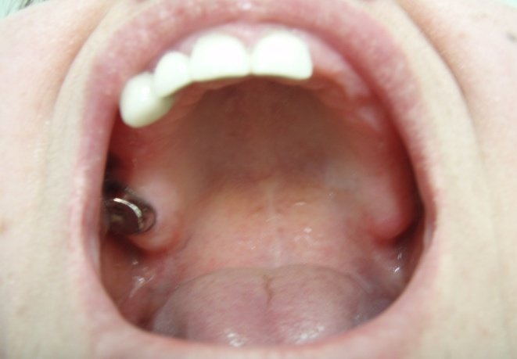
II class
По Кеннеди
Фото из полости рта

Slide 31
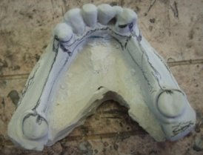
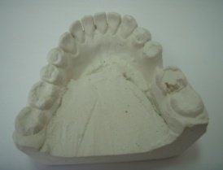
CLASS III – included defect in the lateral region
III class
III class
1 subclass
III class
2 subclass
III class
3 subclass
III class
4 subclass

Slide 32
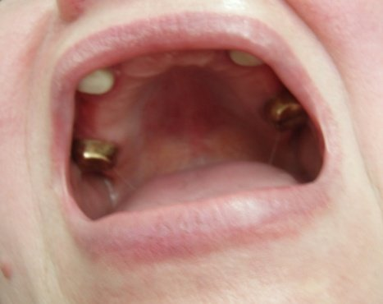
III class
По Кеннеди

Slide 33
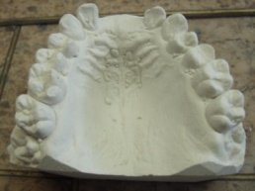
  CLASS IV - included defect, in which the edentulous area is located in front of the remaining teeth and crosses the midline of the jaw

Slide 34
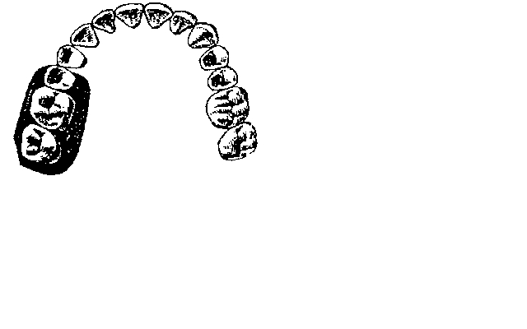
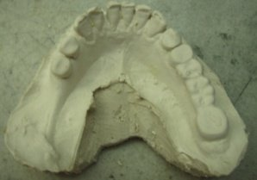
I class –
one-sided end defect

Slide 35
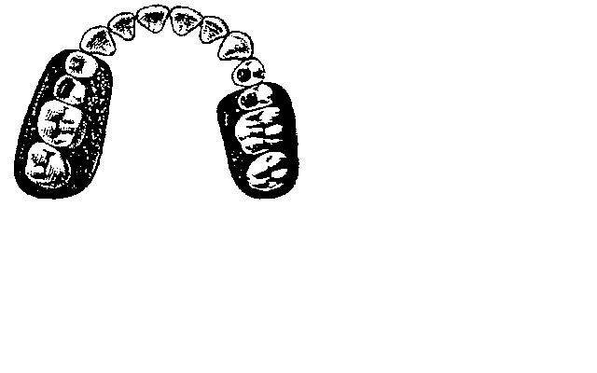

II class –
bilateral end defects

Slide 36
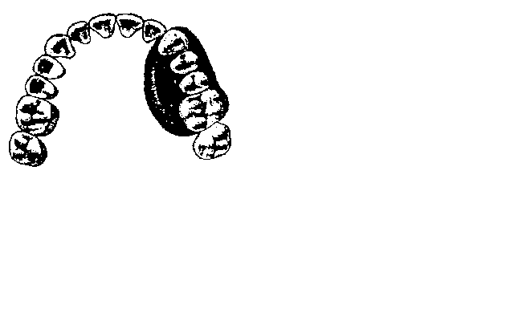
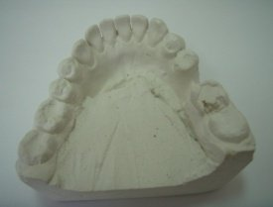
III class –
unilateral included defect of the lateral dentition

Slide 37
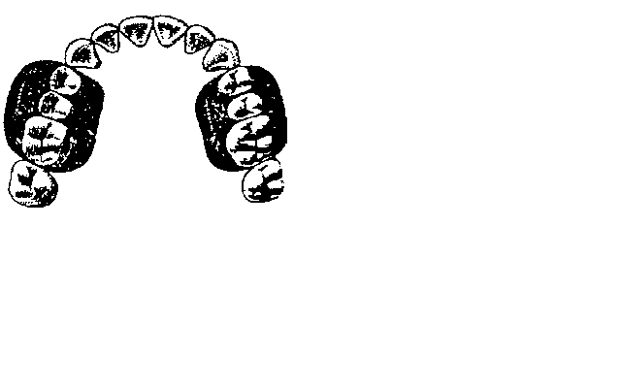
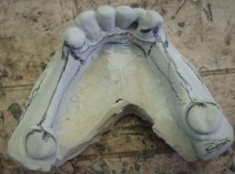
IV class –
bilateral included defects of the lateral parts of the dentition

Slide 38
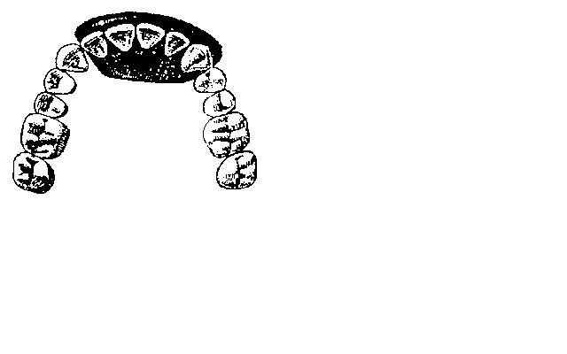
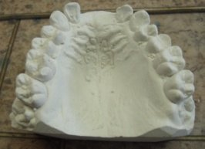
V class –
included defect of the anterior dentition

Slide 39
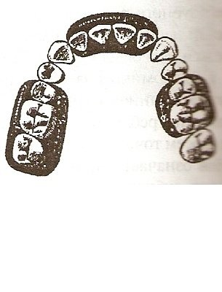
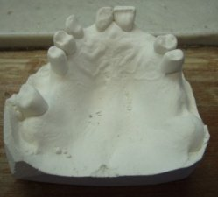
VI class –
combined defects

Slide 40



VI class
По Гаврилову

Slide 41


VII class –
jaw with single preserved tooth

Slide 42




Notes:
Несвоевременное и/или некачественное лечение частичного отсутствия зубов ведет к развитию таких заболеваний зубочелюстной системы, как болезни пародонта, в отдаленной перспективе — к полной утрате зубов — полной адентии обеих челюстей.

Slide 43


Class I - unilateral or bilateral terminal defect of the dentition
По Вильду

Slide 44


Class II - one or more included defects
По Вильду

Slide 45



Class III - combination of terminal(terminal) and included(included) defects of the dentition
По Вильду

Slide 46



Slide 47
Classification of dentition defects according to V.A. Ponomareva:
Class I: Defects of the dentition with preservation of contact between antagonists in the position of central occlusion in three functionally oriented groups;
Class II: Presence of contact in two functionally oriented groups;
Class III: Contact preserved in only one functionally oriented group;
Class IV: Lack of contact between the remaining antagonists.

Slide 48
Classification of dentition defects according to A.I. Betelman (1956):
Class I: dentition in which there are one or more flaws, but at least one of them is limited by the teeth on only one side:
1st subclass: dentition with one terminal flaw;
Subclass 2: dentition with two terminal flaws.
Class II: dentition in which there is one or more flaws, but all of them are limited to the teeth on both sides:
1 subclass: dentition with one or more flaws that arose after the removal of no more than three teeth;
Subclass 2: dentition with one or more flaws, which (all or only one) were formed as a result of the removal of more than three teeth.

Slide 49

Class I: defects of the anterior dental arch:
По Е.Н.Жулеву
Notes:
А) отсутствие одного зуба;
Б) отсутствие нескольких зубов;
В) отсутствие всей фронтальной группы зубов.

Slide 50





Class II: defects of the lateral calving of the dental arch:
По Е.Н.Жулеву
А
Б
В
Г
Д
Notes:
A) one-sided included defect;
B) bilateral included defects;
B) one-sided end defect;
D) bilateral end defects;
D) combined defects.

Slide 51



Class III: anterolateral defects:
По Е.Н.Жулеву
А Б В Г Д
Notes:
A) combination of a defect in the anterior section with a unilateral included defect;
B) a combination of defects in the anterior section with bilateral included defects;
B) combination of a defect in the anterior section with a unilateral end defect;
D) a combination of defects in the anterior section with bilateral end defects;
D) single standing tooth.

Slide 52

Consequences of partial edentia

Slide 53

Popov-Godon phenomenon
Notes:
The Popov-Godon phenomenon (dentoalveolar elongation) is the displacement of teeth as a result of the loss of an antagonist. Antagonists are called similar teeth on the upper and lower jaws. For example, fifth upper left – fifth lower left, etc.

Slide 54

Popov-Godon phenomenon
Notes:
The removal of a tooth or several teeth causes a compensatory reaction on the part of the body, which is expressed in deformation of the dental arch and the jaw itself. Neighboring teeth begin to shift towards the missing one. As a result, the spaces between the remaining teeth increase. Not only the dentition in which the tooth is missing is deformed, but also the dentition of the opposite jaw. With the Popov-Godon phenomenon, a significant displacement of the tooth in the opposite jaw occurs. The tooth seems to “grow” from the dental arch and creates a “lock” when the jaws move

Slide 55




Popov-Godon phenomenon
1 — unilateral;
2 — bilateral;
3 — cross;
4 — general malocclusion.

Slide 56


Notes:
Одновременно со смещением зубов может наблюдаться увеличение альвеолярного отростка (дентоальвеолярное удлинение), что приводит к образованию десневого кармана и обнажению корня зуба. Дентоальвеолярное удлинение происходит из-за изменения строения пародонта вследствие потери привычной функциональной нагрузки (адаптационная перестройка), при которой происходит нарушение обменных процессов и микроциркуляции в пародонте, увеличение размеров альвеолярного отростка и объема костной ткани. В начале процесса адаптационной перестройки пародонта происходит увеличение объема образующихся тканей, при этом зуб смещается за окклюзионную плоскость, а в более позднем периоде преобладает атрофический процесс с явлениями резорбции пародонта («атрофия от бездействия»).

Slide 57


Violation of the occlusal surface of the dentition, preventing free movements of the lower jawти.
Notes:
Another option for dentition disorder due to partial edentia

Slide 58
Classification of secondary tooth movements according to E.I. Gavrilov:
Vertical movement of the upper teeth
Vertical movement of the lower teeth.
Mutual vertical movement of the upper and lower teeth.
Distal and medial movement of the upper and lower teeth.
The inclination of the teeth in the lingual-palatal or buccal direction.
Combined movements.
(Rotation of the tooth around its axis).

Slide 59

Establishing diagnosis

Slide 60
The concept of “tooth loss due to an accident, tooth extraction or localized periodontitis” (K 08.1 according to ICD-C - International Classification of Dental Diseases based on ICD-10) and terms such as “partial secondary edentia” and “partial absence of teeth” (in unlike edentia - disturbances in the development and eruption of teeth - K 00.0), are essentially synonymous and apply both to each of the jaws and to both jaws. A synonym for the terms “partial absence of teeth” and “partial secondary edentia” is also the concept of a dentition defect, meaning the absence of one or more teeth.

Slide 61
CORRECT ICD 10
K00-K93 DISEASES OF THE DIGESTIVE ORGANS
K00-K14 DISEASES OF THE ORAL CAVITY, SALIVARY GLANDS AND JAWS
K08.1 Loss of teeth due to accident, extraction or localized periodontal disease

Slide 62
Subjective examination
Patient's complaints
Allergy history
General condition of the body
Occupational hazards
Living conditions
Notes:
Субъективное обследование.
Анамнез включает жалобы больного, изучение состояния всего организма, условия жизни, профессиональные вредности, аллергологический анамнез.

Slide 63

Scheme: “Biophysical characteristics of the mucous membrane of the alveolar process and palate.”
Zone of compliance of the mucous membrane of the hard palate according to LUNDE:
Notes:
The area of the sagittal suture is thin mucosa, has no submucosal layer - the medial fibrous zone.
The posterior third of the hard palate has the greatest degree of pliability of the mucous membrane and has a submucosal layer - the glandular zone.

Slide 64

Notes:
Альвеолярный отросток – слизистая почти лишена– периферическая фиброзная зона.
Область поперечной складок – слизистая оболочка средней степени податливости.

Slide 65

This is what you NEED to KNOW to plan a prosthesis
Number and position of teeth (inclination, height, rotation) of teeth
Examination of each tooth: condition of the pulp, defects in hard dental tissues, fillings, crowns, marginal fit of crowns, etc.
Examination of the periodontal condition: inflammation, gum retraction, depth of gingival pockets, periodontal grooves;

Slide 66
You need to know this too!
Prosthesis bed: mobility of the oral mucosa, border of the bone protrusion, loss of substance;
Shape of alveolar processes: low and well defined;
Shape of the palate, depth of the bottom (for the hyoid arch);

Slide 67
Manufacturing of a prosthesis for partial secondary adentia includes:
impressions from both jaws, production of diagnostic and working models,
determination of the central relationship of the jaws,
checking the design of the prosthesis, application, fitting, fitting,
remote control and corrections.

Slide 68
Goal of treatment for partially edentulous patients
Restoring sufficient functional capacity of the dental system;
Prevention of the development of pathological processes and complications;
Improving the quality of life of patients;
Prevention and elimination of negative psycho-emotional consequences associated with missing teeth.

Slide 69

Yoke prosthetics
Notes:
A yoke prosthesis (from German bugel - arc) is a removable prosthesis consisting of two main elements: a metal frame (arch with support-retaining elements) and a plastic base (plate simulating gum) with artificial teeth.

Slide 70

The sequence of stages of prosthetics with clasp dentures

Slide 71

1st stage of prosthetics

Slide 72

2nd stage of prosthetics

Slide 73

3rd stage of prosthetics

Slide 74

4th stage of prosthetics

Slide 75

5th stage of prosthetics

Slide 76
Contraindications to prosthetics with removable dentures
1. unsanitized oral cavity
2. diseases of the oral mucosa
3. intolerance (plastic, metal)

