Slide 1

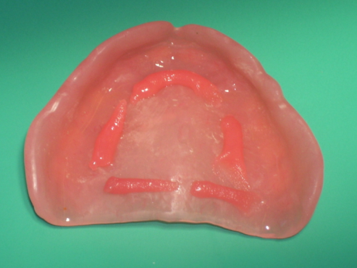
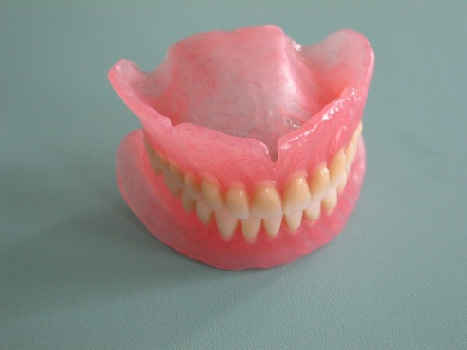
Lecture topic:
METHODS OF FIXATION AND STABILIZATION OF COMPLETE REMOVABLE PLATE DENTURES. CONCEPT OF TRANSITIONAL FOLD, NEUTRAL AND VALVE ZONE. COMPLIANCE AND MOBILITY OF THE MUCOUS MEMBRANE, BUFFER ZONES. LIMITS OF THE BASES OF COMPLETE REMOVABLE DENTURES.

Slide 2
Fixation is the strengthening of the prosthesis on the jaw at rest. Stabilization - ensuring the stability of the prosthesis during the performance of the function.
The quality of prosthesis stabilization depends on:анатомических features of the oral cavity
type of mucous membrane, its moisture content
quality of impressions (anatomical and functional)
correct determination of the boundaries of the prosthesis
literacy of dental technician manipulations
materials for clinical and laboratory stages
alignment of occlusal contacts
properties of the food consumed by the patient
The problem of high-quality fixation of complete removable dentures has existed for several centuries. Many methods have been proposed for fixing dentures on edentulous jaws. For the convenience of their study, classifications have been created.

Slide 3
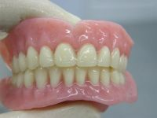
B.K. Boyanov divides all methods of fixing prostheses into:
Biomechanical
Physical
Mechanical
Biomechanical

Slide 4
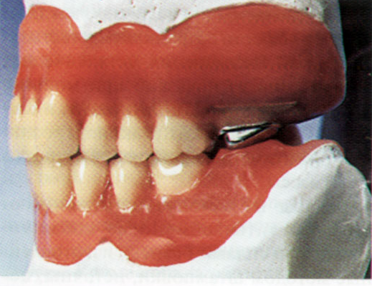
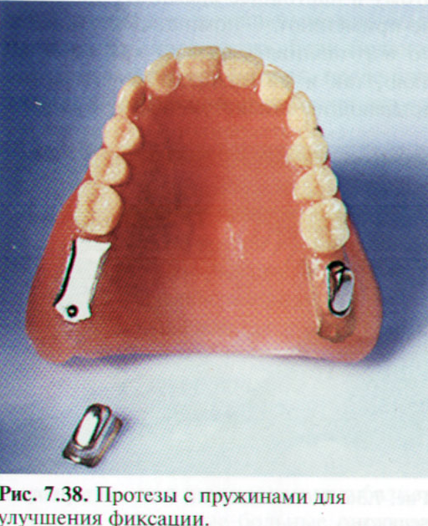
Mechanical methods:
Springs: in the 18th century, P. Fauchard proposed using gold curved leaf springs for fixation of complete removable dentures, which were later replaced by spiral springs placed in nylon tubes.

Slide 5
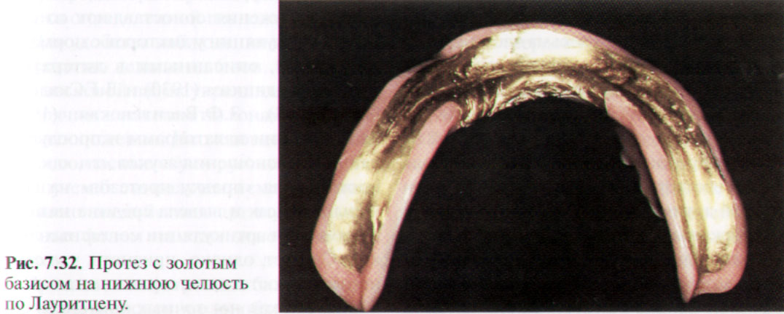
Mechanical methods:
Weightening of the lower prosthesis by introducing metals with a high specific gravity into its base:
Tungsten (Vine),
tin inlays weighing 30-40 g. (V.N. Parshin),
artificial chewing teeth made of metal.

Slide 6
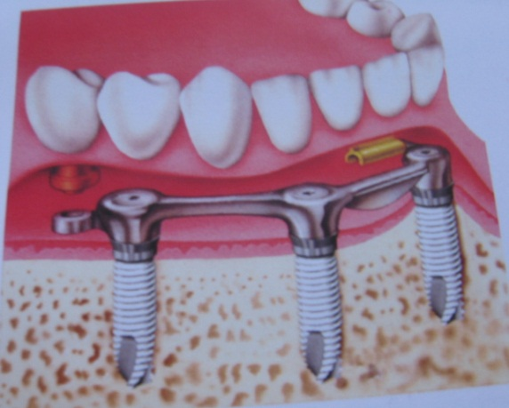
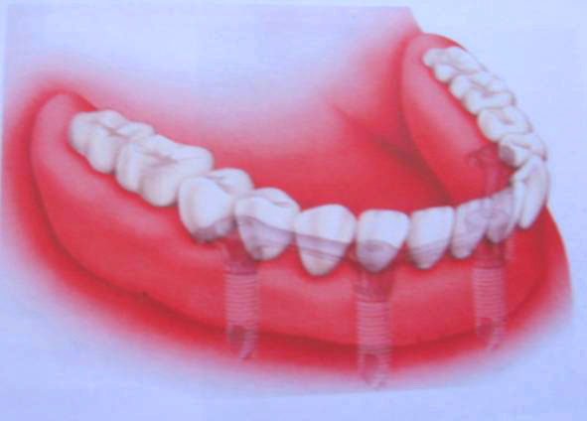
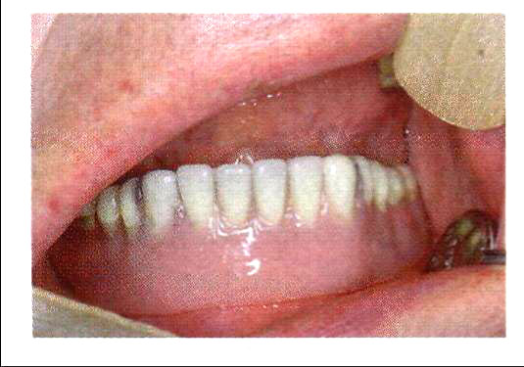
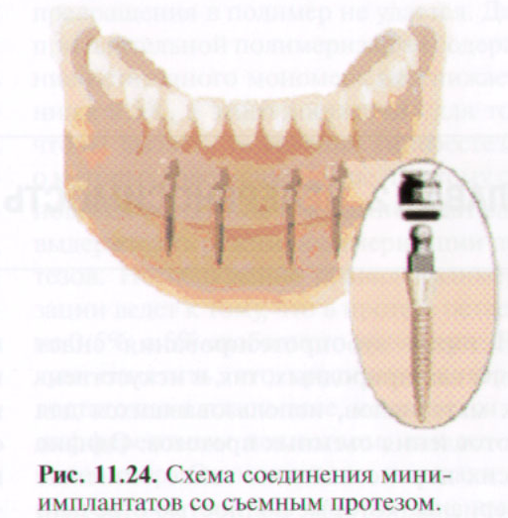
Mechanical methods:
Use of implants

Slide 7
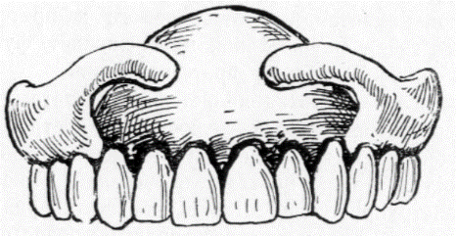
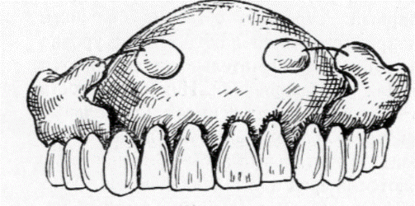
Biomechanical methods
These methods are based on anatomical retention - the use of natural anatomical formations to fix the prosthesis;
gingival clasps: used for protruding alveolar process or overhanging maxillary cusps (if surgical preparation is not possible);
Kemeny pilots: connected to the prosthesis base with an elastic spring lever extending below the mylohyoid line. To prevent the prosthesis from tipping over when the mylohyoid muscle is tense, the author proposed its dissection;
Expansion of the base in the sublingual space

Slide 8
Physical methods
Cohesion is the attraction between like atoms or molecules within the same substance.
Adhesion is the force that connects two dissimilar materials brought into close contact. Occurs when the surface of the prosthesis exactly matches the tissues of the prosthetic bed. The inner part of the prosthesis base must exactly correspond to the microrelief of the oral cavity.
To describe the retention of dentures in the oral cavity, the correct term is adhesion.
The strength of adhesion depends on:
area of contacting surfaces
thickness and viscosity of saliva located between them
The adhesion force of complete removable dentures averages 200-300 g (A.P. Voronov2006)

Slide 9
Using the principle of negative pressure (the principle of rarefied space)
In the part of the prosthesis base facing the hard palate, a recess is created - a chamber. The prosthesis is pressed against the palate, the pliable mucous membrane partially fills the chamber, displacing air from there. Then the elastic tissue pushes back the prosthesis and the chamber is partially freed from the mucous membrane that filled it. Thanks to this, a discharged space appears in it. The mucous membrane along the edge of the chamber forms a “closing valve,” preventing air from entering it and ensuring the existence of a vacuum.
Flaws:
weak fixation of the prosthesis;
hypertrophy of the mucous membrane of the hard palate, which leads to the fact that fixation completely disappears.

Slide 10
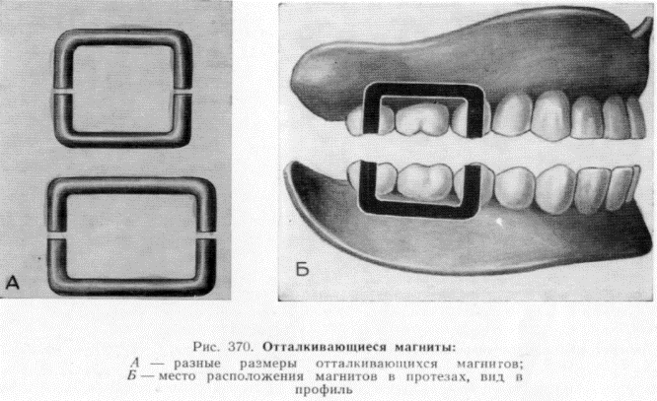
Fastening the prosthesis using rubber discs (Raue suction cups).
Flaws:
bedsores of the mucous membrane under the rubber disk;
a swollen rubber disc swells, losing elasticity, and prevents the prosthesis from fitting to the palate;
The use of magnets for attaching prostheses:
U-shaped magnets directed towards each other with like poles (A.I. Doinikov, M.A. Zektser)
Small magnets in the lateral teeth of the denture
Subperiosteal implantation of magnets
Flaws:
myostatic imbalance
fatigue of the masticatory muscles
negative effect of a constant magnetic field
Possible bone necrosis with subperiosteal insertion of magnets

Slide 11
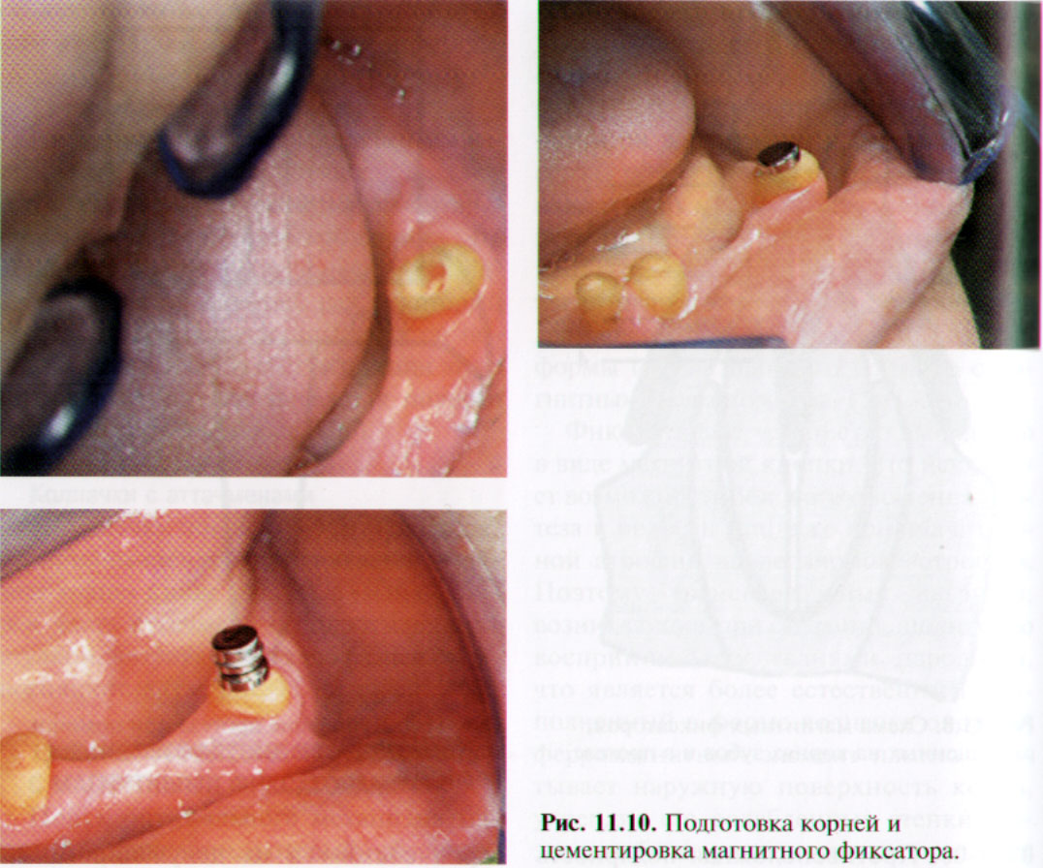

Slide 12
Biophysical method of fixation of prostheses (Physico-biological, combined)
Currently, this method is the most used.
The following principles are used:
anatomical retention
adhesion
principle of rarefied space
functional suction
correct design of artificial dentition prostheses
Functional suction - stabilization of the prosthesis by creating negative pressure under its entire surface (circular closing valve, edge valve).
The mobile mucous membrane in contact with the edge of the prosthesis prevents air from penetrating under it. A marginal closing valve occurs when the edge of the prosthesis somewhat pushes back the mucous membrane of the arch of the transitional fold. This becomes possible because the transitional fold tissues are flexible. When the prosthesis is displaced from its bed, the tense mucous membrane follows its edges, and the marginal valve is not disturbed.

Slide 13
THE CONCEPT OF THE TRANSITIONAL FOLD, NEUTRAL AND VALVE ZONE.
Scheme of a transitional fold with complete absence of teeth
a) actively mobile - the mucous membrane is located on the muscles and makes excursions during their contraction: it covers the cheeks, lips, floor of the mouth, has a loose submucosal layer of connective tissue, and easily folds.
b) passively mobile mucous membrane = neutral zone
The “neutral zone” (anatomical and functional term) is the boundary between the actively mobile and immobile mucous membrane. Well pliable, has a well-defined submucosal layer.
c) immobile mucous membrane. The immobile mucous membrane does not have a submucosal layer; it lies on the periosteum, separated from it by a thin layer of fibrous connective tissue (these are the alveolar processes, the area of the sagittal suture). And only under the pressure of the prosthesis is the compliance of the fixed mucous membrane in the direction of the bone revealed, which is explained by the presence of a connective tissue layer in the thickness of the vessels.

Slide 14
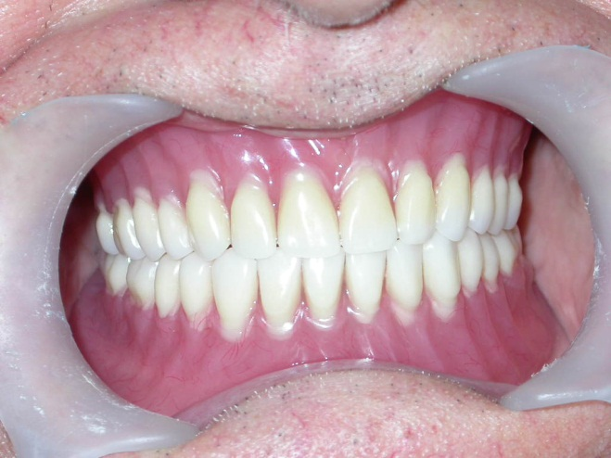
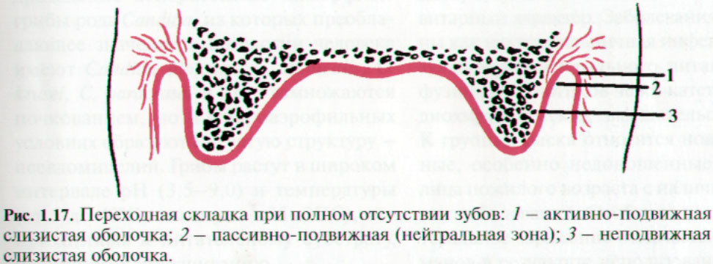
The term “transitional fold” (anatomical term) is the place of transition of the mucous membrane covering the alveolar processes of the jaws on the vestibular side into the mucous membrane of the lips, cheeks, soft palate and floor of the mouth. It has a width of 1 to 3 mm, distinguished by a rather sinuous individual border, both from the side of the vestibule and from the side of the oral cavity itself.
The term “valve zone” - areas of the mucous membrane that take part in the creation of the marginal valve, is used to designate the contact of the edge of the prosthesis with the underlying tissues
When removing the prosthesis from the oral cavity, the valve zone does not exist, since this is not an anatomical formation, but a functional one. On the vestibular side, the valve zone is located in the neutral zone, isolating the frenulum and buccal cords in the area of missing premolars.

Slide 15
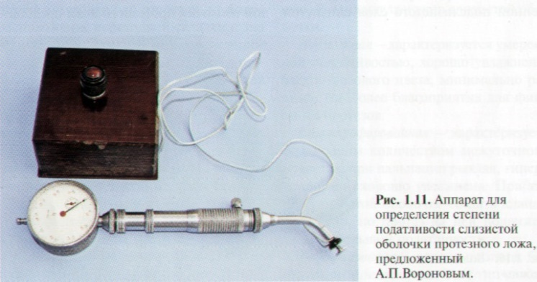
COMPLIANCE AND MOBILITY OF THE MUCOUS MEMBRANE, BUFFER ZONES.
Compliance of the mucous membrane is a physical phenomenon characterized by the ability of the mucous membrane to change shape and volume under the influence of external load.
The degree of compliance and mobility of the mucous membrane in different parts of the prosthetic field can be determined by palpation, as well as using a probe graduated in millimeters or a special device (A.P. Voronov, V.I. Kulazhenko with co-authors, Belarusian scientists - Kruglik Yu. N.)
According to Kopeikin, the mucous membrane in the area of the palatal suture has the least compliance of 0.1 mm, the greatest compliance is up to 4 mm in the posterior third of the hard palate. On the lower jaw, the areas of greatest pliability of the mucous membrane are the retromolar zone and the area of the transitional fold.

Slide 16
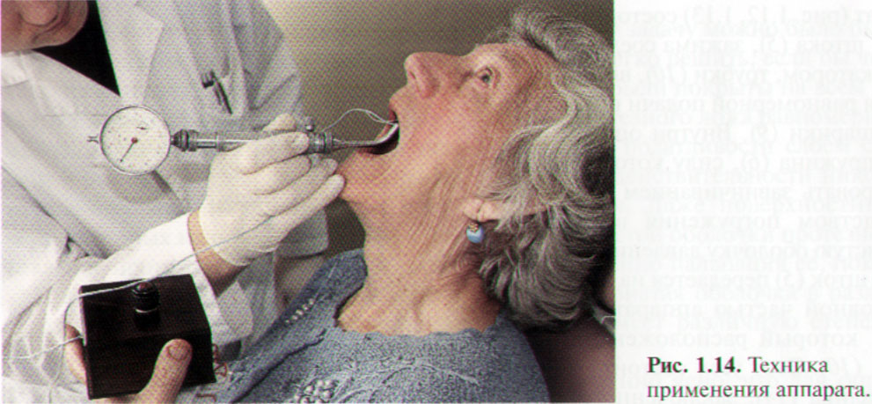
The pliability of the mucous membrane is explained by the characteristics of the submucosal layer, in particular, the location of fatty tissue and mucous glands in it.
E.I. Gavrilov connected the vertical compliance of the mucous membrane of the jaw bones with the density of the vascular network of the submucosal layer. In his opinion, vessels that can be emptied and filled with blood can create conditions for tissue reduction in volume. The more extensive the vascular network, the more pliable the mucous membrane in this area.

Slide 17
Areas of the mucous membrane of the hard palate with a well-developed vascular network, which therefore have spring properties, are called buffer zones.
The buffering properties of the mucous membrane of the prosthetic bed of the upper jaw change throughout life, which is associated with changes in blood vessels under the influence of age, metabolic disorders, infectious and other diseases.

Slide 18
Motility of the mucous membrane is the ability of the surface layer of the mucous membrane to move under the influence of external load.
In the clinic, a distinction is made between mobile and immobile mucous membrane. Mobile - covers the cheeks, lips, floor of the mouth, has a loose submucosal layer of connective tissue and easily folds. When the surrounding muscles contract, this mucous membrane is displaced. The immobile mucous membrane does not have a submucosal layer; it lies on the periosteum, separated from it by a thin layer of fibrous connective tissue (these are the alveolar processes, the area of the sagittal suture).

Slide 19
Based on the varying degrees of pliability of the mucous membrane, Lund distinguishes 4 zones on the hard palate:
area of the sagittal suture;
alveolar ridge;
area of the hard palate in the area of transverse folds;
posterior third of the hard palate.
The mucous membrane of the first zone is thin and does not have a submucosal layer. Therefore, its flexibility is negligible. Lund called this area the medial (middle) fibrous zone.
The second zone covers the alveolar process and is also covered with a mucous membrane, almost devoid of a submucosal layer. It is called by Lund the peripheral fibrous zone.
The third zone is covered with a mucous membrane, which has an average degree of pliability.
The fourth zone - the posterior third of the hard palate - has a submucosal layer rich in mucous glands and containing some adipose tissue. This layer is soft, has the greatest degree of pliability and is called the glandular zone.

Slide 20
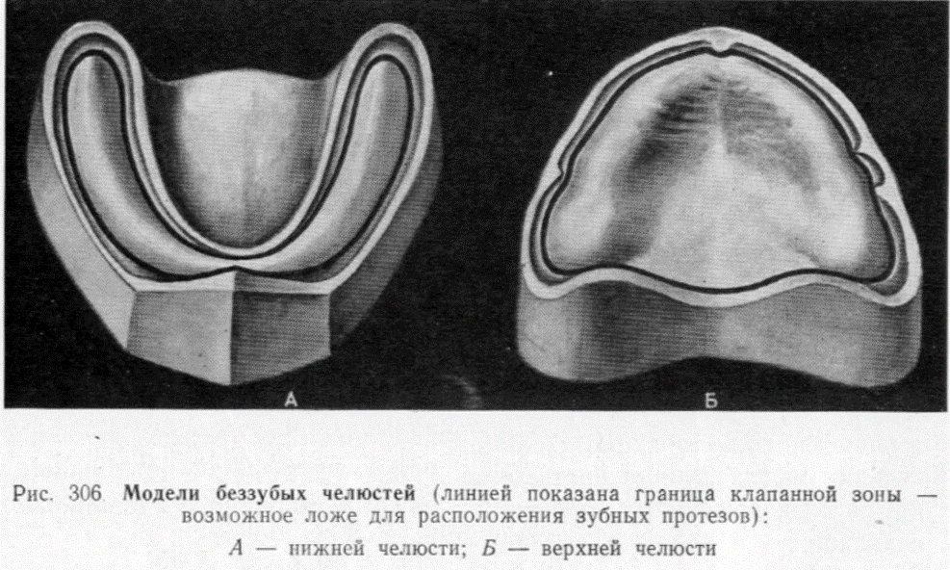
LIMITS OF COMPLETE REMOVABLE DENTURE BASES
On the upper jaw, the boundaries of the base overlap the maxillary tubercles, go around the pterygomaxillary folds, the buccal-maxillary cords, the frenulum of the lip and extend onto the palatine vault. Along line A, the prosthesis base overlaps the blind holes by 2 mm.
On the lower jaw, the boundaries of the base are covered by mucous tubercles, bypassing the buccal-maxillary cords and the frenulum of the lip and tongue.

