Slide 1
MISTAKES AND COMPICATIONS IN DIAGNOSIS AND TREATMENT OF DENTAL CARIES

Slide 2
FACTORS CONTRIBUTING TO MISTAKES IN DIAGNOSIS OF CARIES
Dental specialists perform a variety of procedures during diagnosis and management of dental caries. Poor execution of the latter often leads to complications. Mistakes can occur both during diagnostics, carious cavity preparation, at different stages of cavity filling and after sealing.
Conventionally, medical mistakes can be classified as tactical and technical, objective and subjective.
Tactical medical mistakes include mistakes in diagnosis.
Mistakes in diagnosis occur when the basic principles of therapeutic dental clinic organization are not observed.
The reasons leading to mistakes in the diagnosis of caries can be divided into two groups: caused by dental professionals and due to insufficient dental equipment.

Slide 3
The mistakes caused by the doctor are the following:
1. The doctor's ignorance of etiology, pathogenesis and clinical manifestations of caries;
2. Use of outdated methods of caries diagnosis;
3. Misinterpretation of the results of the patient examination;
4. Inability to generalize the results of the examination;
5. Negligent filling in dental medical record and other forms of medical
documentation.

Slide 4
The mistakes due to insufficient dental equipment are:
1) absence of diagnostic equipment (X-ray unit, devices for electric pulp testing, etc.);
2) equipment of poor quality (blunt probe, poor lighting, etc.);
3) absence of diagnostic sets (for determination of lactobacilli and streptococci in saliva, buffer capacity of saliva, solutions for indentification of oral hygiene level, etc.).
However, despite the variety of reasons for diagnostic mistakes, the basis for most medical mistakes is insufficient doctor’s knowledge and inability to apply it in practice. The doctor who committed the mistake must do everything to prevent negative consequences.

Slide 5
Mistakes and complications in diagnosis of caries:
1.Diagnostic mistakes due to insufficient identification of the patient’s complaints and inadequate assessment of the pulp condition.
When a patient complains of pain from irritants, one can diagnose deep caries without taking into account the duration and nature of pain. Sealing a tooth like this even with a medical cap can lead to the appearance of acute pain.
Sometimes long-lasting pains from irritants appear, which is characteristic of chronic pulpitis. The diagnosis of pulpitis can be confirmed by electric pulp testing. However, clinical findings are usually sufficient to provide adequate treatment of such cases — pulp extirpation.

Slide 6
2.Mistakes in diagnosis of «hidden» caries.
Special difficulties for diagnosis are «hidden» cavities on the approximal tooth surfaces (Fig. 1). If the contact point has not yet been destroyed by caries, complaints of pain from thermal irritants are usually absent. Probing the cavity is difficult or not feasible. In this case, it is necessary to take into account indirect signs:
– change in the color of the enamel because the shadow from the carious cavity can be illuminated through the lingual, vestibular walls or marginal crest;
– complaints of discomfort between teeth during meals, difficulty in using floss when cleansing the interdental space;
– presence of inflammation of the interdental papilla (pain and bleeding when touching);
– complaints about an esthetic defect (the appearance of dark spots on densely located teeth).
In the presence of such signs it is necessary to use additional diagnostic methods (interproximal radiography, temporary selective separation of teeth, etc.).

Slide 8
3. Mistakes in differential diagnosis with non-carious lesions.
Difficulties in diagnosis can arise when differentiating initial multiple cervical caries and fluorosis opacification of the enamel, which is often localized in the cervical area of the teeth. In this case it is necessary to take into account that a pronounced cariogenic situation in the oral cavity is characteristic of caries: high caries intensity, poor oral hygiene, etc.

Slide 9
Mistakes in diagnosis can occur with enamel hypoplasia when it appears as white or pigmented spots located on the vestibular surfaces of the incisors and canines of both jaws closer to the cutting edge of the teeth. One must remember that hypoplasia is formed before the eruption of the tooth; its dimensions and color in the process of tooth development do not change. In hypoplasia stains are sharply limited on periphery from healthy enamel; they have a glassy shine and are not stained with methylene blue and other dyes.

Slide 10
Diffuse opacification of the enamel (defect in the transparency of the enamel) is often mistaken for caries of the enamel. A similar feature is subsurface opacification of the enamel, multiple lesions and localization of defects in the cervical area of the tooth crown. When diagnosing such lesions, it is necessary to use the method of vital staining of enamel (2 % aqueous solution of methylene blue, water solution of alizarin red), drying of the tooth surface with air. In the case of diffuse opacification, the surface of the enamel in the hypomineralization zone is smooth, shiny, and in the case of caries — matte, dull, often rough.
Mistakes in diagnostics lead to the wrong treatment plan; therefore, it is important to conduct the diagnostic steps carefully and thoroughly, and to use additional and special diagnostic tests (drying, staining, laser-induced fluorescence, electric pulp testing, quantitative light-induced fluorescence, radiographic examination, etc.).

Slide 11
MISTAKES AND COMPLICATIONS ARISING DURING CARIOUS CAVITY PREPARATION
In most cases, the treatment is limited to the preparation of carious cavity without taking into account the oral hygiene status of the patient, individual dietary habits, the intake of fluoride compounds. Before operative cavity treatment every dentist should identify oral hygiene indices and conduct quality control of teeth cleaning, give recommendations on the dietary regime and additional fluoride intake. Failure to comply with this rule leads to poor treatment effectiveness (emergence of new cavities and secondary caries) even with an unmistakable sealing.
Knowledge of the following possible mistakes during carious cavity preparation and filling material placement will prevent young clinician from the complications arising as the result of mistakes.

Slide 12
1. Insufficient cavity preparation (Fig. 2).
The basis of preparation of dental hard tissues includes removing carious tooth tissue and ensuring the retention of restorations with regard to the prevention of dental caries.

Slide 13
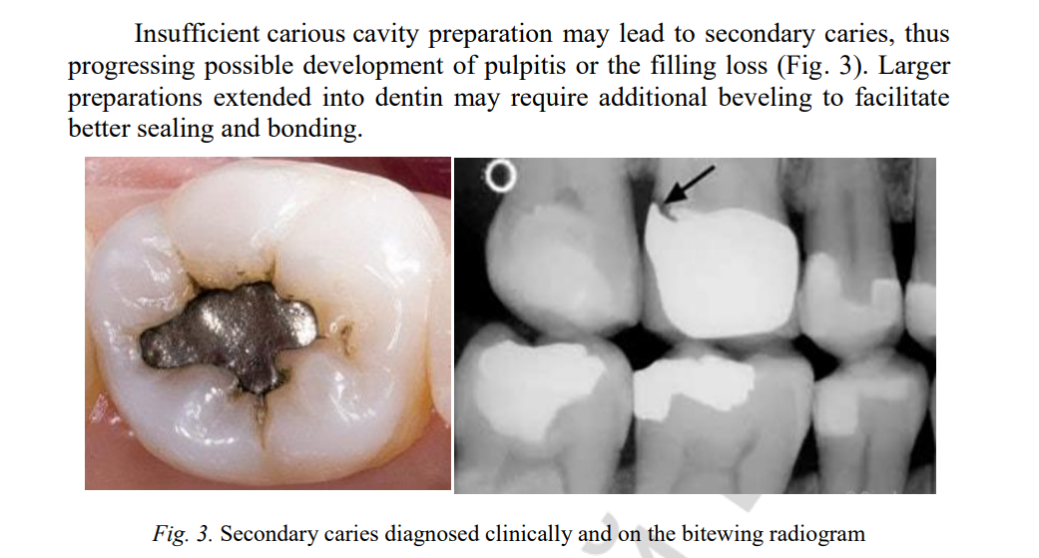

Slide 14
2. Perforation of the carious cavity bottom or carious cavity wall and fracture of the carious cavity wall may happen if the clinician’s hand is not properly fixed thus leading to such complications. Perforation of the carious cavity floor may happen in the case of acute deep dental caries, when the bottom is softened and a thin layer of demineralized dentin separates carious cavity from tooth cavity.
3. Injury to the adjacent tooth crown by bur may happen when visible control of operative field is not provided.
4. Injury to the gingival margin by bur may happen during the preparation of carious cavities that go deep under the gums, or if a good visibility of the operative field is not provided.
5. Wrong cavity formation. The stage of cavity formation should be carried out simultaneously with the verification of occlusal contacts (the edge of the cavity should not set on the border of the occlusal contour when forming the cavity).
6. Inadequate beveling and smoothing of enamel. Insufficient bevel of enamel can lead to deterioration of adhesion and to violation of marginal fit in future. With a small bevel on the frontal group of teeth, the esthetics of restoration will worsen (a transition from the filling material to the tooth tissue is noticeable). However, in the operative treatment of cavities on molars and premolars there are several points of view with respect to the bevel of enamel:
– on the chewing surface, a bevel is recommended at 410 (to enhance adhesion, to improve esthetics);
– enamel bevel is not recommended (R. Jordan, 1993)

Slide 15
In clinical practice, we dissect the bevel in patients with increased erosion of the tooth tissues, pathology of the occlusion, bruxism. If the bevel significantly weakens the walls and mounds of the tooth, beveling is not done, either.
When preparing the frontal group of teeth:
– the bevel shouldn’t be exceed 2 mm;
– with fuzzy contours (better wavy);
– deep at the base of the cavity (at the entire thickness of enamel) (Fig. 4)

Slide 16
MISTAKES AND COMPLICATIONS ARISING IN THE RESTORATION OF CARIOUS CAVITIES
Composite resins have been used for nearly 50 years, and year after year improvements have been made regarding their composition and their handling properties. However, there are problems, which have limited the use of composites. So even if composites have become one of the most preferred esthetic restorations at the present time, they say: «all that looks gold is not gold», even these restorations have their own drawbacks».

Slide 17
Failures that can be seen in a composite restoration are as follows:
1. Improper selection of filling material. Composites are the material used both in the anterior and posterior teeth restorations. They are indicated in Class III, IV and V lesions in the anterior teeth and in case of small to moderate Class I and II cavities. A wrong selection of filling material is made in case of poor oral hygiene as composite resins accumulate more pathogenic bacteria than amalgam or glass-ionomer cement restorations, which may lead to secondary caries due to microleakage. It is not recommended to use composites in a permanent bite if it is impossible to provide good isolation from saliva in patients with high-risk caries (multiple caries, poor oral hygiene, or if the patient does not follow proper hygiene after training and motivation).
Composite resin has less wear resistance. In patients with heavy occlusion, such as bruxism, excessive wear of the composite filling may lead to the failure of the restoration. So, pretreatment assistance of occlusion with articulating paper should be provided to guide the practitioner in the preparation design.

Slide 18
2. Color of composite. Determining the color of the tooth plays an important role in performing esthetic restorations. However, discrepancy between optical properties of the restoration and natural tooth tissues is quite often found in medical practice. Absence of special training in identifying shades, nonobservance of the rules for choosing shade of the tooth, ignorance of the psychophysiology of visual perception can have a significant influence on the correctness of the shade selection.

Slide 19
3. Lack of isolation. Composites are very sensitive to moisture contamination. Isolation is very mandatory during adhesion and bonding of composite resin to tooth structure. Failure to maintain isolation causes decreased bond strength; and ultimately, physical and mechanical properties of composite restoration also decrease. Keeping the area isolated is also a key step in contamination prevention.
4. Incorrect placement of rubber dam. Isolation can be done with rubber dam, gingival retraction cords, etc. But the most important procedure is placement of rubber dam. Appropriate contour and contacts are important for success and longevity of composite restorations. It is achieved by proper placement of rubber dam.

Slide 20
5. Incorrect manipulation:
5.1 Acid etching. Appropriate time for acid etching shouldn’t exceed 30 seconds for enamel and 15 seconds for dentin. Enamel requires more etching time as fluoride content in enamel is higher and more resistant to acids.
5.2 Acid strength. Buonocore used 85 % phosphoric acid first. But later studies showed that higher concentration was less effective and is more likely to denude the surface; so research suggests 37 % phosphoric acid is the ideal concentration. Care should be taken before using an etchant as it evaporates during storage.
5.3 Under-etching. Failure to achieve a frosty surface could result from under-etching.
5.4 Over-etching. Over-etching can cause formation of an insoluble residue called monocalcium phosphate dehydrate, which prevents further etching and causes weak bonding. Average washing time is 10 sec. Insufficient washing leaves debris that interferes with the flow of resin. 60 sec washing with heavy water spray weakens resin-enamel bond strength as enamel rods get crushed.

Slide 21
6. Inadequate pulp protection. Deep composite restoration may lead to pulpal pathology and irreversible damage if not lined with a medical capping from MTA, Bioceramics, Ca(OH)2 or similar materials. Zinc oxide eugenol based materials as insulating cappings over the medical capping are contraindicated under composites as they inhibit resin polymerization.

Slide 22
7. Improper placement of insulating lining. Incorrect placement of the insulating lining in deep caries can cause irritation or damage to the pulp by chemical, toxic or thermal irritants of permanent filling materials. The presence of a lining on the side walls of the carious cavity (above the enamel-dentinal junction) worsens the marginal fit and fixation of the permanent filling material, predisposes to the emergence of secondary caries and the loss of a seal. Applying a lining to the vestibular wall of the carious cavity in the frontal teeth leads to a cosmetic defect. Opaque lining in the form of a yellow patch shines through the translucent enamel of the vestibular wall. The use of adhesive systems of the fourth and fifth generation greatly facilitates the work of the dentist, since it requires the minimum size of the insulating liner. However, in many cases a lining is necessary.

Slide 23
8. Improper bonding. Bonding mechanism of enamel and dentin differs.
The inorganic component of enamel is 95 % and is more hydrophobic. Contrary to that, dentin is more hydrophilic as dentinal tubules have fluid flow, which makes bonding a hydrophobic resin into the dentin substrate difficult. Bond strength to all dentin surfaces is lower than to enamel. The bonding between the tooth and resin may fracture because of the following reasons:
1) Non-uniform application of bonding agent.
2) Role of evaporation
3) Lack of isolation

Slide 24
9. Improper modeling and shaping of a filling (Fig. 6):
9.1 The absence of contact point, placement of a single filling in adjacent carious cavities will lead to inflammation of interdental papilla, thus causing pain to the patient and development of periodontal diseases. That’s why during restoration of Class II by Black (proximal cavities) it is necessary to use matrix holder, matrices and wedges in order to restore contact point, and prevent these complications.
9.2 Hanging edges of a filling. Matrix system should provide appropriate contour and contact, which prevents overhangs. The matrix band should be burnished to have an appropriate contour of desired shape to prevent open contact development. If it happens in the anterior teeth, it causes non-esthetic restoration, and for the posterior teeth there might be food impaction, pain and subsequent perio-problems. Matrix band should be 1 mm above the adjacent teeth.
Wedges are applied in the area of gingival embrasure to provide proper contour and contact, to prevent gingival overhangs and to hold the matrix band in place.
9.3 Formation of high occlusion usually happens when filling is not adjusted to the bite, when «high spots» of the material are left. The tooth in traumatic occlusion will be painful while biting (diagnostic feature) and will lead to development of apical periodontitis in future.
9.4 Voids. Leaving the voids between the layers of the filling material leads to the failure of restoration. The causes of voids are improper mixing and insertion of composite in the prepared cavity, pulling of the material during insertion, improper condensation. The void between the tooth and composite may result in recurrent caries.

Slide 26
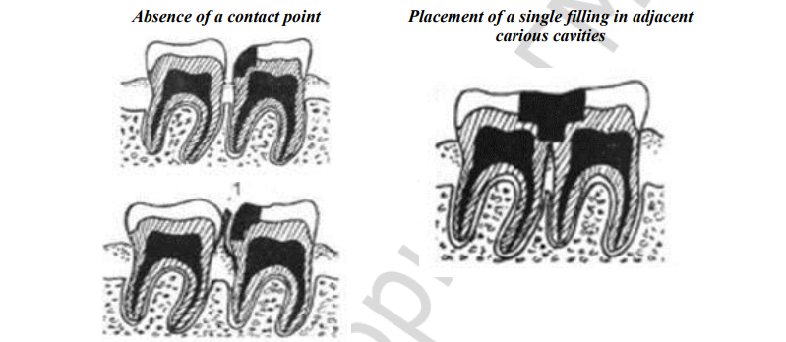

Slide 27
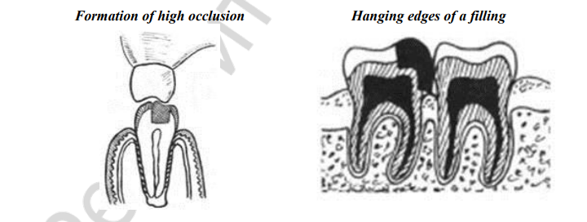

Slide 28
10. Improper angle and direction of light. As angle of light deviates from perpendicular direction, the penetration and intensity of light is affected and reduced. e.g. marginal ridges can block the light passage. Optimum polymerization occurs at depth of just 0.5 to 1 mm of the composite resin thickness. As the direction of composite polymerization is to the source of light, the lamp should be placed opposite to the filling.
11. Formation of oxygen-inhibited layer. Oxygen in air competes with polymerization and inhibits setting of resins. Covering the tooth with air inhibiting gel reduces oxygen inhibition.
12. Improper light intensity. Optimum curing intensity is 468 + 20 mm. The causes of decreased intensity are: 1) Age of bulb 2) Voltage 3) Sterilization of curing tips reduces light transmission. 4) Filter to increase blue light transmission. Exposure of light should be 20 or 40 sec. Any deviation in intensity range results in partially cured restoration.
13. Temperature. Light cure composites are less effective if they are cold during application. Heat accelerates polymerization but excess heat and undue pressure result in pulpal irritation and inflammation.
14. Inadequate finishing and polishing. Meticulous finishing and polishing of the filling has to be done because all rough surfaces act as niches for microorganisms. Dry polishing and finishing is detrimental as it can open dentinal margins at the dentin-restoration interface and cause pulp damage.

Slide 29
MISTAKES AND COMPLICATIONS ARISING AFTER CARIES TREATMENT
1. Inflammation (necrosis) of the pulp. If pulpal viability and function are to be preserved, the potentially injurious effects of cavity cutting, cavity conditioning, and cavity restoration must be assessed. The most influential variables in terms of causing pulp necrosis are the cavity’s remaining dentin thickness, cavity preparation in the absence of coolant, and the selection of restorative material if the pulp tissue is exposed. Some investigations have found that the amount of intra-pulpal injury generated during cavity preparation and restoration is determined by the drill rotation speed, size, type, and shape of the cutting instrument, as well as the length of time the instrument is in contact with the dentin, the amount of pressure exerted on the handpiece, the cavity’s remaining dentin thickness, restoration material temperature, and the use of cooling techniques. Other potential sources of pulp injury during cavity restoration include: conditioning of the dentin cavity walls with acid and the choice of cavity restoration materials. All aspects of restorative treatment require careful consideration in order to minimize injury and optimize pulp-dentin regeneration.

Slide 30
2. Secondary caries. Secondary, recurrent caries or caries adjacent to restoration occurs under existing dental restorations, such as fillings, crowns, or onlays. It may be caused by poor oral hygiene, leading to plaque accumulation around the margins of the filling, insufficient carious cavity preparation, or by development of a microscopic pathway for leakage (microleakage) past the dental restoration.
Microleakage allows acids and bacteria access to areas of the tooth that are not accessible to toothbrush bristles or other oral hygiene aids. The possibility of microleakage is a strong motivator for replacement of questionable dental restorations, as well as complete removal of old restorative materials (for example, core buildups and bases) in a tooth that will be receiving a new crown or onlay.

Slide 31
3. Papillitis (inflammation of an interdental papilla). As noted earlier, the absence of contact point, placement of a single filling in adjacent carious cavities, overhanging margins of dental restorations have been cited as local irritants in periodontal disease from papillitis to alveolar bone loss (Fig. 7). The patient with acute or chronic papillitis complains of pain upon biting, difficulties using dental floss. In order to avoid these mistakes one should use matrix system while filling the carious cavities of Class II.

Slide 32
4. Acute or chronic apical periodontitis. Having an insufficient cooling of the prepared tooth surface may damage odontoblasts or irreversibly change the pulp causing apical periodontitis.
The other reason for the development of apical periodontitis after the restorative treatment is the insufficiently adjusted height of the filling.

Slide 33
5. Displacement, fracture and loss of filling. A dental filling when properly placed is designed to withstand a great amount of pressure for a long time. Although rare, a filling can come out of a tooth for various reasons. One of the most common is decay under a filling. An older filling can change shape and create gaps between the filling and the tooth. This allows bacteria and food byproducts to get under the filling which causes tooth decay over time. When the tooth structure is destroyed, there is no solid support for the filling. This leads to loosening of the filling and eventual displacement. Another reason for filling displacement can be breakage of a supporting wall of a tooth. This is more common with silver amalgam fillings since there is no bond formation between the tooth and the filling. A tooth that has displaced a filling can be either sensitive, usually to cold, or asymptomatic

Slide 34
