Slide 1
Lecture 3 Studying demand in marketing activities
Associate Professor, Institute of Pharmacy, Ph.D. Garifullina G.Kh.

Slide 2
Demand- this is the desire to buy a product, supported by the financial capabilities of the consumer

Slide 3
Classification and characteristics of various types of demand
From the source
demand generation
Generated
institutional
consumer
Generated
intermediate
consumer
Generated
population
Notes:
3
General and local symptoms

Slide 4
Classification and characteristics of various types of demand
By degree
satisfaction
Valid
Realized
Unsatisfactory
military
Real
unsatisfied
Hidden
unsatisfied
Notes:
4
1. Rhinitis
- spicy
- chronic
a) simple – the result of prolonged acute rhinitis
b) hyperplastic – characterized by the proliferation of connective tissue on the nasal turbinates
c) atrophic – characterized by atrophy of the mucous membrane
d) vasomotor – characterized by paroxysmal course, most often attacks are caused by neurogenic and endocrine disorders
d) allergic
2. Nasal polyps– the result of a long-term inflammatory process in the nose caused by chronic purulent sinusitis
3. Sinusitis– inflammation of the paranasal sinuses
1) downstream:
- acute (catarrhal, purulent, necrotic)
- chronic (catarrhal, purulent, hyperplastic, polypous, fibrous, vasomotor)
2) due to the cause of occurrence (rhinogenic, odontogenic, traumatic)
3) by the nature of the pathogen (viral, bacterial-aerobic, bacterial-anaerobic, fungal, mixed)
4) according to the prevalence of the process (ethmoiditis, sinusitis, frontal sinusitis, sphenoiditis, pansinusitis)
4. Adenoiditis– inflammation of the pharyngeal tonsil
- acute – more often in infants
- chronic – usually combined with hypertrophy of the pharyngeal tonsil
5. Chronic tonsillitis– chronic inflammation of the tonsils
- compensated (there are no phenomena of intoxication and allergization of the body)
- decompensated (symptoms of intoxication and allergization of the body are recorded)
6.Pharingitis- inflammation throats
- acute – more often with acute respiratory infections
- chronic (hypertrophic, atrophic, allergic)
7. Bronchitis– inflammation of the bronchi
-acute – most often a consequence of acute respiratory infections
- chronic (obstructive and non-obstructive

Slide 5
Types of demand:
Actual demand is the entire effective demand for drugs actually offered on the market, equal to the number of calls to the pharmacy for the product;

Slide 6
Realized is part of the actual demand, which manifests itself in the acquisition of medicines; it is equal to the number of goods actually sold;
Unsatisfied demand is part of the actual demand, which manifests itself in the refusal or replacement of drugs; it is equal to the difference between the actual and realized types of demand.

Slide 7
Factors influencing demand:
Changes in the structure of diseases;
Population size;
Income level of the population;
Commodity prices;
Time periods;
Advertising;
Conditions for the release of goods.

Slide 8
Elasticity of demand is the change in demand influenced by income or prices

Slide 9
Elasticity of demand is determined by the ratio of the change in quantity demanded (as a percentage) to the change in prices (as a percentage).
Accordingly, to establish the type of elasticity of demand, use the formula:
E = S/c
E – elasticity of demand.
C – change in demand as a percentage.
C – price change as a percentage.

Slide 12
Elasticity of demandmore than 1is elastic demand. A small change in price leads to a large change in demand. When prices fall, income increases; when prices rise, income decreases.
Elasticity of demandless than 1- This is inelastic demand. Price fluctuations have virtually no effect on the demand for goods, therefore, when prices rise, income increases, and when prices fall, income decreases.
Elasticity of demandequals 1is unit elasticity, i.e. a change in price is fully compensated by a change in the level of demand. With unit elasticity of demand, the total volume of sales revenue always remains constant.
.

Slide 14
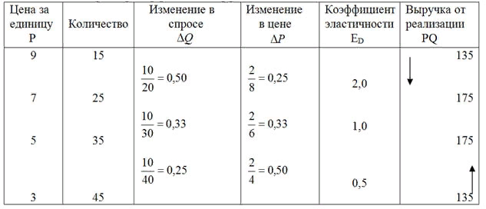

Slide 15
It is recommended to lower prices for goods with increased elasticity of demand.
It is recommended to increase prices for goods with low elasticity of demand.

Slide 16
Time periods
Maximum revenue accounts for
in the autumn - winter period,
and decreases in summer.
By day of the week:
maximum sales perMonday,Tuesday,
minimum –Saturday,Sunday
Peak sales from 12 to 13 and from 16 to 18 hours

Slide 17
Using data from a sociological survey (questionnaire), you can determine the annual sales of a new product.
For example, its price is 400 rubles, and the number of residents of the microdistrict is 50 thousand. 100 pharmacy visitors were surveyed: do they intend to buy a new drug?

Slide 18
Survey result:
Definitely “YES” - 15%;
Probably “YES” - 20%;
Definitely “NO” - 25%;
Probably “NO” - 10%;
I find it difficult to answer – 30%.
Positive responses account for 35%.

Slide 19
Let's determine the number of potential purchases:
50 thousand inhabitants - 100 %
X - 35%
X = 17.5 thousand purchases
You can determine the potential income from the sale:
400 * 17.5 thousand = 7 million rubles

Slide 20
Calculate the realized demand for VALOCORDIN
Let's assume that the number of hits per day for it was:
There are 24 bottles in January;
In February there are 20 bottles;
There are 22 bottles in March.
Average :
(24+20+22)/3 = 22 bottles per day.
Demand for the quarter:
22 * 90 days = 1980 bottles.

Slide 21
Example Calculate the monthly demand for the laxative drug “Guttalax”. For this purpose, a random “field” study was carried out at the pharmacy within 3 working days.

Slide 22
period | Actual demand | Realized demand | Unsatisfied demand hidden | Unsatisfied demand real
1st day 2nd day 3rd dayaverage per day In just a month | 6 4 5 5 ? | 5 2 2 3 ? | 1 0 2 1 ? | 0 2 1 1 ?

Slide 23
Actual demand (D) for a month is equal to:
6 + 4 + 5
3 x 30 = 150 packs
Realized demand (P) is equal to the amount of guttalax supplied:
5 + 2 + 2
3 x 30 = 90 packs
The amount of unsatisfied demand will be the difference between actual demand (D) and realized demand (R)
N = D – P = 150 – 90 = 60 packs

Slide 24
Including latent unsatisfied demand (Hc), equal to the number of replacements, will be for the quarter:
1+ 0 + 2
3 x 30 = 30 packs
Real unmet demand (Np):
Нр = Н – Нс = 60 – 30 = 30 packs

Slide 25
period | Actual demand | Realized demand | Unsatisfied demand hidden | Unsatisfied demand real
1st day 2nd day 3rd dayaverage per day In just a month | 6 4 5 5 150 | 5 2 2 3 90 | 1 0 2 1 thirty | 0 2 1 1 thirty

Slide 26
The quantity of demand is influenced by two groups of factors:
- factors that shape the need for pharmaceutical products, since demand is a form of manifestation of need;
- a group of economic indicators (price of a product and its analogue, buyer’s income, etc.), since demand is an effective need.

Slide 27
The degree of influence of individual factors on the amount of demand can be determined in various ways, for example by calculating correlation coefficients or elasticity.
The simplest way to establish a correlation between demand and the factor that forms it is to calculate the Spearman rank correlation coefficient.
When using this method you must:

Slide 28
1) carry out the selection of factors of interest in a logical way (gender, age, income, duration of the disease, frequency of visits to the doctor, to the pharmacy);
2) register demand and factors of interest to you in the registration sheet;
3) rank demand indicators (resulting characteristic “at") and each of the factor characteristics ("X"). Ranking is carried out from the smallest indicator to the largest, the same values ​​are assigned the same ranks;

Slide 29
4) determine the difference, the square of the difference between the rank numbers of parallel observations and sum the resulting squares of the difference;
5) calculate the correlation coefficient using the formula:

Slide 30
The correlation coefficient values ​​range from +1 to -1.
The sign indicates the nature of the dependence: “+” - straight;
“-” - reverse.
If p value =+1, then the connection between the resultant and factor characteristics is functional.
If p = 0, there is no connection.

Slide 31
With absolute values ​​of the coefficient less than 0.3, we speak of a weak correlation dependence,
from 0.3 to 0.7 – average,
more than 0.7 – close correlation.
Establishing a close relationship between a factor and demand serves as a guideline for its inclusion in multifactor demand forecasting models.

Slide 32
Example.
Determine the degree of correlation between the demand for cardiovascular drugs and the age of consumers, if the following results are obtained from 10 observations:

Slide 33
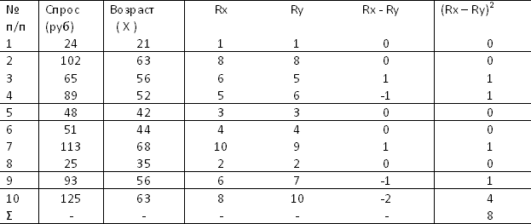

Slide 34
6 x 8
p = 1 - 10 x (100 – 1) = 1 – 0.05 = 0.95
The dependence is close and direct (with increasing age, demand increases).

