Slide 1
Merchandising in pharmacy
Abdullina Ylia

Slide 2
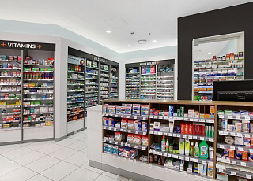
merchandising in pharmacy
Merchandising in pharmacies is a set of efficient rules and techniques, which enable to achieve significant growth in turnover of a pharmacy and, consequently, resulting profit.

Slide 3
Merchandising in pharmacies: purpose and objectives
to increase sales volumes, turnover and profit level;
to build a positive image, drawing new customers, and increase the number of pharmacy regular visitors;
to improve the quality of service in general.

Slide 4
to achieve customers’ longer stay in pharmacy sales area;
to prompt a customer to make impulse purchases;
to draw their attention to certain product items and groups of goods;
to create an atmosphere of total physiological comfort for making a purchase.

Slide 5
Rules of laying out pharmaceutical products: basic principles
OTC drugs should occupy the most advantageous spaces and to be offered in face-ups clearly separated by treatment groups;
separate zones should be allocated among each large group of products of similar designation .
checkout aisle should be organized for high-demand general medical products with due account for seasonality.

Slide 6
MERCHANDISING IDEAS FOR PHARMACIES
MAKE THE RIGHT IMPRESSION: EXTERIOR
Choose a single theme or message and use large striking visuals understood from a distance.
Have a clear call to action that invites customers to come in and access the product or service on offer.

Slide 8
MAKE THE RIGHT IMPRESSION: INTERIOR
Over the past few years, some pharmacy retailers have made a dramatic shift from sterile or traditional store formats to a more “boutique” format.

Slide 9
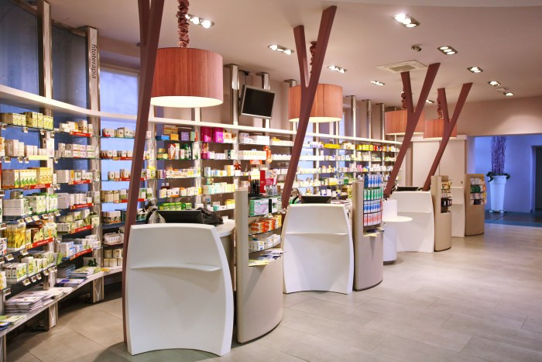
Brands like Cedar Pharmacy in New York have curated a unique space highlighting their core values of wellness and personalization.

Slide 11
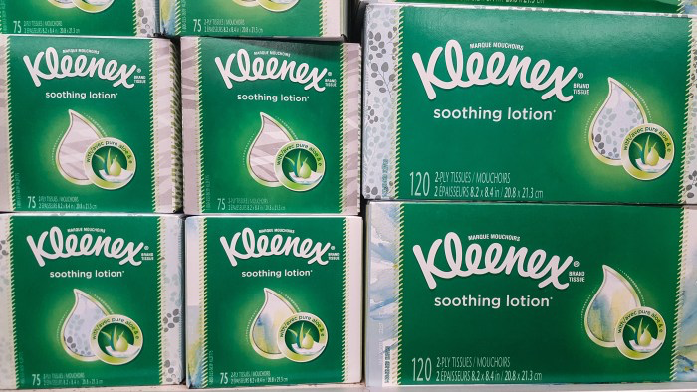
FOCUS ON SEASONALITY
Using the seasons to guide your product focus is a great way to utilize merchandising for maximum impact. Take cold and allergy season for example.

Slide 12
Merchandising is a component of the marketing activities aimed at ensuring the most effective product promotion at the retail level, promotion of activities in the field of trade. Or, merchandising – is marketing in the retail point, consisting of equipment for product placement, design and layout of promotional materials at point of purchase.
Common law defines merchandising favorable conditions of sale: products with a corresponding name of the respective prices must be available in the right place at the appropriate time and appropriate promotional support.

Slide 13
Merchandising helps to increase the so-called spontaneous purchases under the influence of incentive items, including: attracting attention; the emergence of interest; motivation of purchase; expression of willingness to act.
Found that 30% of buyers make a planned purchase, and 60% are unplanned, including impulsive. The main rule of effective merchandising is that it must be the result of joint efforts of producers, distributors and pharmacies.
Because the pharmacy enterprises (institutions) and their structural units combine the functions of the pharmaceutical trade visitor services, and medicines and other pharmaceutical products have their own specific range, usually in pharmacies using common principles, laws and rules of merchandising with a certain branch of adaptation.

Slide 14
Registration of pharmacy and trading hall.
Merchandising begins with the design of the facade pharmacy, its front windows and signage. This takes into account the fact that the flow of pedestrians on the right side of the stronger pavement. Analyze the placing of public transportation stops, parking places, large commercial and cultural centres, offices and businesses. Visitors should bring to the pharmacy a modern and comfortable interior design, style, layout, lighting sales area, cleanliness, lack of foreign smells and sounds, the concentration of product placement and sales departments. The orientation of the buyer in the sales area must go 20-25 sec., so must have appropriate labels. For example, the “Prescription department”, “Department of OTC”, “Medicinal Plants”, “Beauty”, “Help”, “Cash”, etc.

Slide 15
Registration of pharmacy and trading hall.
In planning and implementing calculations of pharmaceutical product take into account the form of implementation: the traditional sale of over the counter or through the open sale of self-service with professional advice. More effective to use merchandising in the second case. It should be borne in mind that most visitors to the pharmacy with the open form of implementation: - prefer to go straight, without turning to the right or left, but it is preferable considering the goods from left to right, take it to the right; - when traversing direction of the pharmacy is usually counter-clockwise is right to left; - stop passing one-third of the space the pharmacy; - avoid close, dark and poorly lit areas of the shop floor; - seek to find the necessary drugs and other pharmaceutical products range without going long distances and not turning back.

Slide 16
Registration of pharmacy and trading hall.
Based on these provisions can be identified strengths and weaknesses for the location of the goods. “Strong” places are shelves on the right side in the direction of buyer, the intersection of rows of shelves with a good overview of the front, the space near the cash register and freestanding counters with shelves. “Weak” is a place shelves on the left side in the course of buyers, the corners of the room service and location near the entrance to the pharmacy

Slide 17
Principles for placing a pharmaceutical product in shop windows and shelves
The principles calculations of OTC medicines and other pharmaceutical products should be well thought out method of computation must be simple enough to provide review, accessibility, attractiveness and convenience for the customer. As a result of long-term observations of American marketers identified a number of basic principles of product placement that contribute to stimulating purchases and increasing sales: 1. Placing of goods on the shelves should be directly proportional to consumer demand: the goods should occupy as much space as there is demand for it, how it is sold. It is important that the demand should be measured in monetary terms, but not in the number of packages sold. 2. Product placement near the top-selling type of products increases the volume of its sales, since the goods immediately attracted a well-known view of the buyer.

Slide 18
Principles for placing a pharmaceutical product in shop windows and shelves
3. The optimum is to place the goods on the shelves at the level of the waist (women of average height) to the eye (120-170 cm). This level is most convenient to read. Research has established that the movement of goods from the bottom shelf at the level of the waist increases the volume of its sales by more than 40%. If you move it from eye level to the bottom shelf, the volume of sales will decreased by 80%. 4. Product placement on a shelf near the label increases the volume of its sales. 5. Recommended that the principle of asymmetry is not to put the goods on display accurately and precisely symmetrical. Showcase, where goods are ordered, gives the impression of a successful sales associate with a lively trade. This principle is acceptable for a small pharmacy where the rules must be respected pharmaceutical order, but the computation parapharmaceutical products can be used. 6. The principle of "left-right": the goods are most packaging must be placed on the right, as a man looks at everything from left to right.

Slide 19
Principles for placing a pharmaceutical product in shop windows and shelves
Provided are a number of rules and recommendations merchandising: 1. Overly large windows with drugs adversely affect the buyer's impulse to buy something 2. Spontaneously purchased products should be set in locations where the flux density of customers, the highest 3. A variety of packages (dosage form, dosage) promotes effective sales: - 2 variants package increase turnover by 15%; - 3 variants – up to 30%; - 4 variants – up to 60%; - 5 variants – more than 100%

Slide 20
Principles for placing a pharmaceutical product in shop windows and shelves
4. Due to the fact that the range of drugs is very broad and restricted the ability to represent them in the shop windows and shelves, consumers should take into account the contingent and its price category (low-price, mainstream or high-price). Classically, it is recommended to focus on the mainstream group of customers with highprice goods interspersed

Slide 21
Principles for placing a pharmaceutical product in shop windows and shelves
5. The buyer should be easy to find the product in a particular place. In this regard, the pharmacy priority groups (categories) of OTC medicines (antipyretic, Cough, pain relievers, vitamins, etc.) should be laid so as to constantly remind myself 6. For quick and easy orientation of the buyer of one category of drugs should be placed horizontally on one line, symmetrically with respect to each other 7. Pharmacy must respond to advertising campaigns and make appropriate changes in the calculations of the widely advertised drug is in high demand 8. The price must be indicated on each package of the drug exposed or parapharmaceuticals

Slide 22
Principles for placing a pharmaceutical product in shop windows and shelves
9. Must comply with the rule of "castle walls": the best selling drugs of one company of the manufacturer shall be in the form of the castle walls at the edges (as if they have same type used and combined dosage forms) 10. Appropriate to respect the rules of corporate power. For this purpose, can be used by additional features such as a mobile shelving or stand, display, and other structures that allow the manufacturer to submit their products 11. It is recommended usually overlap: lead sales medicinal products should occupy an area two times larger than the other positions 12. Must be complied with the order of the brands 13. The most profitable and sold drugs to be placed on a priority 14. All items posted must be provided with at least three day supply.

Slide 23
Placement of promotional materials in the pharmacy
Placement of promotional materials in the pharmacy is one of the methods of merchandising. The main purpose of placing this effect on the buyer, therefore, should be provided with access available in the drugstore advertising products and ordered its storage performance. It is considered unacceptable presence of the table on the trading floor with booklets and leaflets, as it is difficult to maintain a permanent procedure. More appropriate to lay a pile of leaflets about the desktop or a pharmacist in the course of the queue, if there is a possibility

Slide 24
Placement of promotional materials in the pharmacy
Other promotional materials: posters, flags, stripes to attract attention, stands with information about a product, etc. are placed in traditional locations and additional calculations of the goods. However, the specific solution calculations of promotional materials on the trading floor pharmacy depends on the spatial features pharmacies, the intensity of cooperation with enterprises-producers, the frequency of visits by medical representatives, etc.

