Slide 1
What is? Define the following words
Marketing
Consumer
Marketing research
Advertising
Market segmentation
Write definitions on paper

Slide 2
Tasks 1. Show schematically 4 blocks of the main complex marketing functions and a number of subfunctions in each of them.

Slide 3
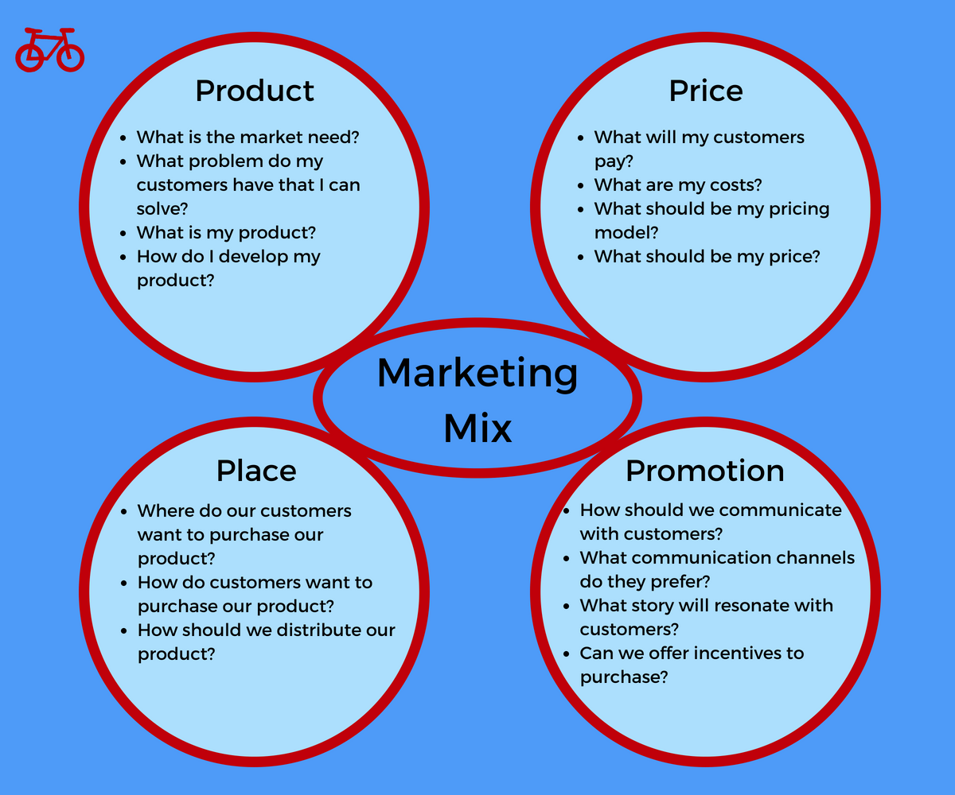
https://redbikemarketing.com/marketing/marketing-mix-4ps/

Slide 4
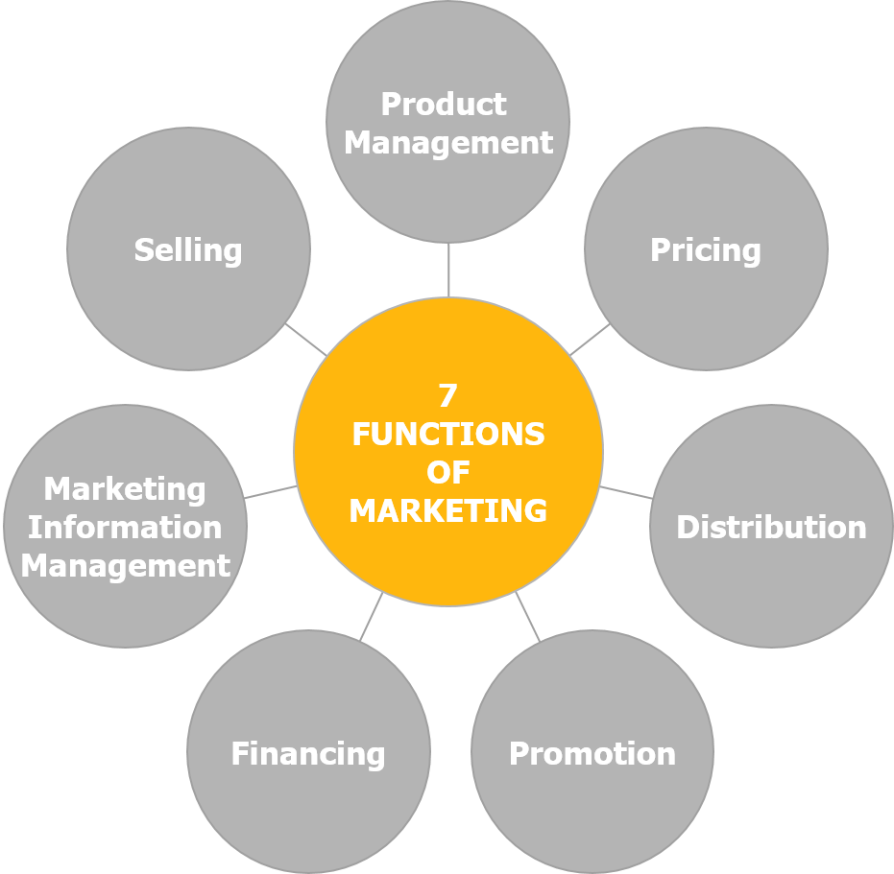
https://marketing-insider.eu/

Slide 5
Think of a marketing plan as a detailed roadmap—a roadmap that outlines all the activities required to achieve your overall marketing objectives. The marketing plan maps out all of the steps you need to take to get there

Slide 6
1. Set a clear marketing strategy
2. Define key metrics for success
3. Research your competition
4. Integrate your marketing efforts
5. Stand out from the crowd with unique creative
6. Operationalize your marketing plan
7. Get the right tech stack
8. Measure performance

Slide 7
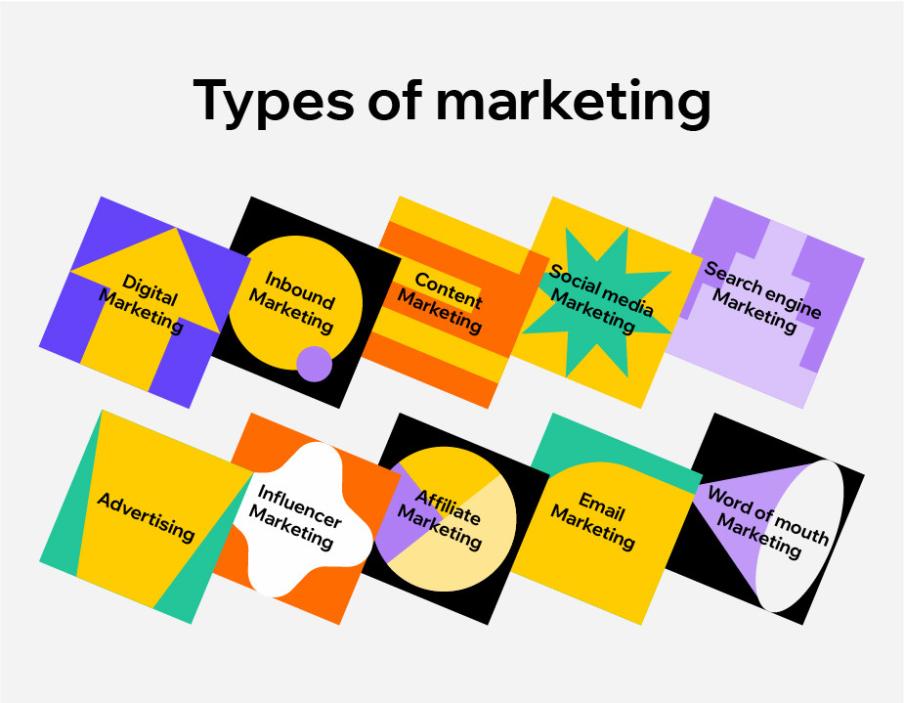
https://www.wix.com/blog/2021/06/types-of-marketing/

Slide 8
TASKS 3
The population of the district where the pharmacy is located is made up of elderly people (65%), adults of working age (28%), children and adolescents (7%). Marketing analysis showed that the sale of goods in this market segment for a number of periods amounted to: 820.0 thousand rubles, 850.0 thousand rubles, 875.0 thousand rubles, 890.0 thousand rubles.

Slide 9
- Analyze the dynamics of sales of goods in this market segment using all the analytical values you know.
- What are the absolute and relative indicators of dynamics? Examples.
- What methods of economic analysis of this indicator can you suggest?
- Market segmentation. Name the market segments in the area. What are the requirements for the target market segment?
- Marketing complex; its components.
- What components of the marketing mix can be used to influence this target market segment?
- What marketing activities can increase the volume of sales of goods?

Slide 10
SWOT-analizy
Prepare a swot analizy of the following drugs:
-FENKAROL (ERIUS, DIAZOLIN, LORATADIN)
-FURAMAG ( MONURAL, TOVANIK, SUPRACS)
-ADAPTOL ( GRANDAXIN, ATARAX)
Stregths (сильные стороны)
Weakness (слабые стороны)
Opportunites (возможности)
Threats (угрозы)

Slide 11
STEIGTHS
PRICE
RECOGNIZABLE BRAND
ORIGINAL/GENERIC
CONVENIENT PACKAGING
AVAILABILITY IN CLINICAL RECOMMENDATIONS
AVAILABILITY IN PHARMACIES

Slide 12
Weakness
the pharmaceutical company does not work with doctors and pharmacies
bad reviews online
lack of digital promotion (no website)

Slide 13
Opportunites
packaging rebranding
promotions in pharmacies
organization of conferences for doctors
increase of distribution

Slide 14
Threats
price reduction of competitors
inability to order at the pharmacy
lack of contracts with pharmacy chains
lack of funding for marketing activities
negative clinical trials

Slide 15
key messages
Сome up with key messages for each of the drugs
-NOSHPA
-HEPTRAL
-HEXORAL
-OMEZ
The key can be considered such a message, in which the greatest attention is paid to the interests of visitors. Such a message, as if it were presented to the listeners of the detention, should be received in the near future.

Slide 16
Benefit-property - advantage
Adaptol - can be used while driving, due to the absence of a sedative effect, which allows us to recommend it to a large number of patients
Ketorol will quickly help all patients, since the maximum concentration is already after 15 minutes, due to the unique form of release

