Slide 1
Advertising and sales promotion of pharmaceutical goods. Modern information technologies

Slide 2
Promotion is the creation and support term relations between the enterprise and the market in order to activate selling of goods and creating a positive image through information, persuasion and reminders about their activities. Promotion policy is carried out in order to increase sales, enhance their efficiency and overall profitability of business

Slide 3
Purposes: - to inform prospective customers about the goods, services, terms of sale; - to convince the buyer to give preference to these products, go shopping in these retail establishments; - to make the buyer to act to direct his behavior to the fact that the market offers at the moment and not to delay the purchase for the future; - to form loyalty to this brand; - to stimulate process of acquiring of goods and others

Slide 4
Main methods of promoting products on pharmaceutical market
Advertising
Publicity
Personal sale
Sales promotion
Public relations (PR)

Slide 5
Advertising is public presentation of information about goods and services using artistic, technical and psychological techniques in order to awaken demand and sales.

Slide 6
Advertising is tool convincing information about a product or company, the commercial promotion of consumer goods and the good qualities of the company, the tool that prepares an active and potential customer to purchase

Slide 7
Advertising as a process typically involves four components: 1. Advertisers (clients). 2. Advertising agencies. 3. Means of advertising (advertising package). 4. Consumers (advertising audience) goods and services.

Slide 8
Advertising of medicines is particularly associated with the characteristics of this market. These features are: - consumer of advertising often is not a consumer of product; - advertising of the merits of the company (a prestigious advertising) is more important in the market of drugs than many others; - due to the nature of products is often confused with advertising information science. On the one hand, advertising can make the results of studies on the other – positive research reports in prestigious journals may promote the sale of products; - doctor is a person who takes a rational decision, because the emotional appeals of advertising may be unacceptable to the consumer;

Slide 9
Classification of advertising
Advertising in periodicals
Print advertising
Advertising on television
Advertising on a radio
Cinema advertising
Outdoor advertising
Advertising at a points of sale
Advertising in a product design
Advertising at fairs and exhibitions
Advertising "public relation"

Slide 10
Federal law “On advertising "
No. 38-FL of 13.03.2006
International codex of advertising practice of the international Chamber of commerce

Slide 11
General requirements for advertising
Advertising must be conscientious and reliable.
Advertising should not:
induce to сommission of illegal actions
call for violence and cruelty
be similar to road signs or otherwise threaten safety of road, rail, water, air transport
form a negative attitude towards persons who do not use advertised goods, or condemn such persons

Slide 12
Products, advertising of which is not allowed
goods, production and (or) sale of which is prohibited by legislation of Russian Federation
narcotic medicines, psychotropic substances and their precursors
explosives, except pyrotechnic products
human organs and (or) tissues as objects of purchase and sale

Slide 13
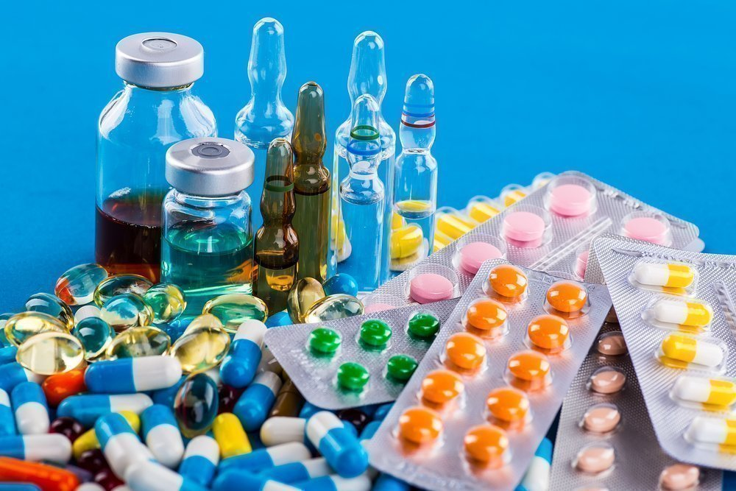
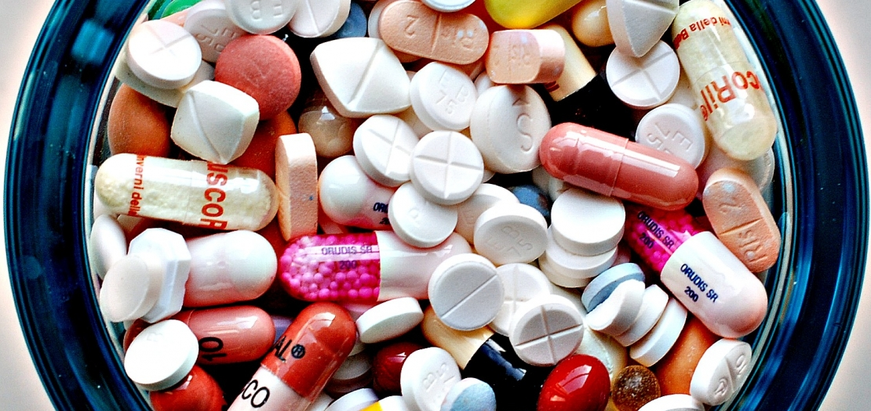
goods subject to state registration, in absence of such registration
goods subject to mandatory certification or other mandatory confirmation of compliance with requirements of technical regulations, in absence of such certification or confirmation of such compliance
goods, production and (or) sale of which requires obtaining licenses or other special permits, in absence of such permits

Slide 14
Advertising of prescription medicines
Advertising of narcotic medicines and psychotropic substances
Advertising of medical devices and medical equipment that require special medical training
allowed only in specialized printed publications for medical and pharmaceutical specialists and during medical and pharmaceutical exhibitions

Slide 15
Publicity
Free information in media about
a product.
Published articles in media can help increase sales of goods.

Slide 16
Personal sale
Direct sale is activity without intermediaries in order to involve real and potential consumers of goods and get feedback about their needs, desires, interests. It consists in an oral description of goods and services, in conversation with an aim of selling them.

Slide 17
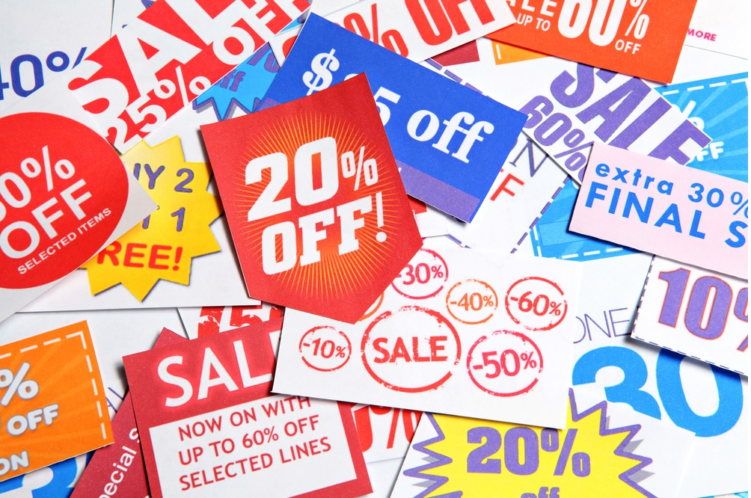
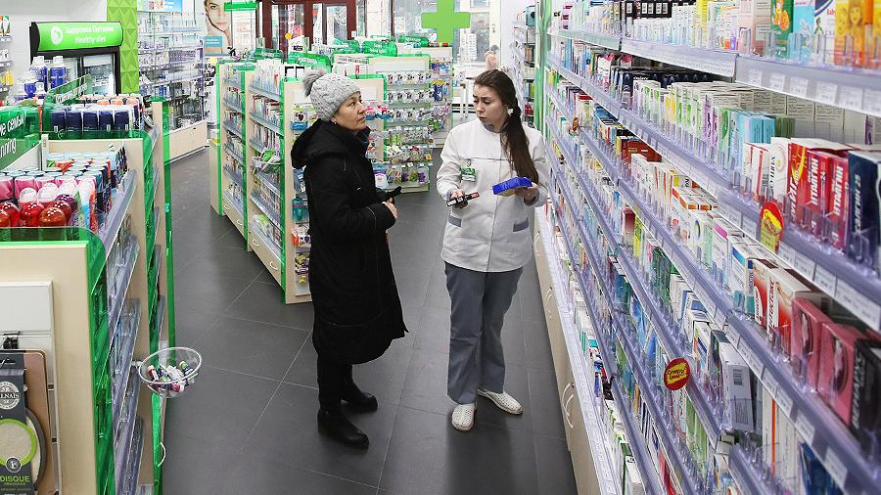
Sales promotion
Sales promotion is a type of marketing communications, a set of measures to promote goods along a route from a manufacturer to a consumer in order to accelerate sale of goods

Slide 18
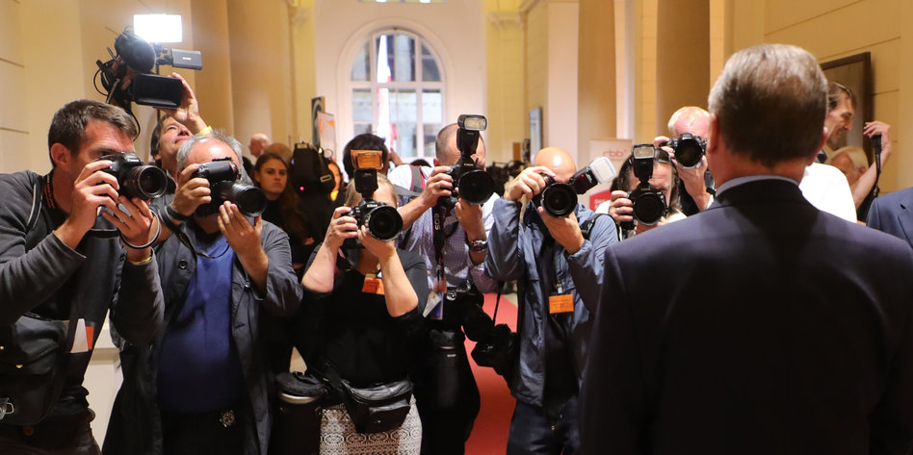
Public Relations (PR)
Public relations, public interaction is technology for creating and implementing an image of goods, a company in order to consolidate this image as an ideal and necessary in life

Slide 19
Corporate style is a kind of language with which a company designates its products, as well as everything that is somehow related to it

Slide 20
Corporate style functions
Distinctive
Protective
Competitive
Propaganda

Slide 21
Elements of corporate style
Corporate style
Trademark
Corporate block
Logo
Printing constants
Corporate color and font set

