Slide 1
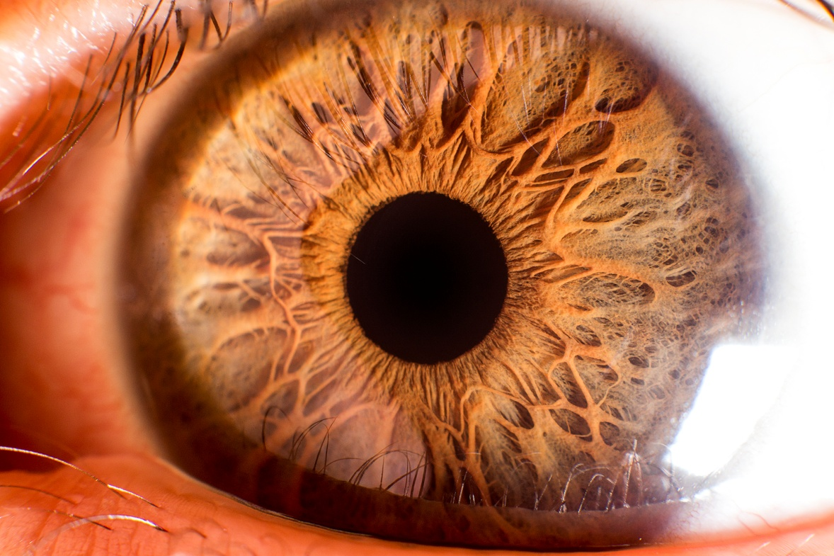
Organ of vision

Slide 2
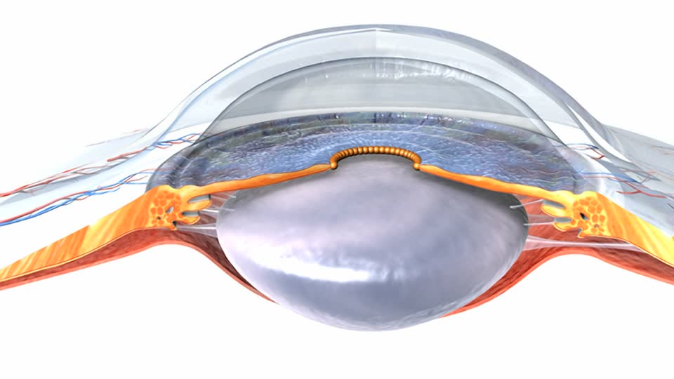
Cornea
Transparent
No blood vessels – nutrition due to the fluid of the anterior chamber
High refractive power
High tactile sensitivity

Slide 3
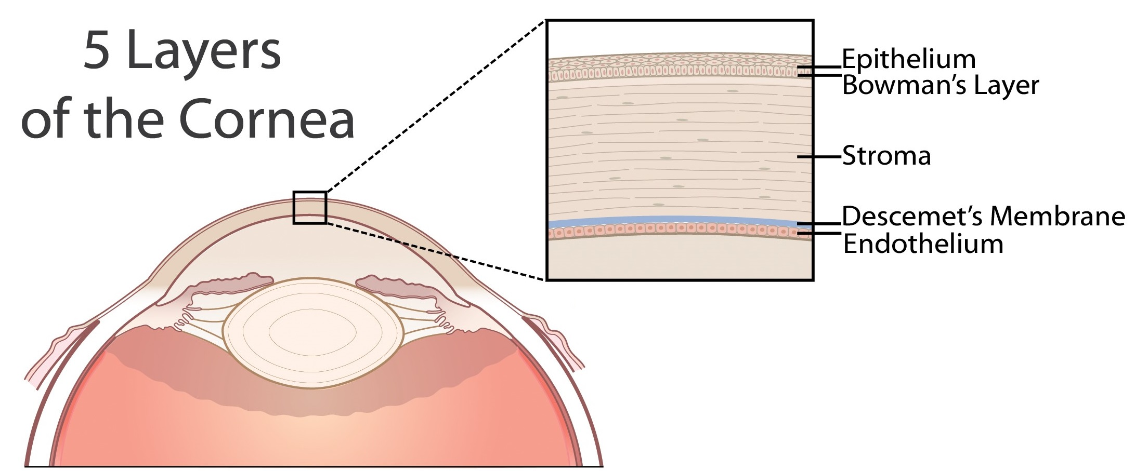
Cornea

Slide 4
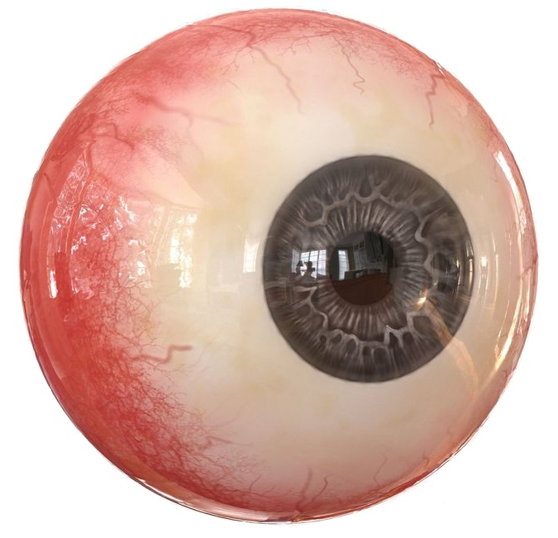
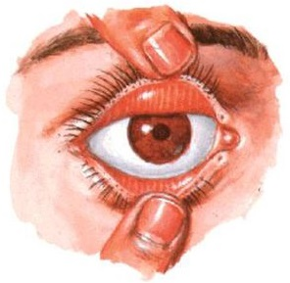
Sclera
Consists of dense connective tissue, almost devoid of vessels and nerve endings
Place of eyeball muscles attachment
Transition from cornea to sclera - limb

Slide 5
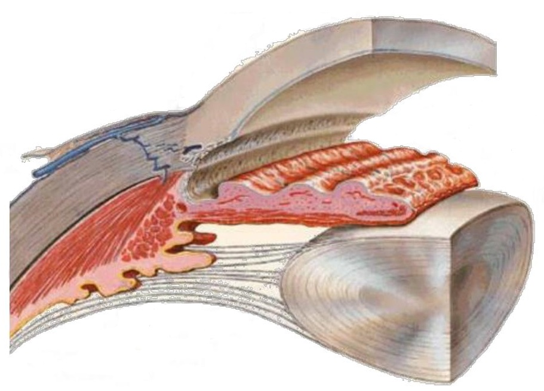
Tunica vasculosa bulbi
Iris
Corpus ciliare
Choroidea

Slide 6
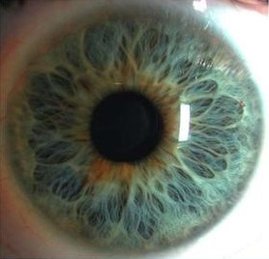
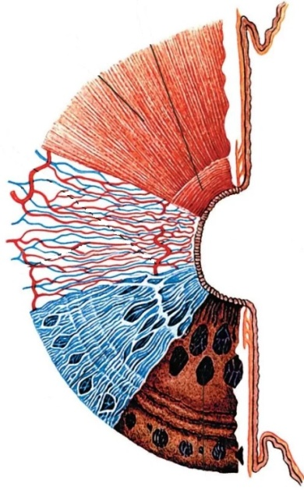
Iris
Disk with a hole inside – Pupilla
Formed by vessels, chromatophore cells, muscles
M. sphincter pupillae, m. dilatator pupillae

Slide 7
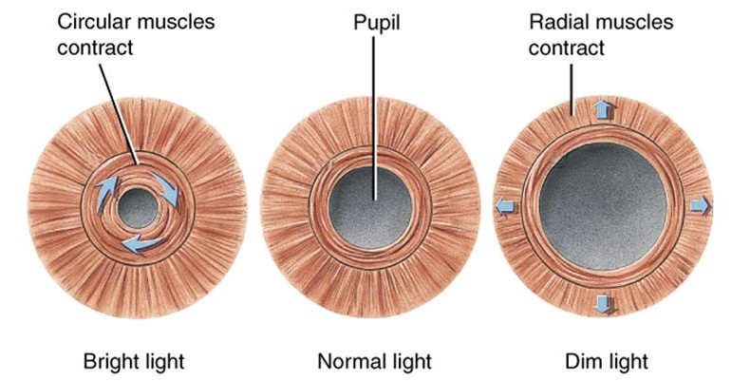
Iris
M. sphincter pupillae, m. dilatator pupillae

Slide 8
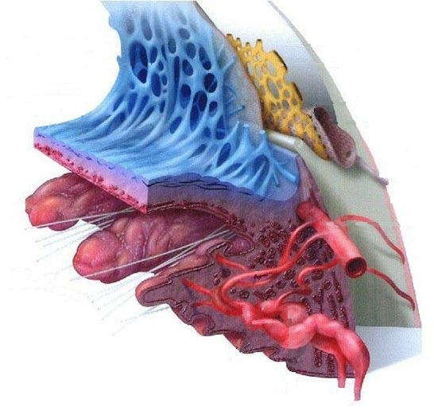
Corpus ciliare
Blood vessles → Ultrafiltration
Ciliar muscle → Focusing

Slide 9
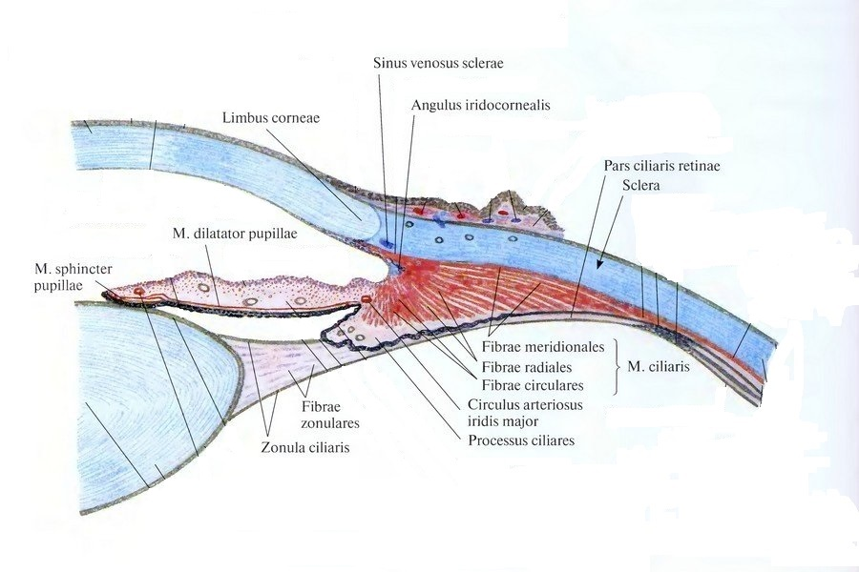
Musculus ciliaris
Fibrae meridionales
Fibrae circulares
Fibrae radiales

Slide 10
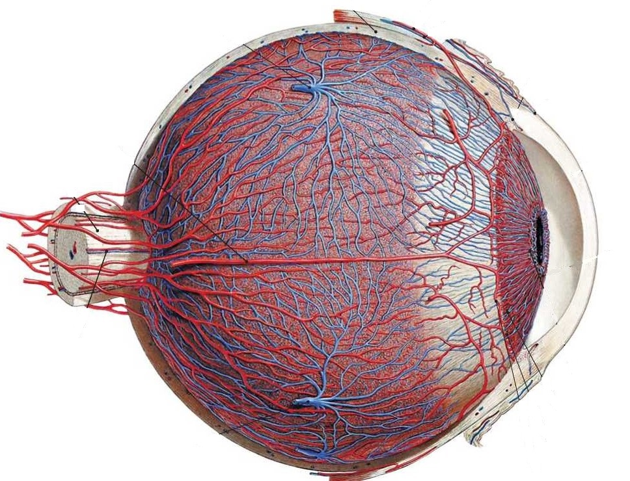
Choroidea
Artery and 4 ciliar veins
Spatium perichoroidale –space between sclera and choroid

Slide 11
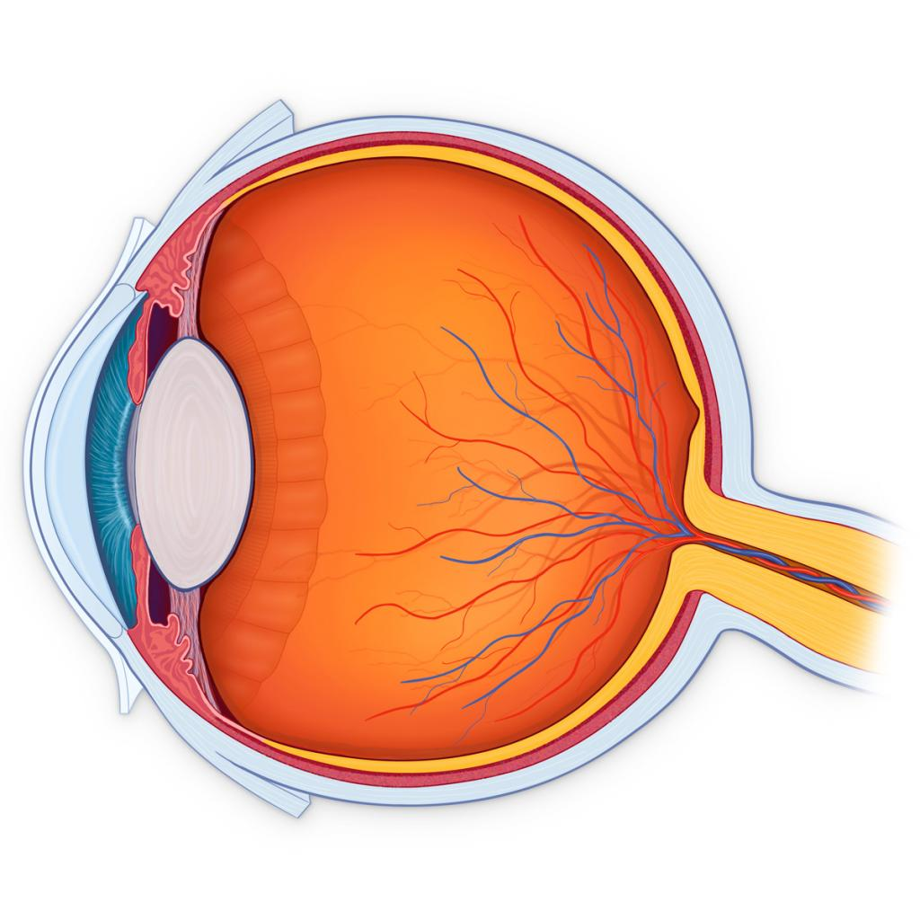
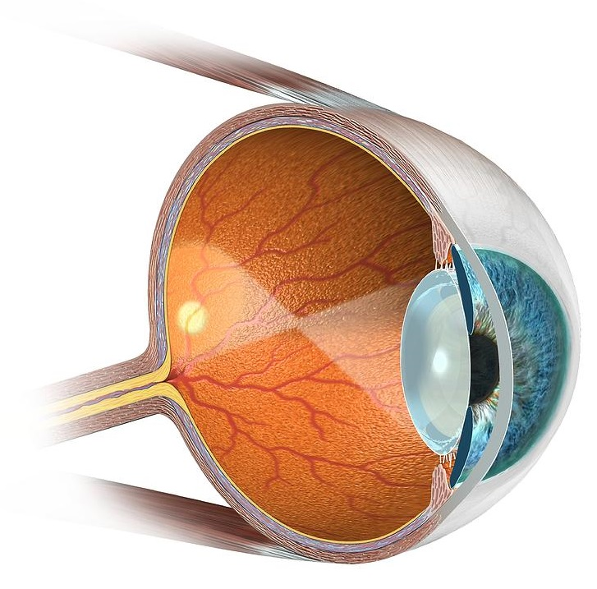
Retina
Pars optica
Pars caeca

Slide 12

Pars caeca
Pars ciliaris
Pars iridica
Discus nervi optici

Slide 13
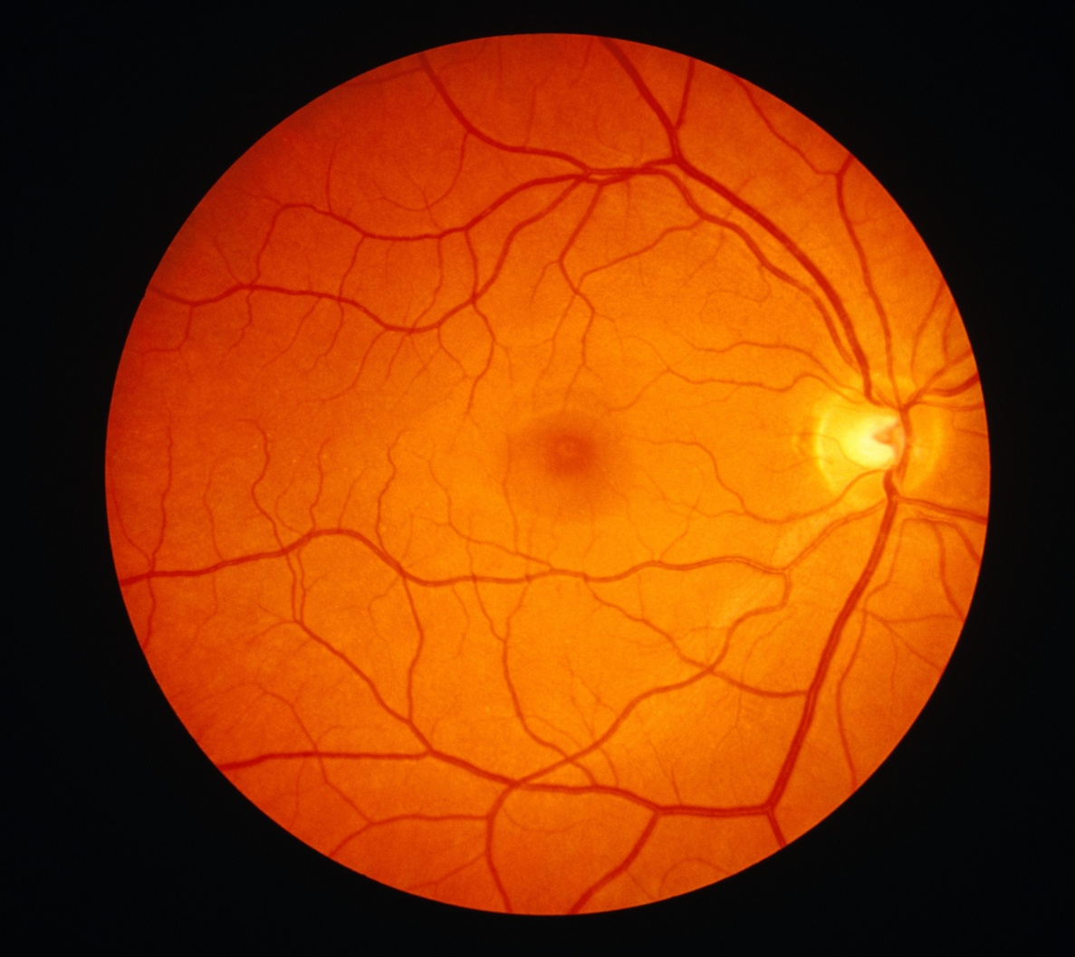
Pars optica
Baculi
Coni
Macula lutea

Slide 14
Lens

Slide 15
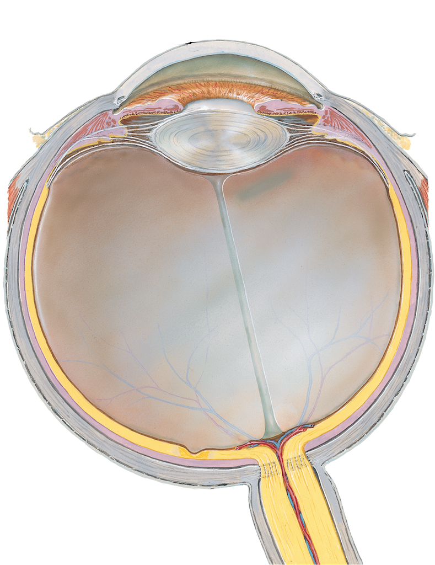
Camera vitrea bulbi
Corpus vitreum
Fossa hyaloidea

Slide 16
Humor aquosus
Produced by blood ultafiltration through the wall of ciliary processes body
Composition is close to blood plasma
Pressure 25 – 27

Slide 17
Camara posterior
Anterior – Iris
Posterior – Zonula ciliare
Lateral – Corpus ciliare
Medial – Lens

Slide 18
Camera anterior
Anterior – Cornea
Posterior – Iris, Lens
Lateral – Angulus iridocornealis

Slide 19
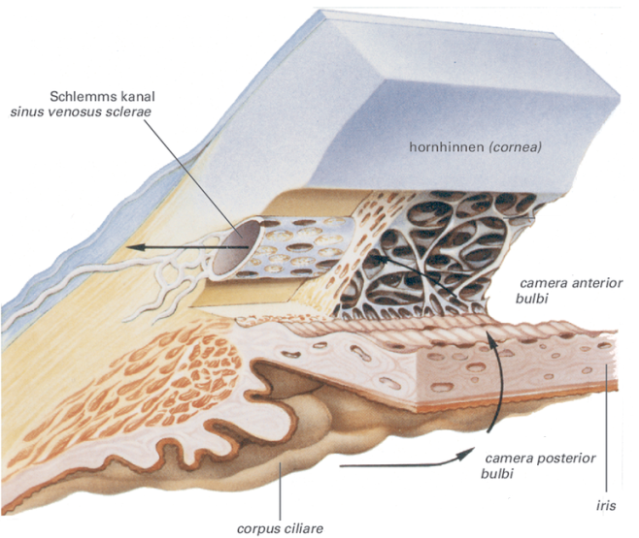
Camera anterior
Angulus iridocornealis
Ligamentum pectinatum iridis
Sinus venosusus sclerae

Slide 20
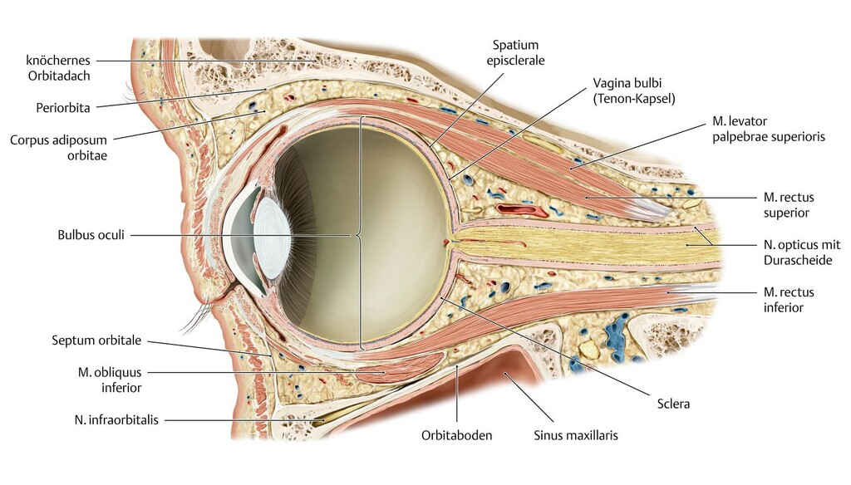
Supporting structures

Slide 21
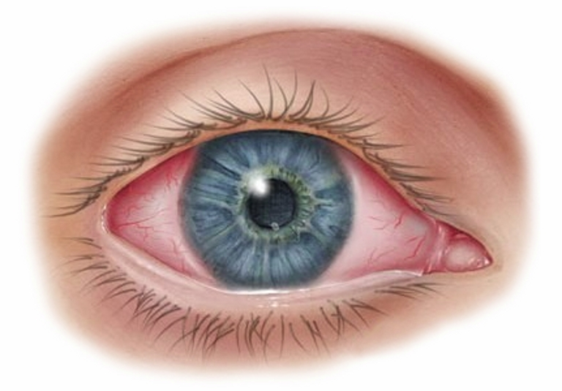
Supporting structures
Supercilium
Palpebrae
Cilia
Conjuctiva
Caruncula lacrimalis
Plica semilunaris conjuctivae

Slide 22
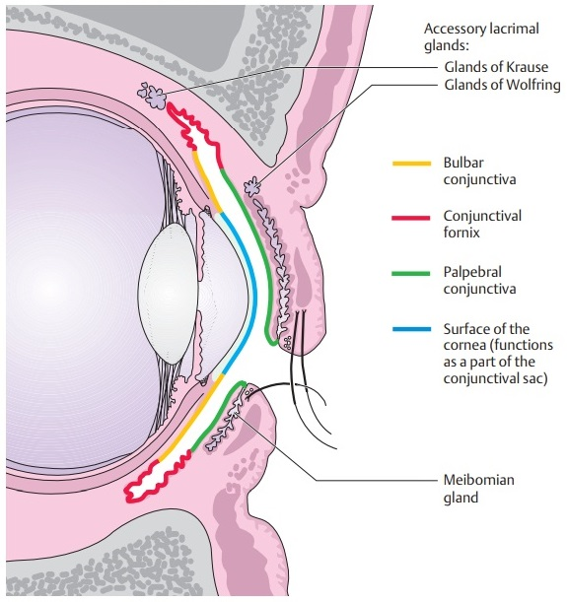
Conjuctiva

Slide 23
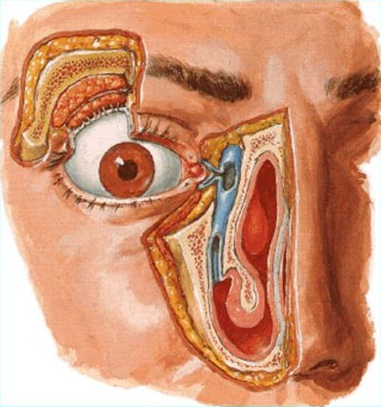
Apparatus lacrimalis
Glandula lacrimalis
Rivus lacrimalis
Lacus lacrimalis
Papila lacrimalis
Punctum lacrimalis
Canaliculi lacrimalrs
Saccus lacrimalis
Canalis nasolacrimalis

