Slide 1
Concepts and definitions of the essence of the main categories of logistics

Slide 2
Concepts and definitions of the essence of the main categories of logistics
Logistics – management of material, information and financial flows.
In pharmaceuticals – providing the population and medical facilities with high-quality and safe drugs.

Slide 3
The main categories of logistics
Material flow – medicines, medical devices.
Information flow – orders, prescriptions, certificates.
Financial flow – monetary calculations.
Logistic chain – the path from the manufacturer to the patient.
Logistic system – a set of elements for managing flows.
Inventory management – the optimal level of medical supplies.

Slide 4
Object and subject of logistics
The object is material, information, and financial flows.
The subject is the methods and patterns of their organization.
In pharmaceuticals, the object is the movement of drugs, and the subject is the organization of movement, taking into account storage conditions and expiration dates..

Slide 5
Modern logistics concepts
SCM – Supply Chain Management.
Just-in-Time – Just-in-Time deliveries (limited in pharmaceuticals).
Lean Logistics – Cost reduction.
Green Logistics – Environmental responsibility.
Digital Logistics – Digitalization of processes.

Slide 6
Features of pharmaceutical logistics
Compliance with storage and transportation conditions.
Control of expiration dates.
Compliance with GDP, GSP, and GMP standards.
Social significance – the health and lives of patients.
Ensuring the availability of medications even during a crisis.

Slide 7
Self-test questions
What is logistics?
The main categories of logistics.
The object and subject of logistics.
Modern concepts of logistics.
Features of pharmaceutical logistics.

Slide 8
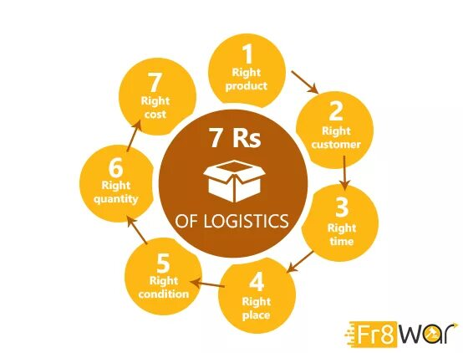

Slide 9
Conclusion
Logistics is a holistic system of flow management.
Pharmaceutical logistics = efficiency + safety.
The specialist's task is to ensure the availability and quality of pharmaceutical products.

